Slide 1
Software Defined Networking
Enable Dynamic Layer 3 Routing with Python and Open vSwitch
Alan Quillin, Sr. Software Engineer
alan.quillin@rackspace.com
alanquillin@gmail.com

Slide 2

Software Defined Networking
A software abstraction (control plane) that allows applications, devs and network admins to easily manage their underlying networks (data plane)

Slide 3
Open vSwitch
Open source, Linux based SDN framework
Rich set of command like management tools
ovs-appctl (allows querying and controlling the ovs daeman)
ovs-vsctl (allows management of the OpenFlow ovs-vswitchd)
ovs-ofclt (allows querying and management of OpenFlow)
more

Slide 4
ryu
Pronounced ree-you
Means “flow” in Japanese
Python based SDN framework build around OVS
Supports multiple protocols
Supports OpenFlow 1.0-1.5 + nicira extension
Allows multiple “apps” to be run async
Simple packet parsing for most known packet types
Event driven
Supports both manager and controller function
Other built-ins
Supports BGP
RESTful web services

Slide 5
Demo
Tools
OVS
Mininet
Python >= 2.7
Virtualenv (optional)
Setup
OpenFlow 1.3
mininet

Slide 6
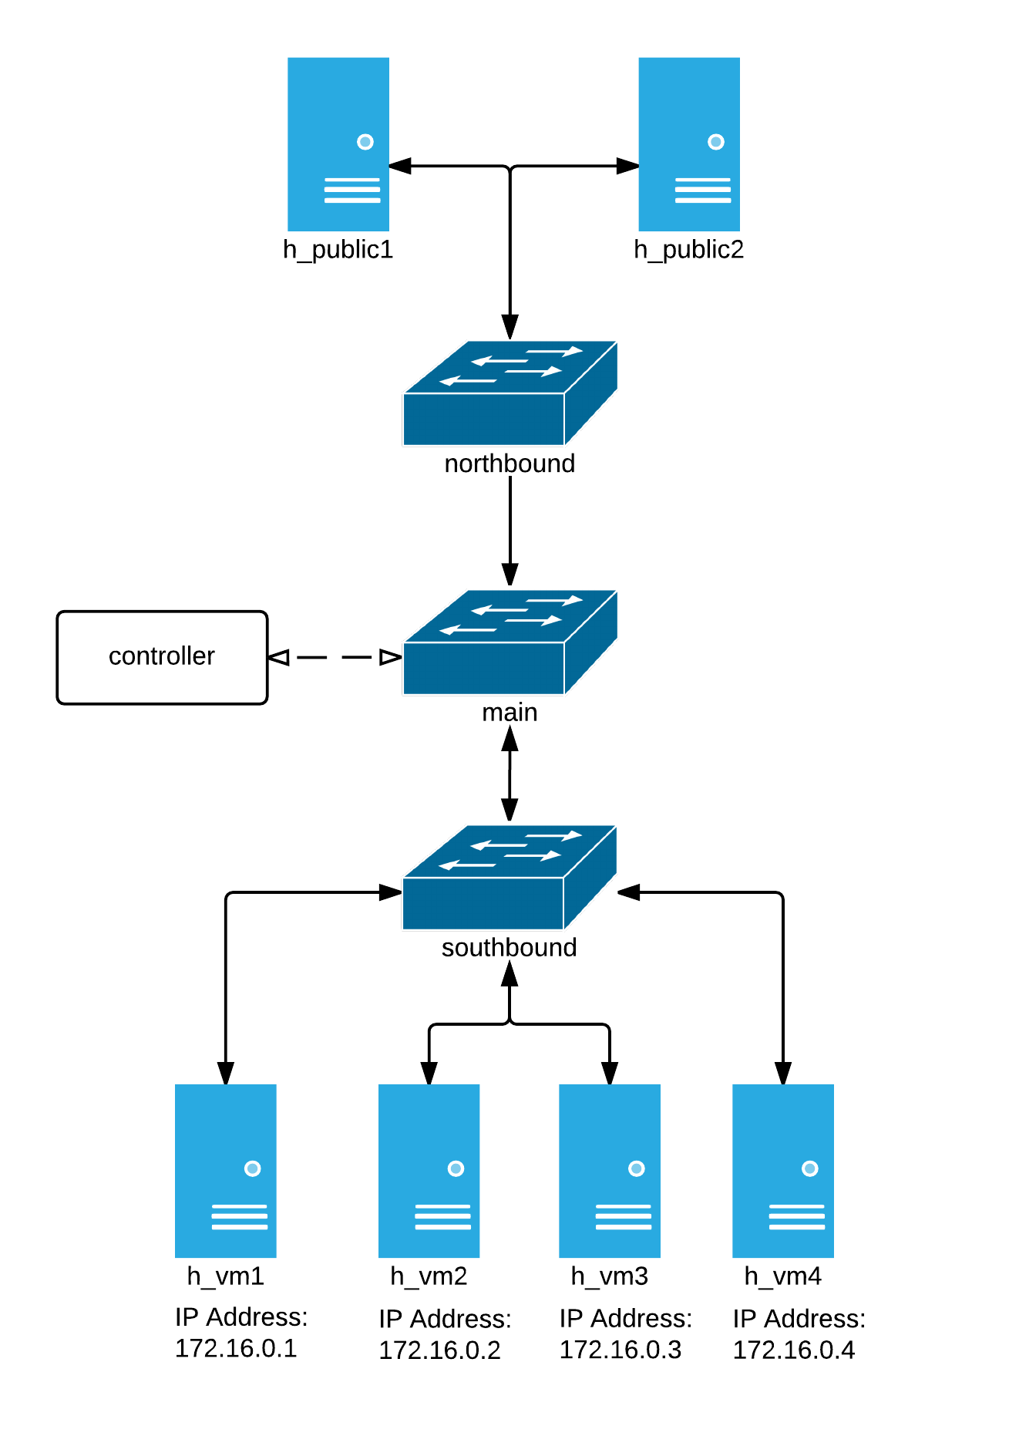
Test Topology
Public
Public

Slide 7
A few “gotcha”s
OpenFlow v1.0
Does not support tables unless you are using the nicira extension
Support for tables is off by default, so you must either turn it on manually, or you can do it when the bridge connects to the controller
parser = dp.ofproto_parser msg = parser.NXTFlowModTableId(dp, 1) dp.send_msg(msg)
The table id is set by adding the value to the upper 8 bits of the command value (super awkward)
return (int(table_id) << 8) + int(command)
Layer 3 Routing
You need to think about all protocols involved and handle them (i.e. Arp)

Slide 8
Resources
https://github.com/alanquillin/pytexas2015
Slides and demo source code
http://osrg.github.io/ryu/
https://github.com/osrg/ryu
http://openvswitch.org/
http://mininet.org/
https://www.opennetworking.org
https://www.opennetworking.org/sdn-resources/openflow

