Slide 1


Cyclistic Bike-Share
Analysis Case Study
Presented by Alan Reed
Last Updated 03/04/2023

Slide 2
Summary
Analysed data from January to December 2022 inclusive to determine trends of Cyclistic usage by Members and casual riders
Usage of Cyclistic services differs between the different member types
Members have highest demand over every month of 2022
Casual riders average longer rides over every month of 2022
Casual riders prefer weekends and Members weekdays and their ride duration is consistent the whole week.
Recommendations are presented at the end of the slide deck based on ride durations and limited time memberships

Slide 3
Data Sources
Historical Cyclistic Data was provided which spans trip data : January 2022 through to December 2022
Each file held one month of data
Raw CSV files can be found: Link
See Appendix for data analysis

Slide 4
Business Requirements
Goal:
Design marketing strategies aimed at converting casual riders into annual members
Task:
Analyse Cyclistic historical bike trip data to identify trends in how casual and annual members differ in their usage of Cyclistic services

Slide 5
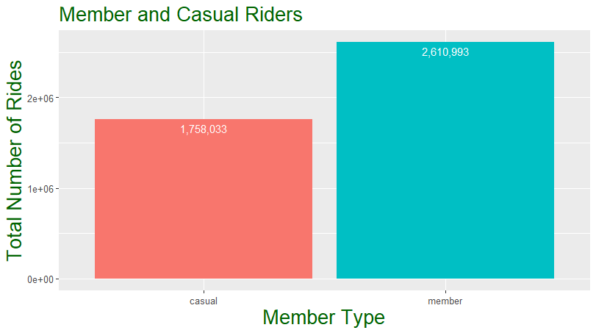
Total Number of Rides in 2022
The total number of rides in scope of the analysis is 4,369,026
Member Type | Number of Rides
Casual | 1,758,033
Member | 2,610,933
Total | 4,369,026
*This is total number of unique rides, number of rides per person is not available

Slide 6
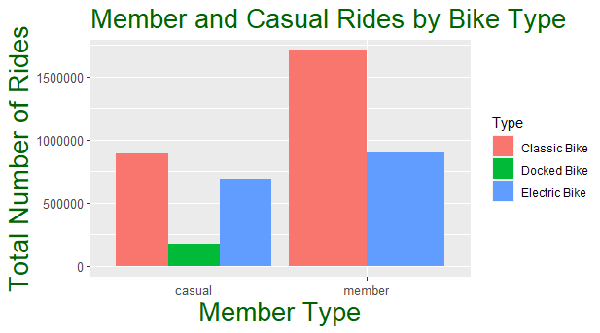
Rider Preference
Classical bikes are preferred by both Members and Casual Riders
Members use classic bikes almost twice as much as electric bikes
Casual Riders use classic bikes about 30 % more than electric bikes

Slide 7
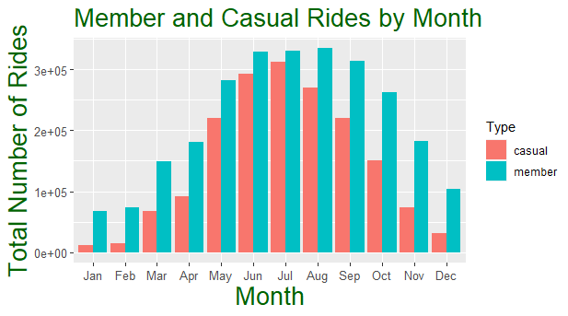
Ride Distribution in 2022
Highest demand in summer months for both rider types
Members use service substantially more in autumn months

Slide 8
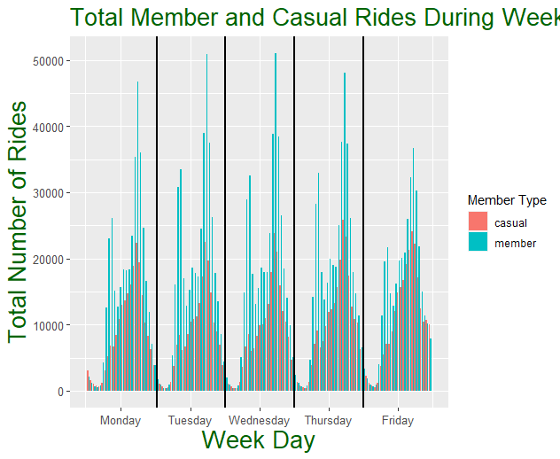
Ride Distribution by Weekday
Members have highest demand in weekday
Highest demand during “commute” hours before and after work

Slide 9
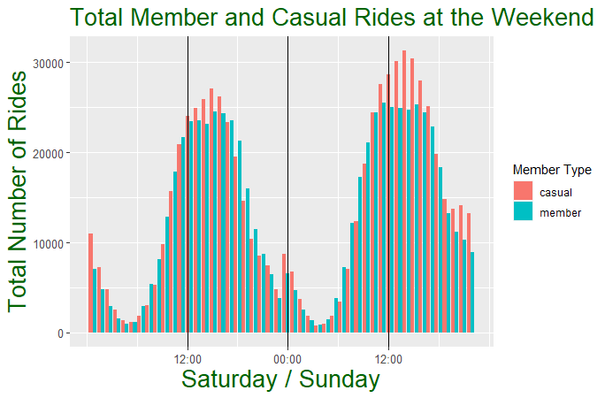
Ride Distribution at Weekend
Casual Riders have highest demand in weekday
Highest demand on Sunday after midday to 6pm

Slide 10
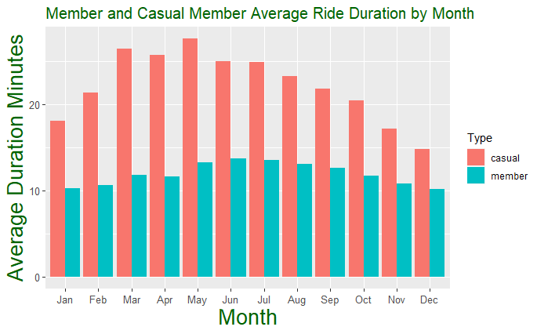
Average Ride Duration in 2022
For all months Casual Riders have the longest average ride duration
Average ride duration for Members is consistent throughout the year

Slide 11
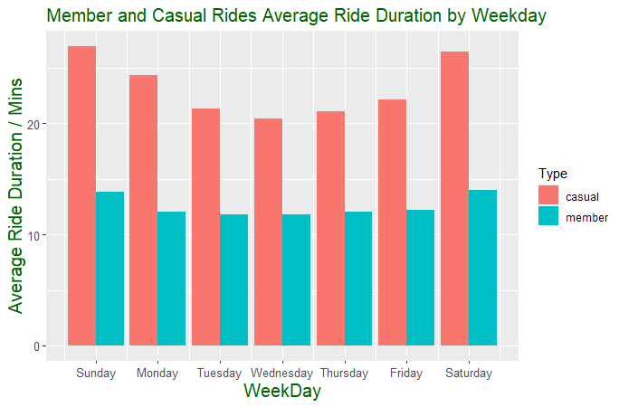
Average Ride Duration by Weekday
Casual Riders have the longest average ride duration
Members have a consistent average duration throughout the week

Slide 12
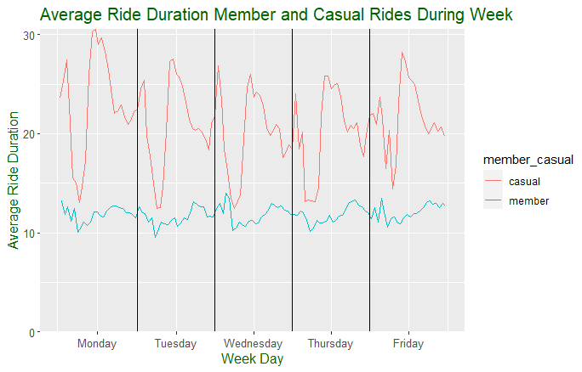
Average Ride Duration by Weekday Hour
Casual Riders have the longest average ride duration
Members have a consistent average duration throughout a weekday

Slide 13
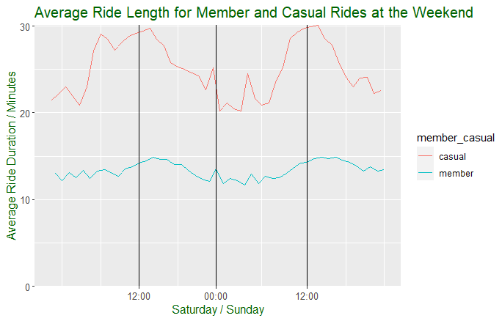
Average Ride Duration by Weekend Hour
Casual Riders have a longer average ride duration for any given hour at the weekend.
Members have a consistent average ride duration throughout the weekend

Slide 14
Conclusions and Recommendations
Annual members complete more rides than casual riders
Casual riders have the longest average ride duration
Casual riders have highest demand for bikes at the weekend
Classic bikes are the most popular choice by all member classes
Add additional membership levels, Weekend Only; Weekday Only.
Allow members to buy membership for limited time duration: week or month
Use tiered membership which allows people to either purchase limited time usage or usage at only certain times of days

Slide 15
Appendix – Data Cleaning
Total number of individual records of raw data = 5,667,717
The following rules were applied to clean the data:
Any rows containing NA values
Duplicate rows
Rows with duration less than and equal to 0 minutes
Rows with duration longer than 24 hours
Total number of rows remaining: 4,368,870

