Slide 2
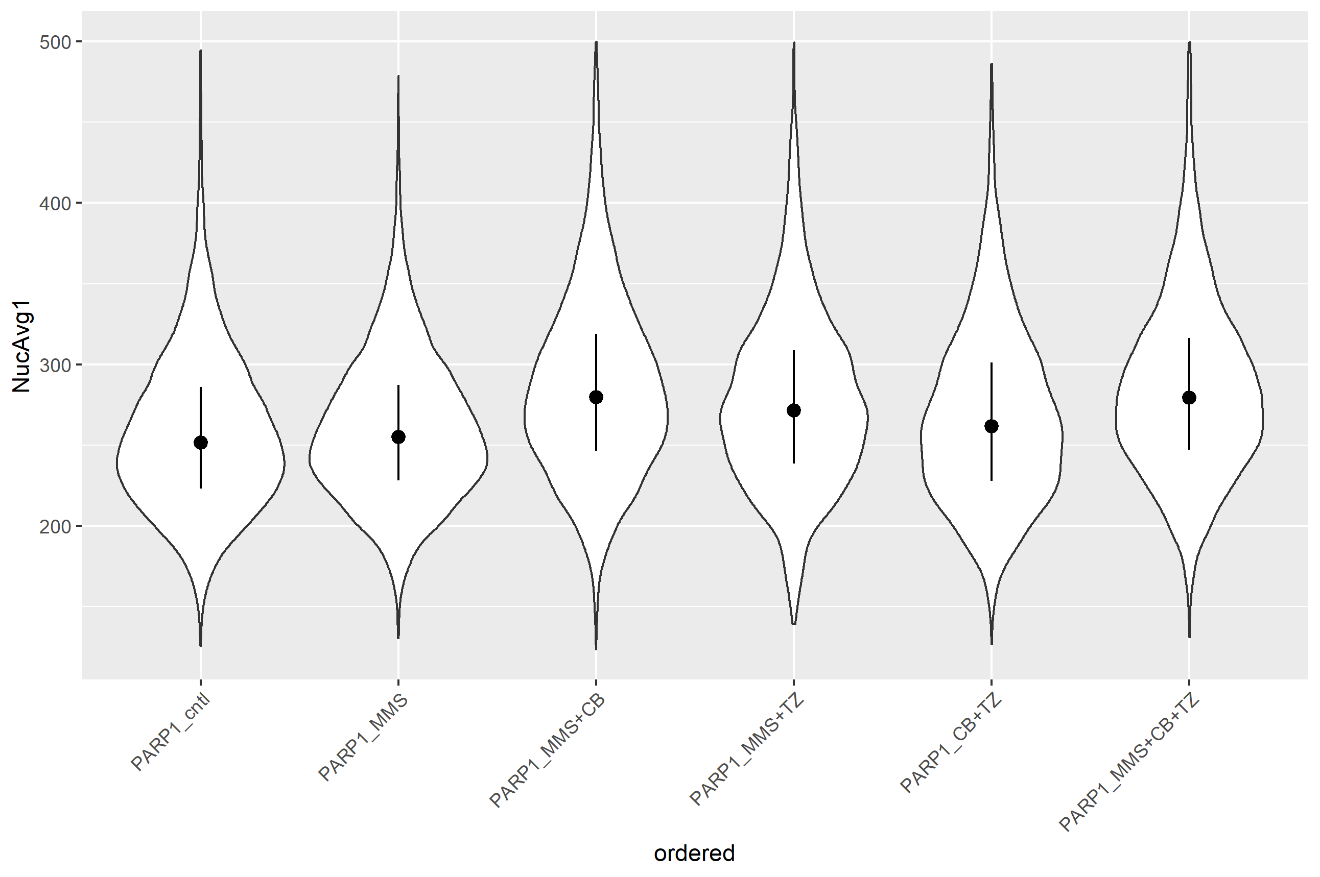

Nuclear PARP1 Immunofluorescence single cell analysis OVSAHO 3-25-2022 (NB4, pg. 85)
15 minutes
1 hour
*
*
280 272 280 281 280
252 255 262 267 270 268 263
Showing median value with quartile range. Using SCBT PARP1 mouse monoclonal antibody. (*) p < 0.00001

