Slide 1
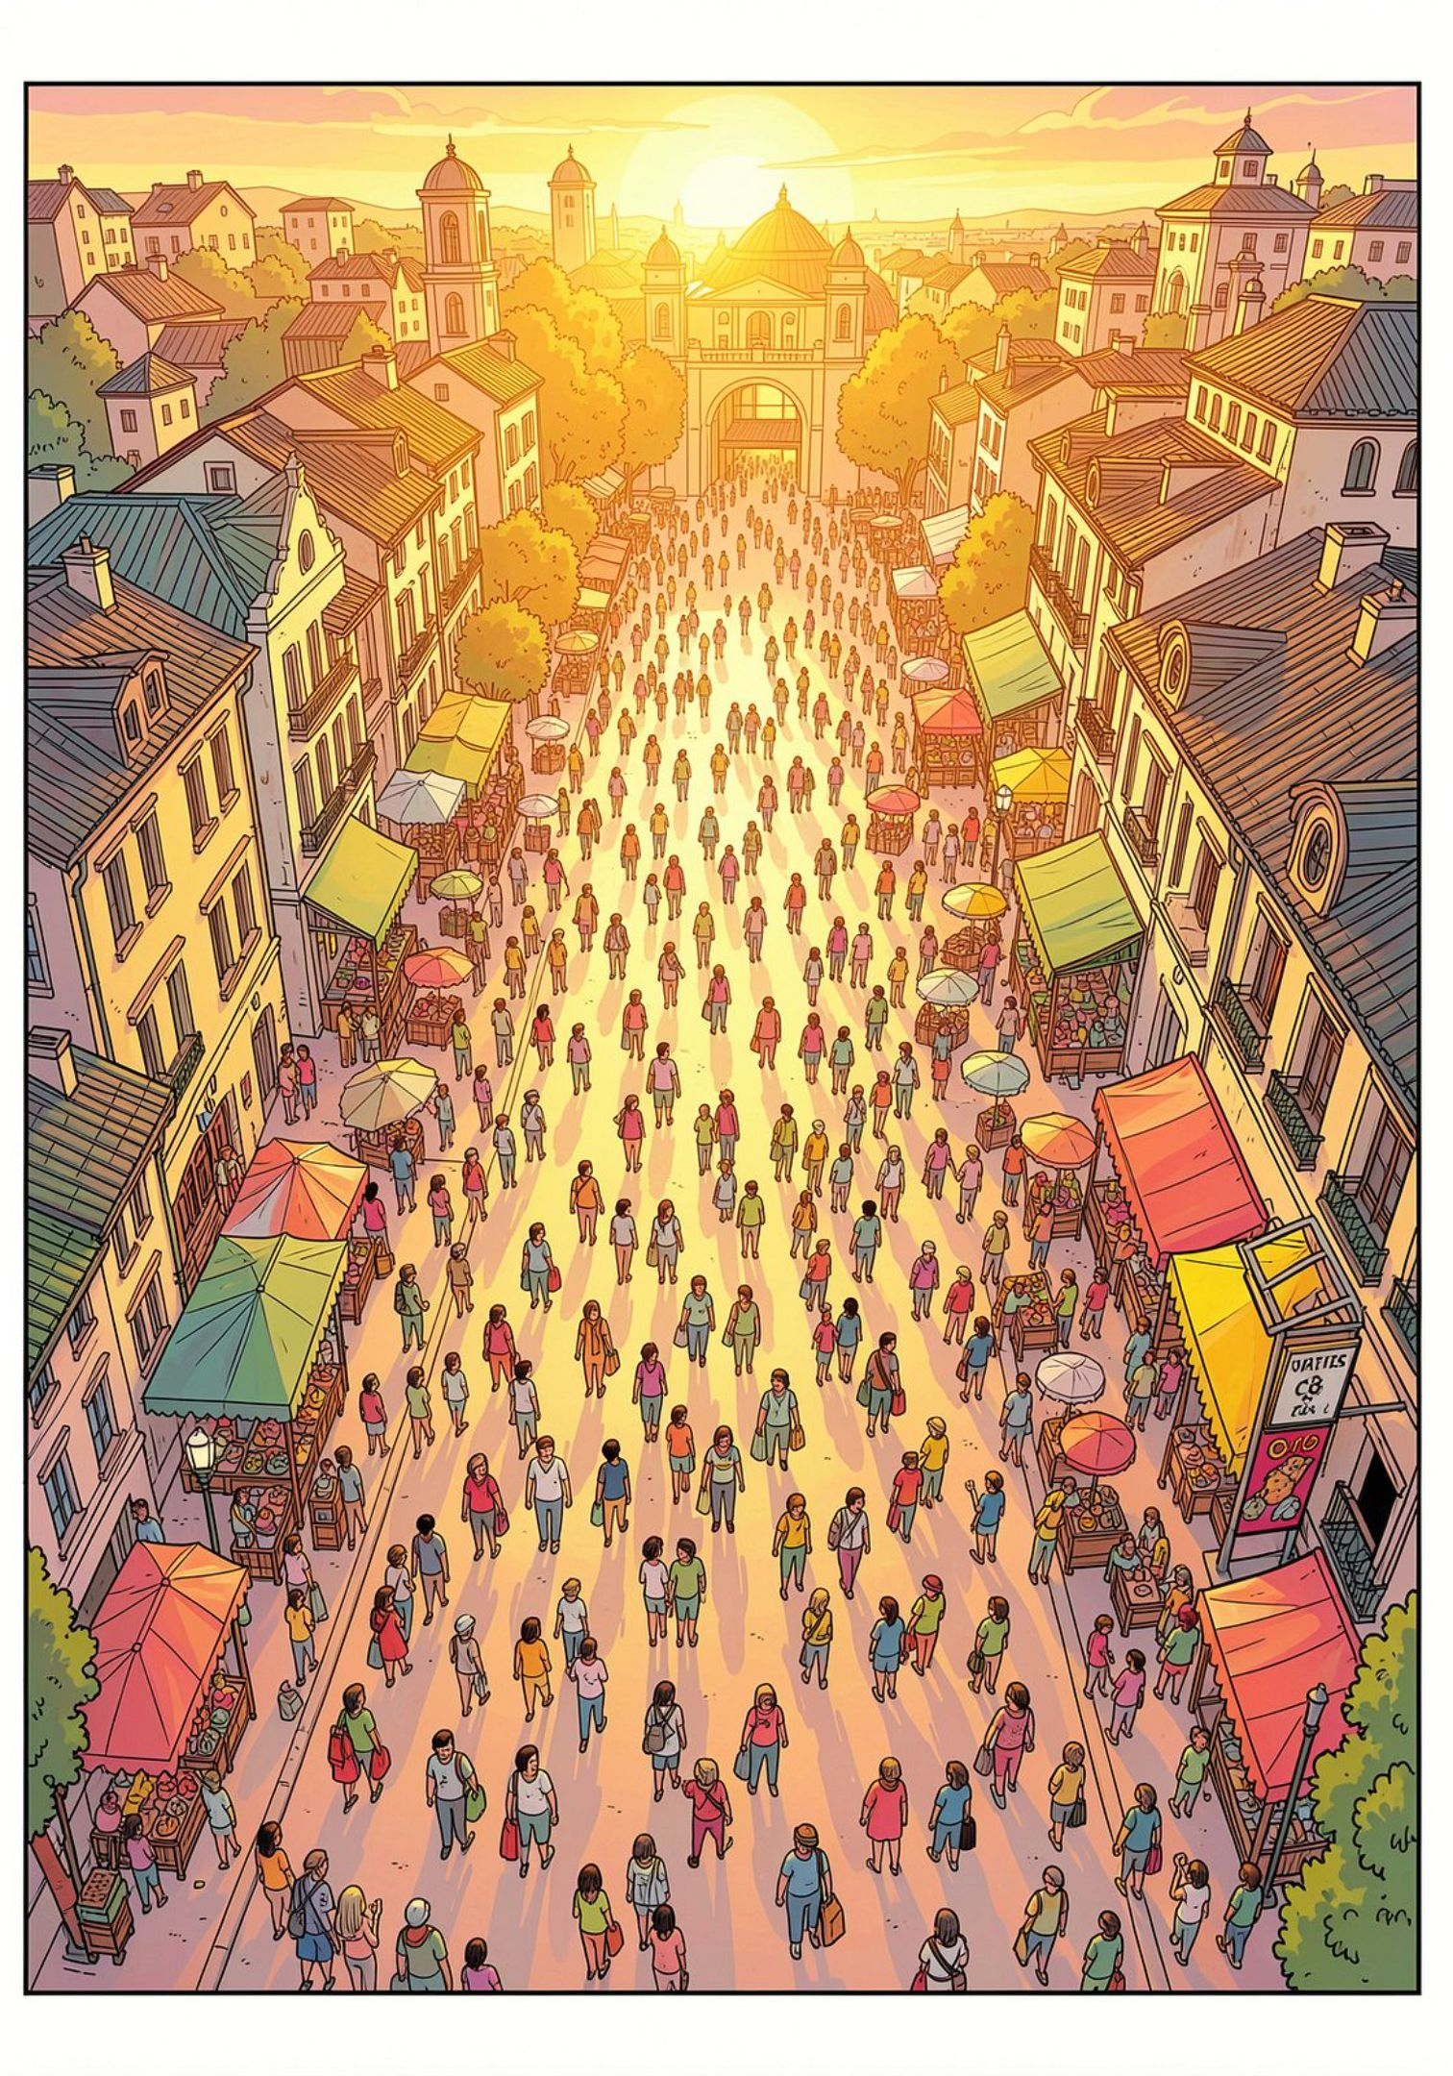
Crowd Level Prediction System for Tourist Destinations
Department of Artificial Intelligence and Data Science
Group 2 :
Presented to:
MS. RUKSANA K H
MS . SANI JOHN
MS . MARY NIRMALA GEORGE
Presented by:
AKSA ROSE BINU
ALAKANANDA SHINOY
ALAN RENNY

Slide 2

The Overcrowding Challenge in Tourism
Tourism is a major driver of the global economy, yet popular destinations face a persistent challenge: overcrowding during weekends, holidays, festivals, and peak seasons.
Long Wait Times
Traffic & Parking
Queues at entry points, attractions, and facilities frustrate visitors and reduce satisfaction.
Congestion and limited parking create logistical headaches for travelers and local authorities.
Poor Experience
Overcrowding degrades the quality of the visit, discouraging repeat tourism.

Slide 3
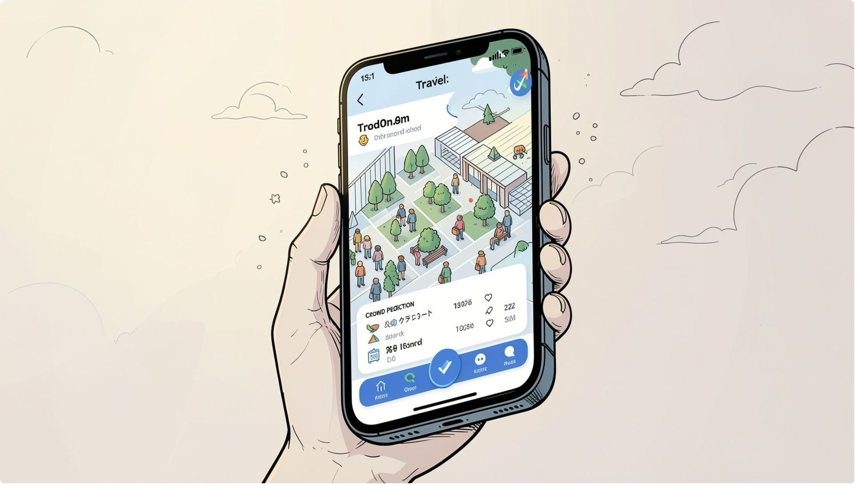

Introducing the Crowd Level Predictor
The Crowd Level Predictor leverages Artificial Intelligence and Machine Learning to forecast expected visitor density at tourist destinations. By classifying crowd levels as Low, Medium, or High, the system empowers travelers to make informed decisions before they visit.
For Travelers
For Tourism Management
Plan trips at optimal times and avoid peak hours.
Enable data-driven crowd control and resource allocation.

Slide 4
Objectives
01
02
Predict Crowd Levels
Analyze Influencing Factors
Classify expected crowd as Low, Medium, or High using supervised Machine Learning.
Model the impact of location, date, time, weather, holidays, and festivals on visitor flow.
03
04
Enable Advance Planning
Demonstrate AI in Tourism
Help tourists identify the best visiting windows and avoid peak congestion periods.
Showcase how AI and Data Science can improve real-world travel experiences.

Slide 5

Dataset Overview
The dataset captures tourist crowd-flow information from destinations across India over a two-year period (2024–2025), comprising 730 records across 13 attributes.
Temporal
Environmental
Contextual
Target
Date, Time, Day of Week, Week of Year
Weather, Temperature (°C)
Holidays, Events, Region, Transportation Type
Crowd Count (in thousands)

Slide 6
Dataset Attributes in Detail
Attribute | Description | Example Values
Date & Time | Timestamp of the visit | 2024-07-15 10:00
Place | Tourist destination name | Taj Mahal, Mysore Palace
Crowd Count | Number of visitors (in thousands) | 1.2, 3.5, 8.0
Weather | Weather conditions | Sunny, Cloudy, Rainy
Holiday & Event | Festivals, cultural events, regular days | Diwali, National Holiday
Temperature | Ambient temperature in °C | 22°C – 38°C
Transportation Type | Mode of travel to the destination | Walking, Private, Public

Slide 7
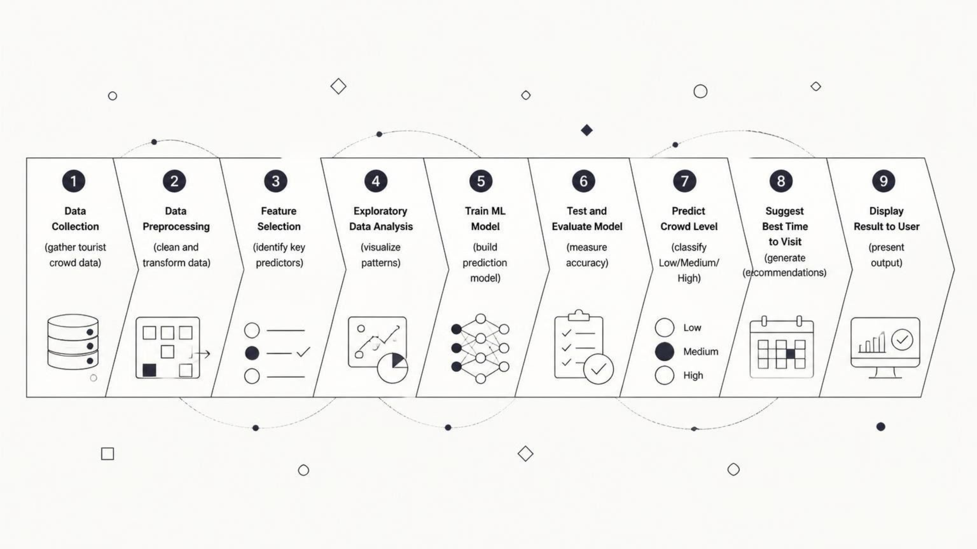
Workflow
The pipeline follows a standard supervised learning approach — from raw data ingestion through model training and evaluation, culminating in an actionable crowd-level prediction and visit-time recommendation for the end user.

Slide 8






Key Benefits of the System
Better Trip Planning
Reduced Overcrowding
Tourists can select optimal visiting windows well in advance.
Distributed visitor flow reduces strain on infrastructure and attractions.
Improved Travel Experience
Easier Parking & Transport
Shorter wait times and less congestion make visits more comfortable.
Avoiding peak hours reduces traffic and parking difficulties.
Smarter Tourism Management
Quick Crowd Prediction
Authorities gain data-driven insights for resource planning.
Instant Low / Medium / High classification for any planned visit.

Slide 9
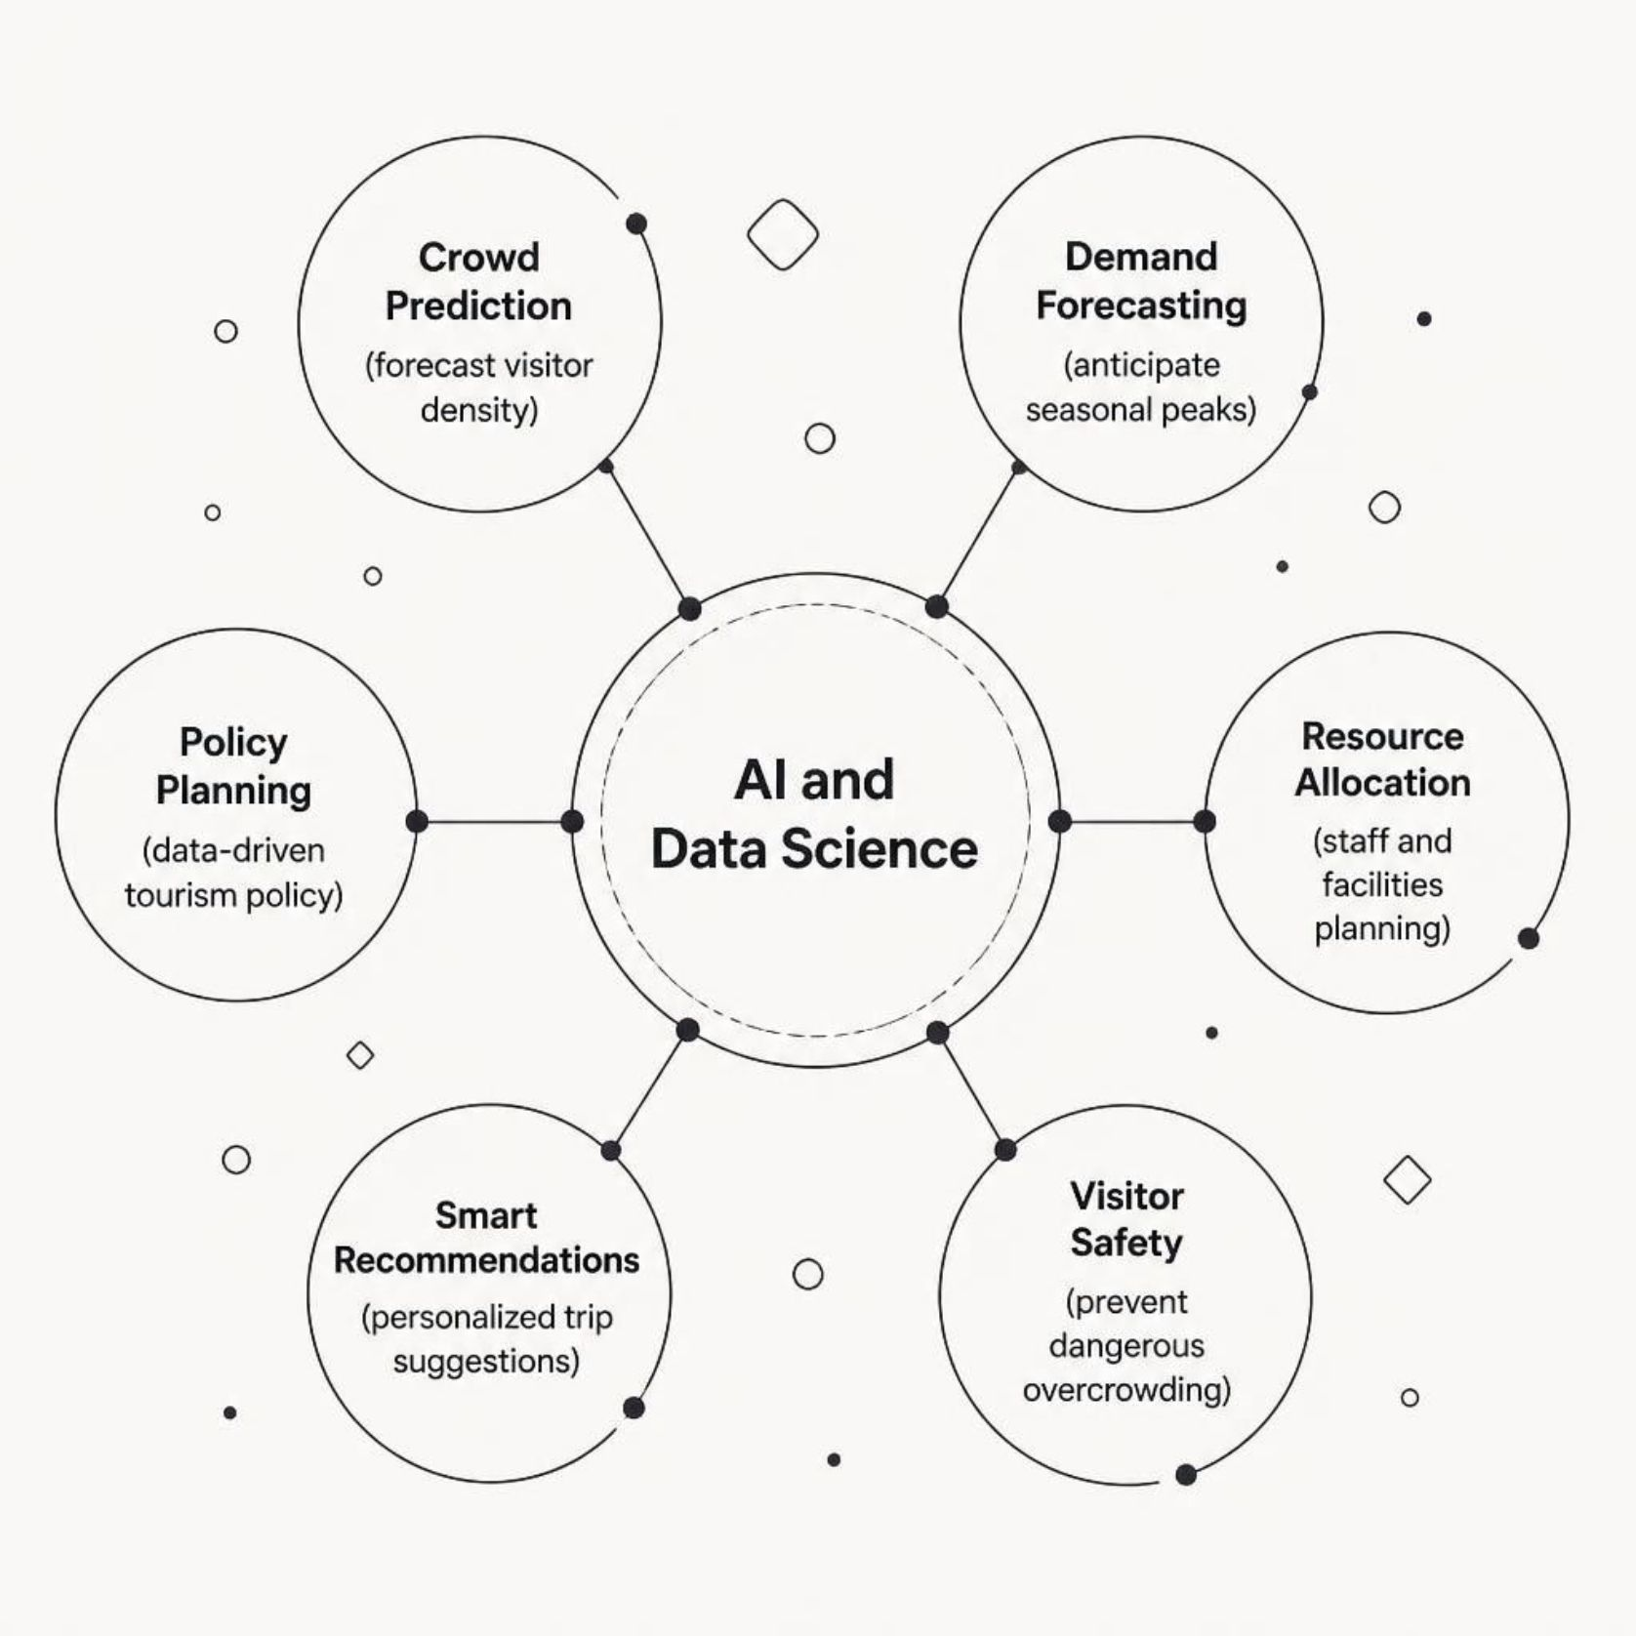
Why AI & Data Science for Tourism?
This project demonstrates how AI and Data Science can transform traditional tourism management. By learning from historical patterns in weather, events, and visitor behavior, the model generalizes to provide reliable predictions — bridging the gap between raw data and real-world decision-making.

Slide 10

Conclusion
The Crowd Level Prediction System addresses a real-world tourism challenge using the power of Machine Learning. By analyzing temporal, environmental, and contextual factors, the model delivers actionable Low / Medium / High crowd classifications — helping travelers plan smarter and authorities manage better.
Problem Solved
Approach Used
Overcrowding, long waits, and poor visitor experience at popular destinations.
Supervised ML on a 2-year, 730-record dataset with 13 attributes from Indian tourist sites.
Impact Delivered
Proactive trip planning, smarter tourism management, and improved visitor satisfaction

Slide 11
Thank You
We hope you enjoyed our presentation.

