Slide 1
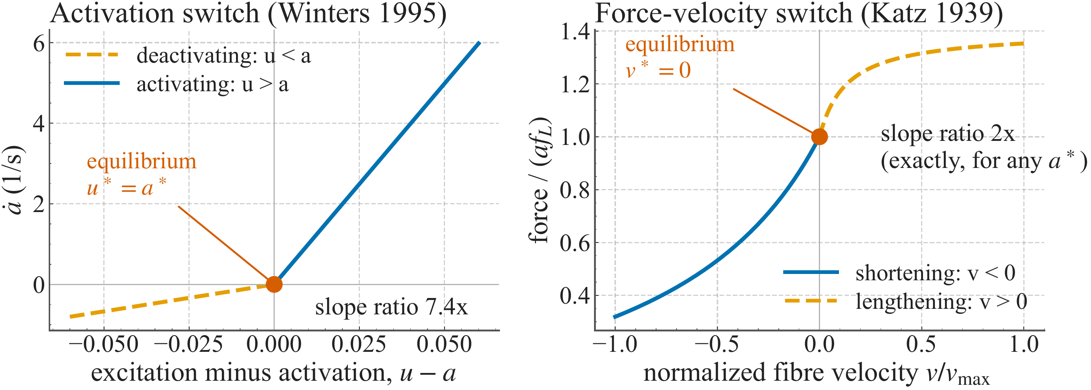
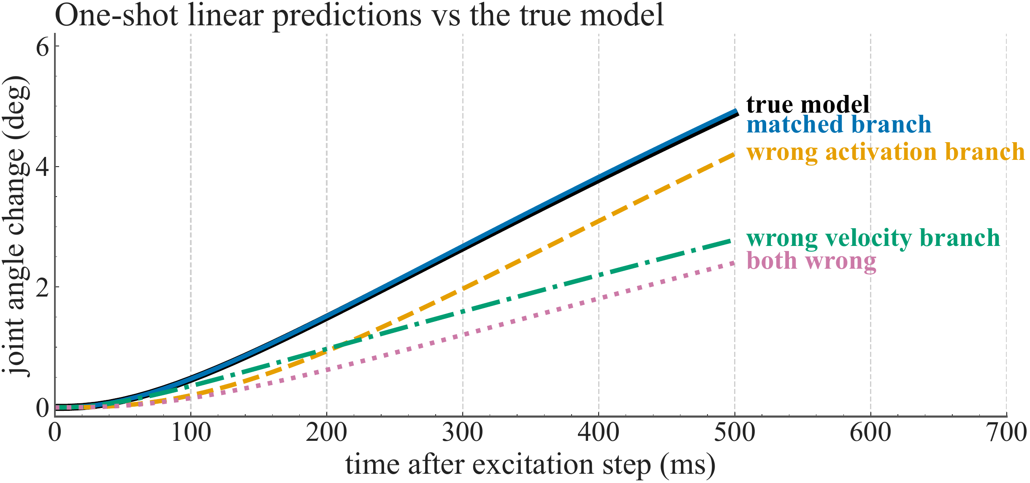
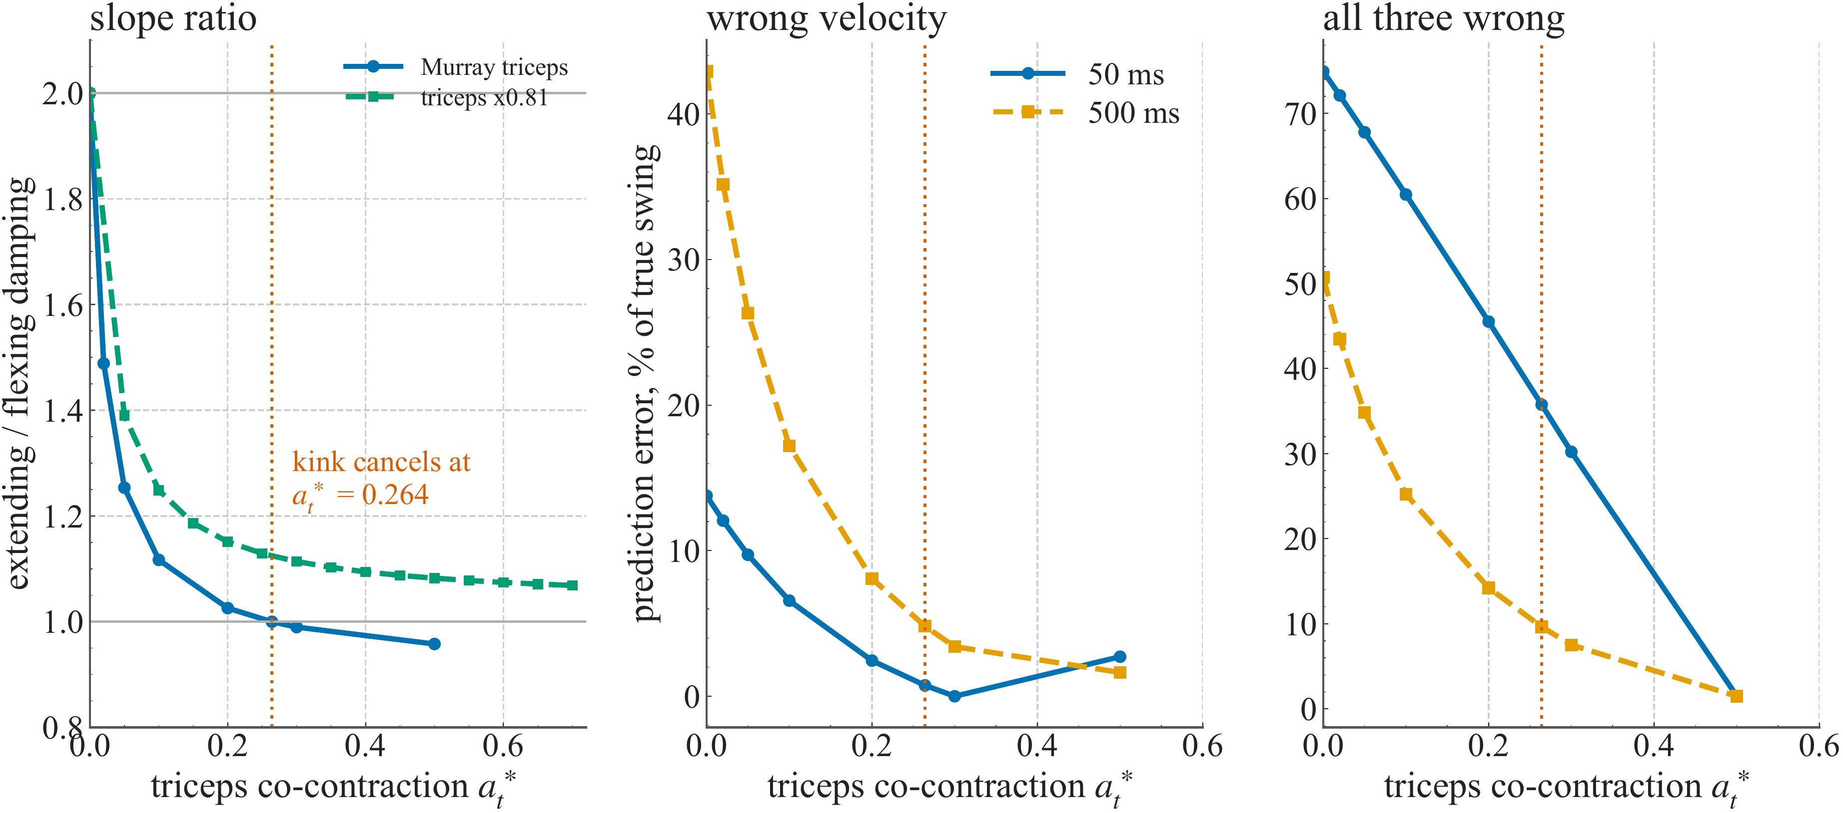
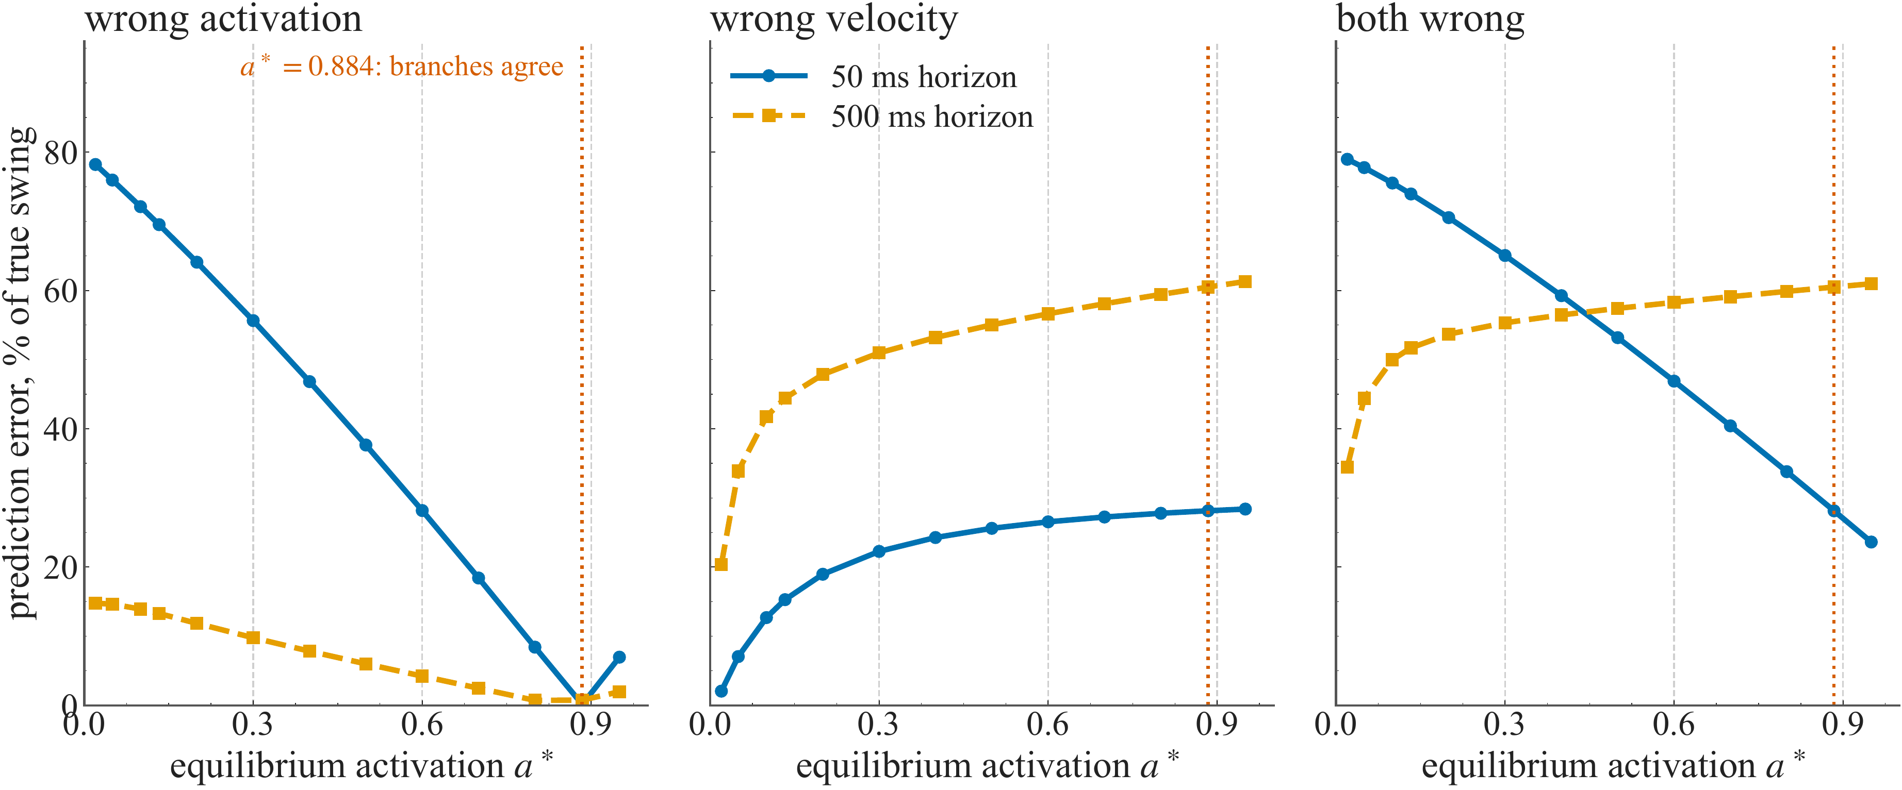
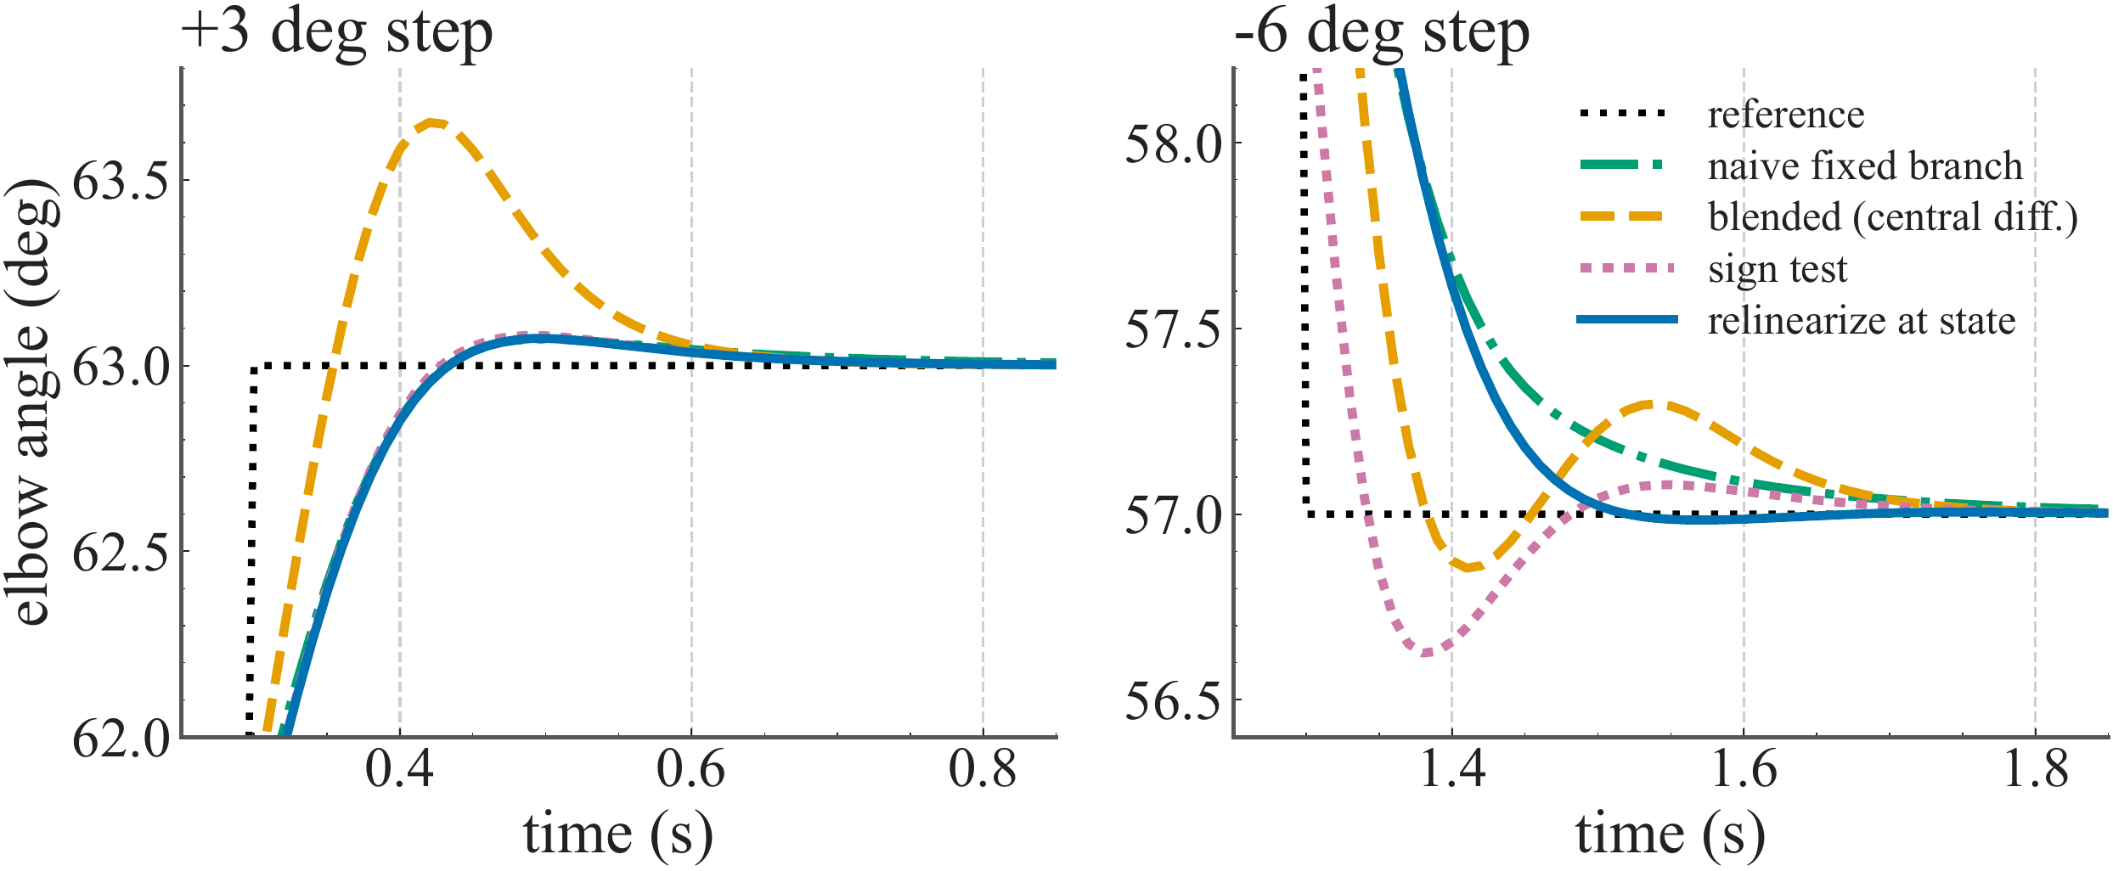
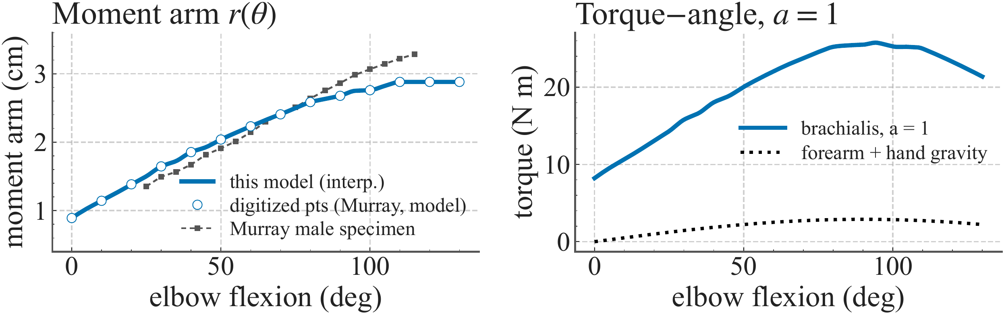
IIT MADRAS
POSTER 5
Non-Smooth Equilibria in Hill-Type Muscle Models
Alan Royce Gabriel Samuel
Indian Institute of Technology Madras, Chennai, India
IROS 2026 · Workshop on Neuromuscular Robotics
INTRODUCTION
RESULTS
DISCUSSION
One equilibrium. Four directional linear models.
Muscle-driven robots, prostheses and exosuits often use controllers designed around an equilibrium linearization. This assumes that a single local model describes small perturbations.
The Hill-type formulation studied here switches twice: activation dynamics changes when excitation crosses activation, and the force–velocity relation changes between shortening and lengthening.
At equilibrium, excitation equals activation and velocity is zero. Both switching surfaces therefore pass through the operating point.
Question: how much does the choice of branch affect prediction and closed-loop control?
14–75% prediction error from a wrong branch
At the reference posture, matched-branch error stays near 1% of the true angular swing. Mismatched models diverge within 50–100 ms.
At 50 ms: wrong activation branch, 71%; wrong velocity branch, 14%; both wrong, 75%. These are errors relative to the true swing, not absolute angles.
The effect persists across operating points
With both branches wrong, error is at least 23% of the activating-step signal at every single-muscle equilibrium tested.
Feedback changes the consequence
In the tested delay-free cases, feedback preserves stability and steady-state tracking, but differences in transient quality remain. Blending the branches gives 8–9× more raising overshoot than the fixed, sign-test and relinearized designs.
Relinearize at the measured state
During lowering, braking re-activates the muscle. A branch chosen only from the initial sign misses this mid-plan change.
Lowering overshoot falls from 0.37° with the sign test to 0.02° with relinearization.
Smoothing activation retains much of the transient cost. Tracking rankings depend on weights and noise.
A predictor restored stability under the tested 20 and 50 ms delays.
Baseline MPC: overshoot and tracking error (degrees).
Model | Up | Down | Sine RMS
Blended | 0.65 | 0.15 | 0.196
Smooth act. | 0.42 | 0.48 | 0.169
Sign test | 0.08 | 0.37 | 0.153
Relinearize | 0.07 | 0.02 | 0.149
CONCLUSIONS
Choose the branch as well as the operating point.
Use directional local models and relinearize as the state changes. Co-contraction can reduce the velocity kink, but adds an activation switch and effort.
Scope: one simulated joint. Hardware validation, reflexes and history-dependent muscle effects remain open.
Activation slopes differ by 7.45× at the reference equilibrium; velocity slopes differ by 2×.
METHODS
A small excitation step: the matched branch tracks the nonlinear model; wrong branches diverge.
A simulated elbow against gravity
A forearm–hand pendulum is driven by a rigid-tendon Hill-type brachialis model. Muscle parameters follow Holzbaur; activation dynamics follows Thelen; moment arms are digitized from Murray et al.
Reference posture: 60°
Equilibrium activation: 0.113
Prediction test: apply a small +0.01 excitation step and compare all four local models with the nonlinear trajectory.
Feedback test: linear MPC with a 10 ms sample time and 20-step horizon. Keep controller weights fixed; vary only the branch and linearization point.
Extensions: held-load equilibria, a brachialis–triceps antagonist pair, noise, plant mismatch and delay.
Antagonist co-contraction reduces the velocity kink toward cancellation.
REFERENCES
Held-load sweep: activation-branch error falls as activation rises; velocity-branch error grows.
Thelen (2003). J Biomech Eng 125:70–77.
Katz (1939). J Physiol 96:45–64.
Holzbaur et al. (2005). Ann Biomed Eng 33:829–840.
Murray et al. (1995). J Biomech 28:513–525.
Camlibel et al. (2008). Automatica 44:1261–1267.
De Groote et al. (2016). Ann Biomed Eng 44:2922–2936.
CONTACT & MATERIALS
Alan Royce Gabriel Samuel
bs22b001@smail.iitm.ac.in
Poster source and figures:
github.com/alanroyce2010/hill_IROS
Closed-loop steps: 60° → 63° → 57°. Relinearization reduces lowering-step overshoot.
Model checks: moment arm and torque–angle relationship. Brachialis peaks at 25.8 N m near 94°.
Read together: branch choice affects prediction across operating points and remains visible in closed-loop transients.
Simulation results from the existing project draft.
IROS 2026 · 1st Workshop on Neuromuscular Robotics · Poster 5 | Layout: SciFig AI Classic Navy
Notes:
Visual draft populated from the existing muscle-activation-control poster. Numerical results have not been independently revalidated. Original SciFig template preserved separately. Images fitted without cropping. Text and results table remain editable.

