Slide 1
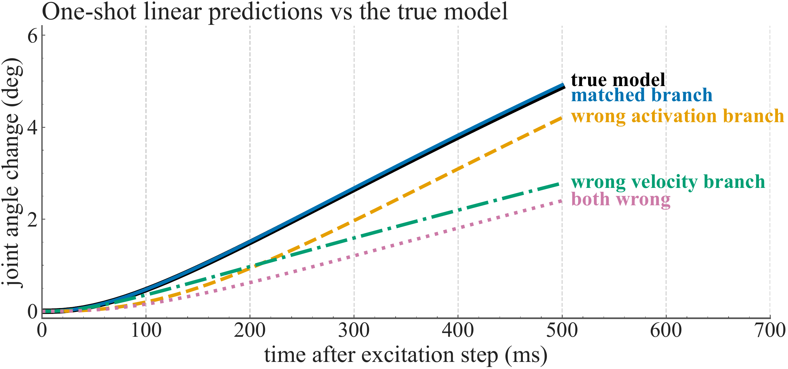
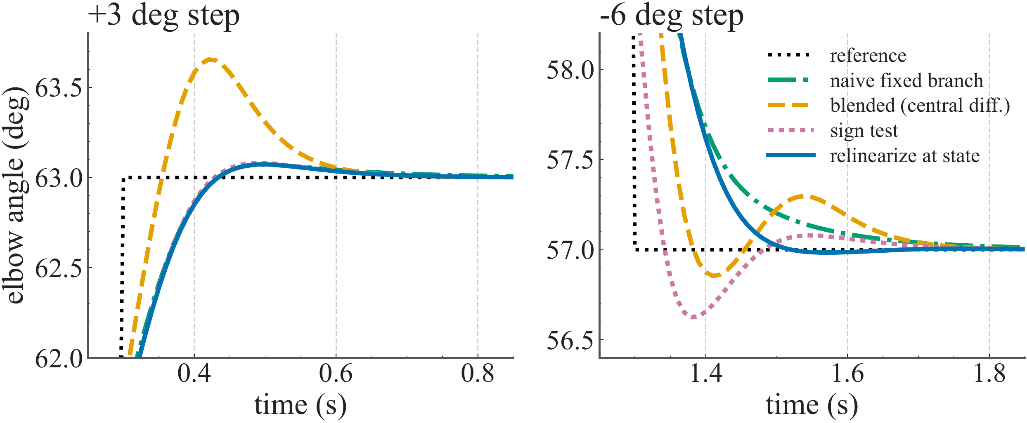
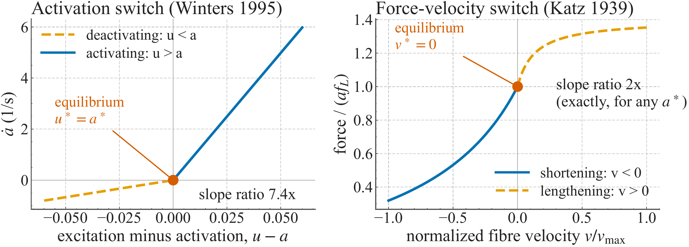
Non-Smooth Equilibria in Hill-Type Muscle Models
A Quantified Consequence for Linearization-Based Control
Alan Royce Gabriel Samuel · Indian Institute of Technology Madras
IROS 2026 · Workshop on Neuromuscular Robotics · Poster 5
ABSTRACT
Hill-type muscle models with switched activation dynamics have four directional linearizations at equilibrium. In a simulated elbow, choosing the wrong branch causes 14–75% prediction error. In closed-loop MPC, relinearizing at the measured state reduces lowering overshoot from 0.37° to 0.02°, showing that branch selection matters for prediction and transient control.
INTRODUCTION
FIGURE 1 · PROJECT OVERVIEW
Muscle models connect excitation to force in prostheses, exoskeletons, FES and tendon-driven robots. LQR and successive-linearization MPC use a local Jacobian to predict motion [1,2].
But an equilibrium lies on two switches: excitation equals activation, and fibre velocity is zero. The perturbation direction selects one of four local models.
We quantify the prediction error and test how much of it survives feedback.
MUSCLE + JOINT
TWO SWITCHES
FOUR MODELS
CONTROL TEST
Excitation → activation
→ force → elbow angle
u* = a*
v* = 0
Activation branch ×
velocity branch
Prediction horizon
+ closed-loop MPC
Wrong branch: 14–75% prediction error | Relinearize: 0.37° → 0.02° lowering overshoot
Figure 1. From equilibrium switching to controller performance. Read the active branch and update the local model at the measured state.
RELATED WORK
RESULTS
CONCLUSION
Hill-type modelling. Thelen models activation and force generation; Millard et al. characterize computational muscle formulations [1,2].
Smoothing. Kirsch et al. smooth torque–velocity dynamics; De Groote et al. smooth activation for optimization [3,4]. Here we measure the cost of branch choice at equilibrium.
Non-smooth systems. Camlibel et al. give continuity conditions for bimodal linear systems [5]. Yeo et al. study a distinct force–length instability, not the activation-switch control problem [6].
Prediction: 14–75% wrong-branch error
Matched-branch error stays near 1% at the reference posture. With both branches wrong, error is ≥23% at every tested single-muscle equilibrium for activating steps.
Choose the branch as well as the operating point.
1. Equilibria of the studied switched Hill-type model require directional local linearizations.
2. Branch mismatch causes substantial prediction errors. Feedback reduces the effect to transient quality in the tested delay-free cases.
3. Relinearize at the measured state, avoid central differences across a kink, and compensate delay.
Limits: simulation only; one joint, one or two muscles; no reflexes, short-range stiffness or history dependence. Hardware validation remains open.
FORMULATION / MODEL
Figure 3. Response to a +0.01 excitation step: branch errors separate within 50–100 ms.
Plant: one elbow, a forearm–hand pendulum, and a rigid-tendon Hill-type brachialis. Muscle parameters follow Holzbaur; moment arms follow Murray [7,8].
State x = [θ, θ̇, a]ᵀ; input u is neural excitation.
Iθ̈ = Fᴹᵀ r(θ) − mglc sin θ
v = −r(θ)θ̇ / l₀ᴹ
Feedback: transient quality remains
Central-difference blending gives 8–9× more raising overshoot than the naive, sign-test and relinearizing rules.
REFERENCES
[1] Thelen DG (2003). Adjustment of muscle mechanics model parameters to simulate dynamic contractions in older adults. J Biomech Eng 125:70–77.
[2] Millard M et al. (2013). Flexing computational muscle: modeling and simulation of musculotendon dynamics. J Biomech Eng 135:021005.
[3] Kirsch NA et al. (2018). Model-based dynamic control allocation in a hybrid neuroprosthesis. IEEE TNSRE 26:224–232.
[4] De Groote F et al. (2016). Evaluation of direct collocation optimal control problem formulations for solving the muscle redundancy problem. Ann Biomed Eng 44:2922–2936.
[5] Camlibel MK, Heemels WPMH, Schumacher JM (2008). A full characterization of stabilizability of bimodal piecewise linear systems with scalar inputs. Automatica 44:1261–1267.
[6] Yeo SH et al. (2023). Numerical instability of Hill-type muscle models. J R Soc Interface 20:20220430.
[7] Holzbaur KRS, Murray WM, Delp SL (2005). A model of the upper extremity for simulating musculoskeletal surgery and analyzing neuromuscular control. Ann Biomed Eng 33:829–840.
[8] Murray WM, Delp SL, Buchanan TS (1995). Variation of muscle moment arms with elbow and forearm position. J Biomech 28:513–525.
ȧ = (u − a) / τa
τa = τact (0.5 + 1.5a), when u > a
τa = τdeact / (0.5 + 1.5a), when u ≤ a
Figure 4. Raising and lowering steps. Updating the model at the measured state reduces lowering overshoot.
Rule | Up | Down | Sine RMS
Blended | 0.65 | 0.15 | 0.196
Smoothed act. | 0.42 | 0.48 | 0.169
Naive fixed | 0.07 | 0.00 | 0.200
Sign test | 0.08 | 0.37 | 0.153
Relinearize | 0.07 | 0.02 | 0.149
Figure 2. At θ* = 60° and a* = 0.113, the activation slope ratio is 7.45 and the velocity slope ratio is 2.
Table 1. Overshoot and sine-tracking RMS, degrees.
Four local models: δẋ = Aᵢδx + Bᵢδu.
Each switch satisfies A₁ − A₂ = ecᵀ and B₁ − B₂ = ed [5]; the two switches affect different Jacobian entries.
MPC: 10 ms sampling, 20-step horizon. Compare rules using the same plant and controller weights.
Co-contraction can cancel the joint velocity kink, while adding a second activation switch.
Unmodelled delay can cause divergence; a predictor restored stability in the tested cases. Tracking rankings depend on weights and noise.
bs22b001@smail.iitm.ac.in | github.com/alanroyce2010/hill_IROS | Layout adapted from SciFig AI Classic Navy
Notes:
Abstract condensed from ICRA 2027 main.tex. Figure 1 is an editable conceptual overview. Numerical results are from the existing submission; no new experiments were run.

