Slide 1

DIGITAL VERIFICATION OF VEHICLES
SUBMITTED BY, GROUP 1
AADHIL MUHAMMED (MBI20CS001)
ALAN SHA (MBI20CS006)
HELVIN PAULOSE (MBI20CS032)
SOJAN P RENNY (MBI20CS054)
SUBMITTED TO,
Mrs.MINNU ELIZABETH ITTAN
ASSISTANT PROFESSOR
PROJECT GUIDE
Dept. of CSE, MBITS
1

Slide 2
CONTENTS
  Abstract
  Introduction
  Work plan
  Er-Diagram
  Database Design
  Case Studies of existing system
  Proposed System
  Conclusion
  References

Slide 3
ABSTRACT
  Population growth leads to an increase in vehicles on the road.Issues related to vehicle registration, driving license verification, emission testing, and insurance validation.
  Verification of vehicle-related documents creates challenges for the RT department and police.RT department's workload includes manual and paper-based tasks like registration, licensing issues, ownership transfer.
  In our proposed website it Store all vehicle and driver-related documents digitally in a database maintained by the RT administrator.
  It can Verify documents and driver information using the vehicle registration number..

Slide 4
INtroduction
The Regional Transport Office (RTO) or Regional Transport Authority (RTA) is the organisation of the Indian government responsible for maintaining a database of drivers and a database of vehicles for various states of India.
The Objective of Digital Verification Of Vehicles is to provide a online tool for the ease of RTO functions such as vehicle registration, Learner license, permanent license, renewal of license, and many more.

Slide 5
CASE STUDY I –
Two wheeler registration process in Kerala
KMVD means Kerala Motor Vehicle Department.
Is an online website for Kerala.
To develop road transport technology.
Website for registration purpose, documentation purpose, etc.
The KMVD has made ‘one person one application’ rule as mandatory across all the RTOs.

Slide 6
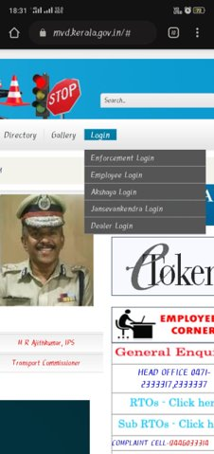
https://www.mvd.kerala.gov. in
Website Page Figure

Slide 7
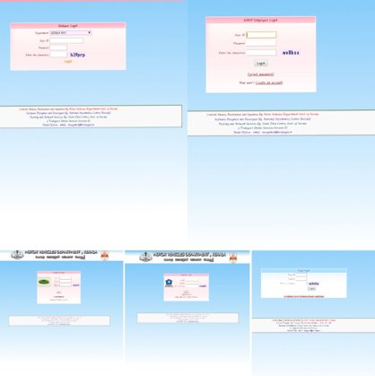
Website Login Figure
https://www.mvd.kerala.gov.in

Slide 8
Advantages
Registering new bike or Scooter in Kerala.
Documents for renewing RC.
Easy to handle.
To serve the customer’s instead of them running to different counters for different services.
It provides different insurance.

Slide 9
Disadvantages
There is no facility for four wheeler’s vehicle.
No details about pollution certificate and fitness certificate.
It doesn’t have tracking system.

Slide 10
CASE STUDY II–
Transport system of Karnataka
A website for state Karnataka.
Used to check vehicle validation.
Check PUC.
For tracking purpose .

Slide 11
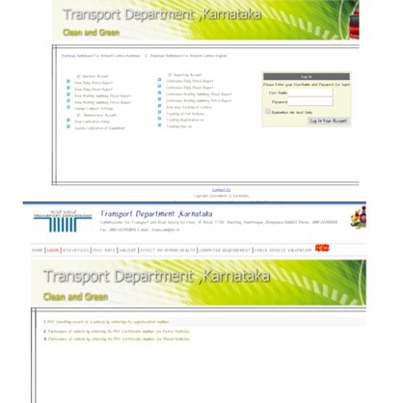
Figure Of Login Process
http://etc.karanataka.gov.in/ValidationRegno.aspx

Slide 12
Advantages
Gives the details about PUC records of vehicles.
This also help to check the validity.
Provides tracking system.

Slide 13
Disadvantage
This has no information on other details about the vehicles.
Even though it checks the validation of the PUC certificate it doesn’t give any remainder to the user.
Has no any platform for feedback.

Slide 14
CASE STUDY IIi–
Department of Transport, Goa
Transport website in Goa.
Enforcement of the motor vehicle act and rules.
Collection of taxes and fees.
Provides rendering services.
Controls automobile pollutions and gives road safety measures.
Provides better and speedy service to common man.

Slide 15
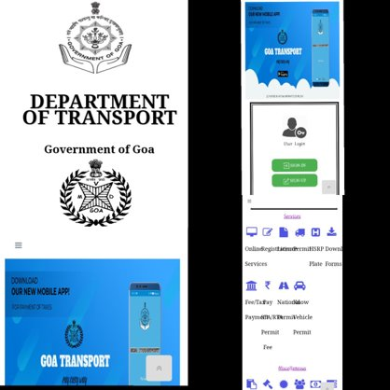
Website and Login Process Fig
https://goatransport.gov.in/Default

Slide 16
Advantages
Issues driving license, and other certificates.
Providing transport facilities to the public by granting permits.

Slide 17
Disadvantage
It doesn’t give remainder even if the certificate validity expired.
Pollution certificate is not recorded.
Tracking of vehicles is not there.
Have no platform to register online complaints

Slide 18
Proposed system
The purpose of preparing this document is to explain complete design details of our Digital Verification Of Vehicles
This detailed design report will mainly contain the general definition and features of the project, design constraints, the overall system architecture and data architecture. Additionally, a brief explanation about our current progress and schedule of the project will be provided in related sections.
Design of the system and subsystems/modules will be explained both verbally and visually by means of diagrams in order to help the programmer to understand all information stated in this document correctly and easily.

Slide 19
System Requirements
  FRONT END
    Language : PHP
  BACK END
    MySQL

Slide 20
Work plan
Work to be done | Done by | By when
UI Design | Alan Sha & Sojan P Renny | February to March
Wireframing | Alan Sha & Sojan P Renny | March to April
Front end, Back end | Aadhil Muhammed & Helvin Paulose | April to May
Connectivity | Aadhil Muhammed & Helvin Paulose | May to June

Slide 21
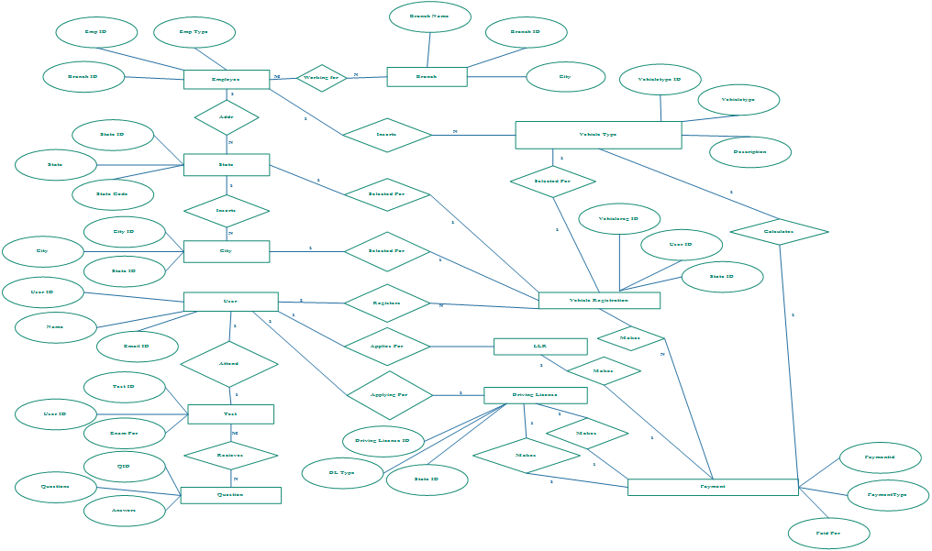
ER-diagram

Slide 22
Database design
branch
city
employee
Payment

Slide 23
Table
Branch
Column​ | Data Type​ | Index​ | Description​
branchid​ | int(10)​ | Primary key​ | Branch ID​
branchname​ | varchar(25)​ | Not null​ | Branch name​
branchaddress​ | Text​ | Not null​ | Branch address​
city​ | varchar(15)​ | Not null​ | City​
pin​ | varchar(10)​ | Not null​ | PIN code​
state​ | varchar(25)​ | Not null​ | State ​
status​ | varchar(10)​ | Not null​ | Branch status​
City
Column​ | Data Type​ | Index​ | Description​
cityid​ | int(10)​ | Primary key​ | City ID​
city​ | varchar(50)​ | Foreign key​ | City​
stateid​ | int(10)​ | Foreign key​ | State ID​
citycode​ | varchar(10)​ | Not null​ | City Code​
discription​ | Text​ | Not null​ | Discription​
status​ | varchar(10)​ | Not null​ | Status​

Slide 24
Table
Employee
Column​ | Data Type​ | Index​ | Description​
Empid​ | int(10)​ | Primary key​ | Emp ID​
Emptype​ | varchar(20)​ | Not null​ | Emp Type​
Branched​ | int(10)​ | Foreign key​ | Branch ID​
Empname​ | varchar(25)​ | Not null​ | Emp Name​
Loginid​ | varchar(100)​ | Not null​ | Login ID​
Password​ | varchar(100)​ | Not null​ | Password​
Status​ | varchar(10)​ | Not null​ | Status​
Payment
Column​ | Data Type​ | Index​ | Description​
Paymentid​ | int(10)​ | Primary key​ | Payment ID​
Paymenttype​ | varchar(25)​ | Not null​ | Payment Type​
Paidfor​ | varchar(20)​ | Not null​ | Paid For​
Paidamt​ | float(10,2)​ | Not null​ | Paid Amt​
Paiddate​ | Date​ | Not null​ | Paid Date​
Description​ | Text​ | Not null​ | Description​
Status​ | varchar(10)​ | Not null​ | Status​

Slide 25
Table
Employee
Column​ | Data Type​ | Index​ | Description​
Drivinglicenseid​ | int(10)​ | Primary key​ | Driving License ID​
Dltype​ | varchar(25)​ | Not null​ | DL Type​
Stated​ | int(10)​ | Foreign key​ | State ID​
Cityid​ | int(10)​ | Foreign key​ | City ID​
Vehicletypeid​ | int(10)​ | Foreign key​ | VehicleType ID​
Photo​ | varchar(100)​ | Not null​ | Photo​
Name​ | varchar(50)​ | Not null​ | Name​
Swdof​ | varchar(50)​ | Not null​ | SWD of​
Paddr​ | Text​ | Not null​ | PAddress​
Taddr​ | Text​ | Not null​ | TAddress​
Paddrduration​ | varchar(50)​ | Not null​ | PAddr Duration​
Dob​ | Date​ | Not null​ | DOB​
Qualification​ | varchar(50)​ | Not null​ | Qualification​
Identificationmarks​ | varchar(50)​ | Not null​ | Identification Marks​
Bloodgroup​ | varchar(10)​ | Not null​ | Blood Group​
Previousdl​ | varchar(50)​ | Not null​ | Previous DL​
Startdate​ | date​ | Not null​ | Start Date​
Enddate​ | date​ | Not null​ | End Date​
Entrydate​ | date​ | Not null​ | Entry Date​
Dlno​ | varchar(25)​ | Not null​ | DL No​
Note​ | text​ | Not null​ | Note​
Status​ | varchar(10)​ | Not null​ | Status​

Slide 26
Conclusion
The following subsections provide complete overview of the Documentation for the product “Digital Verification Of Vehicles”.
The document, we first define the overall product. Then, we give the external interface requirements, followed by a brief description of the product components and features.
In the last section, we have provided the non-functional requirements of the product. This Time we are presenting the Product

Slide 27
REFERENCES
Books:
    Software engineering by Pankaj Jalote.
    Learning PHP, MySQL, JavaScript and CSS: A Step-by-Step Guide to Creating Dynamic Websites by Robin Nixon.
    Website:
    www.w3schools.com
    www.tutorialspoint.com

Slide 28
THANK YOU

