Slide 1
关联规则算法
权鑫
2013年8月15日

Slide 2

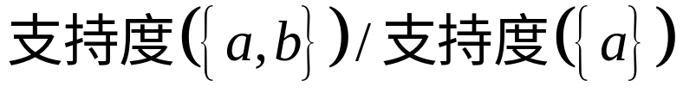
支持度：数据集中包含某项集的记录所占的比例
置信度：对于关联规则 ，其置信度为
频繁项集：支持度不小于给定最小支持度的项集
关联规则：置信度不小于给定最小置信度的规则

Slide 3
Apriori原理
若某个项集是频繁的，那么它的所有子集也是频繁的
若某个项集非频繁项集，那么它的所有超集也非频繁
避免项集数目指数增长，
可在合理时间内计算得到频繁项集。

Slide 4
Apriori算法
apriori(freqSet, k)
while len(freqSet) > 0
create a list of k items sets from freqSet
check whether the sets are frequent
keep the frequent item sets as freqSet
save freqSet
apriori(freqSet, k+1)
*freqSet is a set of frequent item sets whose length is k-1, so that we can create candidate sets whose length is k through ‘or’ each different sets.

Slide 5
FP-Tree
class fpTreeNode{
item_name
count
node_link
}
*item_name : name of item
*count : count of item in dataset
*node_link : point to next node which has the same item_name

Slide 6
FP-growth
createFPTree()
for each transaction in dataset
count each element item
keep frequent element items
for each transaction in dataset
if path of the transaction is existed
update count of the path
else
create a new path from difference
add first pointer of each element item into header table as index

Slide 7
FP-growth
mineTree(FPTree)
for each element item in header table:
add the element item into frequent set
get conditional pattern base
create conditional tree
if conditional tree is not null
mineTree(conditional tree)
*conditional pattern base is a set of path which is ending by the seeking element item

Slide 8
Apriori VS FP-growth
数据集：实际流量数据集kosarak（990002行）
算 法 | Apriori | FP-growth
耗 时 | 3小时以上 | 28s

Slide 9
Apriori VS FP-growth
Apriori
FP-growth
算法较为朴素简单
每次增加频繁项集大小时都需要重新扫描整个数据集，在数据集较大的情况下速度会明显下降
数据的增量式增加会较大程度上影响算法效率
算法使用了较为复杂的数据结构FP-Tree
只需完全扫描两边数据集，在大数据上具有较高的效率优势
对于增量型数据，更新FP-Tree的代价较低

Slide 10
关联规则挖掘
generateRules()
for each frequent set
for each kind of splitting
check whether it is generate rules

