Slide 1

2020 Engagement Survey
Jan 1 2020 – Jan 15 2020
Responses
Response Rate
Business Unit 1
6,742
75%

Slide 2
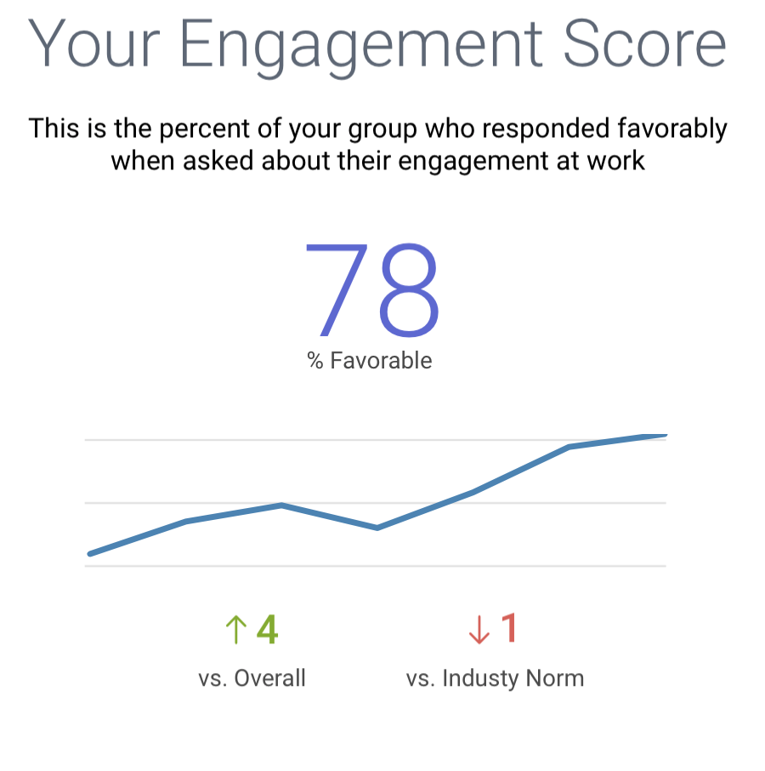

Slide 3


Slide 4
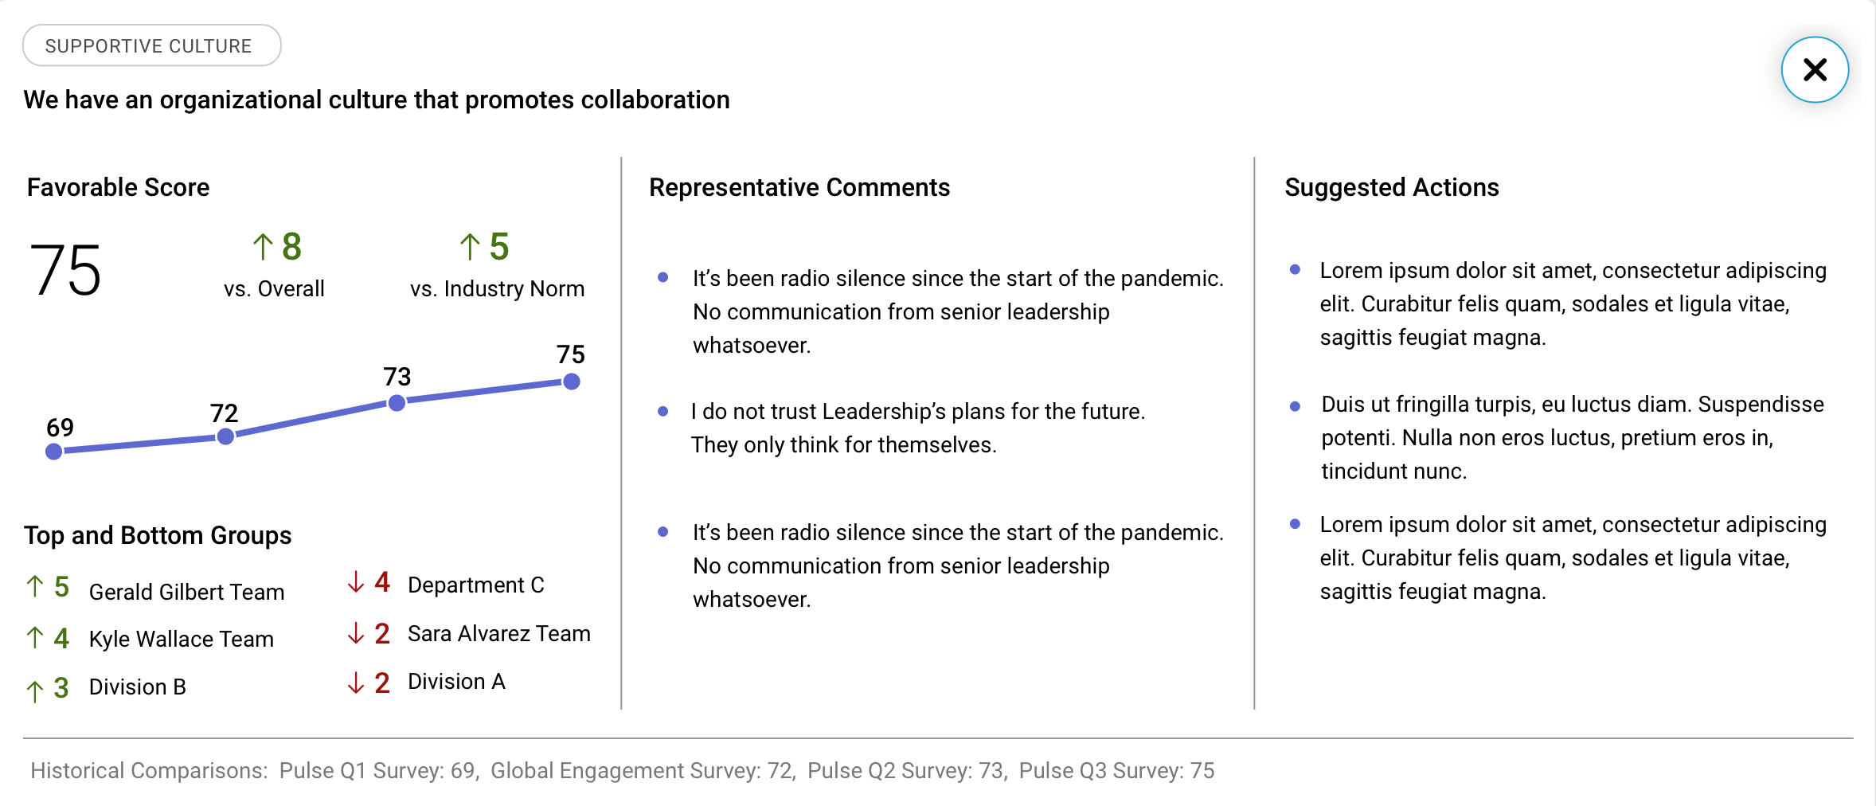

Slide 5
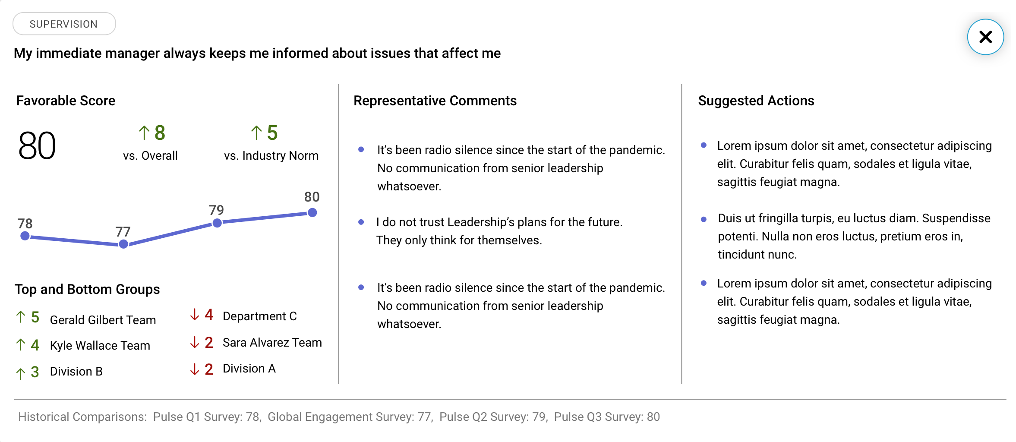

Slide 6
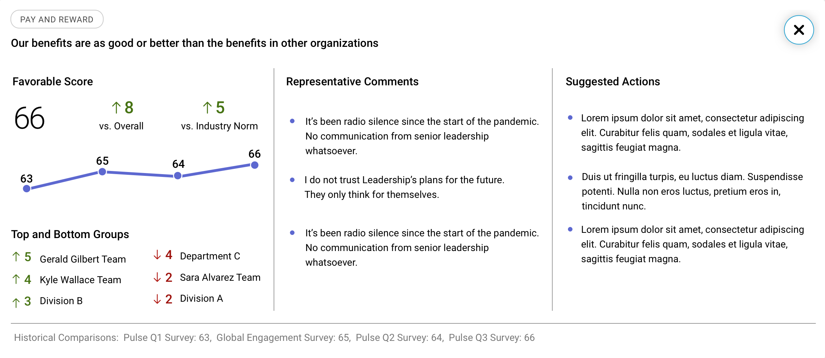

Slide 7


Slide 8
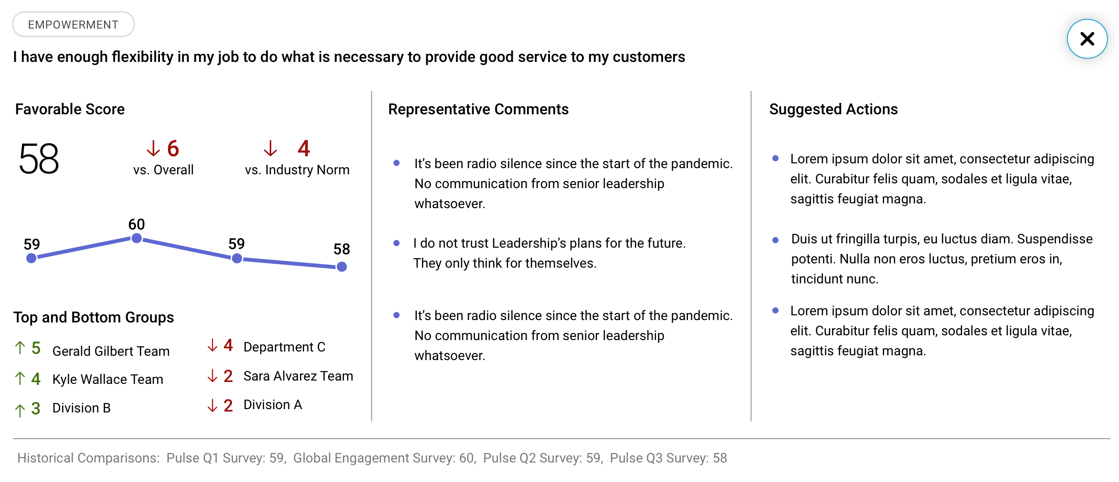

Slide 9
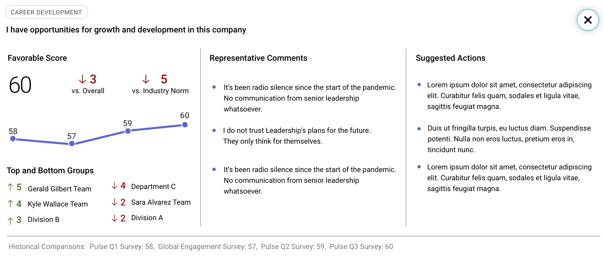

Slide 10
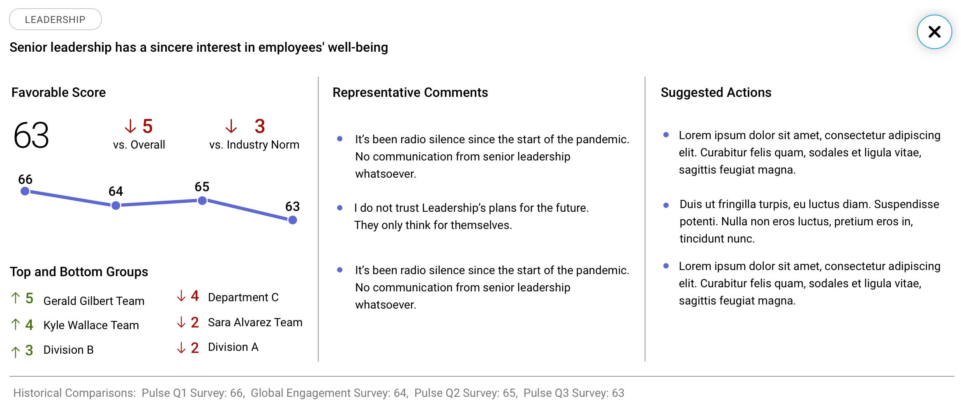

Slide 11
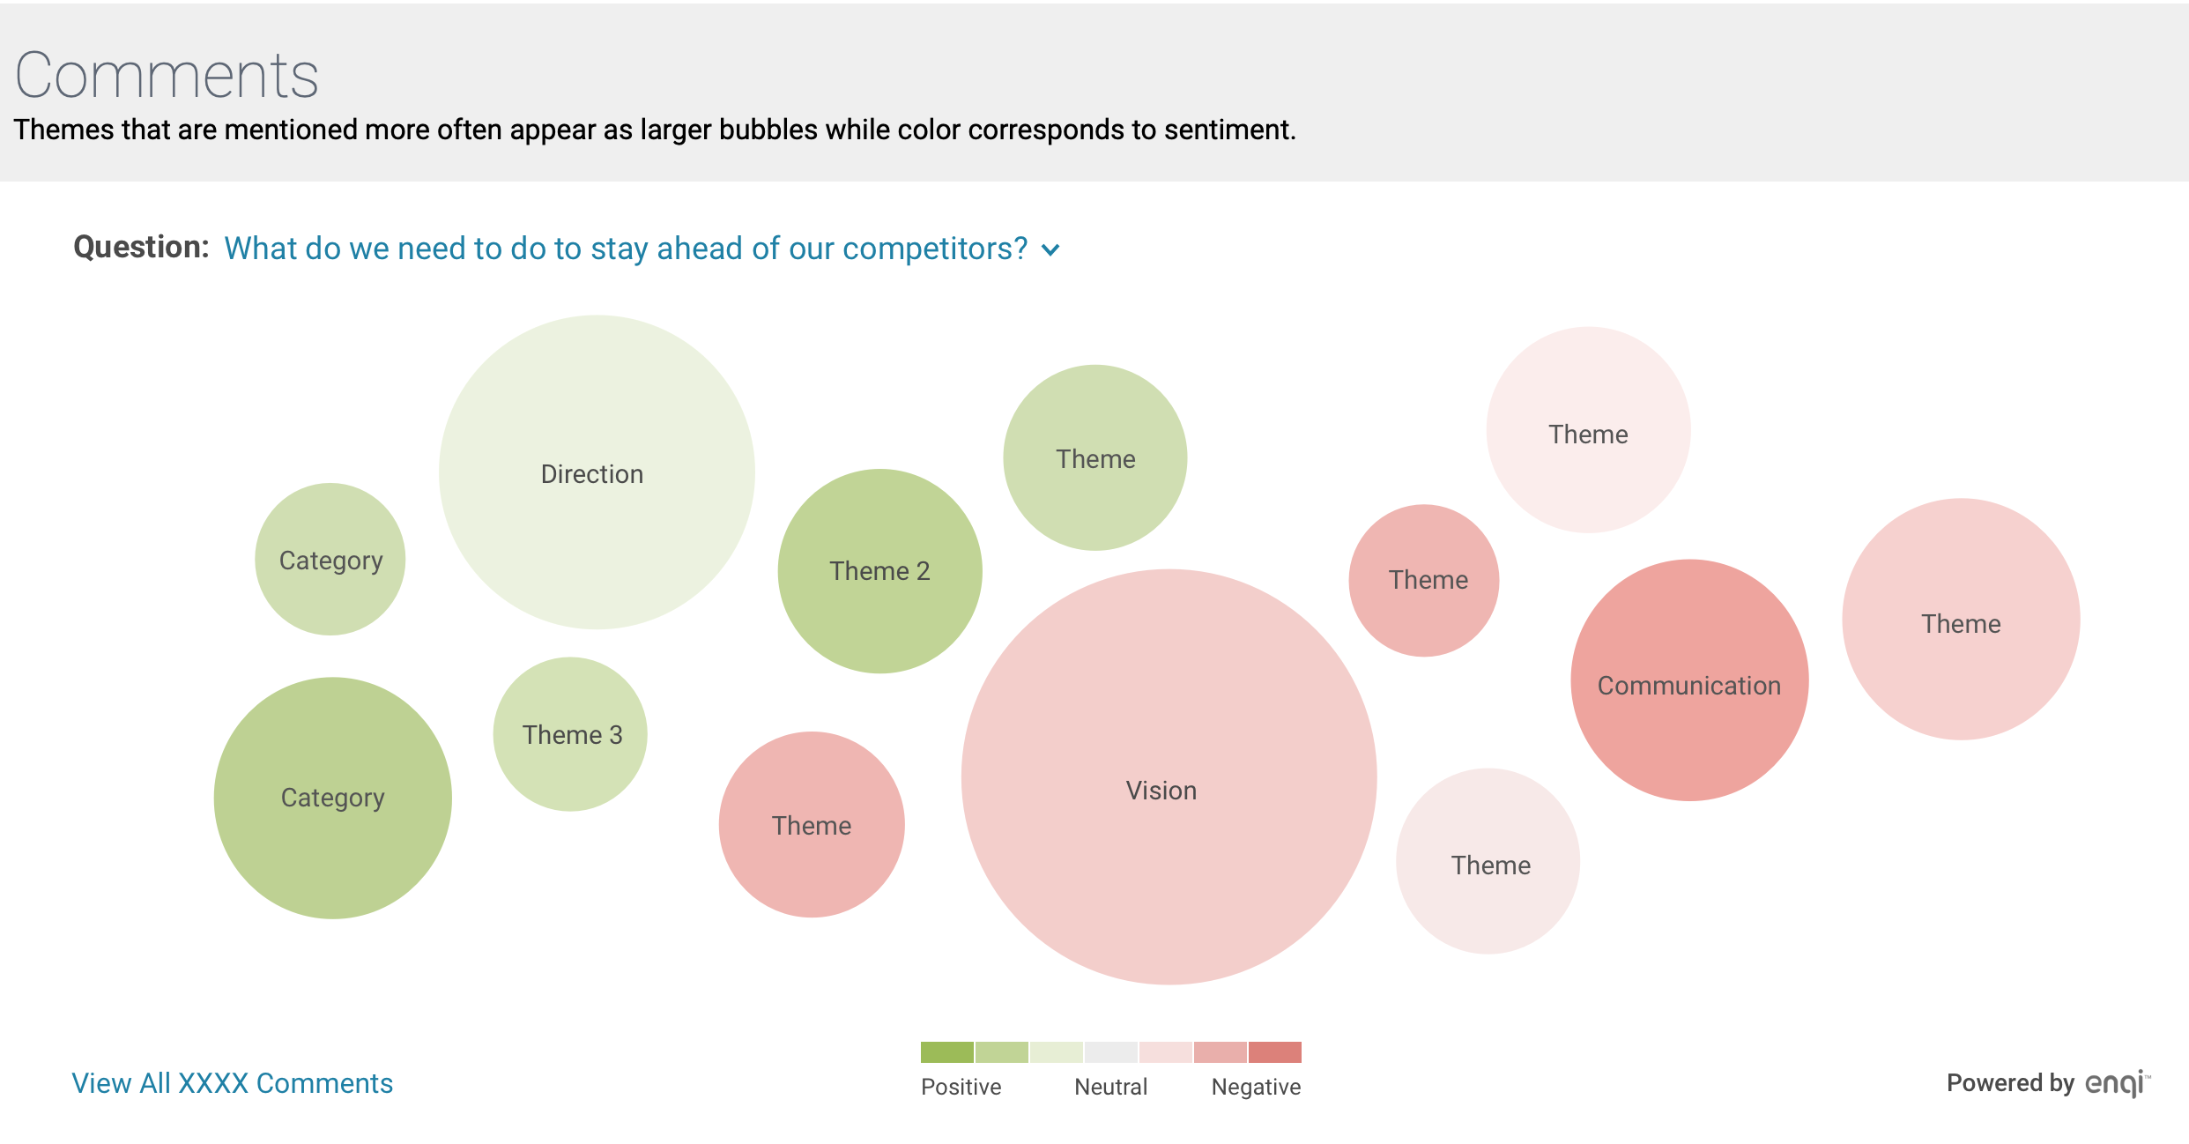

Slide 12
