Slide 1
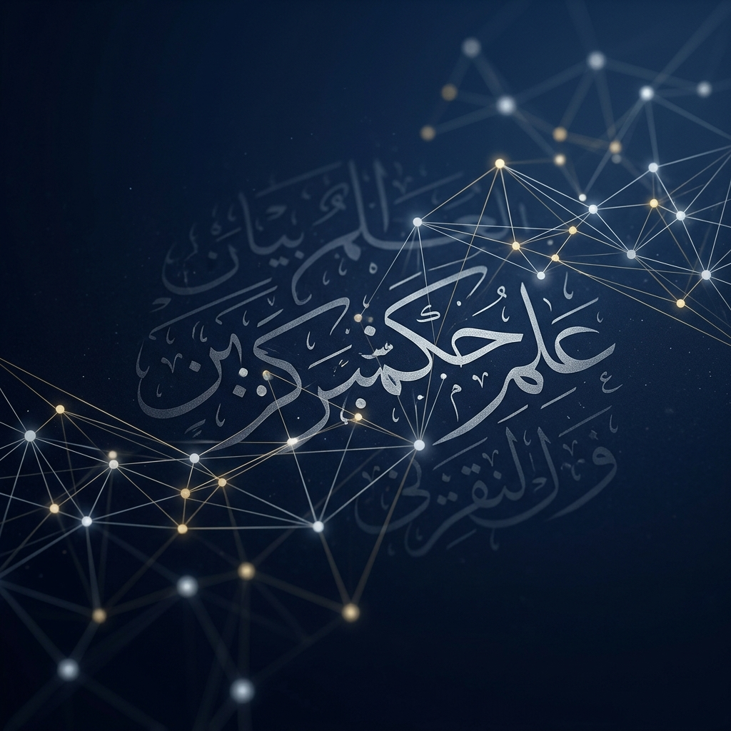
Automating Hadith Narrator Reliability
A Multi-modal Data-driven Framework for 'Ilm ar-Rijal
Presented by: [Your Name]

Slide 2
THE FOUNDATION
Understanding Hadith & Isnad
Hadith: Historical records of the Prophet Muhammad's teachings and actions.
Isnad (Chain): The list of narrators who transmitted the report (the 'Provenance').
The Problem: One unreliable link in the chain invalidates the entire report.
Analogy: A digital 'Blockchain of Trust' where every block (human) must be verified.

Slide 3
THE FOUNDATION
The Science of Narrators ('Ilm ar-Rijal)
Historical Context: Scholars tracked 500,000+ individuals over centuries.
Verification Criteria: Moral integrity, memory accuracy, and historical continuity.
Peer-Review (Jarh wa Ta'dil): A technical system of praise and criticism for grading.
Scale Problem: Manual verification cannot keep pace with the speed of digital texts.

Slide 4
THE PROJECT
Project Objectives
Automation: Quantify qualitative peer-reviews into a reliability index (0-1).
Network Modeling: Use Graphs to detect 'hidden' anomalies in transmission.
Benchmarking: Compare AI-generated scores with established historical gradings.
Decision Support: Empowering scholars, not replacing them.

Slide 5
THE TECHNOLOGY
Pillar 1: Named Entity Recognition (NER)
Challenge: Arabic names are complex (titles, lineages, affiliations).
AI Model: Fine-tuning AraBERT to extract names and resolve identities.
Identity Resolution: Ensuring 'Narrator A' in text 1 is the same as 'Narrator A' in text 2.

Slide 6
THE TECHNOLOGY
Pillar 2: Graph Neural Networks (GNN)
Knowledge Graph: Mapping student-teacher relationships as nodes and edges.
Structural Integrity: Detecting chronological errors (e.g., student born after teacher died).
Latent Features: Learning reliability patterns from the 'neighborhood' of narrators.

Slide 7
THE TECHNOLOGY
Pillar 3: Sentiment Quantization
Translation: Converting words like 'Trustworthy' (Thiqah) to 1.0 or 'Weak' (Da'if) to 0.2.
Aggregation: Calculating the 'Total Chain Reliability Score' (R = ∏ w_i).
Accuracy: Validating against canonical books (Sahih Bukhari, etc.).

Slide 8
FINAL SUMMARY
Significance & Future Impact
Historical Preservation: Modernizing the world's oldest peer-review system.
Digital Safety: Protecting the Sunnah from digital misinformation.
Interdisciplinary: Merging 7th-century scholarship with 21st-century AI.

Slide 9
Thank You
Questions & Discussion

