Slide 1
Distributed and Parallel Systems Truck Platooning System Prof. Stefan Henkler, Prof. Olaf Borchert, Prof . Noura Sleibi
Team Members:
Alan Thomas - 7209936
Anish Salvi - 7210036
Ninad Dehadrai - 7210380
Rohan Ijare - 7209800

Slide 2
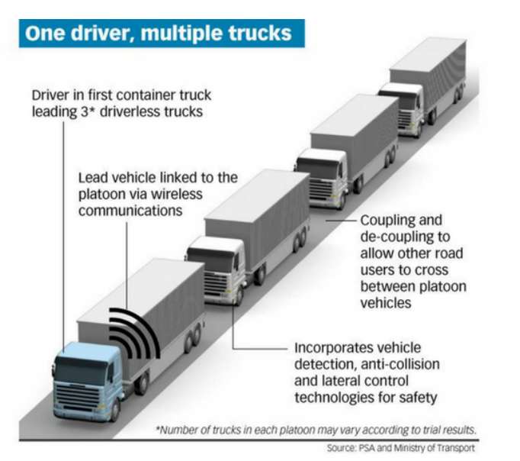
Use Case : A Truck Platooning Scenario
GOAL
Implementation and realization of a truck platooning system using the concepts of distributed and parallel system.
Understand how the distributed systems works and how parallel processes are performed.

Slide 3
WHAT IS TRUCK PLATOONING?
Truck platooning is the linking of two or more trucks in convoy, using connectivity technology and automated driving support systems.
Vehicles automatically maintain a distance between each other when they are connected for certain parts of a journey, for instance on highways.
The truck at the head of the platoon acts as the leader, with the vehicles behind reacting and adapting to changes in its movement .

Slide 4
WHAT ARE THE BENEFITS OF PLATOONING
Truck platooning holds great potential to make road transport safer, cleaner and more efficient in the future. That’s why truck manufacturers are eager to bring these platoons to Europe’s roads, and the first real-life tests are already underway.
Clean
Truck platooning lowers fuel consumption and CO2 emissions. Given that trucks can drive closer together, the air-drag friction is reduced significantly.
Safe
Truck platooning helps to improve safety. Braking is automatic and immediate; the trucks following the lead vehicle only need one-fifth of the time a human would need to react.
Efficient
Platooning optimizes transport by using roads more effectively, delivering goods faster and reducing traffic jams. The driving range of trucks can also be extended in certain situations.

Slide 5
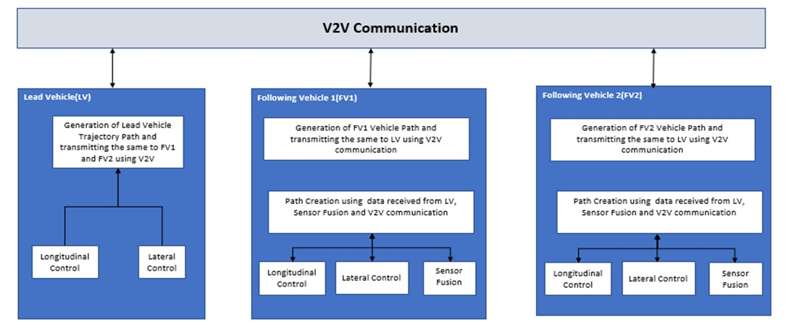
BLOCK DIAGRAM

Slide 6
CHARACHTERITICS OF TRUCK PLATOONING SYSTEM
Transparency
The system looks transparent in a way that only the driver in the Leading/Master truck controls the whole platoon but in real the preceding trucks can react to the environmental inputs. Since the precedence trucks are autonomous, logical algorithms for every truck is mapped to work in all environment scenarios independently.
Openness
Components from any supplier can be integrated into the system and can interoperate with the other system components. In case of communication V2V protocol is used for vehicle data communication. In our can we have implemented our system using TCP protocol.
Scalability
In case of truck platooning, system can be made scalable by connecting many follower vehicles. Join, maintain, leave, and keeping a safe distance between the trucks are the operations performed. At a given instance of time any number of trucks can join the platooning, for this additional configuration is required.

Slide 7
CHARACHTERITICS OF TRUCK PLATOONING SYSTEM
Security
The system needs to be highly secured and protected using Encryption and Decryption algorithms. If the system is not secured, then it can cause severe fatality on roads. The system should be robust enough to protect itself from any type of attacks in the form of interception.
Latency
In truck platooning where services are managed autonomously, it will result in a more efficient system but at the same time, it will have latency as services are operated independently. When the messages are not received from the front vehicle for a long period then an alive counter logic can implement to check the status of the platoon. In case when messages are not received then platoon can be decoupled, and every system can act independently using the data received from sensor fusion.

Slide 8
FUNCTIONAL REQUIREMENTS

Slide 9
COMMUNICATION PROTOCOL
For Truck Platooning V2V communication technology is used.
In our project, for implementing communication between Lead Vehicle(Server) and Follower Vehicle(Client) we are using TCP/IP protocol.
Advantage of using TCP/IP Protocol –
It ensures the data sent is error free and complete and in the same order as it is sent. IP is responsible for data routing and for data integrity.
It allows cross-platform communications among heterogeneous networks.
It is a scalable, client-server architecture. This allows networks to be added without disrupting the current services.

Slide 10
FAILURE MANAGEMENT
Truck platooning can be referred to us as the number of trucks run as a fleet with shorter inter-vehicular distance, this communication is easy and reliable using V2V communication. Autonomous driving of the following vehicles does not depend on GPS since the vehicle cannot receive correct GPS signals in a few conditions like when driving through a tunnel or when there is communication loss. So V2V communication is more reliable. If there is any communication failure i.e., V2V communication is disconnected during platooning operation, and longitudinal/lateral cannot be performed. The controller cancels platooning, and the control mode of each vehicle is changed to independent autonomous driving mode this notification is sent to the driver.
For example, the longitudinal control mode is changed to Adaptive Cruise Control mode and lateral control is switched to Lane Keeping System.

Slide 11


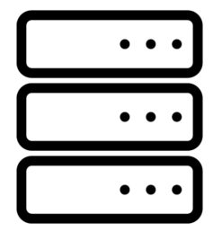
CLIENT-SERVER MODEL
Client Server Model is a distributed system that partitions task or workload between the providers of a resource or service, called servers and server requesters called client.
In this architecture, when a client sends a request for data to the server through the internet, the server accepts the requested process and deliver the data packets requested back to the client.
For the implementation of the Truck Platooning System, we are using 1-Tier Client-Server Architecture.
Request
Request
Response
Internet
Response

Slide 12
CLIENT-SERVER MODEL ADVANTAGE
Centralized system with all data in a single place.
System can be made scalable using client-server model.
Easier to take data backup as information is stored on server side.
Easier for authentication and controlling over access.
Reduce repair as the data or information can be accessed from anywhere.
Data communication is secure.

Slide 13
WHAT IS SOCKET ?
Socket is defined as one endpoint of two communication link between two programs running on the network.
The socket is bound to a port number so that TCP layer can identify the application that data is destined to be sent.
Stream Socket is a connection-oriented socket which uses TCP.
Server
Port
Connection
Client
Port

Slide 14
WHY JAVA?
Java is high level language and purely object-oriented programming language that provides features like modularity, information hiding etc.
Java is platform independent language which makes it easy for network programming.
It contains large number of readily available libraries.
Java includes classes that help network program communicate with certain types of servers and process different types of data.
Developing multithreaded application in Java is easy because Java provides inbuilt support with API.

Slide 15
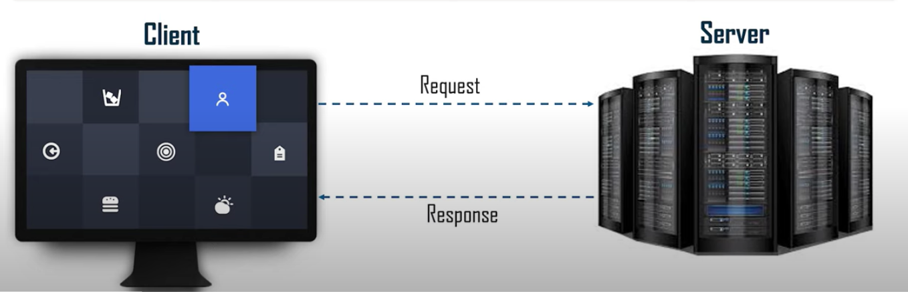
SOCKET PROGRAMMING IN JAVA
Java Socket programming is used for communication between the applications that is running on different JRE (Java Runtime Environment). It can be either connection-oriented or connection-less.

Slide 16
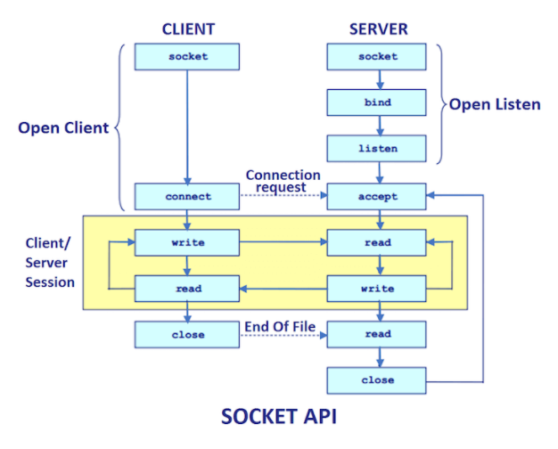
SOCKET PROGRAMMING IN JAVA
Two classes ServerSocket (server) and Socket (client) are present in java.net package
Creating Server –
ServerSocket ss=new ServerSocket(6666);
Creating Client –
Socket s=new Socket("localhost",6666);
Methods of Socket and ServerSocket Class –
getInputStream() – Returns the input stream attached with the socket
getOutputStream() – Returns the output stream attached with the socket
accept() – Returns the socket and establish between client & server
close() – Closes the socket/server socket

Slide 17
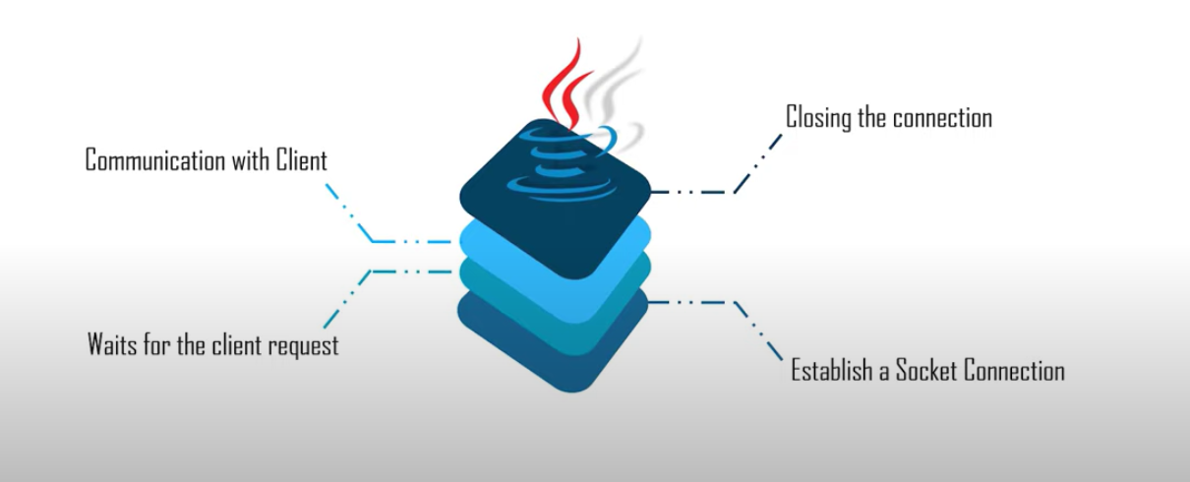
SERVER-SIDE PROGRAMMING

Slide 18
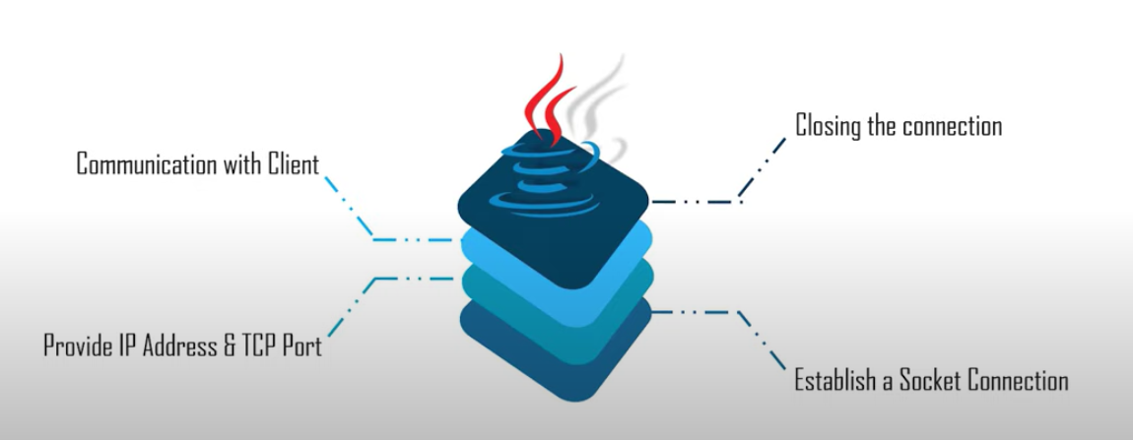
CLIENT-SIDE PROGRAMMING
Server

Slide 19
THREADS IN JAVA
Multithreading is a feature that allows concurrent execution of two or more parts of a program for maximum utilization of CPU. Each part of such program is called a thread.
Threads are light-weight processes within a process.
Threads can be created by using two mechanisms :
Extending the Thread class present in java.lang.Thread -> overrides run() method
Implementing the Runnable Interface -> overrides run() method
Thread execution start when start() method is called.

Slide 20
SCENARIOS IMPLEMENTED
Scenario 1
Truck platooning moving on the highway with no traffic travelling along a straight path.
Scenario 2
If an obstacle is detected in front of the leading vehicle on the highway, the leading truck will apply brakes and send a message to the following trucks, accordingly the follower truck will respond by applying brakes.
Scenario 3
If an obstacle is detected in between the follower truck, the follower truck will respond by decelerating its speed by applying the brakes and communicate the same with the master truck.
Scenario 4
If the leading truck finds a curve path on its ways, the driver will make the required turn and the vehicle lateral control signal message is sent to all the trailing trucks. The trailing trucks will then respond accordingly and keep following the master truck.

Slide 21
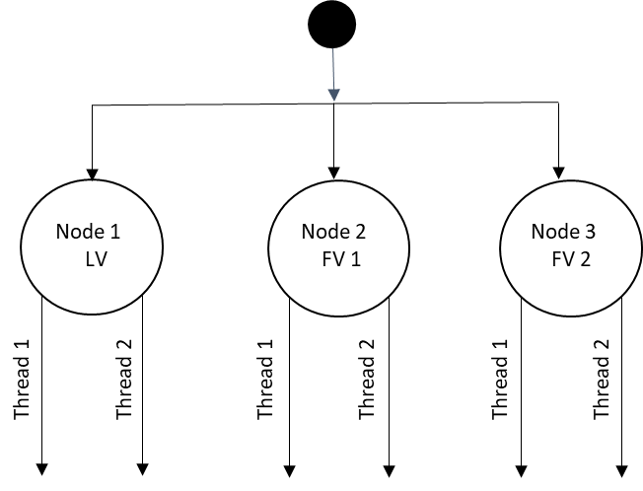
IMPLEMENTATION ARCHITECTURE
DISTRIBUTED & PARALLEL IMPLEMENTATION
Models of Interaction - In this Mode of interaction between vehicles can be done through Message-based protocol.
Architectural Pattern – For this platooning, we are using Serve –Client architecture, in which the lead vehicle will act as a Server and follower vehicles act as a Clients.
Architectural Styles – Event-based architecture.
For the Node Specific Parallel Implementation, Thread 1 and Thread 2 are used for data communication between LV(Server) and FV(Client).

Slide 22
CLASS DIAGRAM

Slide 23
ACTIVITY DIAGRAM

Slide 24
GitHub Code Link
https://github.com/alanthomas29/Truck-Platoon-System/tree/main/TruckPlatoonSystem

Slide 25
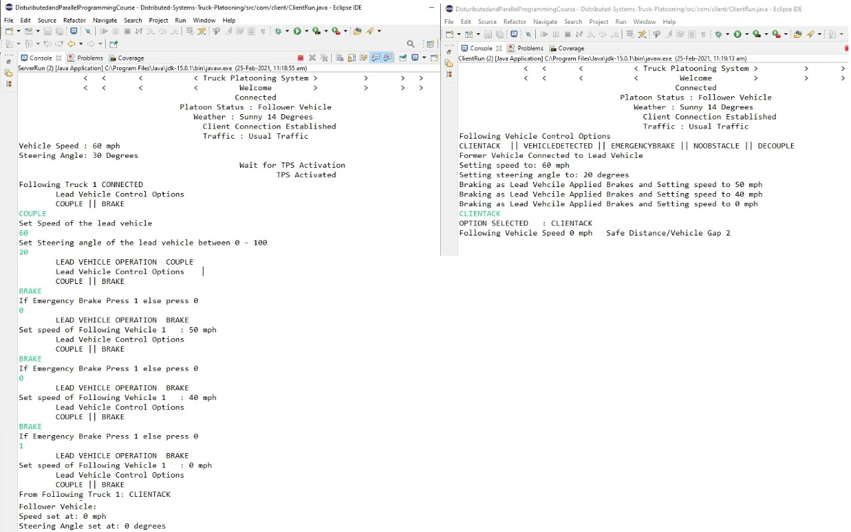
IMPLEMENTATION OUTPUT (Scenario 1)

Slide 26
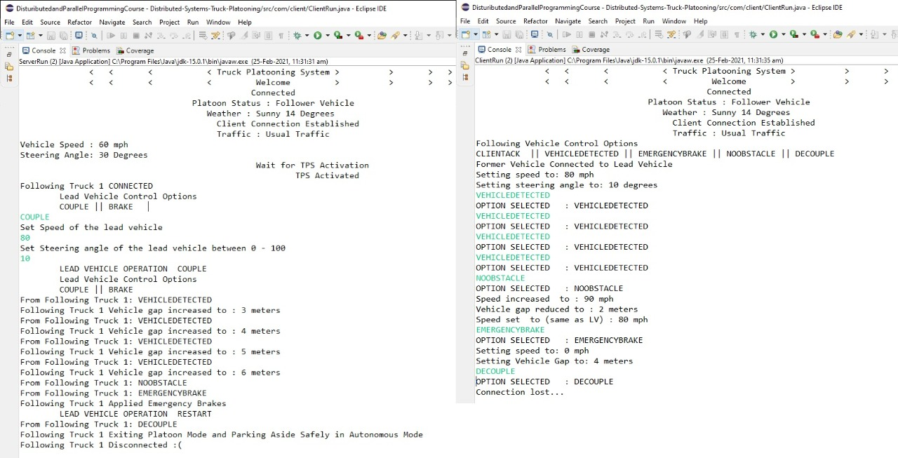
IMPLEMENTATION OUTPUT (Scenario 2)

Slide 27
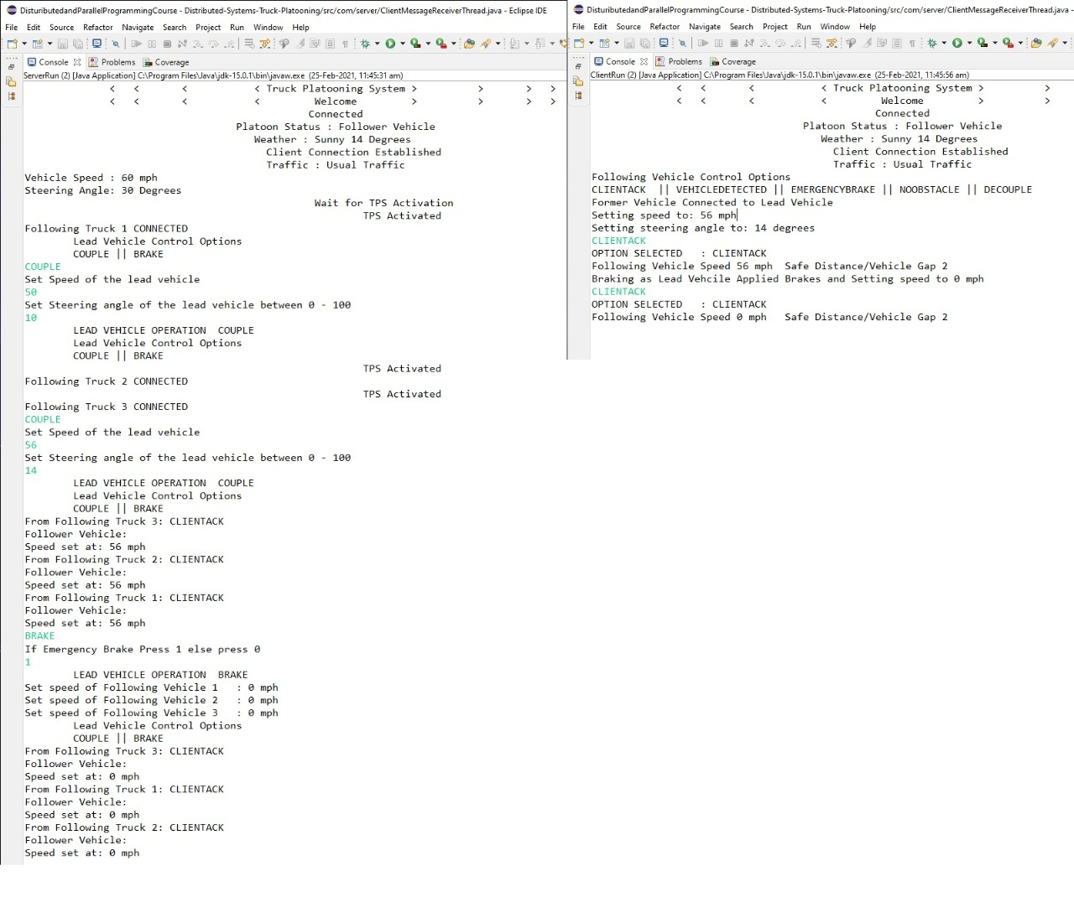
IMPLEMENTATION OUTPUT (Scenario 3)

Slide 28
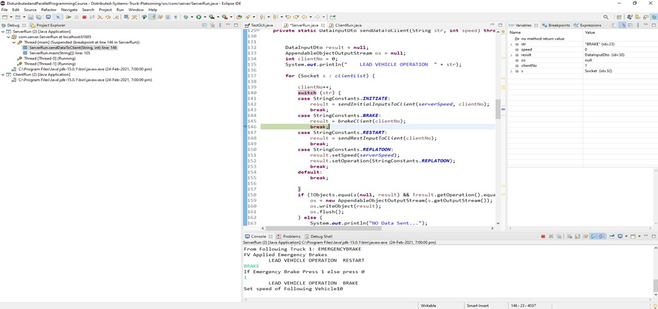
DEBUGGING SCREENSHOT

Slide 29
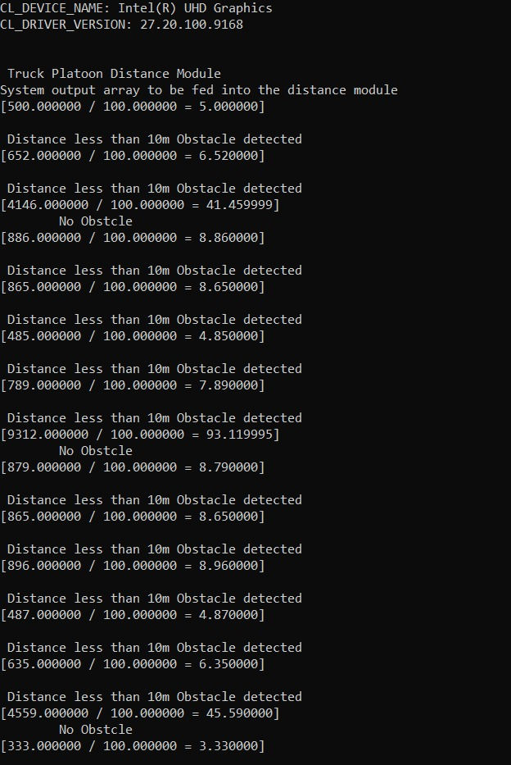
OPENCL MODULE OUTPUT

Slide 30
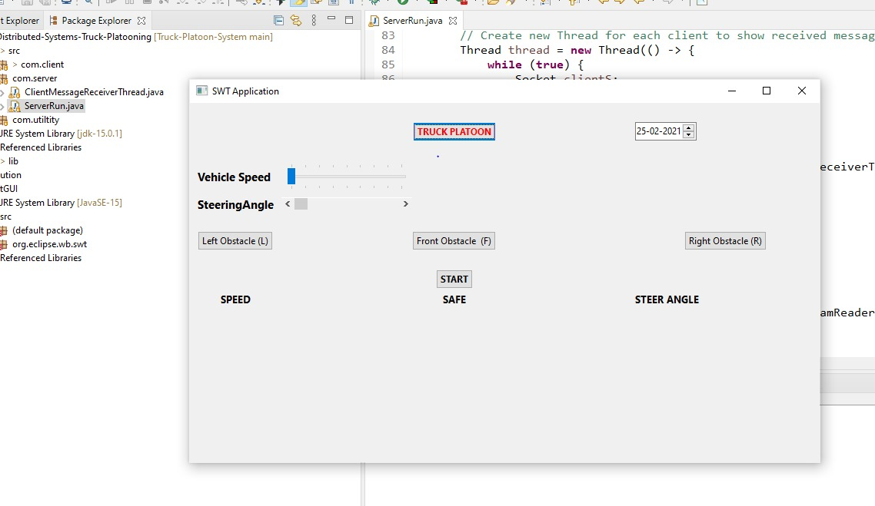
GUI FOR TRUCK PLATOON SYSTEM(Future Scope)

Slide 31
References
ACEA European Automobile Manufacturers Association Publication - https://www.acea.be/uploads/publications/Platooning_roadmap.pdf
www.edureka.co/java-j2ee-soa-training
https://www.geeksforgeeks.org/client-server-model/
https://www.labroots.com/trending/chemistry-and-physics/7405/band-semi-trailers-truck-platooning
https://www.javatpoint.com/socket-programming
Abhijit A. Sawant, Dr. B. B. Meshram / International Journal of Engineering Research and Applications (IJERA) ISSN: 2248-9622 www.ijera.com Vol. 3, Issue 1, January -February 2013, Network programming in Java using Socket.
https://www.aptiv.com/insights/article/what-is-sensor-fusion
Article - A Novel Path Planning Algorithm for Truck Platooning Using V2V Communication.
DPS Lecture notes

Slide 32
THANK YOU

