Slide 1
Fab Lab
Group 3: Alan Lam, Jared Madden, Jay Zhang

Slide 2
What is the design problem being addressed here?
TIME MANAGEMENT PROBLEMS
&
LOW EFFICIENCY LEVELS AT THE FABLABS.
Notes:
**Go into more detail about time management problems and efficiency levels**
Our project consists of creating an app to help users of Fabrication Laboratories (Fab Labs) with time management problems involving equipment scheduling. To increase the efficiency of Fab Labs, our app will offer features which include, but are not limited to, helping the users check the availability of different equipment, scheduling usage of equipment. We expect users to take advantage of the equipment scheduling function in our app to reduce productivity and time management problems. This app will be helpful at Fab Lab locations with high traffic and to connect potential developers with other Fab Lab users. Our app will effectively improve users’ time management by organizing the usage of machinery even with a limited availability from the Fab Lab.

Slide 3
Who are you designing for, and what is the context of their activities?
Lab Owner/Supervisor
Students
Faculty
Notes:
Generally a high knowledge of the system and previous experience dealing with a FabLab and/or scheduling details. The system could be used by the lab owner/supervisor to maintain a sense of order to their lab, ensuring that there are fewer conflicts and easier resolution of conflicts regarding the need of specific machines or workstations. This would potentially allow for an increase in desire to use the space, as the stigma of not being able to use the machine you need when you go to the space would be removed.
Undergraduate students would be expected to have limited to no knowledge of a FabLab or the proposed system, and little to no experience. Graduate students we expect to have a working knowledge of both, as well as at least some experience. The design of the system incorporates the users as those that use the various machinery in the FabLab. The potential for scheduling also allows for users to better conserve their time, as well as to meet with other users to discuss or learn about their projects.
The faculty would use the system in much the same way as students, with the added notion of supervising needs. Their knowledge and experience would be expected to be higher than students, but not necessarily as high as the Owner/Supervisor. The faculty could use it themselves, if they’re performing their own independent research project. Alternatively, they could use the app to both schedule and oversee their students working on their projects, or reserve a specific machine or workstation for use in their projects.

Slide 4
User research methods
Interview
Observation
Secondary Research
Notes:
For our project, we have used three user research methods.
The first method is Interview. Since none of us has been to a fab lab yet, the best way to know about fab labs is to interview a person who has experience with them. We sought both general information as well as details on potential problems with the lab usage.
The second method is Observation. We observed the fab lab on the 6th floor of the Math Science building, watched graduate students doing experiments in it, and took several photos about the lab. This method is useful to see what people actually do in fab labs, rather than just get information from what they said.
The third method is secondary research. We searched published articles, papers and online resources to help us on developing the design ideas. It is a useful and efficient way to ground our observation and to develop a point of view on our design.

Slide 5
main findings described
Fabrication labs are sometimes used as a place for courses, but they are mainly for research purposes.
The individual work time can take up to 6 hours.
Number of machines in a lab are limited.
Users usually do not know the status of the machine they want to use unless they go to the lab to check by themselves.
Notes:
According to our user research, fabrication labs are sometimes used as a place for courses, but they are mainly for research purposes.
The individual work time can be up to 6 hours.
Through our interview, observation, and secondary research, we found that the number of machines in a lab are limited. Therefore, it is inconvenient for users to use the machines at any time they want.
They usually do not know the status of the machine they want to use unless they go to the lab to check by themselves. For example, if one of the users took 30 minutes to come to the lab trying to do research and found that all the machines were occupied, he/she would waste a lot of time. In addition, if the 3D Printers they need have been used by someone, they have to ask that person to collect their project or get permission to move the completed object. Since it is quite inconvenient for users, they would like to know the status of machines and when people use it.

Slide 6
Major design ideas described
We considered building a lab machine booking application
Login Function
Calendar
Booking Function
Machinery Info.
We also found that we would need a page for each lab machine
Descriptions of lab machines
Favorite Function
Signal Light
Support Button
Lock Function
Notes:
In the brainstorm process, we considered building a lab machine booking application. As a booking application, we got an idea to use a login function for registered lab users to login. There should be a calendar built into the app. A book function would be needed and should be linked to certain machine calendars. It would show booked times and add new booking times to calendars when users tried to book machines.
Next, we found that we would need a page for each lab machine. It should have descriptions for certain lab machines and has a picture of that machine. One idea on this page is to create a favorite star selection. Once it is selected, that machine will become a user’s favorite machine and the user can get notifications from the app about that machine anytime. Another idea was a signal light showing the current status of that machine. If the light is yellow, it means the machine is in use. If the light is red, it means the machine is in need of repairing. If the light is green, then it means the machine is available. This signal light would have auto connectivity to each machine. Also, there would be a support button on this page in case users need technical support. What’s more, we found that sometimes users might not go to the lab even when they have a machine booked because of some emergency. So we are thinking about a lock function on the machine page. It will lock such that you can only find it enabled when you are close to the lab or in the lab. It will change the signal light from green to yellow once the user presses it.
In the end, we had an idea of a home page **It will be shown later on throughout this PPT presentation** It would be a list of the names of all lab machines and a signal light on the right. There could also be view buttons to get into certain lab machine pages.

Slide 7
Selected design ideas are discussed, and choice justified
For the calendar function
For the home page of the app
Notes:
During the implementation phase of the project, we had come across a few ideas for different aspects of our UI
Some of the ideas are: day view, week view, month view.
Some of the ideas are: list view, icon view, tile view.

Slide 8
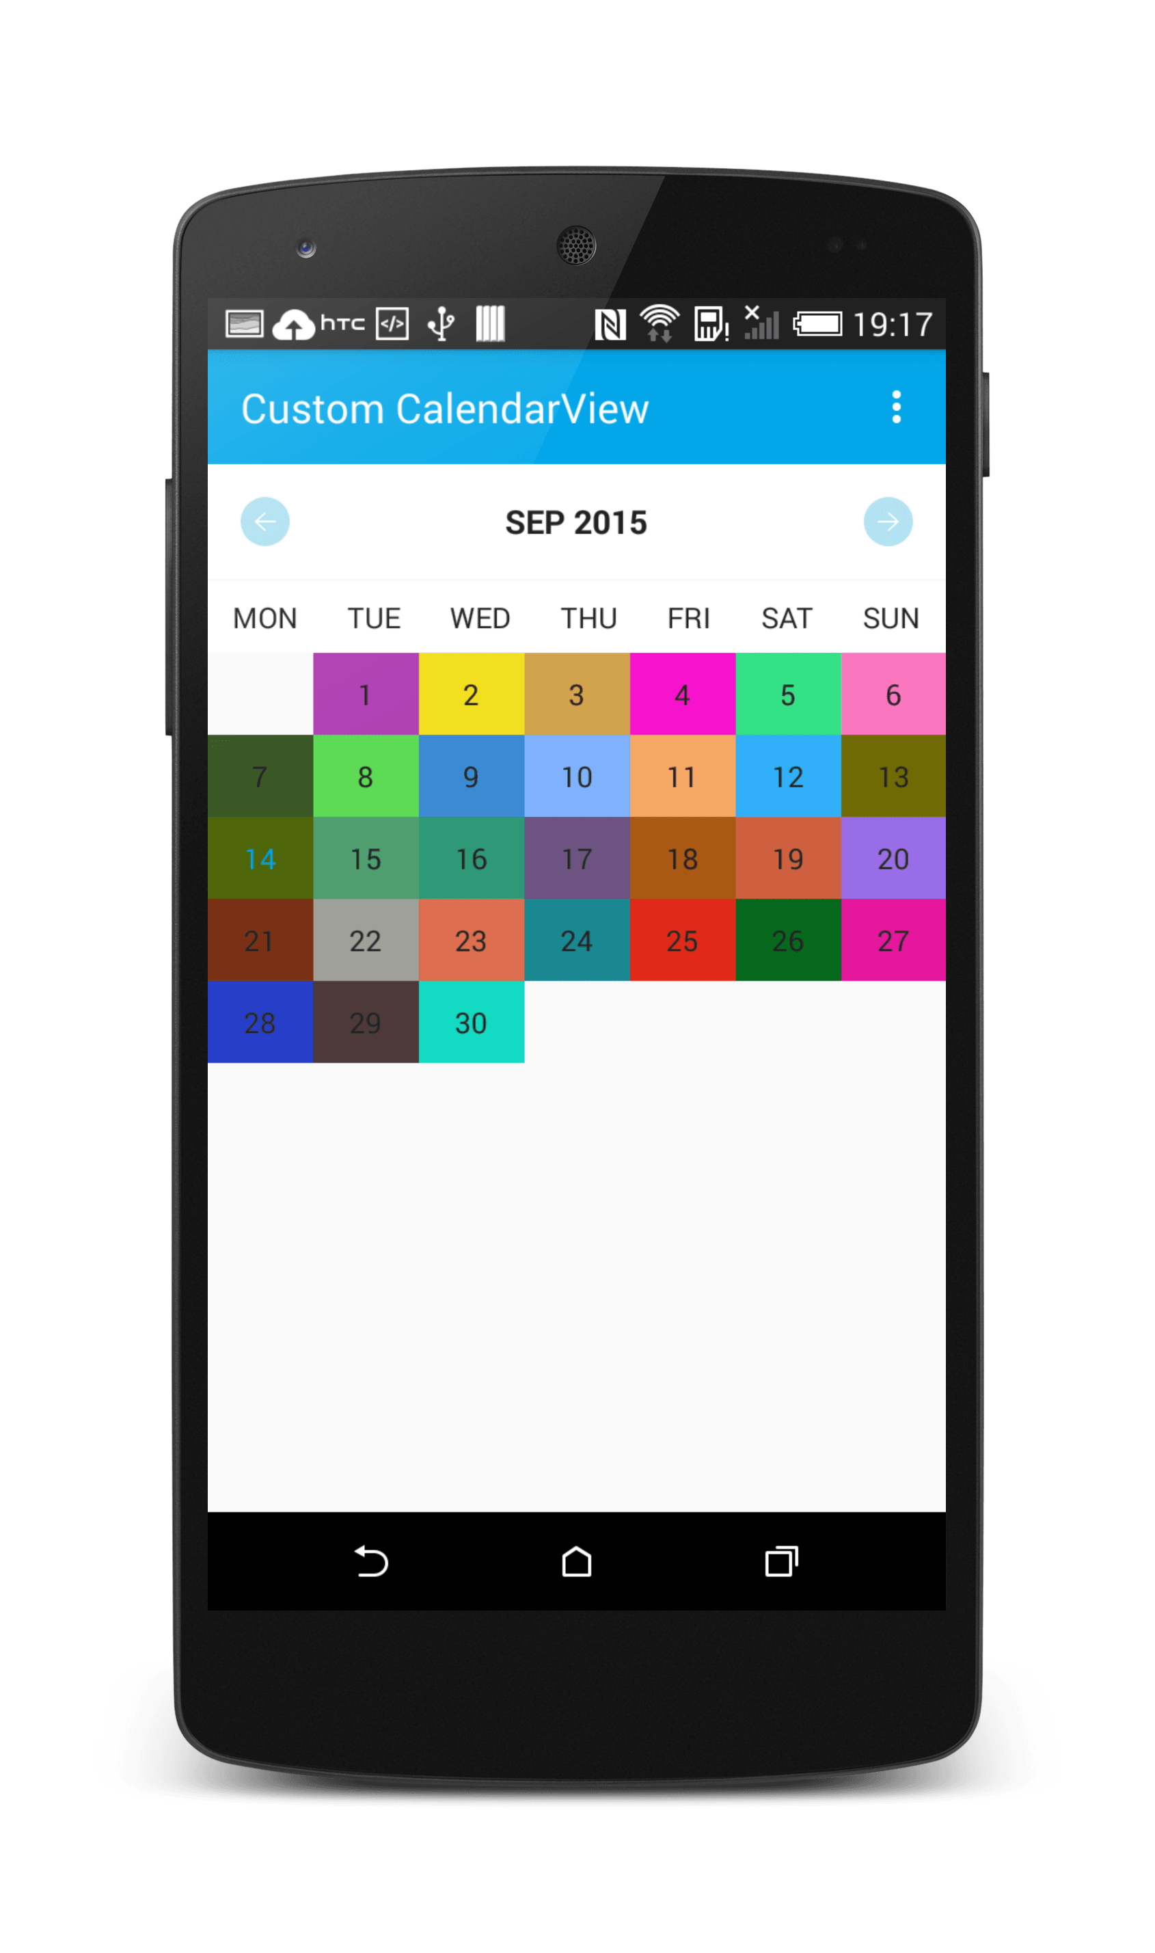
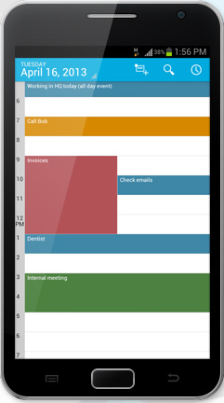
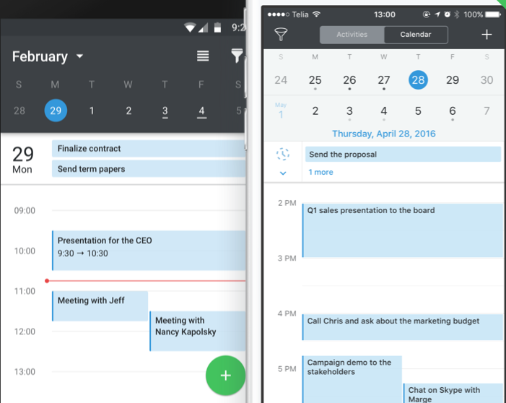
Calendar function

Slide 9
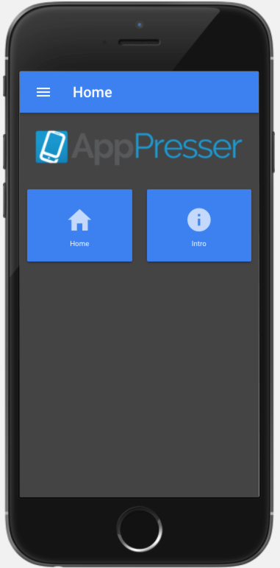
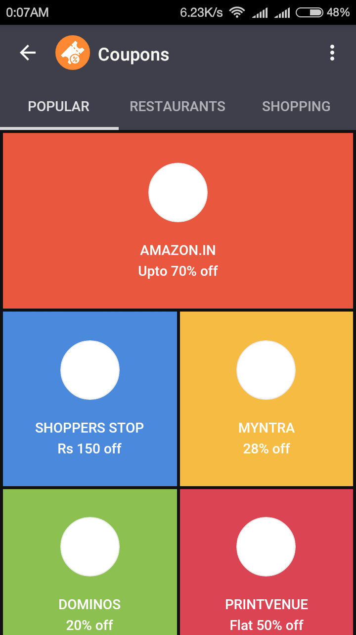
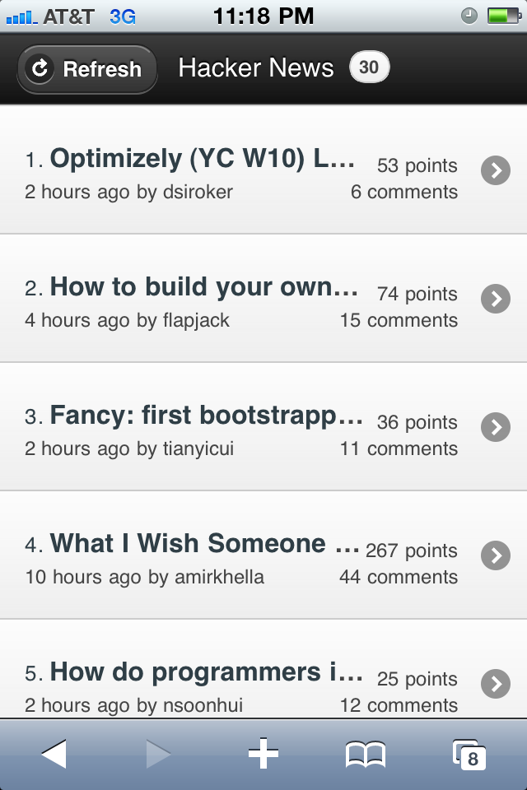
Home page

Slide 10
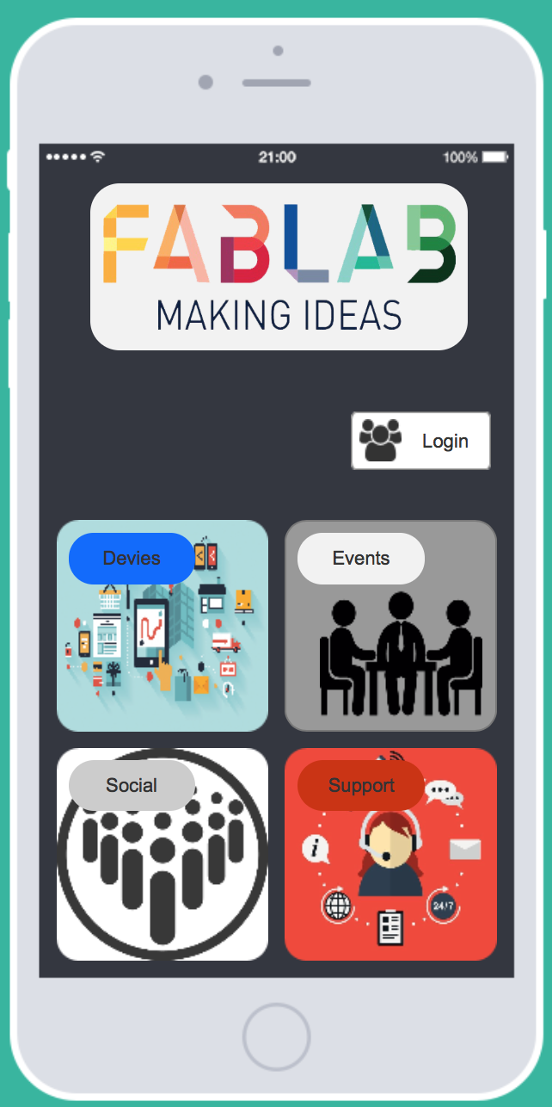
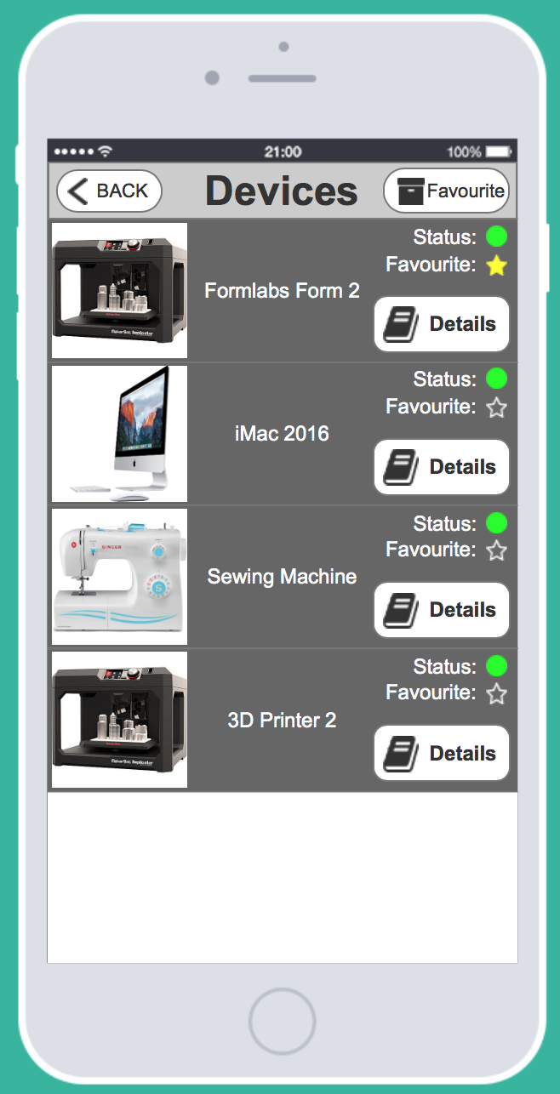
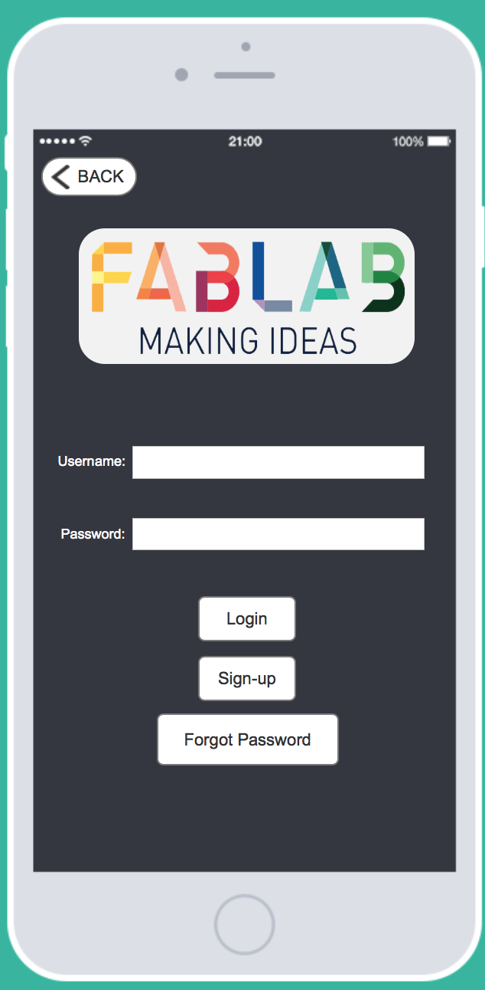
Brief summary of final system

Slide 11
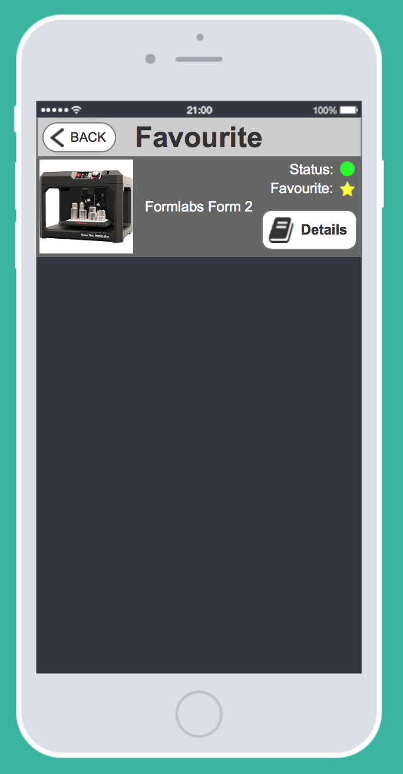
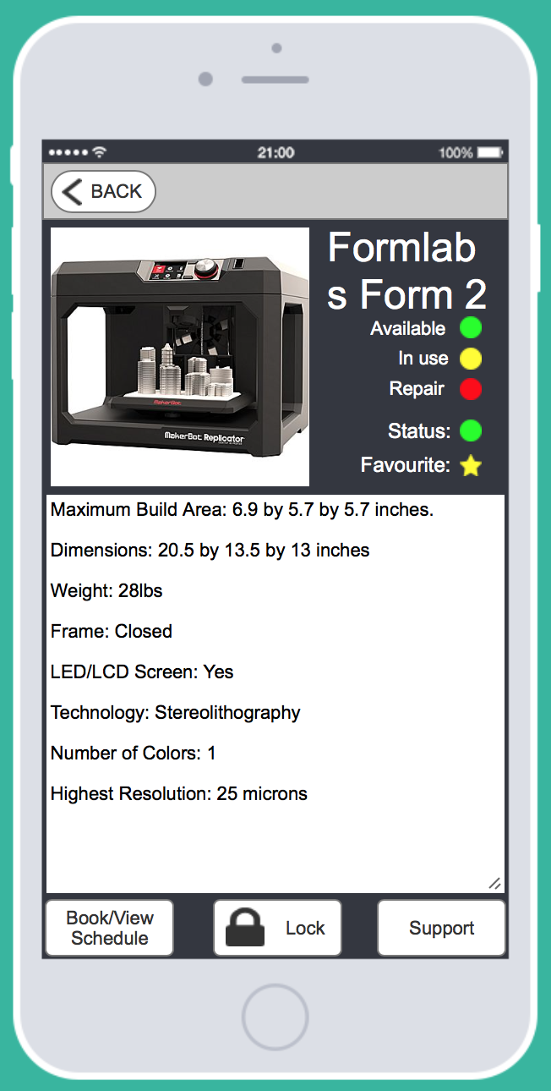
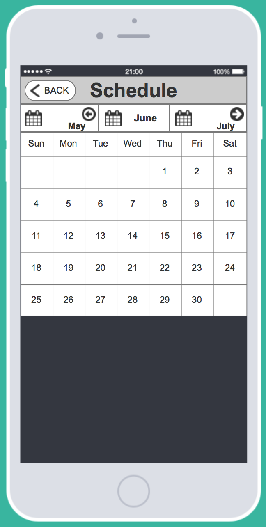

Slide 12
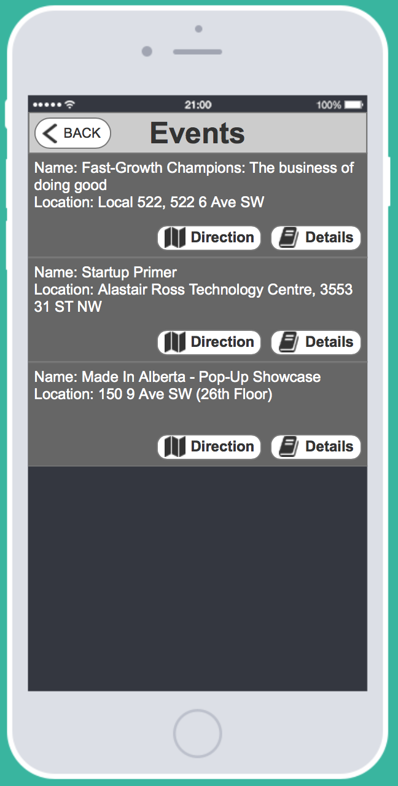
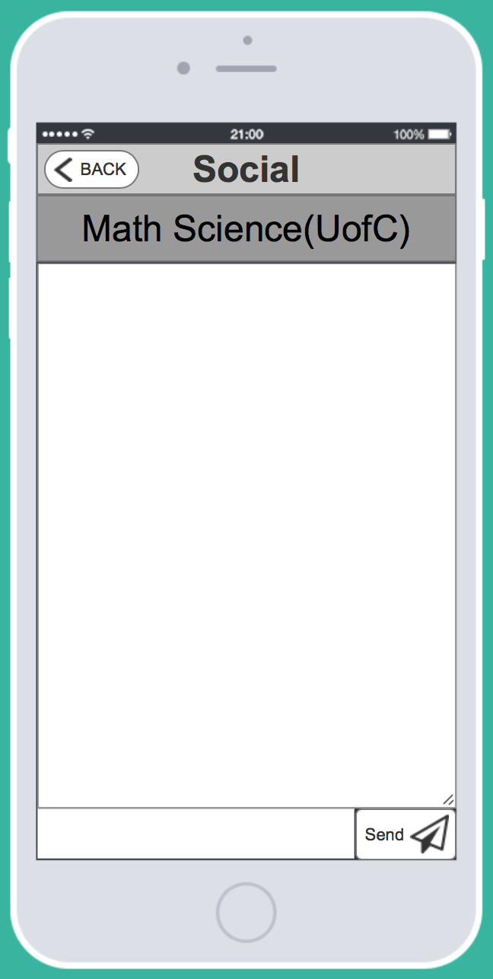
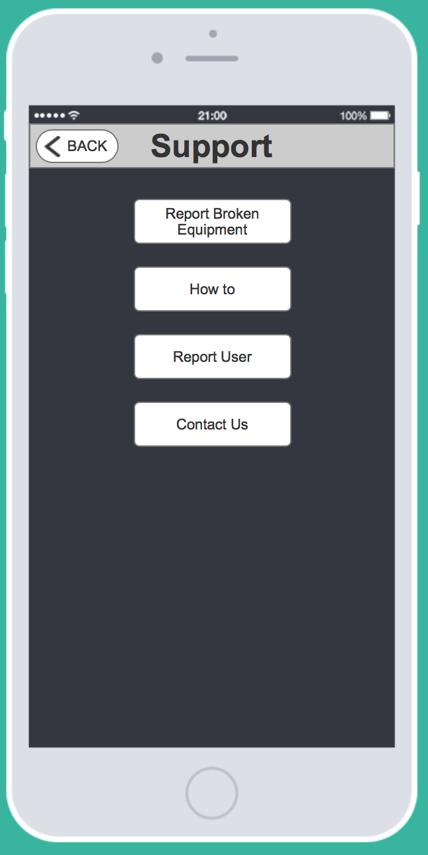

Slide 13
What did you discover from your heuristic evaluation?
Lack of a preventative measure if one user locks the device while another has it scheduled (overlapping time period)
Ambiguous "Lock" button for new users
No logout button for users
Poor navigation from the support page back to the previous page
No quick access functionality for frequent users
An ambiguous repair icon that may confuse users Based on these results, and their severity ratings, we hope to remedy these problems in the next iteration
Notes:
The major problems we identified included:
the lack of a preventative measure if one user locks the device while another has it scheduled (overlapping time period),
an ambiguous "Lock" button for new users,
no logout button for users,
poor navigation from the support page back to the previous page,
no quick access functionality for frequent users,
and an ambiguous repair icon that may confuse users.
Based on these results, and their severity ratings, we hope to remedy these problems in the next iteration.

Slide 14
Suggestions for future iteration of prototype
Notifications
List of ongoing projects
List of all FabLab locations
Calendar features
Notes:
For the next iteration of the design, we will include more features such as
notifications,
list of on going projects within the lab,
list of all FabLab locations in Calgary,
And enhance calendar features,
to create more convenience for its users.
These features intend to assist people who are new to FabLab and to increase the awareness of these facilities.

Slide 15
Thank you!

