Slide 1


Slide 2
Why Python?

Slide 3
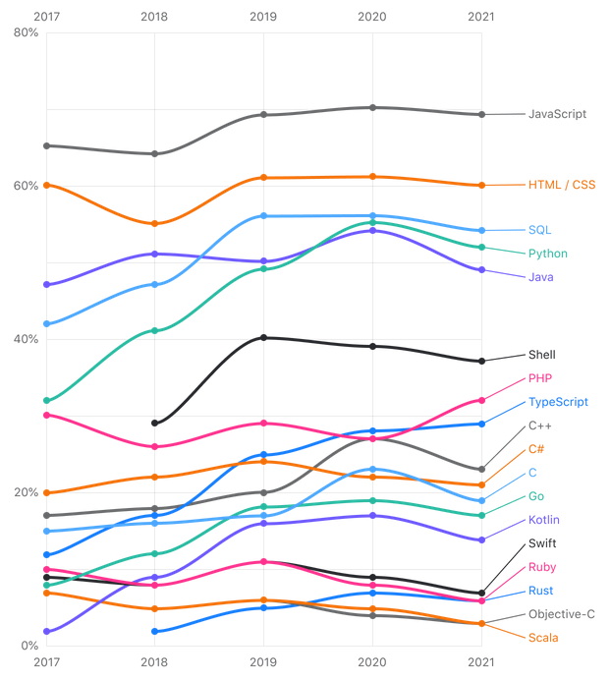
Popularity of programming languages over the last 5 years
  What programming languages have you used in the last 12 months?
  Source: The State of the Developer Ecosystem in 2021. JetBrains.
  https://www.jetbrains.com/lp/devecosystem-2021/

Slide 4
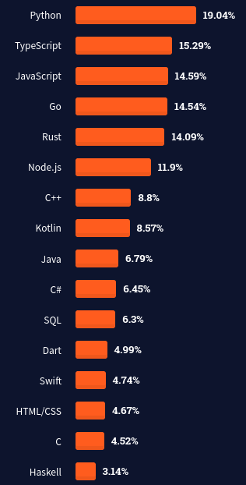
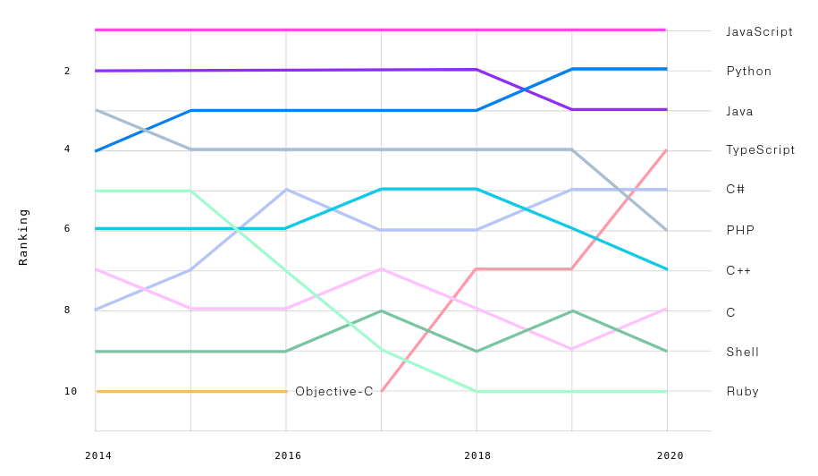
Python popularity
  % of developers who are not developing with the language or technology but have expressed interest in developing with it
  Source: State of the Octoverse 2020
  octoverse.github.com
  Source: Stack Overflow Survey 2021
  insights.stackoverflow.com/survey/2021

Slide 5
The tools

Slide 6




















Tools of the trade
Data engineering
Testing
Web Dev
ML/AI
Back end
SysAdmin
Data Science
Others
Kivy, Pygame, Requests, Tkinter, etc.

Slide 7
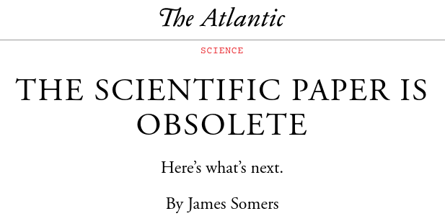

https://www.theatlantic.com/science/archive/2018/04/the-scientific-paper-is-obsolete/556676/

Slide 8
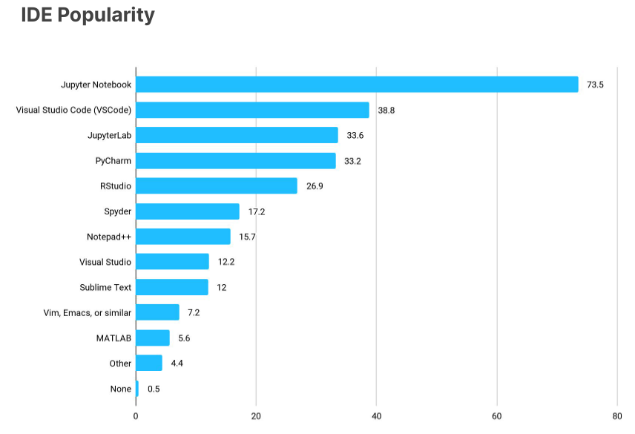
"Python-based tools continue to dominate the machine learning frameworks".
Kaggle – State of ML and Data Science 2021

Slide 9
Recommendations

Slide 10
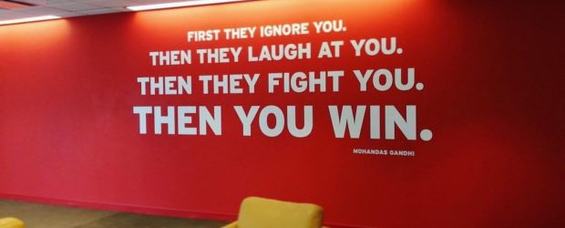


The future present is open
Open a GitHub / GitLab / BitBucket account
Learn what free and open really means
Start a project
Search for interesting projects
Create, contribute, colaborate
https://hacktoberfest.digitalocean.com/

Slide 11
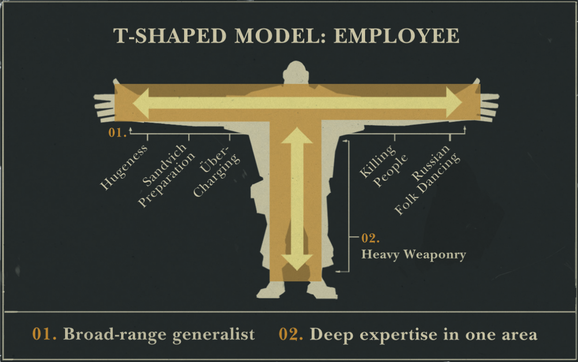
Source: Valve handbook for new employees
valvesoftware.com/en/publications

Slide 12
Bonus!

Slide 13

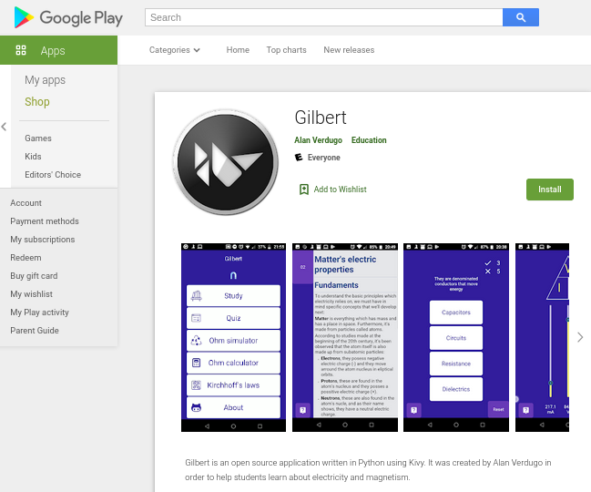
Gilbert
Aplicación Open Source para aprendizaje de Electricidad y magnetismo
Repositorio: https://github.com/alanverdugo/gilbert
Play Store: https://play.google.com/store/apps/details?id=net.kippel.gilbert

Slide 14

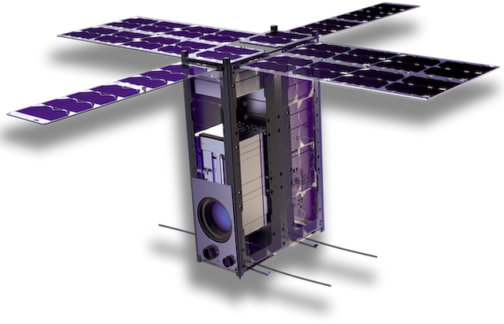
Endurance mission
The Sky Is Not The Limit!
6U CubeSat Platform
Onboard Computer (OBC)
Electric Power System (EPS)
Attitude Determination and Control
Subsystem (ADCS)
X-Band Transmitter
UHF Transceiver
Solar Panel
Leveraging IBM’s Edge Computing in Space solution (Powered by Linux and the microshift project started by Red Hat), developers will be able to execute containerized code on the Cubesat as it orbits the Earth.
The new era of space has just begun: Let us all work together to build the next frontier for innovation - Space!
https://endurancein.space

Slide 15
Recommended reading

Slide 16

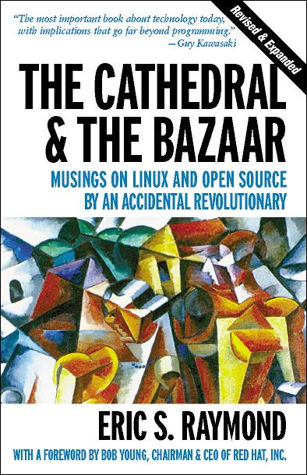

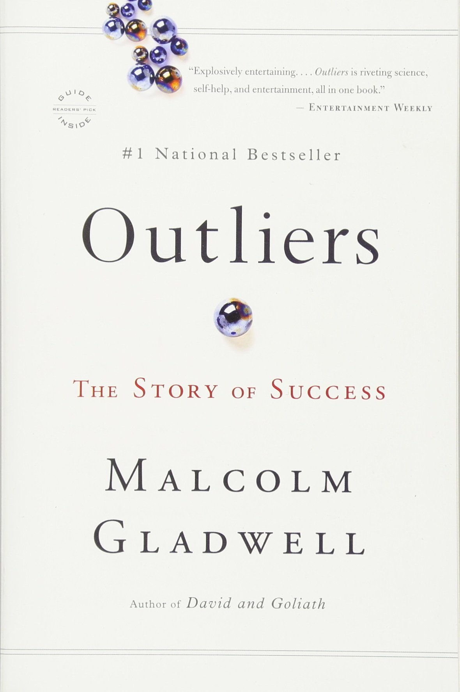
The information: A history, a theory, a flood.
The cathedral and the bazaar.
So good they can't ignore you.
Outliers: The story of success.
- Eric S. Raymond
- Cal Newport
- Malcolm Gladwell
- James Gleick

Slide 17



Q & A
Code:
https://github.com/alanverdugo
Slides:
https://github.com/alanverdugo/CUCEI_talk
E-mail:
alanverdugo@linux.com

