Slide 1
Developing Trilinos Within Containers
Samuel E. Browne, Anderson Chauphan, Joseph R. Frye, Caleb L. Jackson, Justin M. LaPre
Trilinos User-Developer Group Meeting 11/02/2023
SAND2023-11770PE

Slide 2
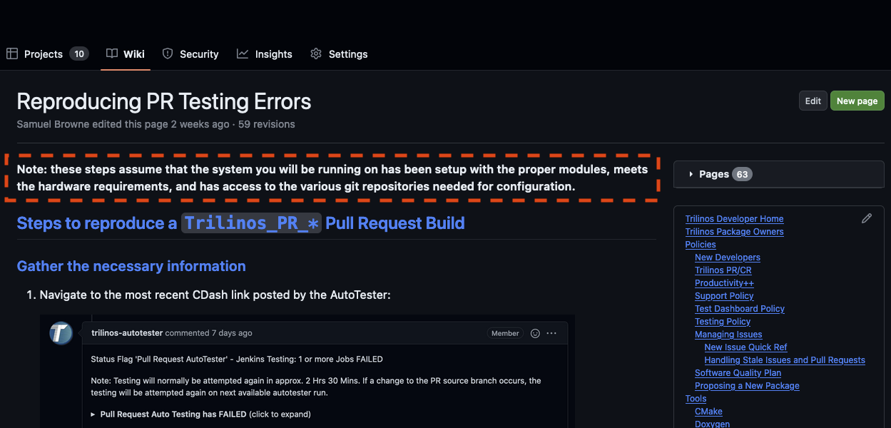
Managing Trilinos Build Environments
Currently use a home-grown system called ‘GenConfig’
Paired with third-party library modules that are maintained on our internal systems
How do individual developers replicate pull request builds/tests?

Slide 3
Externally-UNAvailable Requirements
5/7 GenConfig-related repositories
TPLs on hardware
Hardware itself (note that we have no control over this aspect)
How can we provide the configuration tool and a software environment (TPLs) that work together to external partners?

Slide 4
Making GenConfig Available to the Community
Continuing to use GenConfig (and related tooling) will require open-sourcing to make available to the broader community
This should not be an issue for most or all of the code developed as part of the GenConfig tool
May have some time delays, but doable

Slide 5

Making TPLs available to the community
Currently a team within Sandia deploys third-party libraries, compilers, and MPIs to select systems that are used for automated testing
Unreleasable to external partners for technical reasons
Also unavailable to internal systems outside the scope of the support agreement

Slide 6
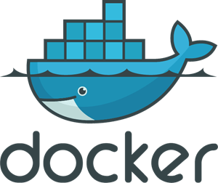

Containers as a mechanism for distributing TPLs
Containers handily solve the third-party software problem
There are limitations of reproducing novel software environments (e.g. DOE ATS systems), but these environments are not currently in pull request testing, and are outside the scope of this effort
Containers greatly simplify the act of setting up build environments
Complexity is still there, but is largely handled within the Dockerfile that describes how to build the container image
Complexity is removed from user workflow

Slide 7
How to run a container
# Authenticate if needed
docker login your-registry.yourdomain.com
# Pull the image that you want to use from the registry
docker pull your-registry.yourdomain.com/yourimage
# Run the image
# Remove container once it exits
# Run interactively and attach tty
# Run bash as the container entrypoint
docker run --rm –it --entrypoint bash yourimage

Slide 8
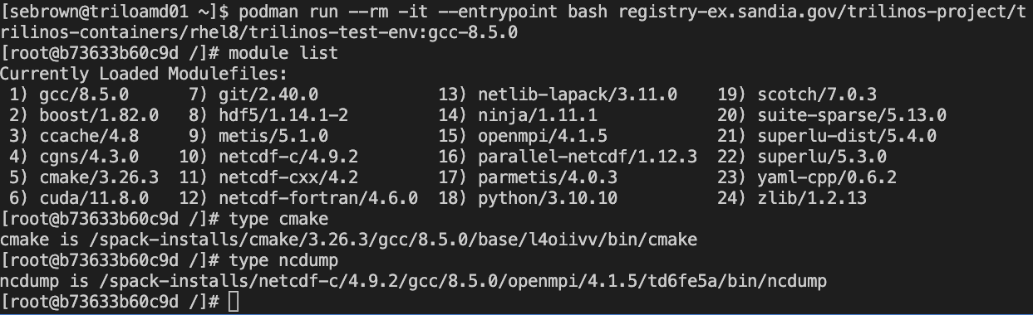
Example
Note that all TPLs are “Just There”, with no module load, source, etc. All (ish) of the complexity is baked
into the container recipe itself.
Can now clone Trilinos, or any other code you wish to develop.

Slide 9
How to mount your local code into a container
docker run --rm –it --entrypoint bash \ --mount type=bind,src=/path/on/your/machine,dst=/path/in/container \ yourimage
Allows you to get data in/out of container through the mounted directory
Depends on host filesystem (e.g. can have some issues when mounting a Windows directory into a Linux container)
Extension: It is possible to point VSCode at a container image and have it boot said image, mount your code project for you, and then place your terminal in the running container.

Slide 10
Containers help ensure consistency
Cons
There is overhead in learning to use containerized development environments
Pros
Near-perfect reproducibility between container runs
Ability to easily share development environments between developers
Anybody can create a new container on any machine with compatible architecture
Can take container used for “validation” runs (PR testing) and run locally on developer machines

Slide 11
Discussion

