Slide 1
Kokkos Kernels
Luc Berger-Vergiat, Siva Rajamanickam V. Dang, N. Ellingwood, J. Foucar, B. Kelley, E. Harvey, K. Liegeois, C. Pearson, E. Prudencio
Trilinos User Group meeting 2023 Albuquerque, New Mexico
SAND2023-11561PE

Slide 2
ECP / Sake updates

Slide 3
sake accomplishments
KPP-3 integrations:
ATDM application integrations SPARC and EMPIRE
Focused on features for solvers and preconditioners on AMD platforms (BlockTriDiag, ILU, Multigrid…)
Supports application milestones
ECP integrations
Integration with Trilinos and PETSc
Integration on AMD and Intel platforms
ALL KPP-3 are reviewed and approved by federal program manager
Trilinos contributes 1pt to Math Libraries
Kokkos Kernels contribute 0.5pt to Math Libraries, 0.5pt to ATDM
Sake amongst the first math libraries project fully approved

Slide 4
Platform support

Slide 5
HIP Backend
HIP moves out of experimental in Kokkos 4.0.0
Kokkos::Experimental::HIP becomes Kokkos::HIP
Kokkos Kernels internal library clean-up
More rocBLAS/rocSPARSE coverage
SpMV: single vector, multivector and block variants supported
SpGEMM and block SpGEMM
All Blas2/3 and most Blas1 supported
Stream support using Kokkos execution space

Slide 6
SYCL Backend
Still experimental, although more mature
Almost all tests passing on Ponte Vecchio (still issue with SpGEMM)
More TPL support of oneAPI MKL
Nightly testing of SYCL, should promote to CI once stable and if testing capacity allows
Integration with Trilinos and PETSc
Runs using ship_003 from SuiteSparse and Kokkos Kernels native SpMV

Slide 7
New features

Slide 8
General Library updates
Library reorganized by components
Blas
Batched dense/sparse
Sparse
Graph
ODE (WIP)
Added oneMKL TPL
Kokkos Kernels version macros
CMake: KokkosKernels_VERSION
Header (KokkosKernels_config.h): KOKKOSKERNELS_VERSION

Slide 9
General Library updates
Google Benchmark TPL
Enable with: KokkosKernels_ENABLE_TEST=ON + KokkosKernels_ENABLE_PerfTests=ON + KokkosKernels_ENABLE_Benchmarks=ON
Configuration output
KokkosKernels::print_configuration(std::ostream&)
Prints library version and TPL information
Feedback welcomed on what additional information should be printed!

Slide 10
BLAS
Blas completeness
Blas1 complete
Blas2
General/Symmetric matrix needs SYMV to be complete
No packed/banded algo yet
Blas3
General/Symmetric: need SYMM, HEMM and rank k/2k updates
All Blas algorithms support stream execution
KokkosBlas::myBlasKernel(space, …);
General maintenance of TPLs
Added support for newer versions of cuBLAS/rocBLAS
Working on oneMKL support for Intel GPUs

Slide 11
Sparse
Sparse format conversion
coo2csr, csc2csr
Merged based SpMV for unbalanced rows in matrix
SpGEMM
New “reuse” interface, saves graph of previous matrix
Improved TPL support (MKL, cuSPARSE) new rocSPARSE support
Incomplete factorizations
New parILUt algorithm (iterative computation of L and U)
New MDF(0) algorithm (re-orders following Frobenius norm of discard factor on the fly)
Stream version of ILU(k) and SpTRSV

Slide 12
Sparse
Brs format support
Improved SpMV performance especially on AMD platform with TPLs
Results below: 1 vector, block size = 7, rocm 5.2.0
CrsMatrix sort and merge
Needed for some TPL
Useful after SpGEMM and or MPI communication

Slide 13
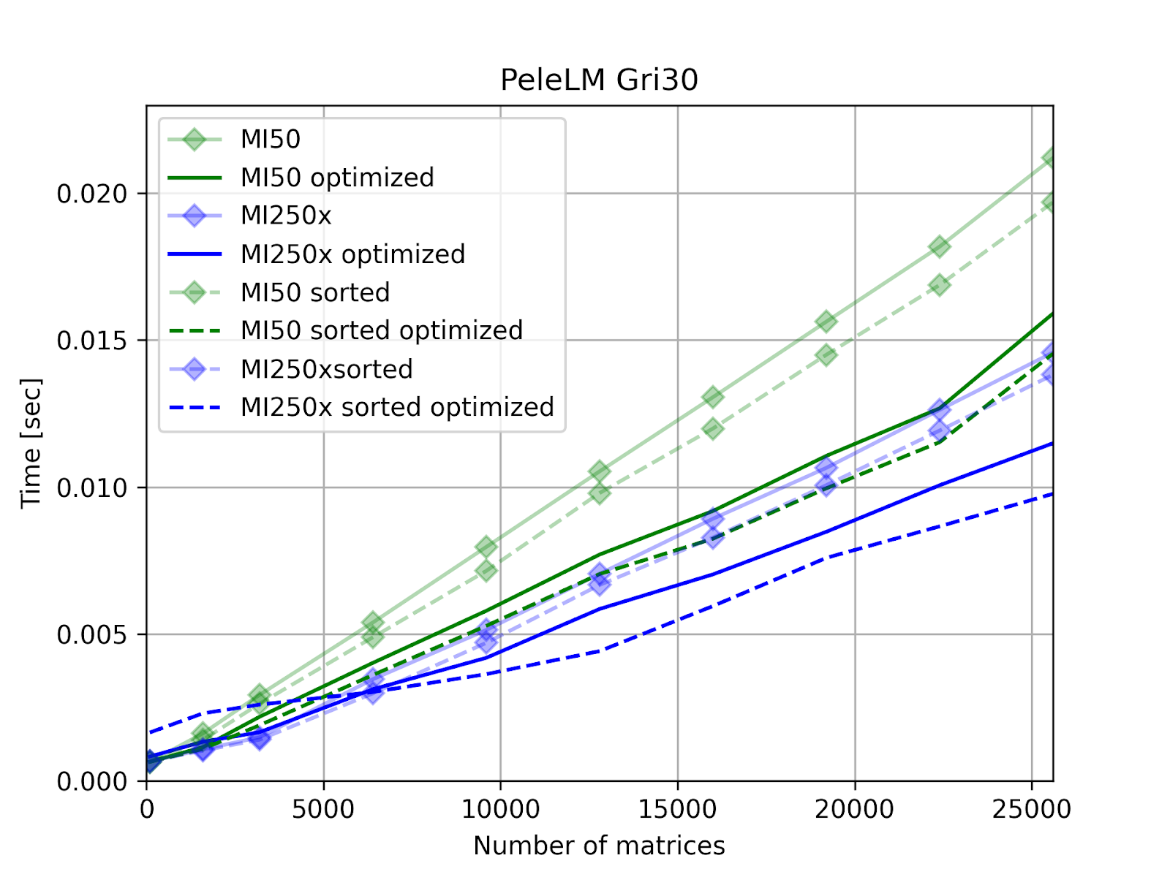
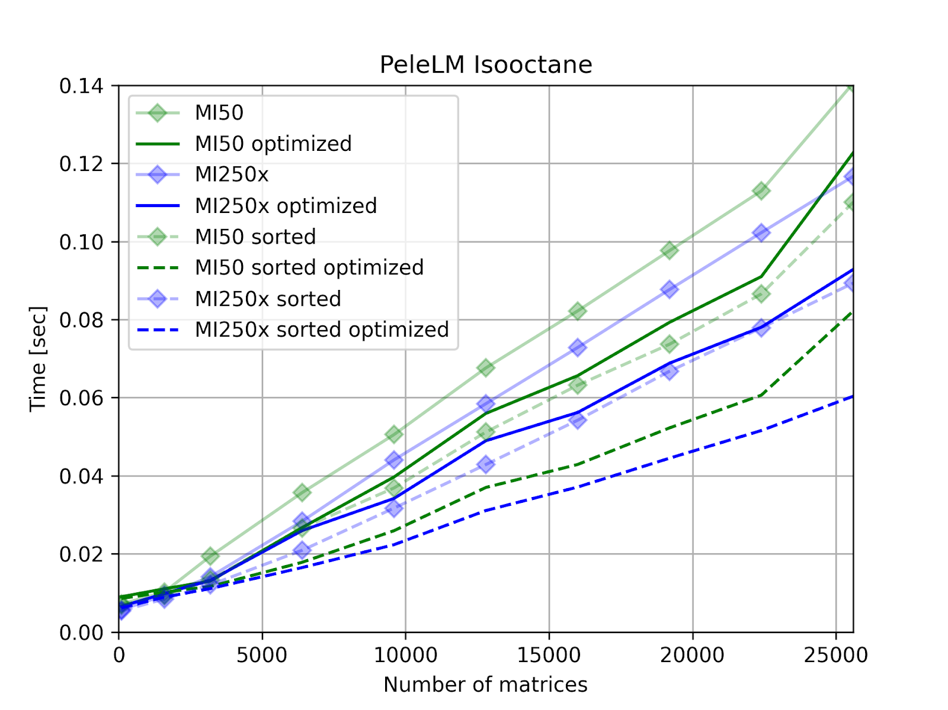
Batched
Sparse Batched algorithms
Algorithms implemented:
Linear algebra (SpMV)
Iterative solvers (CG, GMRES)
Preconditioner (Jacobi)
Launch parameters tunned for architecture
NVIDIA V100
AMD MI50 / MI250

Slide 14
ODE
New component for time integration algorithms
Explicit integrators
Runge Kutta (orders 1 to 5)
Various schemes for stability (Fehlberg 45, Cash-Karp, Dormand-Prince)
Time adaptive
Implementation for GPU work within a RangePolicy
Num systems | 10,000 | 100,000 | 1,000,000
CTS-1 | 3.17128 | 31.709 | N/A
ATS-2 | 0.0303719 | 0.365714 | 2.33355

Slide 15
Release 4.2.0

Slide 16
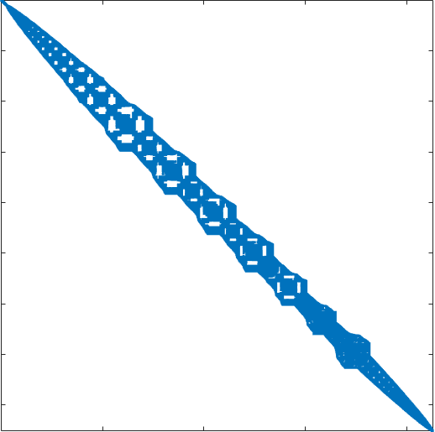
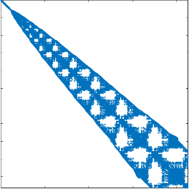
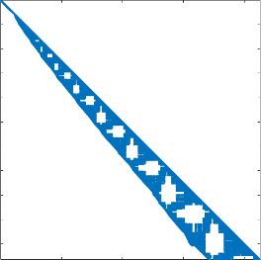
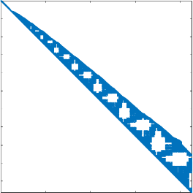
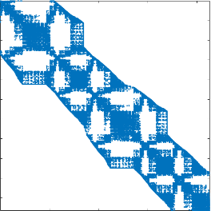
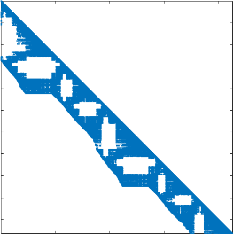
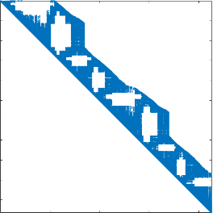
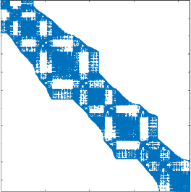
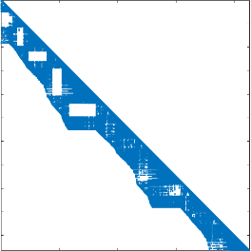
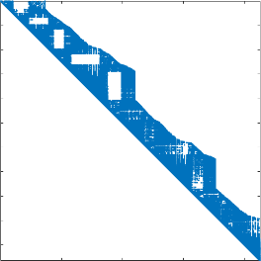
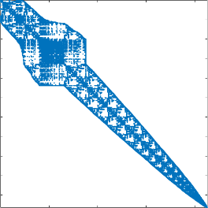
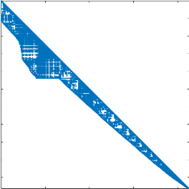
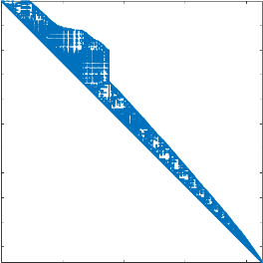
Stream based sparse preconditioners
Stream Gauss-Seidel
Stream ILU(k)/SpTRSV
Decompose the problem as we would with MPI
Use a stream per subdomain
Local MPI rank matrix
Stream split matrices
Stream split factors

Slide 17
Stream based ILU(K)
Scaling study 1 to 8 streams
Good scaling overall
Some scalability loss in SpTRSV on 8 streams
Performance very dependent on CUDA version (results obtained with CUDA 11.8)
Like MPI partitioning, balancing is important!

Slide 18
ODE
Newton solver
Drive adaptation from convergence behavior
Cheaper secant variant option
BDF, implicit time integration
Similar feature to CVODE
Time and order adaptive
Order 1 to 5
Initial time step estimation
Best option for stiff problems see left

Slide 19
Upcoming work

Slide 20
Algorithmic development
Block-ILU(k) variant
Fill based on block graph
Integration with Ifpack2
LAPACK select algorithms implementation (LU, SVD, QR)
Add new library component
Include cuSOLVER, rocSOLVER, MKL and Magma TPLs
Improve BDF features:
Numerical differentiation Jacobian
Backtracking line search
Batched ODE solvers
Reduce branch divergence on GPU
Promote vectorization on CPU
Potentially complicated for BDF, easier for RK algorithms

Slide 21
LIBRARY Improvements
SYCL backend: improve support and performance once Aurora comes online
Improve integration with Trilinos and PETSc
Establish automated performance testing
Improve interface to enable auto-tunning

Slide 22
acknowledgements
Jonathan Hu and Tom Ransegnola for contributing multiple integrations of incomplete factorizations in Ifpack2 and more…
Junchao Zhang for Kokkos Kernels/PETSc liaison, integration and contributing multiple TPL integrations and fixes
Victor Brunini for interfacing with applications, providing design and performance feedback on new features
Satish Balay and Sameer Shende for updating us on various incompatibilities and updates in Spack and xSDK
Mark Adams for all the discussions on the batched linear solver interfaces and performance
And to all the other contributors who help improved the library by providing feedback, documentation updates and bug fixes
We owe you a debt of gratitude, thank you for your continued support!

Slide 23
Any questions?

