Slide 1

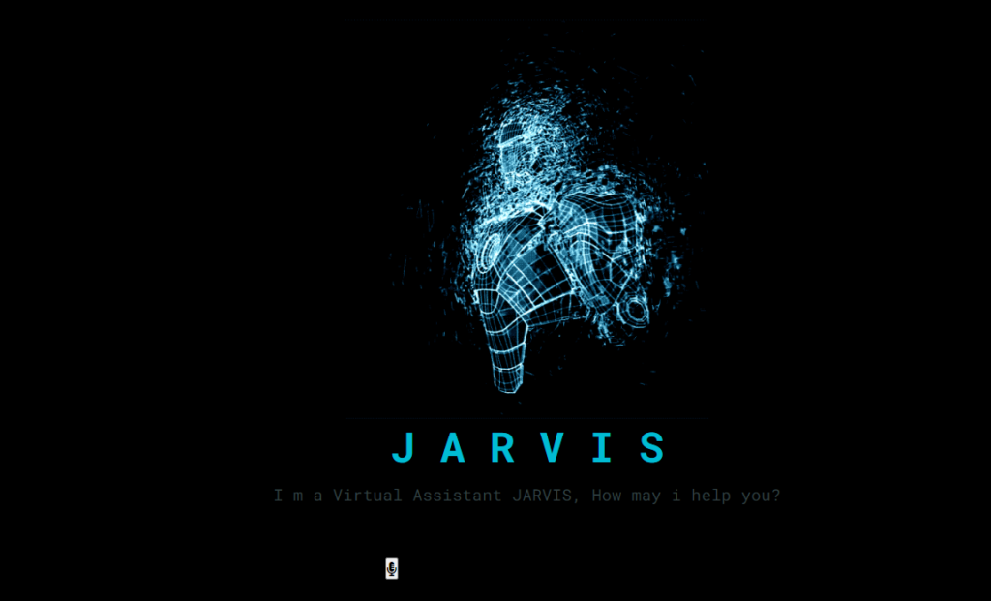

Alan
JARVIS-THE VIRTUAL ASSISTANT
Presented by
Vijayan.N

Slide 2

AGENDA
Introduction
Purpose
Technologies
Working
Architecture
Modules and concepts
Features
Conclusion

Slide 3



Introduction
Jarvis, an acronym for "Just A Rather Very Intelligent System," is a highly advanced artificial intelligence developed by Tony Stark in the Iron Man franchise.A virtual assistant is a sophisticated software designed to help users manage tasks and access information through various interfaces, such as voice, text, or graphical interactions

Slide 4

Purpose
Automates Tasks: Streamlines complex operations and daily routines.
Real-Time Updates: Provides instant information and alerts.
Enhanced Productivity: Manages scheduling and reminders.
Tech Integration: Controls and integrates with advanced systems.
Mission Support: Assists in Iron Man’s superhero activities.
Preservation

Slide 5
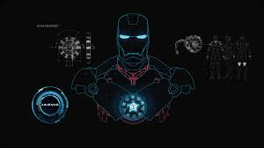




Technologies
Machine Learning
Allows Jarvis to learn from user interactions and improve over time.
Voice Recognition
Facilitates accurate voice command processing and response.
Artificial Intelligence
Powers Jarvis's decision-making, problem-solving, and adaptive capabilities.
Natural Language Processing
Enables Jarvis to understand and interpret spoken and written commands.

Slide 6

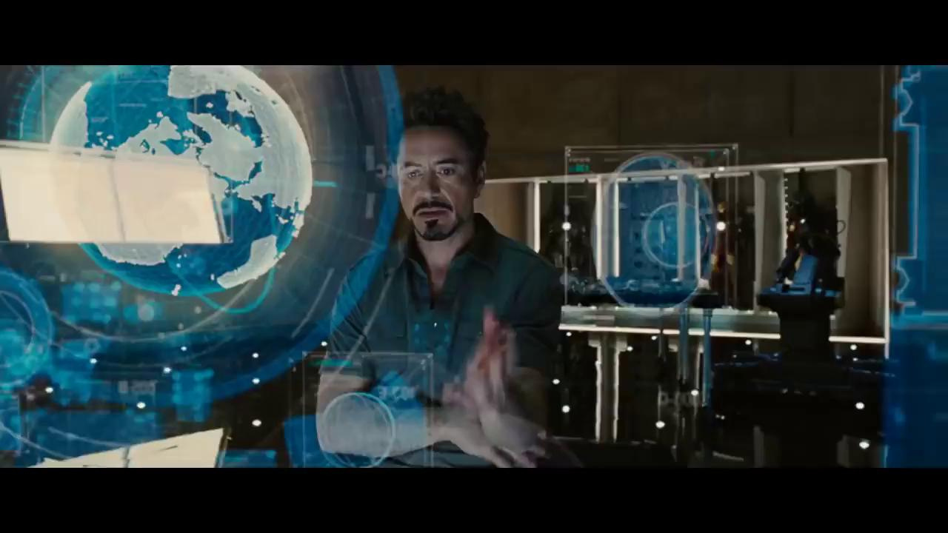
Working
Receive Input: Processes user commands via voice or text.
Interpret Data: Uses NLP to understand and analyze the input.
Execute Commands: Performs tasks or retrieves information based on the input.
Provide Feedback: Delivers responses or updates to the user.
Learn and Adapt: Uses machine learning to refine performance and preferences over time.

Slide 7


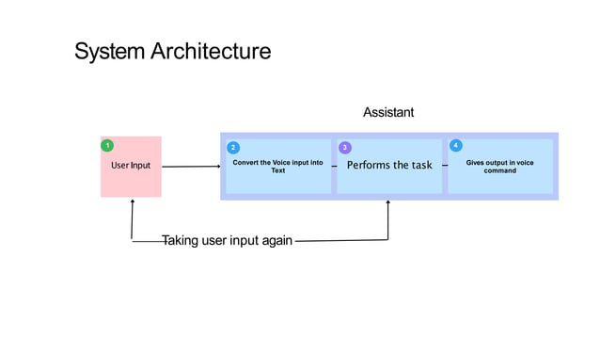

Architecture
The architecture of Jarvis integrates several advanced technological components to create a seamless and efficient virtual assistant. At its core, Jarvis employs Natural Language Processing (NLP) to understand and interpret user commands, allowing it to engage in natural conversations. It uses machine learning algorithms to continuously improve its performance and adapt to user preferences.

Slide 8
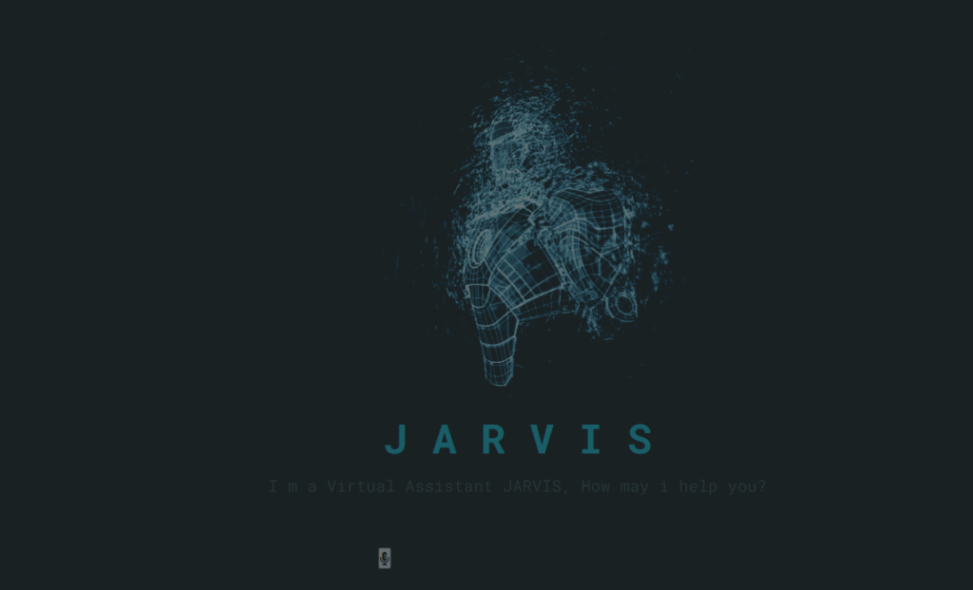
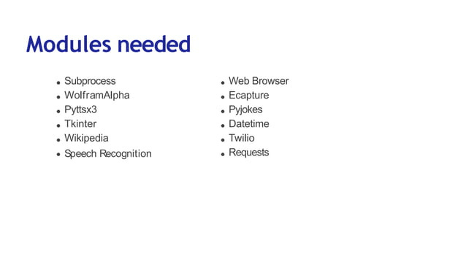
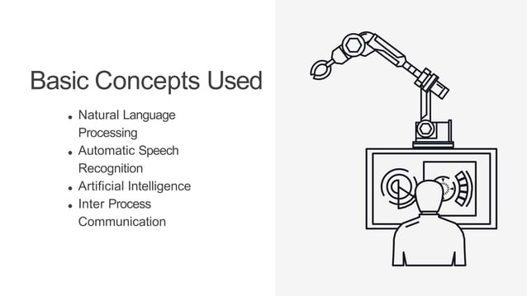
CONCEPTS AND MODULES

Slide 9

Features
Voice Commands: Understands and executes spoken instructions.
Real-Time Updates: Provides instant information and notifications.
Task Automation: Manages and automates routine tasks and processes.
Smart Device Integration: Controls and interacts with connected smart devices.
Contextual Awareness: Adapts responses based on context and user preferences.
Personalized Assistance: Customizes interactions and functionality to suit individual needs.
Data Analysis: Analyzes and processes information for decision-making.

Slide 10

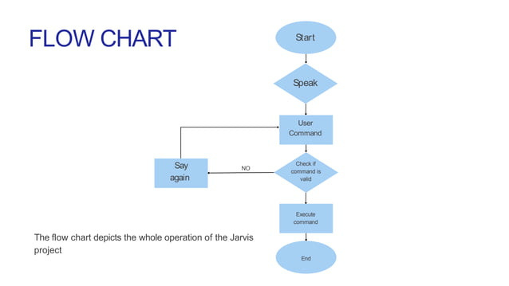

Slide 11



Thank You
Any Queries ?
Gerente General

