Slide 1

U.S. Airport Network
By Alan Wang,
Brenden Cheung,
Kun Xu

Slide 2
Introduction
Literature Review
Main Goal
Table of Contents
“A study of the U.S. domestic air transportation network: temporal evolution of network topology and robustness from 2001 to 2016”, by Siozos-Rousoulis, L., Robert, D. & Verbeke, W.
Measure the airport development in terms of:
Flight Route Map
Relative importance among airports
Resilience of air transportation network
With a span of 10 years
Flight Route Map
Centrality
Assortativity
Small-World Effect
Scale Free Property
Targeted Attack Tolerance
Notes:
Chris

Slide 3

Dataset, Cleaning, EDA
Data Set: all domestic flights from 2009 to 2018
Source: “Airline Delay and Cancellation Data, 2009 - 2018”
Notes:
Brenden

Slide 4
Data Cleaning
Original dataset: ~ 800 MB / Year; we have 10 years; that’s 8GB
We only want the `ORIGIN`, `DESTINATION`, `AIRLINE`, `Date`, and `DELAY`.
We group everything together by `AIRLINE`, `ORIGIN`, and `DESTINATION` and compute the total number of flights and average delay.
Through SQL => Reduced the dataset to ~10MB / Year
Notes:
Alam

Slide 5
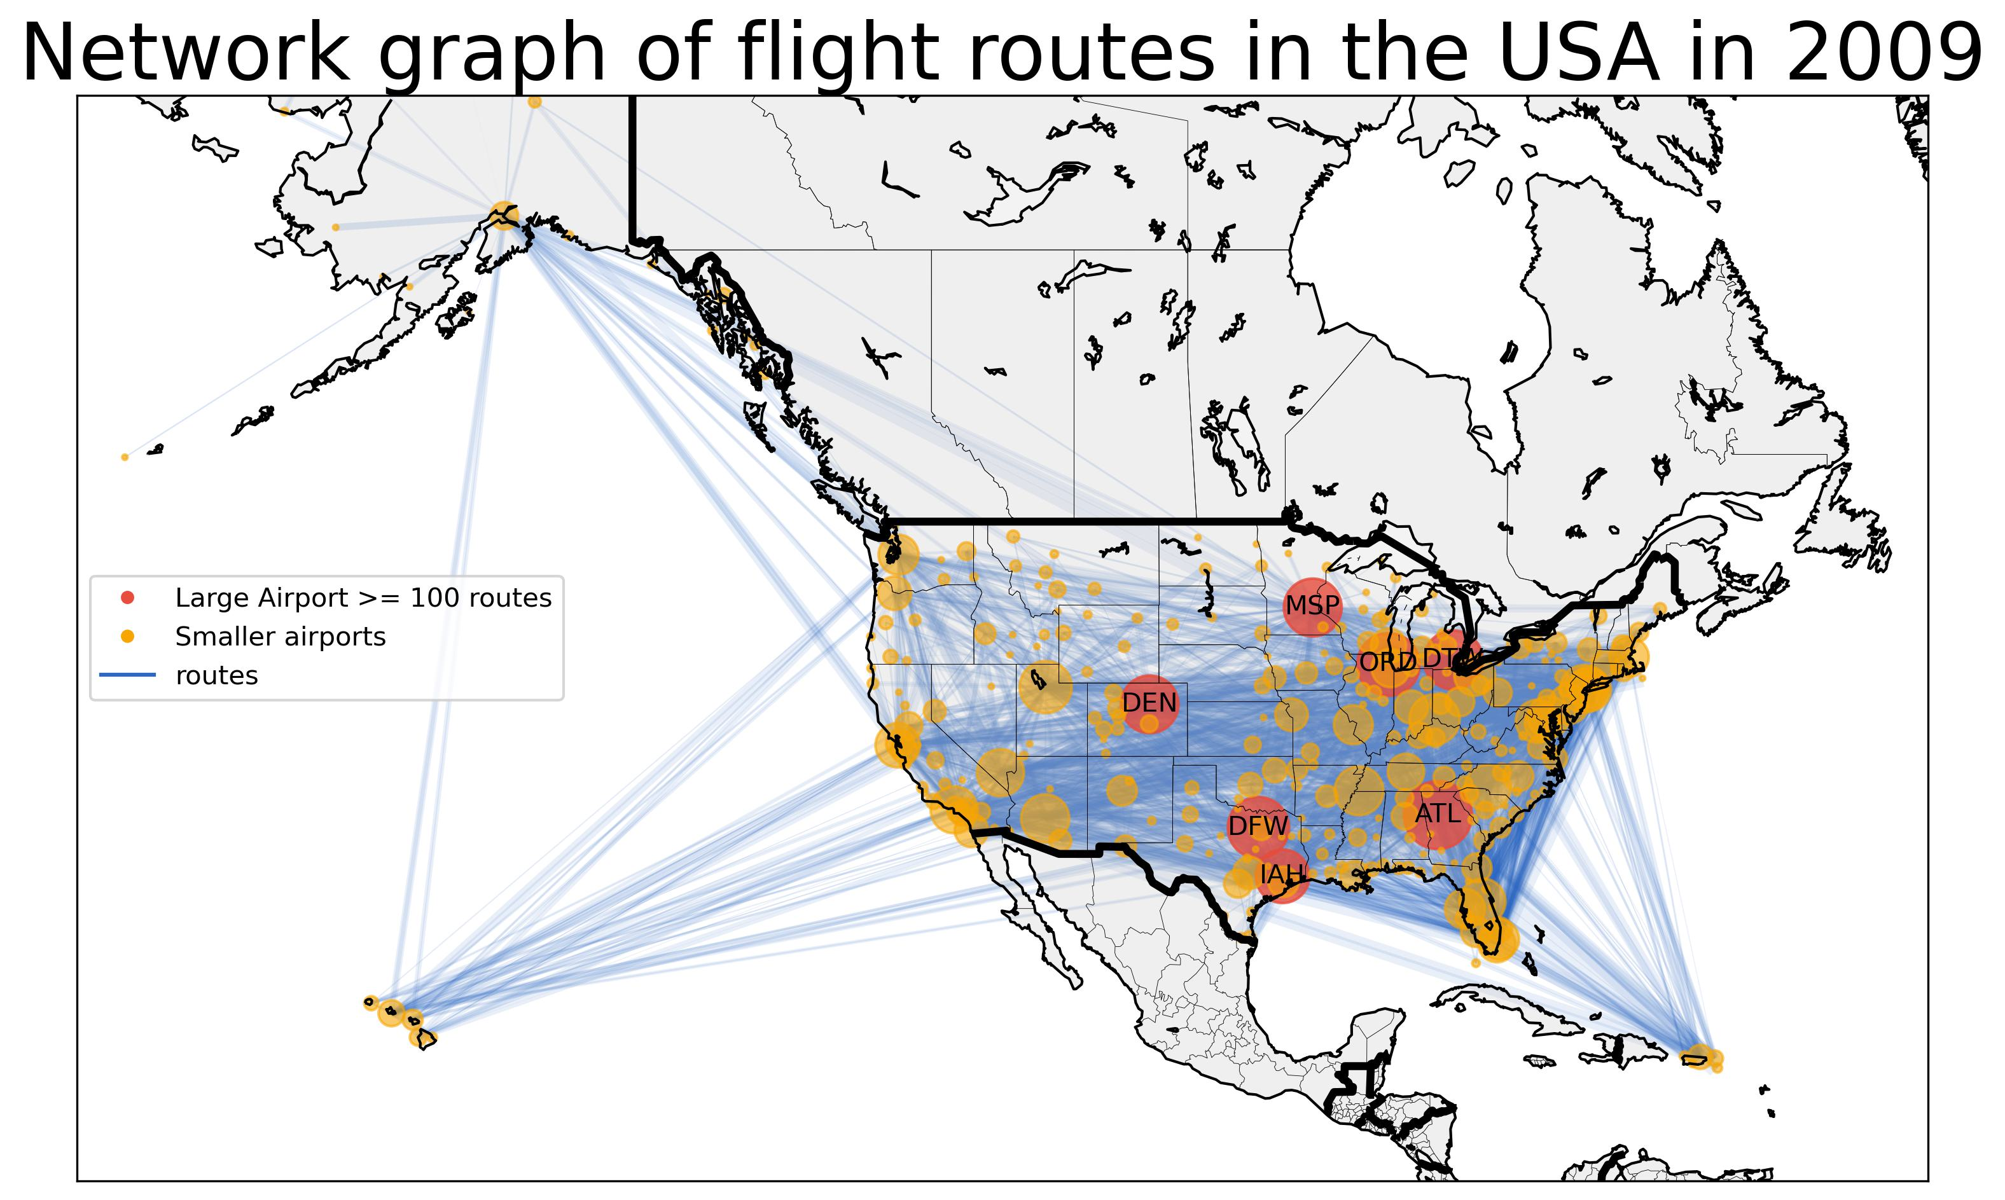
Notes:
Chris

Slide 6
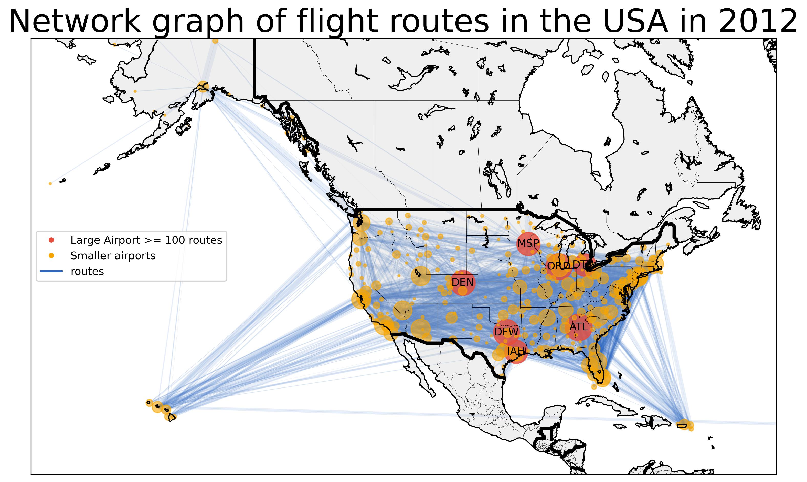

Slide 7


Slide 8
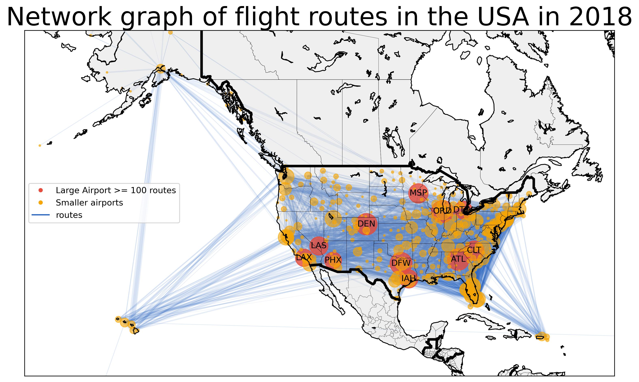

Slide 9
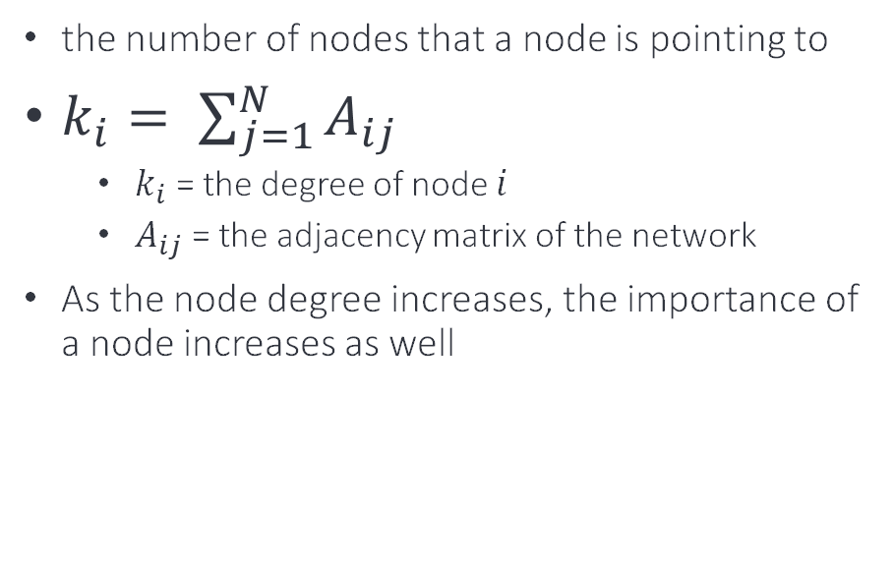
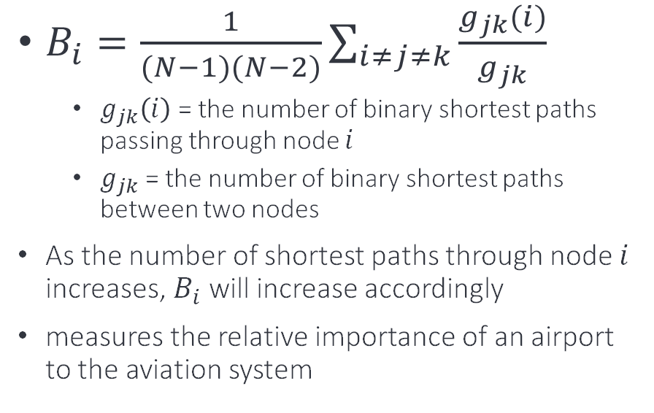
Centrality
Node Degree (k)
Betweenness Centrality (B)
the number of nodes that a node is pointing to
$k_{i}= \sum_{j=1}^{N}{A_{ij}}$
$k_{i}$ = the degree of node $i$
$A_{ij}$ = the adjacency matrix of the network
As the node degree increases, the importance of a node increases as well
$B_{i}=\frac{1}{(N−1)(N−2)}\sum_{i≠j≠k}{\frac{g_{jk}(i)}{g_{jk}}}$
$g_{jk}\left(i\right)$ = the number of binary shortest paths passing through node $i$
$g_{jk}$ = the number of binary shortest paths between two nodes
As the number of shortest paths through node $i$ increases, $B_{i}$ will increase accordingly
measures the relative importance of an airport to the aviation system
Notes:
chris

Slide 10
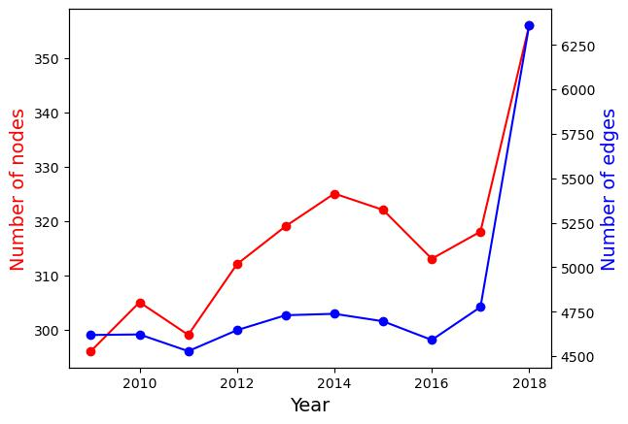
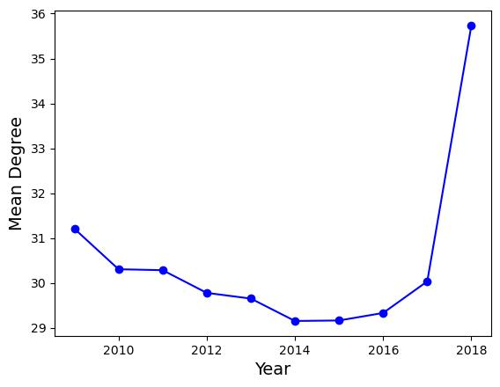
Mean Degree over Years
Smaller airports are constructed
Number of Nodes & Edges
Notes:
Chris

Slide 11
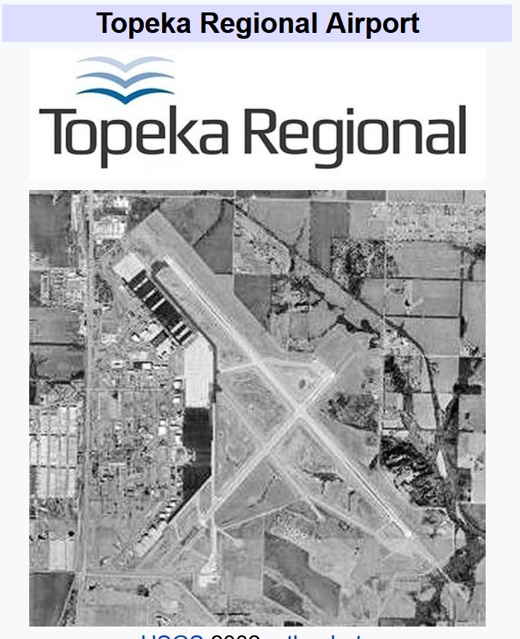
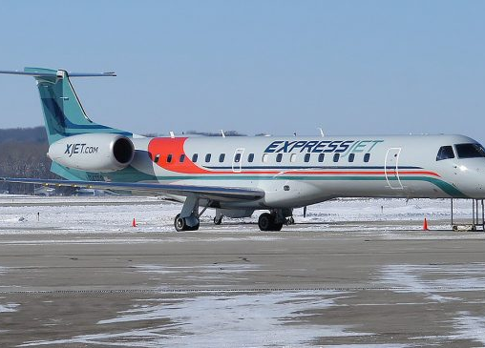
Airline
Airport

Slide 12
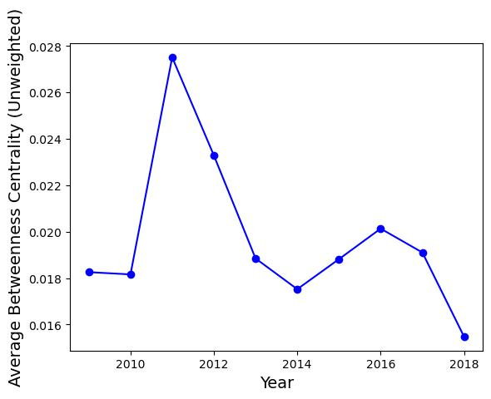

Slide 13
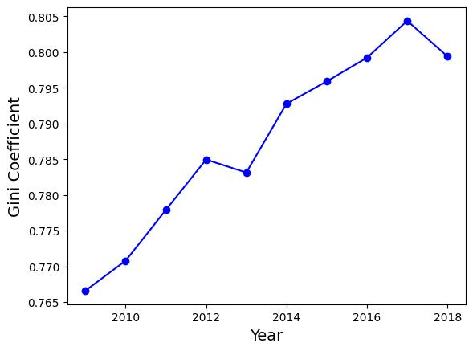
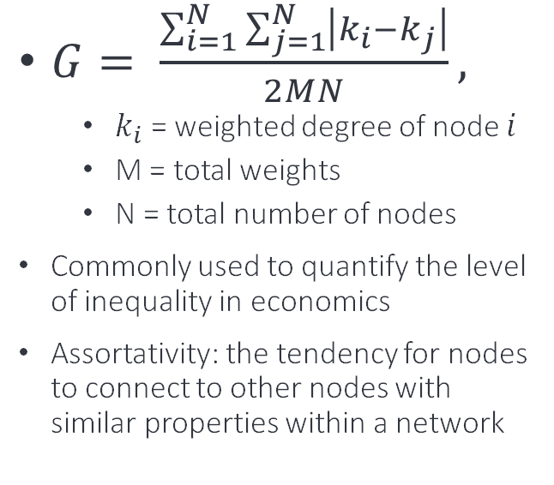
Assortativity
Gini Coefficient (G)
$G= \frac{\sum_{i=1}^{N}{\sum_{j=1}^{N}{\left|k_{i}−k_{j}\right|}}}{2MN},$
$k_{i}$ = weighted degree of node $i$
M = total weights
N = total number of nodes
Commonly used to quantify the level of inequality in economics
Assortativity: the tendency for nodes to connect to other nodes with similar properties within a network

Slide 14
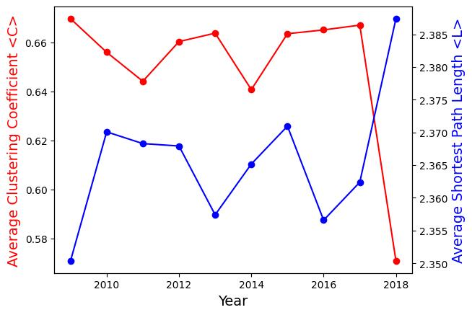
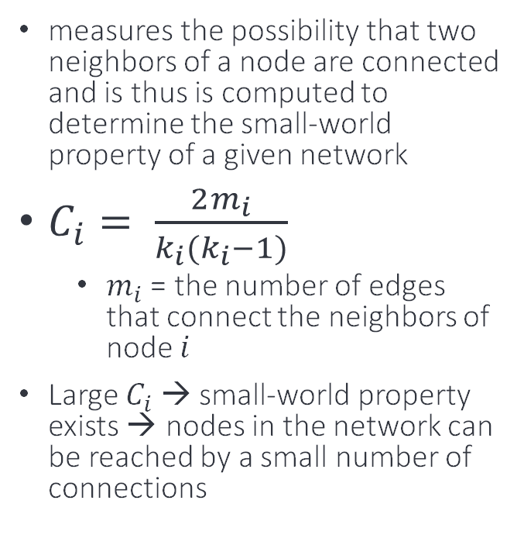
Small-World Effect
Clustering Coefficient (C)
measures the possibility that two neighbors of a node are connected and is thus is computed to determine the small-world property of a given network
$C_{i}= \frac{2m_{i}}{k_{i}(k_{i}−1)}$
$m_{i}$ = the number of edges that connect the neighbors of node $i$
Large $C_{i}$ → small-world property exists → nodes in the network can be reached by a small number of connections

Slide 15
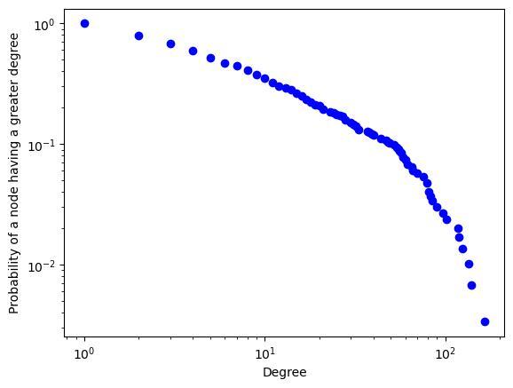
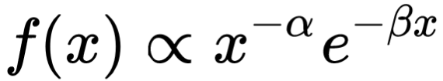
Scale-Free
Power Law with Exponential Cutoff

Slide 16

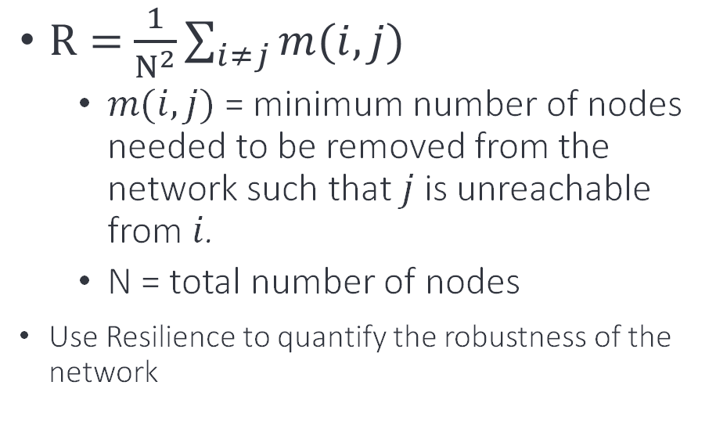
Target Attack Tolerance
Network Resilience (R)
Proportion of Nodes in GCC (S)
$R=$ $\frac{1}{N^{2}}\sum_{i≠j}{m(i,j)}$
$m(i, j)$ = minimum number of nodes needed to be removed from the network such that $j$ is unreachable from $i$.
N = total number of nodes
Use Resilience to quantify the robustness of the network
$S=\frac{size(GCC)}{N}$
Removing highly centralized nodes will split the network up → smaller S

Slide 17
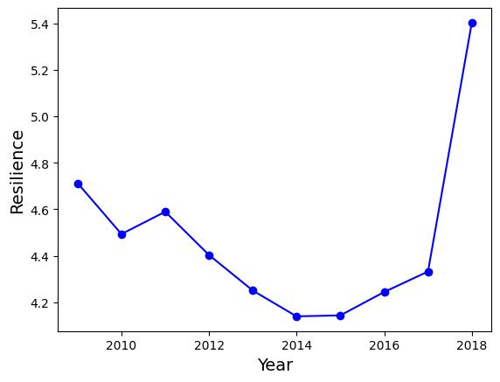
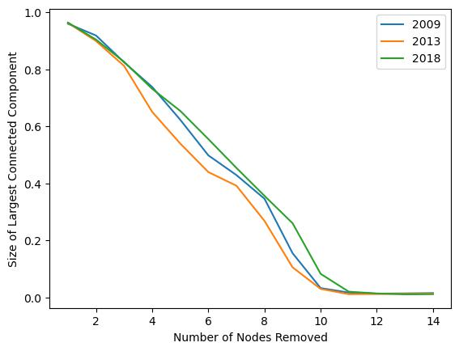

Slide 18
Conclusions
Trend of Small Airports:
2009 – 2014: Following the end of recession, an expansion of smaller regional airports
2014 – 2017: Smaller airports were shutdown due to the saturation of market
2017 - : A reinforcement of the Hub-and-Spoke system; network more interconnected

Slide 19
Limitations / Improvements
Shortest air distance between airports were not provided; could talk about efficiency otherwise
Could do an in-depth research into different airlines to see the expansion of major carriers
Observe seasonal/monthly/holiday/major events changes
When studying targeted attacks, cluster airports into large and small first, as terrorists are more likely attack on major hubs

Slide 20
Roles
Alan Wang
Brenden Cheung
Kun Xu
literature review
data cleaning
coding simulations
literature review
data cleaning
coding simulations
literature review
make slides
write paper
Notes:
Chris

Slide 21
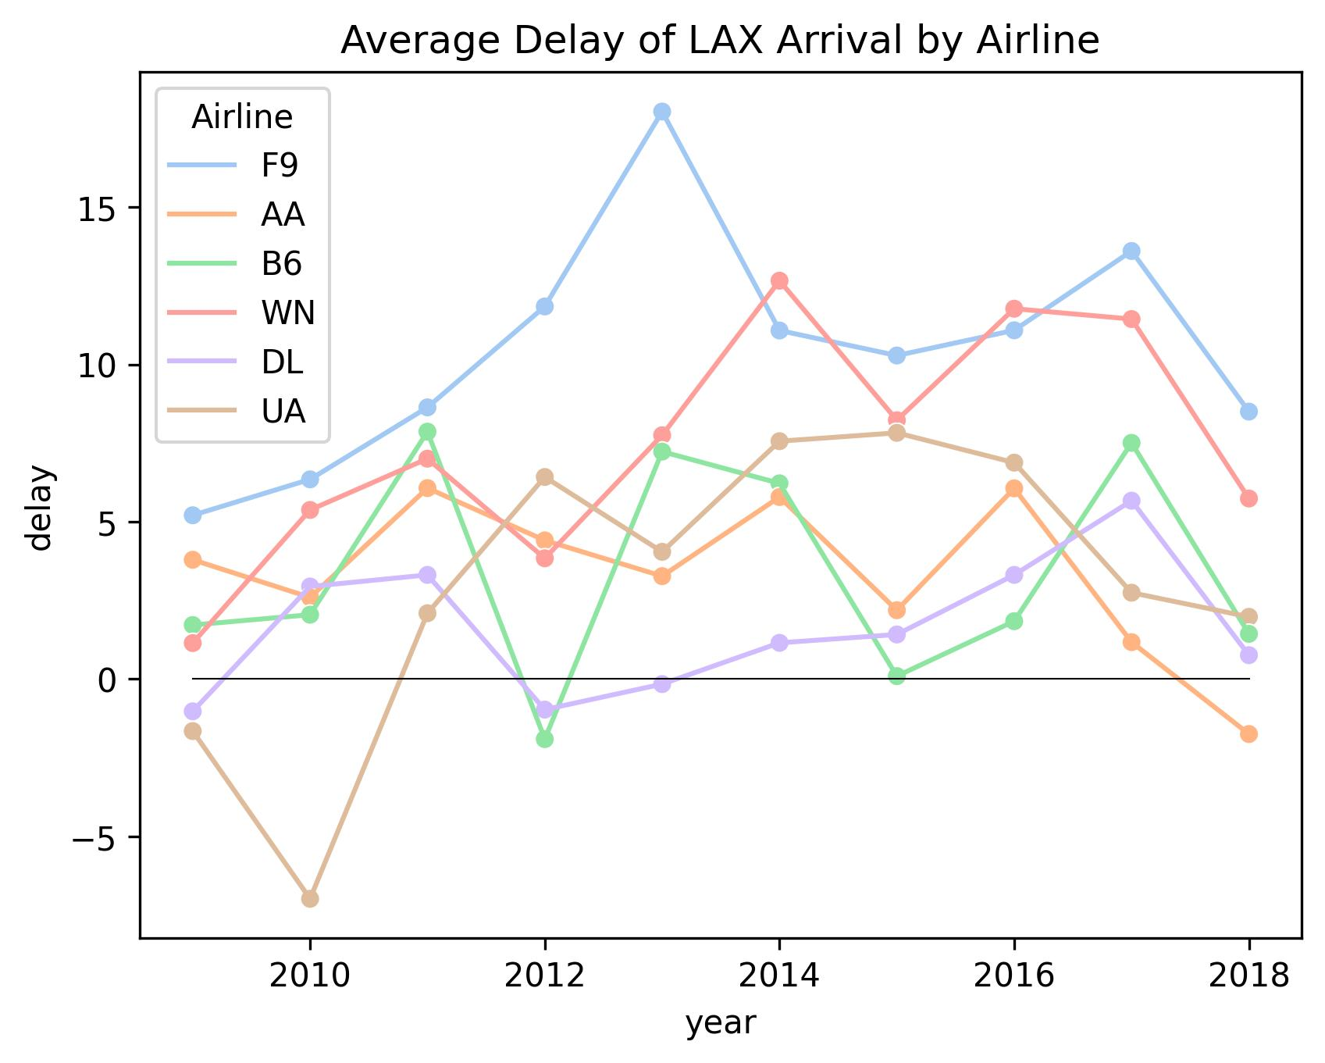
Delay Analysis
Notes:
Chris
Frontier is the worst;
Surprise to see that South West has the second largest delay, because South West tries to maximum the time an airplane is flying so that it can maximize revenue at a given cost; not good for the business
JetBlue has most flights going to the east coast, so average delay has large variations.

Slide 22
Reference
Measuring resilience. Packt. (n.d.). https://subscription.packtpub.com/book/cloud-and-networking/9781789955316/6/ch06lvl1sec41/measuring-resilience. Accessed December 8, 2022.
Siozos-Rousoulis, L., Robert, D. & Verbeke, W. A study of the U.S. domestic air transportation network: temporal evolution of network topology and robustness from 2001 to 2016. J Transp Secur 14, 55–78 (2021). https://doi.org/10.1007/s12198-020-00227-x. Accessed October 27, 2022.

