Slide 1
Read Between the Lines: An Empirical Measurement of Sensitive Applications of Voice Personal Assistant Systems
Review
January 2020

Slide 2
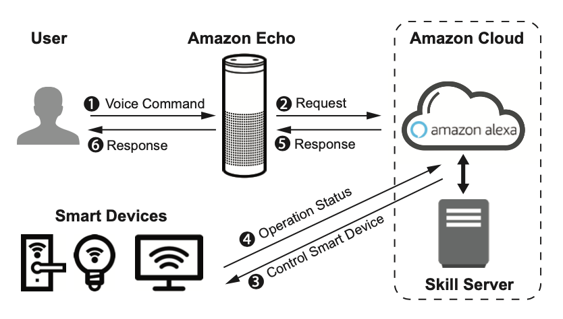
VPA Background

Slide 3
Introduction
Recent research shows that remote attackers can craft hidden voice commands to trigger the VPAs to launch malicious actions without user knowledge.
There is a lack of empirical understanding of what functionality the third-party applications provide, and thus makes it difficult to systematically assess the consequences of these attacks.
In this paper, they claim to have performed the first large-scale measurement on the third-party applications of Amazon Alexa and Google Home to systematically assess the attack surfaces. More specifically, given a voice assistant application, they seek to characterize its risk by detecting and analyzing the sensitive voice commands that are subject to potential attacks.

Slide 4
Overview
Attack consequences
Controlling the system to perform an action.
Obtaining sensitive information.
Goal: Develop a natural language processing tool that classifies a given voice
command from the following two dimensions.
a) The tool examines whether a voice command is designed to insert an action (e.g.,
controlling a smart device) or retrieve information (e.g., obtaining user bank
balance).
b) The tool classifies whether the command is sensitive or non-sensitive.

Slide 5
Overview
Voice commands are sensitive if, when exploited, they bring damage to the user by either leaking private information (e.g., bank balance, inbox message) or violating security (e.g., unlock the front door, stop recording camera) via hacking IoT devices.
In contrast, non-sensitive voice commands do not pose security or privacy threats if exploited.

Slide 6
four key challenges to automatically analyze the functionality of VPA skills
1) Unlike smartphone apps whose binaries (or source code) are available for analysis, voice applications are essentially web programs that are hidden behind the cloud (e.g., Amazon/Google cloud).
2) The voice commands supported by VPA skills are very short, which provides little information to run typical Natural Language Processing tools.
3) There are already many VPA skills in the current markets and labeling their data (for model training) requires expensive manual efforts.
4) The perceived sensitivity of a voice command could vary from person to person, the measurement of which requires user participation.

Slide 7
System design
Two classification models to characterize the capability and the sensitivity of the voice commands, respectively.
1) Convolutional Neural Network (CNN) – used to classify action injection commands that control smart devices and services, information retrieval commands that retrieve information from the application. Ex: “Alexa, ask Watch-Man to open the red door” is an injection command, while “Alexa, ask Macys where is the nearest store to me” is a retrieval command.
2) Regarding the voice command’s sensitivity, they build a model to classify sensitive commands from non-sensitive ones. EX: “Alexa, unlock my front door” is a sensitive command while “Alexa, play Harry Potter Quiz” is non-sensitive.

Slide 8
System design
Voice command’s sensitivity challenge: sensitivity classification is rather subjective, and conventional user studies have limited scalability. As such, they used automated algorithms for sensitive keyword extraction and then performed a user study (N=404) for keyword pruning. Instead of using complex machine learning models (whose results are difficult to interpret during post-analysis), they used a keyword-based model that achieves an accuracy of 95.6% in finding the sensitive voice commands.

Slide 9
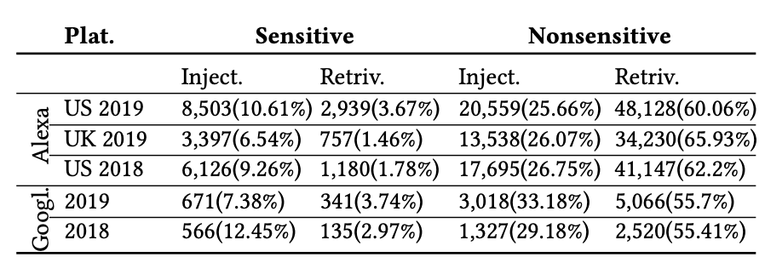
Results
Analyzed 77,957 Amazon Alexa skills and 4,813 Google Home skills over two years (2018-2019). They identified 19,263 sensitive “action injection” commands and 5,352 sensitive “information retrieval” commands.

Slide 10
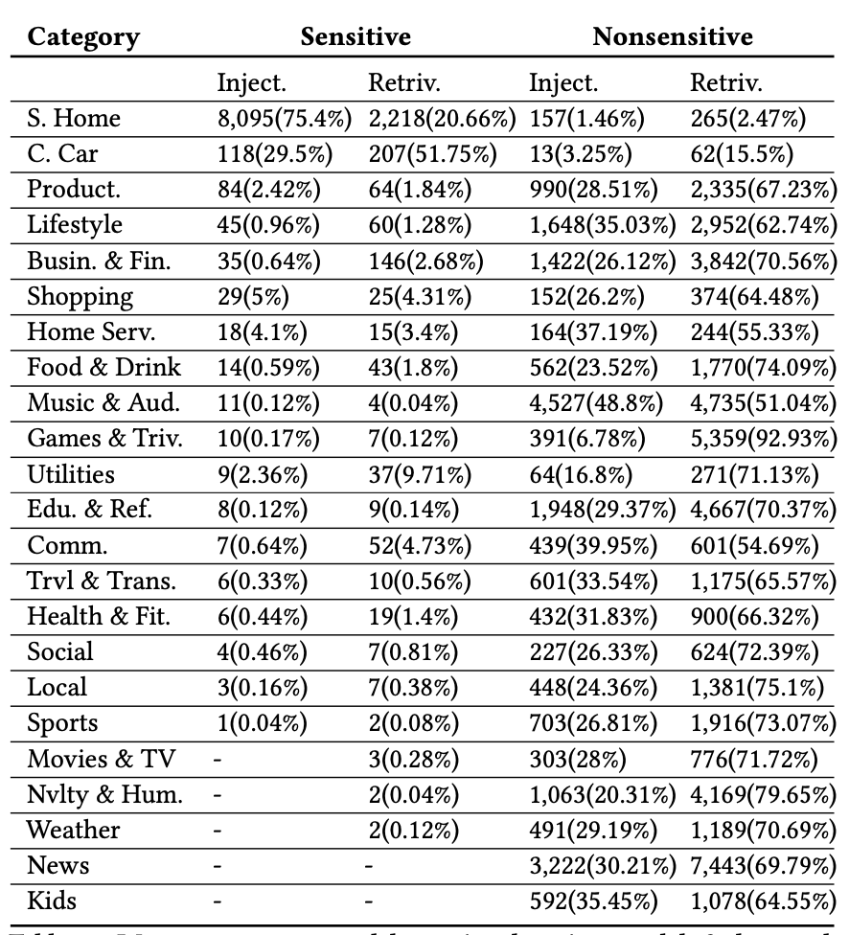
Results: Amazon Echo

Slide 11
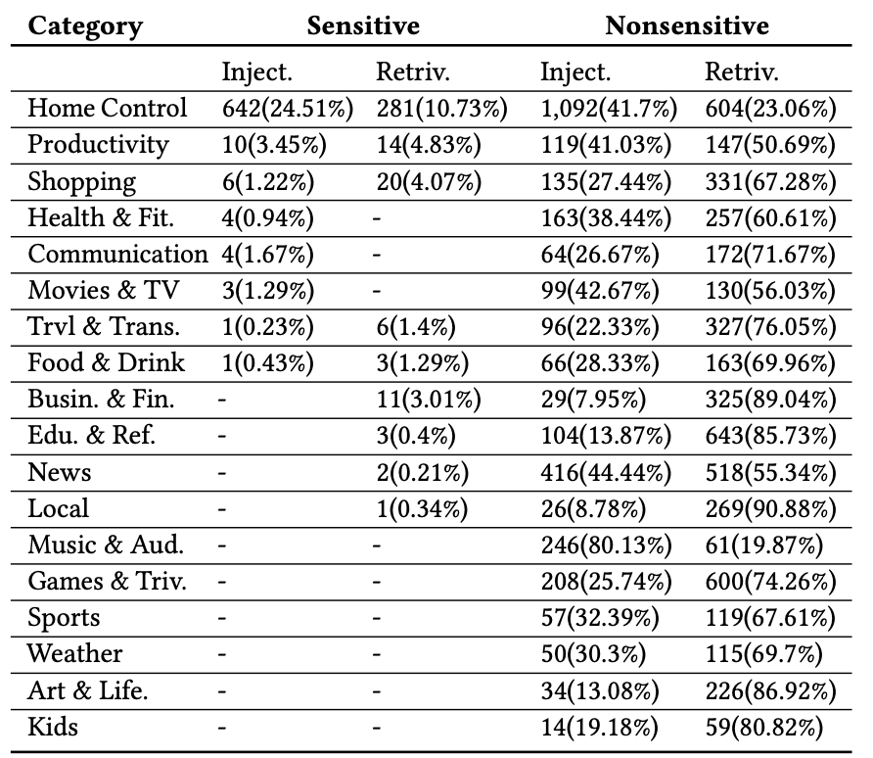
Results: Google Home

Slide 12
Key contribution claims
• First, they perform the first large scale empirical measurement on two dominating Voice Personal Assistant application markets, covering 82,770 skills and 211,843 voice commands. • Second, their results provide new understandings of the capability and the sensitivity of the third-party applications. They identified a small set of sensitive applications (5.55%) that contributed to the most sensitive voice commands.
• Third, they designed and implemented automated tools to classify VPA skills and their voice commands.
• Fourth, we perform a user survey with 400+ participants to measure the perceived sensitivity of voice commands.

