Slide 1

Hierarchical Bayesian Models
Steve Elston
Copyright, 2023 2024, Stephen F Elston. All rights reserved.

Slide 2
Introduction
Many real-world datasets have discrete categories or strata
Example, a chemist might measure a reaction rate at several discrete levels of pH and temperature
Example, demographic categories from different geographic regions
Example, model differences between schools, teachers, and students from different socioeconomic status
Apply an hierarchical Bayes model for these situations

Slide 3
Introduction
Key points in this lesson:
Pooled vs. unpooled models
Defining hierarchical models through hyperpriors and priors
Evaluation and comparison of Bayesian models
Bayesian shrinkage prevents overfitting model

Slide 4
Pooled vs. Unpooled Models
Pooled model computes posterior distributions using all observations
Pooled model has a flat structure
Model coefficients are at the same level
Pooling maximizes statistical power using all available data to fit a model
Assumes exchangeability of observations between cases or strata
Pooling limits flexibility if strata have different behavior

Slide 5
Pooled vs. Unpooled Models
Unpooled models are the opposite of pooled models
Posterior distributions of parameters are fit using independent prior for each category
Assumes exchangeability of of observations within each category
Approach maximizes flexibility
Leads to posterior distributions with wide dispersion
Unpooled models have a flat structure

Slide 6
Overview of Hierarchical Models
Hierarchical models are between the extremes of pooled and unpooled models
Hierarchical models constructed as a hierarchy of hyperpriors and priors
The Hyperpriors represent the prior information on the pooled data
Priors for each specific case are fit from the hyperpriors
Posterior distributions for each strata are fit at the bottom of the hierarchy
Assumes exchangeability of observations within each strata for priors and posteriors

Slide 7
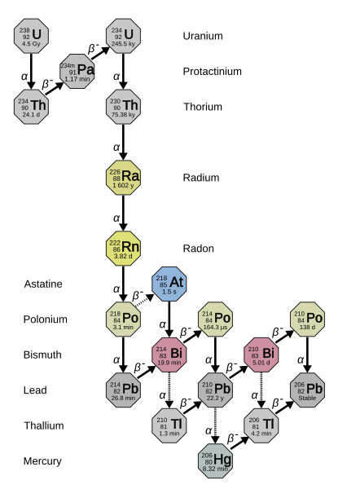
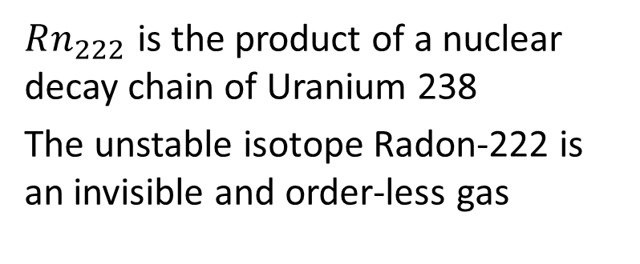
Example: Dangers of Radon in Homes
$Rn_{222}$ is the product of a nuclear decay chain of Uranium 238
The unstable isotope Radon-222 is an invisible and order-less gas
Decay chain of Uranium-238 to Radon-222
Credit: Wilipedia Radon-222 article

Slide 8
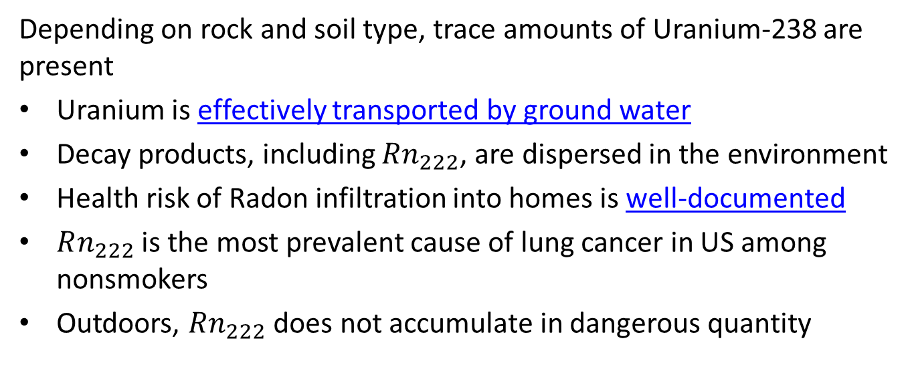
Example: Dangers of Radon in Homes
Depending on rock and soil type, trace amounts of Uranium-238 are present
Uranium is effectively transported by ground water
Decay products, including $Rn_{222}$, are dispersed in the environment
Health risk of Radon infiltration into homes is well-documented
$Rn_{222}$ is the most prevalent cause of lung cancer in US among nonsmokers
Outdoors, $Rn_{222}$ does not accumulate in dangerous quantity

Slide 9
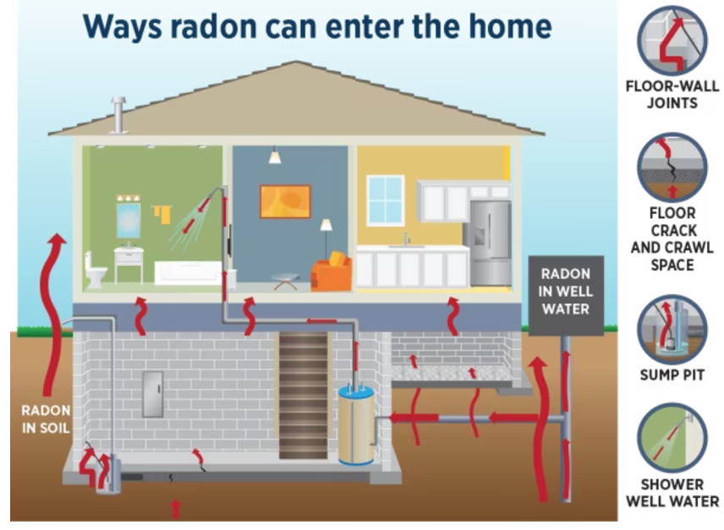
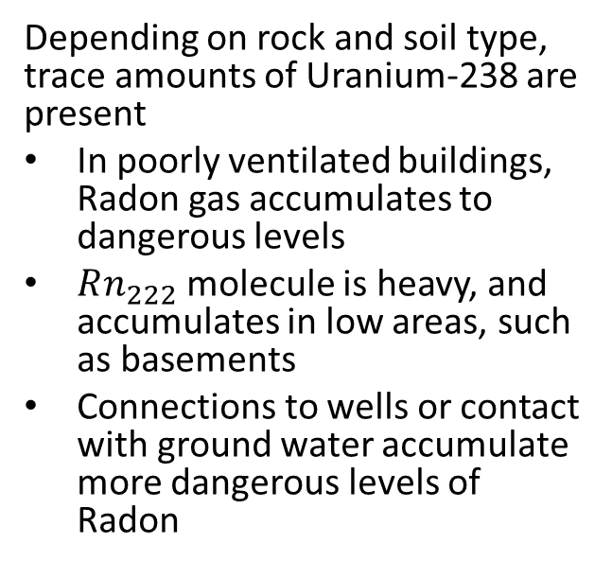
Example: Dangers of Radon in Homes
Depending on rock and soil type, trace amounts of Uranium-238 are present
In poorly ventilated buildings, Radon gas accumulates to dangerous levels
$Rn_{222}$ molecule is heavy, and accumulates in low areas, such as basements
Connections to wells or contact with ground water accumulate more dangerous levels of Radon
Common ways Radon-222 enters homes
Credit: Massachusetts Department of Public Health

Slide 10
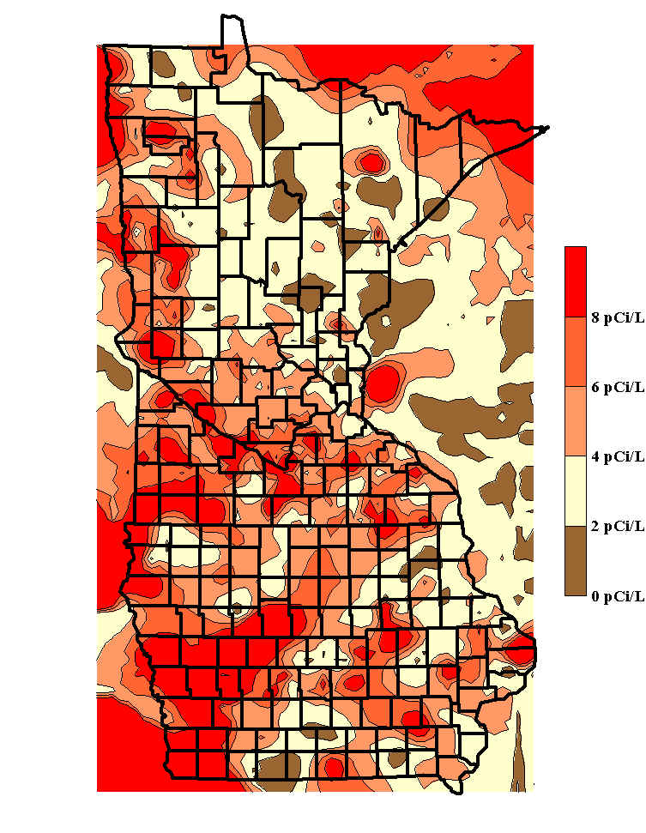
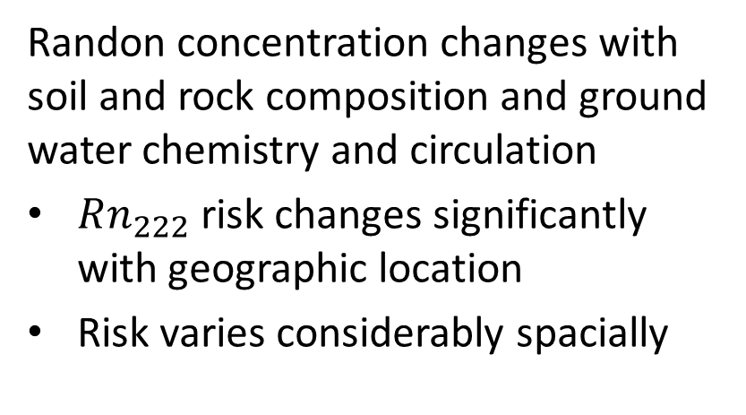
Example: Dangers of Radon in Homes
Randon concentration changes with soil and rock composition and ground water chemistry and circulation
$Rn_{222}$ risk changes significantly with geographic location
Risk varies considerably spacially
Map of Radon in homes for counties in IA and MN
Credit: Minnesota Radon Project

Slide 11
Bayesian Modeling of Radon Concentration
For this example we construct and compare three models:
Pooled model has single intercept and slope for all counties
Unpooled model has separate intercepts and slopes for each county
Hierarchical model
Pooled hyperpriors for all counties at top level
Next level are priors for each county
Slopes and intercepts for each county at the bottom level

Slide 12
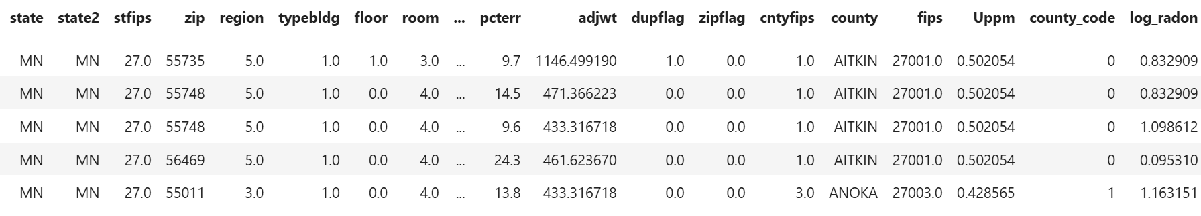
Radon Dataset
Columns of interest
log_radon is the numeric response variable
county is an independent categorical variable
floor is an independent binary variable

Slide 13
Pooled Model
First try a pooled model
Pooled model is a Bayesian linear regression model of the log of Radon concentration
Posterior distribution computed from the data pooled over all counties
Single slope and intercept coefficients
Model has flat structure, with respect to county
Assumes all observations are exchangeable with each other
Exchangeable values are assumed to be iid, and therefore have the same distribution

Slide 14
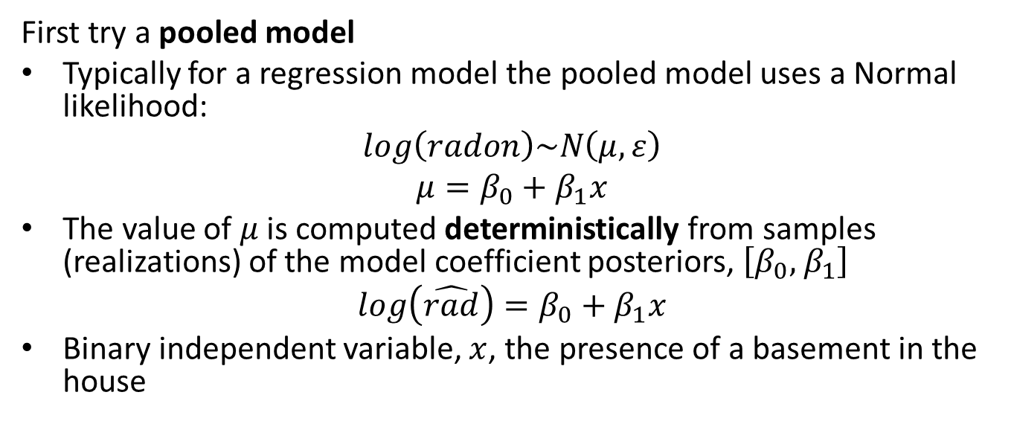
Pooled Model
First try a pooled model
Typically for a regression model the pooled model uses a Normal likelihood:
$$log\left(radon\right)\sim N\left(μ,ε\right)$$
$$μ=β_{0}+β_{1}x$$
The value of $μ$ is computed deterministically from samples (realizations) of the model coefficient posteriors, $\left[β_{0},{ β}_{1}\right]$
$$log\left(\hat{rad}\right)=β_{0}+β_{1}x$$
Binary independent variable, $x$, the presence of a basement in the house

Slide 15
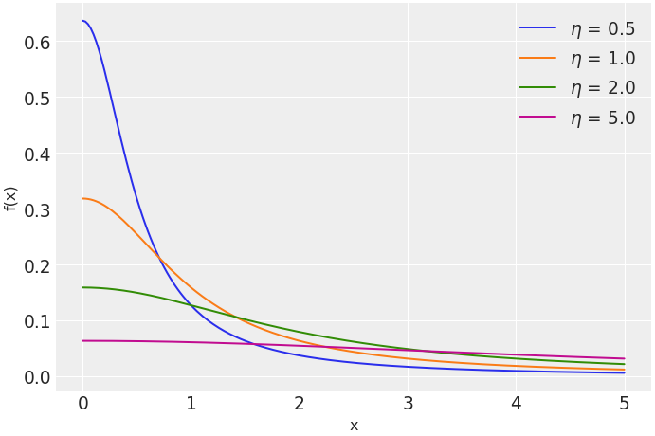
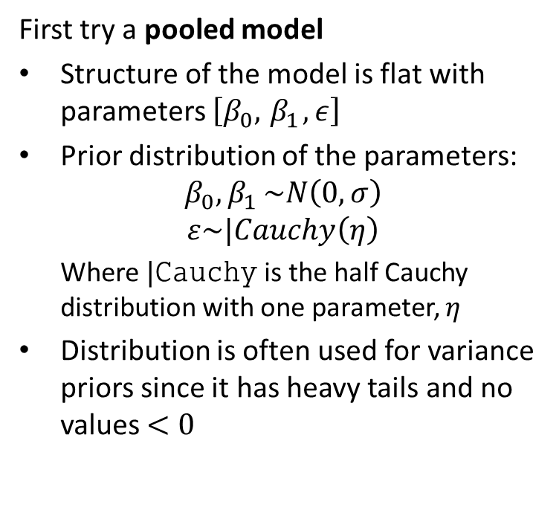
Pooled Model
First try a pooled model
Structure of the model is flat with parameters $\left[β_{0},{ β}_{1}, ε\right]$
Prior distribution of the parameters:
$$β_{0}{,β}_{1}\sim N\left(0,σ\right)$$
$$ε\sim |Cauchy\left(η\right)$$
Where $|Cauchy$ is the half Cauchy distribution with one parameter, $η$
Distribution is often used for variance priors since it has heavy tails and no values $<0$

Slide 16
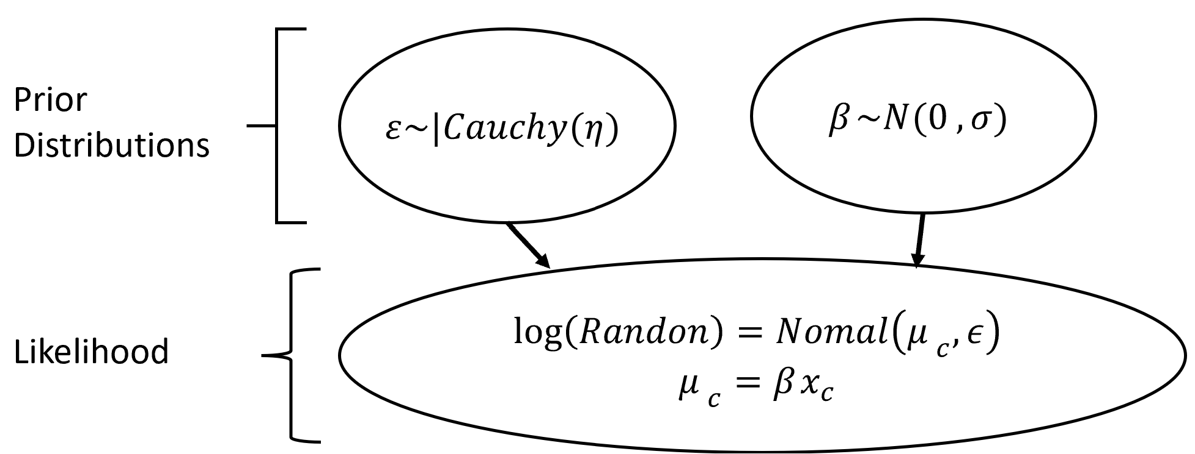
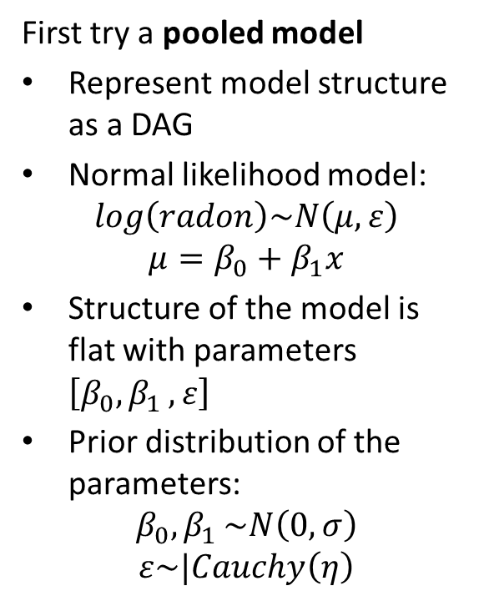
Pooled Model
First try a pooled model
Represent model structure as a DAG
Normal likelihood model:
$$log\left(radon\right)\sim N\left(μ,ε\right)$$
$$μ=β_{0}+β_{1}x$$
Structure of the model is flat with parameters $\left[β_{0}{,β}_{1},ε\right]$
Prior distribution of the parameters:
$$β_{0}{,β}_{1}\sim N\left(0,σ\right)$$
$$ε\sim |Cauchy\left(η\right)$$

Slide 17
Defining and Sampling the Pooled Model
Sampling model defined by this code:
with pm.Model() as pooled_model: # Independent variable is just rumber of floors floor = pm.Data("floor", radon_data.floor.values) # Priors for unknown model parameters betas = pm.Normal("betas", mu=0, sigma=100, shape=2) sigma = pm.HalfCauchy("sigma", 5) # Deterministic response prediction radon_est = betas[0] + betas[1] * floor
# Likelihood of observations y = pm.Normal("y", mu=radon_est, sigma=sigma, observed=radon_data.log_radon)

Slide 18
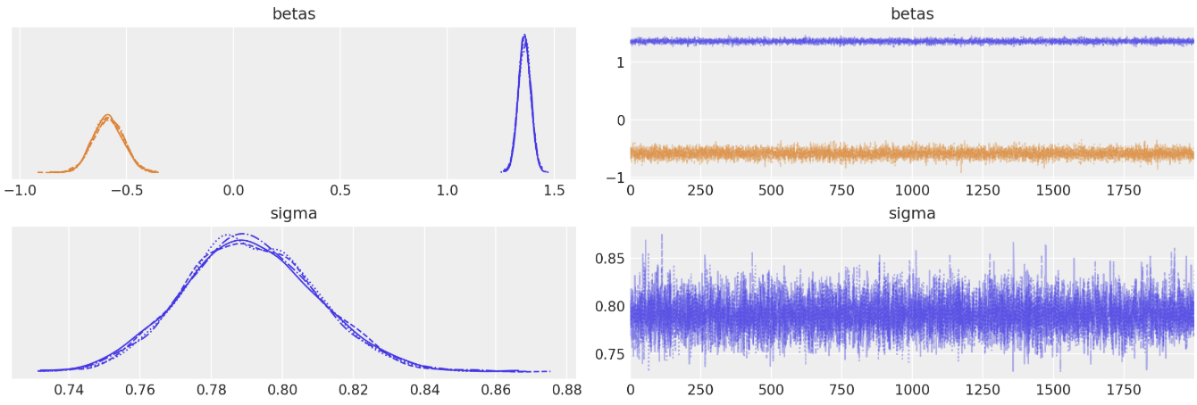
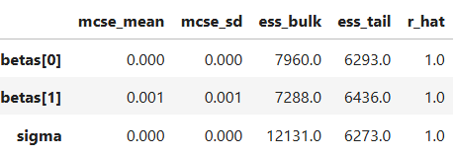
Sampling the Pooled Model
The sampling traces and statistics look reasonable for the three coefficients

Slide 19
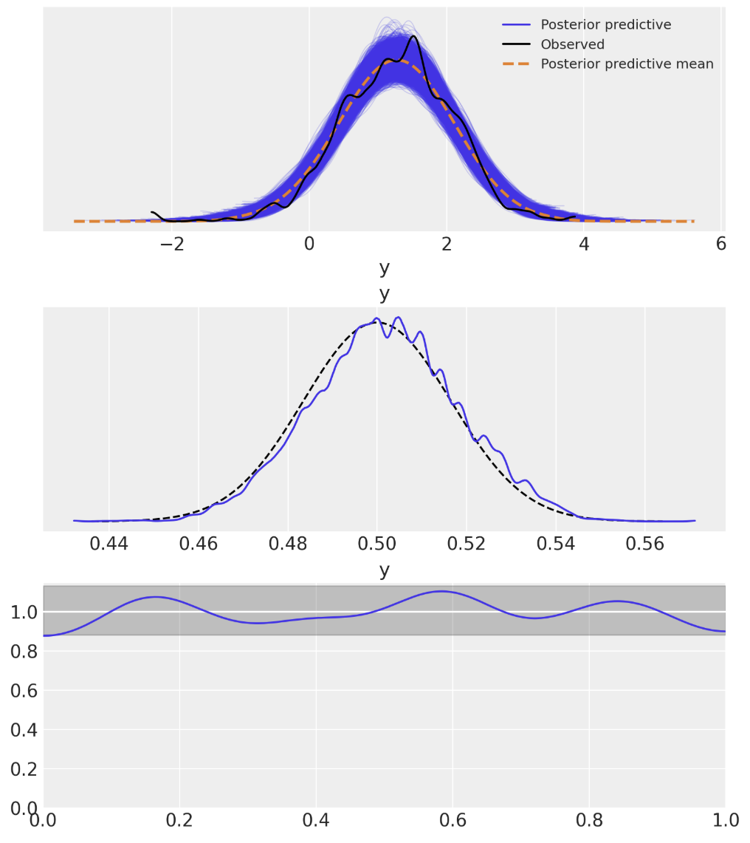
Posterior Predictive Checks for Pooled Model
Posterior predictive checks show good fit
Predicted close to the observed response
The Bayesian p-value shows small skew with respect to the ideal distribution
Bayesian u-value is within credible interval of 1.0

Slide 20
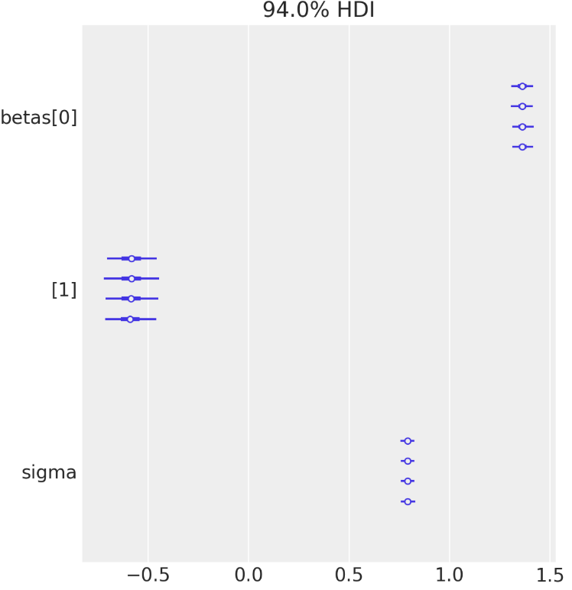
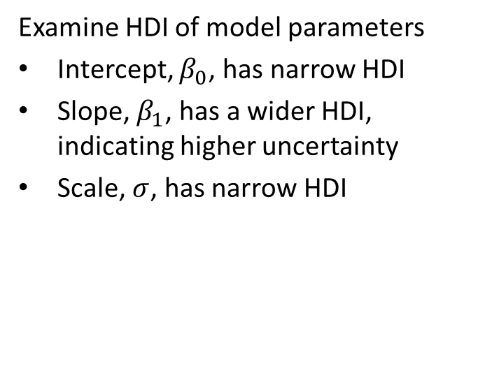
Inference on the Pooled Model Parameters
Examine HDI of model parameters
Intercept, $β_{0}$, has narrow HDI
Slope, $β_{1}$, has a wider HDI, indicating higher uncertainty
Scale, $σ$, has narrow HDI

Slide 21
Unpooled Model
Next, we test an unpooled model
Unpooled model is a linear regression model of the log of Radon concentration
Each category level has independent posterior distribution of the model coefficients
Posterior distributions are independently computed from the data for each county
We assume the observations within each county are exchangeable with each other, but not between counties
Can pool some coefficients, e.g. dispersion

Slide 22
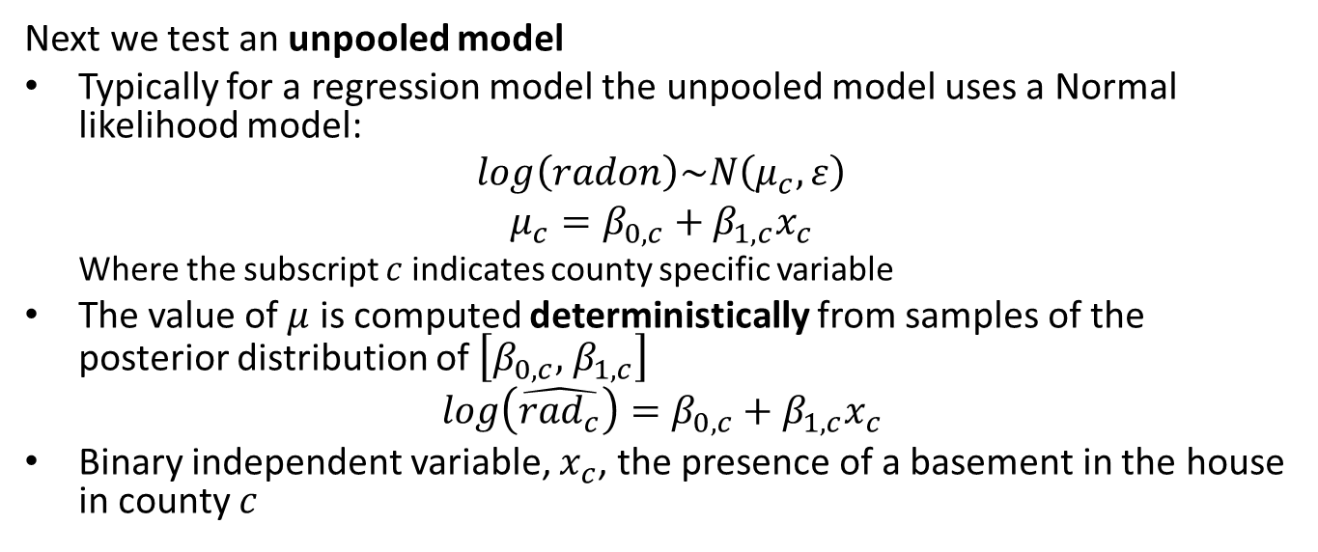
Unpooled Model
Next we test an unpooled model
Typically for a regression model the unpooled model uses a Normal likelihood model:
$$log\left(radon\right)\sim N\left(μ_{c},ε\right)$$
$$μ_{c}=β_{0,c}+β_{1,c}x_{c}$$
Where the subscript $c$ indicates county specific variable
The value of $μ$ is computed deterministically from samples of the posterior distribution of $\left[β_{0,c},{ β}_{1,c}\right]$
$$log\left(\hat{{rad}_{c}}\right)=β_{0,c}+β_{1,c}x_{c}$$
Binary independent variable, $x_{c}$, the presence of a basement in the house in county $c$

Slide 23
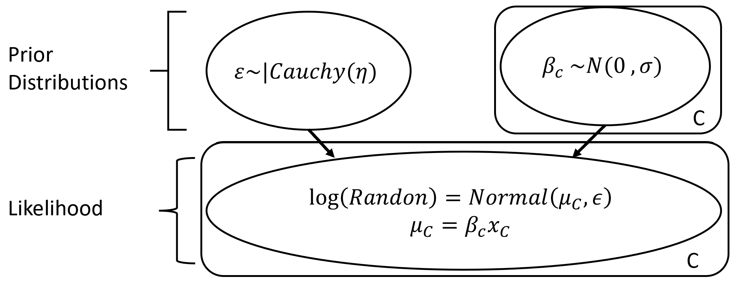
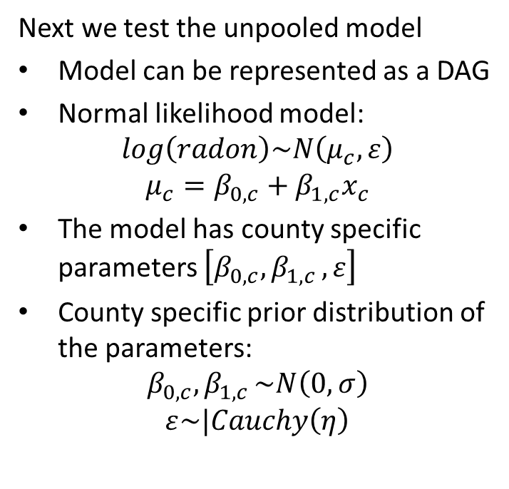
Unpooled Model
Next we test the unpooled model
Model can be represented as a DAG
Normal likelihood model:
$$log\left(radon\right)\sim N\left(μ_{c},ε\right)$$
$$μ_{c}=β_{0,c}+β_{1,c}x_{c}$$
The model has county specific parameters $\left[β_{0,c}{,β}_{1,c},ε\right]$
County specific prior distribution of the parameters:
$$β_{0,c}{,β}_{1,c}\sim N\left(0,σ\right)$$
$$ε\sim |Cauchy\left(η\right)$$

Slide 24

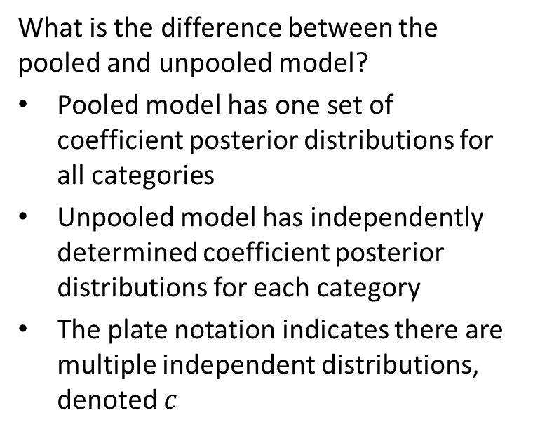
Unpooled Model
What is the difference between the pooled and unpooled model?
Pooled model has one set of coefficient posterior distributions for all categories
Unpooled model has independently determined coefficient posterior distributions for each category
The plate notation indicates there are multiple independent distributions, denoted $c$
$$c$$

Slide 25
Defining and Sampling the Unpooled Model
Sampling model defined by this code:
with pm.Model(coords=coords) as unpooled_model:
# Independent parameters for each county
county_idx = pm.Data("county_idx", county_idxs, dims="obs_id")
floor = pm.Data("floor", radon_data.floor.values, dims="obs_id", mutable=True)
# Beta coefficient priors for each county
Beta0 = pm.Normal("Beta0", 0, sigma=100, dims="county")
Beta1 = pm.Normal("Beta1", 0, sigma=100, dims="county")
# Model error prior
eps = pm.HalfCauchy("eps", 5)
# Deterministic model prediction of radon level by county_idx translates to
#[0, 0, 0, 1, 1, ...], we link multiple household measures in a county
# to unpooled coefficients.
radon_est = Beta0[county_idx] + Beta1[county_idx] * floor
# Data likelihood
y = pm.Normal("y", radon_est, sigma=eps, observed=radon_data.log_radon, dims="obs_id")

Slide 26
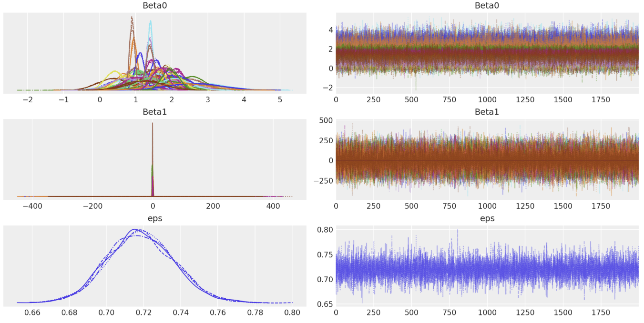
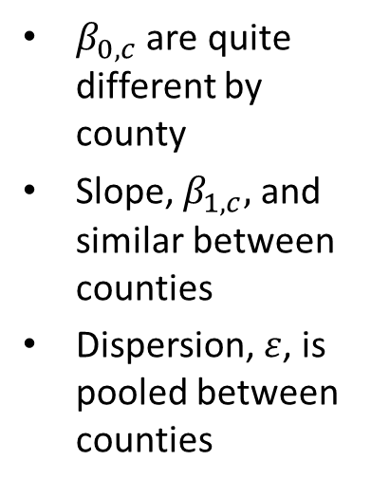
Sampling the Unpooled Model
The sampling traces show independent values by county for two of three coefficients
$β_{0,c}$ are quite different by county
Slope, $β_{1,c},$ and similar between counties
Dispersion, $ε$, is pooled between counties

Slide 27
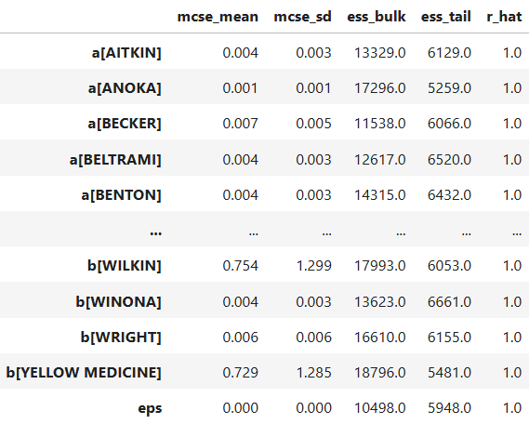
Sampling the UnPooled Model
The sampling statistics are good for all coefficients

Slide 28
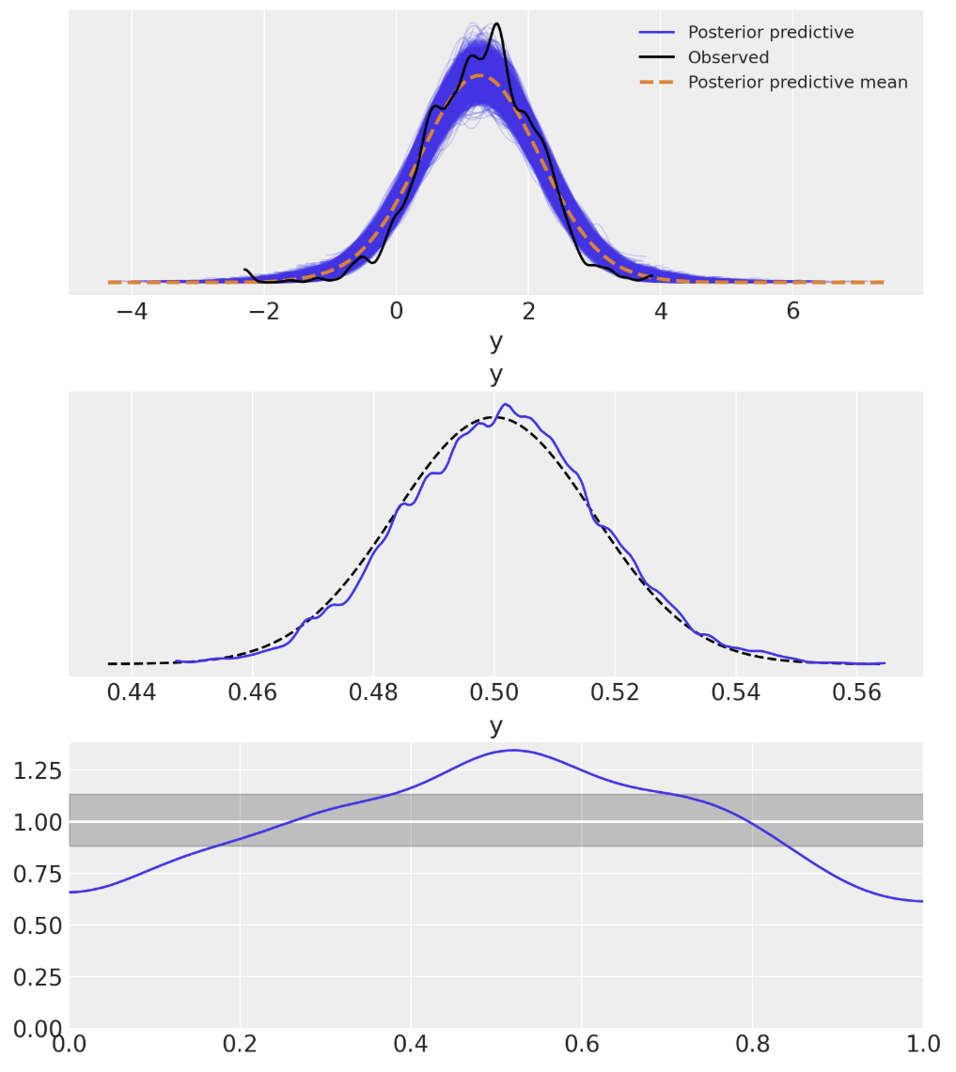
Posterior Predictive Checks for Unpooled Model
Posterior predictive checks show the unpooled model in a poor fit
The posterior predictive mean is close to the observed
The Bayesian p-value shows a skew compared to the ideal distribution
The Bayesian u-value is well outside the desired credible interval!

Slide 29
Hierarchical Model
Finally, we test an Hierarchical Model
The unpooled model has a poor fit
The hierarchical model is organized from top to bottom
Pooled or common hyperpriors at the top level
Each category has a prior for the coefficients, use the hyperpriors as priors
Likelihoods at the bottom level are computed starting with the prior values
Observations are iid within each county
We assume the observations within each county are exchangeable with each other, but not between counties
Can pool some coefficients, e.g. dispersion

Slide 30
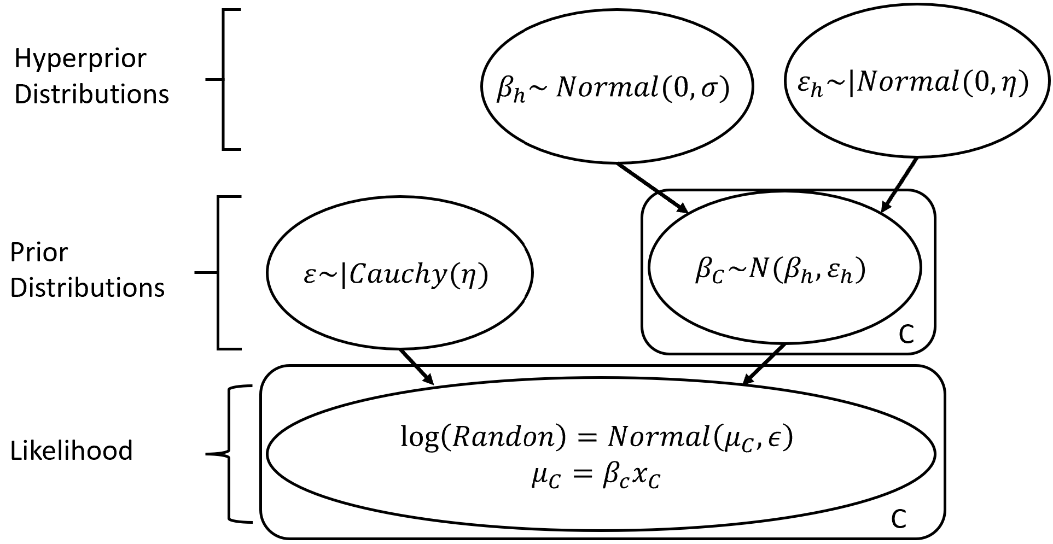
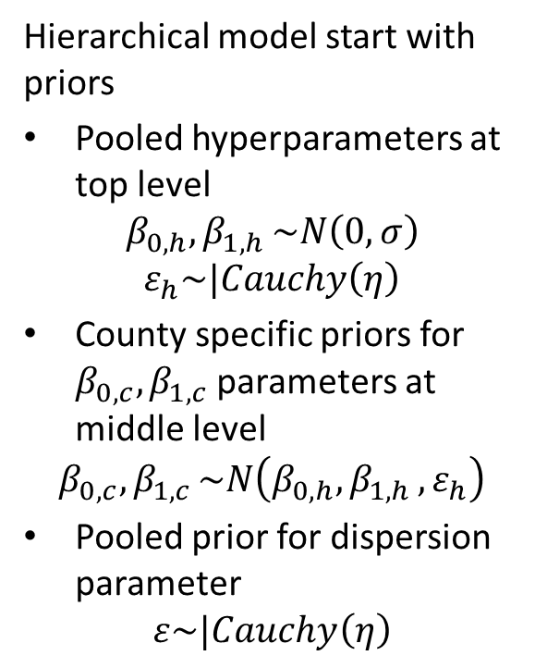
Hierarchical Model
Hierarchical model start with priors
Pooled hyperparameters at top level
$$β_{0,h}{,β}_{1,h}\sim N\left(0,σ\right)$$
$$ε_{h}\sim |Cauchy\left(η\right)$$
County specific priors for $β_{0,c}{,β}_{1,c}$ parameters at middle level
$$β_{0,c}{,β}_{1,c}\sim N\left(β_{0,h}{,β}_{1,h},ε_{h}\right)$$
Pooled prior for dispersion parameter
$$ε\sim |Cauchy\left(η\right)$$

Slide 31
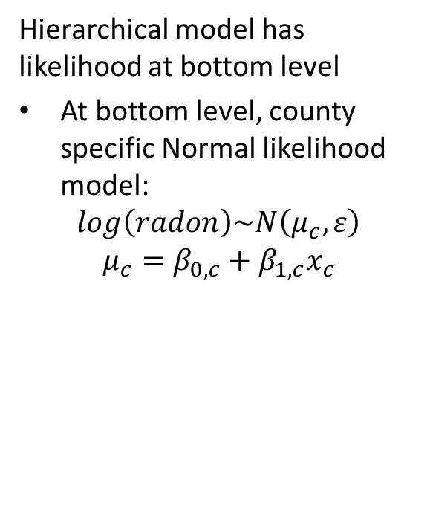
Hierarchical Model
Hierarchical model has likelihood at bottom level
At bottom level, county specific Normal likelihood model:
$$log\left(radon\right)\sim N\left(μ_{c},ε\right)$$
$$μ_{c}=β_{0,c}+β_{1,c}x_{c}$$

Slide 32
Defining and Sampling the Hierarchical Model
Sampling model defined by this code:
with pm.Model(coords=coords) as hierarchical_model:
county_idx = pm.Data("county_idx", county_idxs, dims="obs_id", mutable=True)
# Hyperpriors for pooled nodes
mu_0 = pm.Normal("mu_0", mu=0.0, sigma=20)
sigma_0 = pm.HalfNormal("sigma_0", 5.0)
mu_1 = pm.Normal("mu_1", mu=0.0, sigma=20)
sigma_1 = pm.HalfNormal("sigma_1", 5.0)
# Intercept for each county, distributed around group mean mu_a above we just set mu
# and sd to a fixed value while here we plug in a common group distribution for all
# Beta0 and Beta1 (which are vectors of length n_counties).
Beta0 = pm.Normal("Beta0", mu=mu_0, sigma=sigma_0, dims="county")
# effect difference between basement and floor level
Beta1 = pm.Normal("Beta1", mu=mu_1, sigma=sigma_1, dims="county")
# Model error
eps = pm.HalfCauchy("eps", 5.0)
# Deterministic calculation of response
radon_est = Beta0[county_idx] + Beta1[county_idx] * radon_data.floor.values
# Data likelihood
radon_like = pm.Normal("radon_like", mu=radon_est, sigma=eps, observed=radon_data.log_radon, dims="obs_id")

Slide 33
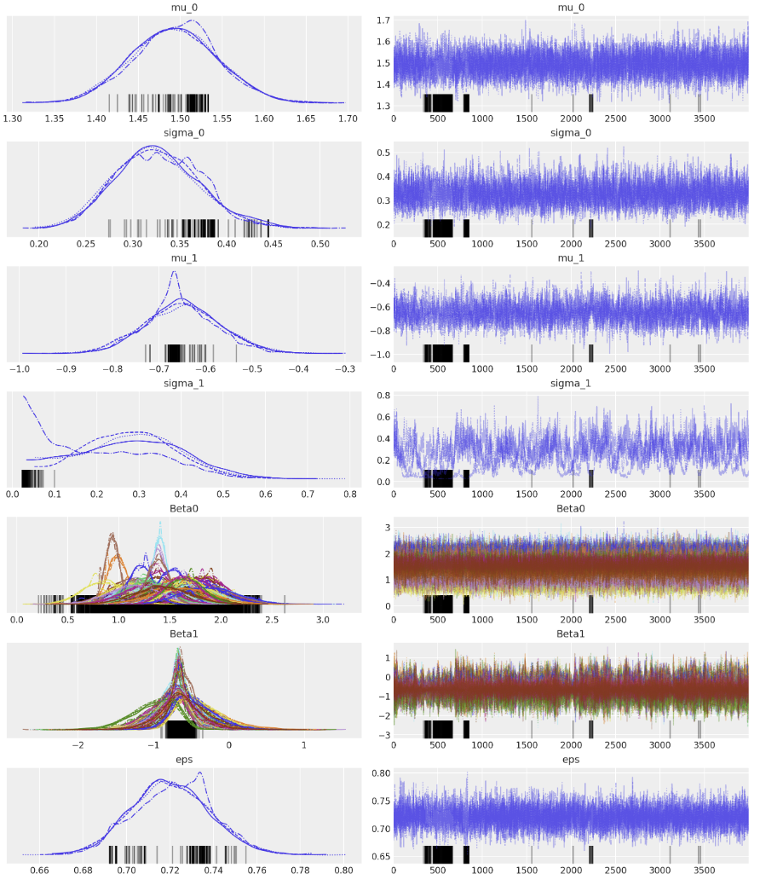
Sampling the Hierarchical Model
The sampling traces show pooled hyperprior distribution and independent parameter values by county for two of three coefficients
There is divergence between traces
At least one trace diverges from the other
Note in particular, divergence of traces sigma_1
We need a better model!

Slide 34
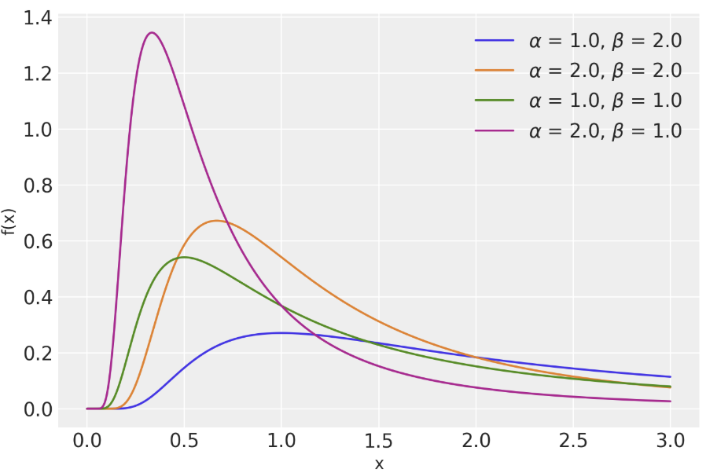
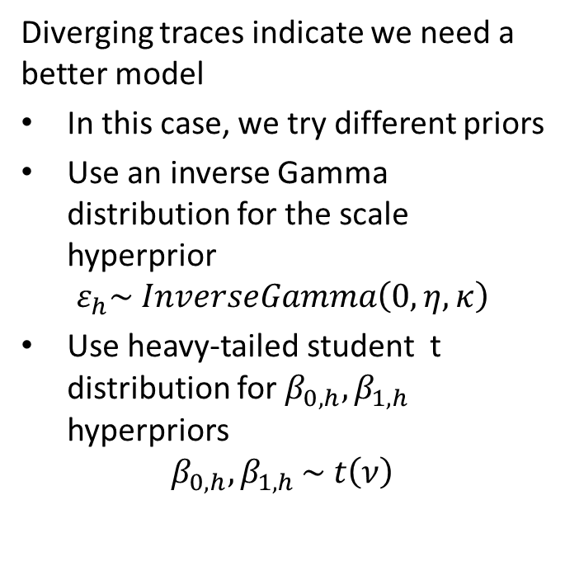
Updated Hierarchical Model
Diverging traces indicate we need a better model
In this case, we try different priors
Use an inverse Gamma distribution for the scale hyperprior
$$ε_{h}\sim InverseGamma\left(0,η,κ\right)$$
Use heavy-tailed student t distribution for $β_{0,h}{, β}_{1,h}$ hyperpriors
$$β_{0,h}{,β}_{1,h}\sim t\left(ν\right)$$

Slide 35
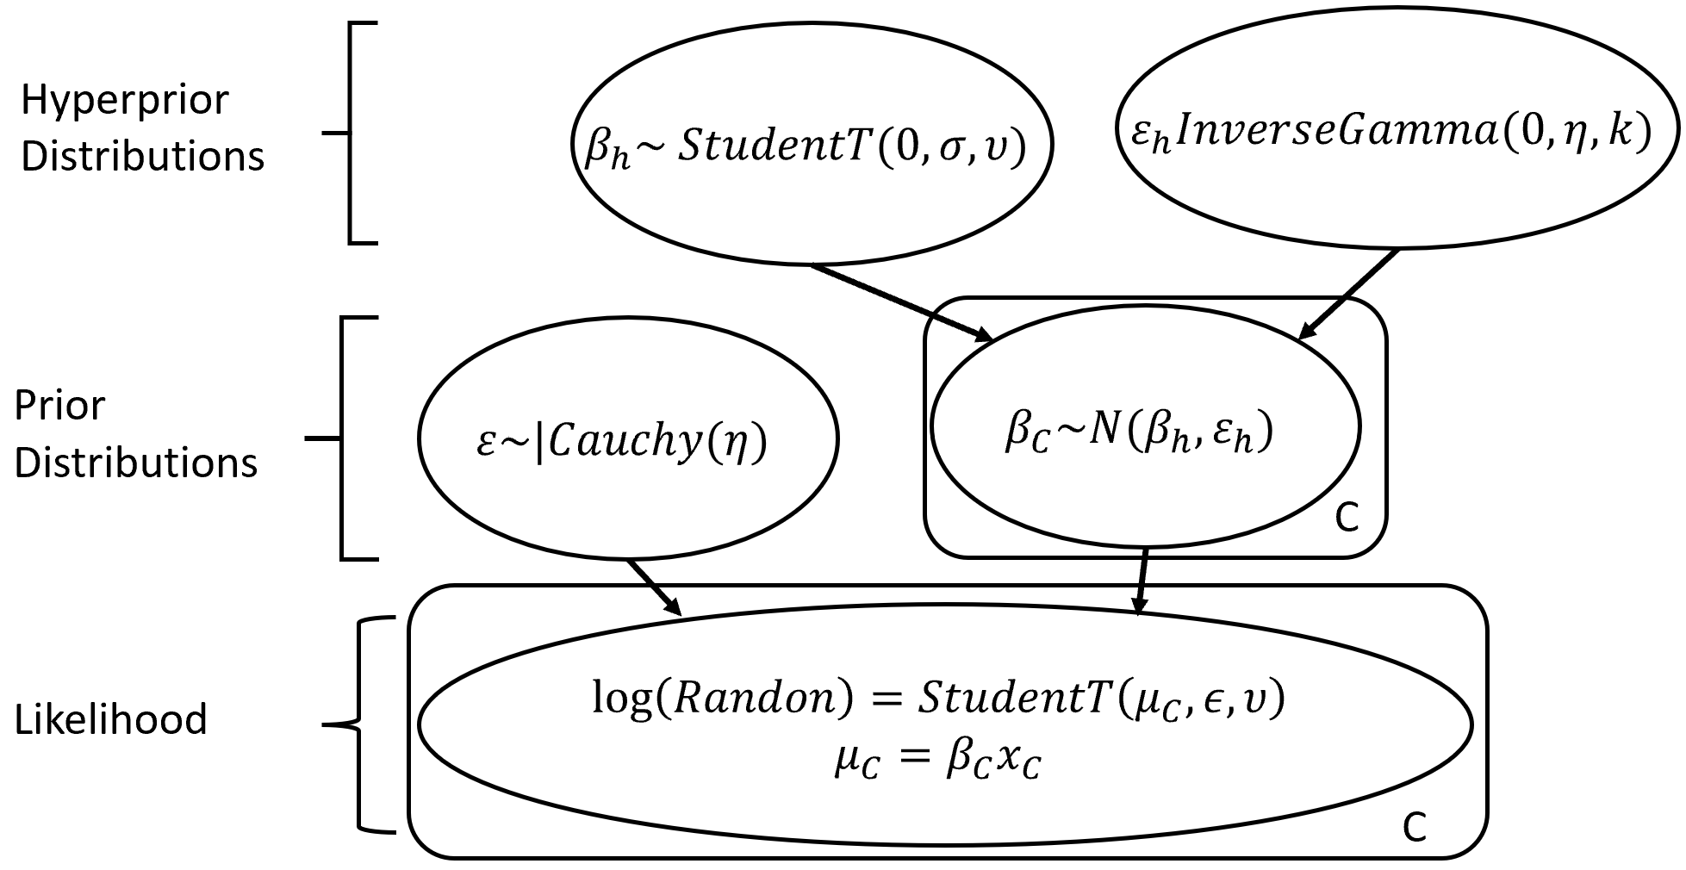
Updated Hierarchical Model
Updated hierarchical model
Updated hyperpriors
Other levels of the model are the same

Slide 36
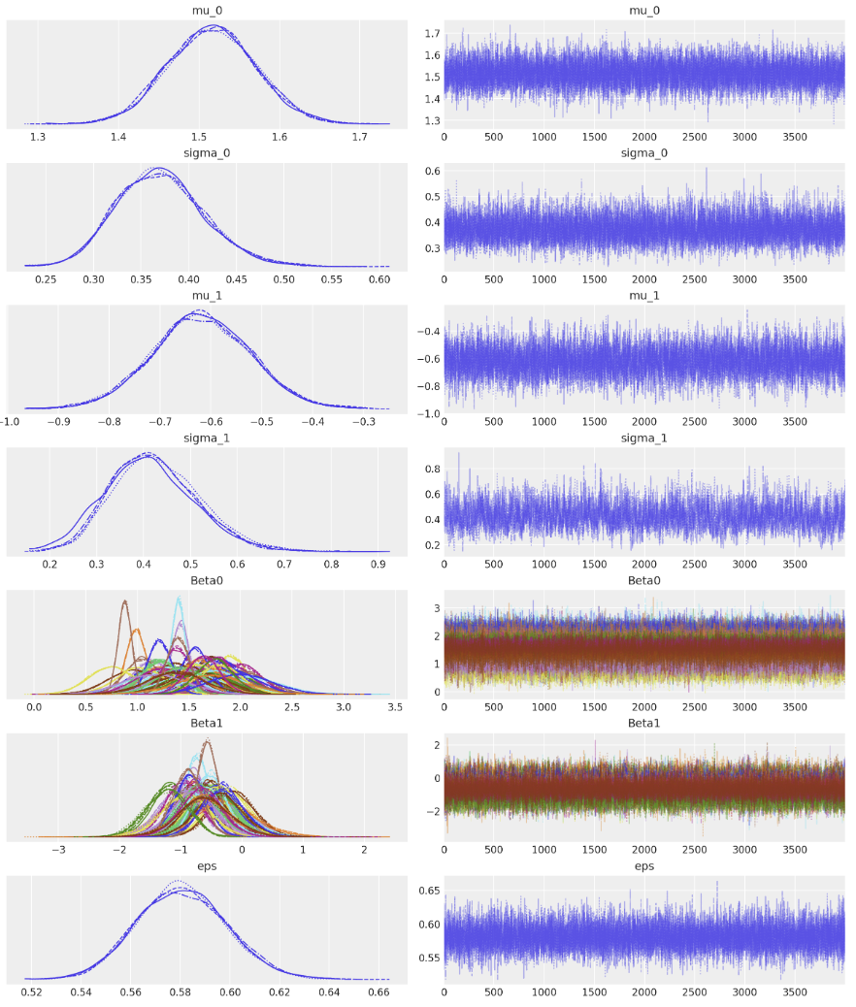
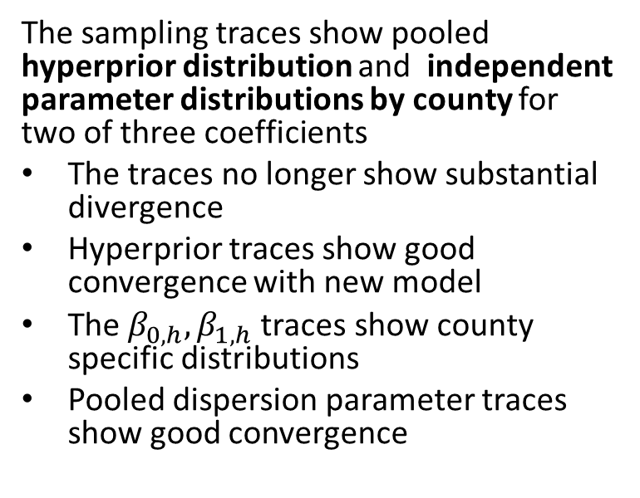
Sampling the Updated Hierarchical Model
The sampling traces show pooled hyperprior distribution and independent parameter distributions by county for two of three coefficients
The traces no longer show substantial divergence
Hyperprior traces show good convergence with new model
The $β_{0,h}{, β}_{1,h}$traces show county specific distributions
Pooled dispersion parameter traces show good convergence

Slide 37
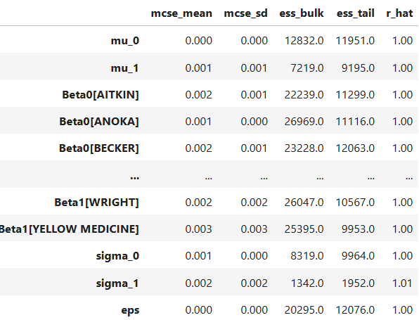
Sampling the Updated Hierarchical Model
The sampling statistics are good for all coefficients

Slide 38
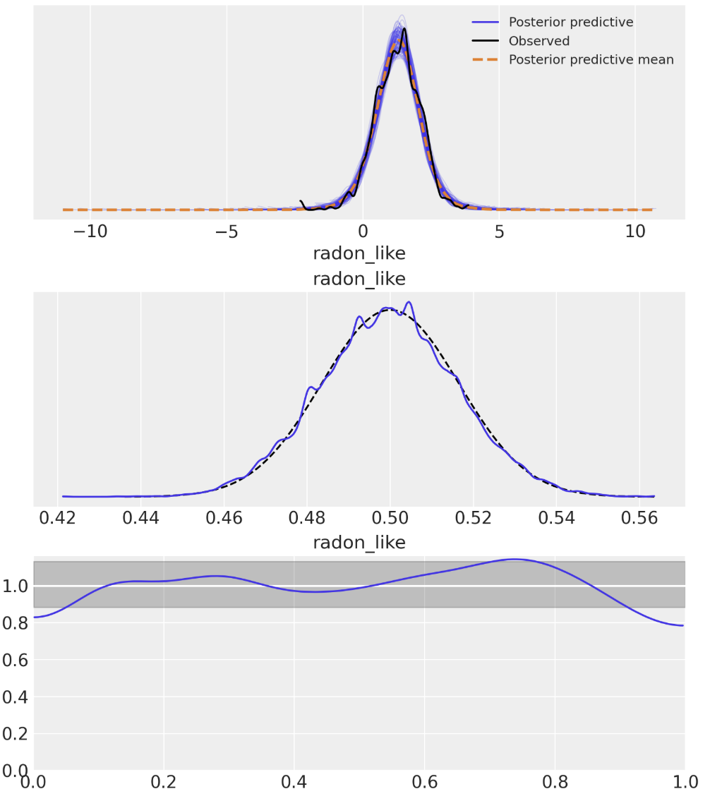
Posterior Predictive Checks for Updated Hierarchical Model
Posterior predictive checks show the update hieratical model is a good fit
The posterior predictive mean is closed to the observed
The Bayesian p-value has no significant skew with respect to the ideal
The Bayesian u-value has a small deviation outside the ideal credible interval around 1.0

Slide 39
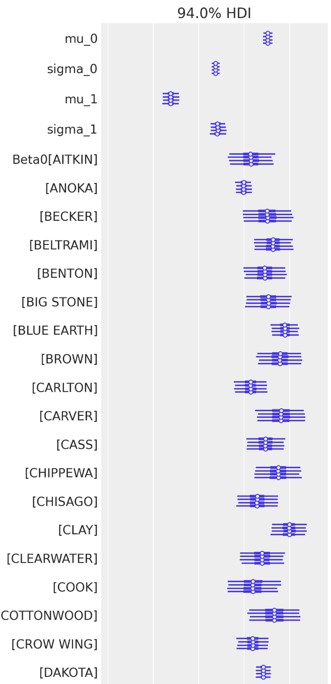
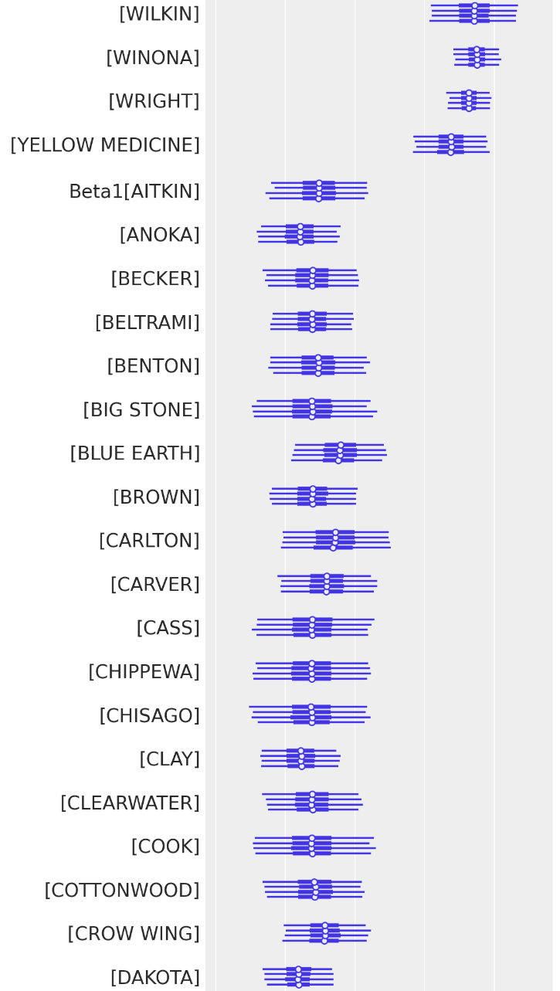
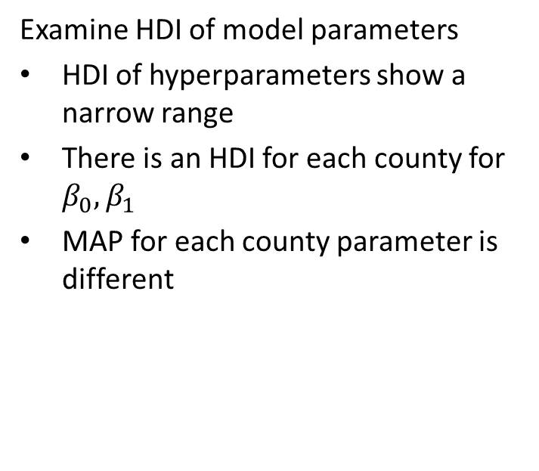
Inference on the Hierarchical Model Parameters
Examine HDI of model parameters
HDI of hyperparameters show a narrow range
There is an HDI for each county for $β_{0}{,β}_{1}$
MAP for each county parameter is different

Slide 40
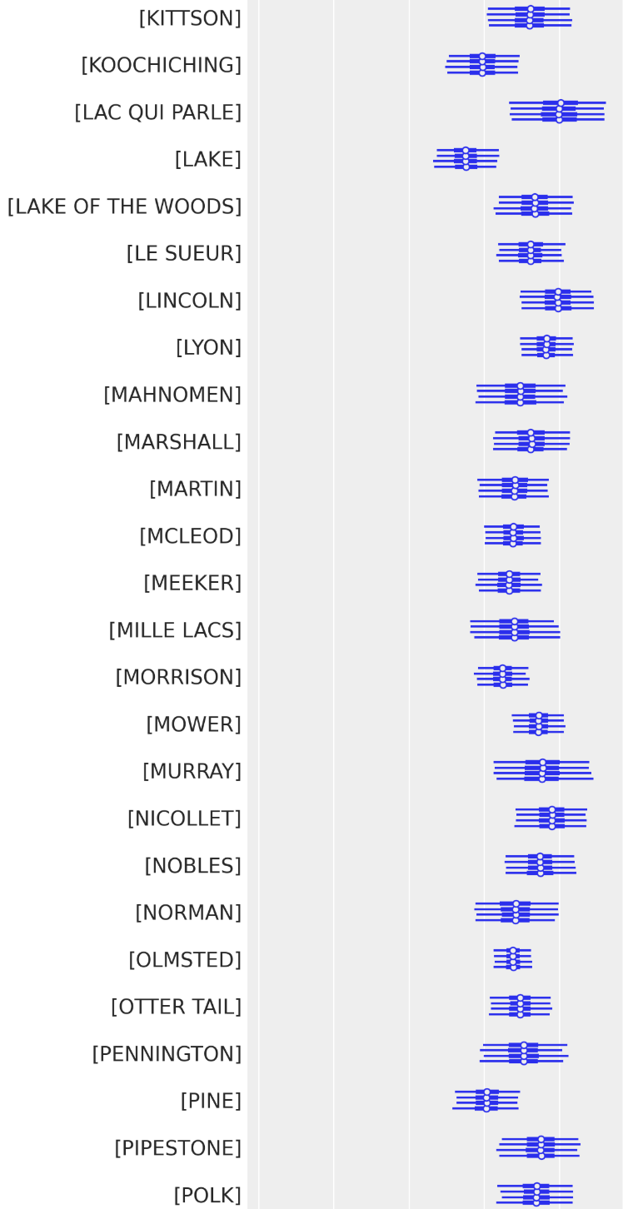
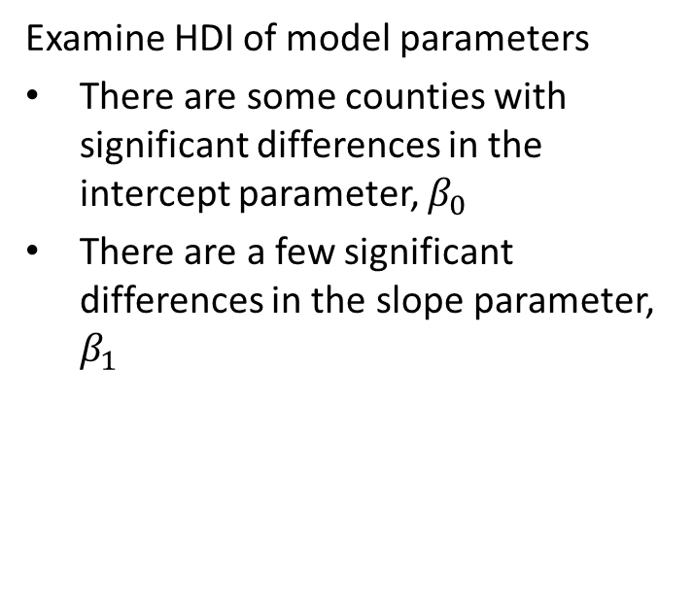
Inference on the Hierarchical Model Parameters
Examine HDI of model parameters
There are some counties with significant differences in the intercept parameter, $β_{0}$
There are a few significant differences in the slope parameter, $β_{1}$

Slide 41
Comparing Bayesian Model
How can we compare Bayesian models?
We need comparison methods within the Bayesian framework
Idea, compare the likelihoods of models
Cannot compute directly from samples
Use leave one out (LOO) cross validation (CV)
Expected log pointwise density (ELPD) is a LOO CV statistic

Slide 42
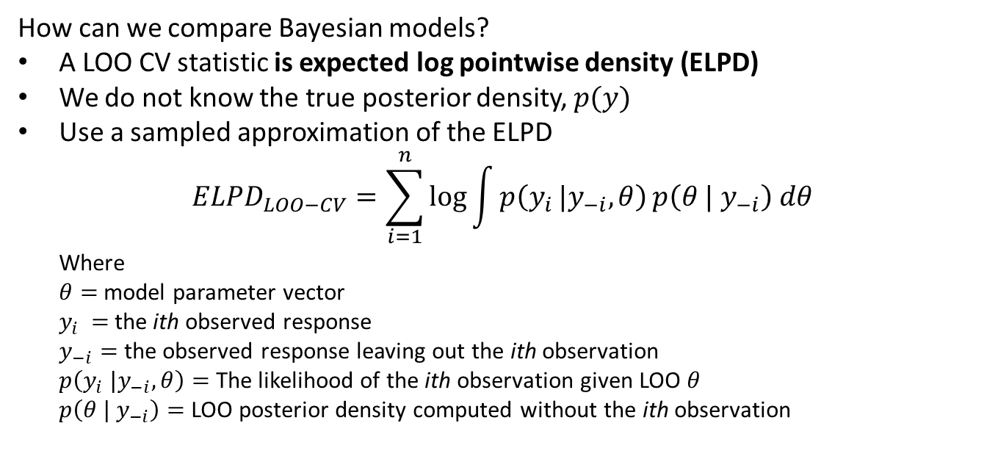
Comparing Bayesian yModel
How can we compare Bayesian models?
A LOO CV statistic is expected log pointwise density (ELPD)
We do not know the true posterior density, $p(y)$
Use a sampled approximation of the ELPD
$${ELPD}_{LOO−CV}=\sum_{i=1}^{n}{\log{\int{p\left(y_{i }|y_{−i},θ\right)}p\left(θ | y_{−i}\right) dθ}}$$
Where
$θ=$ model parameter vector
$y_{i }=$ the ith observed response
$y_{−i}=$ the observed response leaving out the ith observation
$p\left(y_{i} |y_{−i},θ\right)=$ The likelihood of the ith observation given LOO $θ$
$p\left(θ | y_{−i}\right)=$ LOO posterior density computed without the ith observation

Slide 43
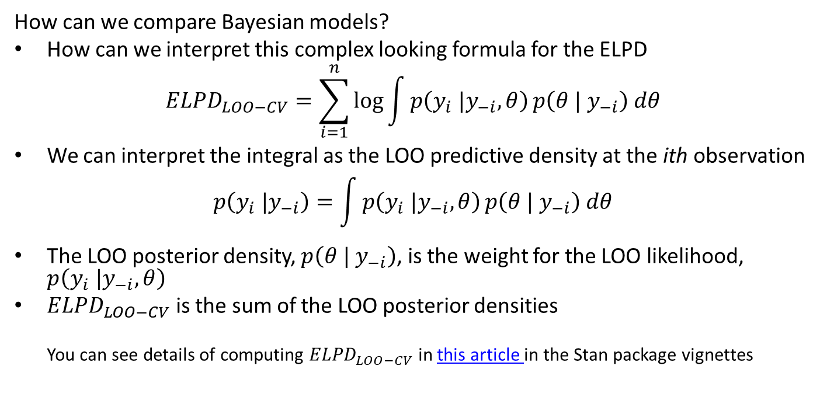
Comparing Bayesian Model
How can we compare Bayesian models?
How can we interpret this complex looking formula for the ELPD
$${ELPD}_{LOO−CV}=\sum_{i=1}^{n}{\log{\int{p\left(y_{i} |y_{−i},θ\right)}p\left(θ | y_{−i}\right) dθ}}$$
We can interpret the integral as the LOO predictive density at the ith observation
$$p\left(y_{i} |y_{−i}\right)=\int{p\left(y_{i} |y_{−i},θ\right)}p\left(θ | y_{−i}\right) dθ$$
The LOO posterior density, $p\left(θ | y_{−i}\right)$, is the weight for the LOO likelihood, $p\left(y_{i} |y_{−i},θ\right)$
${ELPD}_{LOO−CV}$ is the sum of the LOO posterior densities
You can see details of computing ${ELPD}_{LOO−CV}$ in this article in the Stan package vignettes

Slide 44
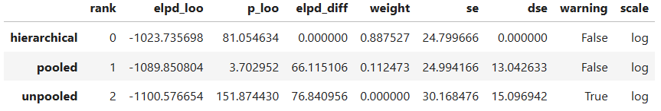
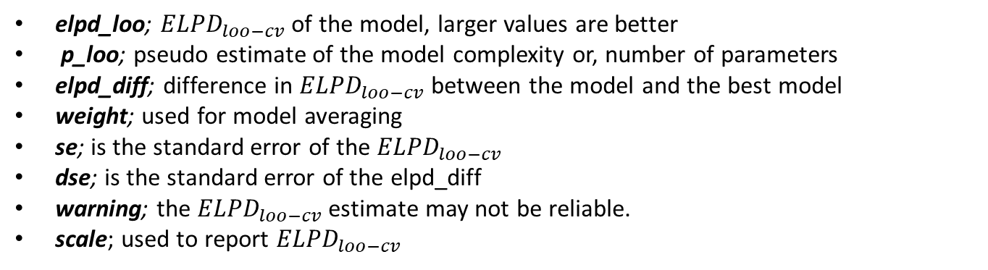
Comparing Bayesian Model
Compare the three models using expected log pointwise density (ELPD)
elpd_loo; ${ELPD}_{loo−cv}$of the model, larger values are better
p_loo; pseudo estimate of the model complexity or, number of parameters
elpd_diff; difference in ${ELPD}_{loo−cv}$ between the model and the best model
weight; used for model averaging
se; is the standard error of the ${ELPD}_{loo−cv}$
dse; is the standard error of the elpd_diff
warning; the ${ELPD}_{loo−cv}$estimate may not be reliable.
scale; used to report ${ELPD}_{loo−cv}$

Slide 45
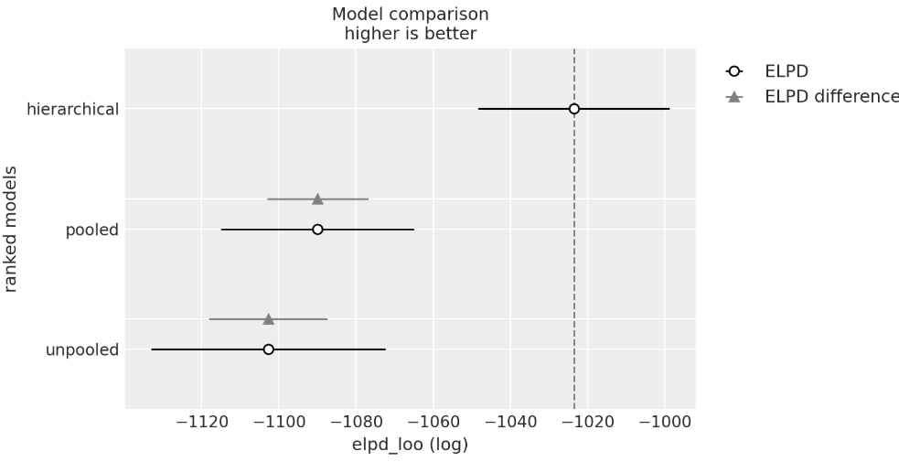
Comparing Bayesian Model
Compare the three models using expected log pointwise density (ELPD)
Compare the HDI of the ELPD and difference of ELPD of each model
The HDI of the hierarchical model is greater than the other two models
The HDIs of the unpooled and pooled models do not over lap the hierarchical model
HDIs of unpooled and pooled models overlap

Slide 46
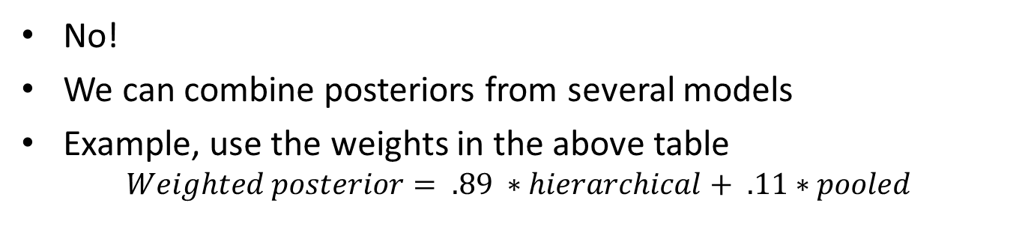
Comparing Bayesian Model
Do we always need to choose one Bayesian model?
No!
We can combine posteriors from several models
Example, use the weights in the above table
$$Weighted posterior= .89 ∗hierarchical+ .11∗pooled$$

Slide 47
Bayesian Shrinkage
How can we account for the difference between unpooled and hierarchical model?
The answer lies in Bayesian shrinkage
Bayesian posterior distributions shrink toward the prior
Shrinkage effect is greatest when there are many parameters
Recall that when there is no data the posterior equals the prior
With limited data the posterior will be close to the prior
Shrinkage is the Bayesian equivalent of regularization
Shrinkage prevents overfitting in Bayesian model

Slide 48
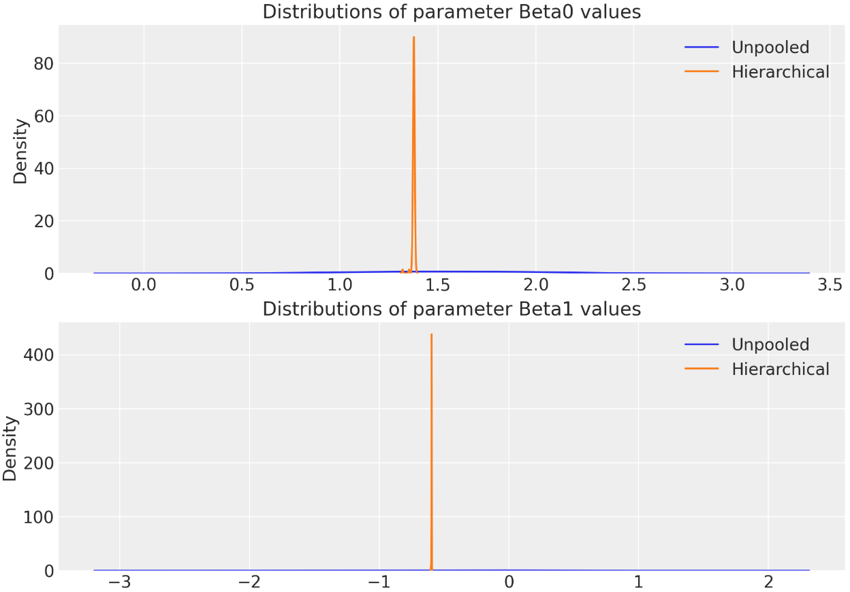
Bayesian Shrinkage
Compare the parameter values of the unpooled and hierarchical models
The model has 2 parameters for each county and few observations per county
The distribution of the parameter MAP values of the two models are significantly different
The MAP values of the unpooled model parameters are under-constrained and widely dispersed
The MAP values of the hierarchical model parameters are shrunk toward the prior and have low dispersion

Slide 49
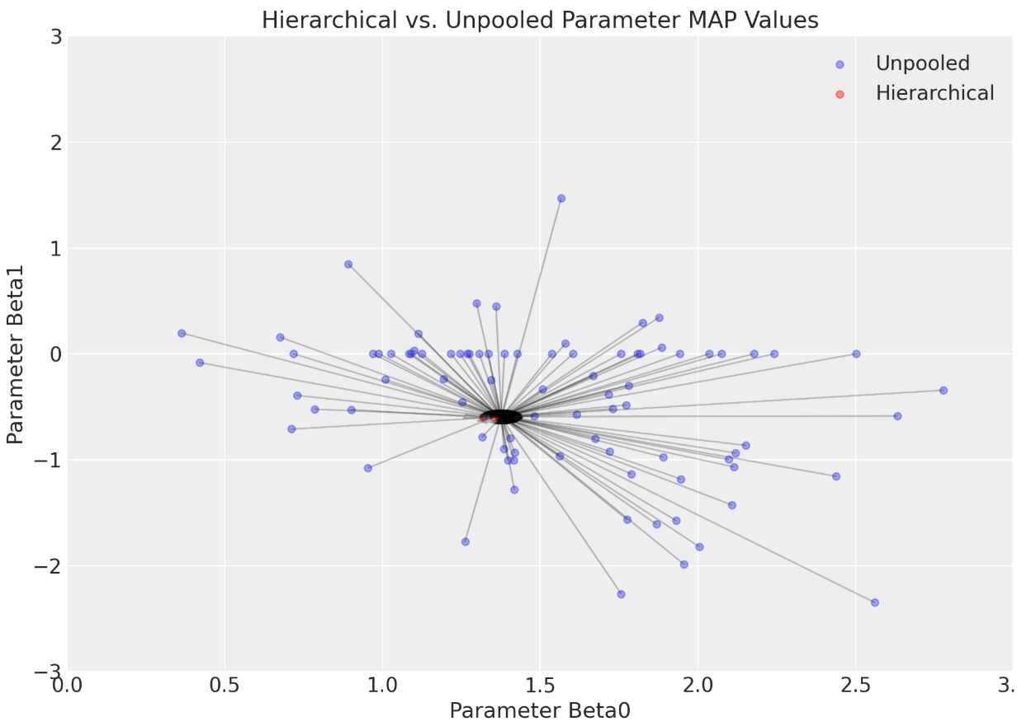
Bayesian Shrinkage
Compare the parameter values of the unpooled and hierarchical models
The model has 2 parameters for each county and few observation per county
The distribution of MAP values of the two models are significantly different
The MAP values of the unpooled model parameters are under-constrained and widely dispersed
The MAP values of the hierarchical model parameters are shrunk toward the priors and have low dispersion

Slide 50
For Further Study
Materials for further study of constructing and evaluating hierarchical Bayesian models include:
Bayesian Data Analysis, 3rd edition, Gelman, et. al., 2014, Chapter 15
Bayesian Modeling and Computation in Python, Martin, et. al., 2022, Chapter 4

Slide 51
Summary
Key points in this lesson:
Pooled vs. unpooled models
Pooled models have single prior and posterior for all parameters
Unpooled models achieve flexibility with posterior distributions for each independent case
Defining hierarchical models through hyperpriors and priors
Priors fit using the hyperpriors
Posterior fit using priors at bottom level
Evaluation and comparison of Bayesian models with LOO CV
Bayesian shrinkage prevents overfitting model

