Slide 1
Teaching the Faculty to Teach Information Literacy: Examples and Considerations
ALAO Conference
October 2020

Slide 2
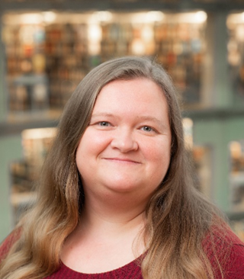
Presenter
Jane Hammons
hammons.73@osu.edu
Assistant Professor, University Libraries, The Ohio State University
Teaching and Learning Engagement Librarian

Slide 3
Presentation Outcomes
Explore how faculty development can be used to support the increased integration of information literacy into the curriculum
Review multiple examples of library-led faculty development programming
Consider how you can support faculty development efforts at your institution

Slide 4
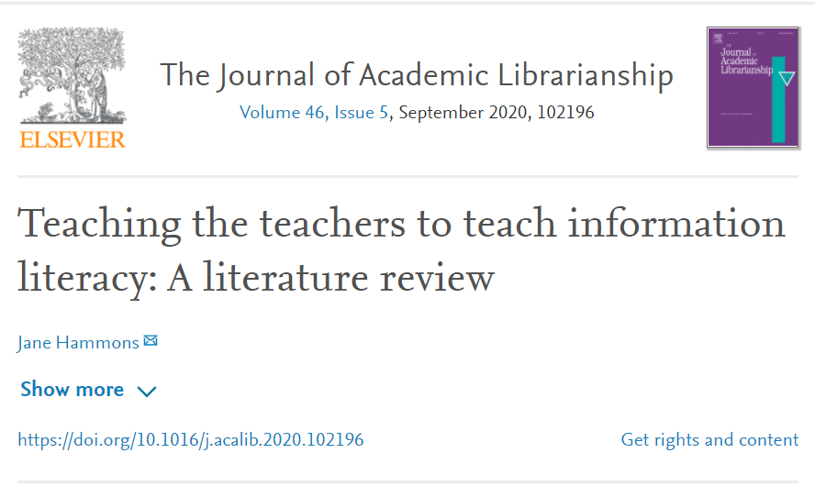
Research Background
Hammons, J. (2020). Teaching the teachers to teach information literacy: A literature review. The Journal of Academic Librarianship, 46(5).
Notes:
As part of this research, I reviewed 24 examples of “teach the teachers” initiatives in academic libraries.

Slide 5
Why Faculty Development?
Notes:
How will focusing on faculty help us with our goal of increasing the integration of information literacy into the curriculum?

Slide 6
Arguments
“The time has come to shift our focus from the students to the faculty---to teach the faculty to teach information literacy.”
Risë L. Smith, 1997, Philosophical Shift: Teach the Faculty to Teach Information Literacy

Slide 7
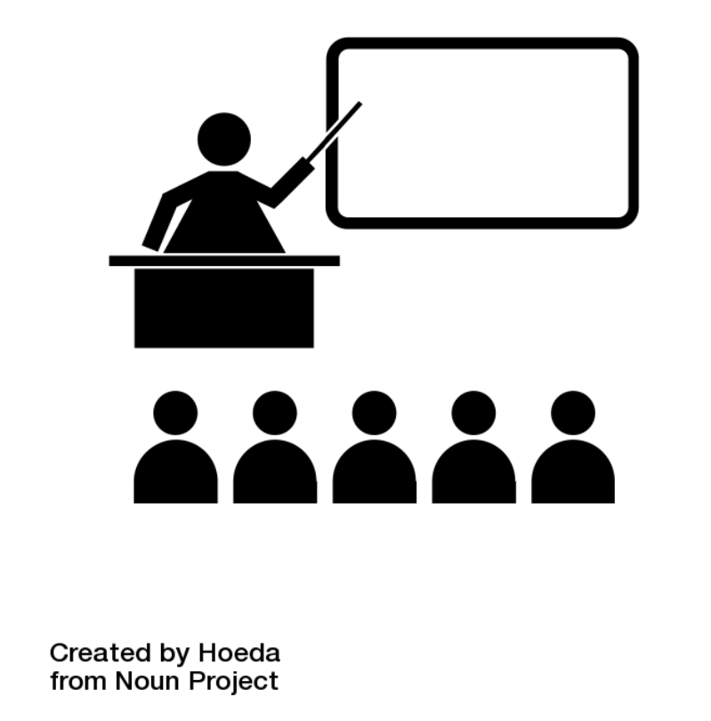
Arguments
Scalability
Limited staffing & time (Smith, 1997)
Inconsistent reach to students (Cowan & Eva, 2016)
Integration of IL into course
May be seen as separate from other course content when taught by librarian (Miller & Bell, 2005)

Slide 8
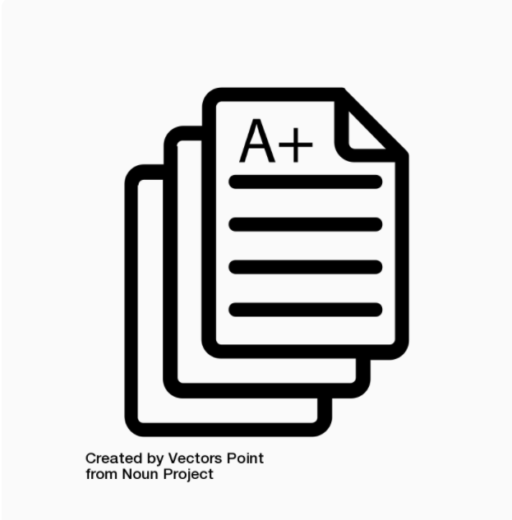
Arguments
Faculty Role in Classroom
Time with students (Fister, 2009)
Control over grades (Cowan & Eva, 2016)
Information Literacy in the Disciplinary Context
IL as essential part of discipline (Smith, 1997)
IL too big for librarians alone to teach (Cowan & Eva, 2016)
Librarians would continue to support IL in a meaningful capacity (Miller & Bell, 2005)

Slide 9
Arguments
This “teach the teachers” model, which puts the instruction of information literacy (IL) in the hands of those who actually teach classes, may seem like a radical idea; it certainly runs counter to what most librarians have internalized from our graduate studies and professional lives.
Cowan, S., & Eva, N. C. (2016). Changing our aim: infiltrating faculty with information literacy. Communications in Information Literacy, 10(2), 163-177.

Slide 10
Arguments
Librarians have played primary role in developing the concept of information literacy
IL as “…perhaps the most profound evidence of success in the modern academic library” (Cowan, 2014, p. 27)
Concerns over loss of professional legitimacy and relevance
Do faculty want the responsibility?
…most faculty “seem unwilling to value information literacy sufficiently to take viable ownership of it” (Badke, 2014, p. 69).

Slide 11
Faculty Development Initiatives

Slide 12
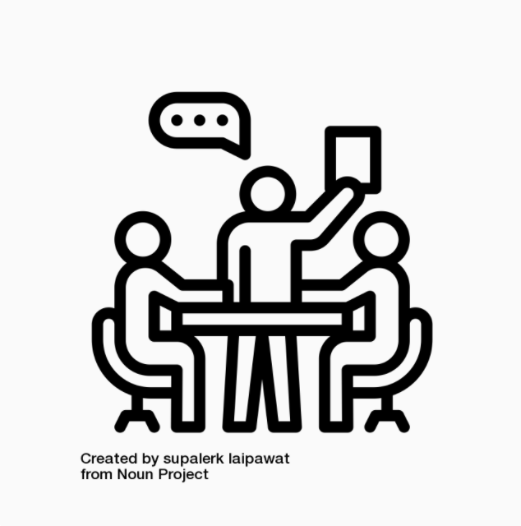
Research Findings—Formats
Workshops (standalone, series, multi-day)
Online workshops, courses, curriculum guides
Training sessions (instructors, graduate teaching assistants)
Learning communities, faculty fellows programs, course redesign programs/grants

Slide 13
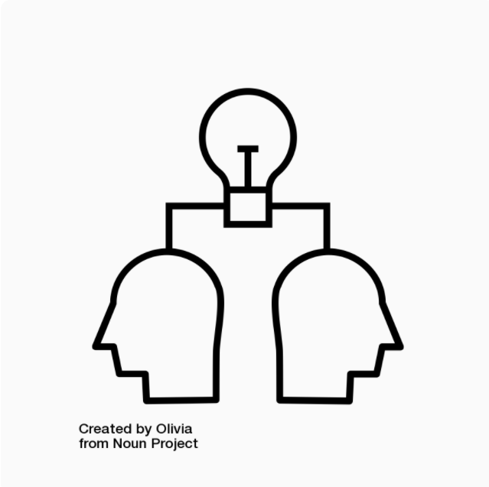
Research Findings—Goals
Increase faculty knowledge of IL
Assignment or course revision to integrate IL
Change responsibility for teaching IL in specific courses

Slide 14
Examples
Information Literacy Quality Enhancement Plan, Trinity University (TX), (Millet, M. S., Donald, J., & Wilson, D. W., 2009)
Workshops, Course Redesign Grant Program
Information Literacy Learning Community, Westminster College (VanderPol, D. & Swanson, E., 2013)
Monthly meetings focused on ACRL Standards
Goal: Each participant add IL to an assignment or course
Graduate Teaching Assistant Training, University of Kentucky (Hartman, P. J., Newhouse, R., & Perry, V. E., 2014)
Goal: Teach graduate students to teach IL in intro BIO courses
Online Information Literacy Course, Southeastern University (Veach, 2009)
Required of all faculty as part of technology training

Slide 15
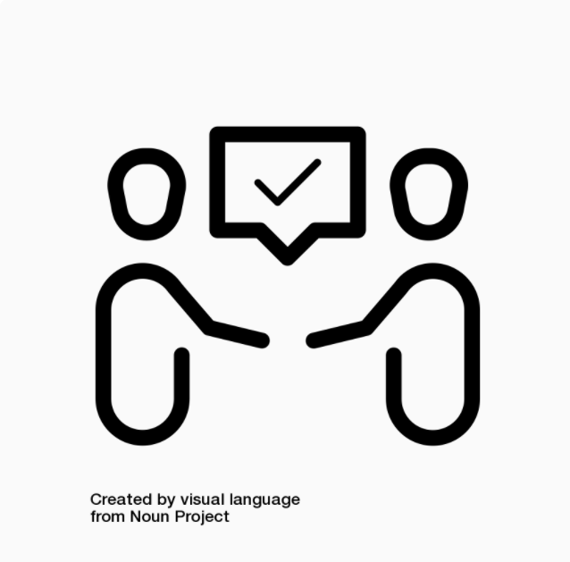
Research Findings
Connection to campus developments
Accreditation, Strategic Plan, Course Grant Programs
Collaboration with other campus units
Teaching & learning centers, writing programs
Incentives for participants
Stipends, credit

Slide 16
Faculty Development Initiatives

Slide 17
Faculty Summer Institute on Information Literacy
Information Literacy Faculty Ambassador Program
Northern Kentucky University
GEARUP with Information Literacy Quality Enhancement Plan
Hammons, J., Brooks, A., Chesnut, M., & Warner, L. (2019). Beyond the library walls: How a faculty institute transformed information literacy education across campus. Kentucky Libraries, 83(1), 7-11.

Slide 18
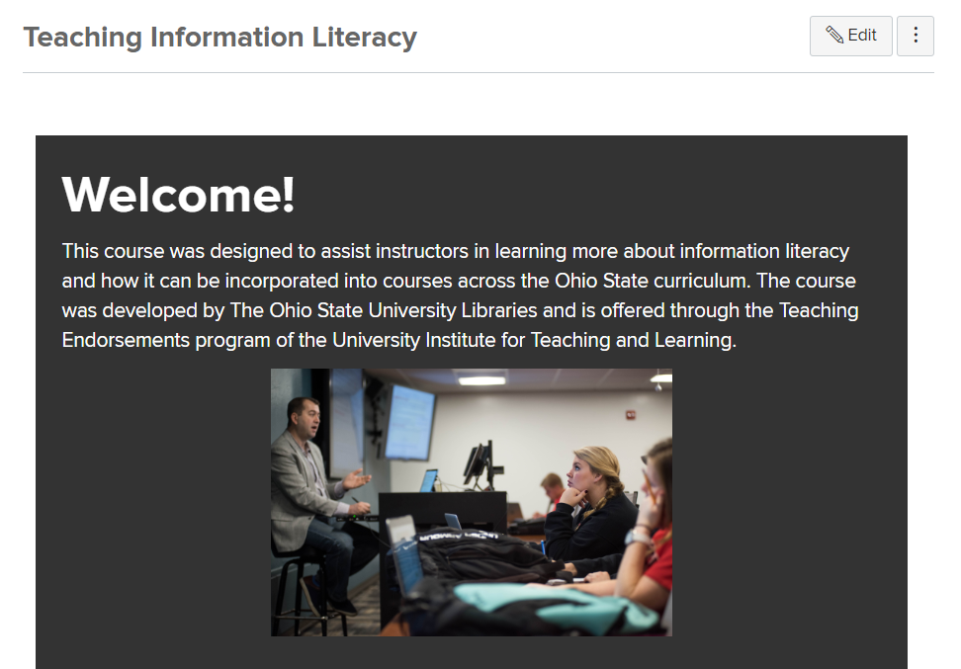
Teaching Information Literacy Course
Self-paced, online course in Canvas
Offered as a Teaching Endorsement through Drake Institute for Teaching and Learning at Ohio State
Course Materials: https://osu.box.com/s/ywjrygpml5fi9837l8h32xi766mdz5qn

Slide 19
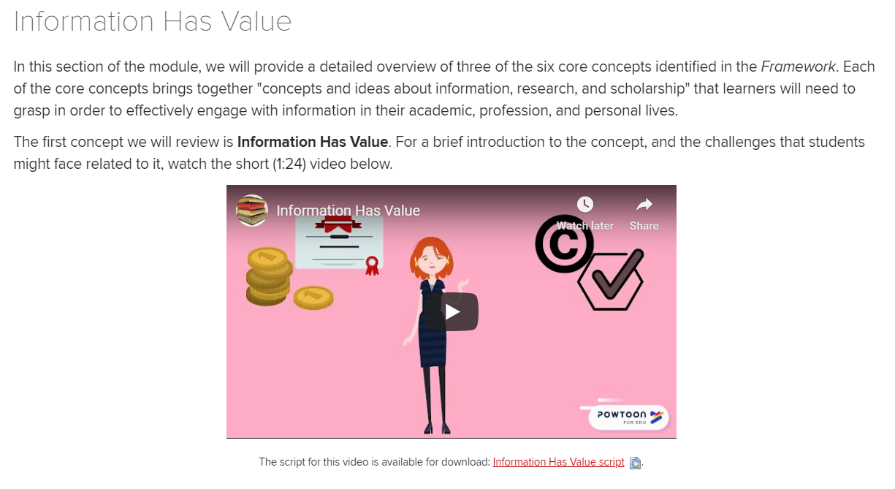
Teaching Information Literacy Course
Course Modules
The Information Environment & Information Literacy
The Framework for Information Literacy Part I
The Framework for Information Literacy Part II
Teaching Information Literacy Part I
Teaching Information Literacy Part II
Bringing It All Together
Deliverable: Information Literacy Action Plan
Hammons, J. (2020). Teaching information literacy: Developing an online course for faculty. College & Research Libraries News, 81(7), 337.

Slide 20
Teaching Information Literacy Course
62 total enrolled, 16 completed
Departments include: Sociology, Teaching & Learning, Horticulture and Crop Science, English, ESL, Theatre, Electrical and Computer Engineering

Slide 21
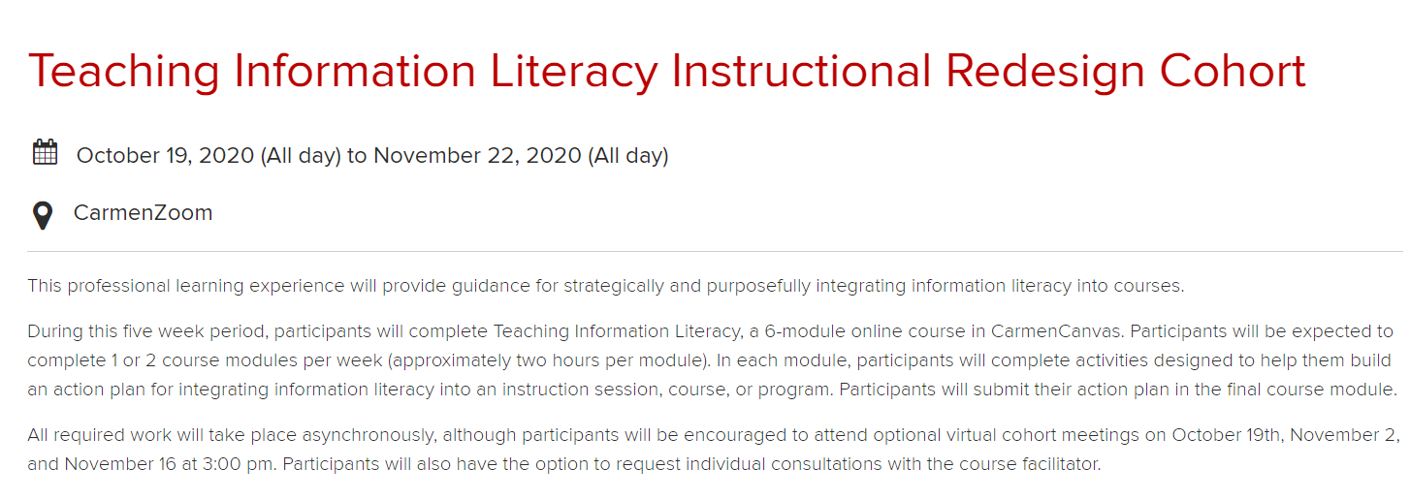
Teaching Information Literacy Course
Instructional Redesign Cohort
3 week program (Summer 2020)
5 week program (Autumn 2020)
Participants complete Teaching Info Lit course as a group
Summer: 6 of 11 completed

Slide 22
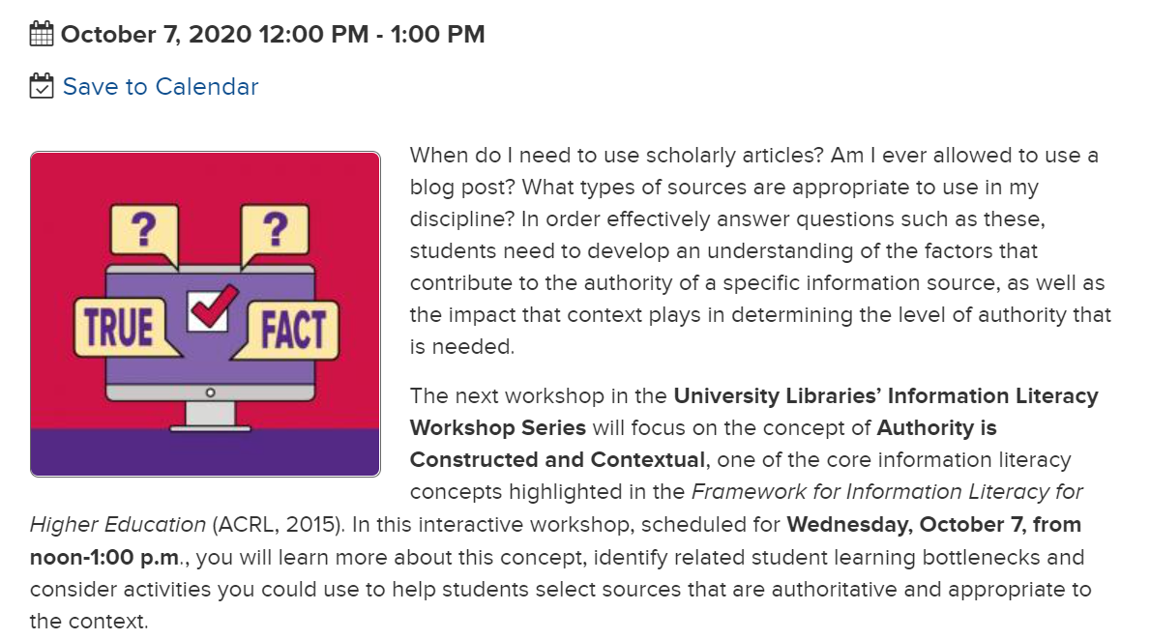
IL Workshop Series
6 Virtual Workshops
Summer 2020
Autumn 2020
Each workshop focusing on a different Framework concept
Workshop Recordings: https://library.osu.edu/covid19/virtual-experiences/recorded-sessions/information-literacy

Slide 23
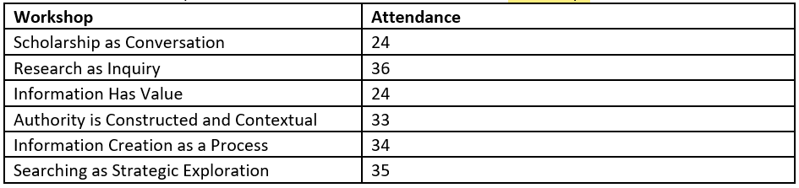
IL Workshop Series
Summer 2020 Attendance

Slide 24
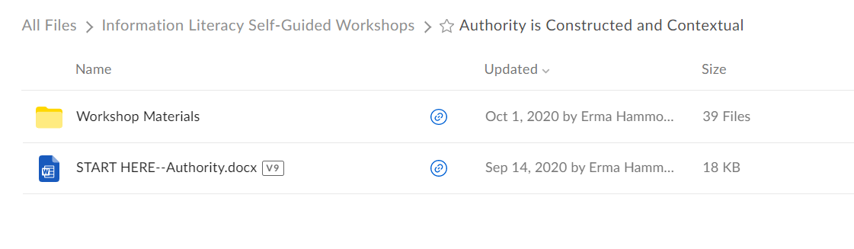
IL Self-Guided Workshops
Each workshop focused on one Framework concept
Workshop materials in Box
Participants work at their own pace
Workshop Links: https://osu.box.com/s/nc2rm9brxq1oekvm4awrsgxmx8bp8vhe

Slide 25
What I’ve Learned
Time and planning
Be on the lookout for opportunities
Willingness to try new things
Not everything will work
Need for patience

Slide 26
Benefits & Challenges of Faculty Development

Slide 27
Research Findings—Benefits
Positive participant feedback at multiple institutions
Faculty may be more willing to engage with library
Can allow for library instruction to reach more students
At University of Kentucky, training graduate students allowed for 78 instruction sessions over 2 semesters in BIO courses, reaching more than 2000 students, librarian teaching/attending 14 sessions (Hartman et al., 2014)

Slide 28
Research Findings—Benefits
Multiple examples of faculty revising courses to integrate IL concepts
At Trinity University, faculty were awarded 86 grants to revise courses, and 54 grants to develop new courses (Jumonville, 2014)
Some (limited) evidence of increase in student learning
Increased visibility of the library as a partner in teaching and learning

Slide 29
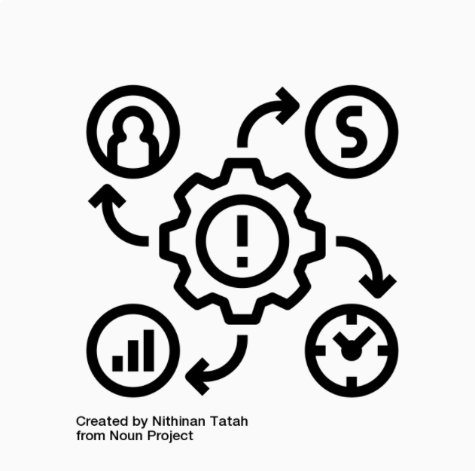
Research Findings—Challenges
Time and effort to develop initiatives
Difficulty of assessing the impact of initiatives
Inability to maintain funding to incentivize faculty to participate

Slide 30
Getting Started with Faculty Development

Slide 31
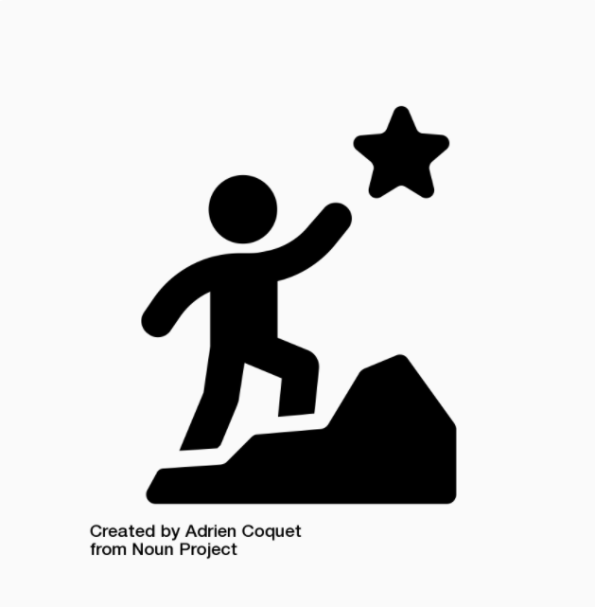
Recommendations
Consider your context
What are your library’s goals?
What assets do you have? How much time do you have?
What will work for your faculty?
Take advantage of campus partnerships and developments
Start small, assess, revise

Slide 32
References
Badke, W. (2014). Who owns information literacy? Online Searcher, 38(4), 68-70.
Cowan, S. M. (2014). Information literacy: the battle we won that we lost? portal: Libraries and the Academy, 14(1), 23-32.
Cowan, S., & Eva, N. C. (2016). Changing our aim: infiltrating faculty with information literacy. Communications in Information Literacy, 10(2), 163-77.
Fister, B. (2009). Fostering information literacy through faculty development. Library Issues: Briefings for Faculty and Administrators, 29(4), 1-4.
Hammons, J. (2020). Teaching the teachers to teach information literacy: A literature review. The Journal of Academic Librarianship, 46(5).
Hammons, J. (2020). Teaching information literacy: Developing an online course for faculty. College & Research Libraries News, 81(7), 337.
Hammons, J., Brooks, A., Chesnut, M., & Warner, L. (2019). Beyond the library walls: How a faculty institute transformed information literacy education across campus. Kentucky Libraries, 83(1), 7-11.

Slide 33
References
Hartman, P. J., Newhouse, R., & Perry, V. E. (2014). Building a sustainable life science information literacy program using the train-the-trainer model. Issues in Science and Technology Librarianship, 77. http://dx.doi.org/10.5062/F4G15XTM
Jumonville, A. (2014). The role of faculty autonomy in a course-integrated information literacy program. Reference Services Review, 42(4), 536-551.doi: 10.1108/RSR-07-2014-0020
Miller, W., & Bell, S. (2005). A new strategy for enhancing library use: Faculty-led information literacy instruction. Library Issues, 25(5), 1-4. Retrieved June 10, 2020 from https://hcommons.org/deposits/item/hc:14889/
Millet, M. S., Donald, J., & Wilson, D. W. (2009). Information literacy across the curriculum: expanding horizons. College & Undergraduate Libraries, 16(2-3), 180-193. doi: 10.1080/10691310902976451
Smith, R. L. (1997). Philosophical shift: Teach the faculty to teach information literacy. Paper presented at the 8th National Conference of the Association of College and Research Libraries.
VanderPol, D. (2013). Rethinking Roles: Librarians and Faculty Collaborate to Develop Students’ Information Literacy. Journal of Library Innovation, 4(2), 134–148.
Veach, G. L. (2009). Teaching information literacy to faculty: An experiment. College & Undergraduate Libraries, 16(1), 58–70. doi: 10.1080/10691310902753983

Slide 34
Resources
Hammons, J. (2018). Faculty Sumer Institute on Information Literacy: Curriculum Guide
Teaching Information Literacy Online Course Materials
Information Literacy Virtual Workshop Series (Recordings)
Information Literacy Self-Guided Workshops

Slide 35
Icon Attributions
Collaboration by visual language from the Noun Project
Discussion by supalerk laipawat from the Noun Project
Goal by Adrien Coquet from the Noun Project
Grade sheet by Vectors Point from the Noun Project
Learning by Olivia from the Noun Project
Impact by Nithinan Tatah from the Noun Project
Teaching by Hoeda from the Noun Project

