Slide 1
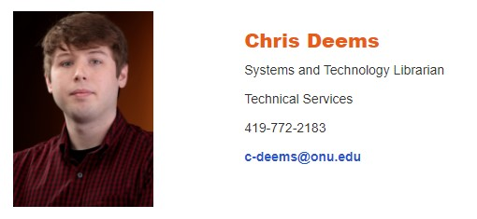
No Login Needed
Developing a New Library Website on Your Own

Slide 2
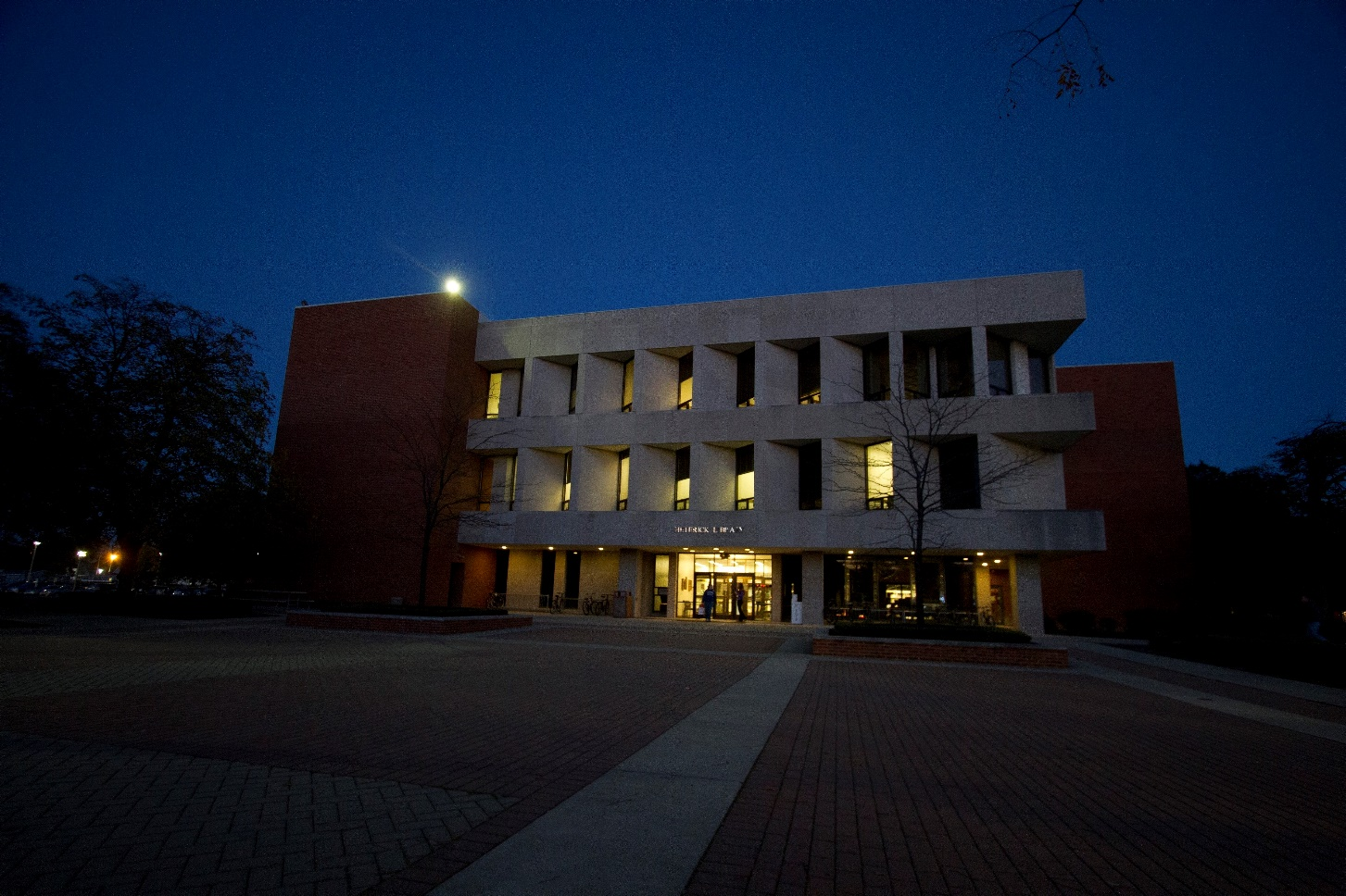
Bio
Systems Librarian at Ohio Northern University
Heterick Memorial Library
2,855 FTE (Fall 2019)
BA in History
The Ohio State University
MS in Information Studies
University of Texas at Austin
Newest TEDSIG Co-Chair

Slide 3
Project Background
University website update in Fall 2019
New two website structure
Internal website (my.onu.edu) for current students, faculty, and staff
External website (onu.edu) for prospective students, parents, and alumni
Access to library web content became extremely limited
Library catalog, databases, and Archives’ content placed on internal website
Additional login step required for members of Ohio Northern University to access
Public content made inaccessible to users outside of the University

Slide 4
Beginning of a New Library Website
New University website structure could not support essential library structures, features, and tools
Sought to petition University stakeholders to allow Heterick Library have it’s own website
Examined and highlighted peer university libraries managing their own websites as examples. Including:
Ohio Wesleyan University (https://library.owu.edu/home)
Wittenberg University (https://www.wittenberg.edu/lib)
Created short document containing findings to share with stakeholders
Stakeholders agreed to allow new separate library website following meeting and discussion with librarians
External University website would retain splash page for the library

Slide 5
Development Process
Document created to detail development and design process. Contained:
List of goals and priorities
Areas requiring additional support and expertise from other library faculty and staff
Outline for user testing
Timetable for completion
New website hosted in LibGuides CMS
Heterick Library already had access to platform prior to new website development
Development of website structures was similar to creating research guides

Slide 6
Design Process
Design followed University guidelines and matched with new website’s overall design
Heavy focus on web accessibility throughout design process for website
Web accessibility extension used periodically during process to check for potential errors
New CSS needed to be developed for library website
Trial and error process
Examined code from other peer institution libraries for inspiration and ideas
Created using code from University’s external website
Some accessibility coding found freely online

Slide 7
User Testing
Three phases of testing
First phase: internal testing with Heterick Library faculty and staff in Spring 2020
Second phase: select students and faculty outside of the Heterick Library in Spring 2020
Third phase: all members of Ohio Northern University in Fall 2020
Original plan included in-person and asynchronous tests
COVID-19 required all testing to be asynchronous
Results of tests were compiled and discussed internally among library faculty and staff
Suggestions and fixes were applied where necessary

Slide 8
Launch & Looking Forward
New Heterick Library website launched in June 2020
https://library.onu.edu/
Followed successful completion of second phase of user testing
Met with positive response from University upon start of Fall 2020 semester
Plans for the future
Completion of third phase of user testing
In-depth accessibility testing of entire website
Creation of routine testing schedule for both website users and website accessibility

Slide 9
Additional Resources
Documentation on the Creation of the New Heterick Library Website
https://docs.google.com/document/d/1sxWgQOA6pDfuN4qPTDx8WIazKJzZ6A_tEwiXm81ZajU/edit?usp=sharing
Heterick Memorial Library Website Files
https://github.com/c-deems/hml_website.git
LibCal Colorblindness Resolver CSS
https://www.dropbox.com/s/h2ym2cjpk9jkwuq/fix-color-alone-convey-availability.css?dl=0
Tota11y: an accessibility visualization toolkit
https://khan.github.io/tota11y/
User Test Questions Compilation
https://docs.google.com/document/d/1q_sbPdR-7GRqV1rscloSpu3Ae60myg62-Bv2vyTW3fE/edit?usp=sharing
WAVE - Web Accessibility Evaluation Tool
https://wave.webaim.org/

