Slide 1
Microaggressions in a Time of Trauma: Engaging Empathy with Colleagues as a Form of Antiracism
ALAO Annual Conference, Virtual 2020​
Chris Robinson-Nkongola and Edith Scarletto​
Reference & Instruction Librarians​
Jerome Library​
Bowling Green State University​
Bowling Green, OH​

Slide 2
Introduction
Trauma
COVID 19
The killing of Black people by police during COVID 19
Racial Microaggressions
Definition

Slide 3
Microaggressions in a Time of Trauma: Engaging Empathy with Colleagues as a Form of Antiracism
Racial Microaggressions Defined

Slide 4
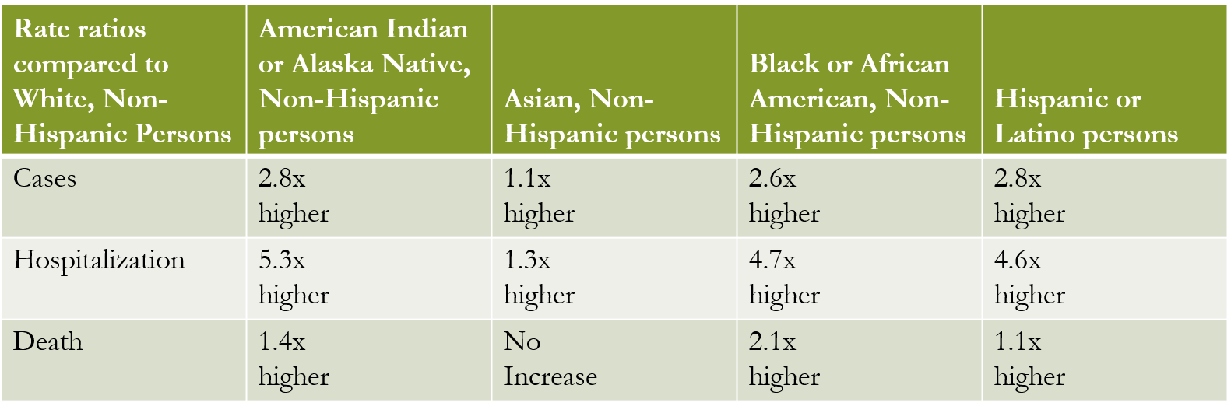
COVID 19 by Race and Ethnicity
Race and ethnicity are risk markers for other underlying conditions that impact health — including socioeconomic status, access to health care, and increased exposure to the virus due to occupation (e.g., frontline, essential, and critical infrastructure workers).

Slide 5
Killing of Black People during COVID 19
Ahmaud Arbery- 02/23/20
Breonna Taylor-03/13/20
George Floyd- 05/25/20

Slide 6
What are Racial Microaggressions? “The power of racial microaggressions lies in their invisibility to the perpetrator and the recipient”. Sue, D. W., Capodilupo, C. M., Torino, G. C., Bucceri, J. M., Holder, A. M. B., Nadal, K. L., & Esquilin, M. (2007). Racial microaggressions in everyday life. The American Psychologist, 62(4), 271-286. doi:10.1037/0003-066X.62.4.271
Are brief and commonplace daily verbal, behavioral and environmental indignities, whether intentional or unintentional, that communicate hostile, derogatory, or negative racial slights and insults to the target person or group.
Racial microaggressions can be environmental where a BIPOC is unintentionally exposed to an office environment that assails their racial identity.
According to Derald Wing Sue, et. al "Almost all inter-racial encounters are prone to microaggressions."

Slide 7
Taxonomy of Microaggressions
Microassaults
Microinsults
Microinvalidations

Slide 8
Microassaults
Conscious and deliberate
Referred to as “old fashion racism”.
Call someone the N-word
Refusing to serve a POC
Displaying the hood of the Ku Klux Klan
Displaying the Confederate Battle Flag

Slide 9
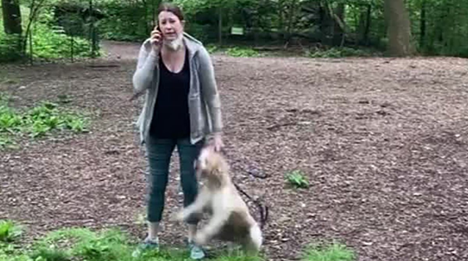
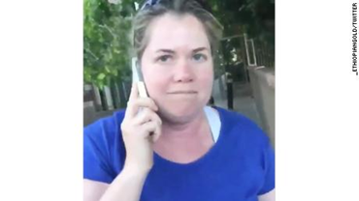
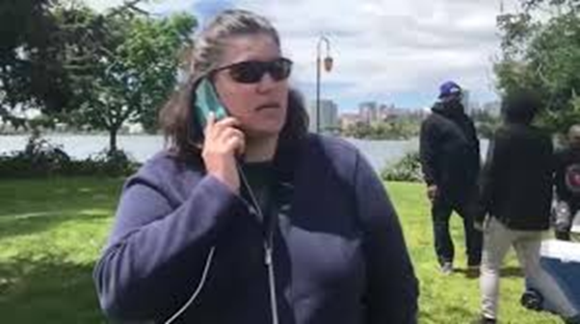
The most recent and well-known microassualts

Slide 10
Themes within the attitudes and behaviors of Microaggressions
Microinsults
Alien in One’s Own Land
Second-class status
Ascription of Intelligence
Assumption of Criminality
Pathologizing cultural values and styles
Microinvalidations
Myth of Meritocracy
Environmental Invalidation
Denial of individual racism
Color blindness

Slide 11
BIPOC are not Crazy or Too Sensitive
Empirical Evidence proves that Racial Microaggressions exist
Mercer, Sterett H., et.al (2011). Development and Initial Validation of the Inventory of Microaggressions Against Black Individuals. Journal of Counseling Psychology, 58, 4.
Nadal, Kevin L. (2011). “The Racial and Ethnic Microaggressions Scale (REMS): Construction, Reliability, and Validity”. Journal of Counseling Psychology, 58, 4.
Sue, Derald Wing, Capodilupo, Christina, Holder, Aisha M.B. (2008). “Racial Microaggressions in the Life Experience of Black Americans. Professionals Psychology : Research and Practice, 39, 3
Sue, Derald Wing, et.al (2007). “Racial Microaggressions in Everyday Life: Implications for Clinical Practice. American Psychological Association, 62, 4.

Slide 12
The Effects of Microaggressions
Depression
Poor performance at work and school
Isolation
Low self-esteem
Feeling of Powerlessness
Self-doubt
Racial rage
Racial Battle Fatigue
Keeps White people from seeing a different racial reality and participating in establishing racial harmony

Slide 13
References
Arnold, N. W., Crawford, E. R., & Khalifa, M. (2016). Psychological Heuristics and Faculty of Color: Racial Battle Fatigue and Tenure/Promotion. The Journal of Higher Education, 87(6), 890-919. doi:10.1353/jhe.2016.0033
Blitt, B. (2018, July 21). The New Yorker July 21, 2008 Issue. Retrieved April 23, 2019, from https://www.newyorker.com/magazine/2008/07/21
Cavna, M. (2018, September 12). An Australian artist's racist Serena Williams cartoon receives swift and international blowback. Retrieved April 23, 2019, from https://www.washingtonpost.com/news/comic-riffs/wp/2018/09/10/an-australian-artists-racist-serena-williams-cartoon-receives-swift-and-international-blowback/
Pilgrim, D. (2000, October). The Picaninny Caricature. Retrieved April 24, 2019, from https://www.ferris.edu/HTMLS/news/jimcrow/antiblack/picaninny/homepage.htm

Slide 14
Further Reading
Drake, H. (2019, April 17). Working 9-to-5 In White Spaces. Retrieved April 24, 2019, from https://www.leoweekly.com/2019/04/working-9-5-white-spaces/
Pizarro, M., & Kohli, R. (2018). “I Stopped Sleeping”: Teachers of Color and the Impact of Racial Battle Fatigue. Urban Education, 004208591880578. doi:10.1177/0042085918805788
Sandhu, S., & Sandhu, S. (2018, September 19). Why the Serena Williams US Open cartoon actually is racist. Retrieved October 03,2020 from https://inews.co.uk/sport/tennis/serena-williams-cartoon-why-racist-herald-sun-caricature/
Smith, W. A., Yosso, T. J., & Solorzano, D. G. (n.d.). Challenging racial battle fatigue on historically white campuses: A critical race examination of race-related stress. In Faculty of Color: Teaching in predominately white colleges and universities (pp. 299-327). Bolton, MA: Anker Publishing.
Smith, W. A., Yosso, T. J., & Solórzano, D. G. (2007). Racial Primes and Black Misandry on Historically White Campuses: Toward Critical Race Accountability in Educational Administration. Educational Administration Quarterly, 43(5), 559-585. doi:10.1177/0013161x07307793
Sue, D. W., Capodilupo, C. M., Torino, G. C., Bucceri, J. M., Holder, A. M. B., Nadal, K. L., & Esquilin, M. (2007). Racial microaggressions in everyday life. The American Psychologist, 62(4), 271-286. doi:10.1037/0003-066X.62.4.271
Swayne, M., & Messer, A. (2011, March 11). Discrimination creates racial battle fatigue for African-Americans. Retrieved October 3,2020 from https://news.psu.edu/story/160177/2011/03/11/campus-life/discrimination-creates-racial-battle-fatigue-african-americans

Slide 15
Engaging Empathy using Nine Why’s
ALAO Annual Conference, Virtual 2020
Chris Robinson-Nkongola and Edith Scarletto
Reference & Instruction Librarians
Jerome Library
Bowling Green State University
Bowling Green, OH

Slide 16
Part II: An interactive reflective exercise
Reflective document for use during this part of the presentation (anonymously)
https://forms.gle/HT6ZA89HkuBfoxni9
View and reflect on the answers of your colleagues
https://bit.ly/30G4UZ9

Slide 17
What is empathy?
noun
the psychological identification with or vicarious experiencing of the feelings, thoughts, or attitudes of another.
the imaginative ascribing to an object, as a natural object or work of art, feelings or attitudes present in oneself:By means of empathy, a great painting becomes a mirror of the self.
Dictionary.com, noun

Slide 18
Why is empathy important in the workplace?
Our workplaces mirror our world
Situations in the world affect our colleagues
Pandemics and protests in our world can mirror and exacerbate the conflicts/inequality in our workplaces
Gibson, A., Chancellor, R., Cooke, N., Dahlen, S., Patin, B., & Shorish, Y. (2020). Struggling to Breathe: COVID-19, Protest, and the LIS Response.
Notes:
Gibson et al. give some great ways that intersections of oppression are exacerbated during the pandemic, economic vulnerability (living paycheck to paycheck, job vulnerabilities (precarious or underemployment or at will employment), disability, vulnerability to covid 19 through preexisting conditions, well as discrimination; race and greater rates of infection and acute disease complications

Slide 19
How might personal events affect you at work?
Stress of being a caregiver for a loved one
Family or loved one who passed
Financial difficulty
Moving, you or a family member
Relationship difficulties
Unrest or unease within your organization
*Use the reflection form to reflect on these events in your own life
Notes:
How did you feel at work during these stressful events?
How did having colleagues who could relate to the events help you cope?
How does having close colleagues who may know your personal situation help you cope?

Slide 20
Consider some world and national events
September 11th
Hurricane Katrina/ Florence
Iowa/ Maryland Flooding
California wildfires/Mudslides
Space Shuttle disasters
Virginia Tech/Pulse Night Club/Church shootings
*Use the reflection form to reflect on these events in your own life
Notes:
How did you feel at work during these stressful events?
How did having colleagues who could relate to the events help you cope?
How does having close colleagues who may know your personal situation help you cope?

Slide 21
What kinds of empathy can we express?
‘affective’ component – vicariously taking on others’ feelings
‘cognitive’ component – reasoning about others’ emotions
‘motivational’ component – desiring for others’ emotional states to improve
Zaki, J. (2016;2017;). Moving beyond stereotypes of empathy. Trends in Cognitive Sciences, 21(2), p.59. doi:10.1016/j.tics.2016.12.004
Notes:
It’s hard to know how colleagues feel
National and world events have an effect on us at work
Personal events can have an effect on us at work
Engaging empathy in our everyday interactions can help us treat everyone with care
You don’t need to know the trauma someone experiences to work with empathy

Slide 22
How has the pandemic affected us?
Know or be someone who has been sick?
Know someone who is extremely vulnerable to illness
Know someone who lives with someone who is vulnerable
*Use the reflection form to reflect on these events in your own life

Slide 23
We can’t know everything about our colleagues
We can be aware of events around us and reason, or express cognitive empathy
The events of the pandemic give us many opportunities for empathy

Slide 24
While situations affect us differently consider the ways colleagues may be affected.
Know or be someone who has been sick
Know someone who is extremely vulnerable to illness
Know someone who lives with someone who is vulnerable

Slide 25
Now let’s talk about race and antiracism
Just like natural disasters, race relations and racist events affect us and our colleagues differently
Colleagues who are black or people of color may experience these events more intensely than white colleagues

Slide 26
George Floyd, Ahmaud Arbery, Breonna Taylor & Covid-19
You may not have experienced some of the world events mentioned earlier.
You may not have experienced racial microaggressions before
You may not be vulnerable to Covid-19

Slide 27
Empathy does not require experience
You can understand that stress from world events may cause stress to your colleagues who are more connected to the event.
You can understand that black folks and people of color are disproportionally dying or becoming ill from Covid-19
You can understand that many things happen to our colleagues we do not know, but you can still extend empathy.

Slide 28
Historical Trauma
Just as you can empathize with trauma that is not your own
You can experience trauma by frequent reminders of triggering events
Notes:
This concept is explored widely for indigenous people as well, Wesley-Esquimaux, C. C. & Smolewski, M. (2004). Historic Trauma and Aboriginal Healing. Aboriginal Healing Foundation (AHF). http://www.ahf.ca/downloads/historic-trauma.pdf.

Slide 29
Vicarious Trauma
“an event that “bring[s] up an array of painful memories. . . it can trigger vicarious traumatization. Even if the specific event has never happened to us directly, we may have witnessed similar experiences, or know people in our communities who have been traumatized or killed in similar ways.”
Kendall, M. (2020). Hood feminism: Notes from the women a movement forgot. New York: Viking.

Slide 30
Empathy as a form of antiracism
Just as you can empathize with trauma that is not your own
natural disasters and world events
You can empathize with folks who experience trauma by frequent reminders of triggering events
repeated acts of violence against people of color
Notes:
Just as you can empathize with trauma that is not your own
You can experience trauma by frequent reminders of triggering events

Slide 31
Antiracism
Be aware of your workplace and how it appears to colleagues who may be experiencing the trauma of the pandemic and/or racist violence in the news
Be aware of and envoke emapthy for, microaggressions as they happen.
Rehearse responding to microaggressions
Notes:
Just as you can empathize with trauma that is not your own
You can experience trauma by frequent reminders of triggering events

Slide 32
Antiracism
"An antiracist is someone who is supporting an antiracist policy by their actions or expressing an antiracist idea. “Racist” and “antiracist” are like peelable name tags that are placed and replaced based on what someone is doing or not doing, supporting or expressing in each moment. These are not permanent tattoos"
Kendi, I. X. (2019). How to be an antiracist. ProQuest Ebook Central https://ebookcentral-proquest-com.ezproxy.bgsu.edu

Slide 33
Antiracism
To do antiracist work is to continue to act against structures and actions that reduce our empathy for our colleagues.
It means constantly decentering white experience as the norm of the world and the workplace
It means making mistakes, recognizing those mistakes and acting to change them
It means extending emapthy to black colleagues and colleagues of color in work situations as well as personal.

Slide 34
What do empathy and microaggressions have in common?
Fiske's Core Social Motives
To belong to a group
To understand the world around us
To control what we can
To trust in the group
To self enhance (self worth)
Have, S., Rijsman, J., Have, W., & Westhof, J. (2018). The social psychology of change management (1st ed.) Routledge.
Notes:
Social Psychology of Change Management. Fiske's core social motives are ways that we organize our lives and understanding of the world. Most conflict comes from one of these ideas of ourselves being challenged. While it is difficult to confront a bully or someone with outright racist actions, we can try to think about the situation and why the microaggression triggered the speaker's defenses. As white people we can think about our own actions and speech and how we may contribute to microaggressions, and also think about how to address them when they happen. As people who are the receiver of microagression we can try to formulate a "professional" response.

Slide 35
Confronting microagressions
When we feel defensive, we feel that one of our social motives has been challenged.
Empathizing with a colleague can help address the issue that prompted a microaggress
Notes:
For this, we are trying to assume a "I didn't mean anything by it" or unconscious bias comment. We understand that in work situations, you cannot always say what you want to say when someone says a microaggression. Think back to Chris' part of the presentation. When have you witnessed a microaggression? Did you realize it at the time?

Slide 36
How can empathy about a social motive help?
What has challenged the person speaking rudely?
What can the receiver say to address that concern or assumption?
*Use the reflection form to reflect on these events in your own life
Notes:
For this, we are trying to assume a "I didn't mean anything by it" or unconscious bias comment. We understand that in work situations, you cannot always say what you want to say when someone says a microaggression. Think back to Chris' part of the presentation. When have you witnessed a microaggression? Did you realize it at the time?

Slide 37
Summary
Using emapthy to understand trauma can help us to care for our colleagues in a time of crisis
Racism and racial trauma can be experienced through vicarious and historical triggers
Decentering the white experience and acknowledging the experience of colleagues through empathy can become antiracist act
Empathy can also be a tool to confront microaggressions and racism in the workplace by applying to social motives

Slide 38
References
Gibson, A., Chancellor, R., Cooke, N., Dahlen, S., Patin, B., & Shorish, Y. (2020). Struggling to Breathe: COVID-19, Protest, and the LIS Response. https://scholarcommons.sc.edu/libsci_facpub/291/
Have, S., Rijsman, J., Have, W., & Westhof, J. (2018). The social psychology of change management (1st ed.) Routledge.
Kendall, M. (2020). Hood feminism: Notes from the women a movement forgot. New York: Viking.
Kendi, I. X. (2019). How to be an antiracist. ProQuest Ebook Central https://ebookcentral-proquest-com.ezproxy.bgsu.edu. New York: One World.
Wesley-Esquimaux, C. C. & Smolewski, M. (2004). Historic trauma and aboriginal healing. Aboriginal Healing Foundation (AHF). http://www.ahf.ca/downloads/historic-trauma.pdf.
Zaki, J. (2016;2017;). Moving beyond stereotypes of empathy. Trends in Cognitive Sciences, 21(2), p.59. doi:10.1016/j.tics.2016.12.004

