Slide 1
A Celebration of Us!: A Telling of a Libraries’ Value During COVID-19 Through Stories and Data

Slide 2
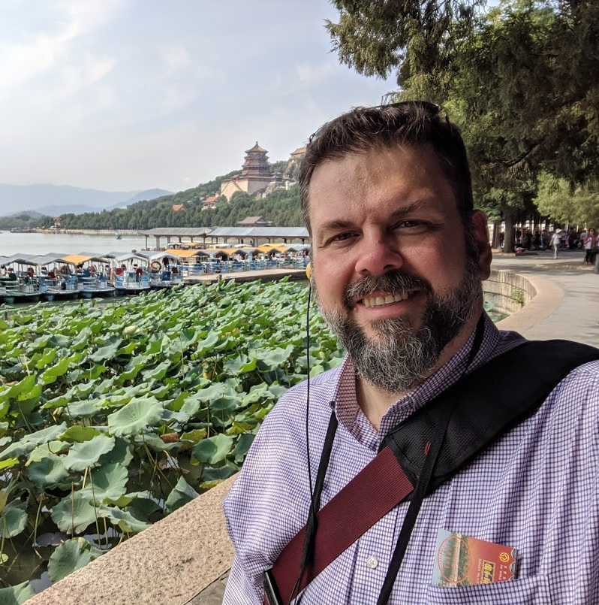
Ted Baldwin
Director, Science and Engineering Libraries Interim Head, Library Collections
University of Cincinnati Libraries
ted.baldwin@uc.edu

Slide 3
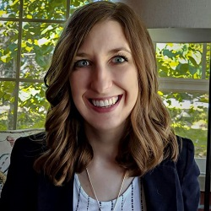
Catie Carlson
Director, Clermont College Library University of Cincinnati
catie.carlson@uc.edu

Slide 4
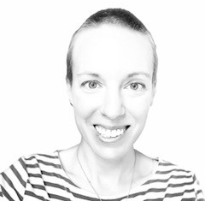
Katie Foran-Mulcahy
Head, College of Education, Criminal Justice, and Human Services Library
University of Cincinnati Libraries
katie.foran@uc.edu

Slide 5
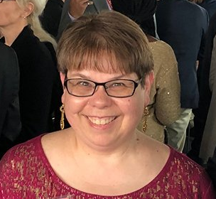
Debbie Tenofsky
Head, Research, Teaching, and Services
University of Cincinnati Libraries
deborah.tenofsky@uc.edu

Slide 6
Purpose
1
Why did we embark on this project?

Slide 7
Project beginnings
Demonstrate the libraries’ value
Highlight support during COVID-19
Engage external and high-level stakeholders
Work began after a Re-Opening Task Force meeting in November 2020.

Slide 8
Methods
2
How did we collect our data and stories?

Slide 9
How we got started
Data collected for March-December 2020 and January-April 2021
All UC Libraries included, plus three library jurisdictions (2 regional campus libraries + law library)
Initial report prepared March 2021
Notes:
Cross-jurisdictional team – Catie, Katie, Ted, and Debbie – ensured varying perspectives and approaches.
Also included non-UCL jurisdictional member. A great way to make sure that the questions we asked had relevance to as many groups as possible.

Slide 10
Our data
Quantitative
Harvested via existing modes of collection
Directly requested via targeted asks from department heads and specialists
Qualitative
Collected via web-based survey
Open answer questions in various categories
Notes:
Examples of emails with targeted ask information
Mention examples of survey questions, mention that these will be included in the supplementary presentation materials

Slide 11
Findings
3
What did we learn?

Slide 12
Data themes
Student and faculty success
Teaching and learning
Innovative solutions
Online collections
Scholarly content

Slide 13
Project artifacts
Report
Crafted with administration in mind.
For internal or inter-campus use.
Visual presentation of data
Crafted for internal and external audiences.
Visual, graphic, interactive.
Microsoft Sway (click to view!)
Source article
Written for audiences outside of the university, including donors.
Newsletter (click to view!)

Slide 14
What were your organizational developments during COVID? What mediums do you have to share that story?

Slide 15
Future Concerns
4
How do we move forward?

Slide 16
Gaps in assessment
Use this data to fill an assessment gap
Demonstrating value should be an ongoing priority

Slide 17
Big questions about gaps in data
What do we want to collect? How often?
What data exist already? Where?
What data are held centrally? By specific teams or individuals?
Are data gaps more prevalent in certain areas?

Slide 18
How does your library collect data?

Slide 19
Gaps in collaboration
Cross-university and libraries teams needed to standardize data collection
Existing discussions on data often siloed

Slide 20
Does your library have a team devoted to assessment?

Slide 21
Next Steps
5
Future communications and assessment

Slide 22
Think of us often; think of us well.

Slide 23
Thank you.
Any questions?
libraries.uc.edu

Slide 24

Free templates for all your presentation needs
For PowerPoint and Google Slides
100% free for personal or commercial use
Ready to use, professional and customizable
Blow your audience away with attractive visuals

