Slide 1

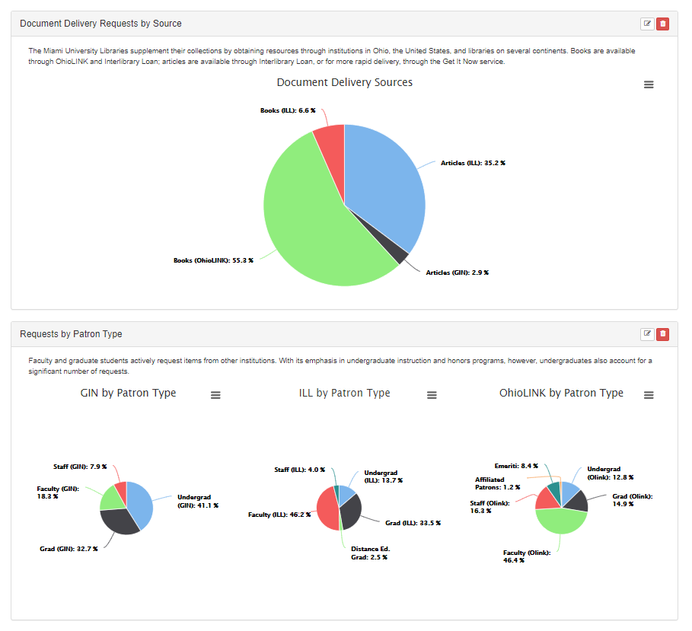
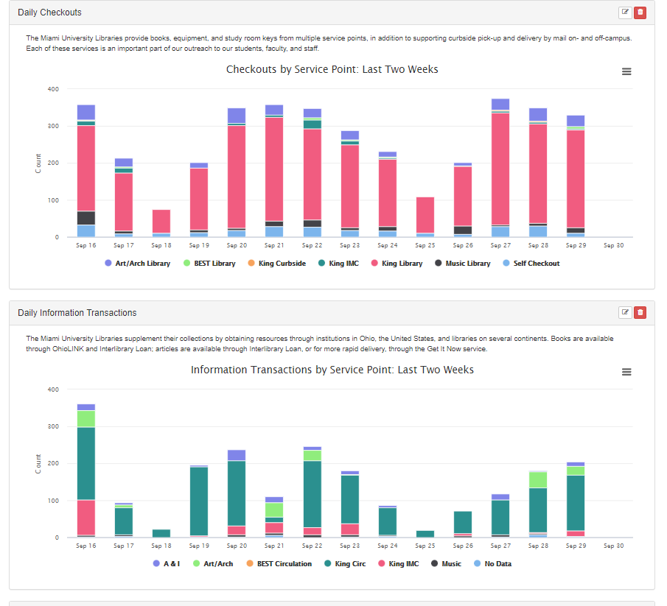
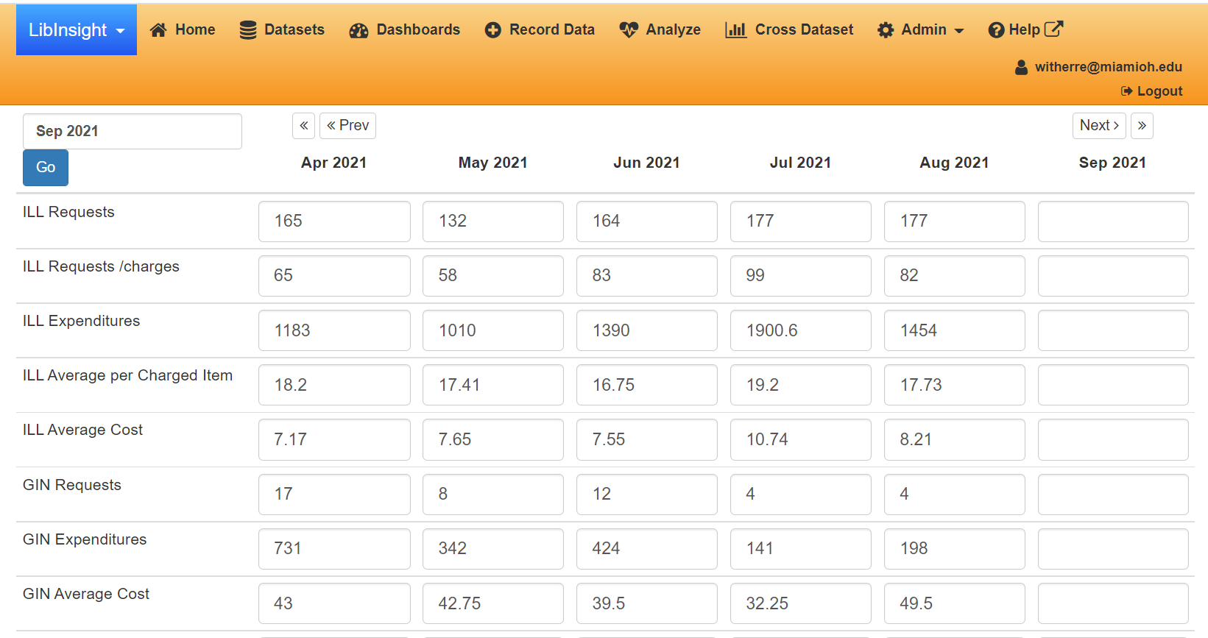
Charting our Course, Measuring our Progress: Creating a Data Dashboard for Library Services
Presenting Data
The dashboard manager allowed me to create charts that cover pre-defined time periods, for example, day-by-day for the past two weeks, previous month, previous year, or information since a specific date. This means that as new data is entered each day or each month, the data displayed in charts and graphs automatically updates to fit the pre-defined time period – no more updating ranges in Excel. There is an option for me, and anyone to whom I assign permissions, the ability to alter the dates if some kind of custom report is needed.
In each of the areas for which I maintain data (circulation, document delivery, and information transactions), I selected three time periods:
Month-by-month since July 2018 (bar charts / column charts / line graphs)
Previous month (pie charts)
Previous year (pie charts – example appears below)
It is possible to create multiple dashboards which draw on the same data tables. This means that it is possible, for example to create dashboards for different audiences (department, library administration, University administration) which pull from the same data.
Rob Withers Access Services Librarian Miami University witherre@miamioh.edu
Origins
At the Miami University Libraries, I maintain statistics and generate charts for circulation, document delivery, and information transactions. During our COVID shutdown, I was challenged to find something a more shareable and easily maintained method of displaying data than an Excel spreadsheet.
I wish I could say that I undertook a review of all available products, but the reality is that we already used multiple tools in the Springshare suite. So I started with LibInsight as a product for tallying and charting statistics.
Adding Data
LibInsight can import data from spreadsheets, which was handy since I had several years’ worth, but it also has an admin interface for entering new data.
Learnings
As with any system, there are drawbacks: there are a limited number of displays available, and there are less options for customizing appearance. However, they are more than offset by the advantages
The ability to delegate data entry to people who don’t have to understand how an Excel spreadsheet is set up
Automatic changes to the display to reflect the time period
A series of pre-defined charts collected onto a single page
Some charts can be crowded and difficult to read – fortunately, LibInsight displays the data on mouseover.

