Slide 1
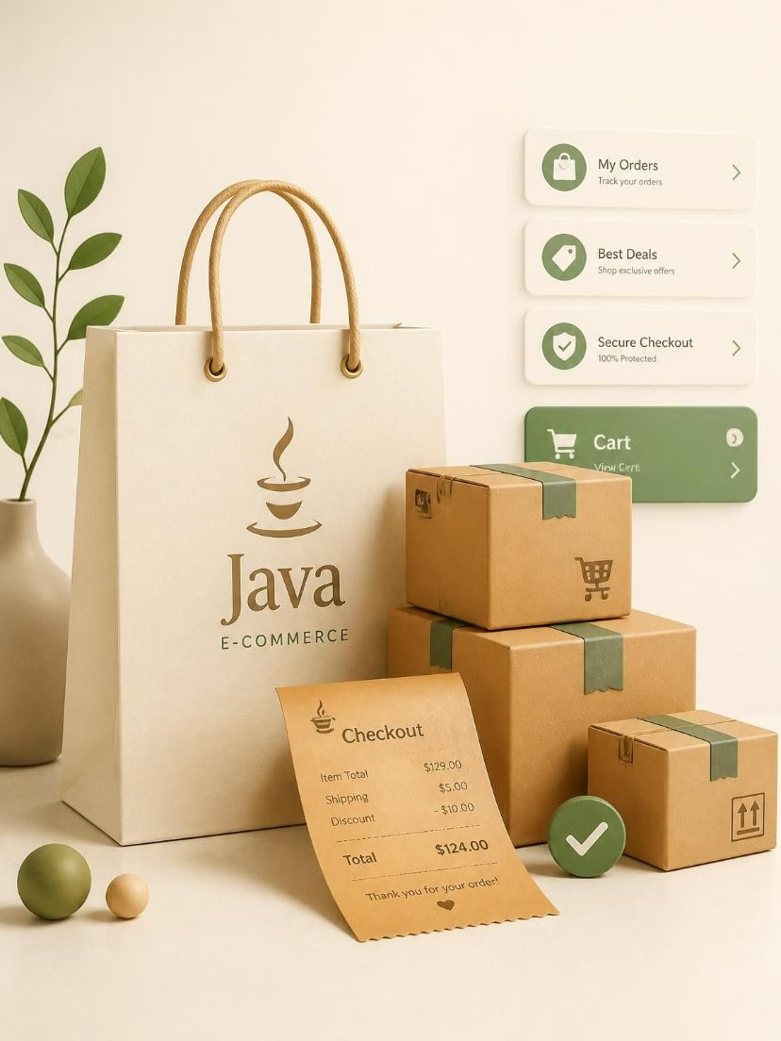
JAVA PROJECT · PROJECT NO. 13 · TEAM 9
ONLINE STORE CART
& ORDER PIPELINE
A clear, testable journey from product selection to order tracking
K. Vishnu Preetham — 2620090013
K. Shashank Goud — 2620030057
A. John Babu — 2620040010
Supervisor: Rakesh.K
KLHB-FED-26-9-13 · Java e-commerce workflow

Slide 2
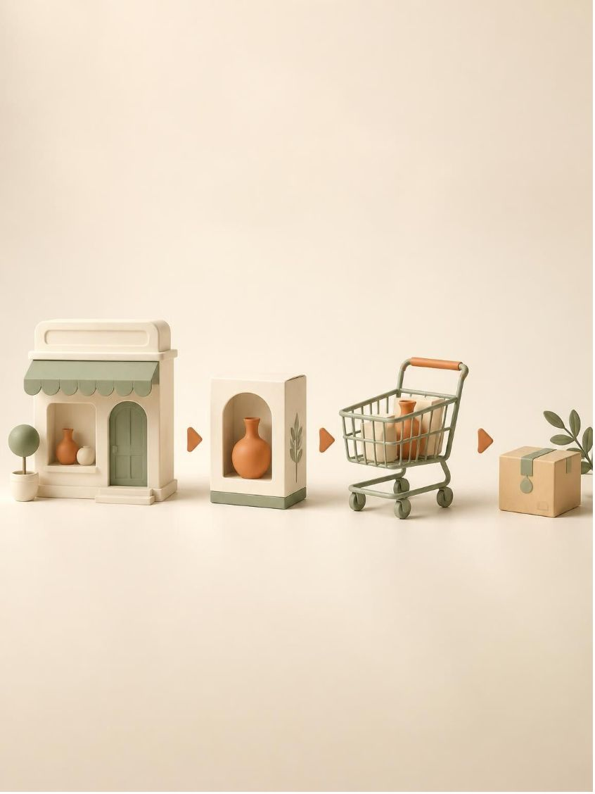
Introduction
From product selection to a trackable order
Why this project matters
Models the core journey of an online store in a focused Java application.
Connects catalog, inventory, cart, checkout and order state.
Uses payment simulation to validate before an order is created.
Keeps responsibilities modular for future interfaces or persistence.
02 · Online Store Cart & Order Pipeline

Slide 3
Problem Statement
The challenge
Catalog data, cart changes, payment checks and order status become difficult to reason about when they are treated as disconnected actions.
The project response
Give products, customers, carts and orders clear responsibilities.
Validate quantities, totals and payment outcomes before commitment.
Represent fulfillment as visible states that can be followed and tested.
03 · From disconnected actions to one traceable pipeline

Slide 4
Objectives
Build · validate · explain
Develop a structured Java simulation of an online-store journey.
Manage products, prices, stock availability and customer selections.
Support cart updates and accurate total calculation.
Validate checkout and simulate payment confirmation.
Create orders and move them through defined fulfillment states.
Apply OOP, collections, validation and modular design practices.
04 · Objectives for a reliable, explainable workflow

Slide 5

Proposed System Workflow
A handoff model with a validation gate at every turn
CUSTOMER → PRODUCTS → CART → CHECKOUT
PAYMENT → ORDER → TRACKING
Each step passes validated data to the next stage.
Key control points
Stock check · cart total · payment result · order status
05 · A linear workflow with explicit validation gates

Slide 6

System Architecture
STORE DOMAIN
Product.java · Inventory.java · Customer.java
CART & CHECKOUT
Cart.java · CartItem.java · Checkout.java · Payment.java
ORDER SERVICES
Order.java · OrderProcessor.java · status transitions
06 · Cohesive classes with clear responsibility boundaries

Slide 7
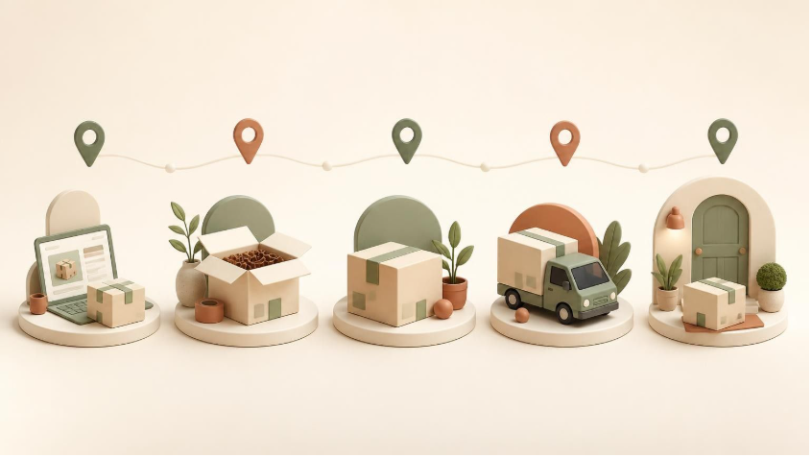
Order Processing Pipeline
PLACED → CONFIRMED → PACKED → SHIPPED → DELIVERED
A status transition makes the order journey visible and testable.
Pipeline logic
Create an order only after checkout and payment validation. Then update status as fulfillment advances.
07 · Order status turns fulfillment into a traceable sequence

Slide 8

Technologies & Development Approach
JAVA — core implementation language
OOP — classes, encapsulation and modular responsibilities
COLLECTIONS — manage products, cart items and orders
VALIDATION — reject invalid quantities, totals or payment outcomes
GIT / TESTING — track changes and verify each workflow stage
08 · Build in small, testable modules

Slide 9

Expected User Interaction
1 View products
2 Add a product to the cart
3 View or modify cart quantities
4 Checkout and review total
5 Confirm simulated payment
6 Create and view the order
7 Track the current order status
Example output: Order ID · status · next pipeline step
09 · A simple interaction model for demonstrating the pipeline

Slide 10

Conclusion & Future Scope
What the project demonstrates
A modular Java model can connect catalog management, cart operations, checkout validation, payment simulation and order tracking into one understandable flow.
Future scope
GUI or web interface · database persistence · authentication · richer inventory rules · coupons · notifications · expanded test coverage
THANK YOU
Questions and discussion
10 · A foundation for a fuller e-commerce application

