Slide 1
A Mathematical Security
Architecture
Authentication • Key Management • Message Integrity
A six-module maths project using discrete mathematics to explain how secure messaging decisions can be modelled and checked.
Team - L :-
2620040010 - Alapati John Babu
2620090013 - Kanduri Vishnu Preetham
2620090006 - Sai Harsha
University Project Presentation
1

Slide 2
The problem we are addressing
How can a messaging system decide whether a message should be trusted?
THE RISK
OUR APPROACH
THE GOAL
A message could come from the wrong user, use an invalid key, or be changed in transit.
Represent important security checks using mathematical rules and structures.
Accept only when required checks pass; otherwise reject or recheck.
Main idea: mathematics makes the security rules explicit, consistent, and easier to reason about.
2
2

Slide 3
The six mathematical modules
Each module contributes one part of the security model.
1. Logic & Proofs
2. Sets, Relations & Functions
3. Combinatorics & Counting
State the security conditions and prove the decision rule.
Model users, roles, permissions, and mappings.
Estimate key-space size and reason about collisions.
4. Number Theory
5. Graphs & Trees
6. Algebraic Structures
Explain modular arithmetic and RSA-style key operations.
Represent communication routes and key-distribution links.
Explain group-based operations used in key exchange and integrity methods.
3
3

Slide 4
How the security decision works
Module 1: mathematical logic turns requirements into a clear accept/reject rule.
ACCEPT = A ∧ P ∧ K ∧ R ∧ I
A
Authentication is valid
P
Permission is valid
K
Key condition is valid
R
Route is valid
I
Message integrity is valid
If even one condition is false, the message is rejected.
4
4

Slide 5
Users, permissions and keys
Modules 2–4: define who may act, then measure and reason about keys.
SET MODEL
COUNTING
NUMBER THEORY
Users = {Ravi, Priya, Anu}
Permissions = {Send, Receive, Manage}
A relation records which actions each user may perform.
For S symbols and a key length L:
Key-space = Sᴸ
An 8-digit PIN has 10⁸ = 100,000,000 possibilities.
Modular arithmetic supports cryptographic operations.
RSA is a mathematical example of public-key encryption and key management.
These models explain access control and key strength; they do not by themselves prove a real system is secure.
5
5

Slide 6
Routes and mathematical operations
Modules 5–6: model communication paths and the structures behind cryptographic methods.
GRAPH THEORY
ALGEBRAIC STRUCTURES
Represent users or devices as vertices and communication links as edges.
A route can be checked before a message is delivered.
Groups and modular operations provide a foundation for methods such as Diffie–Hellman key exchange and elliptic-curve cryptography.
Together, these modules connect abstract maths to the design of secure communication.
6
6

Slide 7
Case study: Ravi sends Priya a message
A simple scenario connects the six mathematical ideas.
1
Identify
Check who is sending and who may receive.
2
Prepare keys
Use the key model and cryptographic operations.
3
Check route
Represent the delivery path as a graph.
4
Protect message
Use integrity checks to detect changes.
5
Decide
Apply the rule: all required checks must pass.
This is the project’s conceptual case study, not a claim that every cryptographic step has been independently security-tested.
7
7

Slide 8
What the project demonstrates
A concise summary of the mathematical contribution.
FORMAL RULES
MATHEMATICAL MODELS
ONE ARCHITECTURE
Logic expresses when a message should be accepted or rejected.
Sets, counting, number theory, graphs, and algebra model different security needs.
The six modules work together to explain authentication, key management, and message integrity.
Conclusion: discrete mathematics provides the structure for describing and analysing secure messaging systems.
8
8

Slide 9
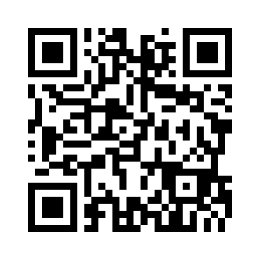
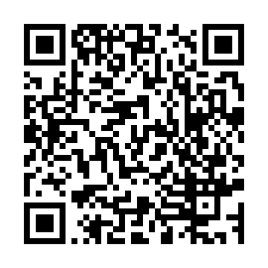
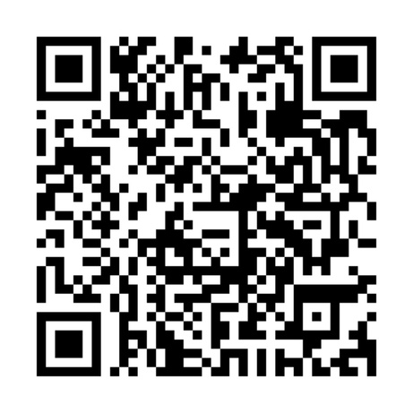

PROJECT LINKS & QR CODES
GitHub Repository: https://github.com/alapatijohnbabu-bit/mathematical-security-architecture
Live Website: https://strong-sorbet-1fbd13.netlify.app/
LIVE WEBSITE
GITHUB PROJECT
BASE APP / APK
Scan to open the project
in a laptop or phone browser.
Scan to view the source,
README and project files.
Scan the QR code you provided
to access your app.
Base app QR code provided by the project owner.

