Slide 1



A Mathematical Security Architecture
Authentication · Key Management · Message Integrity
Module 1 — Decision & Correctness Lock | University Project
DISCRETE MATHEMATICS · PROPOSITIONAL LOGIC · PROTOCOL CORRECTNESS
Notes:
1

Slide 2

The Six Lock Security Architecture
A proposed framework for secure campus messaging — each lock represents a mathematical security layer. Module 1 governs the Decision & Correctness Lock: the logical engine that decides whether a message is accepted or rejected.
🔐 Lock 1
🔑 Locks 2–6
Decision & Correctness
Module 1 focus
Authentication, Key Mgmt, Route, Integrity, Session
📨 Running Example
Ravi sends a message to Priya across the secure campus network
Notes:
2

Slide 3

Security Requirements as Propositions
Each security condition is modelled as a proposition — a statement that is either true or false. The final ACCEPT decision is a conjunction of all five conditions.
Final Decision Rule
A
P
ACCEPT = A ∧ P ∧ K ∧ R ∧ I
The conjunction is a tautology of safety: all conditions must hold simultaneously. Even one false proposition makes the entire expression false — a contingency becomes a contradiction.
Authentication valid
Permission valid
K
R
Key condition valid
Route valid
Contrapositive Law
If ¬A ∨ ¬P ∨ ¬K ∨ ¬R ∨ ¬I, then ¬ACCEPT
By De Morgan's Law and the contrapositive, any failing condition guarantees rejection — no exceptions, no workarounds.
I
Message integrity valid
Notes:
3

Slide 4
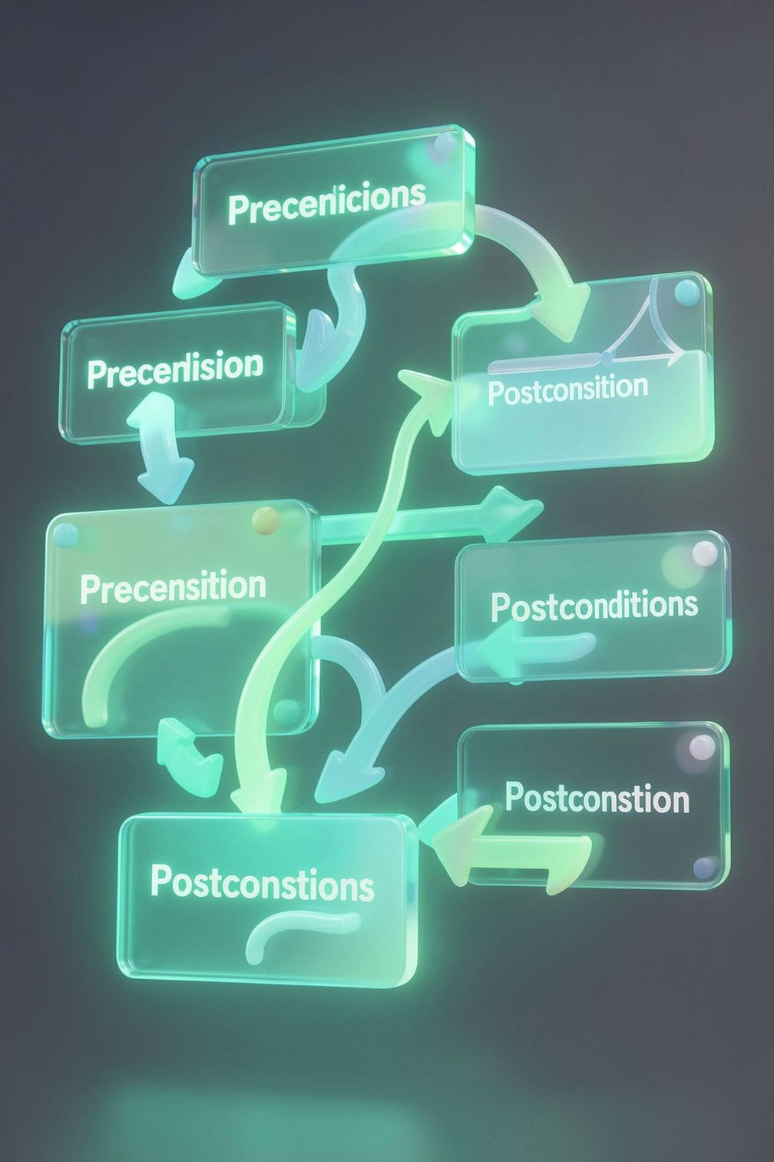


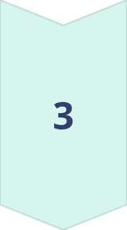
Protocol Correctness
Invariant
Preconditions
An invalid condition cannot return to ACCEPT without full revalidation. The system never silently recovers — every rejected state requires an explicit re-check of all propositions.
Sender verified · Permission granted · Key state valid
Action
Direct Proof (sketch)
Ravi transmits the message to Priya
Claim: If ACCEPT = true, then all five propositions hold.
Proof: ACCEPT ≡ A ∧ P ∧ K ∧ R ∧ I. A conjunction is true if and only if every conjunct is true. Therefore A = P = K = R = I = true. ∎
Postcondition
Only a message satisfying A ∧ P ∧ K ∧ R ∧ I is accepted
Notes:
4

Slide 5


Thank You
Logic is the first lock.
When every security requirement is expressed as a proposition and joined by conjunction, mathematics itself guarantees that a single failure means rejection — no ambiguity, no exceptions.
Takeaway: Propositional logic, contrapositive reasoning, and protocol invariants transform informal security intuitions into provably correct, formally verifiable architectural decisions.
Notes:
5

Slide 6

A Mathematical Security Architecture
Authentication · Key Management · Message Integrity
Module 2 Focus — Identity & Access Lock | University Project Presentation
Notes:
1

Slide 7

Identity & Access Lock — Sets & Structure
The Identity & Access Lock forms the first barrier of the Six Lock Architecture. It is built entirely on Module 2 set theory.
Users (U)
Roles (R)
U = {Ravi, Priya, Anu}
The universal set of system principals.
R = {Student, Faculty, Admin}
Subsets partition the user set by responsibility.
Permissions (P)
P = {Send, Receive, Manage}
Power set 𝒫(P) yields all possible access combinations.
The Cartesian product U × P defines the universe of all possible user–permission pairs, from which the authorised subset is selected. Cardinality and the Inclusion–Exclusion Principle govern overlap between role-based access groups.
Notes:
2

Slide 8

Authorisation Relations & Role Assignment
Role Function f : Users → Roles
A total function assigns exactly one role per user:
  f(Ravi) = Student
  f(Priya) = Faculty
  f(Anu) = Admin
Authorisation Relation Rauth ⊆ U × P
User | Send | Receive | Manage
Ravi | ✓ | ✓ | ✗
Priya | ✓ | ✓ | ✗
Anu | ✓ | ✓ | ✓
An action is permitted only if the pair (user, permission) ∈ Rauth. This relation is reflexive over allowed pairs and can be extended to a partial order on privilege levels.
Notes:
3

Slide 9
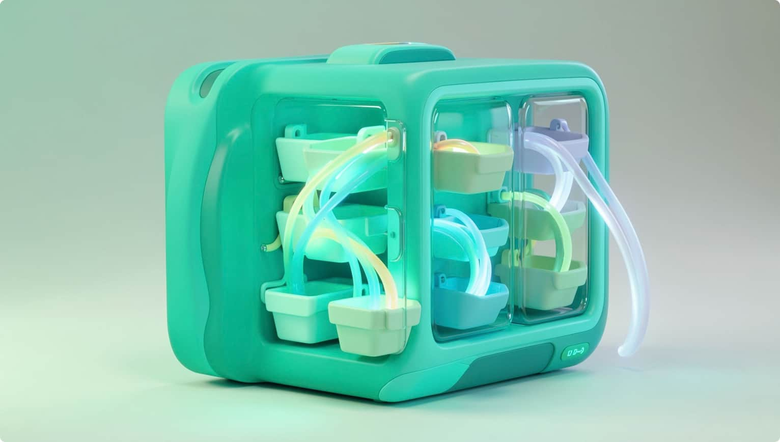
Functions, Hashing & the Pigeonhole Principle
Functions in the Architecture
  Role assignment — f : Users → Roles is a well-defined total function (injective here, since |U| = |R| = 3).
  Hashing — h : Messages → Buckets models message fingerprinting as a function; equivalence classes [m] group messages sharing the same hash.
  Key lookup — g : KeyID → KeyRecord is an injective function ensuring distinct identifiers map to distinct key records.
Pigeonhole Principle & Collision Reasoning
If |Domain| > |Codomain|, then no injective function exists — at least two inputs must share an output. In hashing, this guarantees theoretical collisions are unavoidable when the message space exceeds the bucket count. Robust hash functions minimise collision probability; the principle frames why collision resistance is a design goal, not a weakness.
Equivalence classes partition the message space into buckets: [m] = {m′ | h(m) = h(m′)}.
Notes:
4

Slide 10

Thank You
Security is Mathematics Made Rigorous
Every access decision, hash bucket, and key record in the Six Lock Architecture traces directly back to the formal foundations of sets, relations, functions, and the pigeonhole principle — proving that discrete mathematics is not merely theoretical, but the bedrock of real-world security design.
Sets & Subsets
Define users, roles, and permission spaces
Relations
Govern who is authorised to act
Functions
Map identities, keys, and messages precisely
Pigeonhole
Grounds collision-resistance as a mathematical necessity
Notes:
5

Slide 11


Key-Space & Collision-Analysis Lock
Module 3 — Mathematical Security Architecture
A counting-based framework that measures credential space and reasons about collisions using combinatorics.
UNIVERSITY PROJECT
MODULE 3 OF 6
Notes:
1

Slide 12

The Key-Space Lock: SL
For a key of length L drawn from an alphabet of size S, the Product Rule gives the total number of distinct keys as:
S = 10
Decimal digits (0–9)
Key-Space = SL — each of the L positions is chosen independently from S symbols.
L = 8
Key length (positions)
Example: 8-digit PIN over digits 0–9 → 108 = 100,000,000 possible keys. Doubling the length squares the space, making brute-force exponentially harder.
10⁸
= 100 Million keys
Notes:
2

Slide 13



Counting Structures Inside the Lock
Permutations P(n, r)
Order-sensitive selection — crucial for PIN sequences and ordered credentials. P(n,r) = n! / (n−r)!
Combinations C(n, r)
Order-independent groupings — models key-token sets and unordered access codes. C(n,r) = n! / r!(n−r)!
Inclusion-Exclusion
Avoids double-counting overlapping credential categories: |A∪B| = |A| + |B| − |A∩B|. Gives the exact size of mixed-rule key spaces.
Notes:
3

Slide 14


Pigeonhole & Birthday Collision Reasoning
Pigeonhole Principle
Birthday Collision Probability
If more inputs exist than possible outputs, a collision is guaranteed. Formally: mapping n+1 items into n slots forces at least one shared slot — a mathematical certainty, not a probability.
Among n users/hashes, there are C(n, 2) = n(n−1)/2 distinct pairs — each a potential collision candidate. Even a modest group of ~1,000 users produces nearly 500,000 collision pairs, showing why large key spaces matter enormously for security margin.
This is mathematical collision reasoning — not a claim that breaking a secure hash is computationally easy.
Notes:
4

Slide 15

Thank You
Lock 3 Complete
The Key-Space & Collision-Analysis Lock uses the Product Rule, Permutations, Combinations, Inclusion-Exclusion, the Pigeonhole Principle, and Birthday Counting to measure — not break — the mathematical strength of any authentication credential space.
Counting Tells Us
Pigeonhole Tells Us
How large the key space truly is
When collisions are inevitable
Birthday Tells Us
How many pairs are at risk
Notes:
5

Slide 16

A Mathematical Security Architecture for Authentication, Key Management, and Message Integrity
MODULE 4
The Cryptographic Key Lock — Number Theory & Its Cryptographic Foundations
Establishing the number-theoretic machinery behind secure key operations, RSA, and Diffie-Hellman key exchange.
Notes:
1

Slide 17





Module 4: The Cryptographic Key Lock
Number theory transforms abstract security requirements into concrete, computable key operations. The chain of reasoning is precise and irreversible.
Primes & Divisibility
Foundation: GCD, Euclidean algorithm, FTA, infinitude of primes
Modular Arithmetic
Congruences in Zn, modular inverses, CRT, linear congruences
Euler & Fermat
Euler totient φ(n), Fermat's Little Theorem, Euler's theorem underpins RSA correctness
Key Operations
RSA public-key cryptography and Diffie-Hellman key exchange
Notes:
2

Slide 18


RSA: From Number Theory to Secure Key Operations
Key Pair Summary
① Key Generation
Public key: (e, n) — shared openly
Private key: d — kept secret
Security basis: Factoring n = pq into p and q is computationally hard; recovering d without knowing φ(n) is infeasible.
Choose large primes p, q. Compute n = pq and φ(n) = (p−1)(q−1). Select e with gcd(e, φ(n)) = 1. Find d such that ed ≡ 1 (mod φ(n)) via extended Euclidean algorithm. CRT can accelerate private-key operations.
② Encrypt & Decrypt
Encryption: c ≡ me (mod n) — using public key (e, n).
Decryption: m ≡ cd (mod n) — using private key d.
This integrates established cryptographic mathematics. RSA does not claim a new cryptographic primitive.
③ Correctness via Euler's Theorem
Since ed ≡ 1 (mod φ(n)), Euler's theorem guarantees med ≡ m (mod n), confirming decryption recovers the original message.
Notes:
3

Slide 19
Diffie-Hellman: Building a Shared Secret
The Protocol — Public Channel Exchange
Authentication Limitation & Architecture Role
All parties agree publicly on a prime p and generator g.
Shared Secret: K = Ba mod p = Ab mod p = gab mod p
Basic Diffie-Hellman provides key agreement but not user authentication by itself. An eavesdropper cannot find the shared secret, but a man-in-the-middle may impersonate participants if identities are unverified.
Security rests on the Discrete Logarithm Problem — recovering a from ga mod p is computationally infeasible.
In the Six Lock Architecture, the Logic and Access Locks complement Module 4 by enforcing identity verification and session authorisation — addressing the authentication gap DH alone cannot fill.
Together, the locks form a complete security architecture: Module 4 supplies the key mathematics; other modules supply identity assurance.
Ravi (Alice)
Priya (Bob)
Chooses secret a
Sends A = ga mod p
Chooses secret b
Sends B = gb mod p
Notes:
4

Slide 20

Thank You
Module 4: The Cryptographic Key Lock
Module 4 supplies the number-theoretic machinery behind cryptographic key operations — from divisibility and the Euclidean algorithm through Euler's theorem, RSA, and Diffie-Hellman key exchange.
Number Theory
Primes, GCD, modular arithmetic, Euler φ
RSA
n=pq, φ(n), key pair, Euler's theorem correctness
Diffie-Hellman
Discrete log hardness, shared secret, auth limitation
Architecture
Six Lock integration — Key, Logic & Access Locks
A Mathematical Security Architecture for Authentication, Key Management, and Message Integrity — University Project Presentation
Notes:
5

Slide 21

A Mathematical Security Architecture for Authentication, Key Management, and Message Integrity
MODULE 5
The Communication Route / Topology Lock — Graph Theory & Trees
Modelling secure campus communication as structured mathematical graphs, spanning trees, and connectivity constraints.
Notes:
1

Slide 22

Module 5: The Communication Route Lock
The Graph Model: G = (V, E)
Reachability
Connected Graph
Vertices V — campus users, servers, and trusted relay nodes (e.g., Ravi, Priya, Auth-Server).
Edges E — permitted communication or key-distribution links between nodes.
Ravi can reach Priya iff a walk exists in G connecting the two vertices.
G is connected if every pair of vertices is joined by at least one path — full campus reachability.
A message from Ravi to Priya is structurally accepted only if a valid path exists within the allowed edge set E.
Components
Disconnected sub-graphs form isolated components — modelling security zones that cannot communicate.
Connectivity is not a network feature — it is a mathematical property. If no path exists in G, communication is structurally impossible by the model itself, not by a firewall rule.
Notes:
2

Slide 23



Paths, Cycles, Connectivity & Graph Representations
Key Graph Concepts
Directed & Weighted Edges
Direction models one-way trust; weights model link cost or priority in a key-distribution scenario.
Adjacency Matrix / List
Matrix entry A[i][j] = 1 iff an allowed link exists. Lists compactly represent sparse campus topologies.
Paths vs. Cycles
A path is a walk with no repeated vertices. A cycle returns to its start — relevant for detecting redundant or looped routes.
Security Decision
An allowed path in G is the mathematical certificate that a message route is structurally authorised. No path ⟹ no communication.
Notes:
3

Slide 24


Trees, Spanning Trees & Key Distribution
Trees as Structural Security Models
A tree is a connected acyclic graph. A spanning tree of G is a subgraph that touches every vertex with no cycles — the minimal connected backbone of the campus network.
Cayley's formula: there are distinct labelled trees on n vertices — quantifying the structural richness of possible key-distribution topologies.
Key Distribution Tree
Bipartite Matching
A rooted spanning tree structures how a Key Distribution Centre propagates session keys to all nodes without redundant paths.
Model users-to-services as a bipartite graph G=(U∪S, E). Hall's theorem guarantees a perfect matching exists — every user is assigned an authorised service node.
Notes:
4

Slide 25

Thank You
Module 5 gives the architecture a mathematical model of who can communicate through which network structure.
Graph G=(V,E)
Vertices, edges and allowed communication links
Connectivity
Structural reachability as the security certificate
Spanning Trees
Minimal backbone for key distribution topology
Bipartite Matching
Hall's theorem for user-to-service authorisation
Notes:
5

Slide 26

A Mathematical Security Architecture
Module 6 — The Integrity & Validation Lock
Algebraic Structures, Error Control & Discrete Mathematics — the final layer of the six-lock architecture, completing the chain from Logic to Algebra.
MODULE 6 OF 6
BBA MATHEMATICS PROJECT
Notes:
1

Slide 27

The Message Integrity & Validation Lock
Core Principle
Worked Example
A transmitted message must remain mathematically consistent at the receiver. If the received codeword fails the integrity condition, the validation layer rejects it — corrupted data is never accepted.
x = 101101
y = 100101
Transmitted string
Received string
d(x, y) = 1
One position differs — error detected at bit 4.
The Hamming bound guarantees that beyond a threshold distance, no code can both detect and correct all errors — a fundamental limit from combinatorics.
Parity
Hamming Distance
Hamming Bound
A basic method for detecting single-bit transmission errors using an extra check bit.
d(x, y) counts the number of positions where two binary strings differ.
A mathematical counting limit on how many errors a code can correct.
Notes:
2

Slide 28
Boolean Algebra: One Mathematical Acceptance Decision
ACCEPT = A ∧ P ∧ K ∧ R ∧ I
AND Gate Truth Table
A | B | A ∧ B
1 | 1 | 1
1 | 0 | 0
0 | 1 | 0
0 | 0 | 0
A — Authentication
P — Permission
Identity verified
Access rights valid
K — Key Condition
R — Route
Because all conditions are joined by AND, a single false input collapses the entire decision to ACCEPT = 0. Boolean identities formalise and verify this logic.
Cryptographic key valid
Communication path valid
I — Integrity
Message unaltered
Notes:
3

Slide 29




Algebraic Structures Behind Secure Discrete Systems
Groups & Binary Operations
Architecture Connection
These structures do not independently create a secure cipher. They provide the mathematically controlled environment in which cryptographic and error-control constructions operate with guaranteed algebraic properties.
Structured rules for combining elements. ℤₙ under addition and ℤₚ* under multiplication form well-defined modular groups.
Fields — GF(p) & GF(2ⁿ)
GF(p) provides both addition and multiplication with full algebraic structure. GF(2ⁿ) is a finite-field extension underpinning coding and cryptographic constructions.
Recurrence Relations
Describe repeated state transitions. Used to model structured pseudo-random sequences in discrete secure systems.
ℤₙ (mod n)
ℤₚ* (prime p)
GF(2ⁿ)
Additive modular group
Multiplicative group
Finite-field extension
Notes:
4

Slide 30


Thank You
Module 6 completes the Integrity & Validation Lock — the final layer of the six-module security architecture.
Algebra
Logic
Boolean and formal algebra
Formal decision rules
Graphs
Secure Message
Access
Structural relationships
Permission and control
Cryptography
Counting
Encryption and signatures
Integrity checks and totals
"A secure architecture is strongest when every mathematical condition is checked together."
Boolean Algebra
Formal decision logic for the final ACCEPT condition
Hamming Distance
Precise measurement of transmission error magnitude
Finite Fields
Structured computation environments for cryptography
Recurrences
Repeated-state mathematics for sequence modelling
Notes:
5

