Slide 2
Introducción a Ciencia de Datos con Java
Tech Talk
Eduardo Alapisco
Software Engineer
MySQL - Automation
Junio 29, 2016

Slide 3
Agenda
1
¿Qué es Ciencia de Datos?
Estado actual
¿Porqué Java?
Etapas del análisis de datos
Análisis de las batallas en Game Of Thrones
Preguntas
2
3
4
5
6

Slide 4
“Data! Data! Data!” he cried impatiently. “I can't make bricks without clay.”
―Sherlock Holmes, The adventure of the Copper Beeches
Notes:
This slide can also be used as a Q and A slide

Slide 5
Para cuando termines de leer esta diapositiva :
2.5 millones de usuarios de Facebook habrán compartido contenido en línea
Google habrá recibido mas de 4 millones de peticiones
200 millones de emails se habrán enviado
275,000 tweets se habrán creado
Notes:
This slide can also be used as a Q and A slide

Slide 6
“Nunca antes en la historia de la humanidad habíamos sido capaces de generar un historial en vivo de nosotros mismos.
En el proceso estamos creado datos de tamaño y alcance inmensos. Es de hecho un cambio transformativo ver que dentro de pocas décadas pasamos de quejarnos de la falta de datos a tener un diluvio de datos”
Getting Started with Data Science: Making Sense of Data with Analytics
By: Murtaza Haider
Notes:
This slide can also be used as a Q and A slide

Slide 7
Close to half of the 25 "best jobs in America" named by recruiting site Glassdoor are tech-related, but even more striking is the fact that "data scientist" tops the list.
With more than 1,700 active job openings on the site earlier this month and a median base salary of $116,840, data scientist also garnered Glassdoor's top "job score" ranking and "career opportunity" score.
Computerworld Magazine
January 2016
http://www.computerworld.com/article/3025440/data-analytics/why-data-scientist-is-this-years-hottest-job.html
Notes:
This slide can also be used as a Q and A slide

Slide 8
By 2018, the United States will experience a shortage of 190,000 skilled data scientists, and 1.5 million managers and analysts capable of reaping actionable insights from the big data deluge.
Four in ten (43%) companies report their lack of appropriate analytical skills as a key challenge.
As a result of the scarcity of data scientists, 63 percent of the companies surveyed are providing formal or on-the-job training in-house.
—McKinsey Report 2
—Forbes
December 2015
http://www.forbes.com/sites/gilpress/2015/04/30/the-supply-and-demand-of-data-scientists-what-the-surveys-say/
Notes:
This slide can also be used as a Q and A slide

Slide 9
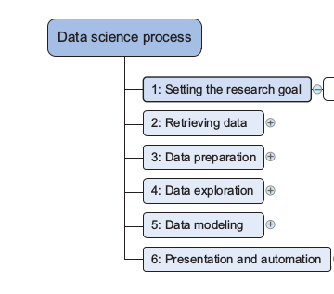
The Data Science Process
Introducing Data Science by David Cieling
Chapter 2: The Data Science Process
Notes:
This slide can also be used as a Q and A slide

Slide 10
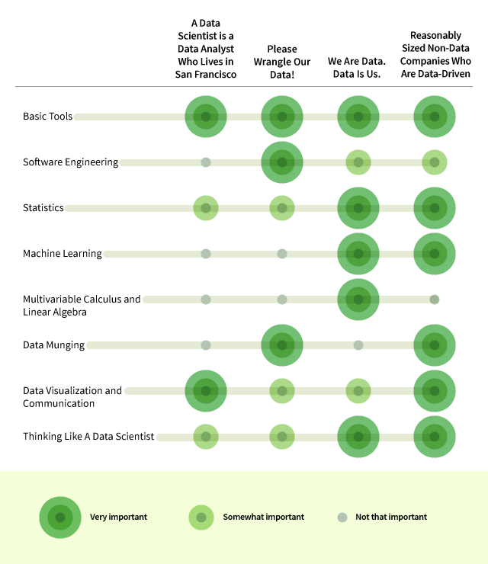
Data Science Job Skills
Udacity
http://blog.udacity.com/2014/11/data-science-job-skills.html
Notes:
This slide can also be used as a Q and A slide

Slide 11
What skills should a Data Scientist have in 2016?
We pulled about 3500 relevant job openings from LinkedIn. We looked at postings for data scientists and analysts at every level–from intern to associate to senior to VP.
SQL , Hadoop, Python, Java, and R round out the top five in-demand skills.
Crowdflower
January 2016
https://www.crowdflower.com/what-skills-should-data-scientists-have-in-2016/

Slide 12
Fijar los objetivos de la investigación
¿Cual es la proporción entre el número de atacantes y defensores en las batallas ?
¿En qué regiones han sucedio mas conflictos?
¿Quienes son los reyes que han ordenado mayor número de ataques?
¿Que tipo de ataques ordena cada rey ?
Notes:
This slide can also be used as a Q and A slide

Slide 13
Obteniendo los datos
Dataset
A dataset of the battles in the War of the Five Kings from George R.R. Martin's A Song Of Ice And Fire series.
Codebook
https://github.com/chrisalbon/war_of_the_five_kings_dataset/blob/master/README.md
Fuentes
https://www.kaggle.com/mylesoneill/game-of-thrones
https://github.com/chrisalbon/war_of_the_five_kings_dataset
Notes:
This slide can also be used as a Q and A slide

Slide 14
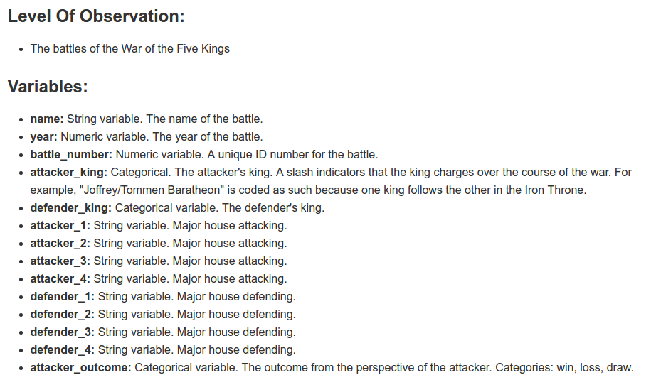
Codebook
Notes:
This slide can also be used as a Q and A slide

Slide 15
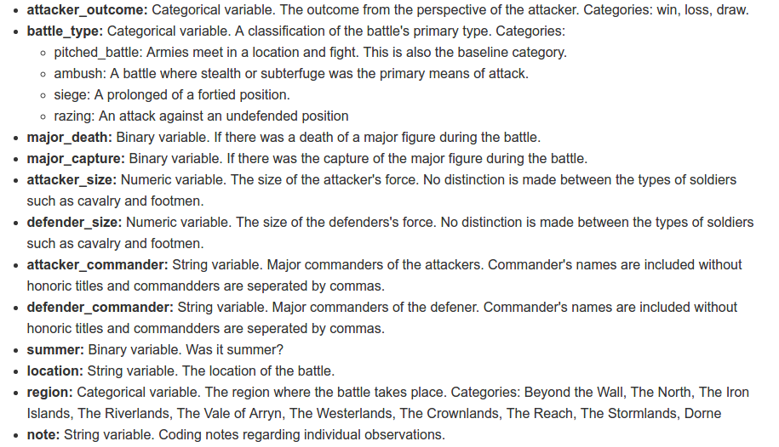
Codebook
Notes:
This slide can also be used as a Q and A slide

Slide 16
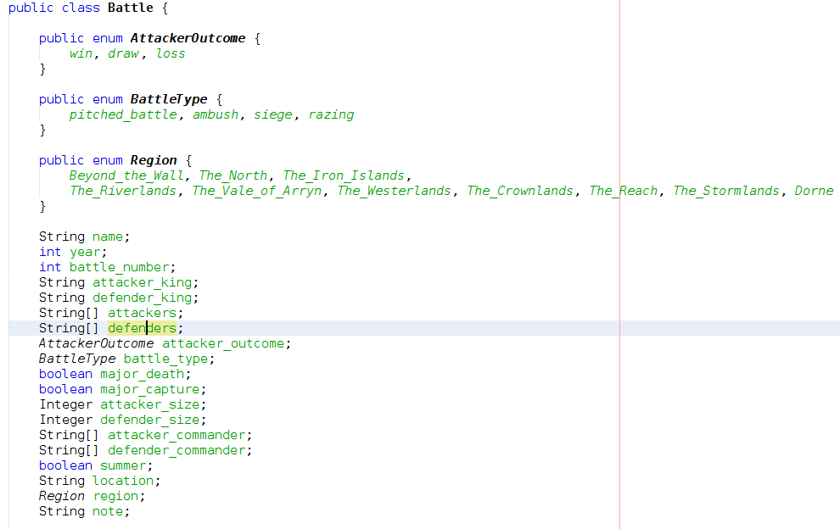
Preparación de datos
Modelo de datos
Notes:
This slide can also be used as a Q and A slide

Slide 17
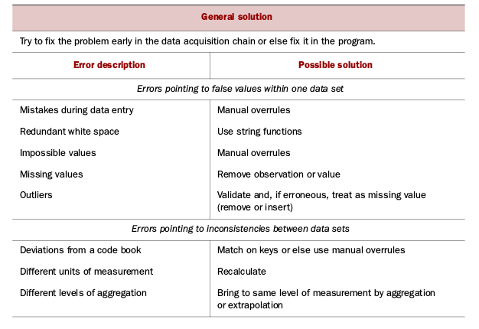
Preparación de datos
Limpiando los datos
Notes:
This slide can also be used as a Q and A slide

Slide 18
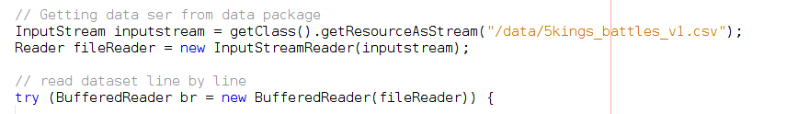
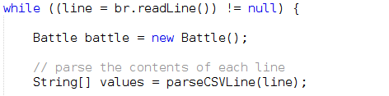
Preparación de datos
Leyendo el archivo (dataset)
Parseando los valores línea por línea
Notes:
This slide can also be used as a Q and A slide

Slide 19
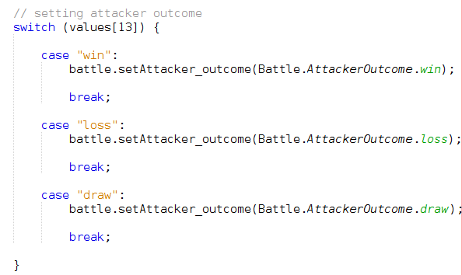
Preparación de datos
Valores sin irregularidades
Variables categóricas
Notes:
This slide can also be used as a Q and A slide

Slide 20

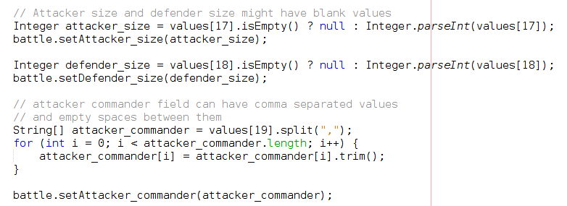
Preparación de datos
Valores binarios
Variables irregulares
Notes:
This slide can also be used as a Q and A slide

Slide 21
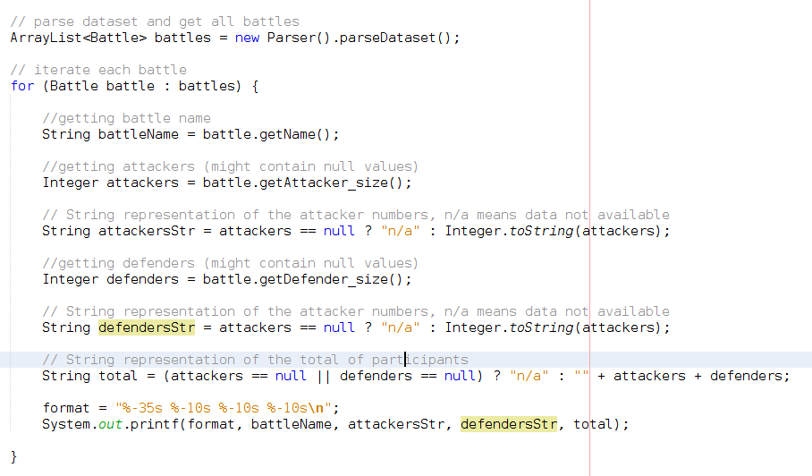
Analisis Exploratorio
Paquete: exploration
Clase: Explorer.java
Notes:
This slide can also be used as a Q and A slide

Slide 22
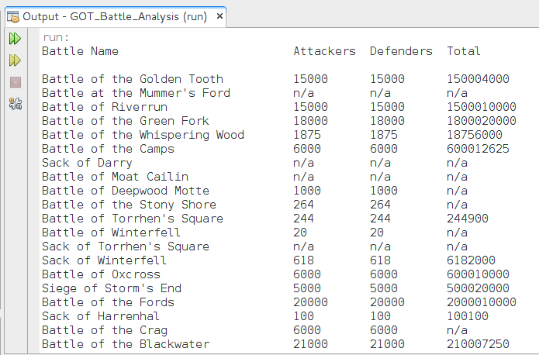
Analisis Exploratorio
Notes:
This slide can also be used as a Q and A slide

Slide 23
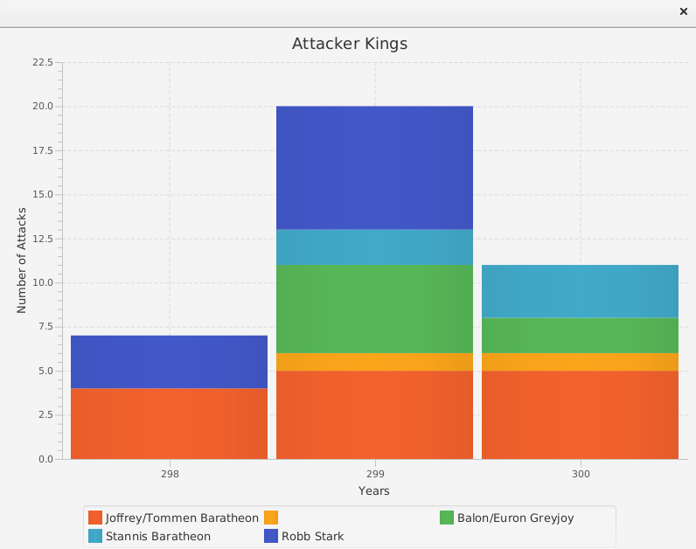
Presentación
Notes:
This slide can also be used as a Q and A slide

Slide 24
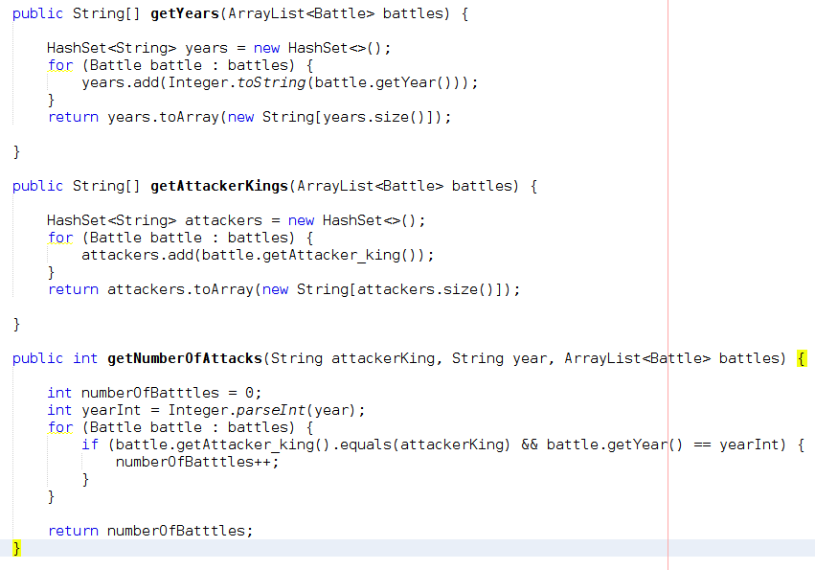
Presentación
Notes:
This slide can also be used as a Q and A slide

Slide 25
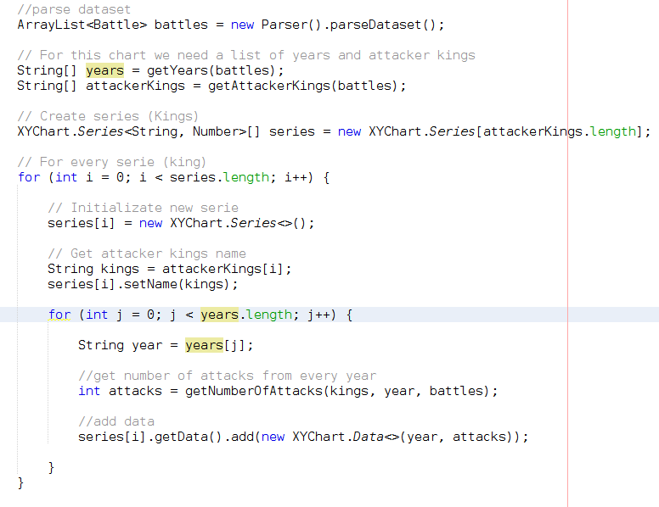
Presentación
Notes:
This slide can also be used as a Q and A slide

Slide 26
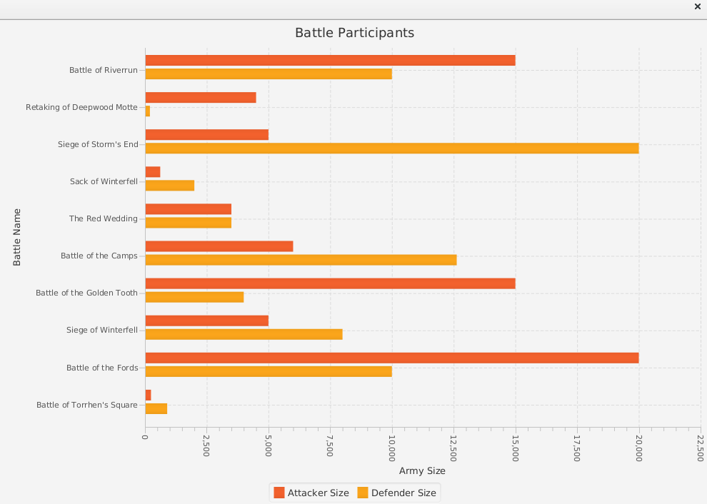
Presentación
Notes:
This slide can also be used as a Q and A slide

Slide 27
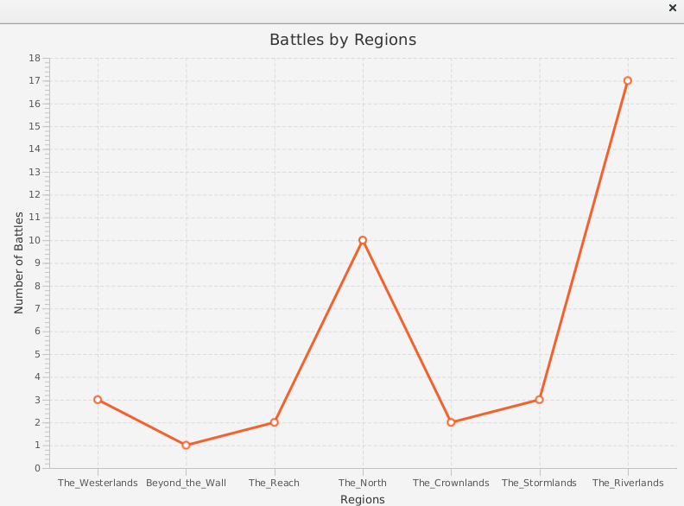
Presentación
Notes:
This slide can also be used as a Q and A slide

Slide 28
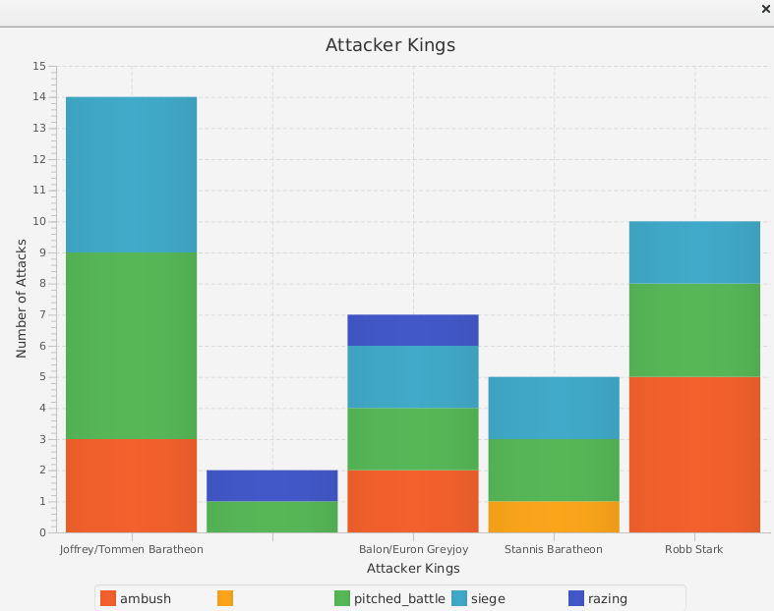
Presentación
Notes:
This slide can also be used as a Q and A slide

Slide 29



Preguntas
@alapisco
fb.com/alapisco
github.com/alapisco

