Slide 1
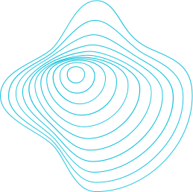

BantayLaot: Fish Catch Documentation and IUU Fishing Monitoring for Municipal Fisheries in the Philippines Using Mobile and Web Technologies
Jose Benjamin Gallero and Dr. Val Randolf M. Madrid

Slide 2
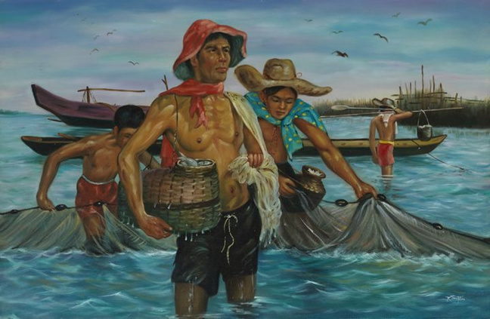
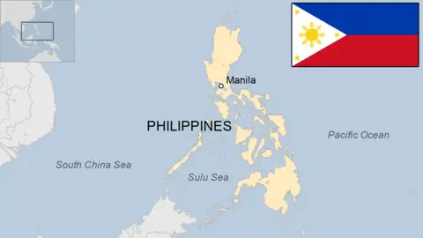
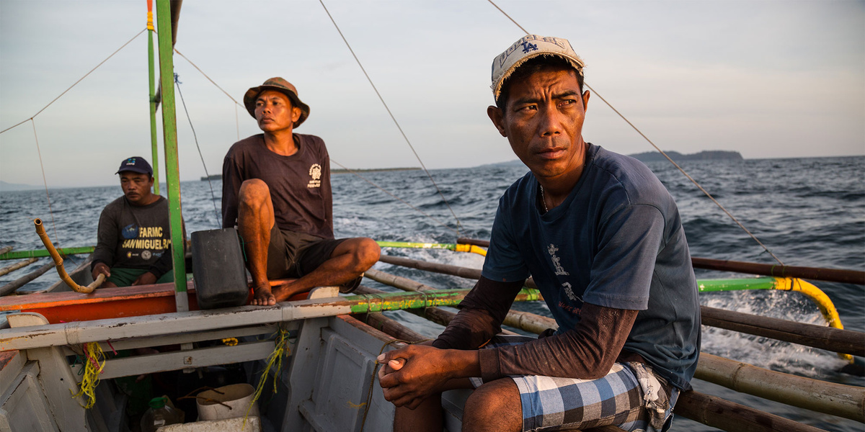
Rich maritime heritage of the Philippines
Challenges: IUU fishing threatens sustainability
Economic and social impact on coastal communities
Introduction

Slide 3
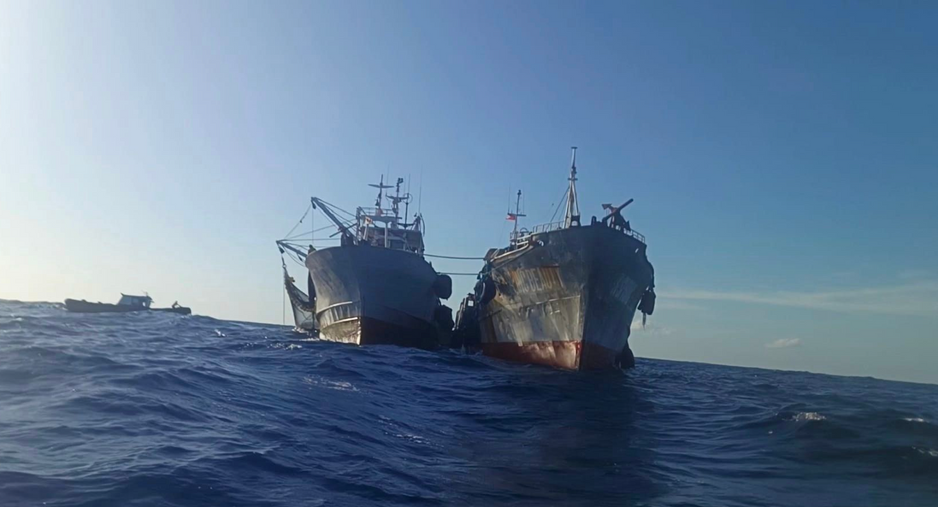
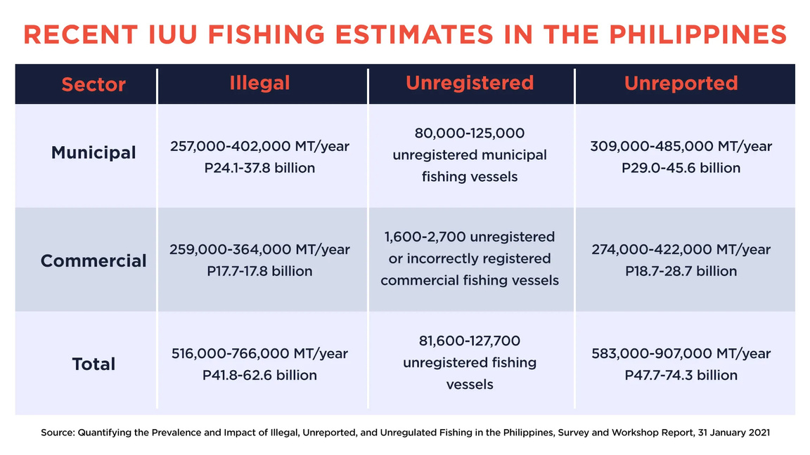
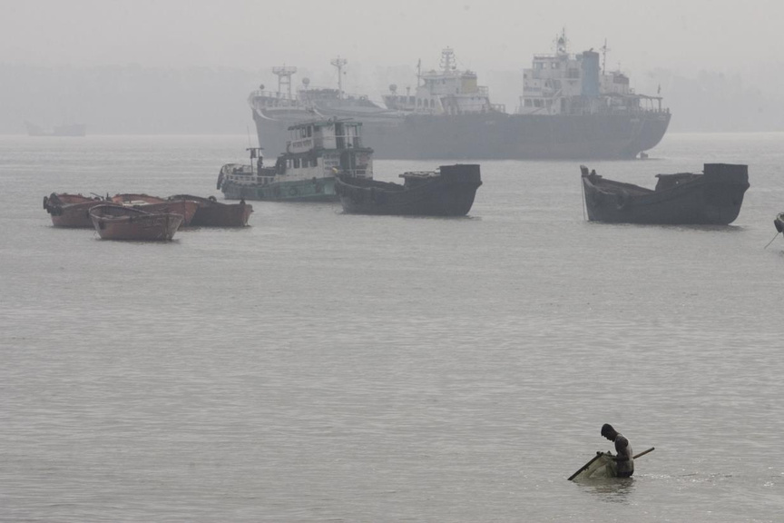
Problem Statement
₱62 billion annual losses
30% unregistered
422,000 metric tons
30.6% Poverty Rates

Slide 4

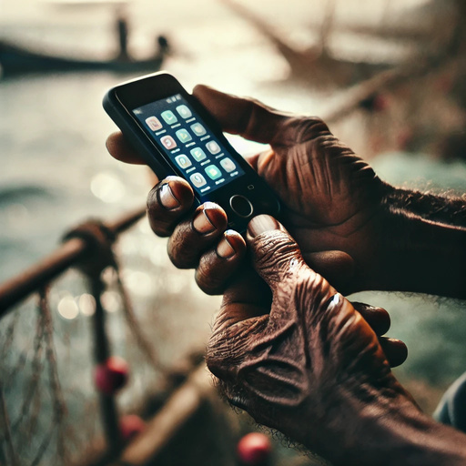
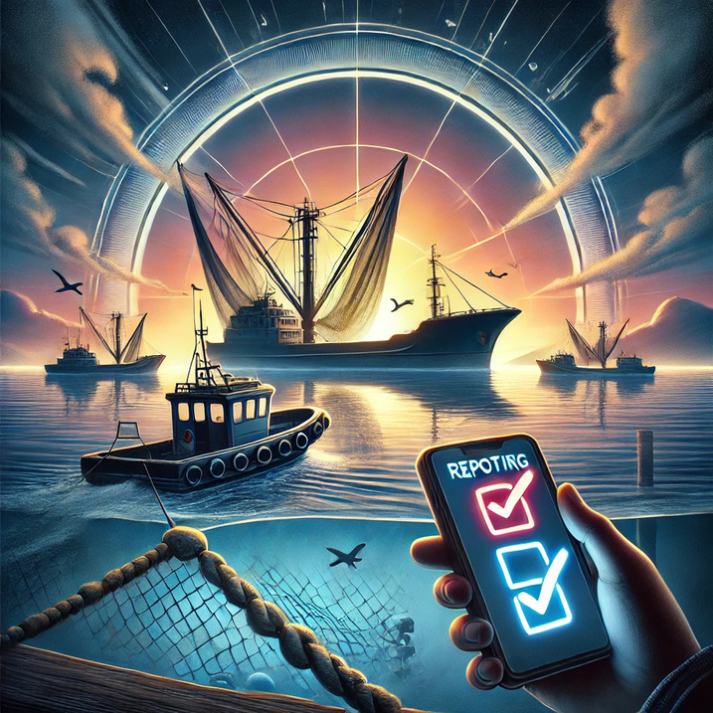
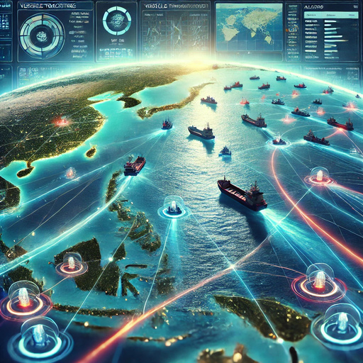
Objectives
Vessel Tracking Feature
Fish Catch Documentation
IUU Reporting Feature
Data Visualisation

Slide 5

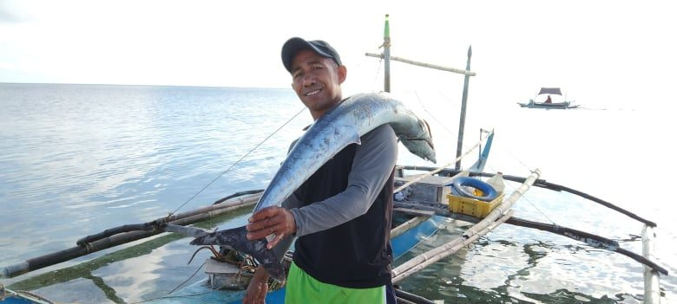
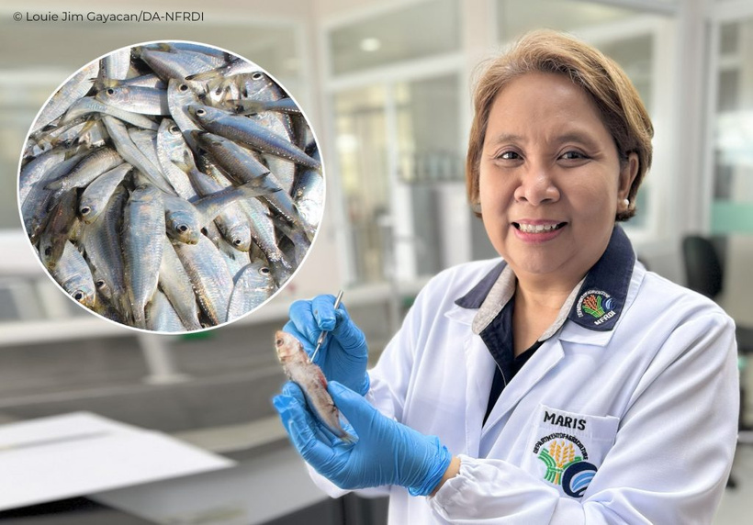
Transparency and accountability
Sustainable fishing practices
Data-driven decision-making
Benefits: fisherfolk, government, researchers
Significance

Slide 6




Methodology Overview
Technology: Kotlin (Mobile), MERN Stack (Web)
Development Tools: Android Studio, Visual Studio Code
System Components: Mobile App & Web Platform

Slide 7
Kotlin
Jetpack
Compose Room
Features:
GPS Tracking
Offline Mode
Violation Reporting
Technology Stack - Mobile Application

Slide 8
Stack:
MongoDB
Express.js
React
Node.js
Features:
Geospatial Visualization
CPUE Analysis
Data Filtering
Technology Stack - Web Platform

Slide 9
Session Data:
Fishing Gear: Types used during sessions
Fish Catch Information: Species and catch weights for each gear
Location Tracking: GPS coordinates
Session Details: Start and end timestamps
IUU Reporting Data
Data Collection

Slide 10
IUU Reporting Data:
Violation Details: Specific violations
Fishing Gear Involved: Illegal or unauthorized gear
Violator Information: Identifier of violator and vessel
Location of Violation: GPS coordinates
Supporting Evidence: Photos or multimedia evidence
Data Collection

Slide 11
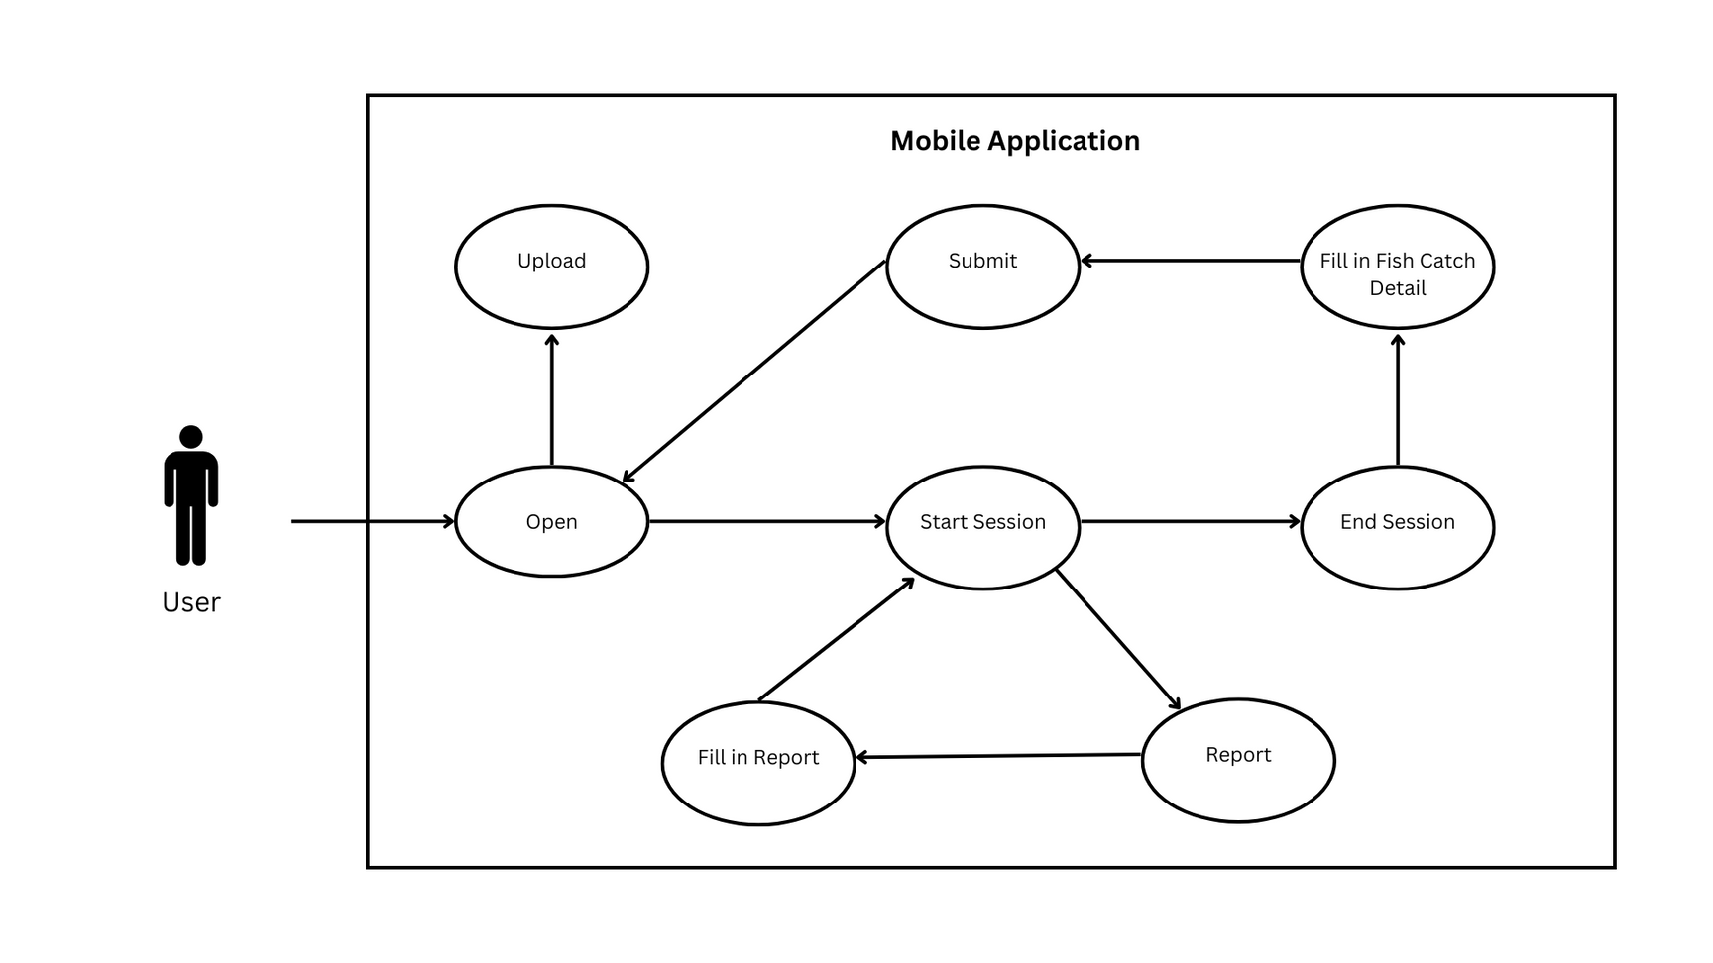
Technology Stack - Mobile Application

Slide 12
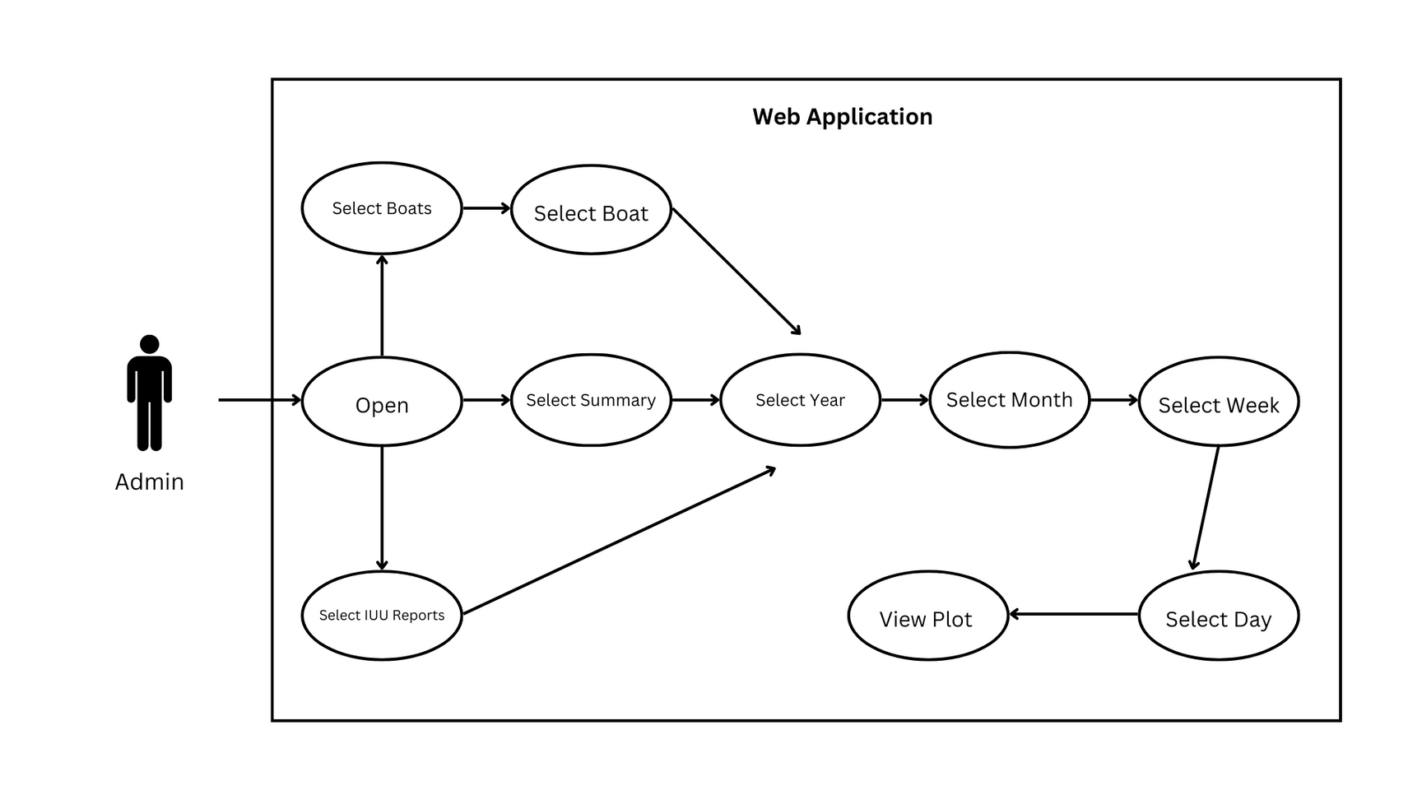
Technology Stack - Mobile Application

Slide 13
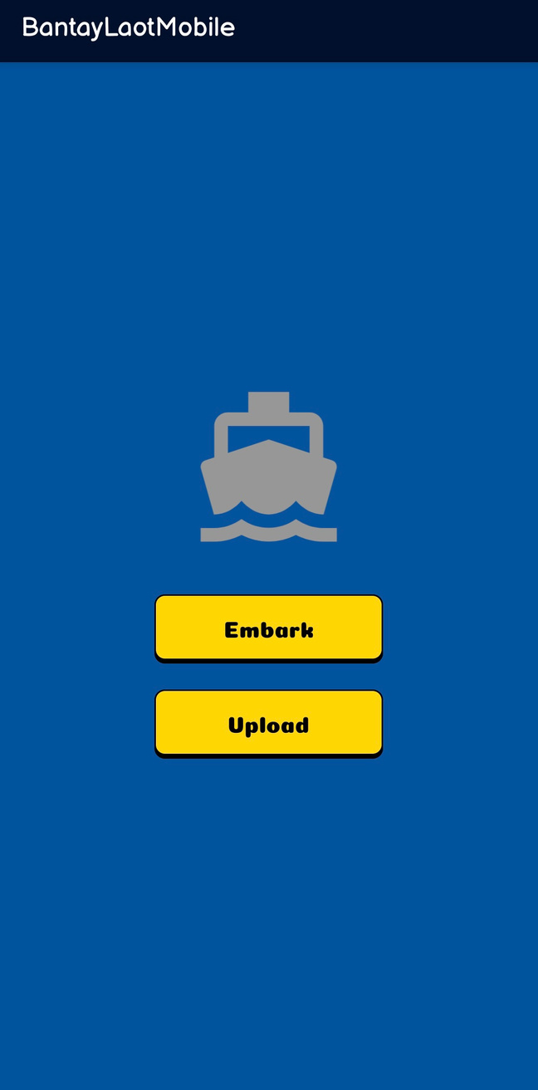
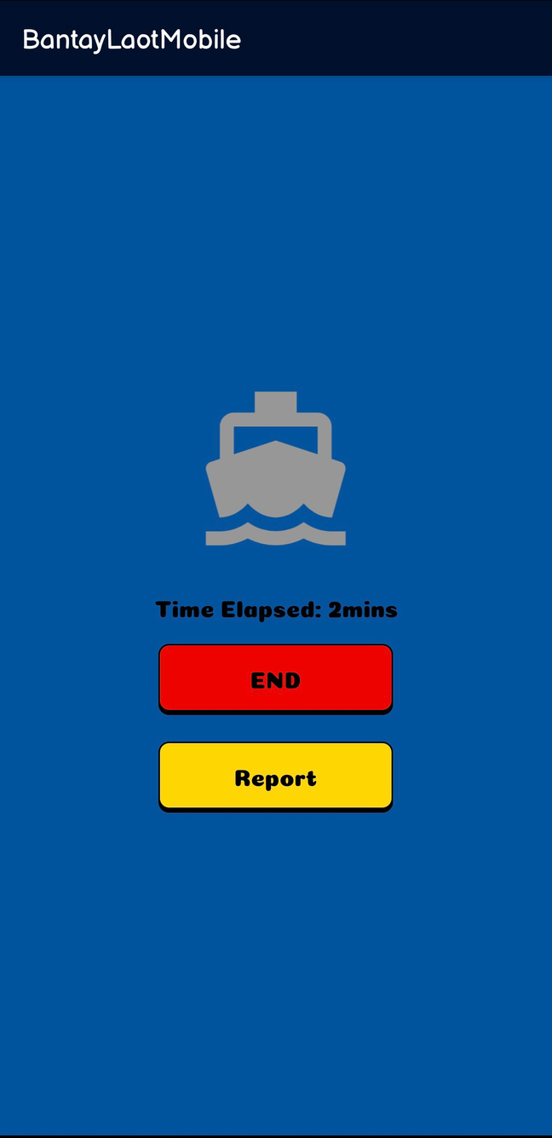
System Features - Mobile Application

Slide 14
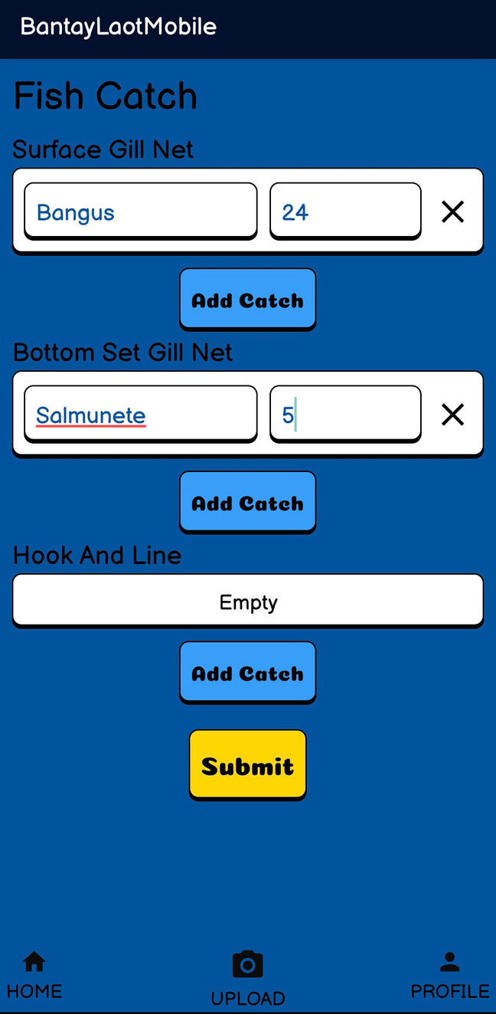
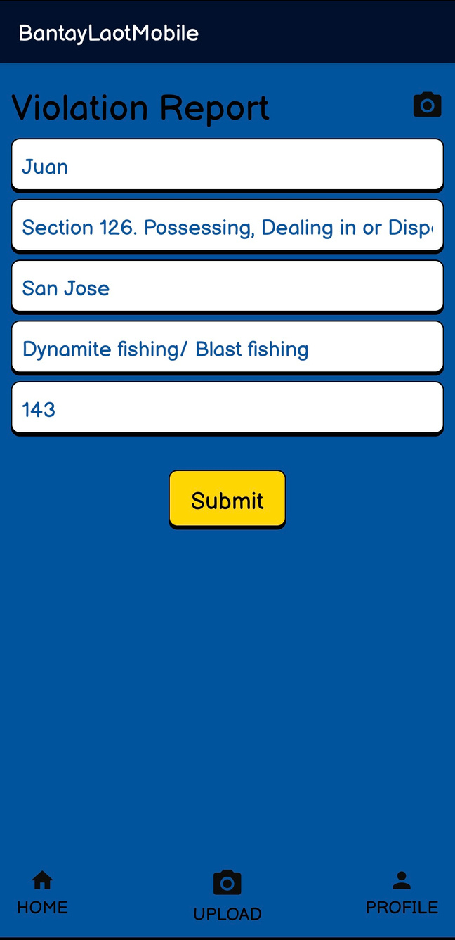
System Features - Mobile Application

Slide 15
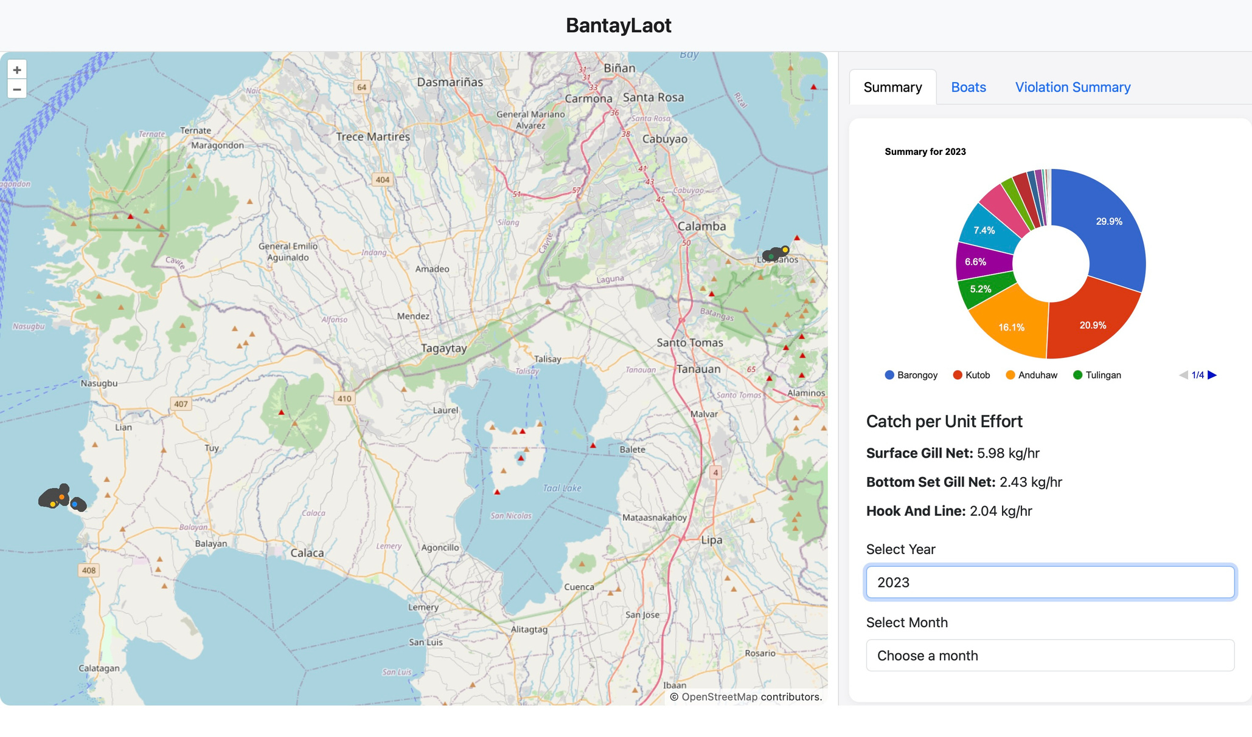
System Features - Web Platform

Slide 16
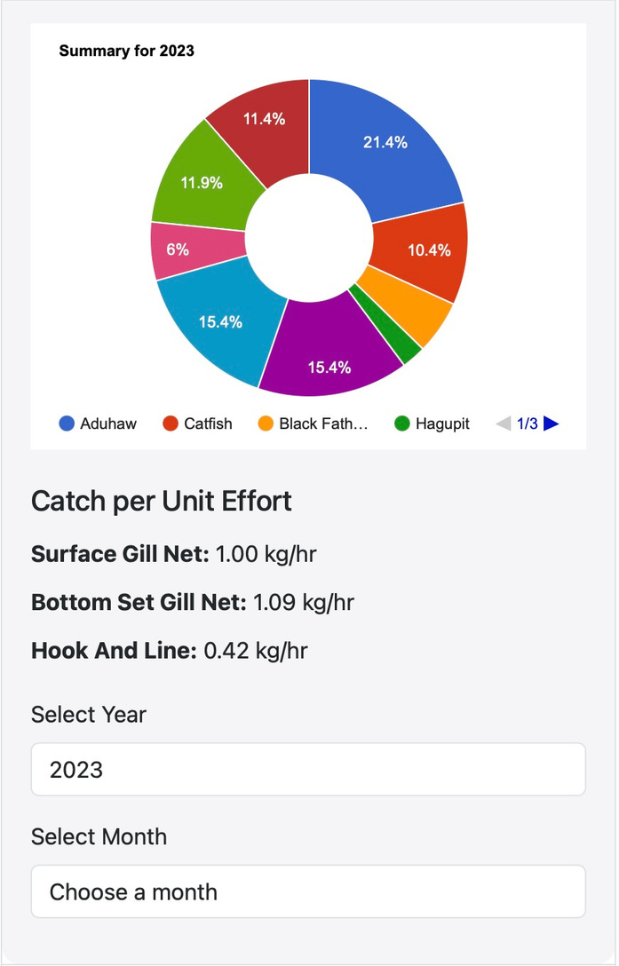
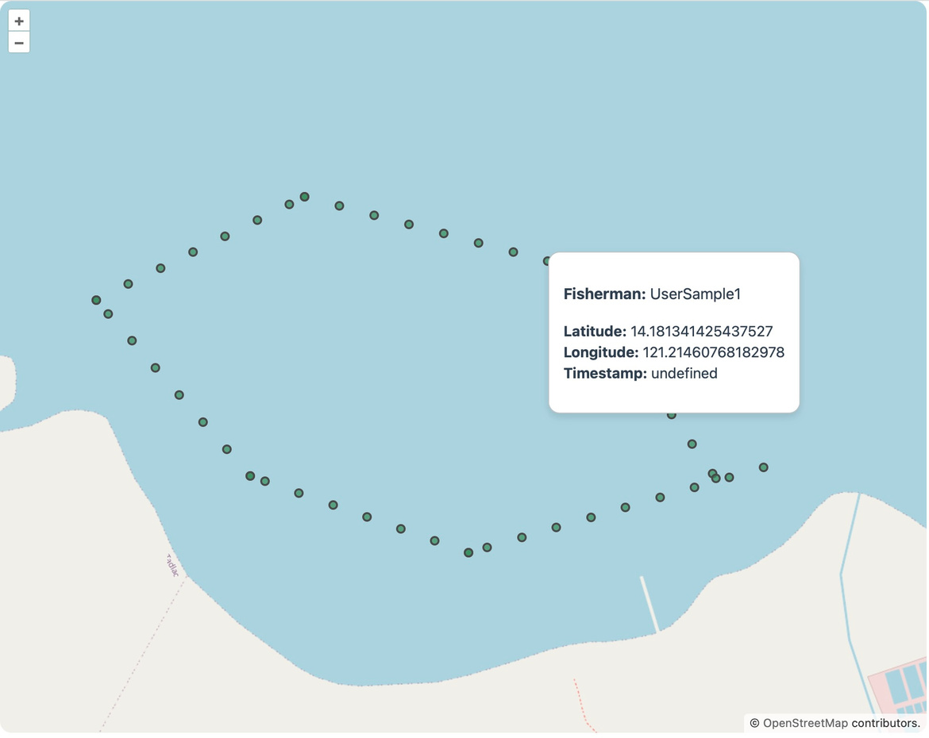
System Features - Web Platform

Slide 17
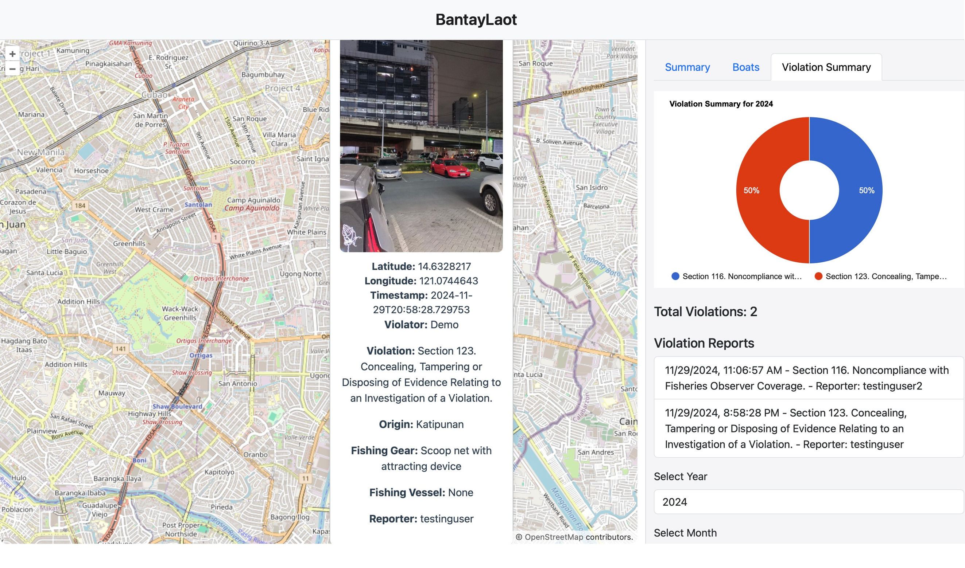
System Features - Web Platform

Slide 18
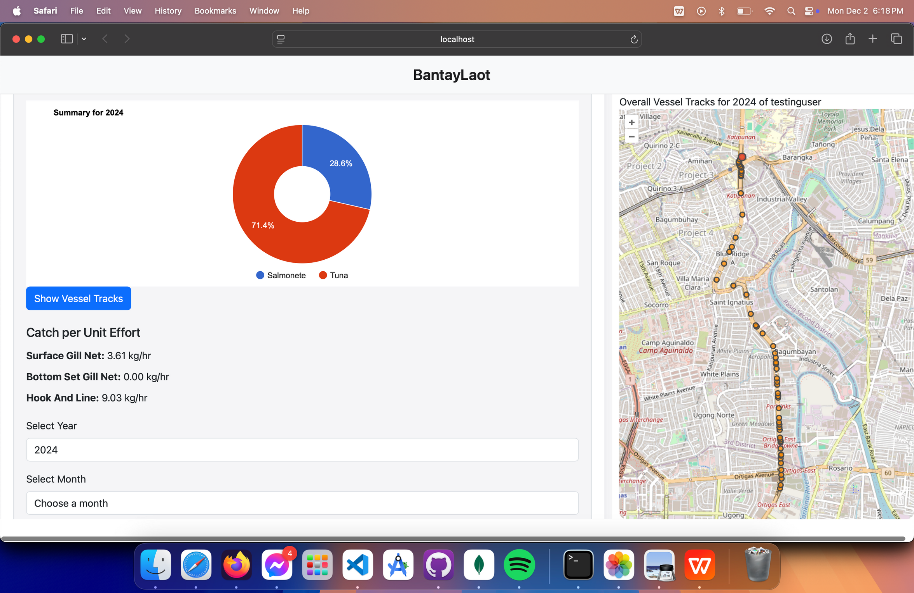
System Features - Web Platform

Slide 19
Results
Results
Mobile App: Data collection and synchronization
Web Platform: Geospatial visualization and analytics

Slide 20

Testing and Limitations
Testing: Real-time land simulations validated functionality
Limitations: No field testing on actual vessels

Slide 21
Conclusion: BantayLaot is a robust solution capable for monitoring IUU fishing
Recommendations:
Conduct field testing
User account system for security
Image processing for automated fish recognition
Connect with government regulatory systems
Conclusion and Recommendations

Slide 22
Thank You!

