Slide 1
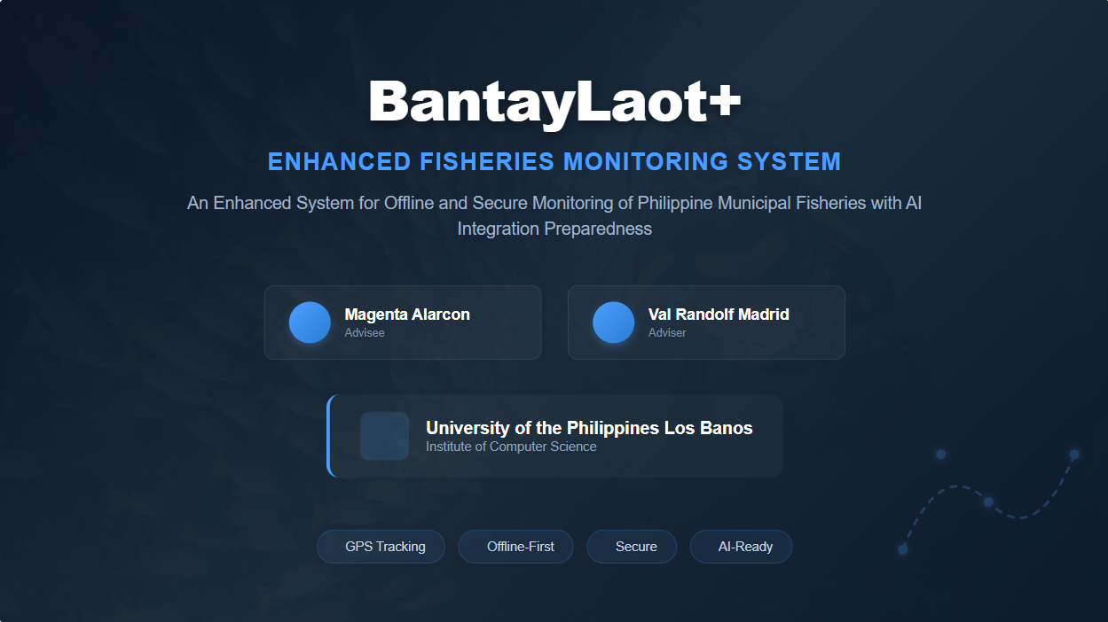

Slide 2
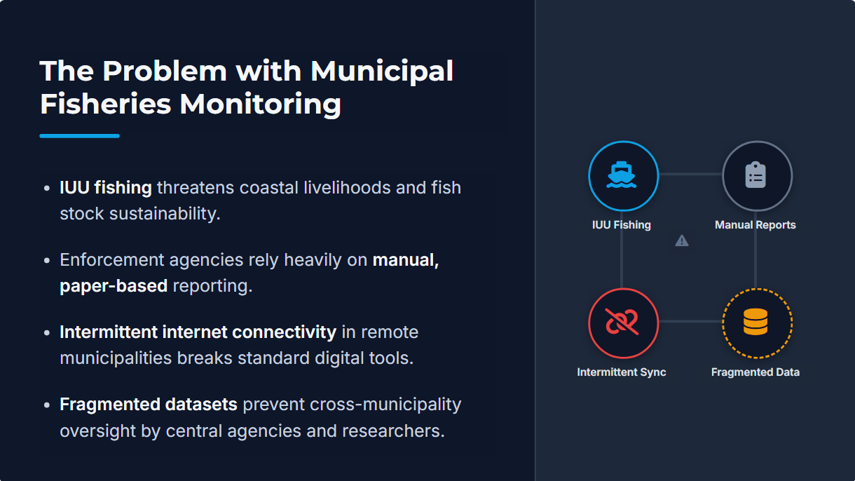


Notes:
The Philippines with over 36000 km of coastlines is heavily dependent on its municipal fisheries, yet these waters are severely affected by illegal, unreported, and unregulated fishing or IUU fishing.
According to the World Wildlife Fund, IUU fishing directly harms marine biodiversity and weakens law enforcement effectiveness.
Current monitoring systems face three main challenges: unreliable internet connectivity, restricted enforcement coverage, and fragmented data management.
Although the original BantayLaot system enables real-time reporting, its offline capabilities are limited, it lacks robust data security, and it does not support intelligent structured data management

Slide 3


Notes:
The Philippines with over 36000 km of coastlines is heavily dependent on its municipal fisheries, yet these waters are severely affected by illegal, unreported, and unregulated fishing or IUU fishing.
According to the World Wildlife Fund, IUU fishing directly harms marine biodiversity and weakens law enforcement effectiveness.
Current monitoring systems face three main challenges: unreliable internet connectivity, restricted enforcement coverage, and fragmented data management.
Although the original BantayLaot system enables real-time reporting, its offline capabilities are limited, it lacks robust data security, and it does not support intelligent structured data management

Slide 4
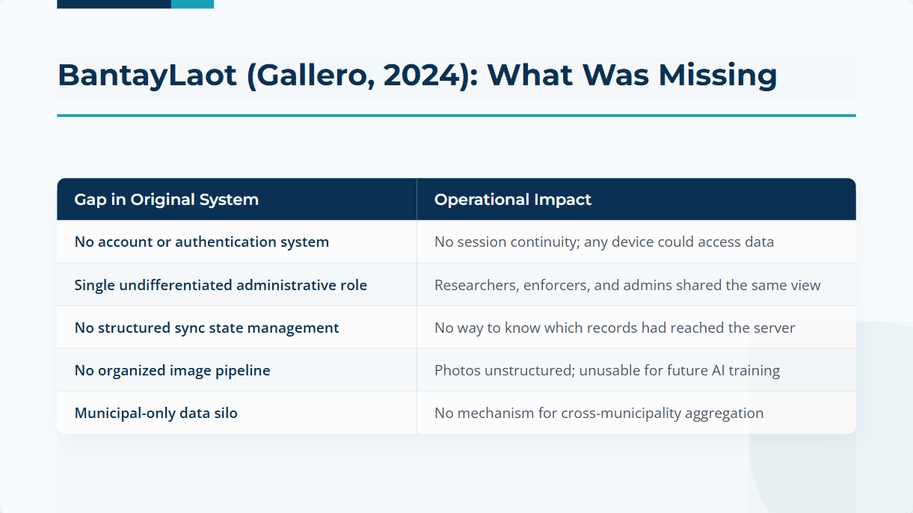
Notes:
Our study has three core technical objectives.
First, to enhance the mobile application with full offline support, encrypted local storage, and placeholder for AI modules.
Second, to develop a secure multi-tier database architecture supporting both municipal and central cloud storage along with the web interface for displaying data
And third, to evaluate the deployed system in real-world monitoring environments across four municipalities in Cagayan, focusing on usability, reliability, and suitability for operational use.

Slide 5
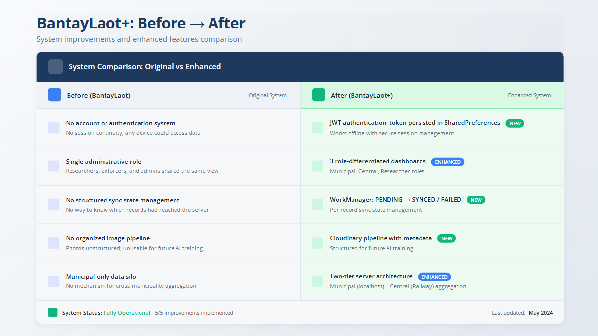
Notes:
Technically, this system supports multiple stakeholders through a data-driven approach.
For fisherfolk, the offline-first design ensures functionality even without internet, allowing consistent data collection.
For LGUs, secure authentication and structured data enable evidence-based enforcement decisions.
For researchers, the system will produce well-organized image datasets, ready for future machine learning and AI analysis.

Slide 6



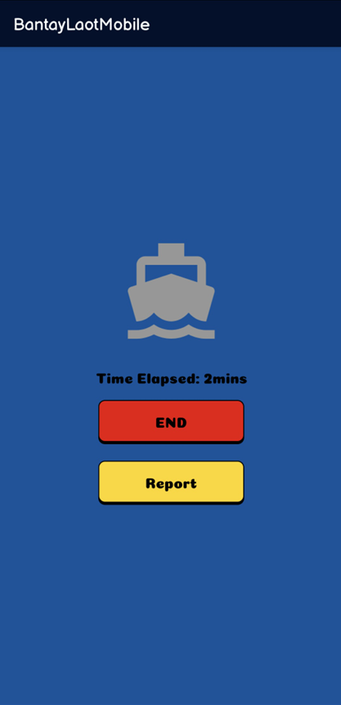
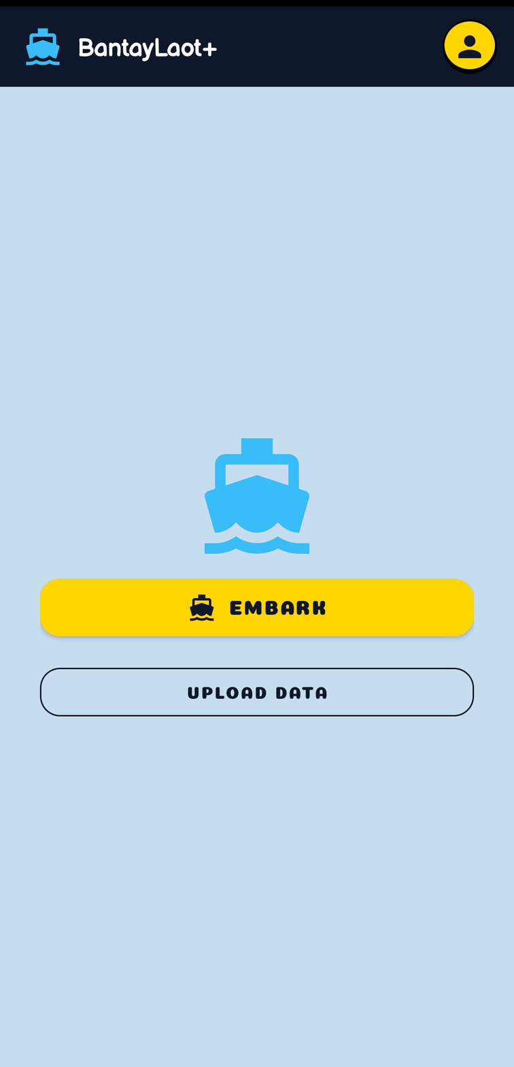

Notes:
Here we see the technical comparison between the original BantayLaot and BantayLaot+.
Previously, the system had limited offline capability, no user accounts, manual reporting, and loosely organized storage.
BantayLaot+ introduces:
Full offline-first mobile operation design consistent with Serrano et al.’s offline-first architecture model.
it also introduces Offline login with encrypted authentication, based on Dahiru and Ibrahim’s secure offline authentication model
A structured local plus cloud database
And a reserved AI module for future AI-assisted identification and estimation, inspired by Norouzzadeh et al.’s work on image-based species identification.”

Slide 7

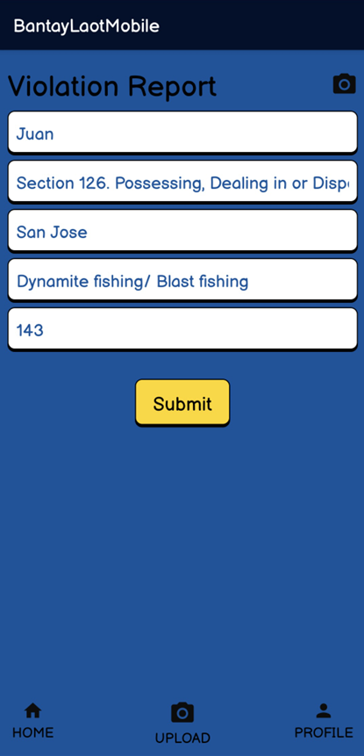
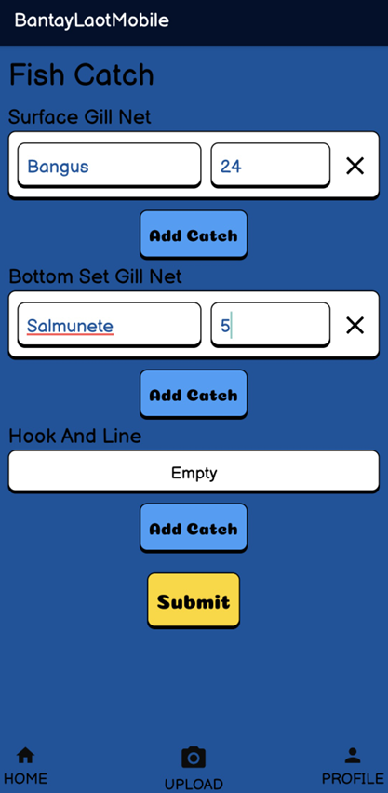
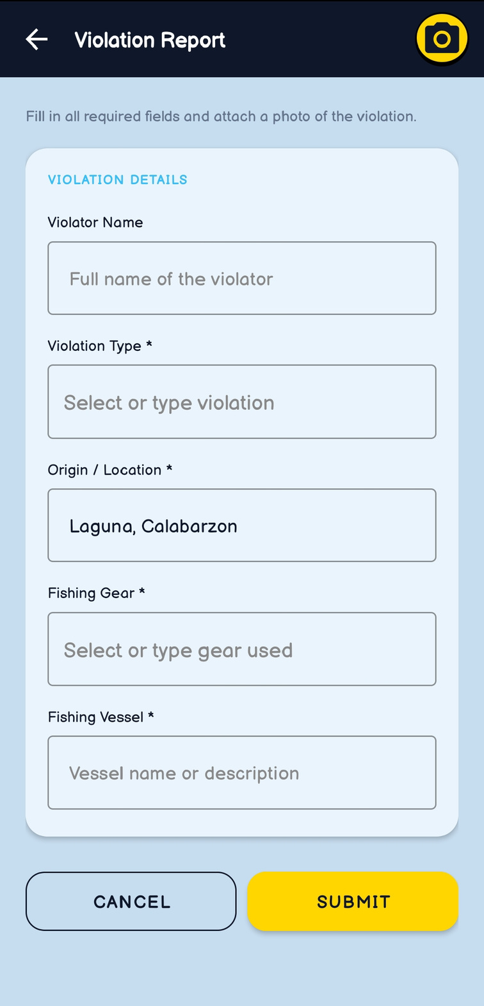
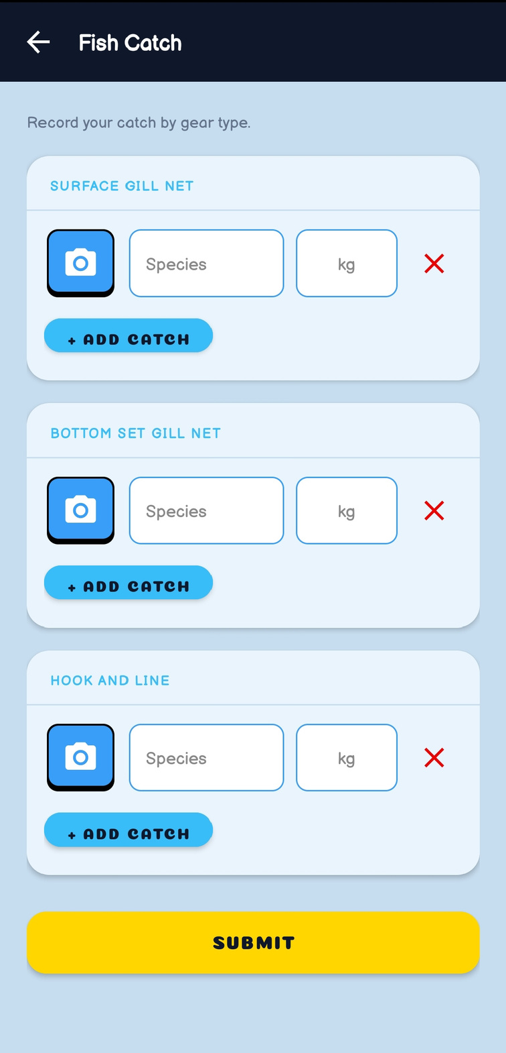
Notes:
Here we see the technical comparison between the original BantayLaot and BantayLaot+.
Previously, the system had limited offline capability, no user accounts, manual reporting, and loosely organized storage.
BantayLaot+ introduces:
Full offline-first mobile operation design consistent with Serrano et al.’s offline-first architecture model.
it also introduces Offline login with encrypted authentication, based on Dahiru and Ibrahim’s secure offline authentication model
A structured local plus cloud database
And a reserved AI module for future AI-assisted identification and estimation, inspired by Norouzzadeh et al.’s work on image-based species identification.”

Slide 8

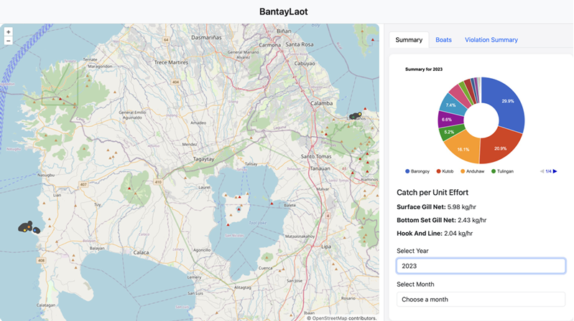
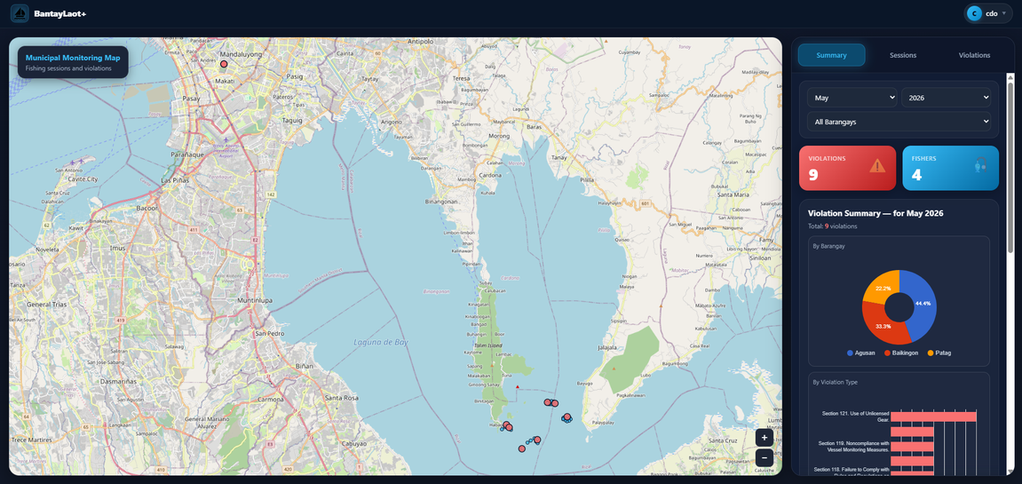
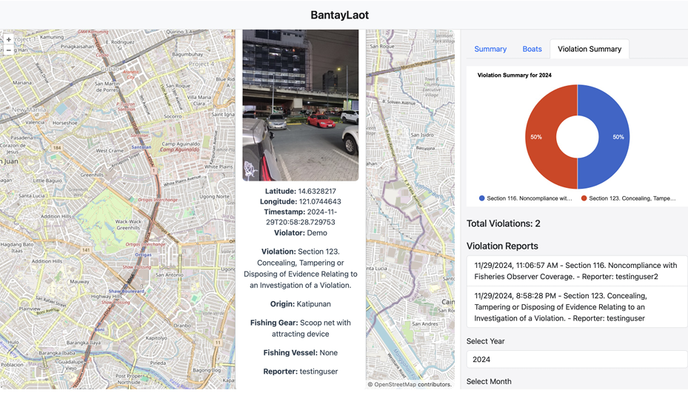
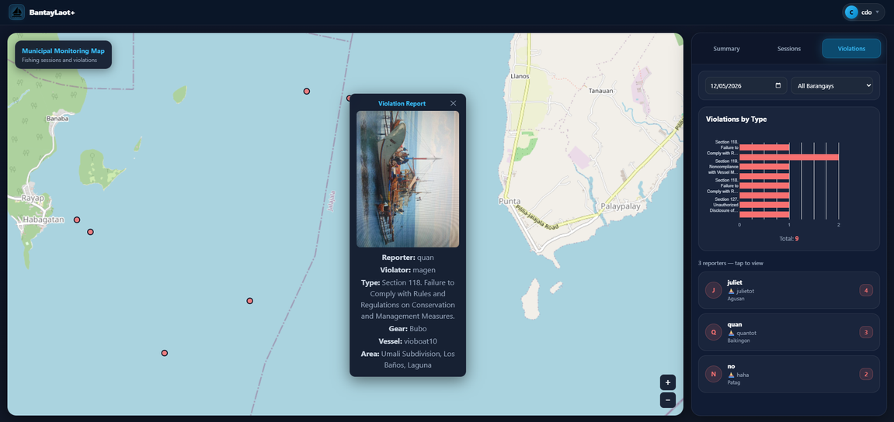
Notes:
Here we see the technical comparison between the original BantayLaot and BantayLaot+.
Previously, the system had limited offline capability, no user accounts, manual reporting, and loosely organized storage.
BantayLaot+ introduces:
Full offline-first mobile operation design consistent with Serrano et al.’s offline-first architecture model.
it also introduces Offline login with encrypted authentication, based on Dahiru and Ibrahim’s secure offline authentication model
A structured local plus cloud database
And a reserved AI module for future AI-assisted identification and estimation, inspired by Norouzzadeh et al.’s work on image-based species identification.”

Slide 9

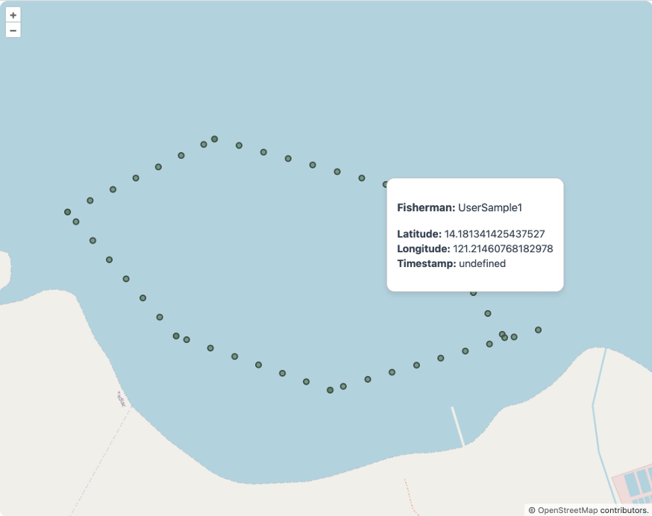
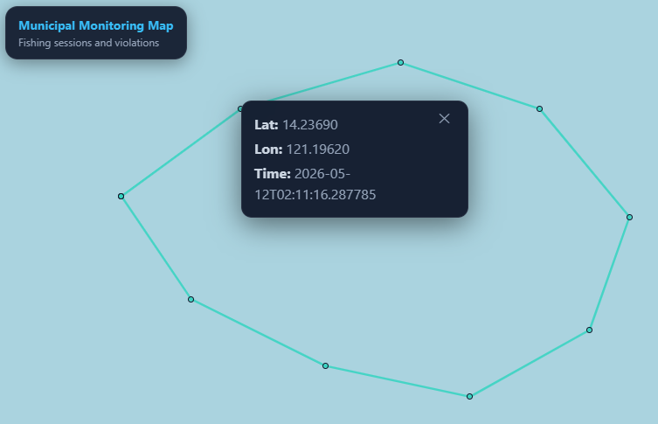
Notes:
Here we see the technical comparison between the original BantayLaot and BantayLaot+.
Previously, the system had limited offline capability, no user accounts, manual reporting, and loosely organized storage.
BantayLaot+ introduces:
Full offline-first mobile operation design consistent with Serrano et al.’s offline-first architecture model.
it also introduces Offline login with encrypted authentication, based on Dahiru and Ibrahim’s secure offline authentication model
A structured local plus cloud database
And a reserved AI module for future AI-assisted identification and estimation, inspired by Norouzzadeh et al.’s work on image-based species identification.”

Slide 10
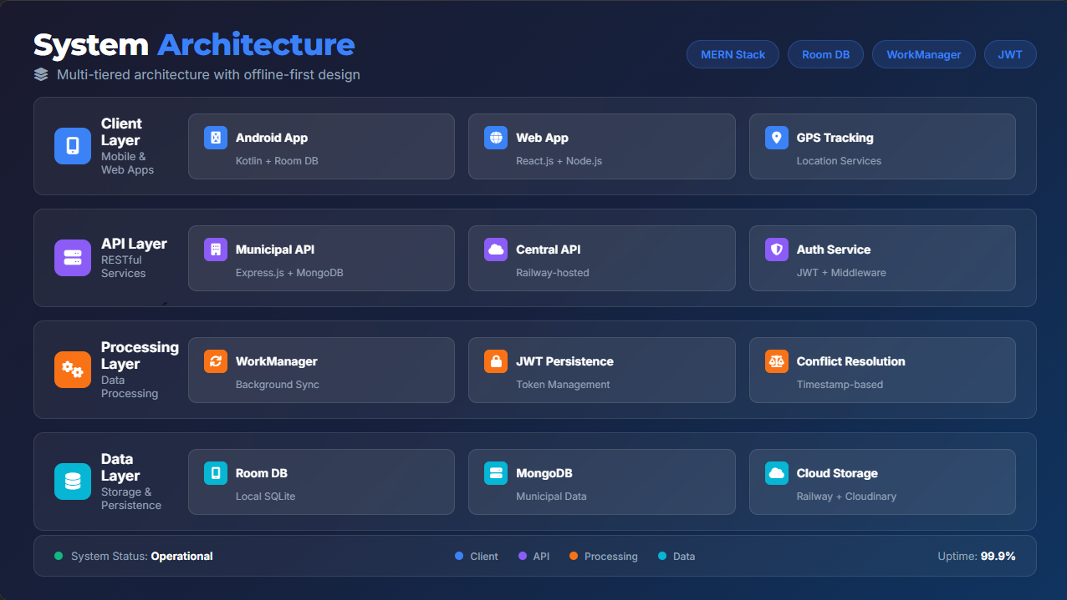
Notes:
Here we see the technical comparison between the original BantayLaot and BantayLaot+.
Previously, the system had limited offline capability, no user accounts, manual reporting, and loosely organized storage.
BantayLaot+ introduces:
Full offline-first mobile operation design consistent with Serrano et al.’s offline-first architecture model.
it also introduces Offline login with encrypted authentication, based on Dahiru and Ibrahim’s secure offline authentication model
A structured local plus cloud database
And a reserved AI module for future AI-assisted identification and estimation, inspired by Norouzzadeh et al.’s work on image-based species identification.”

Slide 11
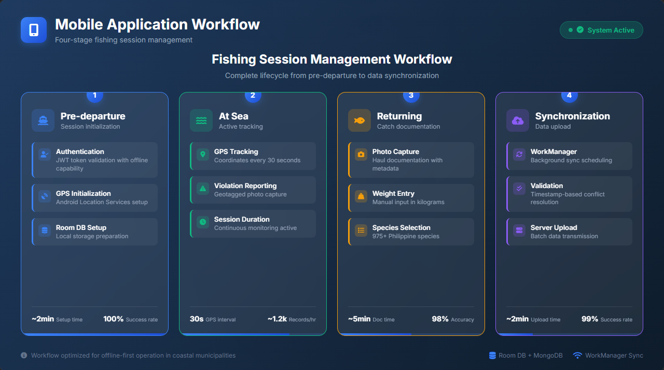
Notes:
So the mobile application will continue to be developed using Kotlin with Jetpack Compose, which Google Developers identifies as optimal for building secure, modern Android UIs and includes built-in support for encrypted local storage.
The web platform is developed using the MERN stack, with
MongoDB providing schema-flexible storage,
Express.js and Node.js for handling REST API services, and
React.js for responsive dashboards."

Slide 12
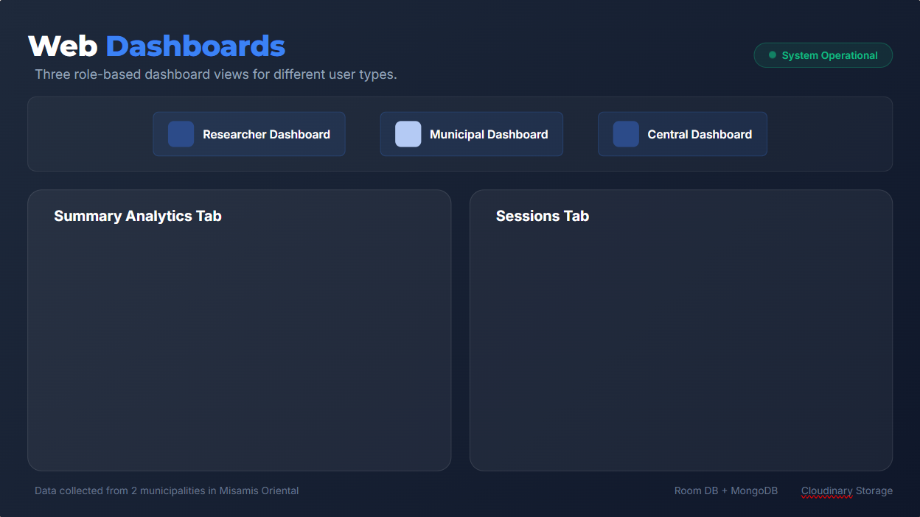

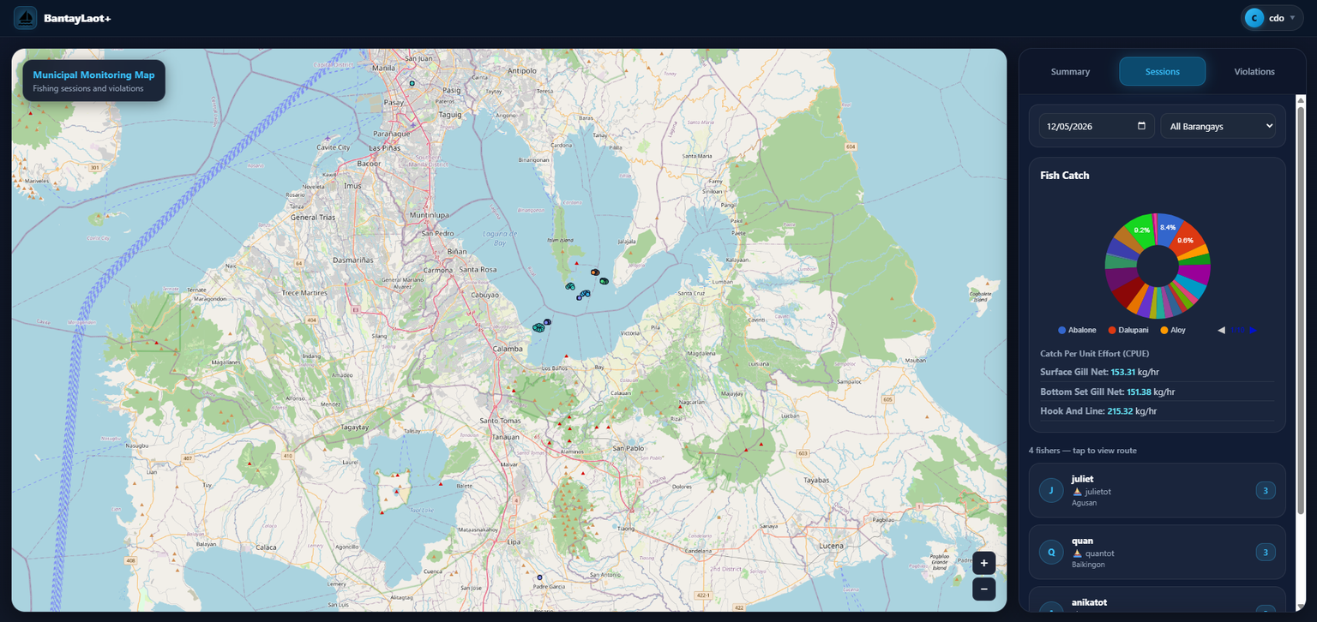

Slide 13
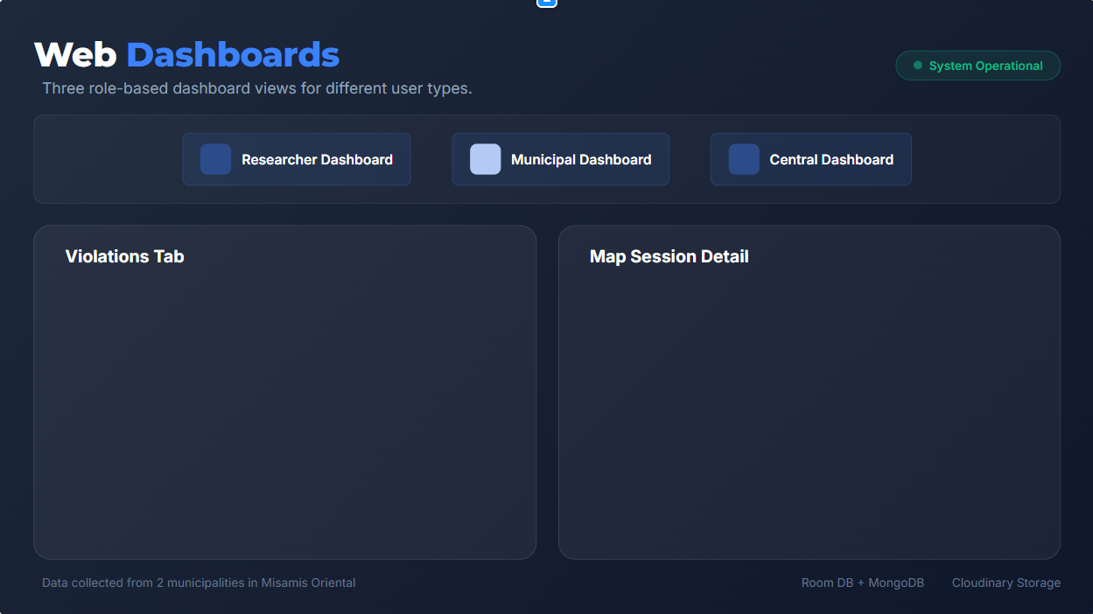


Slide 14
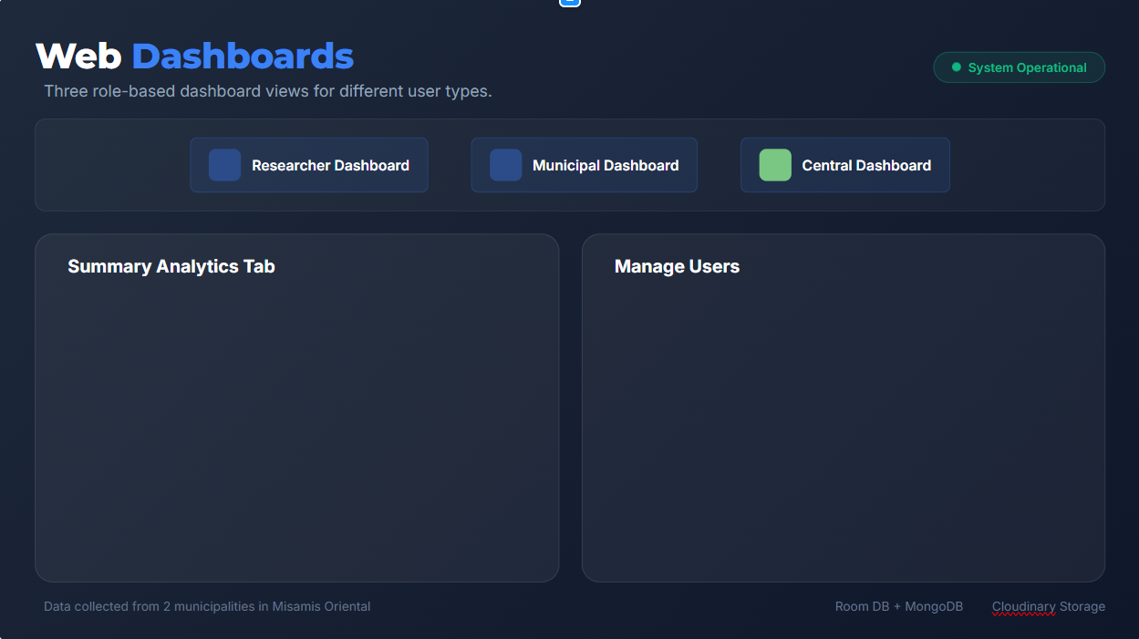
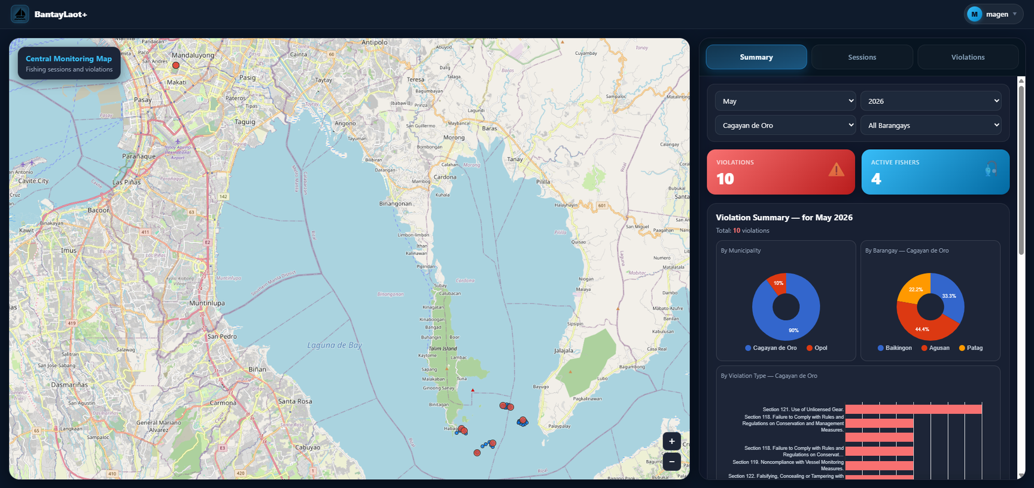
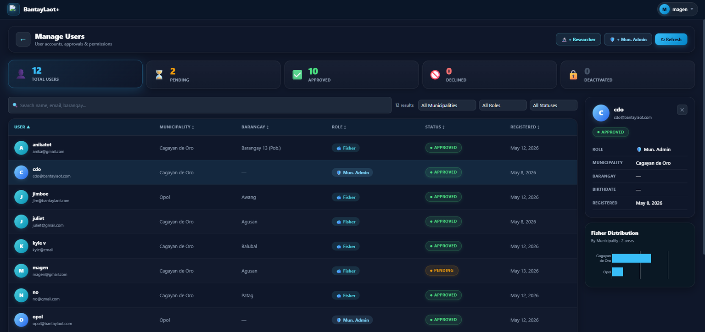

Slide 15
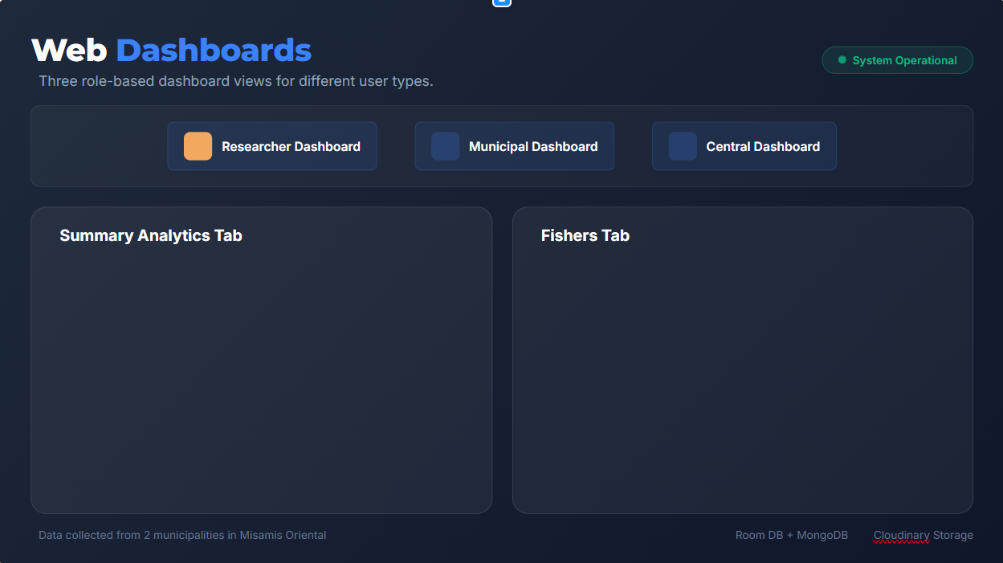
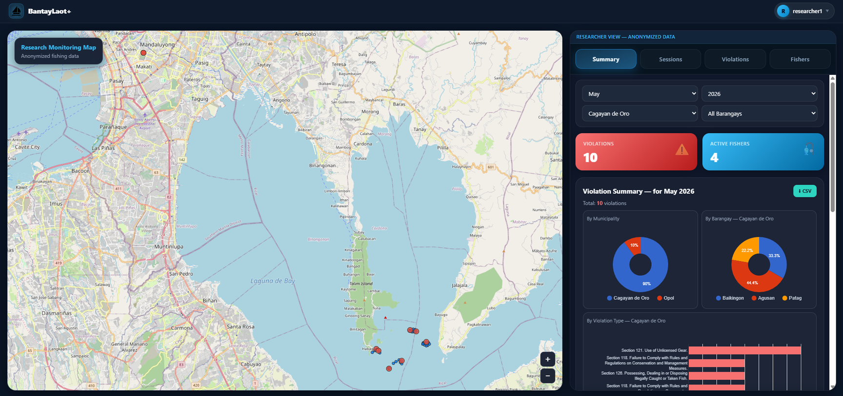
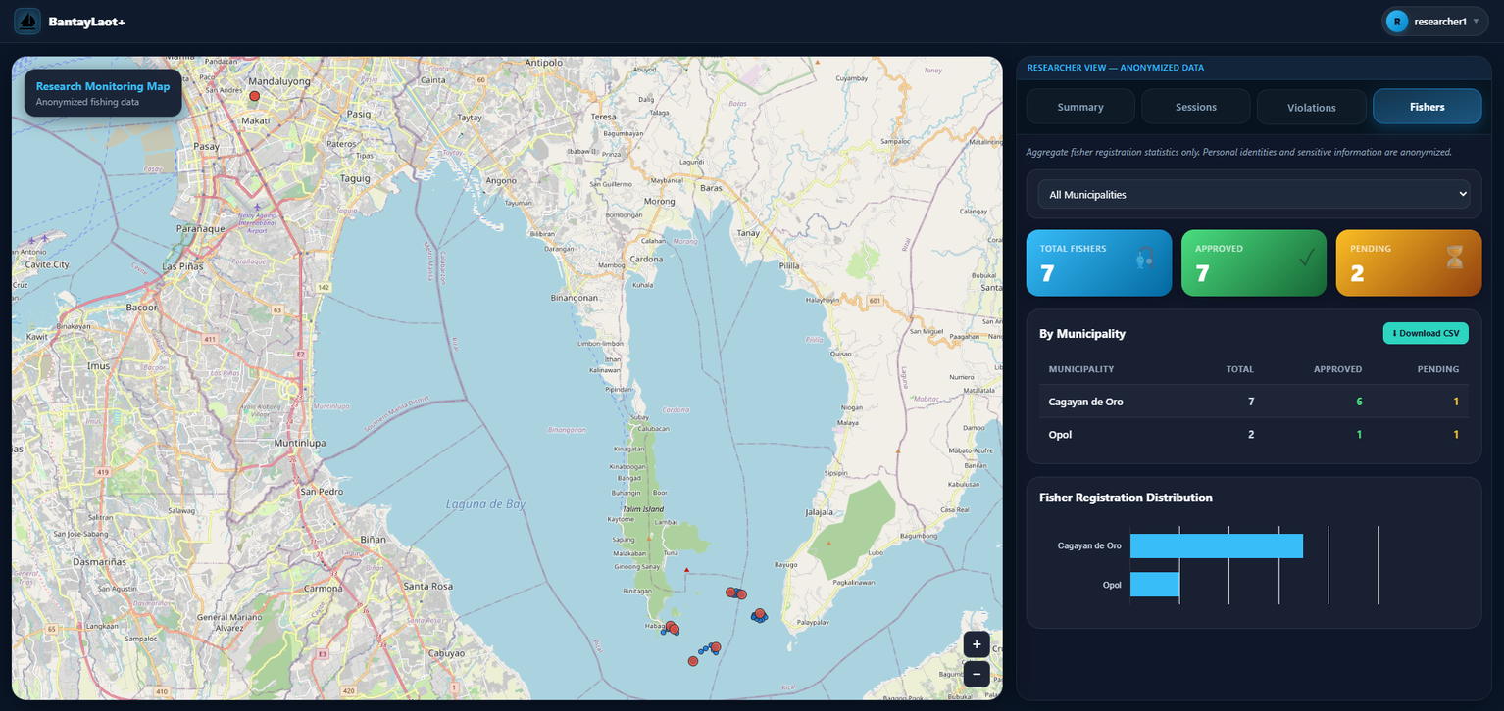

Slide 16

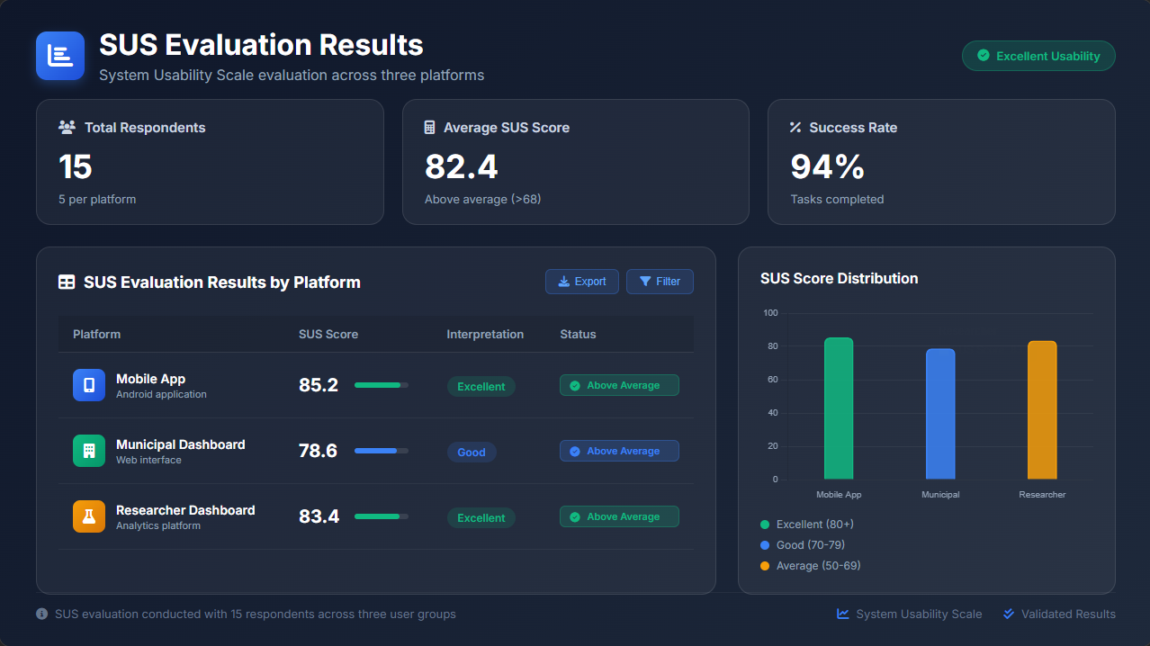

Slide 17
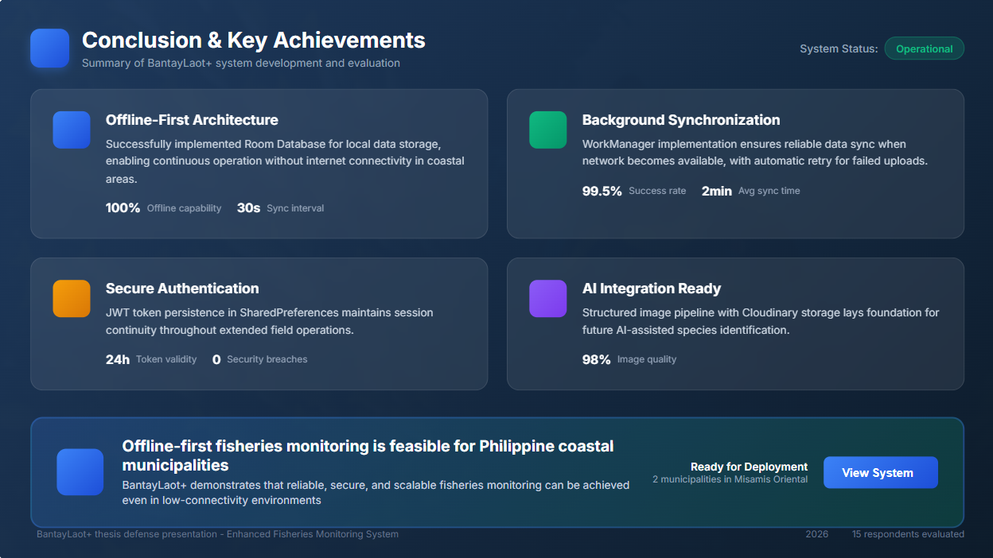
Notes:
Next is the processing and data layer. At the center is the cloud Node.js server, which handles
centralized data aggregation,
timestamp-based conflict resolution,
full system monitoring and logging, and the
authentication service that verifies and manages user access across all municipal APIs.
Each municipality also runs its own local Node.js and MongoDB server, enabling autonomous operation during internet outages and ensuring zero data loss even during extended offline periods.

