Slide 1
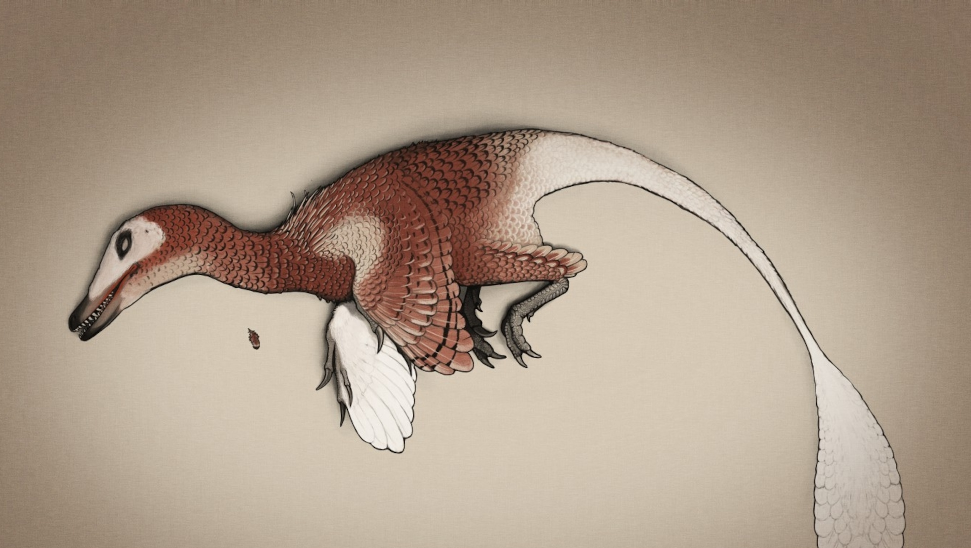
‘Paleo-estimation’:
Body mass in bipedal dinosaurs
Viviana Romero Alarcon
2023 / 12 /07

Slide 2
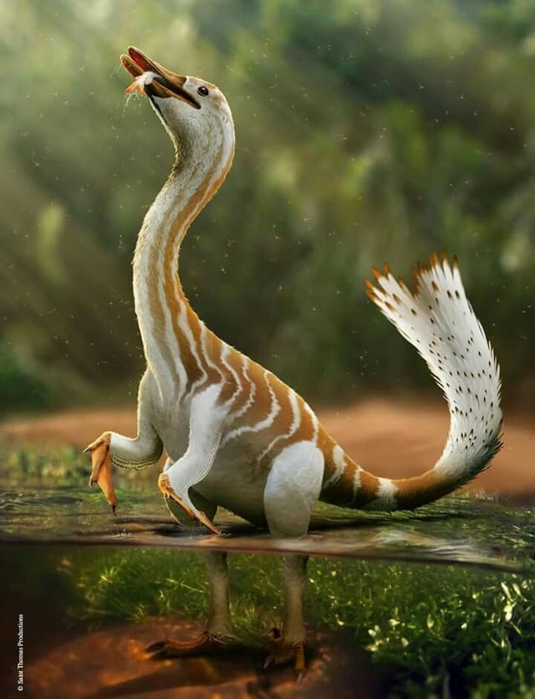
physiology
Body mass
Ecology
phylogeny

Slide 3
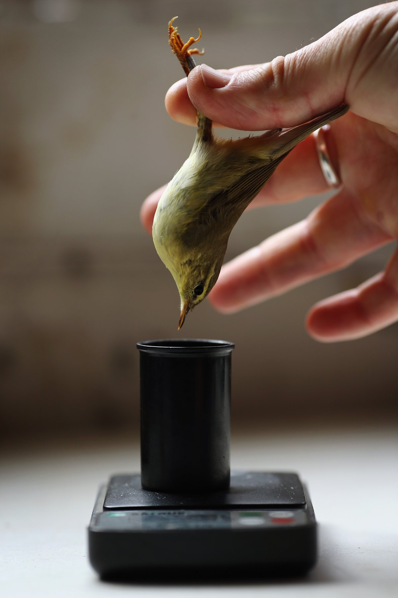
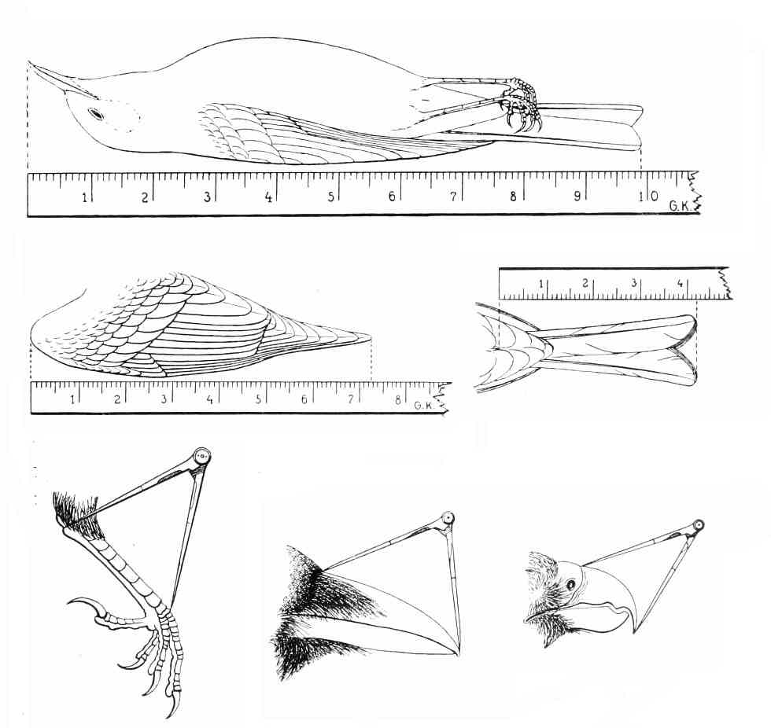
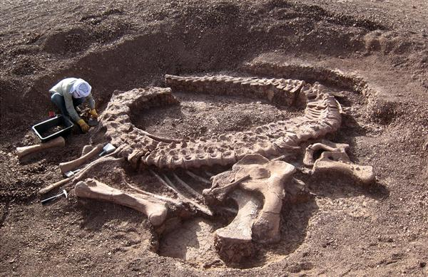
Get body mass extant species => weigh
Get body mass extinct species => Prediction

Slide 4
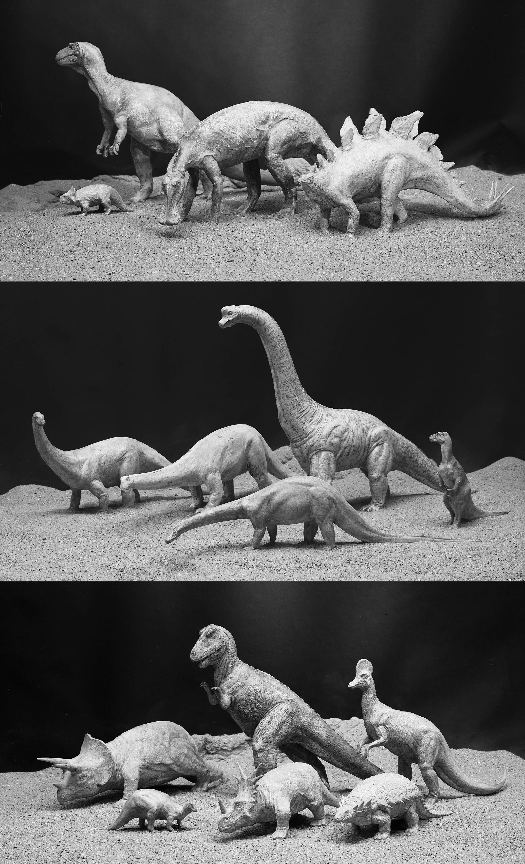
Body mass - paleoEstimation
Volumetric-density (VD)
Extant-scaling (ES)
Physical scale models
Two-dimentional mathematical model
Three-dimentional virtual model
BM ~ 0.16 C_{femur} ^{2.73}
(Anderson et al 1985)
BM ~ 2.411 log₁₀ C_{femur} – 0.065
(Cambell Jr & Marcus 1992)
BM ~ 2.4 log C_{femur} – 0.11
(Field et al 2013)
BM ~ 2.754 log C_{femur} – 0.683
(Campione et al 2014)

Slide 5
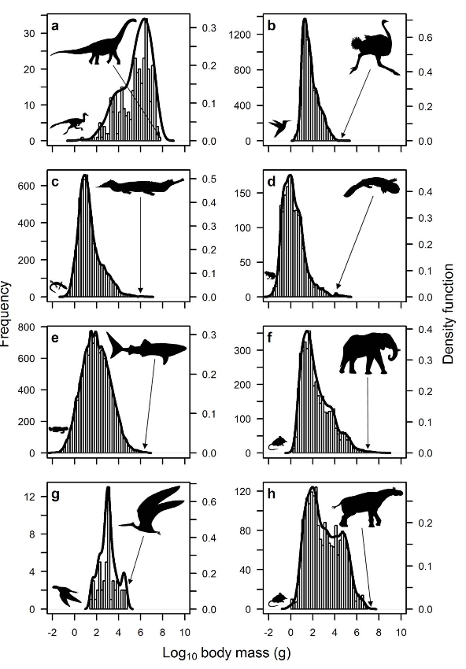
Body mass - paleoEstimation
Extant-scaling (ES)
Pros:
Generate large data sets to reconstruct large-scale patterns of evolution
Allow to study physiological and ecological on a macroevolutionary scale
Cheap and easy to use
Cons:
Overestimation in theropods
No way to measure the actual weight
BM ~ 0.16 C_{femur} ^{2.73}
(Anderson et al 1985)
BM ~ 2.411 log₁₀ C_{femur} – 0.065
(Cambell Jr & Marcus 1992)
BM ~ 2.4 log C_{femur} – 0.11
(Field et al 2013)
BM ~ 2.754 log C_{femur} – 0.683
(Campione et al 2014)
(O`Gornan & Hone 2012)

Slide 6
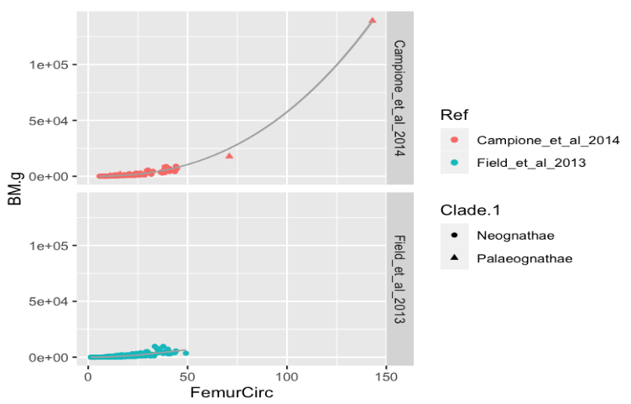
Body mass - paleoEstimation
Extant-scaling (ES)
BM ~ 0.16 C_{femur} ^{2.73}
(Anderson et al 1985)
BM ~ 2.411 log₁₀ C_{femur} – 0.065
(Cambell Jr & Marcus 1992)
BM ~ 2.4 log C_{femur} – 0.11
(Field et al 2013)
BM ~ 2.754 log C_{femur} – 0.683
(Campione et al 2014)

Slide 7
Body mass - paleoEstimation
Extant-scaling (ES)
BM ~ 0.16 C_{femur} ^{2.73}
(Anderson et al 1985)
BM ~ 2.411 log₁₀ C_{femur} – 0.065
(Cambell Jr & Marcus 1992)
BM ~ 2.4 log C_{femur} – 0.11
(Field et al 2013)
BM ~ 2.754 log C_{femur} – 0.683
(Campione et al 2014)
No samples from the biggest modern birds

Slide 8
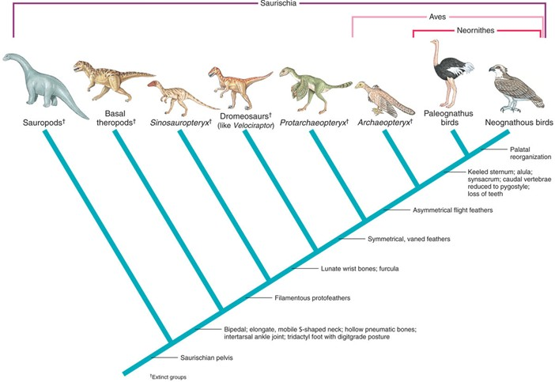
Palaeognathae group:
Heaviest modern birds (extant species)
Flightless birds ~ Theropods

Slide 9
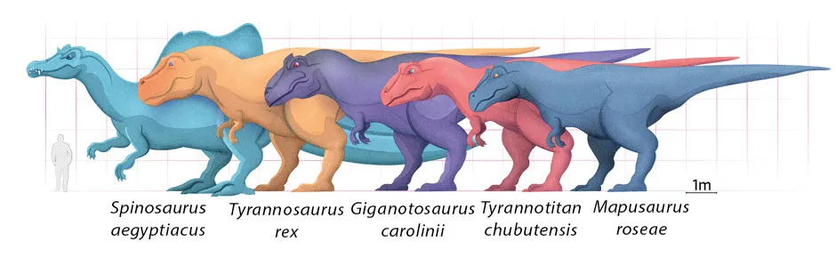
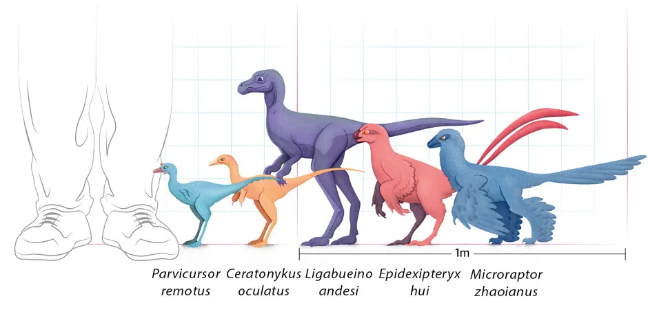
Could I improve the model,
if I would add samples from
the Palaeognathae group?
(Bright, 2021 in BBC)

Slide 10
Could I improve the model,
if I would add samples from
the Palaeognathae group?
Conclusion: No,
It is not possible
(Bright, 2021 in BBC)

