Slide 1
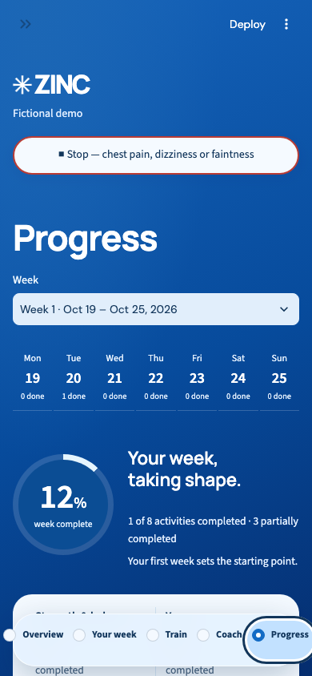
ZINC
Strength for the
years ahead
A weekly wellness coach. A healthy body is a healthy brain.
Notes:
0:00–0:30 · 30 seconds
ZINC is a weekly wellness coach for strength, balance, yoga, reasoning practice and relaxation. We are starting with adults in midlife, while adapting the experience for different ages and movement limitations. The idea is straightforward: make the next activity clear, make progress understandable, and keep people in control of every exercise adjustment. This is a fictional-data prototype, not a clinically validated service.
Source: ZINC Product Description and build plan V261023; screenshot: app/verification/browser/phone-progress.png.

Slide 2
Scientific support
Strength training
Structured support
Reasoning practice
137 reviews
2,111 adults
10-year follow-up
ACSM’s 2026 synthesis supports resistance training for muscle strength and physical performance in healthy adults. [1]
US POINTER found a greater cognitive benefit from structured multidomain support than a self-guided program. [2]
ACTIVE found lasting gains in trained reasoning and processing speed in older adults. [3]
[1] ACSM, 2026 · PMID 41843416 [2] US POINTER, JAMA, 2025 · PMID 40720610
[3] Rebok et al., J Am Geriatr Soc, 2014 · PMID 24417410
Notes:
Optional replacement for slide 2 · 40 seconds. Replacing the existing 40-second problem slide preserves the five-minute delivery schedule; this slide is appended as an optional evidence slide.
The scientific rationale has three parts. Resistance training has direct evidence for strength and physical performance: ACSM’s latest review synthesized a hundred and thirty-seven systematic reviews. US POINTER supports the value of a structured multidomain program for cognition in older adults at risk, but cannot isolate a strength-only or AI-coaching effect. ACTIVE supports lasting improvements in the specifically trained cognitive skills. These studies motivate the components, not a clinical claim for ZINC. We still need to validate our exact content, audience, dose and delivery.
Sources:
[1] ACSM Position Stand, 2026. Resistance Training Prescription for Muscle Function, Hypertrophy, and Physical Performance in Healthy Adults: An Overview of Reviews. https://pubmed.ncbi.nlm.nih.gov/41843416/ ; https://doi.org/10.1249/MSS.0000000000003897 . Healthy adults; not validation of supported exercise for MCI or frailty.
[2] Structured vs Self-Guided Multidomain Lifestyle Interventions for Global Cognitive Function: The US POINTER Randomized Clinical Trial. JAMA, 2025. https://pubmed.ncbi.nlm.nih.gov/40720610/ . Combined lifestyle intervention in older adults at risk; no attribution to strength alone, AI coaching or ZINC.
[3] Rebok et al. Ten-year effects of the ACTIVE cognitive training trial on cognition and everyday functioning in older adults. J Am Geriatr Soc, 2014. https://pubmed.ncbi.nlm.nih.gov/24417410/ . Structured trial training differs from ZINC’s number-series games. Broader transfer is not assumed.
Yoga and breathing have separate evidence bases; this concise slide is not a complete review of every component.

Slide 3
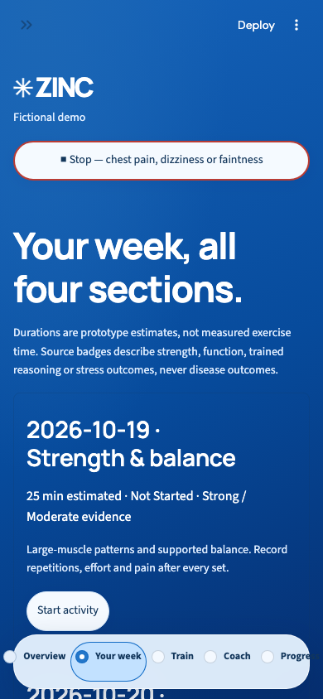
One week. Four kinds of practice
Strength & balance
Yoga
Reasoning and speed games
Relaxation
A dated plan. Activities you can pause and resume.
Notes:
1:10–1:55 · 45 seconds
Meet Maria, our fictional demonstration user. She is fifty-two, a beginner, and reports knee limitations. She enters her profile, answers the safety questions, and chooses whether to add extra focus activities. Her baseline week always contains all four sections shown here. Each activity has a date and its own saved position. Finishing one activity does not finish the others. She can return to a partly completed session, record her feedback, or end an activity early. The plan is organized around what Maria actually does, not just what was scheduled.
Source: app/README.md; engine.py dated scheduling and independent activity state. Screenshot: app/verification/browser/phone-week.png.

Slide 4
The AI coach proposes. You decide.
Rules
Gemini
You
Screen eligibility
Select supported options
Validate each adjustment
Read the plan
Read activity feedback
Explain and propose
Accept or decline
Keep this week intact
Activate next week
Symptoms can stop activity immediately, without an AI call.
Notes:
1:55–2:45 · 50 seconds
The coach has a deliberately limited role. It can read the plan and activity feedback, explain what is already scheduled, and ask the rules engine to calculate a possible strength adjustment. It cannot apply that adjustment. The user accepts or declines it. Accepted changes are staged separately for next week, so the current week is not rewritten. Pain feedback constrains progression, and symptom checks can stop activity without waiting for Gemini. These are prototype guardrails rather than a medical safety guarantee. The important design choice is that fluent AI language never becomes permission to change a plan.
Source: coach.py ToolContext and run_model; engine.py progression, accept_pending_change and stop. General wellness, not medical advice.

Slide 5
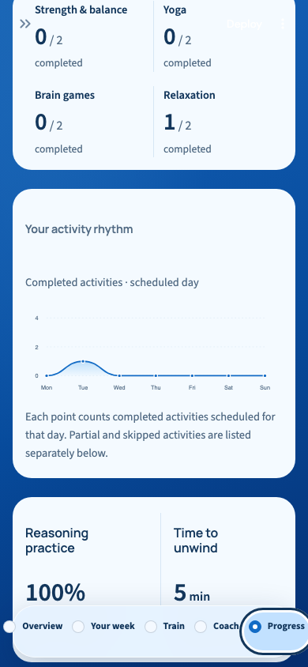
Progress you can explain
Participation,
not a health score
Completed and partial activities stay distinct.
Reasoning results show the answer count.
Relaxation minutes are self-reported.
Notes:
2:45–3:40 · 55 seconds
Here is the Progress board. The circular indicator on the opening screen represents the proportion of scheduled activities completed. It is not a fitness rating or a measure of biological health. The activity curve counts completions by scheduled day. Partial and skipped work remain visible separately, so ending early does not silently become a completed session. Reasoning accuracy includes how many answers were recorded, and breathing minutes are explicitly self-reported. Users can select an earlier week and export their history. Detailed pain and effort records retain activity and movement context. A remaining requirement is to add clearly separated pain and effort trend charts. We want every visible number to have a meaning that a person can explain.
Source: progress_board.py; app.py Progress branch. Screenshot: app/verification/browser/phone-progress-chart.png. Fictional demonstration data.

Slide 6
Next: validate the experience
Test independently on real phones
Review exercise content with people
Optional features:
Complete pain and effort trend charts: personal record
Connect with a smart device to track health stats and running activities, like a running app
Connect with an app like a food record app
Make a consistent weekly routine easier to follow.
Notes:
4:25–5:00 · 35 seconds
The next step is to validate the experience beyond our local environment. We still need public hosting, an independent physical-phone walkthrough, professional review of the exercise content, and the remaining pain and effort trend visualization. Session history currently lives only in browser-session memory and may reset on refresh or reconnection. Before moving toward a pilot, we should test whether people understand the plan, can resume activities, and recognize what an accepted change will do. ZINC aims to make a consistent weekly routine easier to follow, with understandable feedback and visible user control.
Sources: build plan V261023; app/verification/gates.md and checks.json. Presentation uses a five-minute delivery schedule; actual rehearsal timing remains to be measured.

