Slide 1

ReactJS Training
Manjunatha K

Slide 2
Agenda
Introduction to Web Development
Introduction to ReactJS
Components, Props & States
Event Handling
React Hooks
Higher Order Components
React and HTTP
Routing
Handling Forms in React

Slide 3
Requirements
1
HTML
2
JavaScript
3
CSS

Slide 4
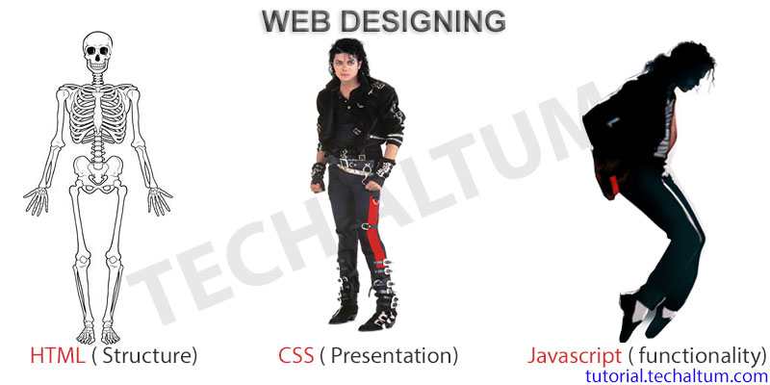
HTML vs CSS vs JS

Slide 5

Web Development – Client – Server Architecture

Slide 6
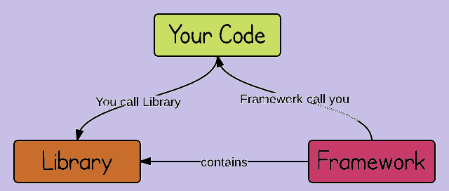
Web Development – Library vs. Framework

Slide 7
Development Setup
Install Node JS and NPM – https://nodejs.org/en/download/
Install VS Code – https://code.visualstudio.com/download

Slide 8
What is React?
A JavaScript library for building user interfaces
Not a framework
Open-source
Focuses only on UI, not routing and HTTP
React.JS Ecosystem for routing and HTTP
Created and maintained by Facebook – https://github.com/facebook/react
Latest stable release – 17.0.2

Slide 9
Why React?
Component-based architecture
Reusable code
React is declarative
Virtual DOM
Flexible integration with any application
React Native for Mobile Apps

Slide 10
Prerequisites
HTML, CSS and JavaScript
ES6 / Modern JS
filter, map, reduce
let & const
template literals, arrow functions

Slide 11
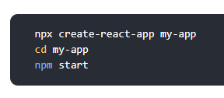
Hello World Application
Create React App CLI
Folder structure

Slide 12
Components
Represent a part of UI
Reusable
Can be nested inside another component
Created in JS / JSX
Types:
Functional components
Class components

Slide 13
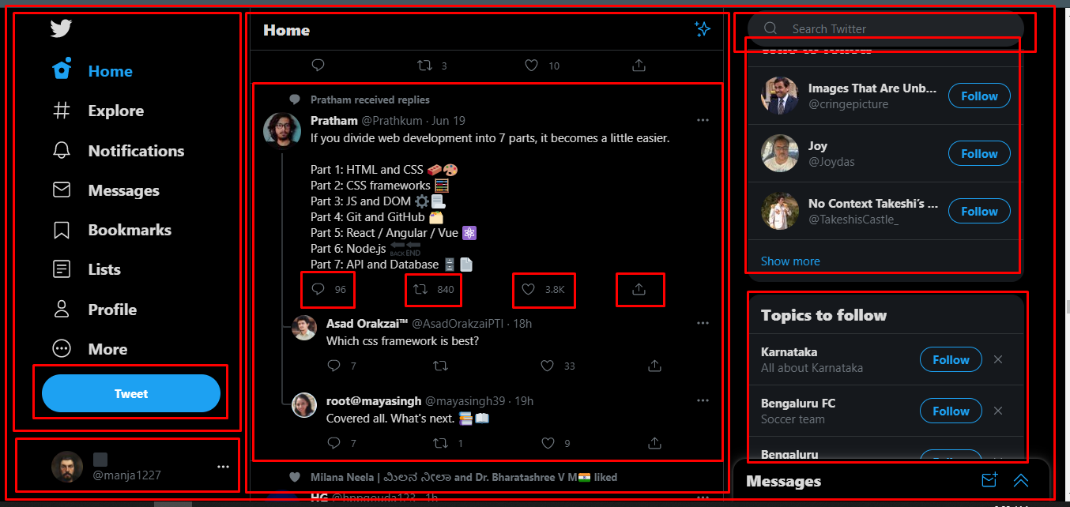
Components

Slide 14
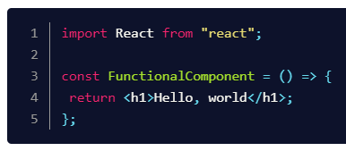
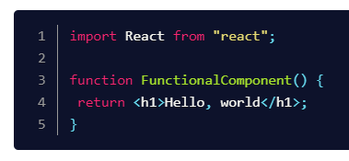
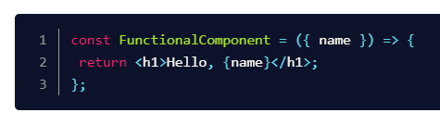
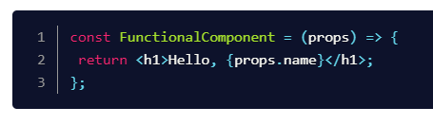
Functional Components
Just JavaScript functions
Properties → JS Function → HTML (JSX)

Slide 15
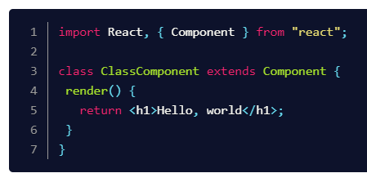
Class Components
Just ES6 Classes
Properties → ES6 Class (State) → HTML (JSX)
Life Cycle Methods

Slide 16
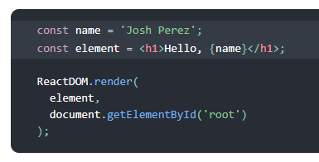
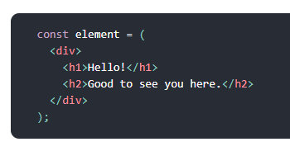

JSX
JavaScript XML
Can write expression inside JSX
Can contain children

Slide 17
ReactJS
EOD

Slide 18
ReactJS – Recap
What is React?
Why is React?
Components and props
Component Types
Functional component
Class component
JSX

Slide 19
ReactJS
SEARCH
CardList
CARD
img
Title
email
CARD
img
Title
email
CARD
img
Title
email

Slide 20
props vs state
arguments passed into components
function parameters
props are immutable
accessing via
props – functional component
this.props – class component
managed within the components
variables declared in function body
state can be changed
accessed via
useState hook – func. component
this.state – class component

Slide 21
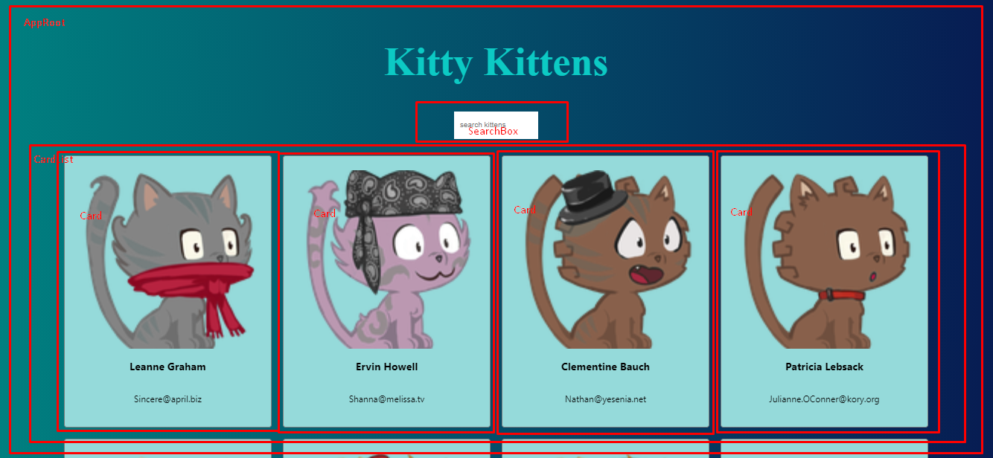
What do we learn?

Slide 22
What did we learn?
Class components
List Rendering
Event Handling
Styling components
Fetching API
Array methods
map
filter

Slide 23
Class components
EOD

Slide 24
Hooks
Hooks are new feature introduced in React v16.8 (2018)
Hooks allow us to use React features without having to write a Class
ex: State of a component
Hooks don’t work in Classes

Slide 25
Why Hooks?
Difficulty in working with this keyword
Event handlers need to bound in Class components
Classes don’t minify well
Classes make the codebase huge – unreadable
Better way to handle stateful logic
Alternative approach to state management and lifecycle methods

Slide 26
Hooks?
React v16.8 or higher
Completely opt-in
No breaking changes
100% backwards-compatible
Classes won’t be removed from React

Slide 27
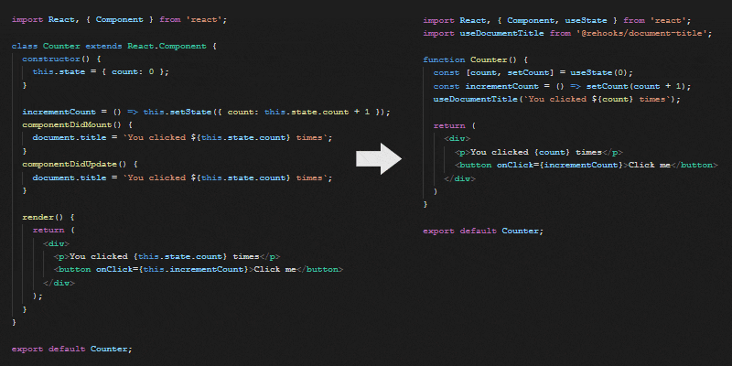
Why Hooks?

Slide 28
useState Hook
Adds STATE to functional components
In classes, the state (this.state) is always on object
With useState, the state can be array, object, boolean, number, string etc.
Returns an array with 2 elements
Current value of the state
State setter function
Use spread operator while dealing with objects and arrays

Slide 29
useState Hooks
EOD

Slide 30
useEffect Hook
The Effect Hook lets you perform side effects in function components.
A "side effect" is anything that affects something outside the scope of the function being executed.
Ex: modifying a global variable in a local function
Data fetching
manually changing the DOM in React components.
Equals to componentDidMount(), componentDidUpdate(), componentWillUnmount() in Class component’s life cycle methods.

Slide 31
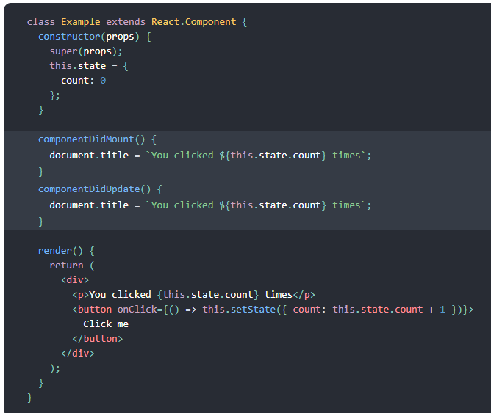
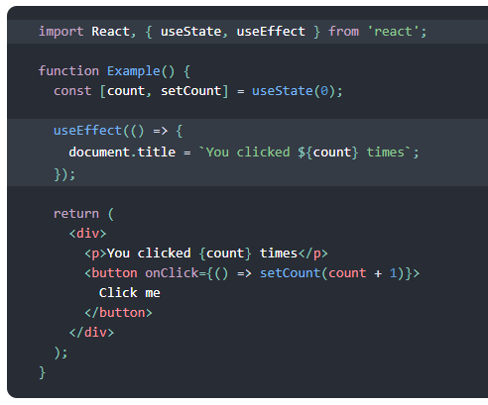
Effects Example

Slide 32
Effects Hook
Conditionally run Effects
Run Effects only once
Effects with Cleanup
Fetch data using Effects
React performs the cleanup when the component unmounts.

Slide 33
ReactJS
EoD

Slide 34
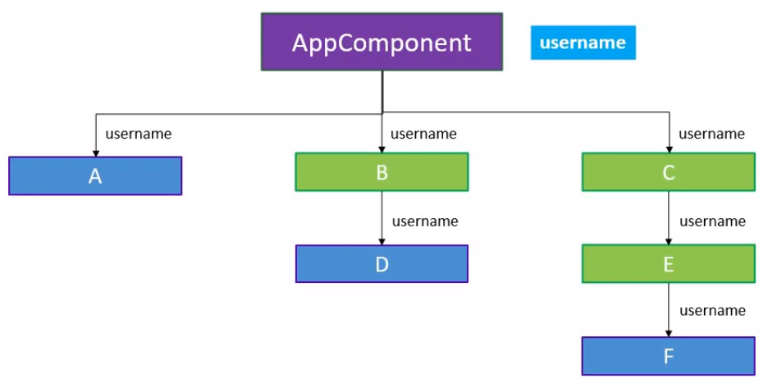
Context Hook

Slide 35
Context Hook
Context provides a way to pass data through the component tree without having to pass props down manually at every level.
useContext hook accepts a context object and returns the current context value for that context.
context object = (the value returned from React.createContext)
Steps
Create a context
Provide context a value
Consume context value

Slide 36
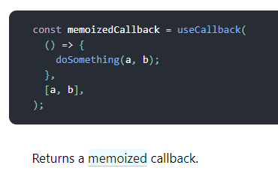
useCallback Hook
In computing, memoization is an optimization technique used primarily to speed up computer programs by storing the results of expensive function calls and returning the cached result when the same inputs occur again.
useCallback focuses on a different thing: it fixes performance issues.

Slide 37
ReactJS
EoD

Slide 38
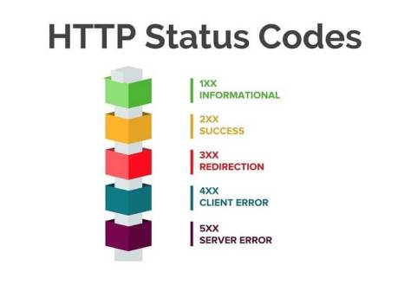
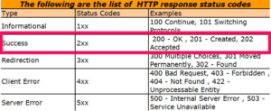
HTTP Status Codes
https://developer.mozilla.org/en-US/docs/Web/HTTP/Status

Slide 39
axios
Promise based HTTP client for the browser and node.js
https://www.npmjs.com/package/axios

Slide 40
axios vs fetch
Automatic JSON data transformation
Response timeout
Backward compatibility
HTTP interceptors
Simultaneous requests

Slide 41
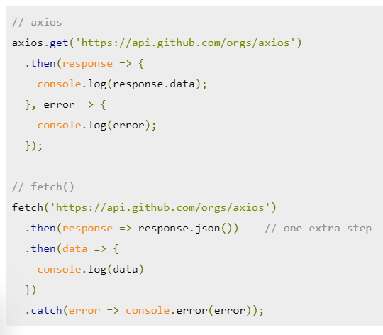
axios vs fetch
Automatic JSON data transformation

Slide 42
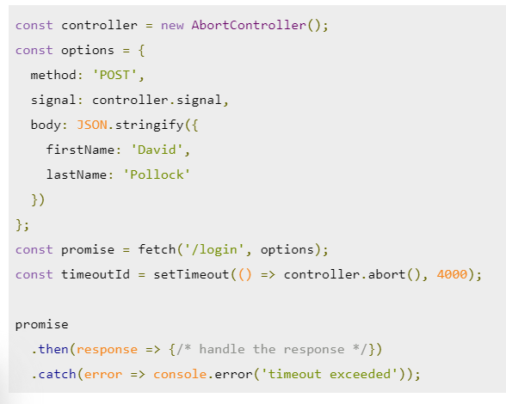
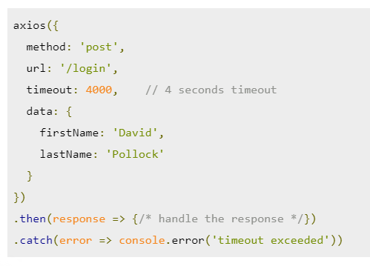
axios vs fetch
Response timeout

Slide 43
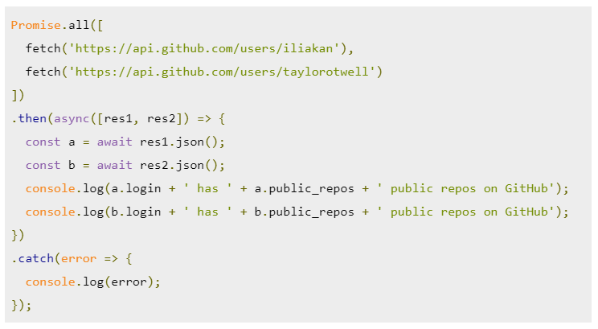
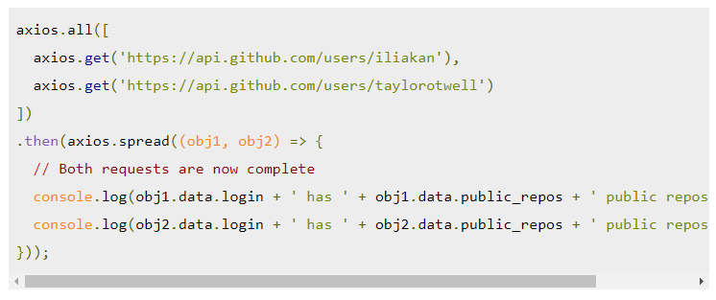
axios vs fetch
Simultaneous requests

Slide 44
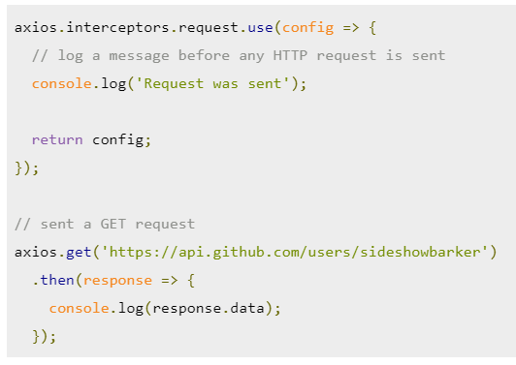
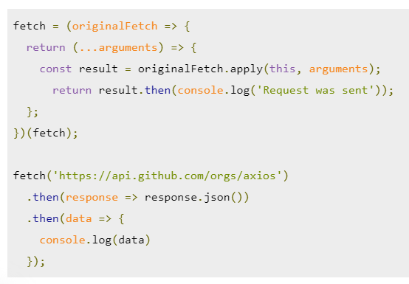
axios vs fetch
HTTP interceptors

Slide 45
ReactJS
EoD

Slide 46
React Router
Routing with href
Routing with react-router-dom library
Creating Routes
BrowserRouter, Switch, Route, Link components
Accessing URL parameters – useParams(), useLocation()
Protected Routes
Nested Routing

Slide 47
React Router Hooks
useLocation()
returns the location object that represents the current URL.
You can think about it like a useState that returns a new location whenever the URL changes.
useParams()
returns an object of key/value pairs of URL parameters.
Use it to access match.params of the current <Route>.
useRouteMatch()
attempts to match the current URL in the same way that a <Route> would.
useHistory()
gives you access to the history instance that you may use to navigate.

Slide 48
React Routing
EoD

Slide 49
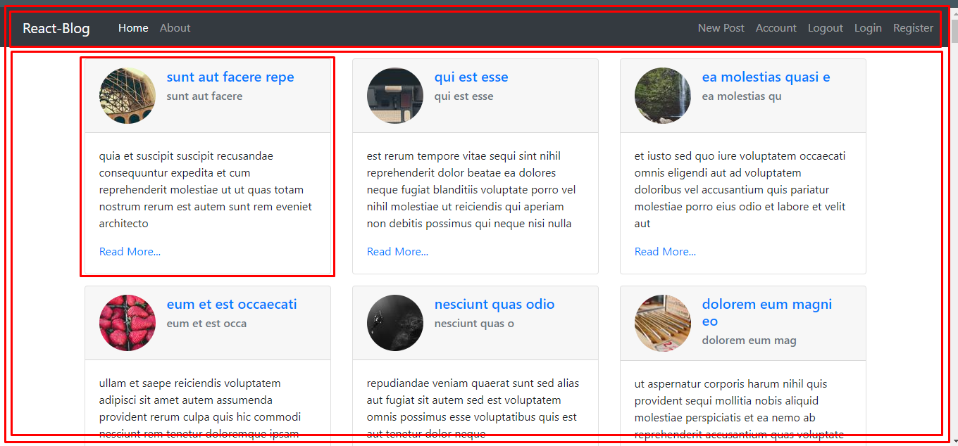
React Blog

Slide 50
React Blog
Demo – https://manja1227.github.io/react-blog/#/
EoD

