Slide 1
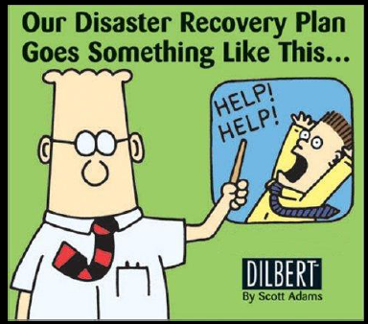
3. Business Continuity and
Disaster Recovery Planning
Notes:
talitusjärjepidevuse kava ja avariitaastekava

Slide 2
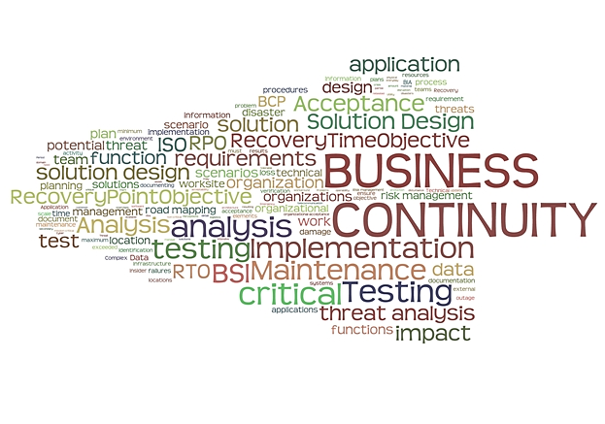
Business Continuity

Slide 3

Fortress Mentality
STATIC
SLOW
INEFFICIENT

Slide 4
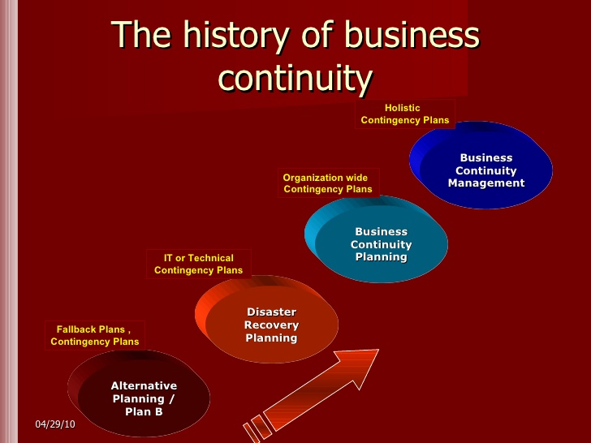
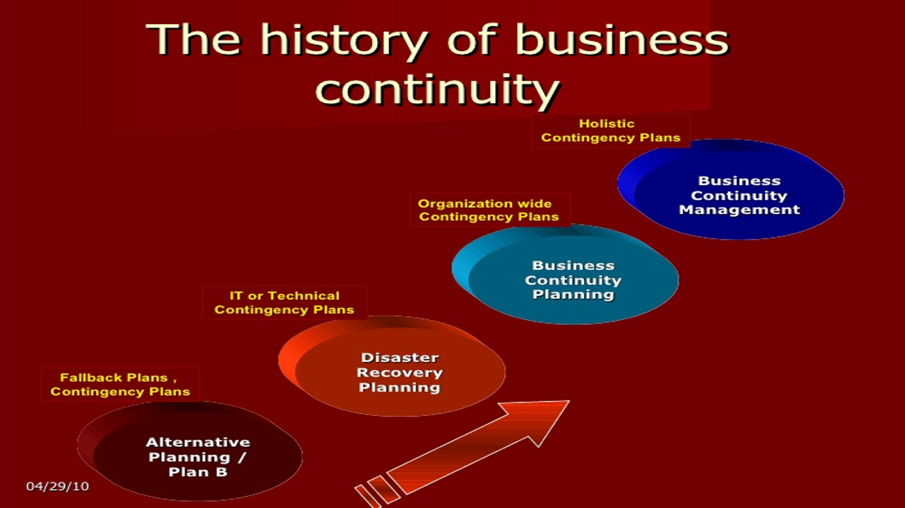
History of BC

Slide 5





Risk Chain
Pre-event
Post-event
BC
Event
Hazard
Prevention
Detection
Surveillance
Exposure
Risk Control
Protection
Insurance
Resiliency
Reactivity
Robustness
Adaptability
Contingency
Restore
Repair
Adapt
Minimise probability of event
Minimise damage if event happens
Cope with the damage caused by the event

Slide 6
Objective of Business Continuity Management
Fully tested effective BCM
Level of business
No BCM – ‘lucky’ escape
No BCM – likely outcome
Critical recovery point
Time

Slide 7
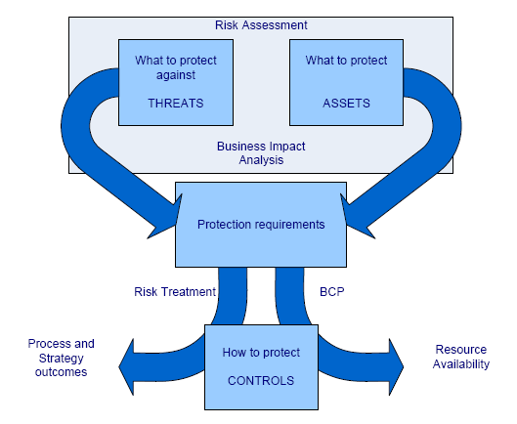
Key Functional Elements of BCM

Slide 8
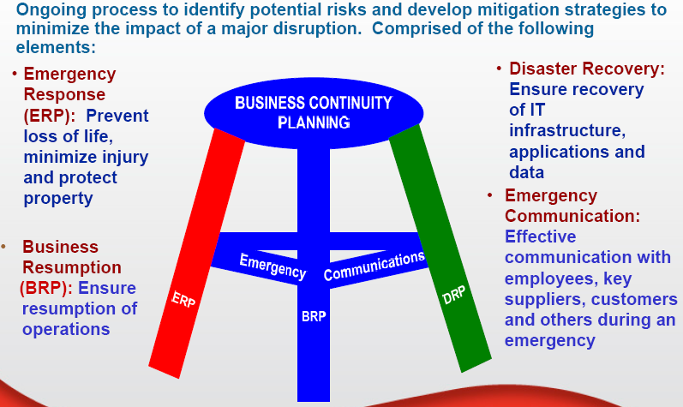
What is Business Continuity Planning?

Slide 9
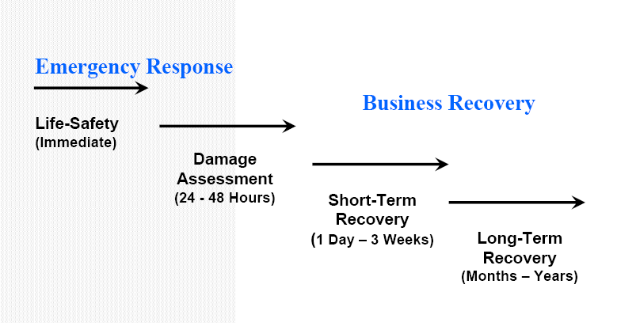
Response and Recovery Phases

Slide 10
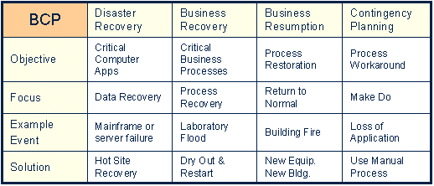
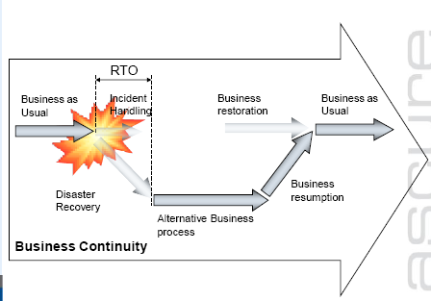
4 Rs of Contingency Planning
Contingency – ettenägematu asjaolu
Contingency planning - situatsioonplaneerimine
RECOVERY TIME OBJECTIVE (RTO)
  The period of time within which systems, applications or functions must be recovered after an outage
RECOVERY POINT OBJECTIVE (RPO)
  The point in time to which systems and data must be recovered after an outage
Resume - uuesti algatama, jätkama
Recover – ellu ärkama, paranema, taastama
Resumption – taastamine
Restore – ennistama, taastama, jalule seadma
Notes:
Restoration – ennistamine
Restoration – ennistamine
Resumption – taastamine

Slide 11
BCP Documents
Focus: | IT | Business
Event Recovery | Disaster Recovery Plan Procedures to recover at alternate site | Business Recovery Plan Recover business after a disaster
 | IT Contingency Plan: Recovers major application or system | Occupant Emergency Plan: Protect life and assets during physical threat
 | Cyber Incident Response Plan: Malicious cyber incident | Crisis Communication Plan: Provide status reports to public and personnel
Business Continuity |  | Business Continuity Plan
 |  | Continuity of Operations Plan Longer duration outages
Notes:
Here Event Recovery is how to react or recover from the incident.
Business Continuity is how Alternate Processing mode should operate.
11

Slide 12
International Business Continuity Standards and Regulatory Requirements (partial list)
BASEL III
COBIT 5
ITIL 2011
ISO 22301:2019 - Societal Security – Business Continuity Management Systems – Requirements
ISO 22313:2020- Societal Security – Business Continuity Management Systems – Guidance ISO 22317 - Societal Security – Business Continuity Management Systems – Business Impact Analysis (BIA)
ISO 22316 – Societal Security – Organizational Resilience – Principles and Guidelines
BS 25999-1/2: Business Continuity Management (2006/2007)
BS 25777: Information and Communications Technology Continuity Management (2008)
ISO 22300:2018- Societal Security – Terminology
ISO 22398:2013 - Societal Security – Guidelines for Exercises
ISO 22320:2011 - Societal Security – Emergency Management – Requirements for Incident Response
ISO 22311:2012 - Societal Security – Video Surveillance - Export Interoperability
ISO 27031:Guidelines for Information and Communication Technology Readiness for Business Continuity (2011)
ISO/IEC 27032:2012: Information technology -- Security techniques -- Guidelines for cybersecurity
ISO/IEC 27035: Information Security Incident Management (2011)
ISO 22399: Societal Security - Guidelines for Incident Preparedness and Operational Continuity Management (2007)
ISO 24762: Guidelines for Information and Communications Technology Disaster Recovery Services (2008)
ISO 27001:2017 - Information Technology - Security Techniques - Information Security Management Systems – Requirements

Slide 13
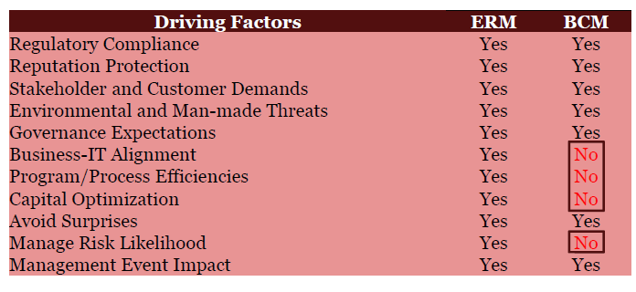
What are Driving Factors of ERM and BCM

Slide 14
Methods and Techniques
The Levels of Response Might be Implemented
Strategic – an incident management plan, with a response team made up of the Top Management;
Tactical – a number of plans, each one covering a major division, product, service or location, each with its own response team consisting of either the functional leaders or division, product or service heads responsible for the areas covered by the BCP;
Operational – usually covered by the individual tactical plans, except for the main support functions of IT, Finance, Sites & Facilities and Human Resources (HR), each of which has its own specialist recovery or response team.

Slide 15
ISO Business Continuity Standards
22301
22313
22317
Requirements
Guidance
Technical Specification

Slide 16
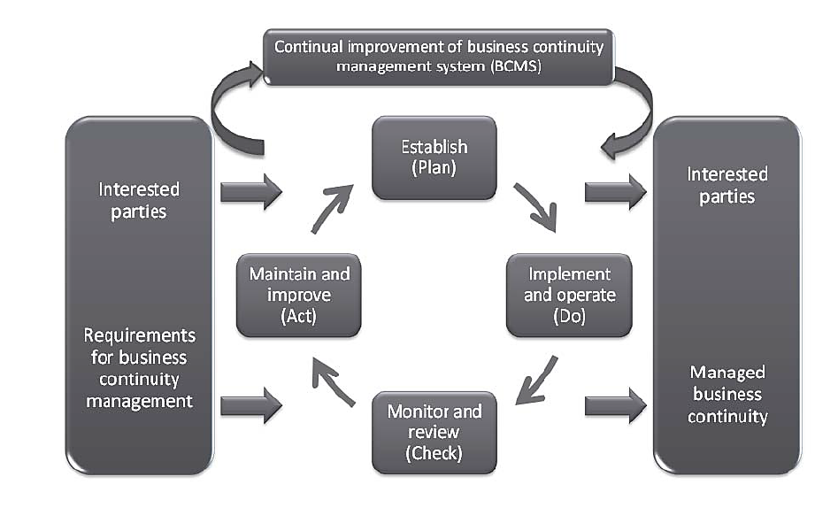
ISO 22301: The Plan-Do-Check-Act Cycle

Slide 17
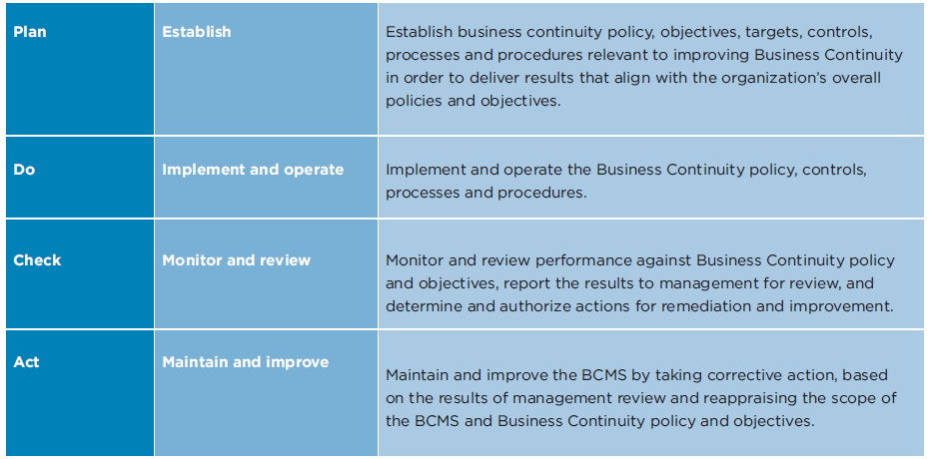
The Plan-Do-Check-Act Cycle (ISO 22301)

Slide 18
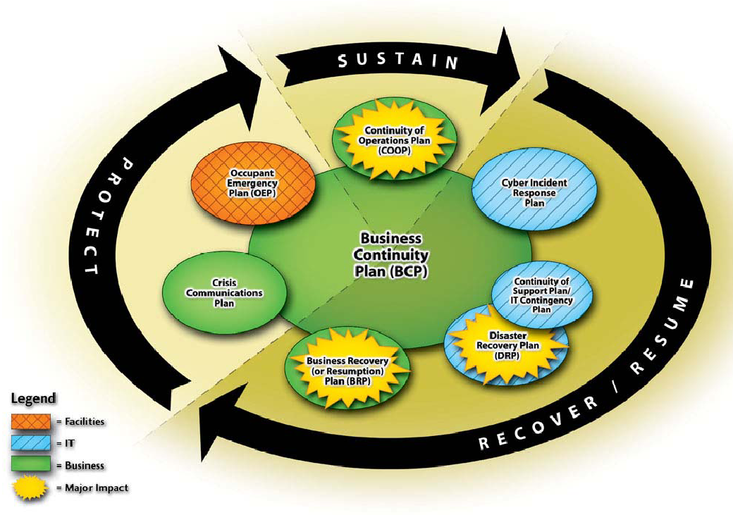
NIST SP800-34
Interrelationship of Emergency Action Plans

Slide 19
BCP Phases
Project Management & Initiation
Business Impact Analysis (BIA)
Recovery Strategies
Plan Design & Development
Testing, Maintenance, Awareness & Training

Slide 20
BCP - Phases
Step 1
Step 2
Step 3
Business
Impact
Analysis
Recovery
Strategies
Management
Initiates
Step 5
Step 4
Test, Train
& Maintain
Design &
Develop Plan

Slide 21
Phase 2: BIA Steps
Determine Information Gathering Techniques
Select Interviewees
Customize Questionnaire
Analyze Information
Determine Time-Critical Business Functions
Determine Maximum Tolerable Downtimes (MTD)
Prioritize Critical Business Functions Based on MTDs
Document and Prepare Report for Recovery Recommendations

Slide 22

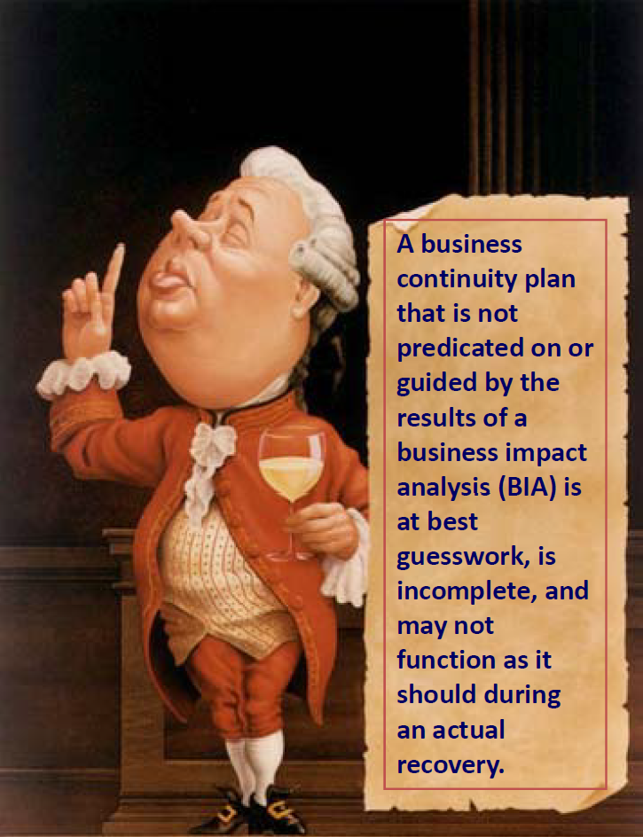

Slide 23
Business Impact Analysis
BIA Goals:
  Prioritize critical functions
  Determine requirements for critical functions
  Estimate Maximum Tolerable Downtime (MTD)

Slide 24
Categorize Events
Disruptions need to be categorized in severity:
Disruption in Service / Non-Disaster
Disaster
Catastrophe
Equipment needs to be measured by:
Mean Time To Repair (MTTR)
Mean Time Between Failure (MTBF)

Slide 25
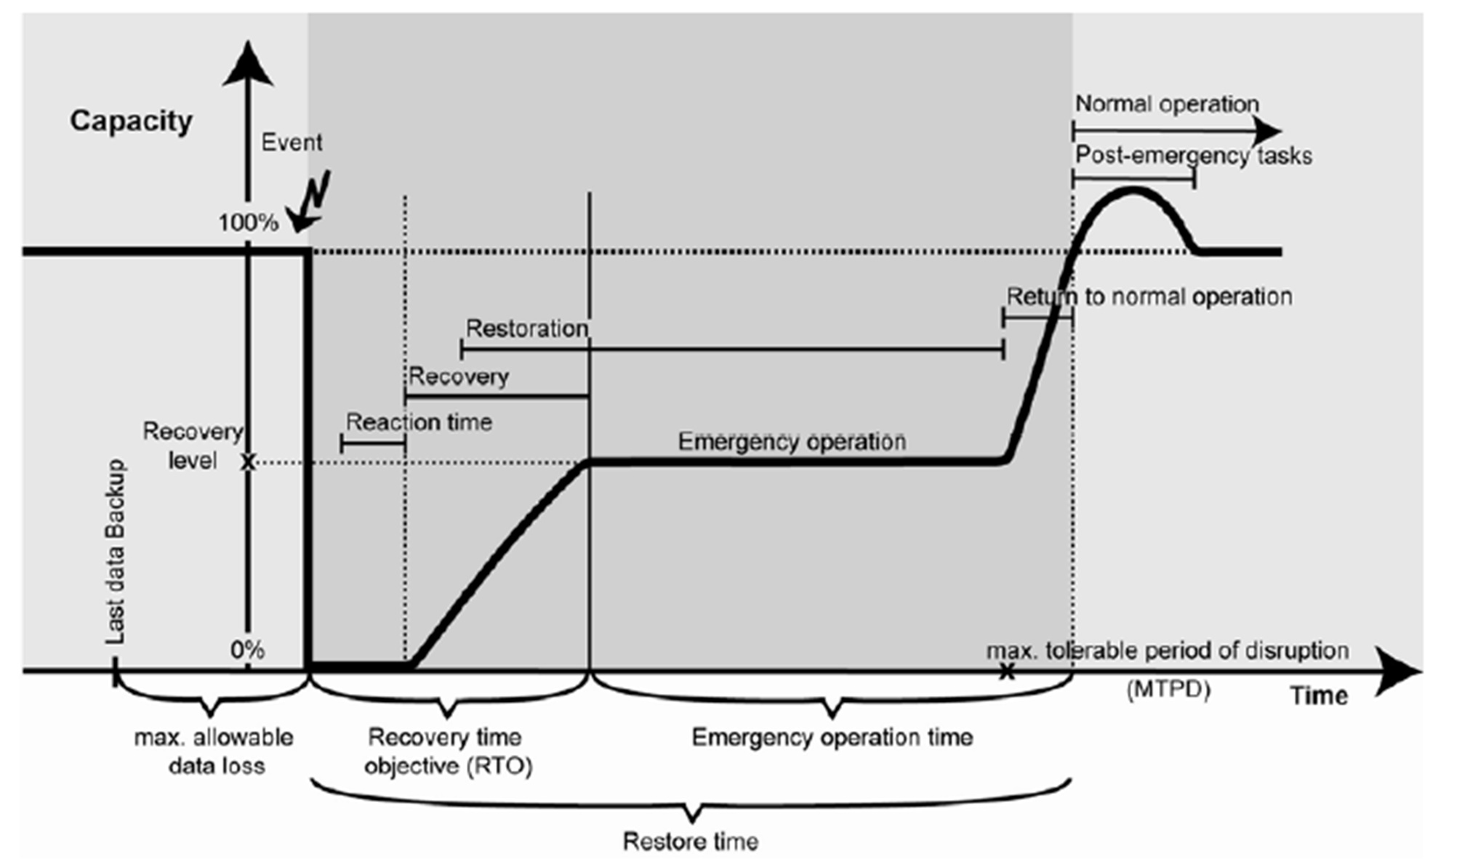
BC Metrics

Slide 26
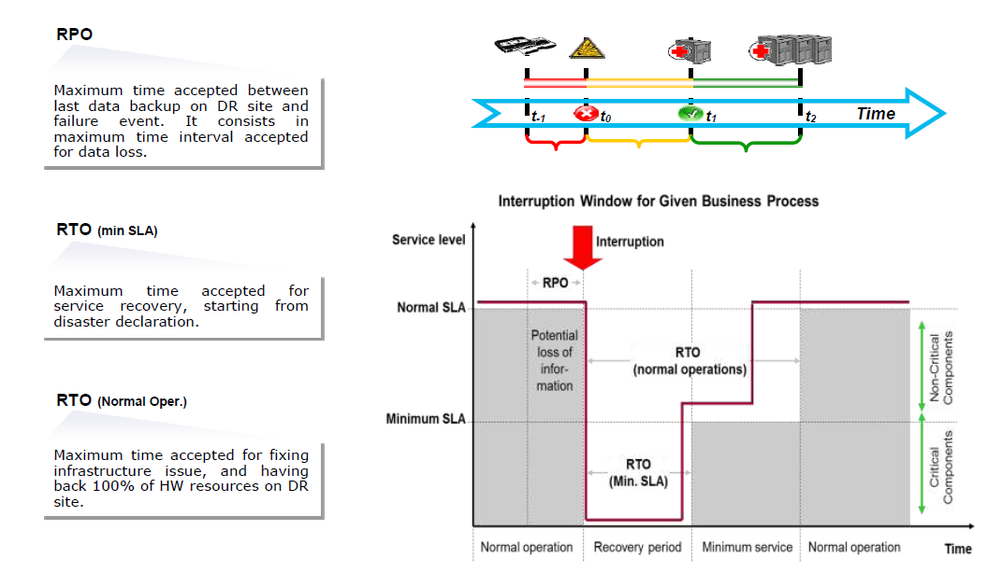
RTO and RPO

Slide 27
Maximum Tolerable Downtime
MTD Examples:
Non-essential – 30 days
Normal – 7 days
Important – 72 hours
Urgent – 24 hours
Critical – Minutes to hours

Slide 28
MTBF & MTTR
Mean Time Between Failure (MTBF)
Mean Time to Repair (MTTR)
Measure of availability:
5 9s = 99.999% of time working = 5 ½ minutes of failure per year.
works repair works repair works
1 day
84 days
Notes:
Mean time means statistical average.

Slide 29
Availability Measurement – Levels of ‘9s’ Availability
% Uptime | % Downtime | Downtime per Year | Downtime per Week
98% | 2% | 7.3 days | 3hrs 22 min
99% | 1% | 3.65 days | 1 hr 41 min
99.8% | 0.2% | 17 hrs 31 min | 20 min 10 sec
99.9% | 0.1% | 8 hrs 45 min | 10 min 5 sec
99.99% | 0.01% | 52.5 min | 1 min
99.999% | 0.001% | 5.25 min | 6 sec
99.9999% | 0.0001% | 31.5 sec | 0.6 sec

Slide 30
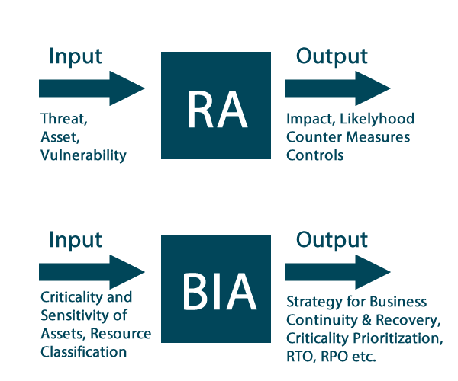
ISO 22317 – Business continuity management systems – Business impact analysis

Slide 31
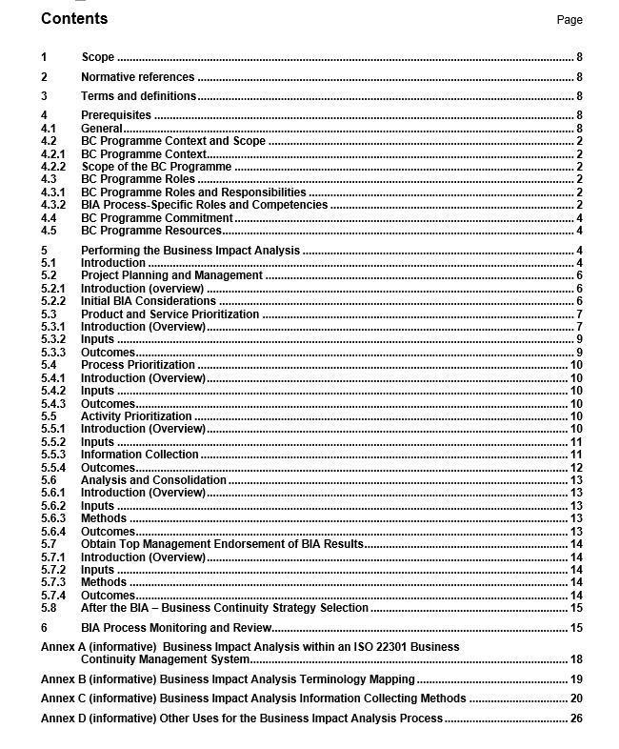
ISO 22317 Table of Contents
Scope
Normative references
Terms and definitions
Prerequisites
Performing the BIA
  Product and service prioritization
  Process prioritization
  Activity prioritization
  Analysis and consolidation
  Obtain top management endorsement of results
  After the BIA
BIA Process Monitoring and Review
Annex A – BIA Within 22301
Annex B – Terminology Mapping
Annex C – Information Collecting Methods
Annex D – Other uses

Slide 32
ISO 22317 Preview: BIA Definition
The BIA process analyzes the consequences of a disruptive incident on the organization. The outcome is a statement of justification of business continuity requirements.
Note: business continuity requirements has the same meaning as continuity and recovery priorities, objectives, and targets

Slide 33
ISO 22317: Impact Category Examples
Impact Categories | Examples of Impacts
Financial | Financial losses due to fines, penalties, lost profits, or diminished market share
Reputational | Negative opinion or brand damage
Legal and Regulatory | Litigation liability and withdrawal of license to trade
Contractual | Breach of contracts or obligations between organizations
Business Objectives | Failure to deliver on objectives or take advantage of opportunities

Slide 34
Product and Service Prioritization
“Management should agree on the priority of products and services following a disruptive incident which may threaten the achievement of their objectives.”
Outcomes:
  Endorsement or modification of the organization’s BC program scope
  Identification of legal, regulatory, and contractual requirements (obligations)
  Evaluation of impacts over time as it relates to a failure to deliver products/services, which serves as the justification for business continuity requirements
  Confirmation of product and service delivery requirements (that may include time, quality, quantity, service levels, and capability specifications) following a disruptive incident that then sets the priorities for activities and resources
  Identification of processes (that deliver the products and services)
  Nomination of lead personnel to assist in identifying which processes deliver products and services
  Documentation of a list of prioritized products and services (grouped by timeframe or customer)

Slide 35
Process Prioritization
“A process is a set of interrelated or interacting activities which transform inputs into outputs (ISO 22300); the priority is determined by the priority of the products and services which are its output.“
Outcomes:
  Identification of the relationship between product and services, processes, and activities
  Identification of dependencies on other business processes
  Evaluation of impacts over time of a process failure
  Priorities of processes
  Interdependency analysis of the processes that deliver products and services to customers
  Interdependency analysis of the activities that deliver processes
  Documented list of prioritized processes that deliver products and services
  Initial documented list of activities that deliver processes
Notes:
Omit?

Slide 36
Activity Prioritization
“Organizations should perform activity level prioritization to obtain a detailed understanding of day-to-day resource requirements, enabling the organization to identify the quantity and timing of resources necessary for recovery and to help confirm impact-related conclusions developed at the process level.“
Resource-related information includes:
  People/skills/roles
  Facilities and equipment (including special tools, spare parts, and consumables)
  Records
  Financing
  Information and communications technologies (including applications, data, telephony, and networks)
  Supplies, supply chains, and partners

Slide 37
After the BIA
“Approved business continuity requirements enable the organization to determine and select appropriate business continuity strategies to enable an effective response and recovery from a disruptive incident.“
Examples include:
  Alternate workplace arrangements
  Alternate supply chain arrangements
  IT recovery options
  Alternate sources of people
  Alternate sources of equipment
  Workarounds and alternate procedures
Reconsideration…

Slide 38
Phase 3
Recovery Strategies
Business recovery
  MTD
Facility and supply recovery
  Required space & equipment
User recovery
  HR
Technical recovery
  Hot / Warm / Cold site
Data recovery
  Backups

Slide 39
Phase 4: Plan Development
Determine management concerns and priorities
Determine planning scope
Establish assumptions
Define prevention strategies
Identify resumption strategies for critical systems
Identify resumption strategies for non-critical systems
Develop service function recovery plans
Develop business function recovery plans
Develop facility recovery plans
Identify response procedures
Gather data for plan completion
Review and outline for interfacing with external groups
Review how organization will cope with further complications

Slide 40
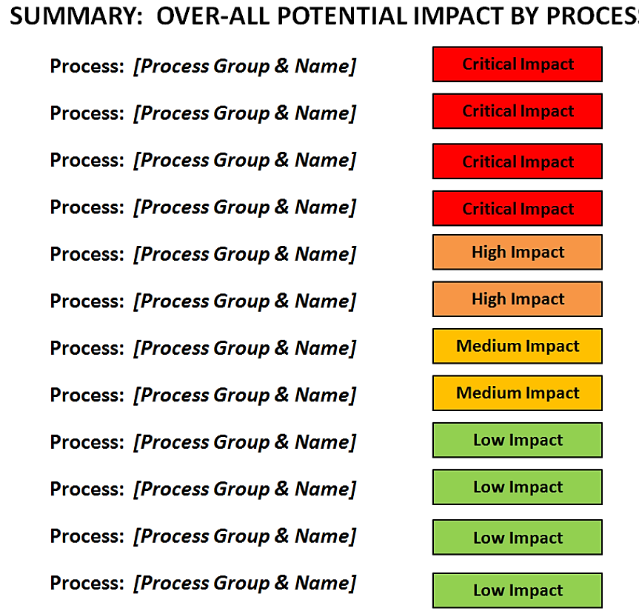
Over-all Impact by Process

Slide 41
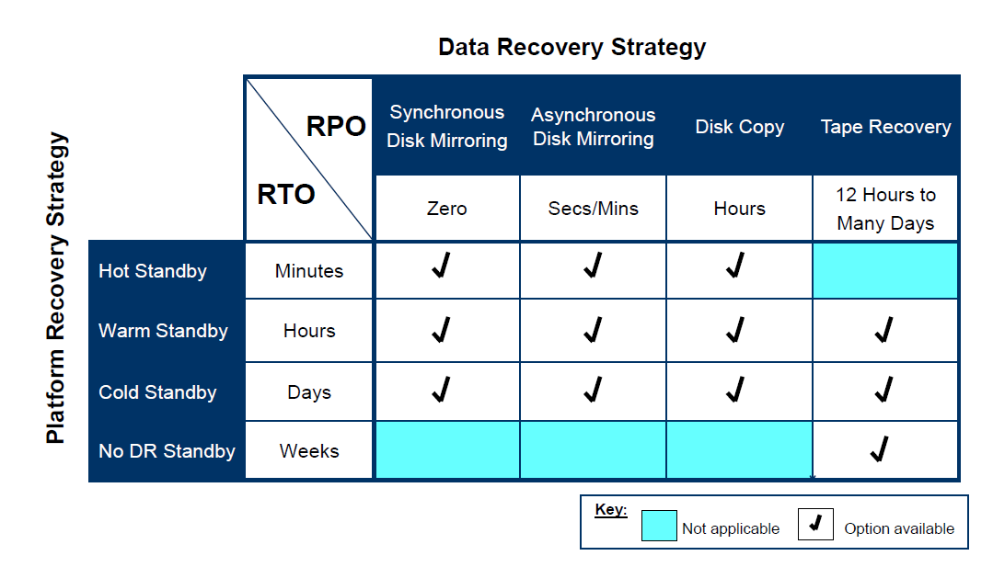
Combing Platform and Data Strategies based on BIA results

Slide 42
Phase 5: Testing & Maintenance
Plan Testing
  Must test to verify viability
  Annual testing
Plan Maintenance
  Keep up with business model
  Change with upgrades (hardware / software)
BCP Awareness
  Business planning must include BCP
BCP Training
  Train personnel on departmental
  Ensure personnel know when to implement it

Slide 43
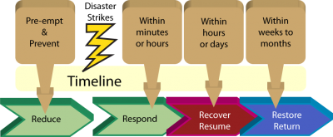
Business Continuity
Management Life Cycle

Slide 44
Typical BCP Process
1
BCP
Project
Initiation
Organization
Resources

Slide 45
Typical BCP Process
1
2
BCP
Project
Initiation
Develop BCP Policy & Scope
Organization
Resources

Slide 46
Typical BCP Process
1
2
BCP
Project
Initiation
Develop BCP Policy & Scope
Identify Risks and their Mitigation
3
Organization
Resources

Slide 47
Typical BCP Process
1
2
4
BCP
Project
Initiation
Develop BCP Policy & Scope
Conduct Business
Impact Analysis (BIA)
Identify Risks and their Mitigation
3
Organization
Resources

Slide 48
Typical BCP Process
1
2
4
BCP
Project
Initiation
Develop BCP Policy & Scope
Conduct Business
Impact Analysis (BIA)
Identify Risks and their Mitigation
Develop Recovery Strategies
5
3
Organization
Resources

Slide 49

Typical BCP Process
1
2
4
BCP
Project
Initiation
Develop BCP Policy & Scope
Conduct Business
Impact Analysis (BIA)
Identify Risks and their Mitigation
Develop Recovery Strategies
5
3
Organization
Resources
Develop & Test Plan
6

Slide 50
Typical BCP Process
1
2
4
BCP
Project
Initiation
Develop BCP Policy & Scope
Conduct Business
Impact Analysis (BIA)
Identify Risks and their Mitigation
Develop Recovery Strategies
5
3
Organization
Resources
Develop & Test Plan
6
Management
Awareness &
Training
BCP
Review, Testing & Verification
BCP
Maintenance & Change Management
7A
7
7B

Slide 51
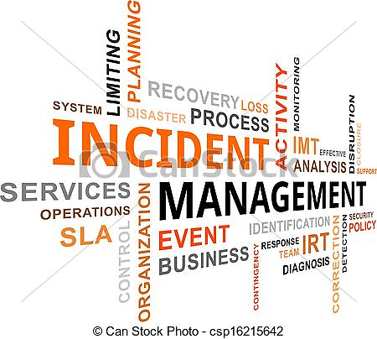
Incident Management

Slide 52
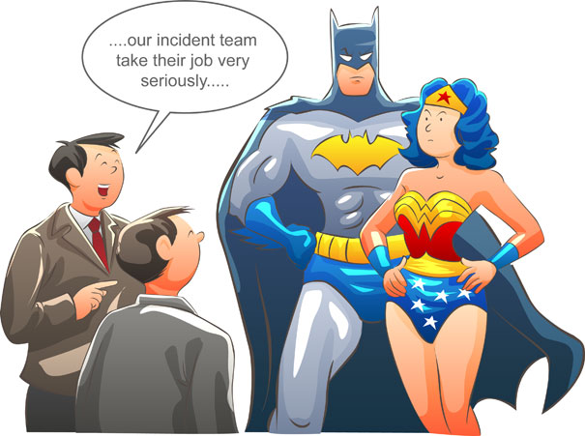

Slide 53
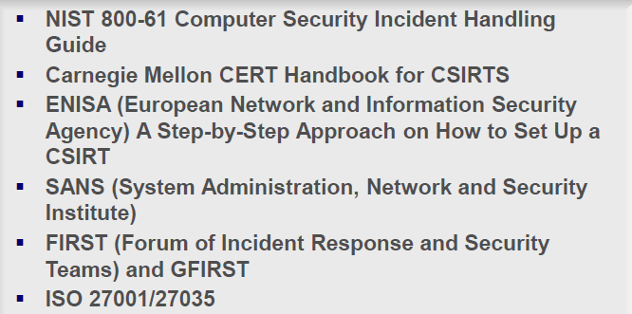
ISO 22317 – Business continuity management systems – Business impact analysis

Slide 54
“There are two kinds of companies.
Those that have been hacked, and those that have been hacked but don’t know it yet.”

Slide 55
Definition of Incidents
By incidents, we mean adverse events that threaten security in computing systems and networks.
Events include any observable thing that happens in a computer and/or network.
Events include connecting to another system via a network, accessing files, system shutdowns, and so on.
Adverse events include
  system crashes,
  packet flooding within a network,
  unauthorized use of another user's account,
  unauthorized use of system privileges,
  defacement of one or more web pages, and
  execution of malicious code that destroys data.
Notes:
Adverse - ebasoovitavad

Slide 56
CIA-Related Incidents
Traditionally, computer and information security efforts have focused on CIA:
  confidentiality
  integrity
  availability
Many incidents that have occurred in the past have fit the CIA model well.

Slide 57
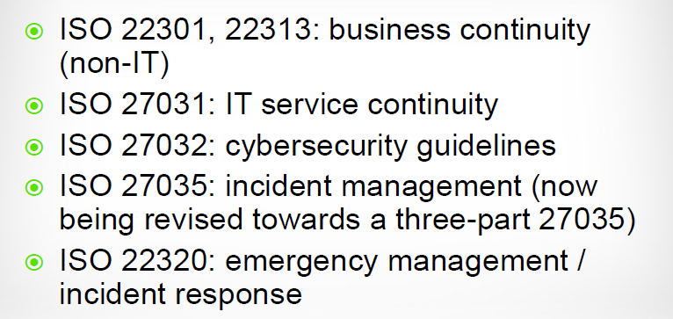
Incident Management Toolset

Slide 58
Incident Management Activities
Receive notifications of (potential) incident
Declare incident or disaster
Communicate – internally & publicly
Document activities

Slide 59
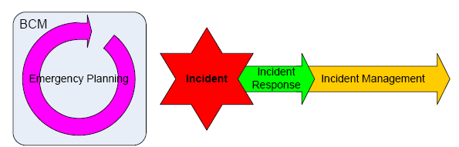
Incident Timeline

Slide 60
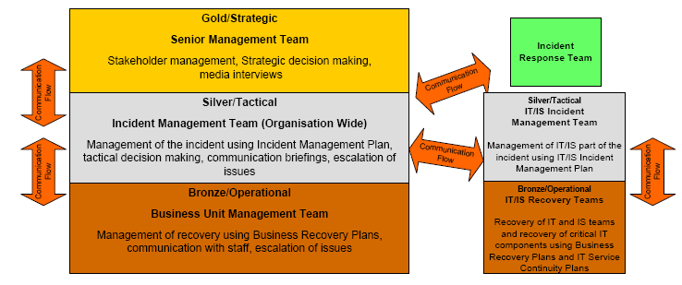
The three tier Incident Management structure and the relationship with Incident Response

Slide 61
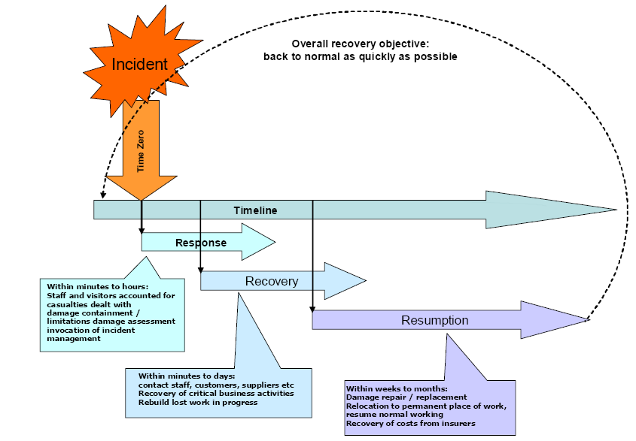
The Incident timeline (based on ISO 22301)

Slide 62
The Incident timeline (based on ISO 22301)

Slide 63
The Incident timeline (based on ISO 22301)

Slide 64
The Incident timeline (based on ISO 22301)

Slide 65
Priority Classification
Systems
General principle for
priority codes......
....... OR
One
System
2. High
Priority
4. Low
Priority
1. Extreme
High
Priority
3. Regular
Priority
Specific & agreed priority
codes:
Depending on SLA’s,
OLA’s
Special agreements for
critical applications
According to customer
requests - internal processes
Many
Systems
Many
Users
One
User
Users

Slide 66
Priority 1: Extreme High
The Incident Manager / Supervisor is in charge.
Immediate action. Notification to CIO and system owners.

Slide 67
Priority 2: High
The Incident Manager / Supervisor in charge.
Prompt action within business hours, information every hour according to predefined lists.

Slide 68
Priority 3: Regular
Related to end users and their calls to a service desk, primarily according to SLA’s

Slide 69
Priority 4: Low
Shall be fixed, but mainly a quality impact

Slide 70
Terms and Definitions – Service Targets (Example)
Service Targets currently defined are:
  Response Time
  Resolution Time
Response Time – how soon an incident is handled by an incident assignee.
  The response time measures the time between the status “New” and “In Progress. 70% of all incidents should meet the target.
Priority | Response Time | Objective
Critical | 20 Minutes | 70%
High | 30 Minutes | 70%
Medium | 2 Hours | 70%
Low | 8 Hours | 70%
Notes:
70
70
70

Slide 71
Terms and Definitions – Service Targets (Example)
Resolution Time – how much time is spent on solving the incident.
  The resolution time measures the time between the status “New” and “Resolved”.
  Status “Pending” is excluded in time measure. 70% of all incidents should meet the target.
Priority | Resolution Time | Objective
Critical | 2 Hours | 70%
High | 4 Hours | 70%
Medium | 8 Hours | 70%
Low | 5 working days | 70%
Notes:
71
71
71

Slide 72
Terms and Definitions – Support Hours (Example)
Support Hours – valid time frames that are used when measuring the Resolution Time and Response Time
  There are two availability (support hours) time segments:
    Critical and High are measured 24/7
    Medium and Low are measured between Monday -- Friday 8am-5pm
Priority | Support Hours | Days
Critical | 24 Hours | All days
High | 24 Hours | All days
Medium | 08.00 – 17.00 | Monday - Friday
Low | 08.00 – 17.00 | Monday - Friday
Notes:
72
72
72

Slide 73
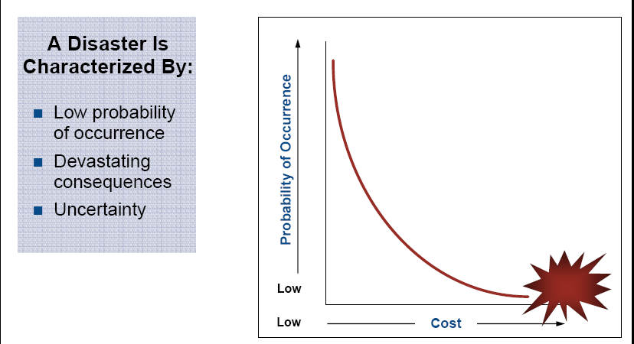
What is a Disaster?

Slide 74
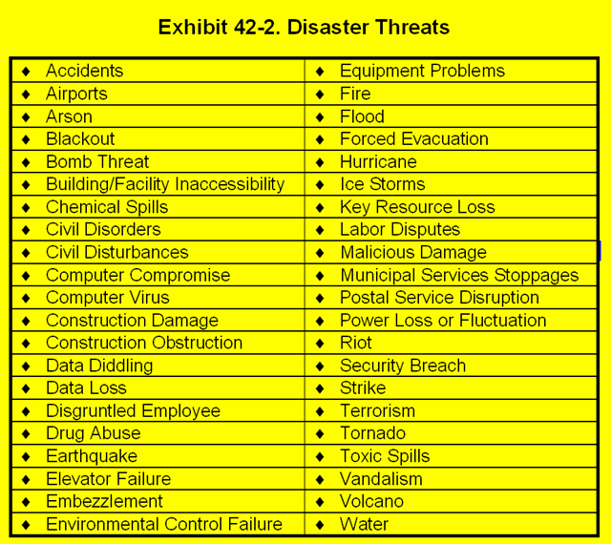
Types of Disasters

Slide 75
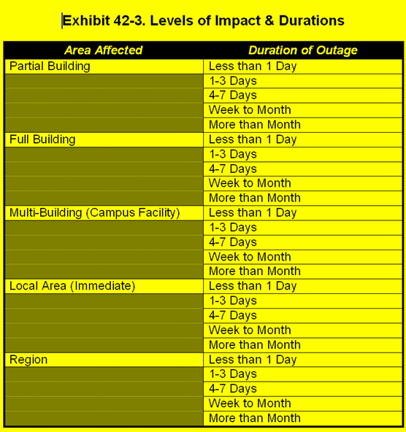
Types of Disasters (cont’d)
The specific disaster scenario is not as important as the recovery process and recovery time
Group disasters into types to facilitate planning
Break BCPs into modules to activate as appropriate

Slide 76
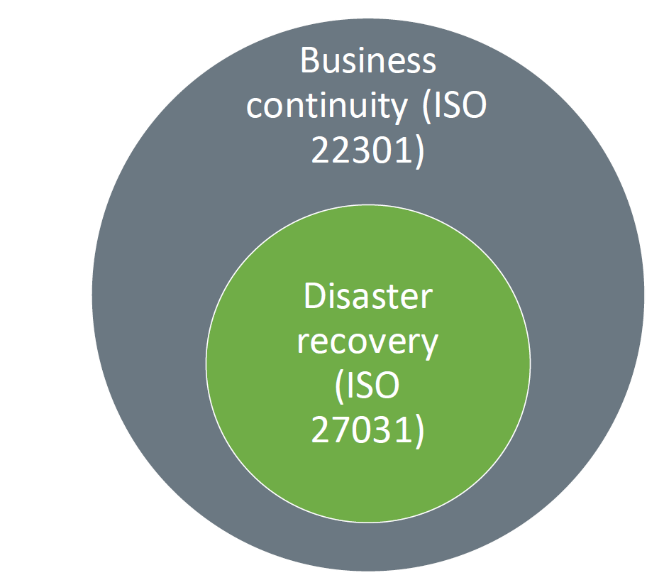
Business Continuity vs.
Disaster Recovery

Slide 77
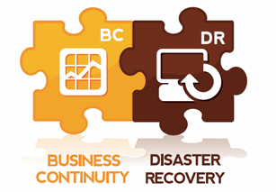
BCP and DRP
Differences and Similarities
BCP
  Activities required to ensure the continuation of critical business processes in an organization
  Alternate personnel, equipment, and facilities
  Often includes non-IT aspects of business
DRP
  Assessment, salvage, repair, and eventual restoration of damaged facilities and systems
  Often focuses on IT systems

Slide 78
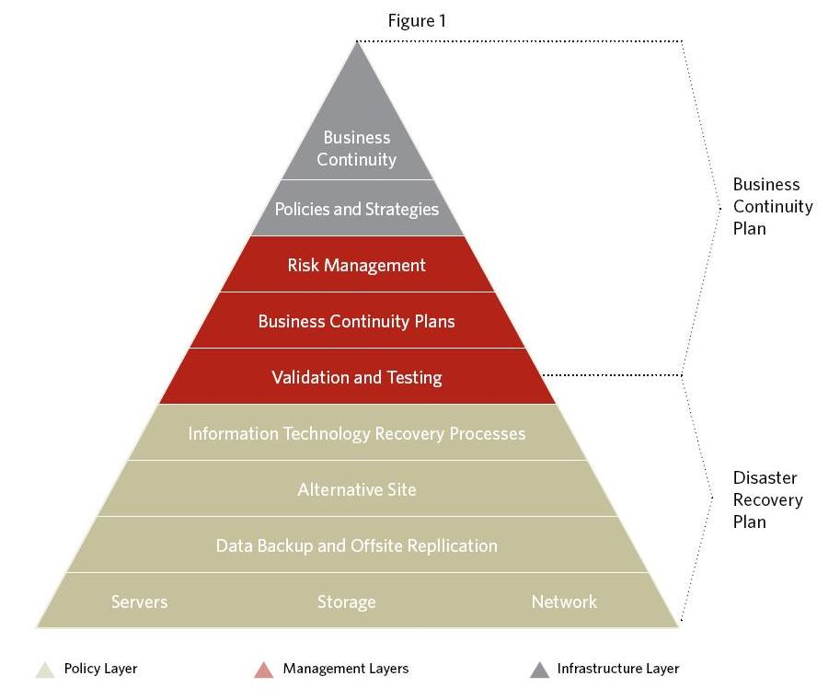
BC-DR Plans

Slide 79
An Incident Occurs…
Call Security
Officer (SO)
Emergency Response
Team: Human life:
First concern
Phone tree notifies
relevant participants
Security officer
declares disaster
Public relations
interfaces with media
(everyone else quiet)
SO follows
pre-established
protocol
Mgmt, legal
council act
IT follows Disaster
Recovery Plan
Notes:
This activity diagram shows that some events can happen in parallel, including all the tasks to the right.
Burri: there is also a procedure that includes the criteria for making the declaration in the first place. Once that determination is made, disaster protocols can begin.
79

Slide 80
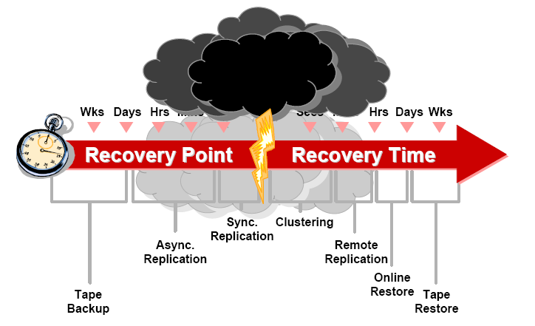
Disaster Recovery Technologies

Slide 81
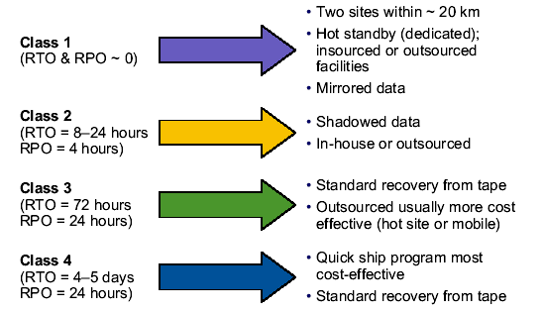
Disaster Recovery Strategies

Slide 82
Concerns for a BCP/DR Plan
Evacuation plan: People’s lives always take first priority
Disaster declaration: Who, how, for what?
Responsibility: Who covers necessary disaster recovery functions
Procedures for Disaster Recovery
Procedures for Alternate Mode operation
  Resource Allocation: During recovery & continued operation
Copies of the plan should be off-site
Notes:
People’s lives take FIRST PRIORITY is often a question on a CISA or CISM exam.
82

Slide 83
Disaster Recovery
Responsibilities
General Business
First responder: Evacuation, fire, health…
Damage Assessment
Emergency Mgmt
Legal Affairs
Transportation/Relocation/Coordination (people, equipment)
Supplies
Training
IT-Specific Functions
Software
Application
Emergency operations
Network recovery
Hardware
Database/Data Entry
Information Security
Notes:
Each of these potentially need addressing
83

Slide 84
Endnotes

Slide 85

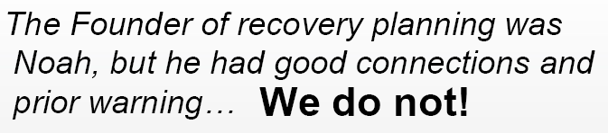


Slide 86
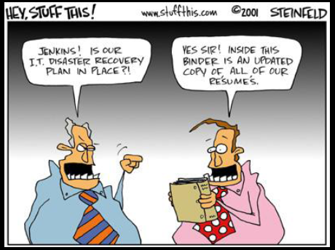
The Plan

Slide 87
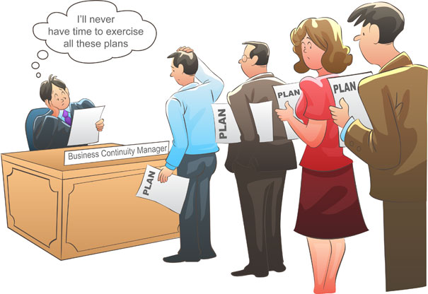

Slide 88
We have to Achieve Balance Between …
Efficiency and Risk,
Efficiency and Compliance,
…
EFFICIENCY
EFFICIENCY
COMPLIANCE
RISK

