Slide 1
Welcome to Foot Pedal Prediction!
Press any button to continue.

Slide 2
Please take note of the control around your right foot.
Hit the up button to continue.

Slide 3
Please take note of the control around your right foot.
Hit the right button to continue.

Slide 4
Please take note of the control around your left foot.
Hit the left button to continue.

Slide 5
Great job! We are an application designed to help Brad communicate more seamlessly with those around him.
Hit the any button to continue.

Slide 6
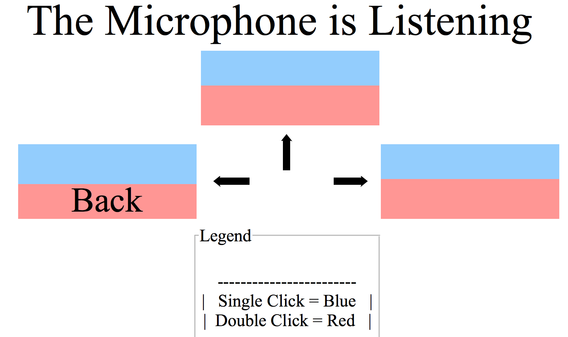
When you navigate to the main application page, you will see something like this:
Hit any button to continue.

Slide 7
As you speak, the colored squares will fill with words we predict you may say next. You can select the blue words with a single click, and the red words with a double click. Let’s practice a double click now.
Double-click any button to continue.

Slide 8
The red button labelled “Back” will always be positioned in its place. A double-click on the left button from the main application will return you to the main menu. Let’s practice now.
Double-click the left button to continue.

Slide 9
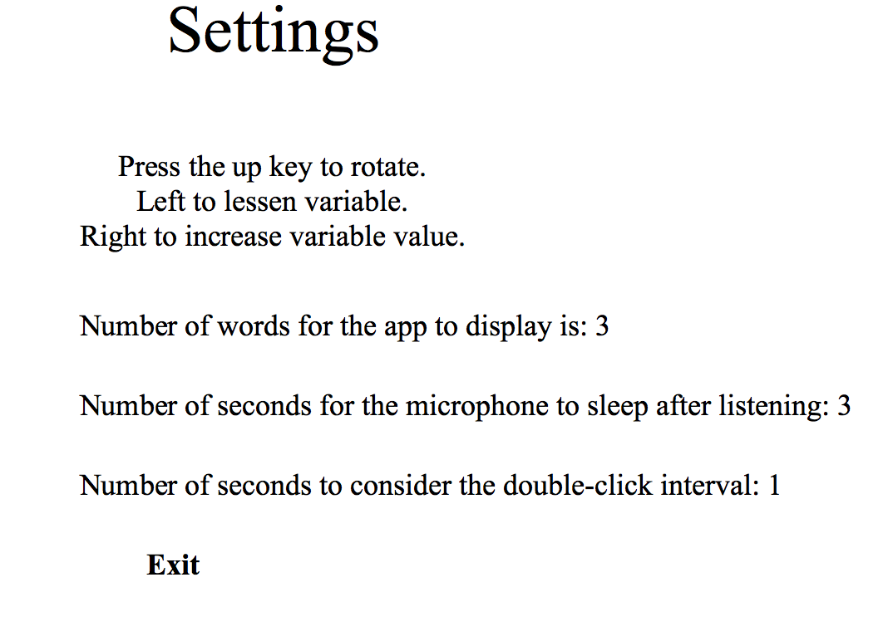
When you navigate to the settings page, you will see something like this:
Hit any button to continue.

Slide 10
When on the settings page, use the up bottom to rotate through the selected setting, and the left and right arrow keys to adjust them according to your preference (pressing either with “Exit” highlighted will return you to the main menu).
Click any button to continue.

Slide 11
Thank you and we hope you enjoy using our product!
Press any button to return to the main menu.

