Slide 1
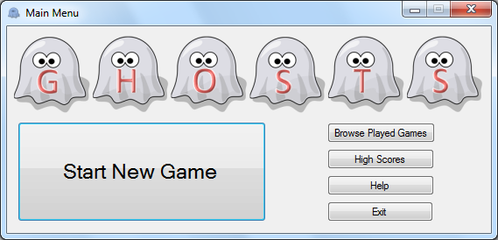
Click here to play a game

Slide 2
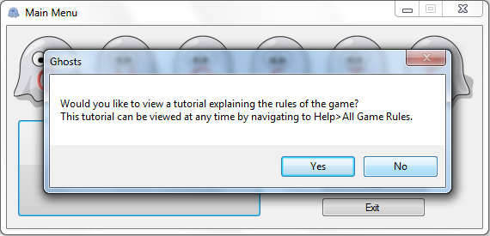
This window will appear the first time that you play a game.
When you play the game you will need to click yes to have the rules explained to you.
Click here to skip the explanation

Slide 3
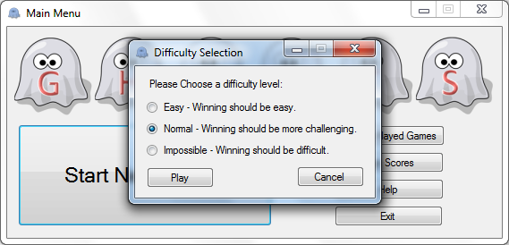
Change the difficulty to ‘Easy’
Easy mode
Normal mode
Impossible mode

Slide 4

Start the game

Slide 5
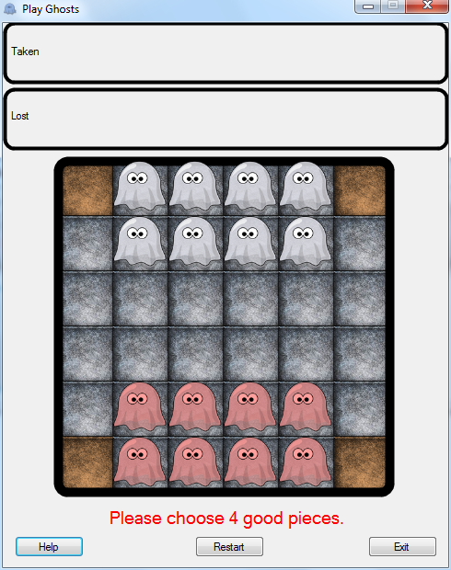
These are the computers pieces.
This is where pieces that are taken are displayed
These are your pieces.
These are the computer’s pieces
These are your pieces
Choose this piece
This restarts the game to the current state
This provides assistance and game rules
This exits the game

Slide 6
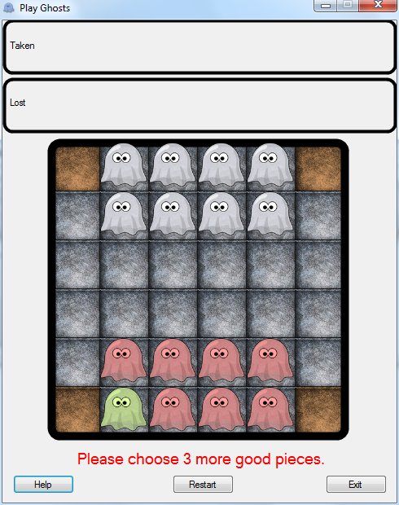
Select this piece
Instructions are displayed here

Slide 7
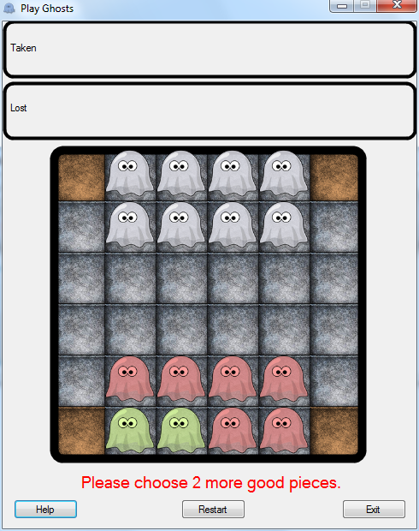
Choose this piece

Slide 8
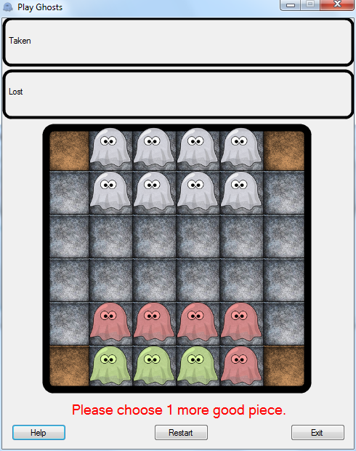
Choose this piece

Slide 9
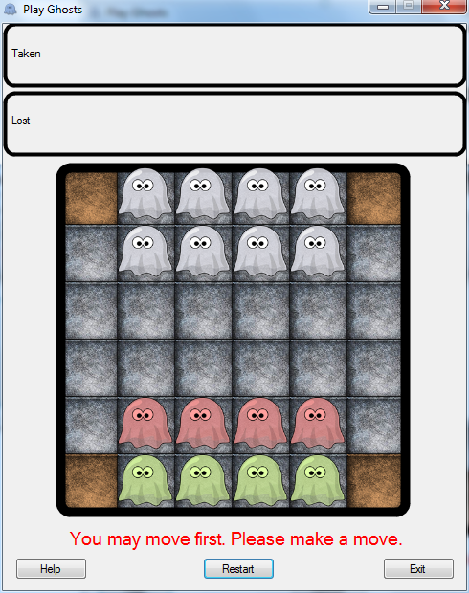
Select this piece to move it

Slide 10
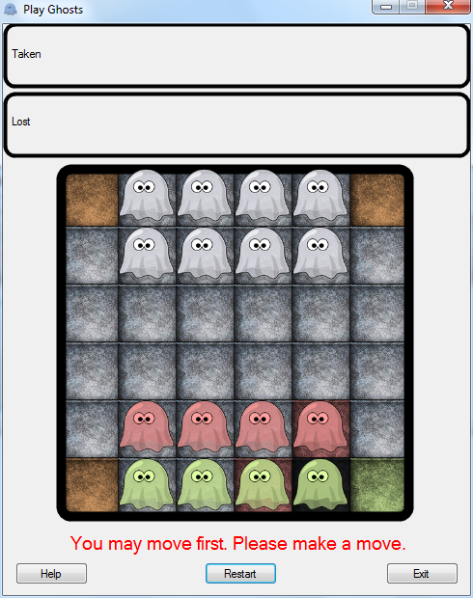
Red squares cannot be moved onto
Green squares can be moved onto
Move to this square

Slide 11
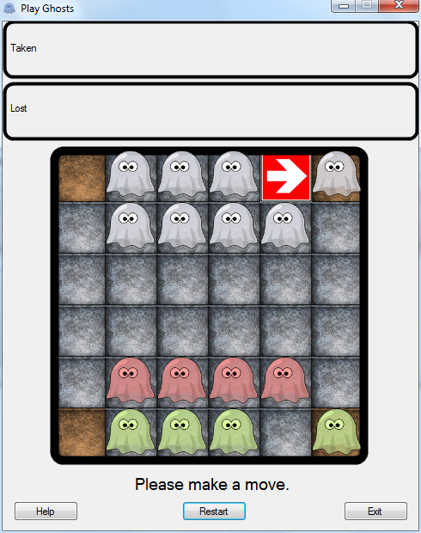
In response to your move, the computer has moved
These red arrows indicate the last move that was made
Click anywhere to skip to the end of the game

Slide 12
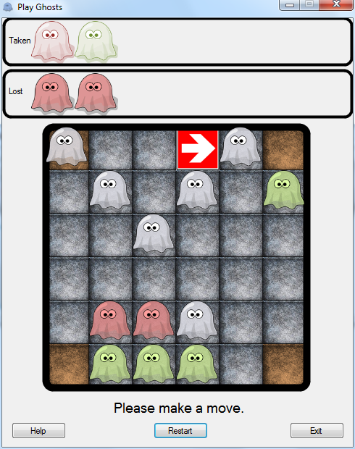
Computer pieces are a dimmer colour than your pieces
These pieces have been taken during the game
Select this piece to move it

Slide 13
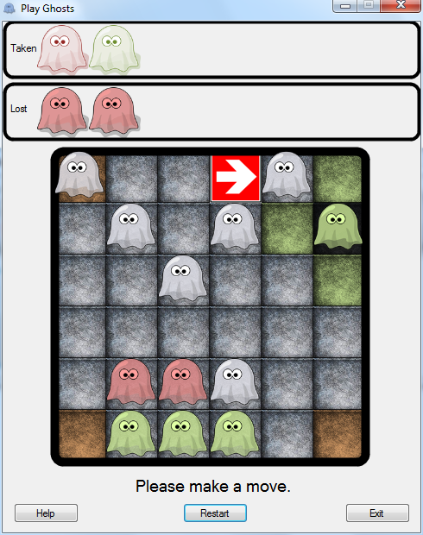
Move to this square to win the game

Slide 14
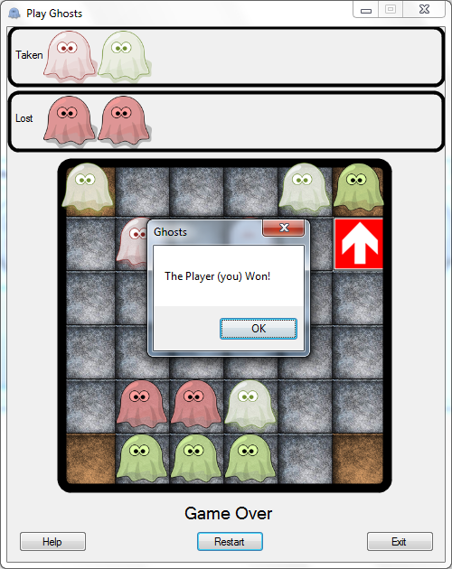
Computer pieces are revealed at the end of the game.
You will be alerted of the winner at the end of the game
Click here to close the alert

Slide 15
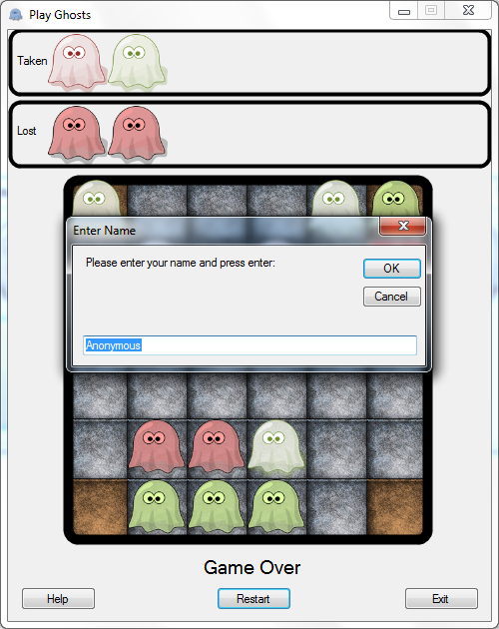
The player name is ‘Anonymous’ by default
Click here to change the name

Slide 16
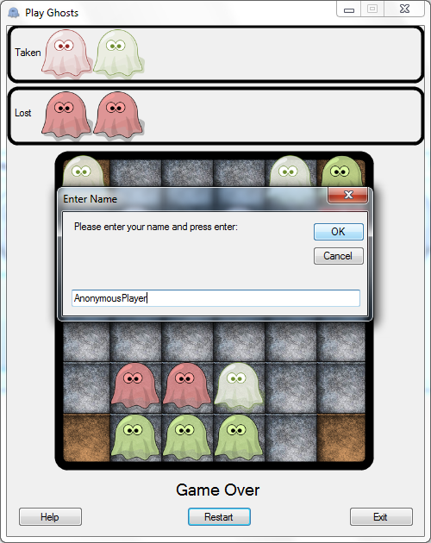
Click here to save the name

Slide 17
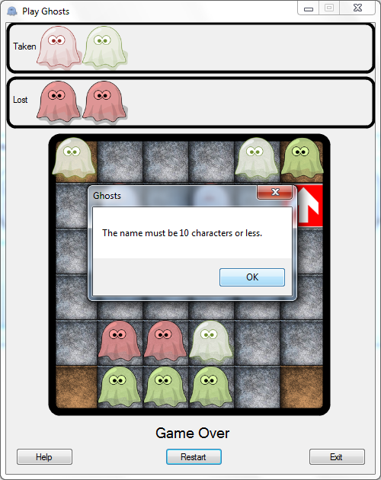
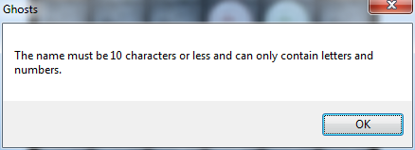
Oh No!
The name that has been entered is too long
Click here to close the alert

Slide 18
Click here to change the name to something shorter

Slide 19
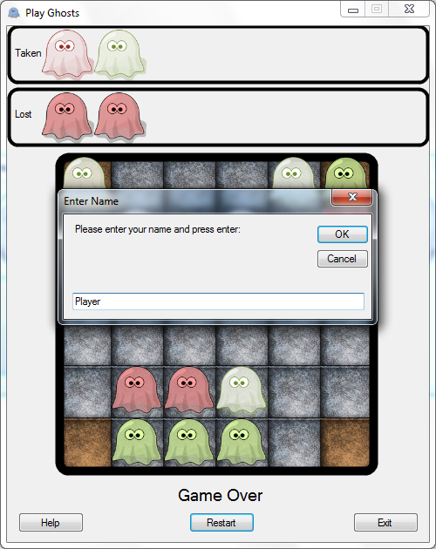
Click here to save the name

Slide 20
Click here to view a replay of the game

Slide 21
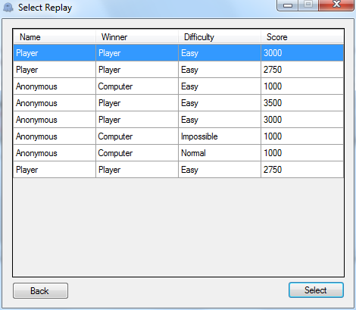
The name that the player entered
The winner of the game
The difficulty level of the game
The player is given a score for each game, this is that score
Select the row of the game
This returns to the main menu
This plays the currently selected game

Slide 22
View the game that is currently selected

Slide 23
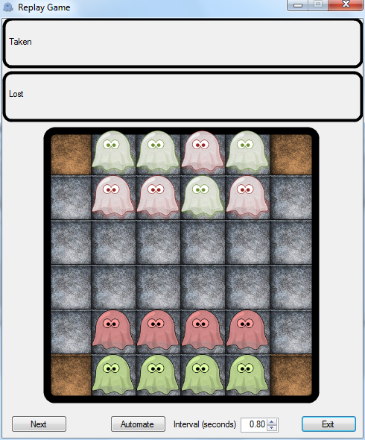
The interface is formatted in a similar way to the game screen
Click here to step a single move forward in the game
This returns to the selection screen

Slide 24
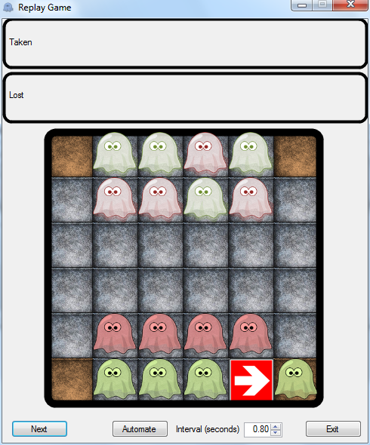
From clicking ‘Next’, the first move of the game was made
Click here decrease the interval length for automated play
This enables automated play, this will automatically step through the game
This value specifies the time interval between steps

Slide 25

Click here to switch to automated mode

Slide 26
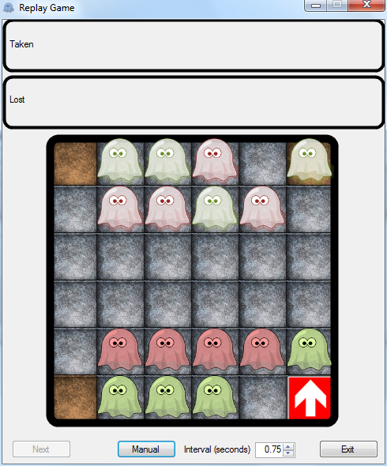
Click anywhere to skip to the end of the game
This returns to manual mode, where ‘Next’ must be clicked for each move

Slide 27
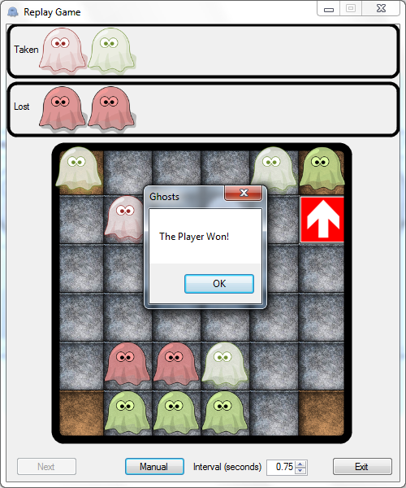
Click here to close the alert

Slide 28
Return to the main menu

Slide 29
View the high score board

Slide 30
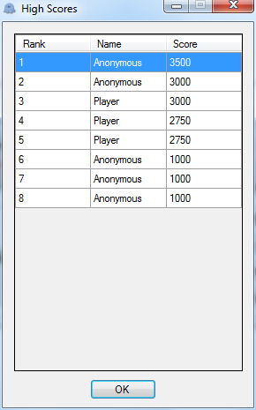
The rank of the player on the scoreboard
The name of the player
The score that the player achieved
Click here to close the high scores

Slide 31
View help

Slide 32
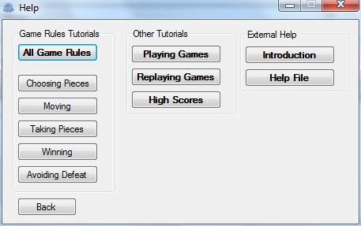
This section shows basic walkthroughs of how to use different features
This section shows help that opens another program
This section details the rules of the game
This button opens the current tutorial
These are the different sections of the rules
This button opens a detailed document about how to use the program
Close help

Slide 33
Click here to close the game (this ends this tutorial)

