Slide 1
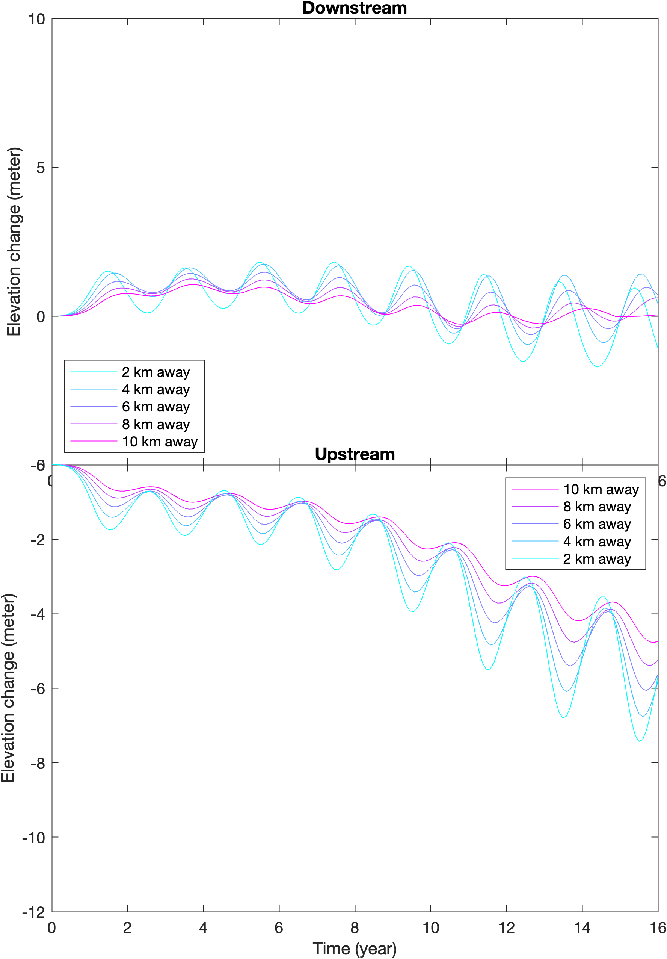
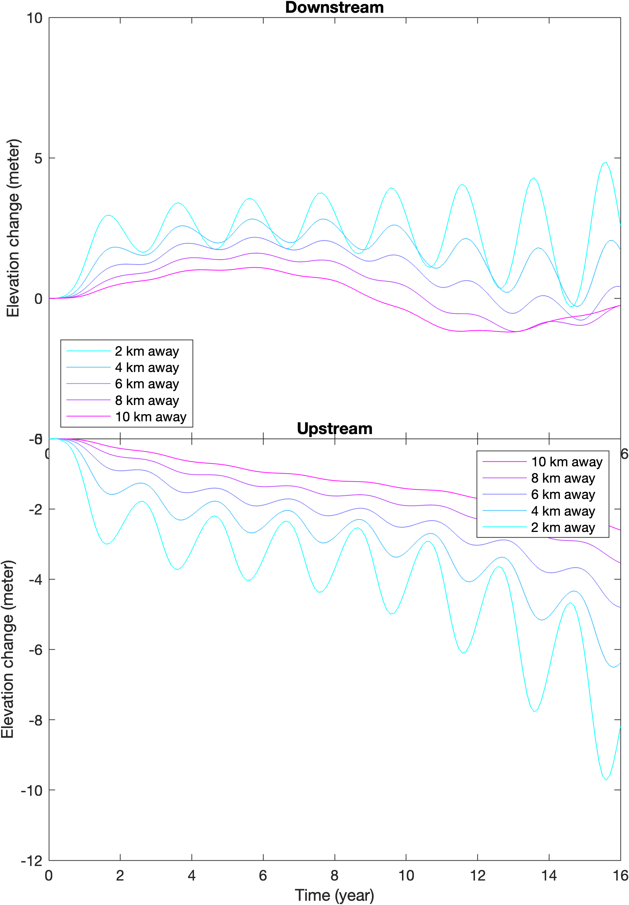
Notes:
From left to right: narrow glacier, with effective pressure, increasing sliding law coefficient.
Observations: 1. Large coefficient corresponds to larger attenuation. 2. Large coefficient corresponds to large elevation change near the perturbation.

Slide 2
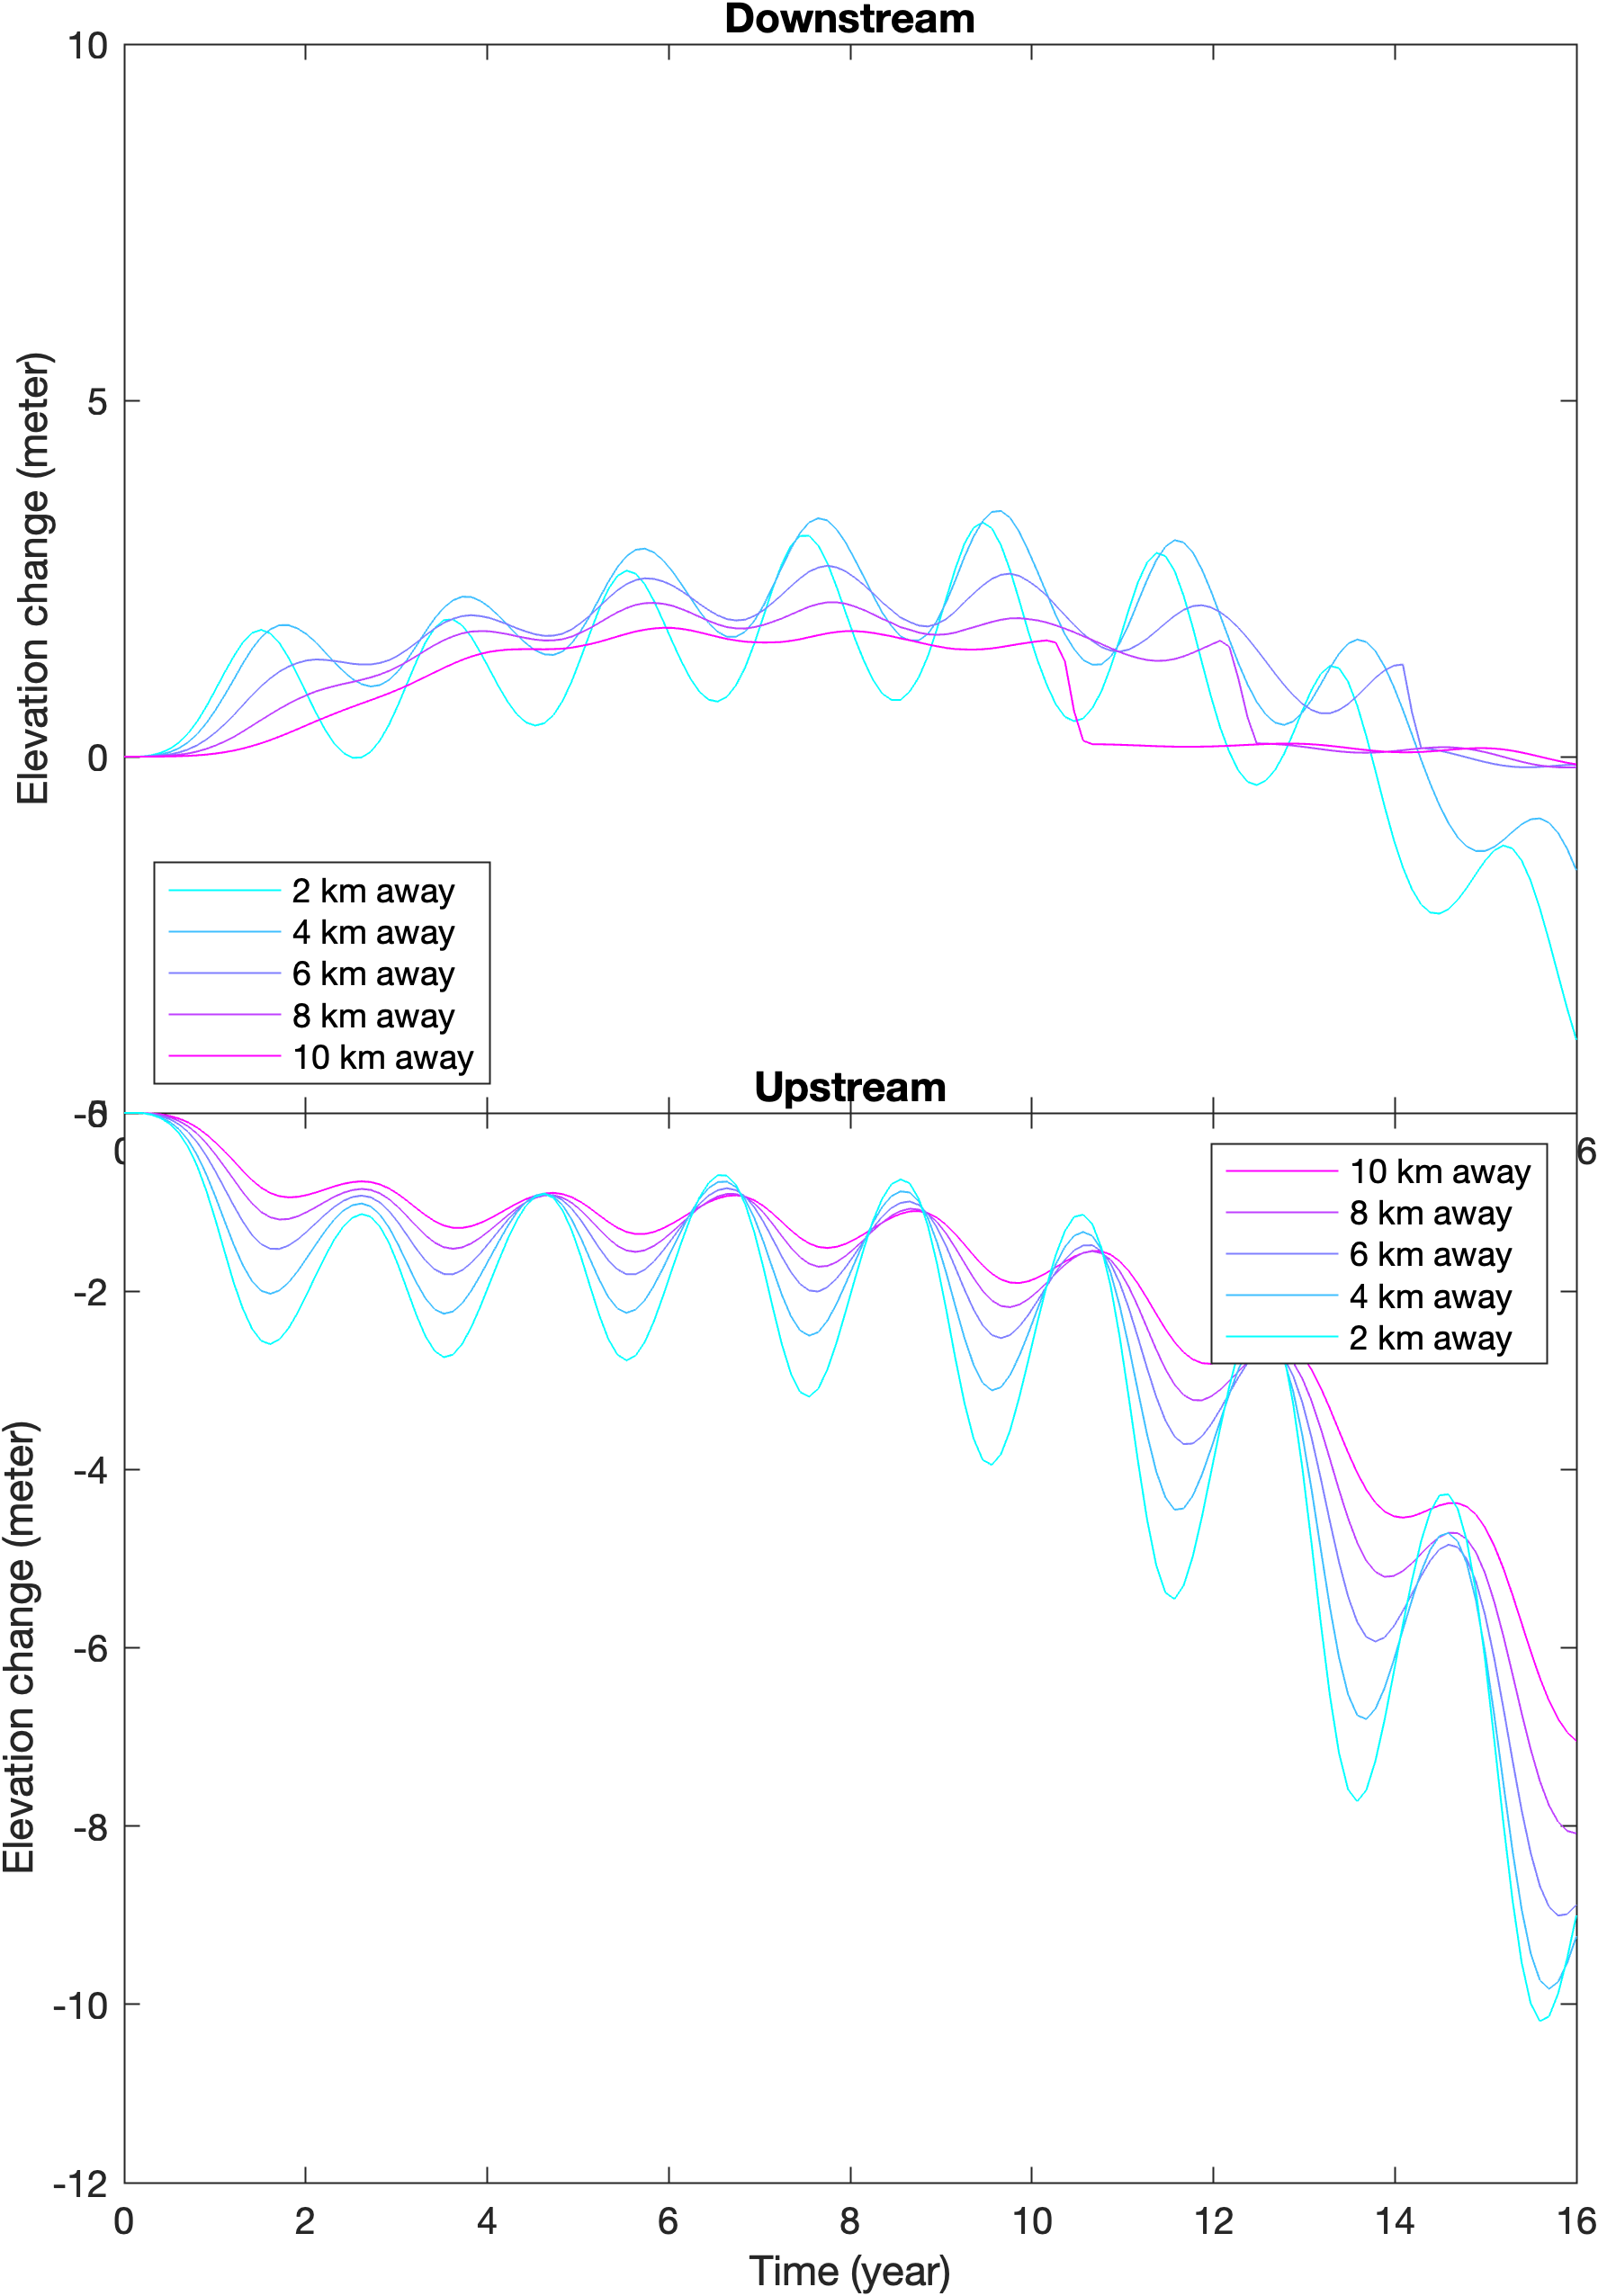
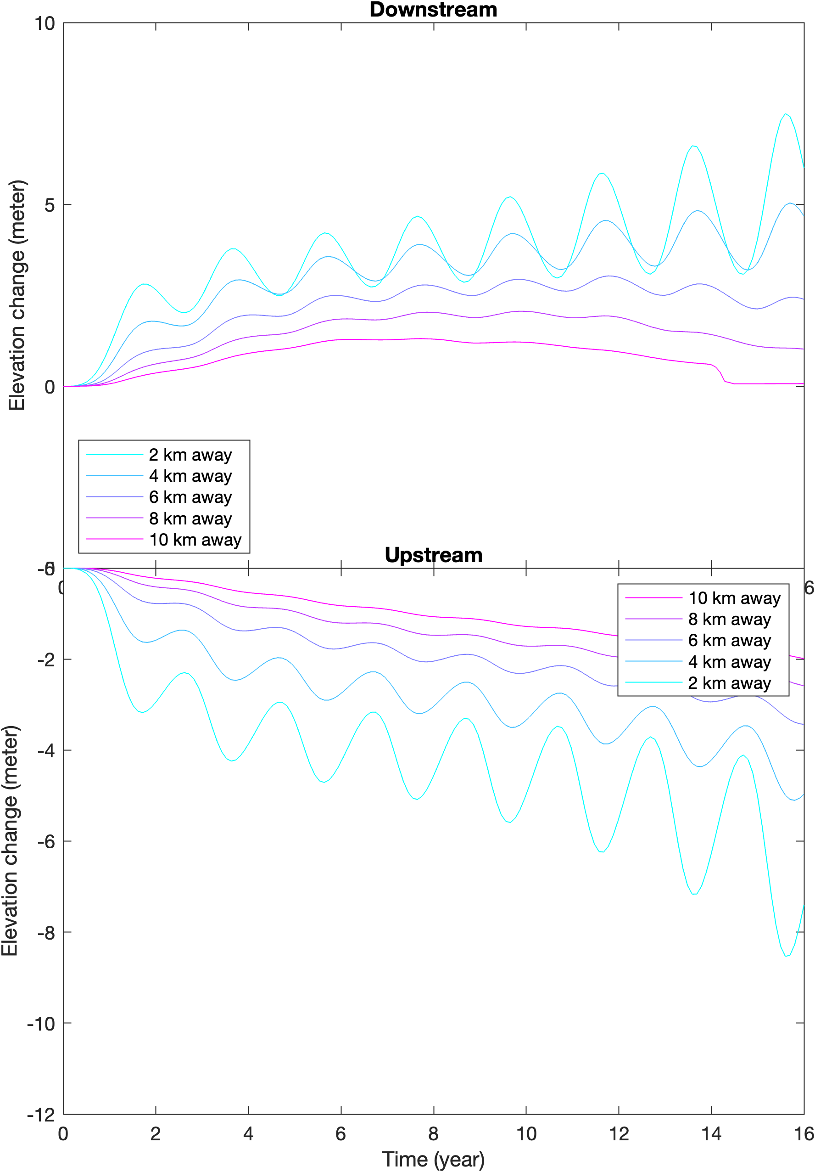
Notes:
From left to right: narrow glacier, with effective pressure, increasing sliding law coefficient.
Observations: we reach rather similar conclusions as in the previous slide. The wider glacier appear to be slightly different (in comparison to narrower glacier) in long term thinning/thickening variability. For the narrower glacier, there appears to be a rebound period where narrower glacier (if it has been thickening) starts to thicken less, or (if it has been thinning) starts to thin less. We hypothesize that this is controlled by the grounding line variability.

Slide 3
Notes:
Combined

