Slide 1
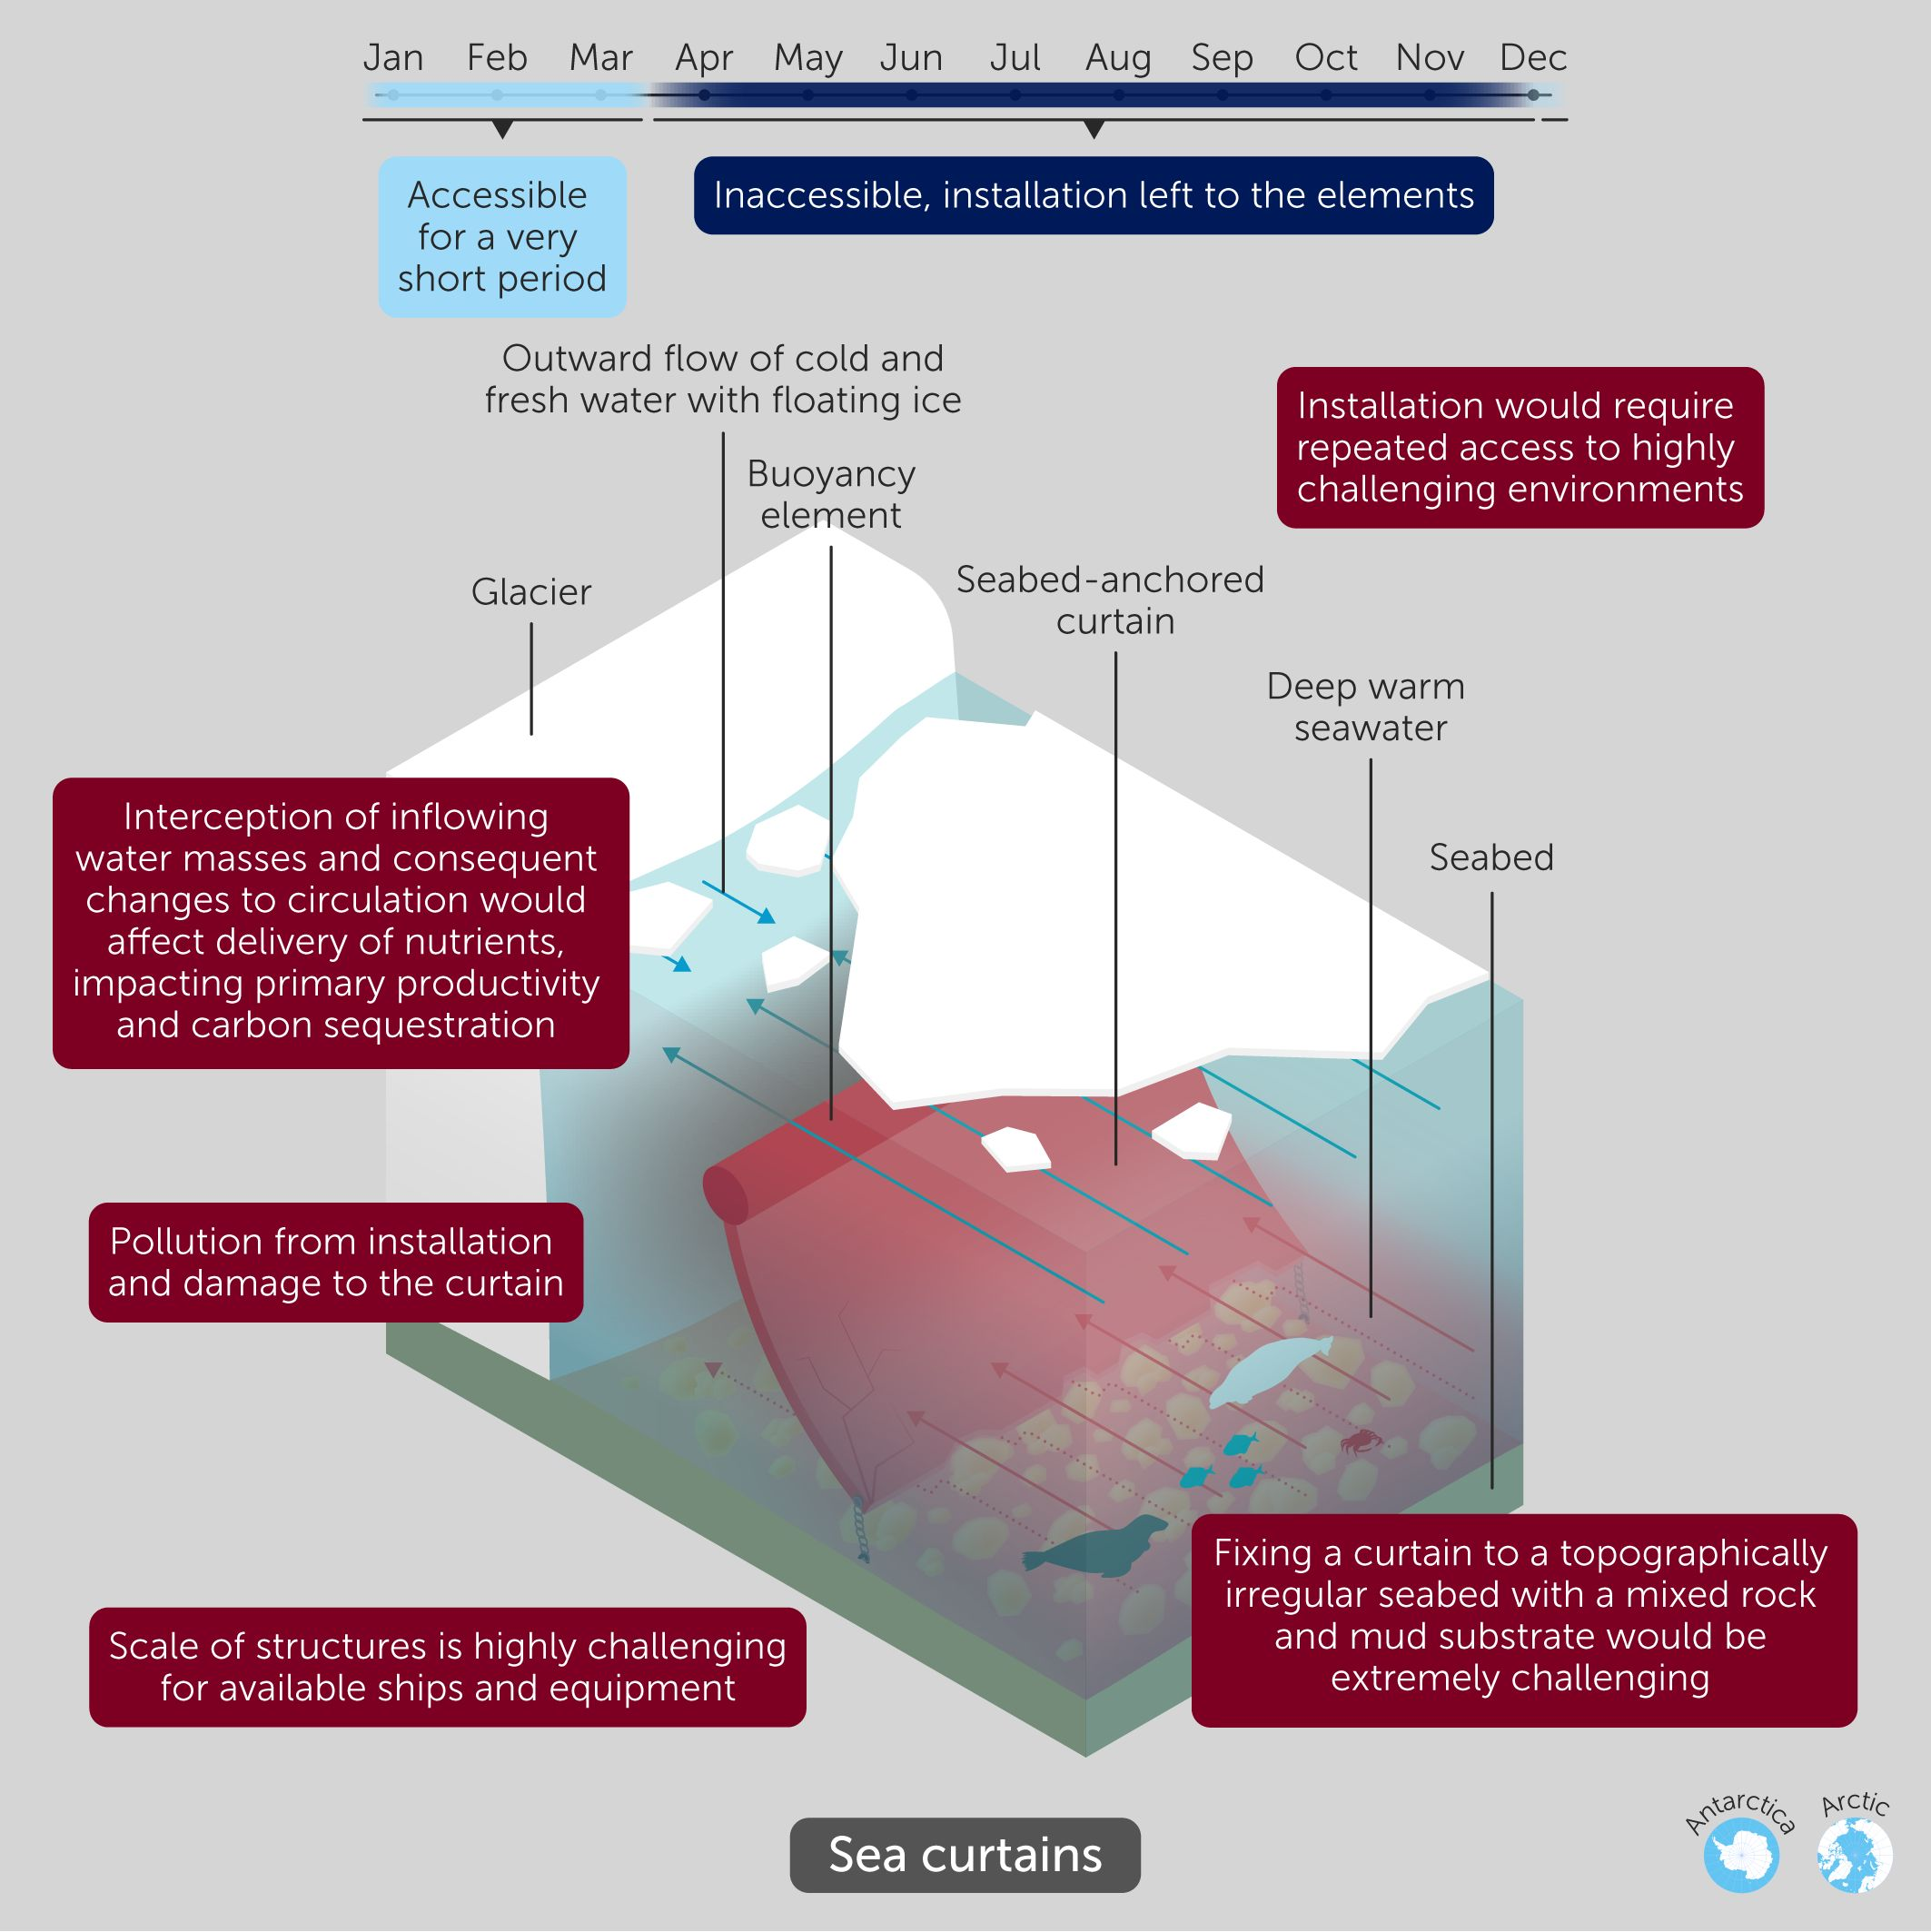
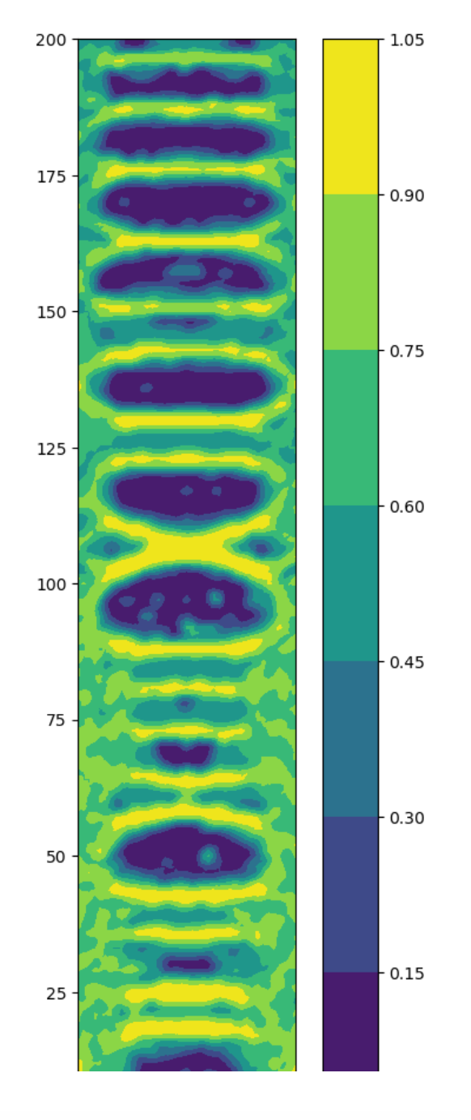
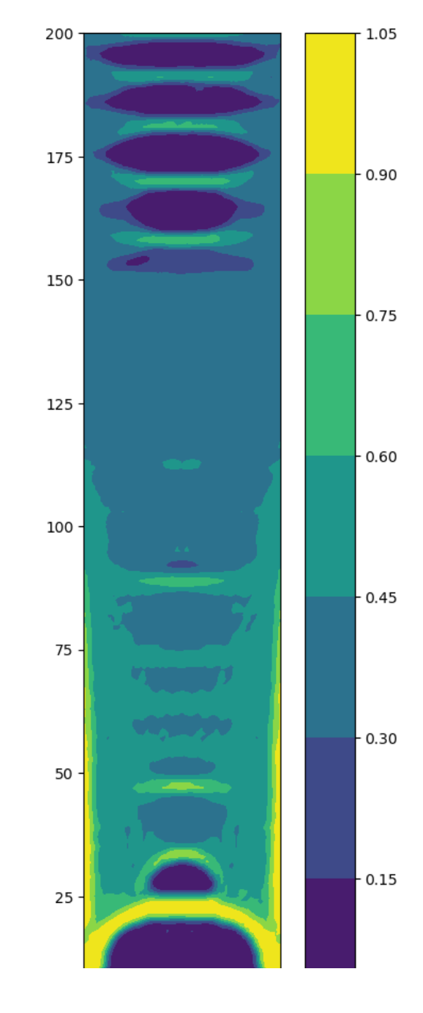
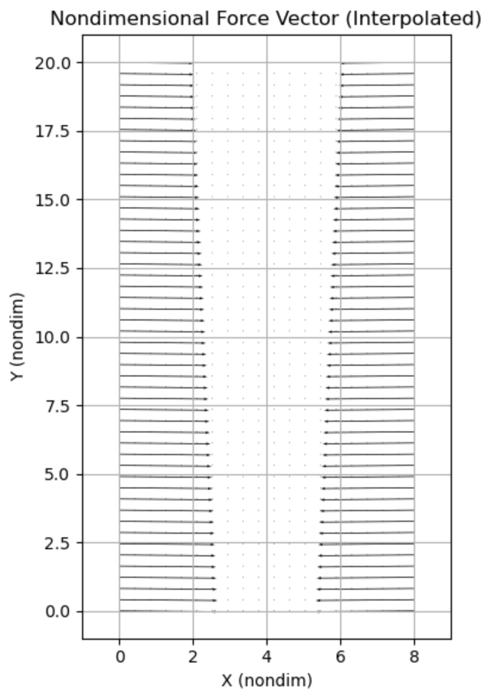
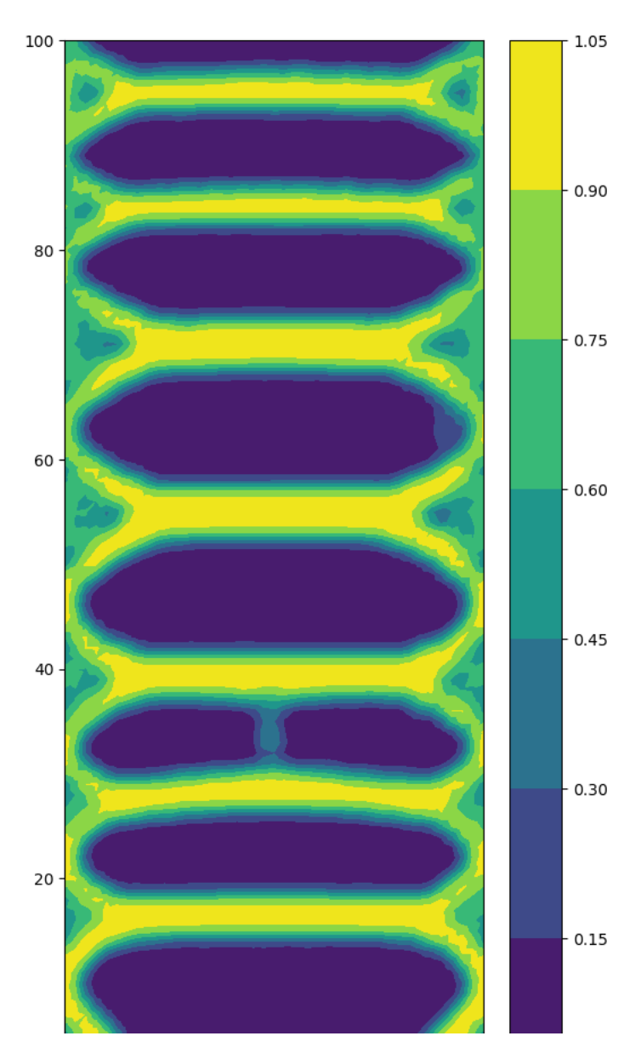
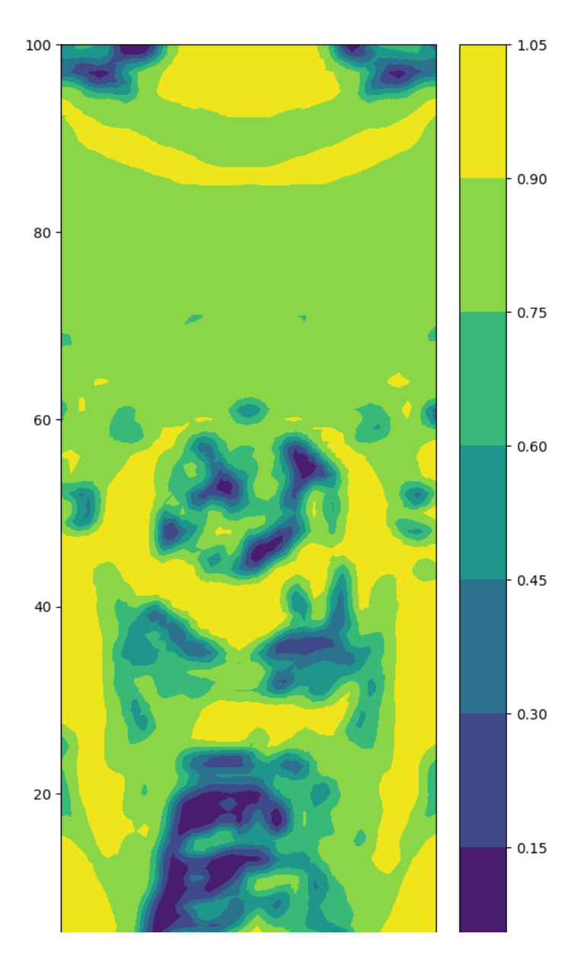
Compliance minimization under frequency and mass constraint: sea curtain optimal design
Donglai Yang, Ph.D. student at Earth and Atmospheric Sciences
200 m tall curtain
Compliance + mass + frequency
Compliance + mass
100 m tall curtain
Compliance + mass + frequency
Compliance + mass
Siegert et al., 2025
Density: 2e3
E: 100e9
Width: 40 m
Height: {200 m, 100 m}
Area fraction constraint: 0.4

