Slide 1

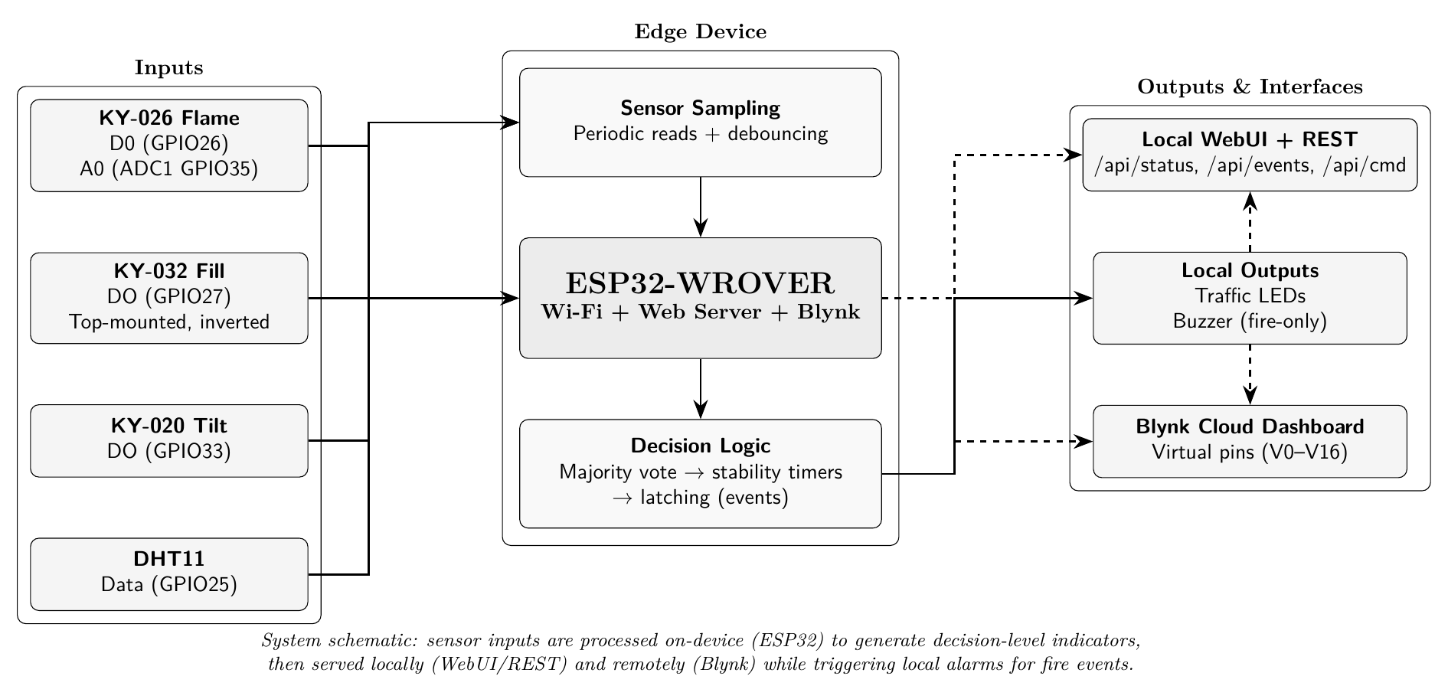
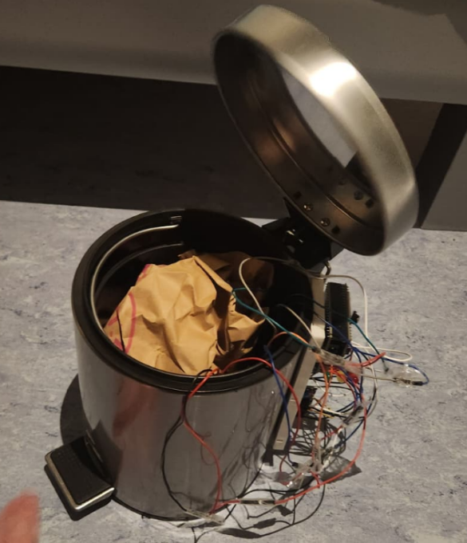
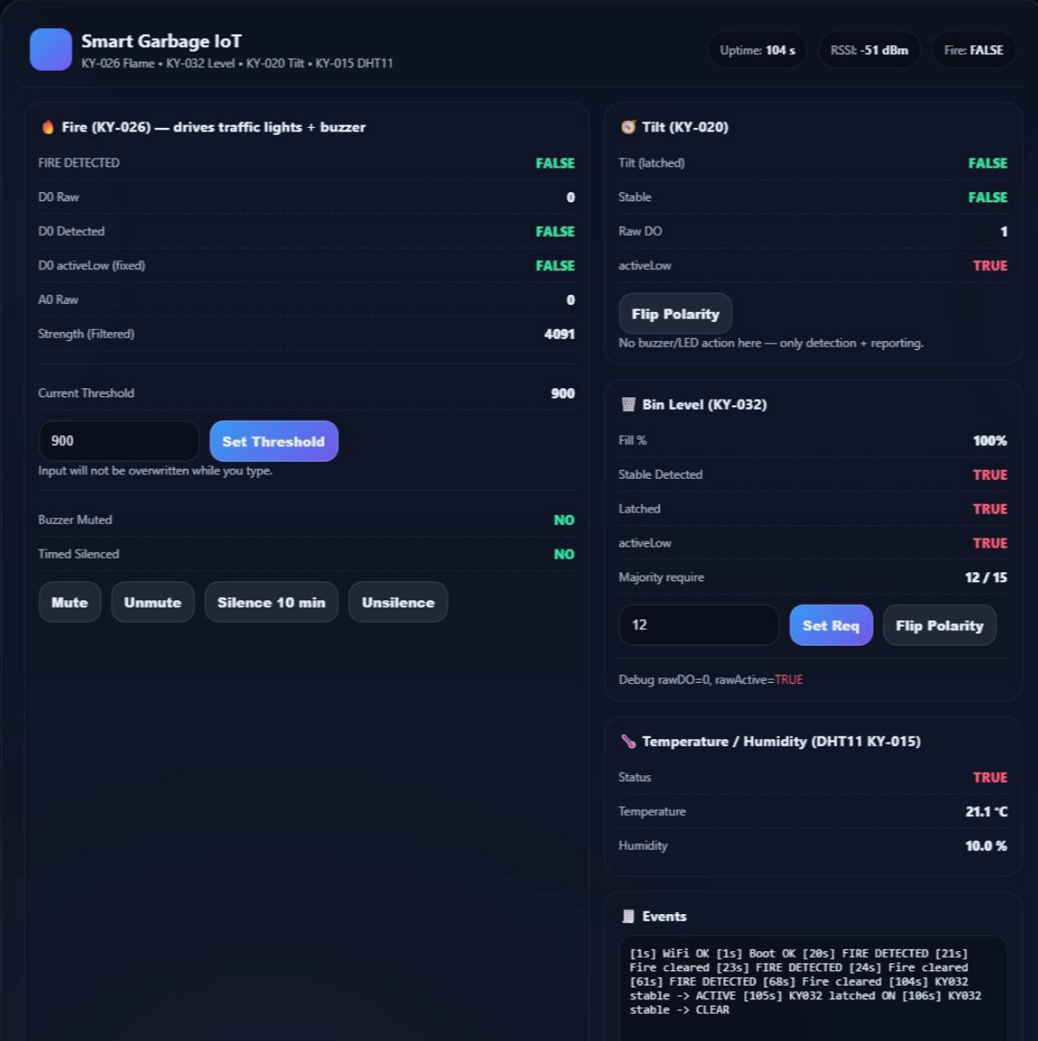
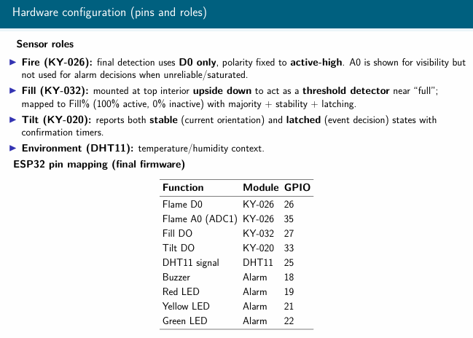
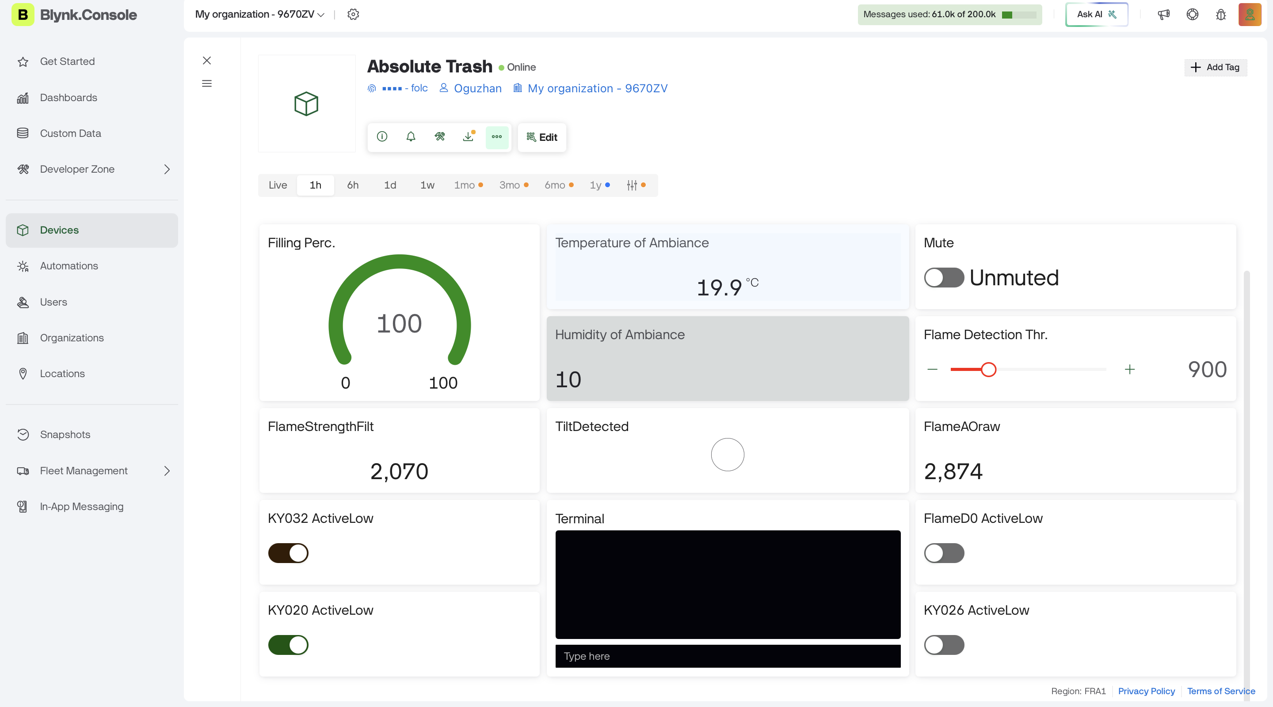
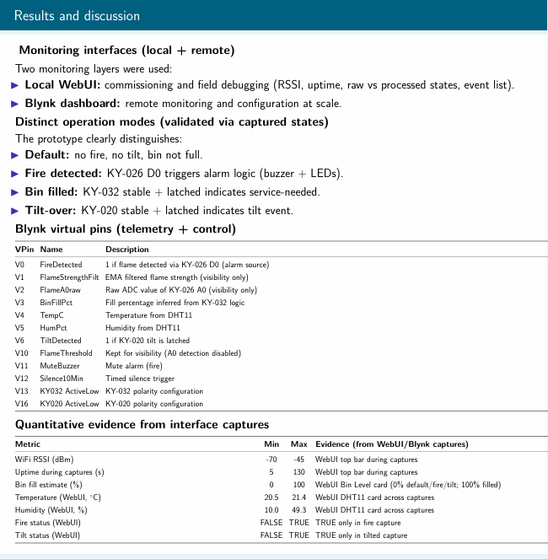
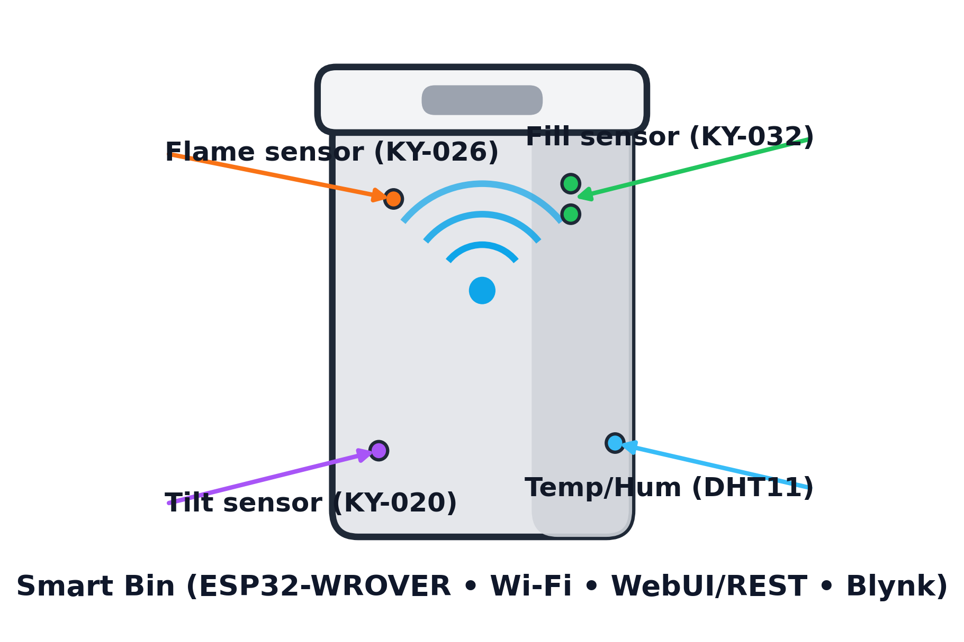


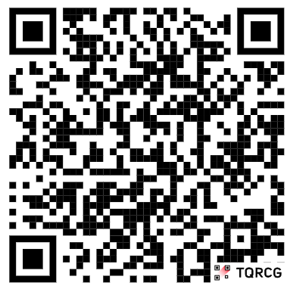






Smart Garbage System “Absolute Trash”
IoT Prototype with FillMonitoring, FireDetection, and Tilt-Over Detection
Oğuzhan Alasulu, Serkan Kıyaklı
Abdullah Gül University, Kayseri, Türkiye
January 2026
Abstract
Background and Motivation
Project Objectives
Municipal solid-waste collection influences public health, safety, operational cost, traffic congestion, and greenhouse-gas emissions. Fixed collection schedules can waste resources by visiting half-empty bins while missing bins that fill early.
This work presents an IoT prototype titled Smart Garbage System for Sustainable Cities using Blynk, implemented on an ESP32-WROVER with Wi-Fi connectivity. The system integrates: (i) a KY-032 top-mounted level sensor (installed upside down at the bin top) to infer a service-needed fill state, (ii) a KY-026 flame sensor using digital D0 detection with polarity fixed to match observed module behavior, (iii) a KY-020 tilt sensor to detect bin tilt-over events, and (iv) a DHT11 module for temperature and humidity monitoring. Observability is provided through a local WebUI and JSON endpoints, and a cloud dashboard via Blynk virtual pins. Practical reliability adjustments were incorporated from integrated testing: fixed flame D0 logic (active-high), analog backup detection disabled when the analog channel saturates, bounded Wi-Fi connection startup, and WebUI stored in flash (PROGMEM) to reduce RAM usage. The platform demonstrates a low-cost and extensible architecture for condition-based collection and safety-aware municipal operations.
Keywords: smart waste management, sustainable cities, IoT, ESP32, Blynk, fire detection, fill-level sensing, tilt detection, WebUI, reliability
Sustainable city operations depend on reliable municipal services. Waste management affects urban cleanliness, public health, operational costs, and emissions due to collection vehicle routing. Fixed schedules may cause:
Unnecessary trips to half-empty bins (inefficient fuel/time usage)
Delayed service for full bins (overflow and hygiene issues)
Safety/service risks due to localized bin fires or bins being displaced/tilted by wind, impacts, or vandalism
Design principle: decision-level indicators
A sensing system becomes valuable only if it produces signals that map cleanly to operational actions. Therefore, we focus on:
Service-needed (fill): “Should this bin be routed soon?”
Safety hazard (fire): “Is there an immediate hazard requiring escalation?”
Integrity/availability (tilt): “Has the bin been knocked over and needs attention?”
O1 — Multi-sensor monitoring: implement fill inference (KY-032), fire detection (KY-026 D0), tilt-over detection (KY-020), and environment sensing (DHT11).
O2 — Dual observability: provide both local commissioning/diagnostics (WebUI + REST/JSON endpoints) and remote monitoring/configuration (Blynk dashboard).
O3 — Reliability-aware firmware: mitigate unstable raw sensor toggles using majority voting, stability timing, and latching; include Wi-Fi timeout and PROGMEM WebUI storage for robust integrated operation.
Project Schema
Project Implementation
Project Remote Dashboard
Hardware Configuration
Blynk Dashboard
Result and Discussion
Conclusion
Multi-sensor ESP32 bin monitoring achieved (fill/tilt/fire + environment) with local alarms and remote visibility.
Fire event triggers immediate buzzer + LEDs, while dashboard logs and shows real-time status.
Threshold + latching approach improves reliability against noisy / temporary readings.
As a Future work;
Add continuous fill-level sensing (e.g., ToF/ultrasonic) + calibration for different bin types.
Improve outdoor readiness: enclosure, cable management, waterproofing, mounting.
Add power strategy (battery + deep sleep / solar) and estimate runtime.
Add stronger comms option (LoRa/cellular) for non-WiFi areas + alert escalation.
GitHub Project

