Slide 1
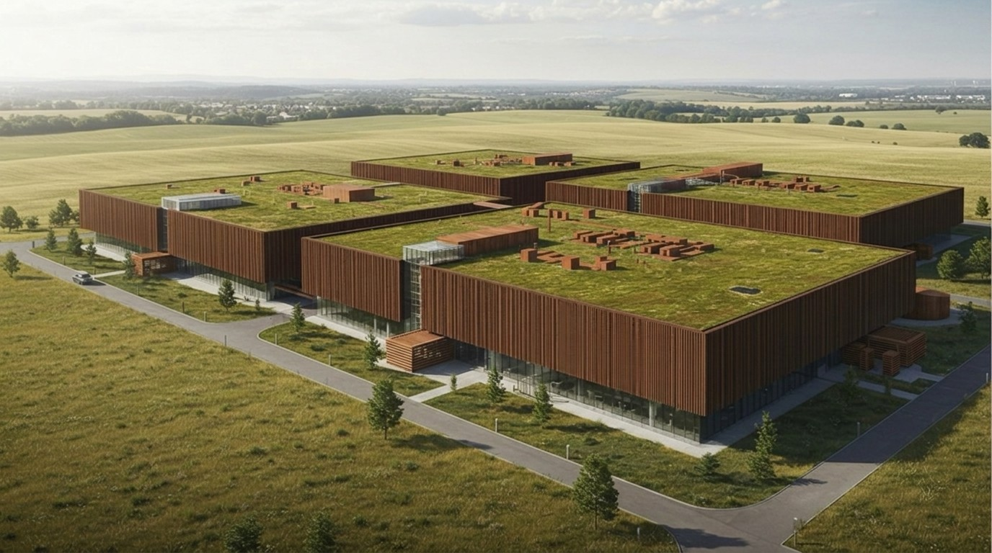

Concept rendering
SUPERWOOD for Data Centers
Companion to the SUPERMILLS Investor Overview
September 2026
INVENTWOOD · CONFIDENTIAL

Slide 2
THE THESIS
We help data centers decarbonize and improve their impact on communities, while they accelerate SUPERWOOD's journey from premium skins into structural applications
01
02
03
The buyer is short of steel and already building with wood
We turbocharge the wood they already use
One basis-of-design win is SuperMill Two-scale demand
Data centers are among the fastest-growing buyers of structural steel. Customers report backlogs and shortages, and Microsoft and Meta already build data-center structures in mass timber.
Mass timber replaces concrete floors. SUPERWOOD, stronger than A36 steel in tension at one-sixth the weight, adds the steel: members, skins and screens — and strengthens the mass timber itself. It ships today from SuperMill One; truss design and mass-timber enhancement are under way.
A gigawatt data center's skins alone are one to three years of SuperMill One's output; its structure is a year or more of SuperMill Two. Long term: prefabricated envelopes and, eventually, foundations.
Note 1
InventWood · The thesis
Confidential

Slide 3
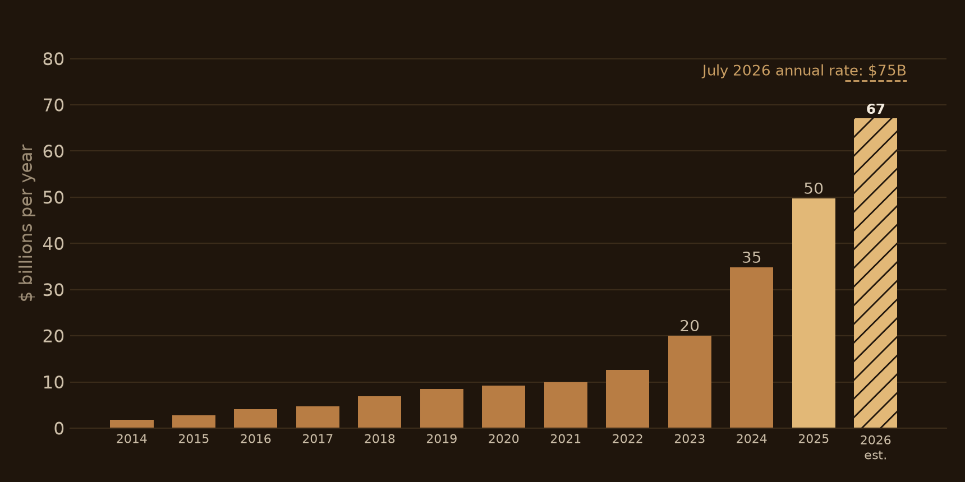
MARKET
Data center construction is growing dramatically
US data center construction is running at $75 billion a year, up 57% in twelve months.
HOW IT IS PROJECTED TO GROW
66 GW under construction in North America
JLL, midyear 2026 — more electricity than Germany uses. At the published 50–100 tons of structural steel per MW, that pipeline alone is 3.3–6.6 million tons of structural steel.
Global capacity roughly triples by 2030
McKinsey: 82 GW in 2025 to about 219 GW in 2030, AI workloads driving 71% of the growth. JLL: 103 GW to 200 GW.
Global data center capex passes $1 trillion in 2026
Dell'Oro: up 57% in 2025, above $1 trillion in 2026, $1.7 trillion by 2030 — mostly servers and chips; the buildings are the Census share on the left.
Note 2
InventWood · Market
Confidential

Slide 4
MARKET · SUPPLY CHAINS
Resulting in supply chain challenges
Power
Aluminum
Structural steel
Power transformers average 128 weeks to deliver, substation transformers more than 160. Grid connection sets the schedule.
On the federal Critical Minerals List since 2022, confirmed in the 2025 list. The metal of skins, louvers and busway.
Customers report backlogs and shortages. Section 232 tariffs at 50% since 2025, on full product value since April 2026.
Every week of lead time is a week of unearned power.
Note 3
InventWood · Market
Confidential

Slide 5
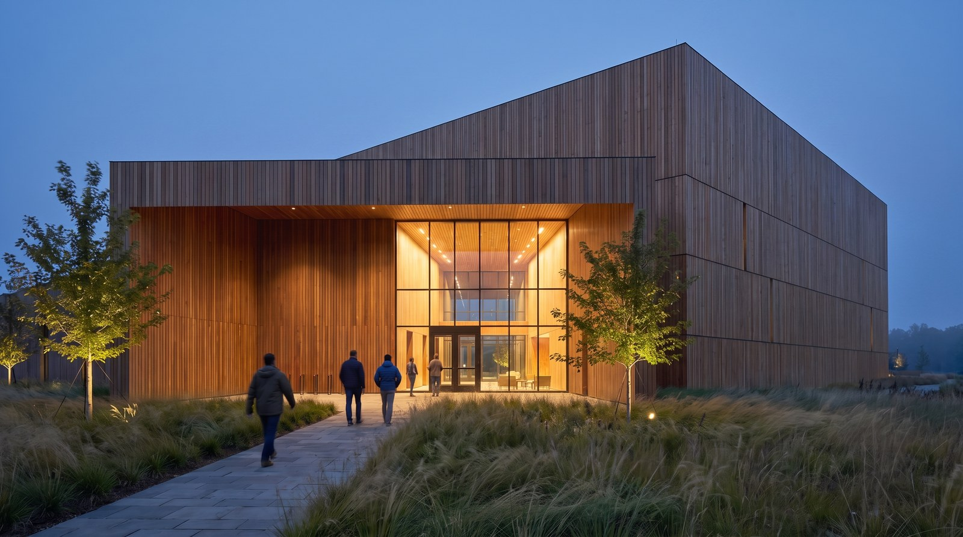
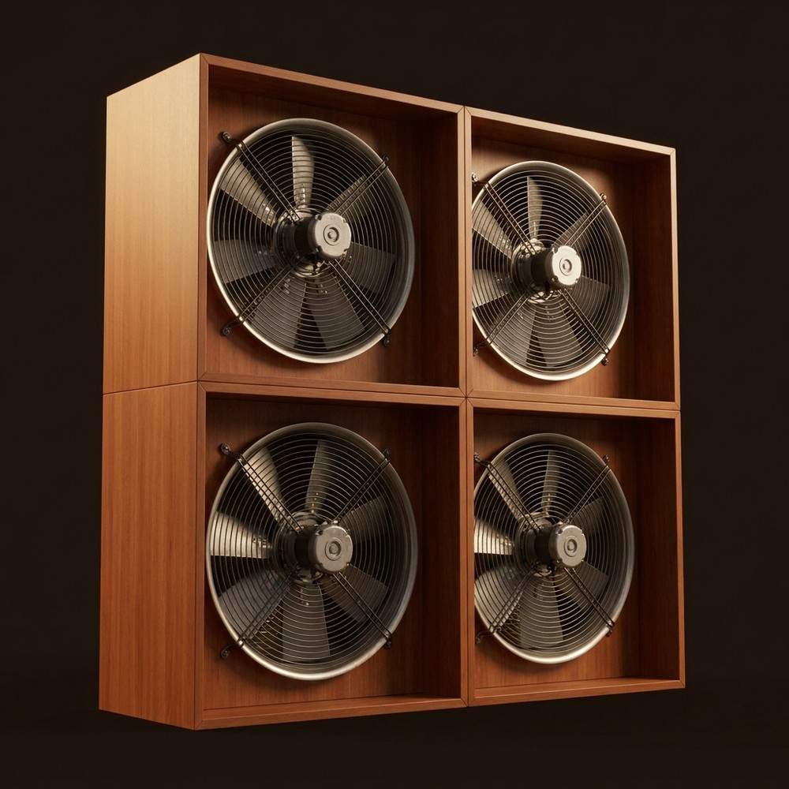
MARKET · PUSHBACK
And communities are pushing back
Community pushback now blocks or delays more data center projects than ever.
COMPLAINT
COMPLAINT
Aesthetics
Noise
Windowless boxes on farmland. Counties answer with setbacks and design standards.
Fans, chillers, generator tests. Property-line decibel limits are spreading.
SUPERWOOD Facades, fences and screens that read as architecture.
SUPERWOOD Acoustic screens and barriers; quieter fan enclosures and ductwork.
Concept renderings
75 projects, about $130 billion, blocked or delayed in one quarter
Rules are following
Q1 2026, as much as all of 2025. 833 opposition groups in 49 states.
Henry County, Virginia: 1,000 ft setbacks, 50 dBA at the property line.
We help with these two. We can go much further: into the structure of the building and what is inside it.
Note 4
InventWood · Market
Confidential

Slide 6
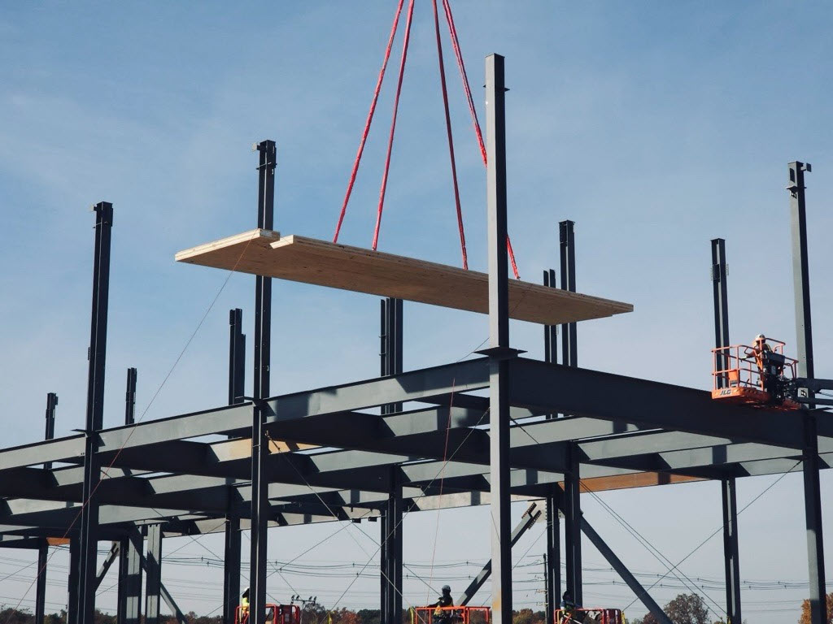
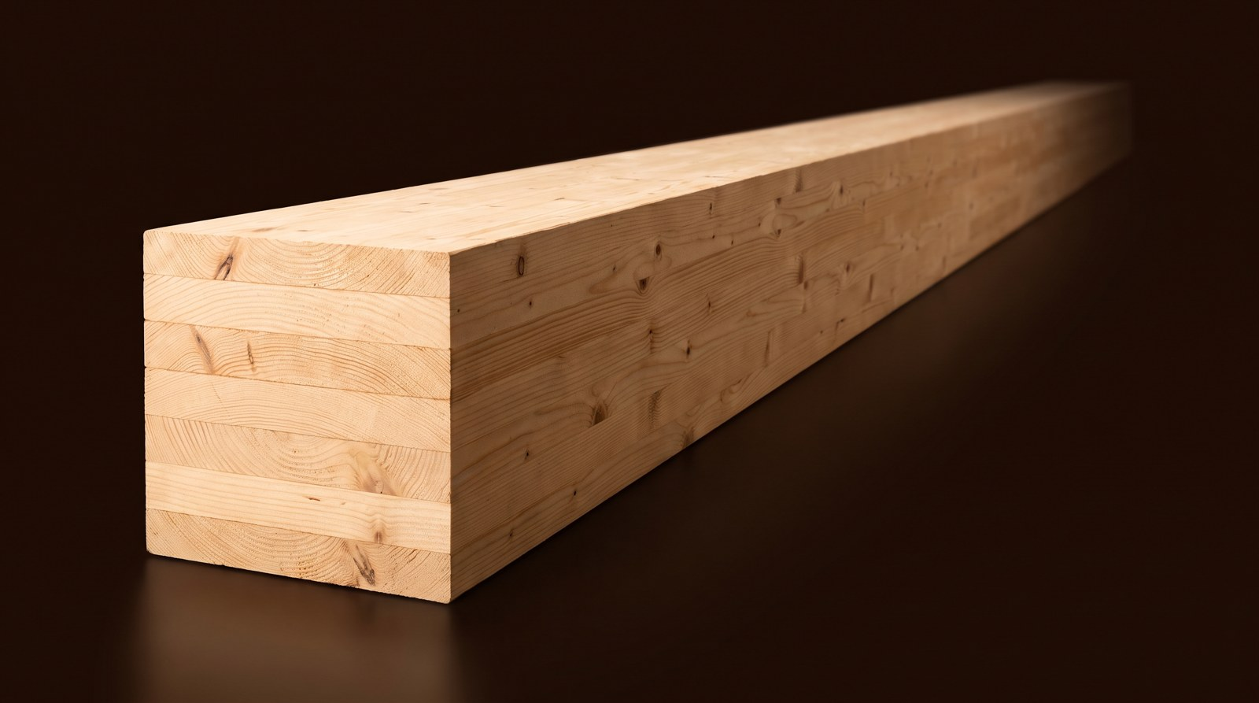
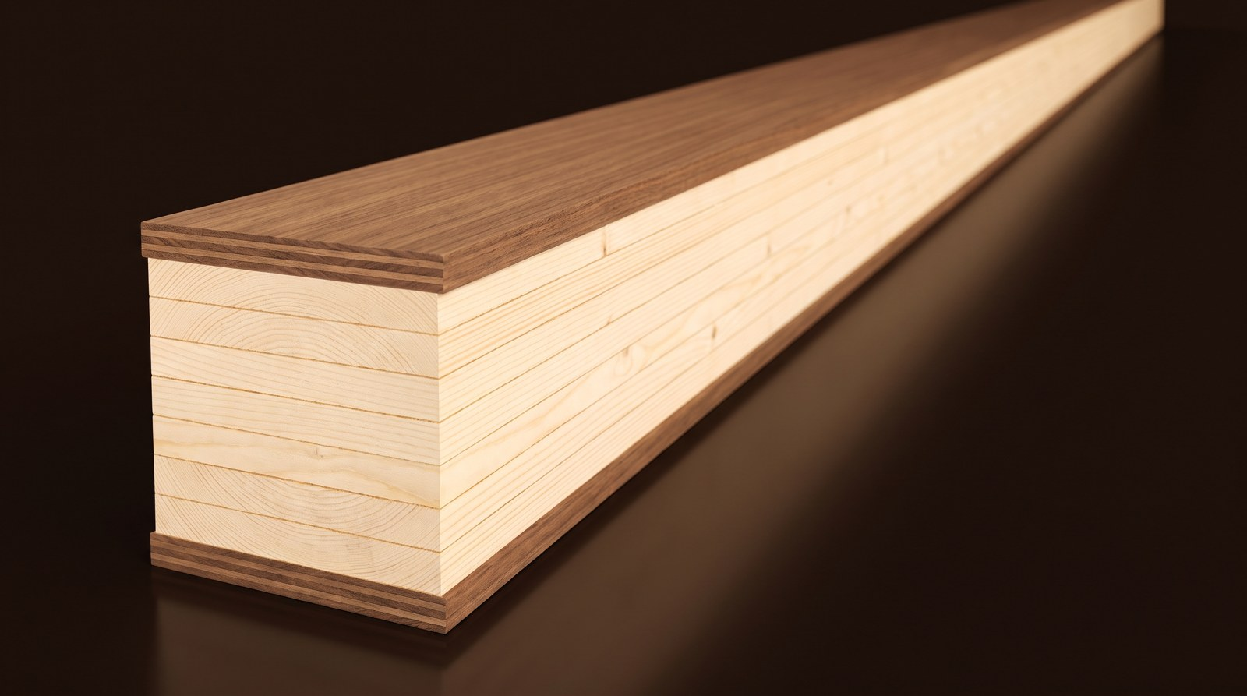
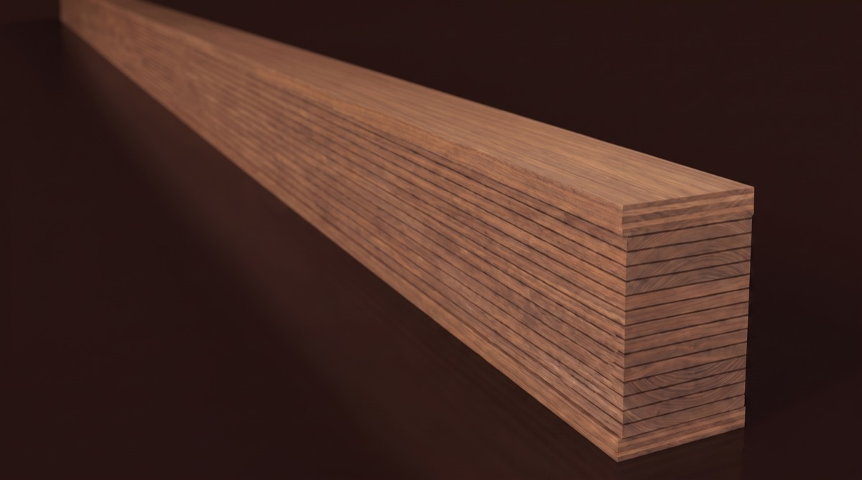

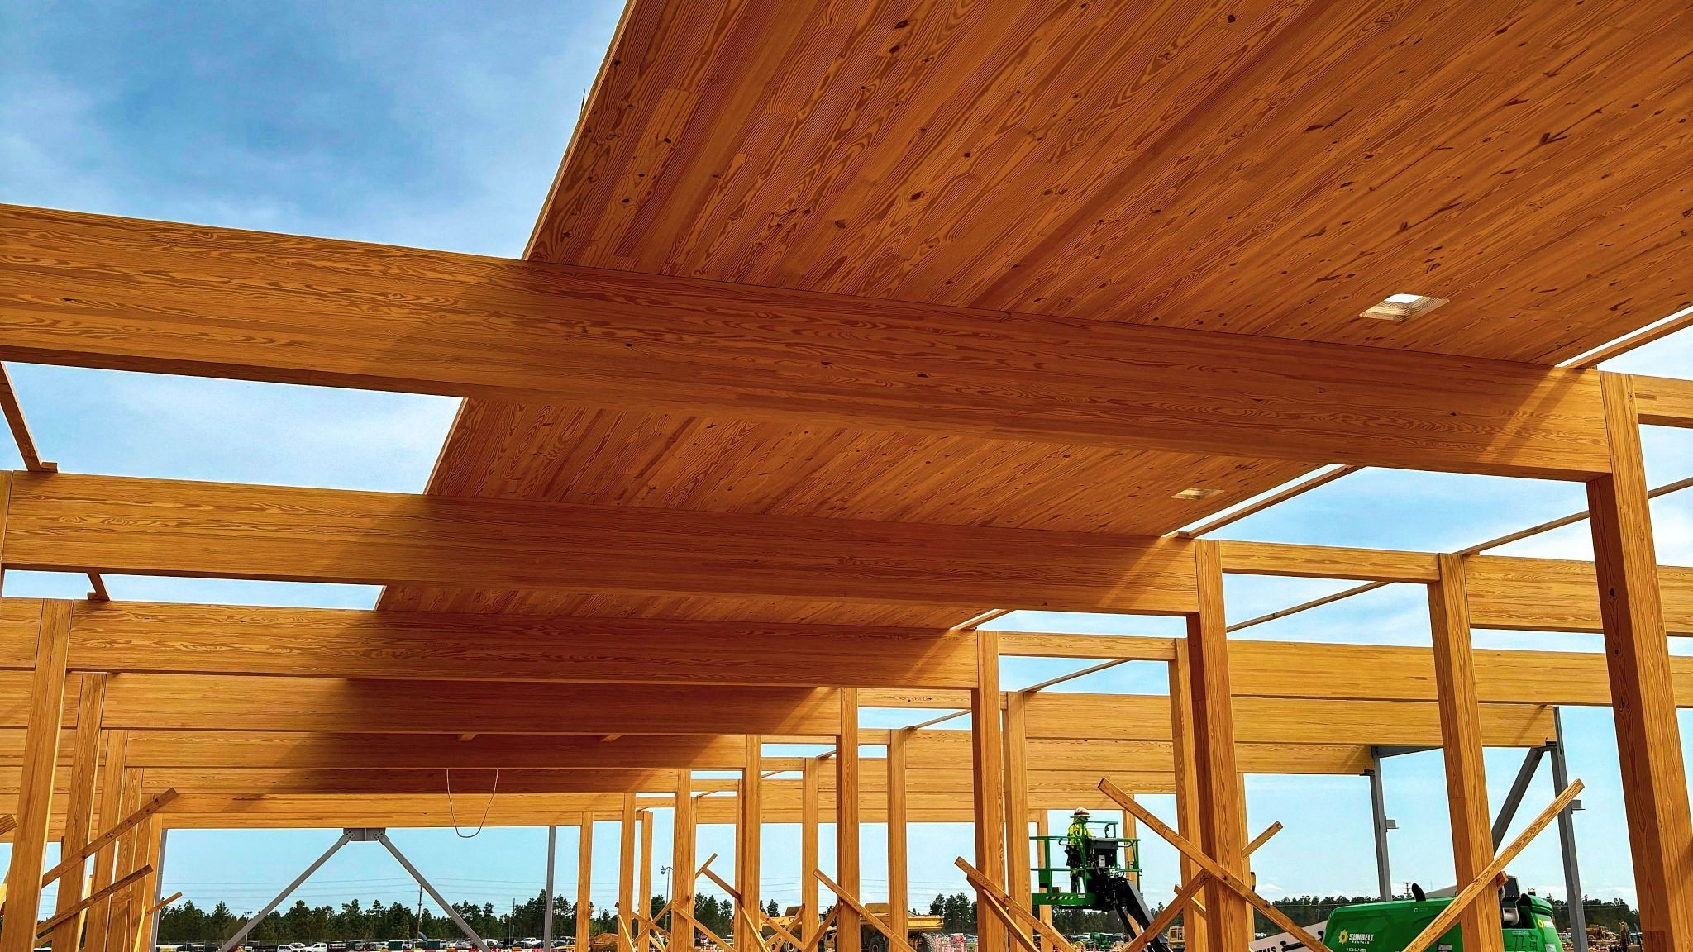

MARKET · MASS TIMBER
Hyperscalers are already building structures with wood. We turbocharge wood.
MASS TIMBER TODAY (CLT, GLULAM)
WITH SUPERWOOD
Photo: Microsoft
Two Northern Virginia datacenters with cross-laminated timber floors on a steel frame — about 35% less embodied carbon than conventional steel construction, 65% less than precast. Gensler; Thornton Tomasetti.
What it replaces
Concrete floor slabs and decks; some columns and beams
Adds the steel: members, skins, screens and fences; later, enclosures and foundations
Microsoft Source, Nov 2024
Strength
Lumber-grade; large sections carry the load
Tensile strength above ASTM A36 steel in samples, at one-sixth the weight; thin, dense members
Enhancing mass timber
Glulam and CLT at lumber stiffness
Mass-timber enhancement: SUPERWOOD outer laminations (~10% of section) raise a glulam beam's stiffness ~75% and strength ~100%
Photo: Meta
Exterior use
Needs protection from weather
Exterior grade; resists moisture, pests and rot
Mass-timber data-center administrative buildings: Aiken, South Carolina completed 2025 (DPR, SmartLam); Cheyenne and Montgomery under way; about 41% less embodied carbon in the materials substituted.
Fire
Chars; established assemblies
Chars; far better than ordinary wood — Class A demonstrated in testing
Meta Sustainability, 31 Jul 2025
Code path
Established in the building codes
Certifiable under wood standards today; SUPERWOOD-specific standards are the goal
Note 5
InventWood · Market
Confidential

Slide 7
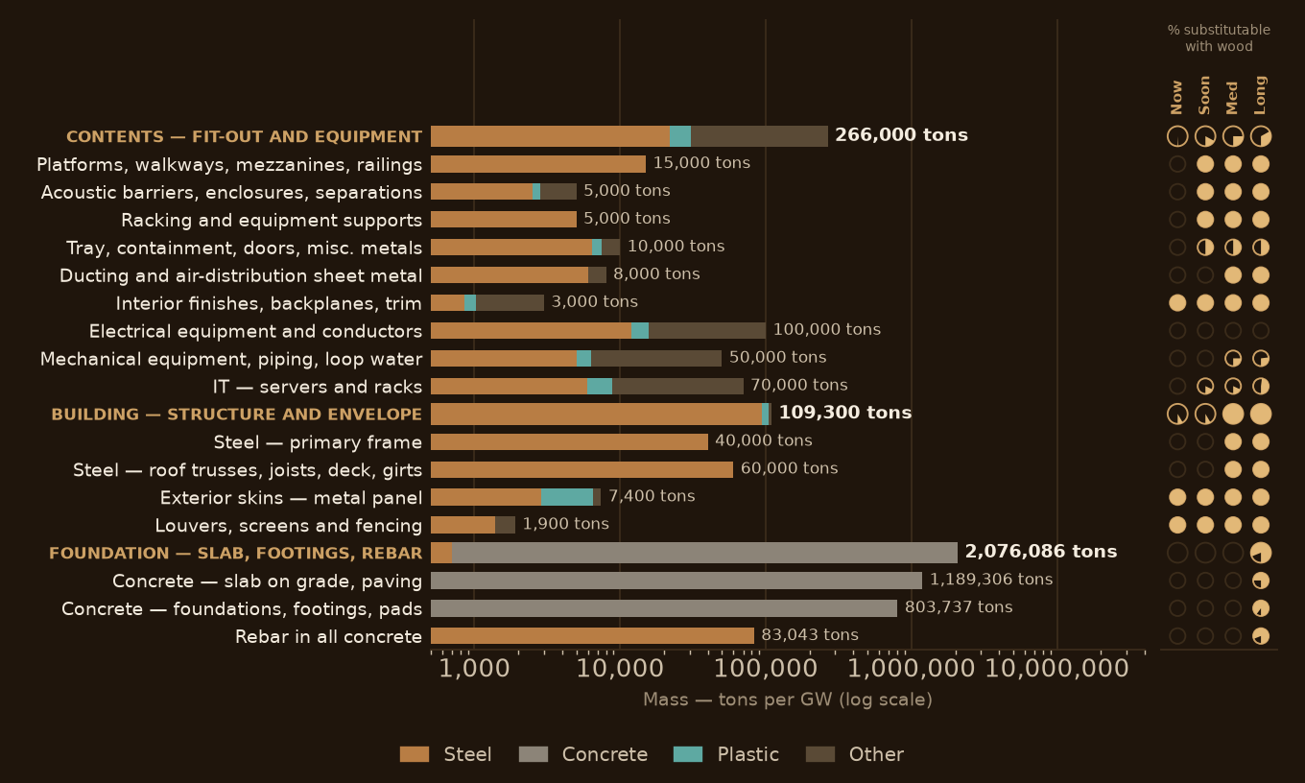
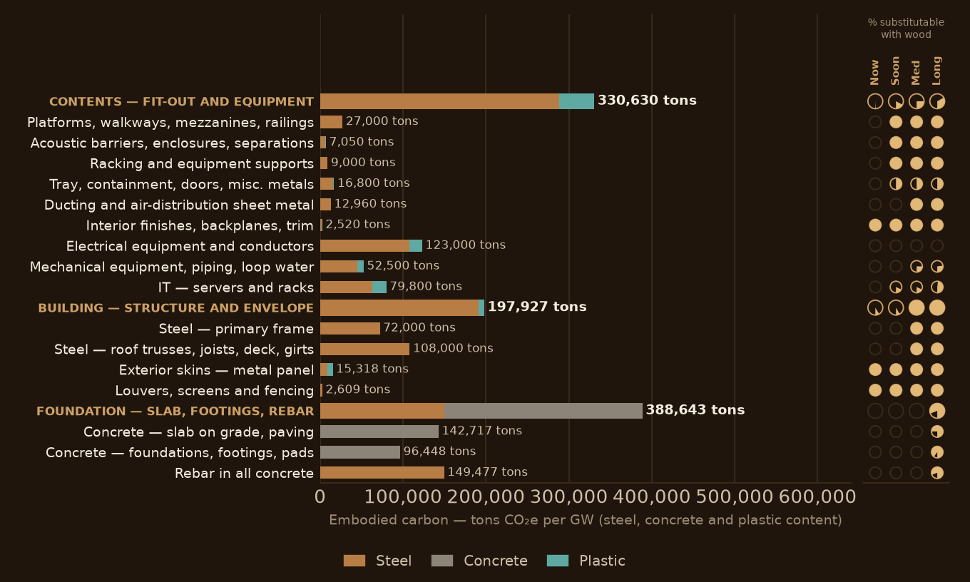
MATERIALS
50–80% of a data center’s building and contents are steel
BY MASS
BY EMBODIED CARBON
50–80% of the above-ground portion of a data center is steel
By embodied carbon, steel is about two-thirds of everything estimated, including the steel inside the equipment
Structure, envelope and contents — frame, roof, skins, platforms, racks, enclosures, equipment. Skins, screens and fences now; racks, platforms and barriers next (racks are a few months of development away); frame and roofs as structure; server enclosures eventually; never the electronics.
Building materials alone are about 60% steel at the global-average factor, about a third with recycled steel. The steel and plastics in electrical, mechanical and IT equipment add roughly 250,000 tons CO₂e.
Note 6
InventWood · The size
Confidential

Slide 8
THE SIZE
Just one data center can consume the entire output of a SUPERMILL
SUPERWOOD a 1 GW data center could require, by horizon, against what each mill makes in a year.
bar scale 0–12 years, dashed tick at one year
HORIZON
SUPERWOOD REQUIRED
YEARS OF MILL OUTPUT
Immediate — skins, screens, fences
1,200–2,700 tons (1.4–3.1M sf)
1.4–3.1 years of SuperMill One
Soon — racks, platforms, barriers
4,300–26,000 tons
0.1–0.8 years of SuperMill Two
Medium term — frame, roofs, enclosures
17,000–72,000 tons
0.6–2.3 years of SuperMill Two
Long term — slab, foundations
25,000–296,000 tons
0.8–9.4 years of SuperMill Two
SuperMill One ≈ 900 tons a year (1M sf) · SuperMill Two ≈ 31,000 tons a year (36M sf)
Note 7
InventWood · The size
Confidential

Slide 9
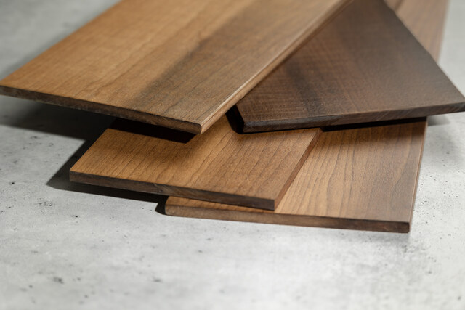







THE FIT
SUPERWOOD’s properties are a great fit for data centers
STRONG
Able to carry the required loads — tensile strength above ASTM A36 steel in production samples
LIGHT
One-sixth the weight of steel: faster and safer to transport and install, and reduced structural requirements
NATURALLY BEAUTIFUL
The texture, colors and warmth of wood — the biophilic, community-facing surface
DURABLE AND IMPACT RESISTANT
Harder and more dent-resistant than oak; impact and storm resistant; exterior grade resists moisture, pests and rot
INSULATING, NOT CONDUCTING
Stronger than steel. One-sixth the weight. Made from wood, in America.
Thermal and electrical insulator — no thermal bridging, and non-conductive around electrical infrastructure
SOUND AND VIBRATION DAMPING
Particularly for HVAC enclosures, acoustic barriers and equipment screens
RF TRANSPARENT
Useful in niches: antenna screening, timing-antenna enclosures, telecom shelters
Note 8
InventWood · The fit
Confidential

Slide 10
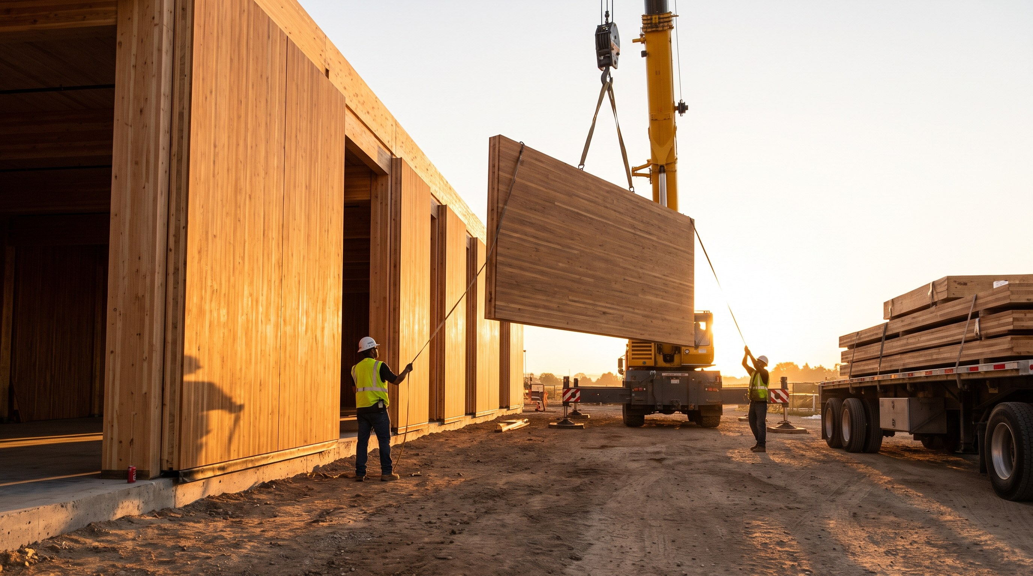
THE FIT
Enabling data centers that are faster to build, lighter, reconfigurable and relocatable
01
One-sixth the weight of steel
Smaller cranes and crews, easier transport, lighter foundations. Time to power is what hyperscalers optimize.
02
Prefabricated to precision
Panels and modules built off site and set like mass timber — standardized designs, plug-and-play systems.
03
Designed for assembly and disassembly
Reusable, reconfigurable components for infrastructure that changes with every hardware generation.
Concept rendering
04
Mass timber's schedule record
About 20% average schedule savings across seven case studies, up to 25–30% in others. SUPERWOOD builds the same way.
In a fast-changing industry, this really matters.
Note 9
InventWood · The fit
Confidential

Slide 11
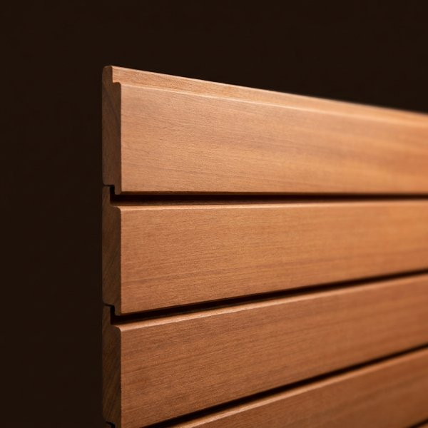
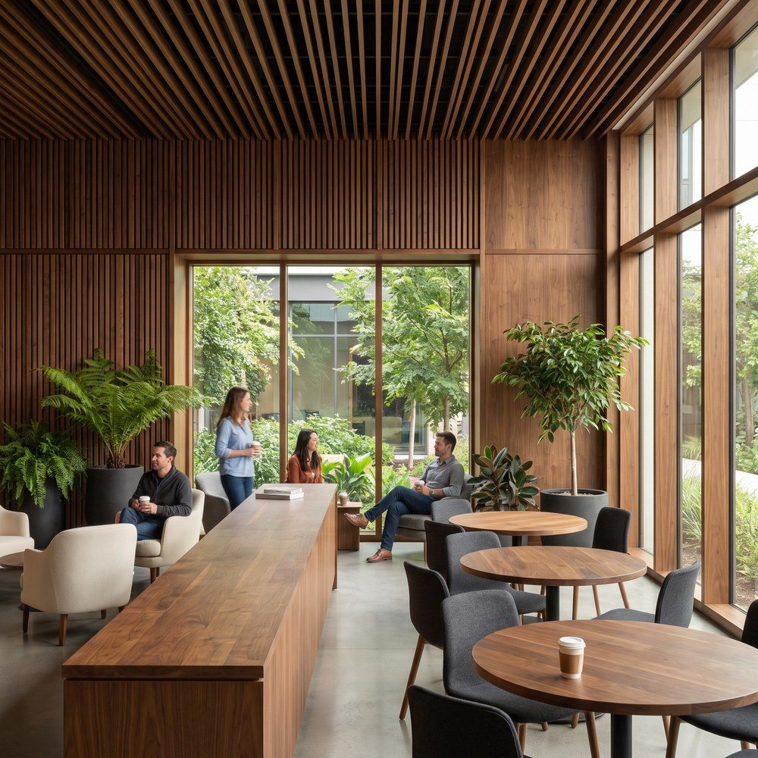

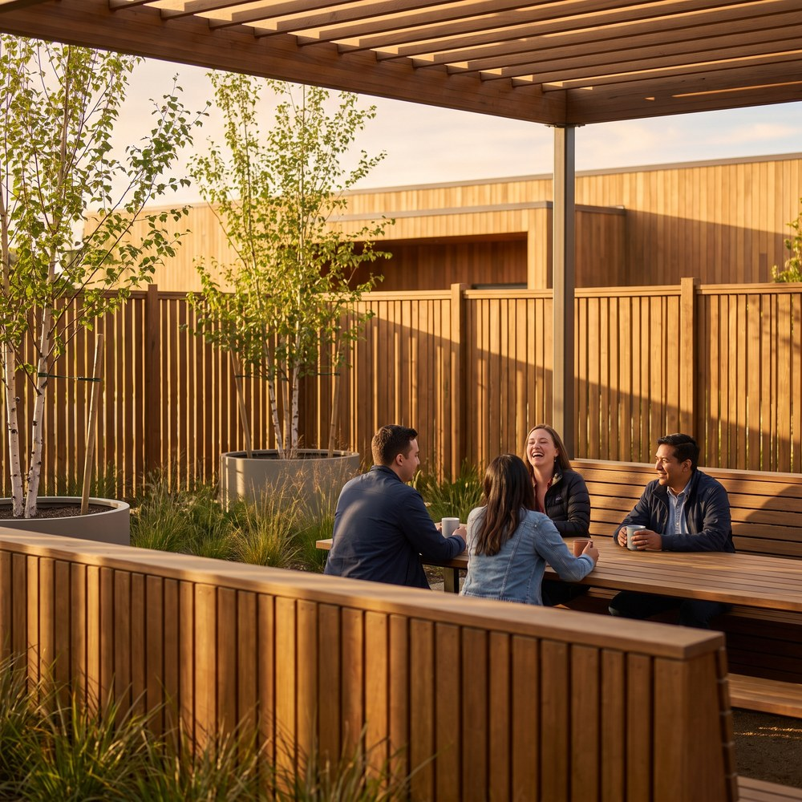
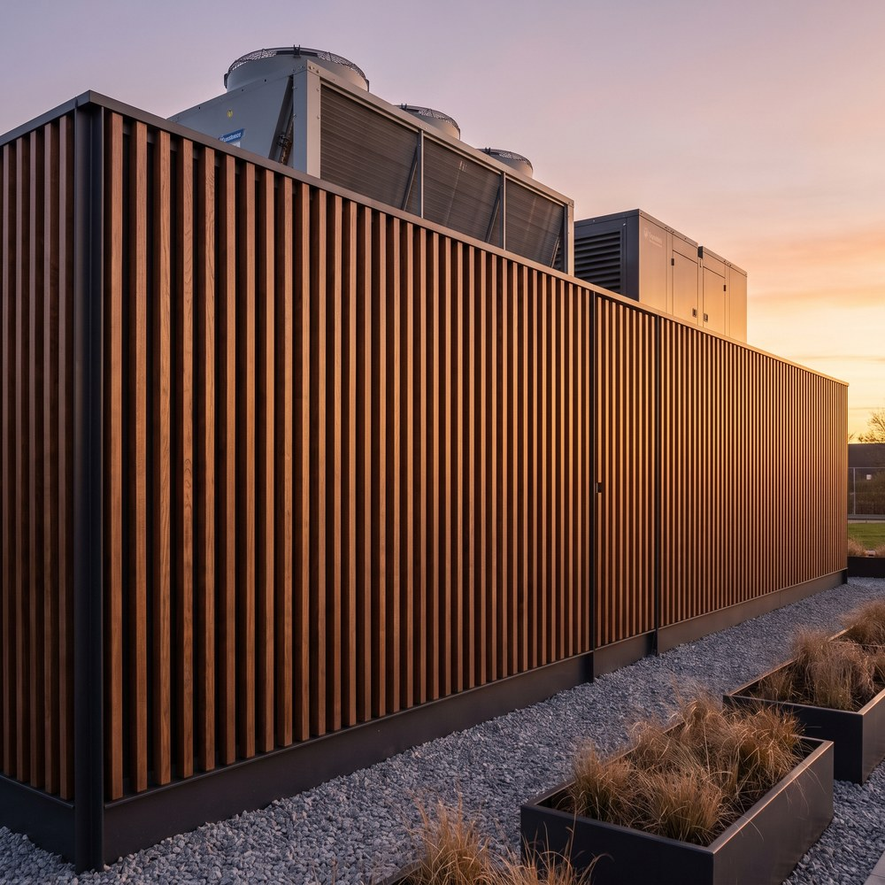
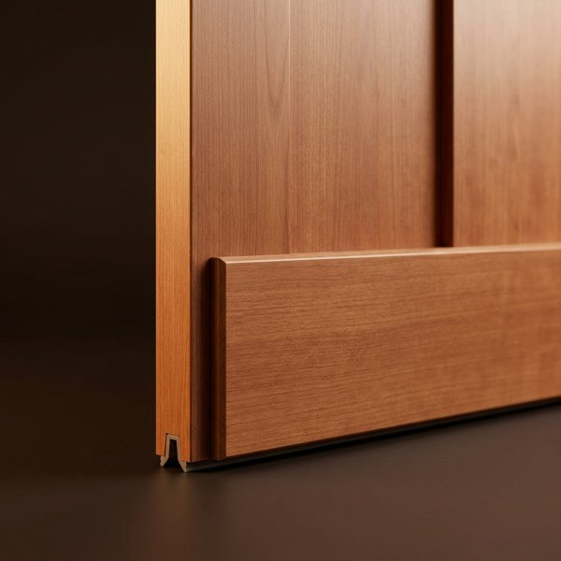
APPLICATIONS · IMMEDIATE
Skins, screens and fences ship today from SuperMill One
Every item below ships today as boards up to 8" × 16' × 3/8", exterior or interior grade. SuperMill One makes about one million square feet a year across all markets.
IMMEDIATE shipping from SuperMill One · SOON 1–3 years; straightforward applications engineering · MEDIUM TERM complex applications engineering such as full building systems, new form factors, or materials engineering · LONG TERM 5+ years; technical potential with no design or code pathway yet
Facades, cladding & rain screens
Biophilic interiors for office space
Louvers & equipment screening
Fencing for staff outdoor spaces
Security fencing around transformers & outdoor infrastructure
Trim, door kicks & sub-framing
Concept renderings
Why these first. They need no assembly fire rating — where a finish rating applies, Class A has been demonstrated and is specified per order. They sit where the community and the workforce see the data center. And they are the near-term projects our hyperscaler customers asked for: facades, biophilic office interiors, staff-area fencing, security fencing around critical outdoor infrastructure.
InventWood · Applications
Confidential

Slide 12
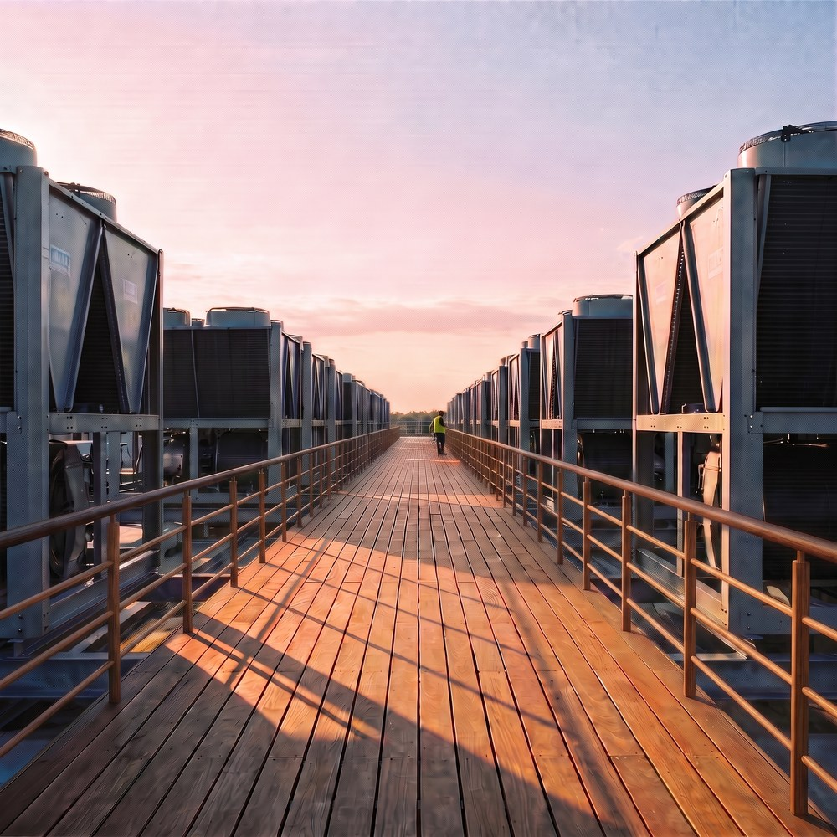
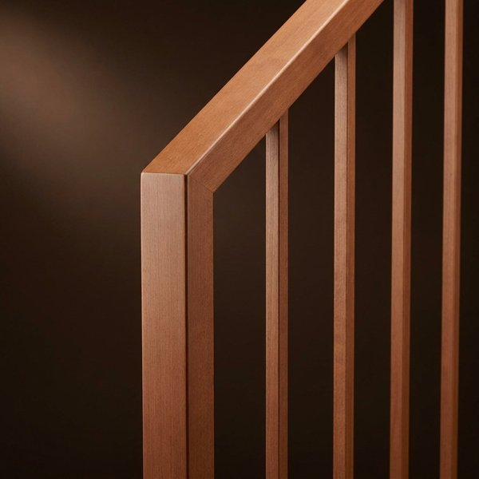
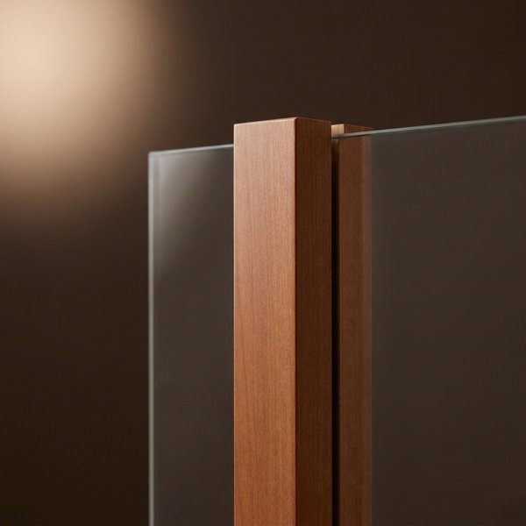
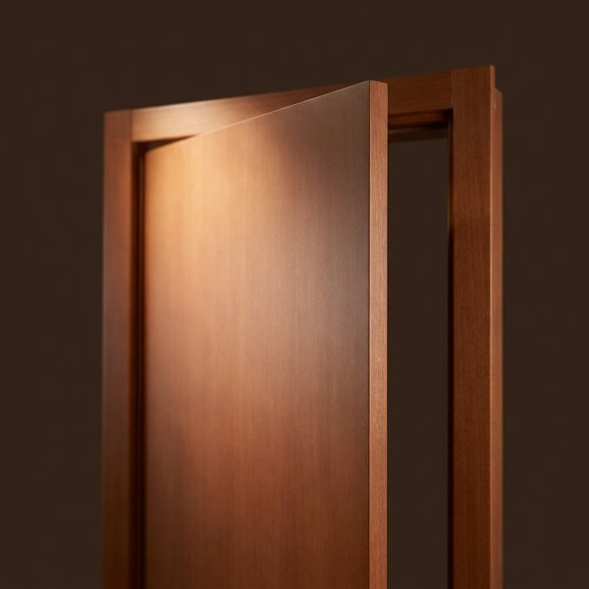
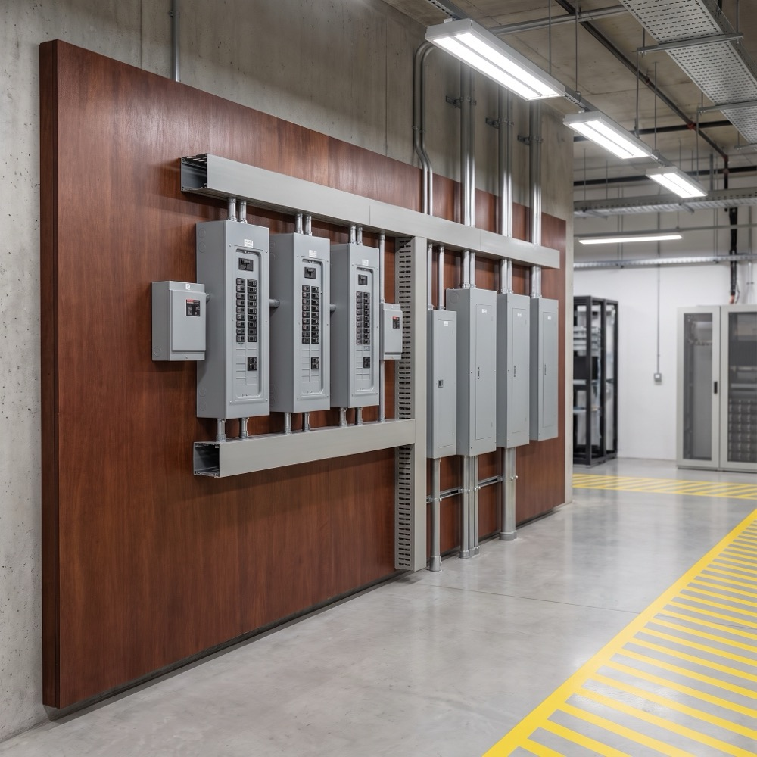
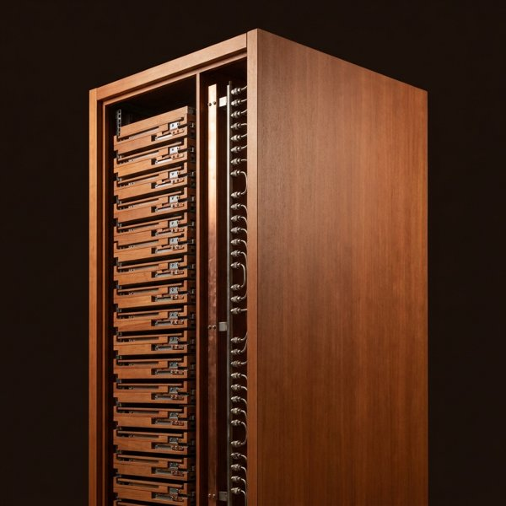
APPLICATIONS · SOON (1–3 YEARS)
Other products require only straightforward engineering
Fan enclosures & ducting
Walkways & platforms
Railings
Window mullions
Interior doors & door protection
Equipment backplanes
Racks & equipment supports
Concept renderings
Each needs one scoped test program, which can be co-funded with a customer. Order depends on which a customer picks up first.
InventWood · Applications
Confidential

Slide 13
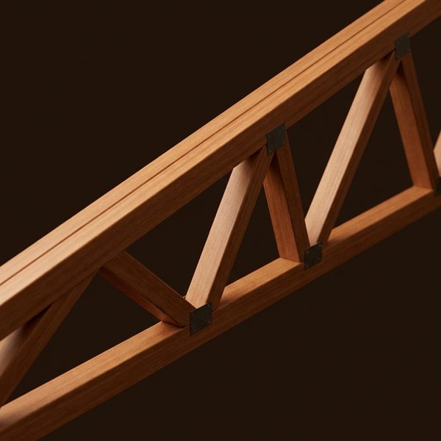
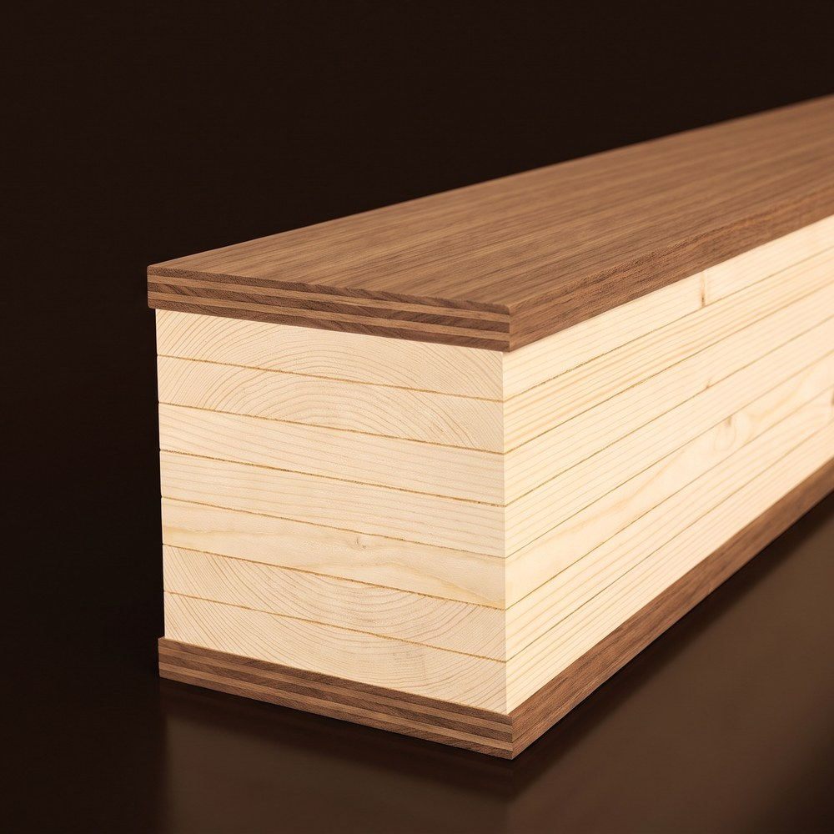
APPLICATIONS · MEDIUM TERM
We’re starting structural product development today, enabling scale with SUPERMILL TWO
UNDER DEVELOPMENT WITH SUPERMILL ONE OUTPUT
AT SUPERMILL TWO SCALE
Truss design is starting. Mass-timber enhancement — SUPERWOOD laminations that stiffen and strengthen glulam and CLT-type members — is under way. Light structural components (non-life-safety): strut-type supports, window mullions, deck boards.
We expect structural sales on the way to SuperMill Two. Replacing structural steel is the first thing new data-center customers ask about.
Window mullions
Trusses, roofs & long-span members
Slender, stiff curtain-wall and storefront mullions in place of aluminum and steel — light structural, non-life-safety
Roof structure first; long-span floors and canopies follow
CLT-type floor, roof & wall assemblies
Heavy equipment supports & server enclosures
Starting with SUPERWOOD hybrid glulam: SUPERWOOD outer laminations on a glulam core. Thin, far stronger panels follow through the mass-timber product route
Racks come soon, a few months of development; enclosures for servers and equipment follow; the electronics are never replaced
Concept renderings
How qualification works. Every structural application is qualified through a scoped test program with the customer who picks it up first, on the pathway mass timber has already opened in the building codes, with insurer acceptance for structural use. Test methods and property data are available on request.
InventWood · Applications
Confidential

Slide 14
APPLICATIONS · LONG TERM (5+ YEARS)
Longer term, we can do fully prefabricated envelopes and even fast, light foundations
Prefabricated building envelopes
Foundations, slabs and paving
Hyperscalers are asking for this now, to simplify design and delivery and accelerate schedules.
Biggest unaddressed impact both to speed of development and construction, and with huge carbon impact. Geotechnical requirements greatly impact schedule and site selection.
Structure and skin shipped as panels and modules — the co-development target with our hyperscaler customers' architects and engineers. Shells that carry their own loads, weigh far less than steel and precast, and can be disassembled and moved.
Lightweight, insulated SUPERWOOD foundations and slabs in place of concrete — installed faster, with lower geotechnical demands, and potentially movable.
Stated technical potential, not an engineered plan: slab, paving and foundations are on the order of 1–2 million tons of concrete and rebar per gigawatt. No design or code pathway exists yet.
InventWood · Applications
Confidential

Slide 15



CUSTOMERS
We’re engaging thoughtfully and deeply with customers
CONVERSATIONS
APPLICATIONS IDENTIFIED
PROJECTS SCOPED
TESTING & MOCKUPS
FIRST PURCHASE
BASIS OF DESIGN
WHAT THEY ARE DOING WITH US
Microsoft
Facades, biophilic interiors, staff and security fencing under discussion; roof-truss and enclosure work with their architecture and engineering firms; interest in SUPERWOOD in the basis of design
Next: First skin project on one building or yard
Meta
Engaged for over a year across the data-center ecosystem; facade applications and backplanes under way; structural applications and racking to follow
Next: Backplane listing; first facade project
Google
Engagement just begun; initial focus on replacement of structural steel
Next: Scope with their design teams
Vertiv
Data center equipment builder exploring SUPERWOOD components
Next: Identify first applications
Data center operators
Operators focused on security fencing around outdoor infrastructure
Next: Fence specification and quote
ENGINEERING AND CONSTRUCTION COLLABORATORS
Don Davies, advisor
Top timber engineers
#1 US data center contractor, ENR 2025
#1 US contractor, ENR Top 400
Former president of MKA; structural engineer for several hyperscalers
Note 10
InventWood · Customers
Confidential

Slide 16
CUSTOMERS
Working on both immediate and large-scale, strategic opportunities
Microsoft broad engagement
Meta engaged for over a year
Two Northern Virginia datacenters built with cross-laminated timber floor panels on a steel frame — an estimated 35% embodied-carbon reduction vs. conventional steel construction and 65% vs. precast concrete. Design by Gensler; structural engineering by Thornton Tomasetti.
Piloting mass timber for data center administrative buildings: first completed in 2025 at Aiken, South Carolina (DPR, SmartLam); projects under way in Cheyenne, Wyoming and Montgomery, Alabama — about a 41% reduction in the embodied carbon of the materials substituted.
WORKING WITH INVENTWOOD
WORKING WITH INVENTWOOD
Strategic interest
Broad engagement
Incorporating SUPERWOOD into the basis of design for future data centers
Across every part of the data-center ecosystem, for more than a year
Application areas
Under way
Roof trusses, leading to roofs and fast-to-build enclosures — with their principal architecture and engineering firms
Facade applications and equipment backplanes
Immediate opportunities
Next
Building facades · biophilic interiors · staff-area fencing · security fencing around transformers
Concept rendering — security fencing around a transformer yard
Structural applications and racking over time
Concept rendering — equipment backplane in an electrical room
InventWood · Customers
Confidential
Notes:
Sources and details. Microsoft: Microsoft Source, Nov 2024, https://news.microsoft.com/source/features/sustainability/microsoft-builds-first-datacenters-with-wood-to-slash-carbon-emissions/ — two Northern Virginia datacenters with CLT floor panels on a steel frame, about 35% less embodied carbon than conventional steel construction and 65% less than precast; Gensler; Thornton Tomasetti project page https://www.thorntontomasetti.com/project/microsoft-mass-timber-data-centers. Meta: Meta Sustainability, 31 Jul 2025, https://sustainability.atmeta.com/blog/2025/07/31/meta-pilots-mass-timber-for-more-sustainable-data-center-construction/ — mass-timber pilot for administrative buildings; Aiken SC completed 2025 (DPR, SmartLam); Cheyenne WY and Montgomery AL under way; about 41% less embodied carbon in the materials substituted.

Slide 17
BEYOND DATA CENTERS
We’ll build on the data center opportunity to springboard us into much larger markets
01
02
03
04
Data centers
Interior and exterior products
Structural members
Optimized buildings
Skins, fences and screens now; structure with SuperMill Two. A hyperscaler basis of design is the proof point.
The same boards across commercial construction. $100B+ market.
Members proven in data centers move to offices, warehouses and industrial buildings. $400B+ market.
Prefabricated envelopes and light foundations designed around the material. $700B+ market.
Behind all of it: steel is a $1.5 trillion a year market and concrete $1 trillion.
Note 11
InventWood · Beyond data centers
Confidential

Slide 18

Let's build what's next.
Data centers are short of steel and already build with wood.
SUPERWOOD turbocharges that wood: skins and fences now, structure in the medium term.
One basis-of-design win with a hyperscaler is the demand case for SuperMill Two.
Company, mills, cost roadmap and the raise: SUPERMILLS Investor Overview
Alex Lau · CEO / Co-Founder · alex@inventwood.com
Lex Harris · Director, Capital Markets & IR · lex@inventwood.com

Slide 19
APPENDIX · CARBON
Embodied carbon: LCA based on SUPERMILL TWO projections
KG CO₂E, CRADLE TO GATE · EMISSIONS RIGHT OF ZERO, STORAGE LEFT
Steel — global average (BF-BOF), per kg of steel
SUPERWOOD carbon estimates are based on the LCA developed by Professor Ming Hu, University of Notre Dame.
1.8 kg
Steel — recycled (EAF), per kg of steel
0.4–0.7 kg
SUPERWOOD — per kg of steel substituted at 3:1 to 4:1 replacement by weight, projected: emissions right, carbon storage left
+0.1–0.2 · −0.1 to −0.5 kg
Biogenic carbon, reported separately. SUPERWOOD stores 0.5–1.5 kg CO₂e per kg of SUPERWOOD as biogenic carbon, 0.1–0.5 kg per kg of steel it substitutes. Under EN 15804 it is released again in the end-of-life module, so it nets to zero over the life cycle; the lasting advantage is lower manufacturing emissions.
Note 12
InventWood · Appendix
Confidential

Slide 20
NOTES
Notes and sources
1 Slide 2 · We help data centers decarbonize and improve their impact on communities, while they accelerate SUPERWOOD's journey from premium skins into structural applications
The company, team, mills, cost roadmap and the raise are in the SUPERMILLS Investor Overview. This deck covers one application. Strength: company test data vs ASTM A36; data center sizing: company estimate (slides 5–6).
2 Slide 3 · Data center construction is growing dramatically
US Census Bureau, Construction Spending (C30), private data center construction put in place: July 2026 preliminary seasonally adjusted annual rate $75.2B vs $47.8B in July 2025 (+57%); bars are calendar-year totals, not seasonally adjusted; 2026 estimated from the January to July pace; buildings only, servers excluded. JLL North America Data Center Report Midyear 2026 (66 GW). McKinsey, AI power (2025). JLL Global Data Center Outlook 2026. Dell'Oro Group (2026). Steel intensity: arXiv 2509.21312, secondary; tonnage derived. Shortage statements are what customers report to InventWood.
3 Slide 4 · Resulting in supply chain challenges
Lead times: Wood Mackenzie 2026 survey as reported by POWER and Data Center Knowledge. Aluminum: Federal Register, Final 2025 List of Critical Minerals (Nov 2025). Steel shortage: what customers report to InventWood. Tariffs: Congressional Research Service IN12519; Construction Dive on the full-value rule, 2026.
4 Slide 5 · And communities are pushing back
Data Center Watch, Q1 2026 report (June 2026). Virginia HB 153; Henry County, VA ordinance, Aug 2026. Electricity rates and water are the other leading objections; SUPERWOOD does not address them.
5 Slide 6 · Hyperscalers are already building structures with wood. We turbocharge wood.
Sources: news.microsoft.com, Nov 2024; Thornton Tomasetti project page; sustainability.atmeta.com, 31 Jul 2025. Logos and photographs are the companies' own, from the cited publications, used to identify the published projects. SUPERWOOD strength: company test data, parallel-to-grain tension. Hybrid-beam gains: derived from beam theory with SUPERWOOD modulus and strength, engineering write-up pending. Beams: concept renderings.
6 Slide 7 · 50–80% of a data center’s building and contents are steel
Company estimate for a 1 GW IT-load data center, high case. Only the concrete and structural-steel intensities are published (arXiv 2509.21312, a secondary source); other rows are estimates from unit masses. Carbon factors: steel 1.8 kg CO₂e/kg (global average; recycled 0.4–0.7), concrete 0.12; carbon is valued on each row's steel, concrete and plastic content (material split per component: estimates, analyses/material_split.json; polymers at an average 3.0 kg CO₂e/kg); copper, aluminum, electronics, water, gypsum and wood not valued. Concrete: footprint bottom-up with moderate soils (slab, footings, pads, paving, yard mats; the published 500–1,000 m³/MW intensity is the upper comparison). Steel share: company estimate; the 50–80% band covers metal-panel and tilt-up concrete wall designs. Horizons: immediate = shipping; soon = 1–3 years, straightforward applications engineering; medium term = complex applications engineering, new form factors or materials engineering; long term = 5+ years, technical potential with no design or code pathway yet.
7 Slide 8 · Just one data center can consume the entire output of a SUPERMILL
Company estimate from the slide 6 model, low–high scenarios, moderate soils; 0.3–0.6 substitution factor for steel, to be engineering-stamped per element; long-term row also includes server enclosures at 40% of IT mass (a small share of the total), electronics excluded. Mill output at 0.87 kg/sf, 1.3 t/m³. Pricing is set per application; see the SUPERMILLS Investor Overview.
8 Slide 9 · SUPERWOOD’s properties are a great fit for data centers
Company test data; property data package and test methods available on request. Fire: chars rather than burns, far better than ordinary wood; ASTM E84 Class A demonstrated in testing, specified per order.
9 Slide 10 · Enabling data centers that are faster to build, lighter, reconfigurable and relocatable
Schedule figures are mass-timber case studies (ULI Urban Land: ~20% average across seven case studies, 12.7 vs 15.4 months; other studies 25–30%), used as an analogy for a material that builds the same way. No SUPERWOOD schedule data yet.
10 Slide 15 · We’re engaging thoughtfully and deeply with customers
Next steps undated. Published backup for Microsoft and Meta on the next slide.
11 Slide 17 · We’ll build on the data center opportunity to springboard us into much larger markets
Market sizes are company estimates from the SUPERMILLS Investor Overview; steel and concrete figures are global annual market estimates (ready-mix concrete only).
12 Slide 19 · Embodied carbon: LCA based on SUPERMILL TWO projections
SUPERWOOD 0.5 kg CO₂e/kg manufactured and 0.5–1.5 kg/kg biogenic storage: company projections, pre-LCA. Steel 1.8 kg/kg: global BF-BOF average. EAF 0.4–0.7 kg/kg: typical published range for recycled-scrap steel. Replacement 3:1 to 4:1 by weight (0.25–0.33 kg SUPERWOOD per kg steel): company assumption. Reductions are arithmetic on these inputs.
InventWood · Notes
Confidential

