Slide 1
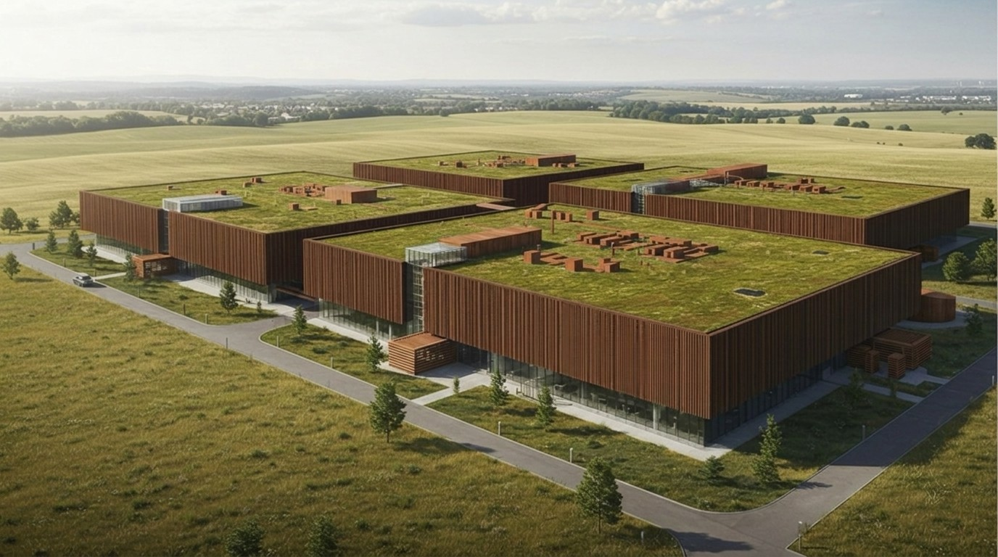

Concept rendering
SUPERWOOD for Data Centers
Companion to Super Mills America · September 2026
INVENTWOOD · CONFIDENTIAL

Slide 2
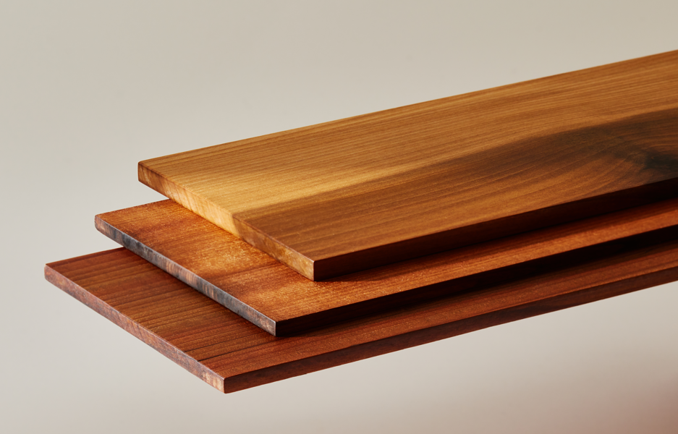
OVERVIEW
What's inside
The company, the mills, the cost roadmap and the raise are in Super Mills America. This deck covers one application: data centers.
01
Why Data Centers
Hungry for materials · large offtake · low carbon and community acceptance · the wedge into structural
02
Technology Fit
How SUPERWOOD is made, what it does, and the standards on the path
03
Impact
Embodied carbon and circularity — labeled as the projections they are
04
Applications
SUPERWOOD boards
Skins and fences now; certification-gated next; structure after
05
Customers
Microsoft, Meta, Google — and who else is at the table
InventWood
Confidential

Slide 3
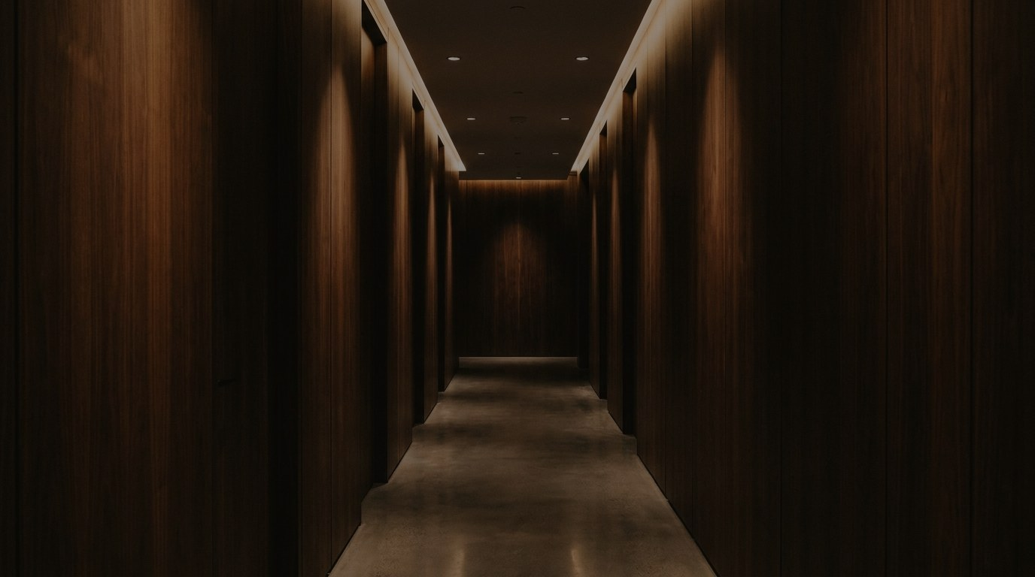
SECTION 01
Why Data Centers
Fast-growing and hungry for materials · large offtake · low carbon and community acceptance · the wedge into structural

Slide 4
WHY DATA CENTERS
Why data centers?
01
Fast-growing market, hungry for materials
02
Large-volume offtake potential
Construction is backlogged and operators tell us they face a shortage of structural steel. Supply chain and timeline are their first concern — and a domestic material that is lighter to ship and faster to erect answers it directly.
Hyperscalers build repeatable campuses to a standard basis of design. One campus envelope program is on the order of SuperMill One's entire annual output; a basis-of-design win is SuperMill Two-scale demand.
03
Desire for low carbon and community acceptance
04
A wedge into structural — a market hungry for solutions
Microsoft and Meta already build data-center structures with mass timber (35% and ~41% embodied-carbon cuts on the elements replaced), reported through EC3 — co-created by our advisor Don Davies. Noise and visual mass drive moratoria; warm, quiet, biophilic exteriors change what the planning commission sees.
Replacing structural steel is the first thing new customers ask about. The mass-timber code pathway lets SUPERWOOD qualify as a new, far stronger species — and what is qualified for a data center is qualified for the broader structural market.
HOW THE WEDGE WORKS
1
Skins and fences today
›
2
Testing, co-developed with customers
›
3
Structural qualification via the mass-timber pathway
›
4
Written into the basis of design
›
5
SuperMill Two-scale offtake
Steel-shortage and backlog statements are what customers report to us (2026). Microsoft: news.microsoft.com, Nov 2024. Meta: sustainability.atmeta.com, Jul 2025. Campus-vs-SuperMill One comparison is a company estimate.
InventWood · Why Data Centers
Confidential

Slide 5
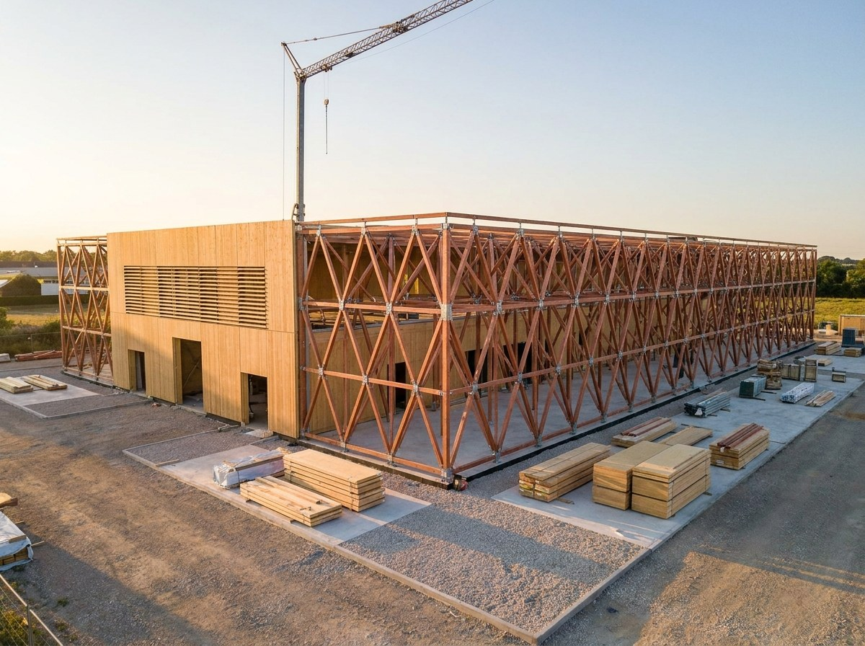
WHY DATA CENTERS
Where SUPERWOOD fits in a campus
NOW · SKINS, SCREENS, FENCES
NEXT · STRUCTURE AND CONTENTS
Facades, cladding and rain screens
Biophilic interiors for office space
Louvers and equipment screening
Fencing for staff outdoor spaces
Security fencing around transformers and outdoor infrastructure
Equipment backplanes
Trim, door kicks, sub-framing
Building enclosures and structural components
Joists, deck and roof assemblies
Trusses and long-span members
Platforms, walkways and mezzanines
Racking and equipment supports
Enclosures and separations
Shells and foundations, longer term
Concept rendering — enclosure and structure are the long game; skins and fences ship now.
Per 10 MW of data center: 500–1,000 t of structural steel and 5,000–10,000 m³ of concrete.
Steel and concrete intensities: arXiv 2509.21312 (Sep 2025), citing Hasan et al. 2022 and Sharma et al. 2023 — secondary literature figures, ranges as published.
InventWood · Why Data Centers
Confidential

Slide 6
SECTION 02
The Technology
How SUPERWOOD is made, what it does, and the standards on the path

Slide 7
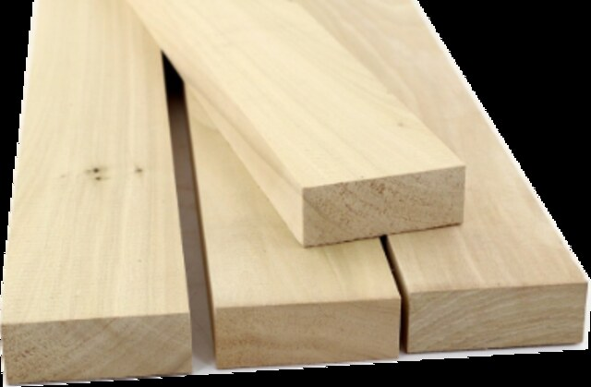
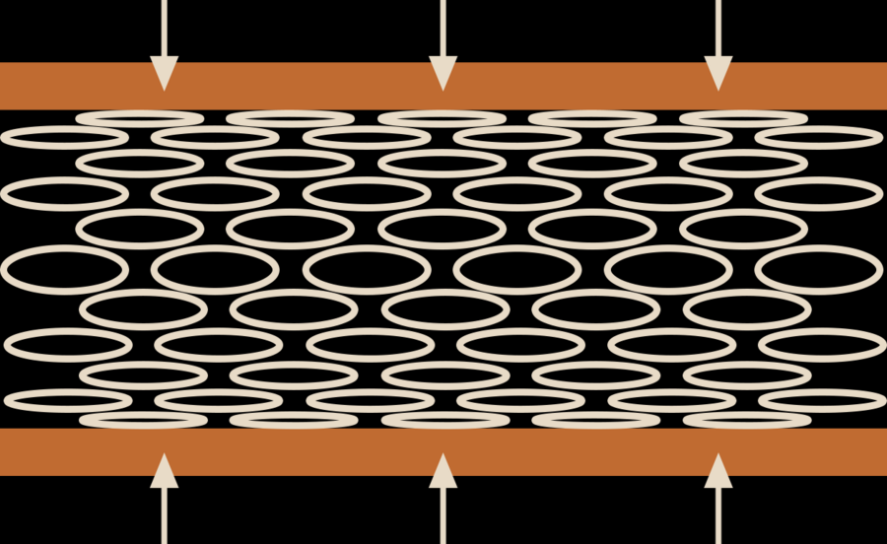
TECHNOLOGY
We unlock the power of cellulose
Our patented process transforms ordinary wood into SUPERWOOD — an environmentally benign process using chemistry common to food and pulp processing.
01 · START WITH WOODY FEEDSTOCK
02 · MOLECULAR RE-ENGINEERING & DENSIFICATION
03 · SUPERWOOD
Hardwoods, softwoods, bamboo, underutilized species, waste wood
3–4× density increase, elimination of pores and defects, and new hydrogen bonds across fibers
Samples more than 50% stronger than A36 steel in tension, at one-sixth the weight
→
→
Before: open cell vessels
No added glues · No polymer binders
After: collapsed, interlocking vessels
InventWood · Technology
Confidential

Slide 8
THE MATERIAL
The strength of SUPERWOOD
50%+
1/6
Up to 10×
600 MPa
stronger than A36 steel in tension — demonstrated in samples
the weight of steel
strength-to-weight ratio of steel
in production today; 1,000 MPa demonstrated in the lab
SUPERWOOD: parallel-to-grain tension, production material. Steel: ASTM A36 structural. Aluminum: 6061-T6. Company test data; design values and methods available on request.
InventWood · Technology
Confidential

Slide 9
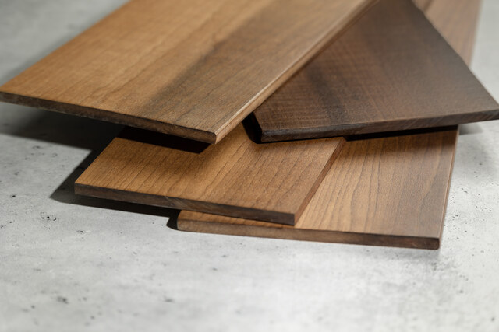







BEYOND STRENGTH
Properties that matter on a data center campus
FIRE RESISTANT
ASTM E84 Class A (surface flame spread) and aerospace standards; dense natural char layer. Assembly ratings: see roadmap
DURABLE AND IMPACT RESISTANT
3× more dent-resistant than oak; impact and storm resistant — suited to fences, screens and door protection
RESISTS MOISTURE, PESTS AND ROT
No rust; protects against termites, mold and fungus for exterior and yard use
THERMALLY AND ELECTRICALLY INSULATING
100× better than steel, 400× better than aluminum; non-conductive around electrical infrastructure
Stronger than steel. One-sixth the weight. Made from wood, in America.
SOUND ATTENUATING
Improved damping vs. steel — the basis for acoustic barriers and equipment screens (STC/OITC testing on the roadmap)
RF TRANSPARENT
Useful in niches: antenna screening, timing-antenna enclosures, telecom shelters
NATURALLY BEAUTIFUL
The texture, colors and warmth of wood — the biophilic, community-facing surface
InventWood · Technology
Confidential

Slide 10
CAPABILITIES & CERTIFICATION ROADMAP
Performance climbs; the code pathway is mapped
IMMEDIATE (2025–26)
MEDIUM TERM (2027–29)
LONG TERM (2030+)
Tensile strength — production
500 MPa
↑
toward 1,000 MPa
Elastic modulus — production
40 GPa
↑
toward 80 GPa
Product forms
Boards up to 8" × 16' × 3/8"
Boards + veneers (SuperMill Two)
Panels & OSB-type products (ChipMill)
Fire & code pathway
ASTM E84 Class A tested. Backplanes: UL 94 (yellow card) — testing not yet started
Trusses: no fire-resistance requirement. ASTM E119 assemblies and NFPA 285 exterior walls — not yet started
FM acceptance and ICC-ES evaluation via the mass-timber qualification pathway
Lab samples have demonstrated 600+ MPa tensile strength, with pathways to 1,000 MPa and 80 GPa. Certification programs are scoped per application with each customer; none has started yet. Test methods and property data available on request.
InventWood · Technology
Confidential

Slide 11
SECTION 03
The Impact
Embodied carbon and circularity — labeled as the projections they are

Slide 12
IMPACT · THE VISION
Can the world's data centers be a carbon sink?
Data centers are poised for massive growth. We asked: can we build them as long-term stores of carbon rather than massive emitters — and earn the social license to operate and scale? We think this is the way to do it:
POWERED by carbon-free electricity
CONSTRUCTED from waste biomaterials
Maximize efficiency and flexibility of load, then power with renewable energy, nuclear, biomass, and potentially BECCS — bio-energy with carbon capture and storage. Serve the grid.
Replace today's carbon-intensive materials with carbon-storing materials — designed for reuse at end of life to maximize lifecycle carbon benefit.
Steel is the lever, SUPERWOOD is the enabler. Steel sits at nearly every level of a data center — frame, joists and deck, platforms, racking, fences and screens. Replacing it element by element with a carbon-storing material is how the building's embodied ledger moves.
InventWood · Impact
Confidential

Slide 13
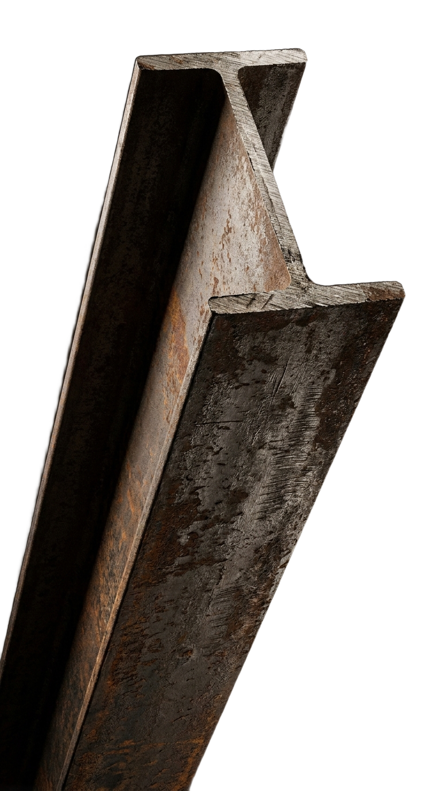
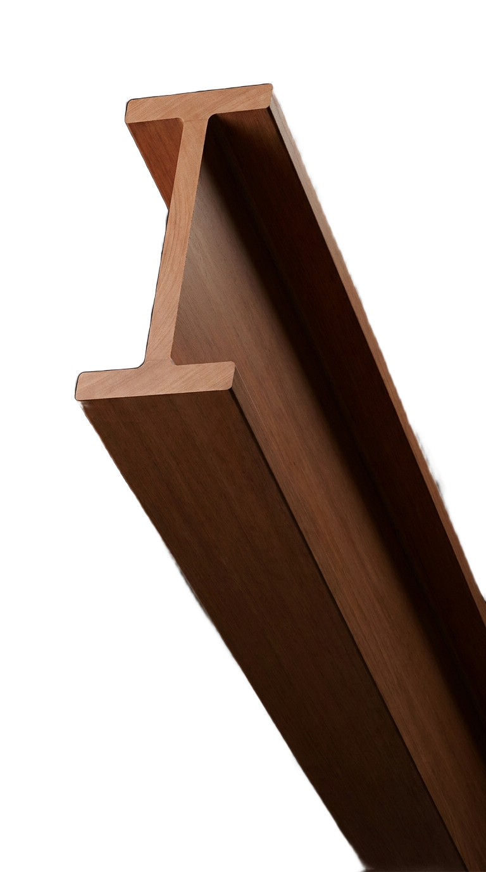
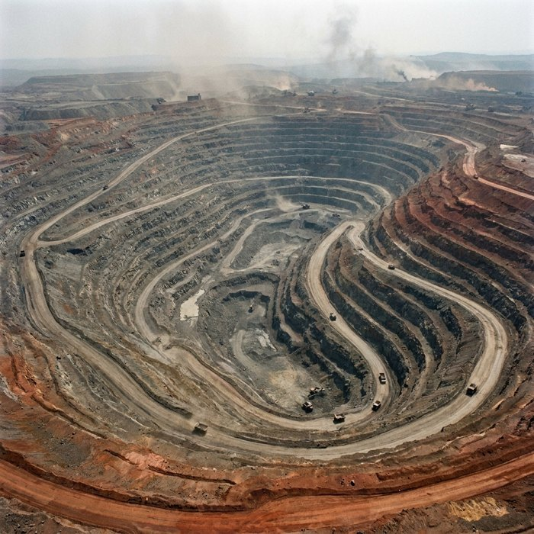
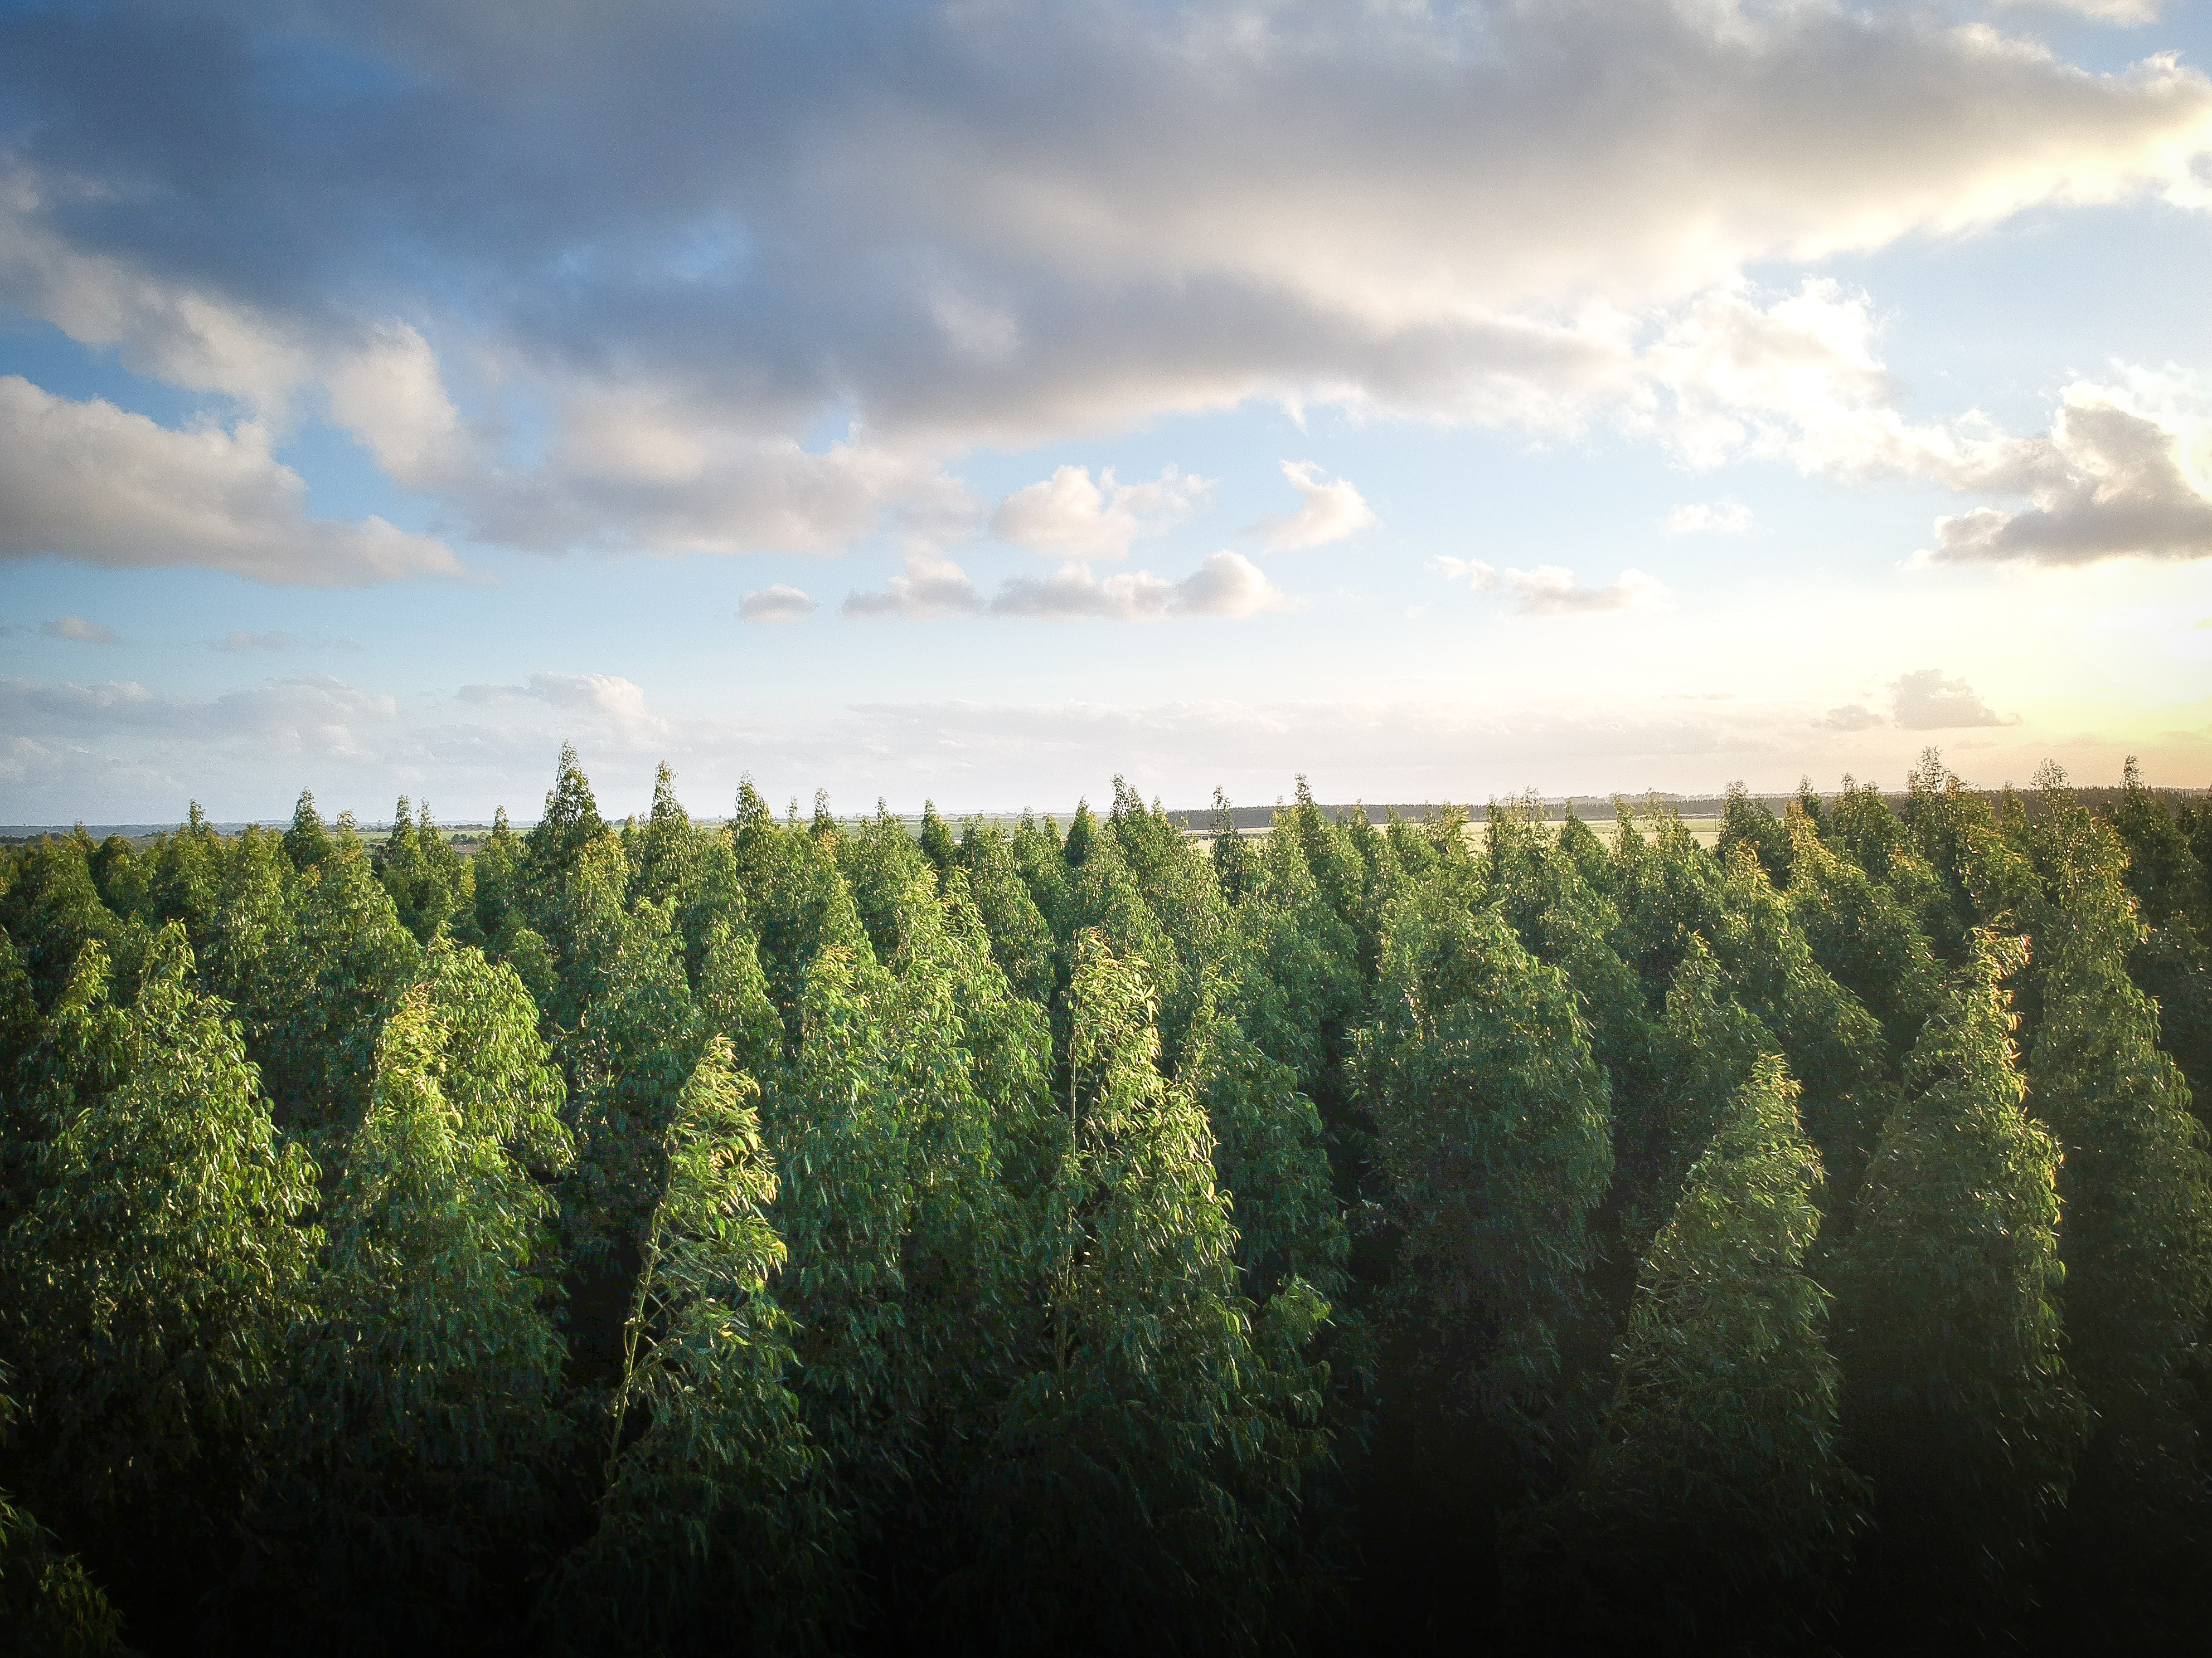
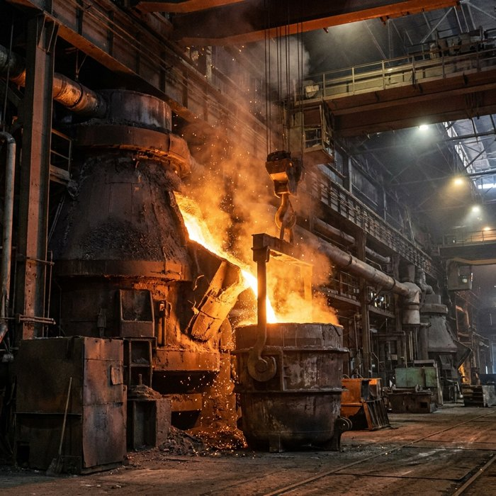
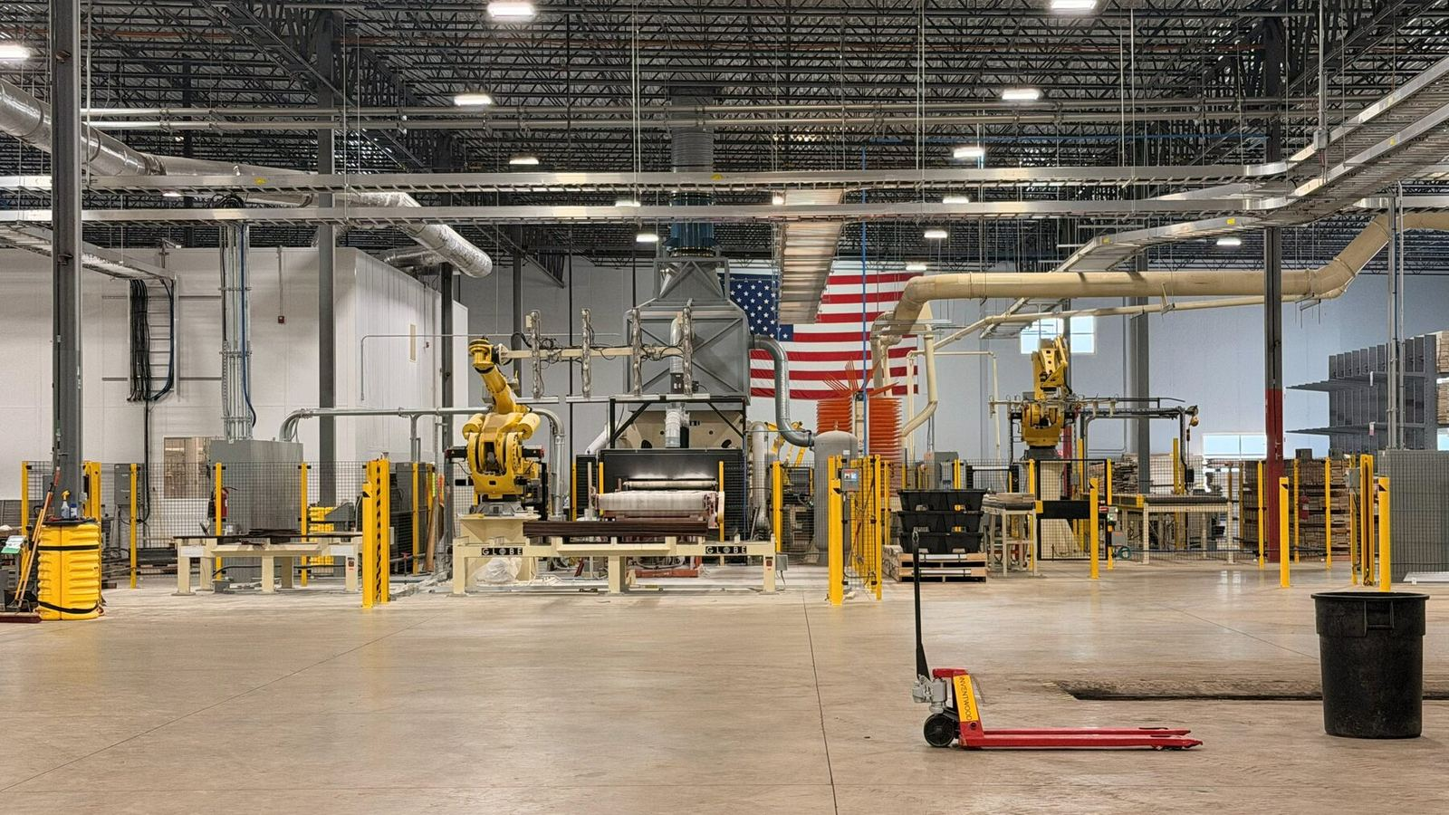
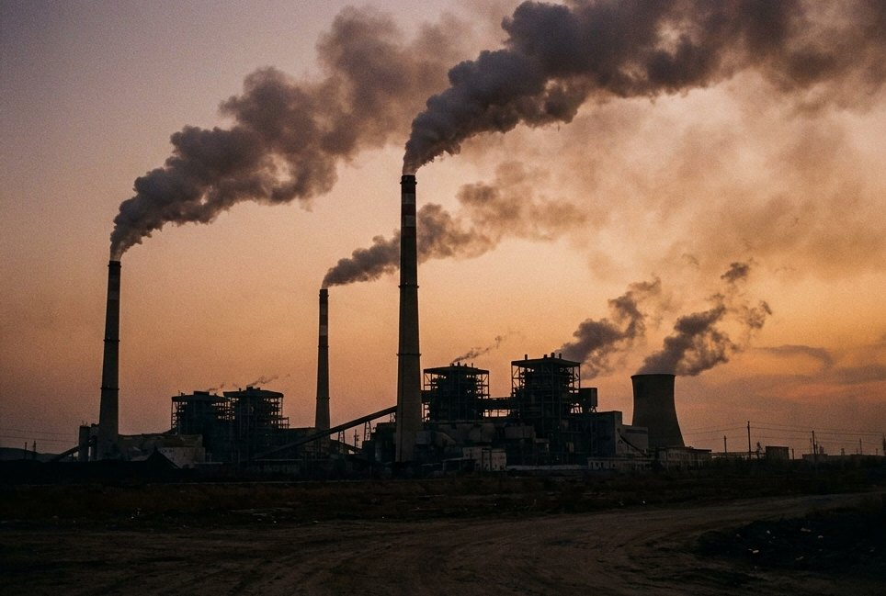
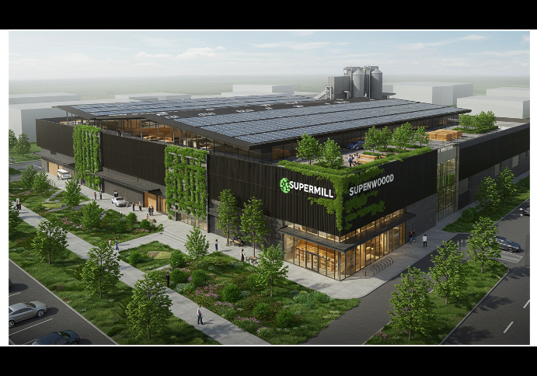
Manufacturing: Steel vs SUPERWOOD
Raw Material
10+ years to develop a mine; highly polluting
Universal, abundant, regenerative
Manufacturing
Energy intensive (1,800° C)
Capital intensive
Energy efficient (< 180° C)
Capital efficient
GHG Emissions — projected
1.8 kg
0.5 kg
CO₂e per kg of steel (global average)
CO₂e per kg SUPERWOOD made; 1.3 kg/kg biogenic carbon stored
Pre-LCA projections for a full-scale plant; LCA under way with Prof. Ming Hu, University of Notre Dame. Biogenic storage reported separately (released at end of life under EN 15804). Recycled (EAF) steel emits less than the average shown.
STEEL
SUPERWOOD

Slide 14

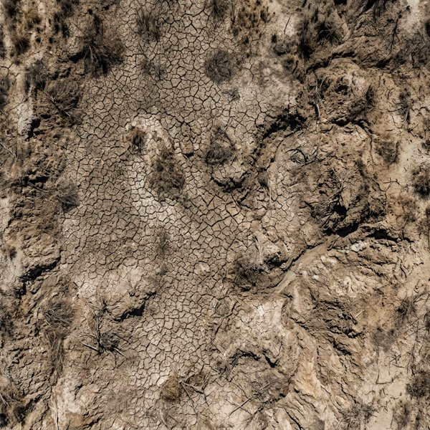

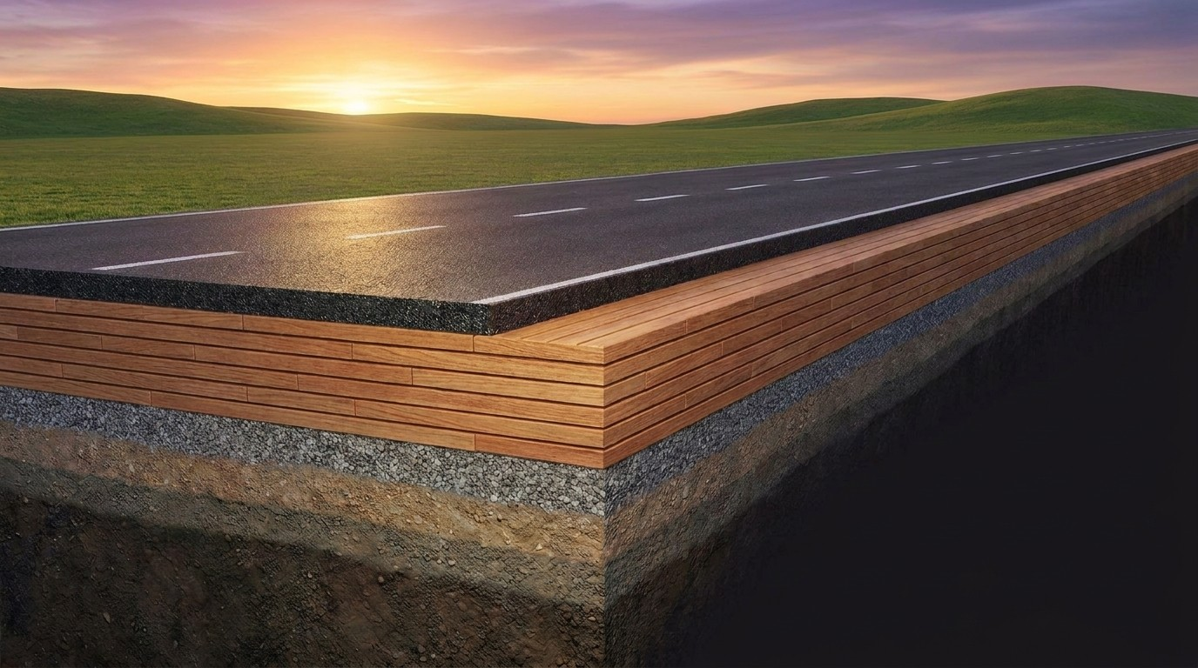
We create an economic engine powering a healthier planet — with long-term storage in forests, in buildings, and even after the end of life of a building
Reuse / recycle
MAKE SUPERWOOD
Store carbon in beautiful structures
Store after life of building
Convert degraded land into healthy forests
Increasing ecosystem diversity and CO₂ removal · storing CO₂ in the biome
Sequestering CO₂ in buildings for the life of the structure
Using underutilized or waste wood — replacing highly polluting steel and concrete
In places like foundations or roads — very long-term storage, with a reuse pathway still to be demonstrated
Concept renderings & photography

Slide 15
IMPACT · FEEDSTOCK
Flexible, renewable, highly scalable feedstock
12.5 million tons per year of SUPERWOOD could displace 50% of steel demand in the US — roughly all the steel used in construction.
EXAMPLES OF EXCESS SUPPLY IN THE US
167 Mt/yr
Forest overburden in Western National Forests
14 Mt/yr
Excess capacity in Southern lumber mills
12 Mt/yr
Wood waste sent to landfills
2.5 Mt/yr
End-of-life fruit and nut trees
Sources: MDPI Mass Timber Consumption Report; EPA.gov; US Forest Service Sawmill Capacity and Production Report; New Leaf Management Ltd. Consulting.
InventWood · Impact
Confidential

Slide 16
SECTION 04
Data Center Applications
Skins and fences now; certification-gated next; structure after

Slide 17
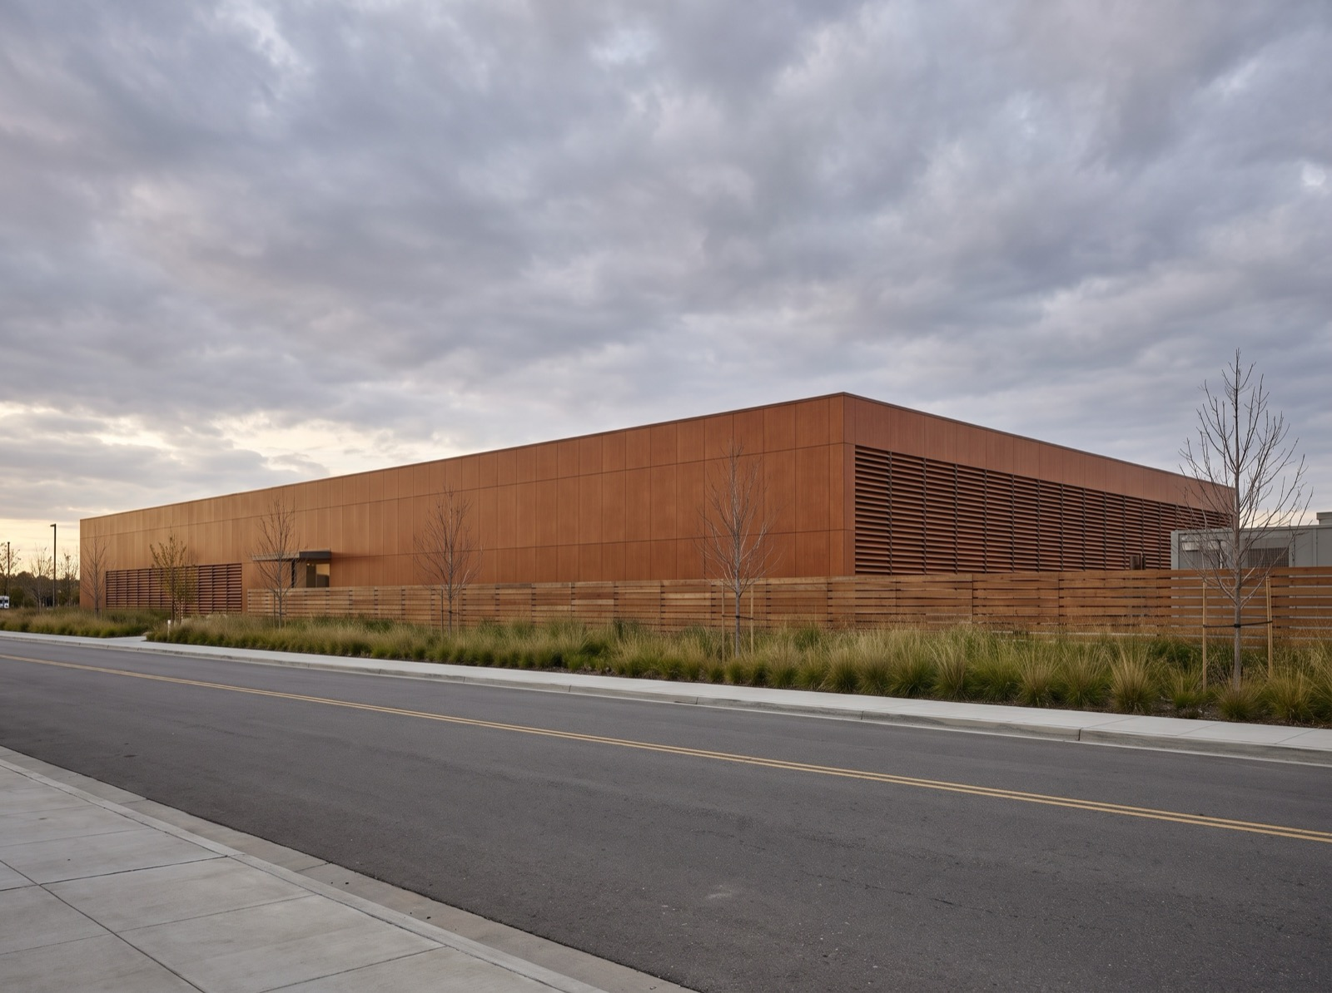
DATA CENTER APPLICATIONS
Fast, cost-effective, carbon-storing data centers
01
Faster, easier builds
Up to 10× the strength-to-weight ratio of steel — lighter to ship and lift, faster to assemble and disassemble, with a short domestic supply chain.
02
Safer construction and operations
Steel is heavy, sharp, and conductive. SUPERWOOD is one-sixth the weight, without sharp edges, and electrically non-conductive.
03
Biophilic, community-friendly design
Natural beauty and texture that meets industrial-grade demands — a way to humanize hyperscale campuses facing public opposition, inside and out.
Concept rendering — the street-facing view of a campus clad and screened in SUPERWOOD.
04
Lower embodied carbon per element
A bio-based material that stores biogenic carbon and is projected to emit far less in production than steel — verified element by element as the LCA lands.
InventWood · Applications
Confidential

Slide 18
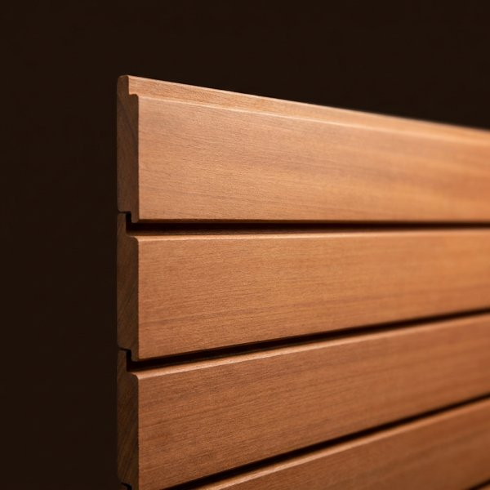
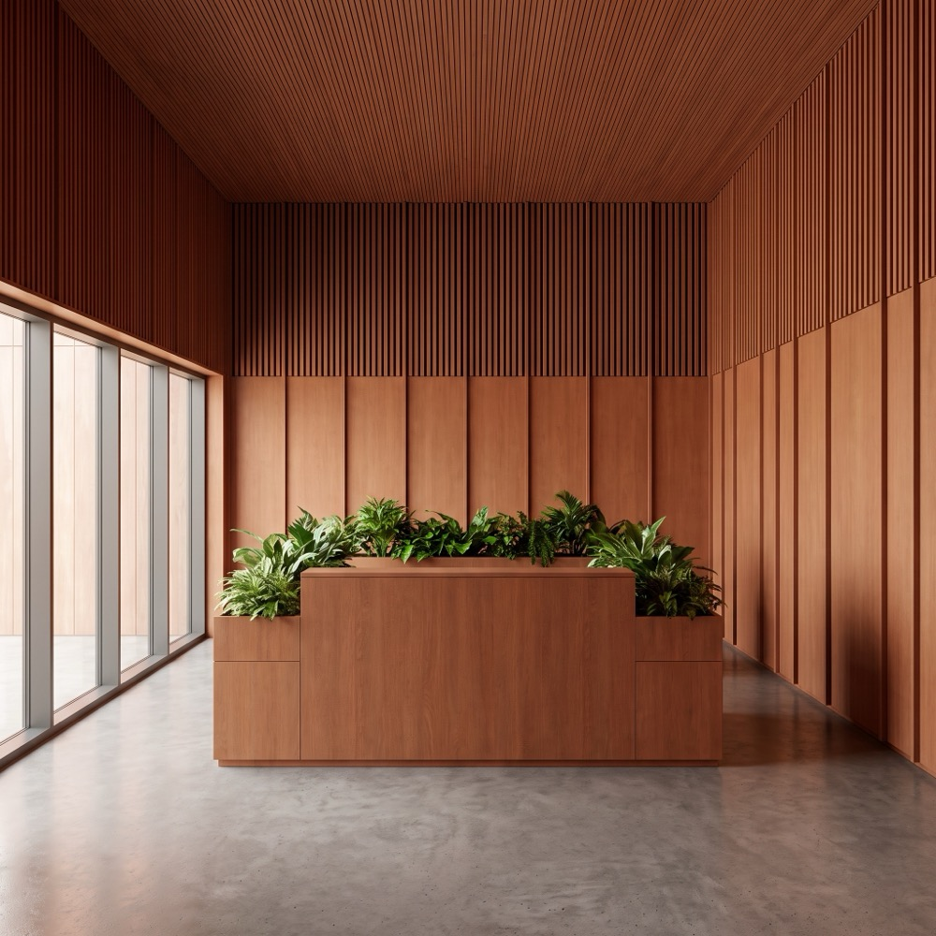

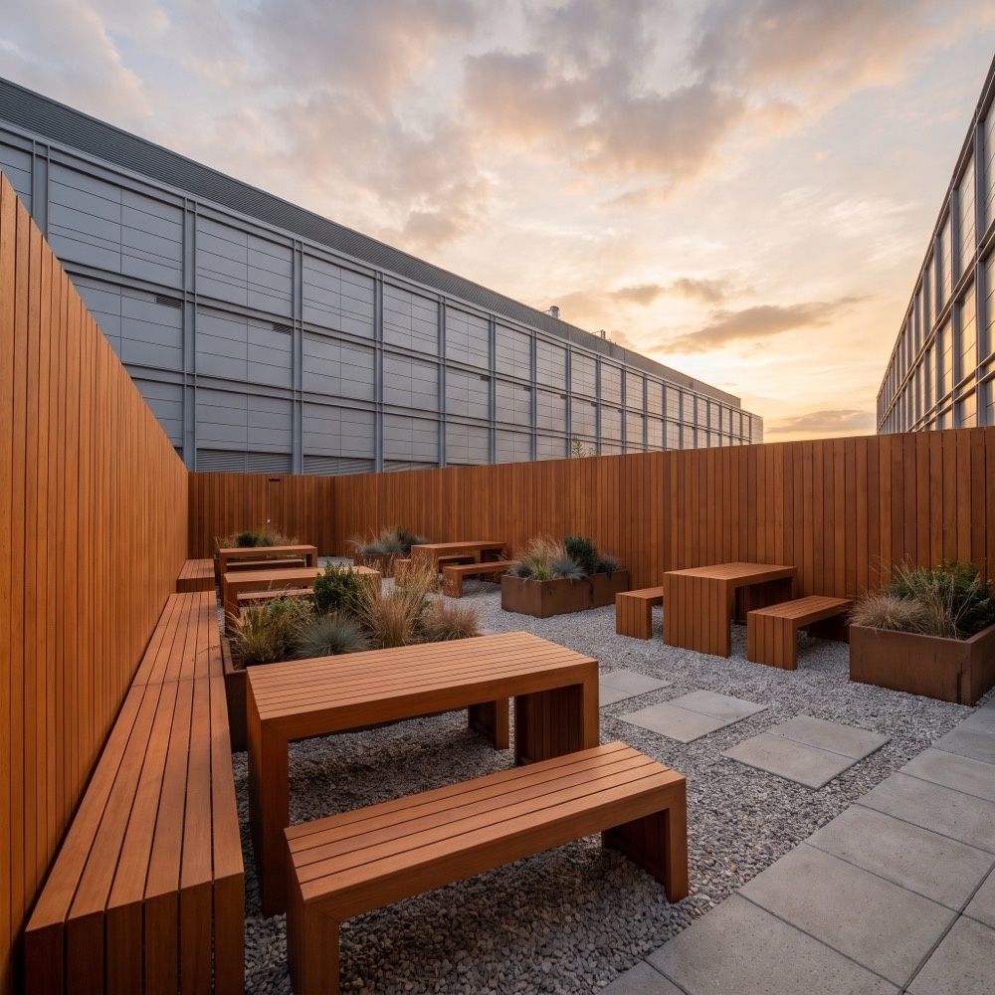
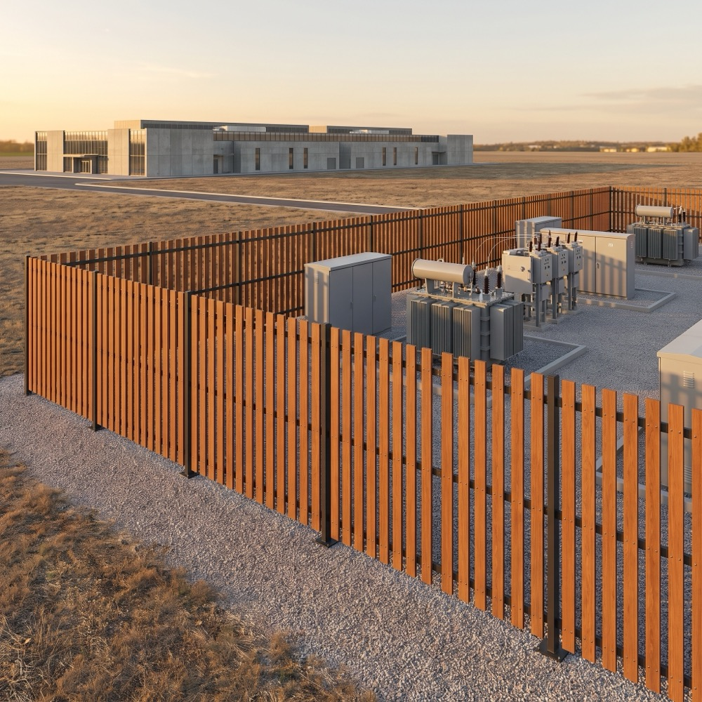
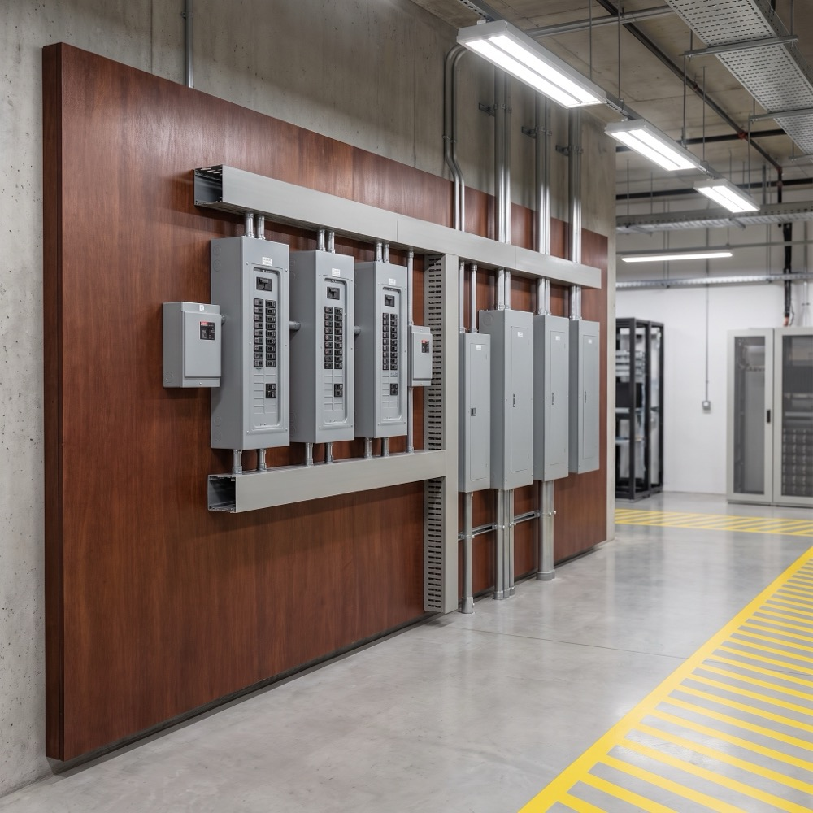
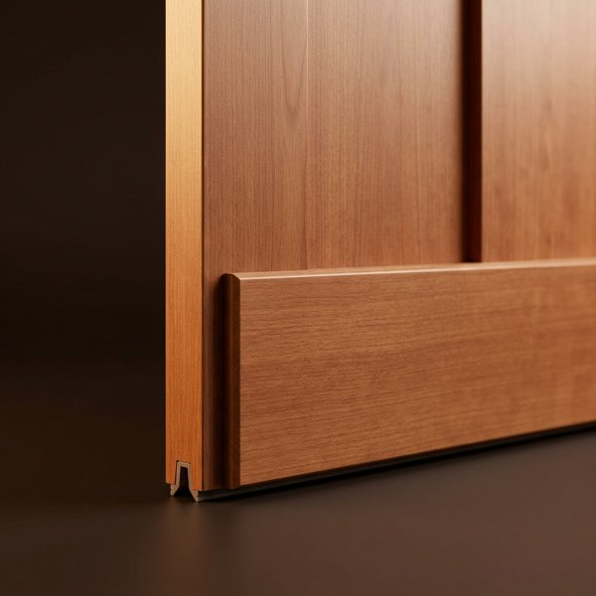
DATA CENTER APPLICATIONS
Available now — skins, screens, and fences
Every item below ships from SuperMill One today as boards up to 8" × 16' × 3/8", exterior or interior grade.
Facades, cladding & rain screens
Biophilic interiors for office spaces
Louvers & equipment screening
Fencing for staff outdoor spaces
Security fencing around transformers & outdoor infrastructure
Equipment backplanes
Trim, door kicks & sub-framing
Why these first. They need no assembly fire rating, they sit where the community and the workforce see the campus, and they are the near-term projects our hyperscaler customers have asked for: building facades, biophilic office interiors, staff-area fencing, and security fencing around critical outdoor infrastructure.
Concept renderings
InventWood · Applications
Confidential

Slide 19
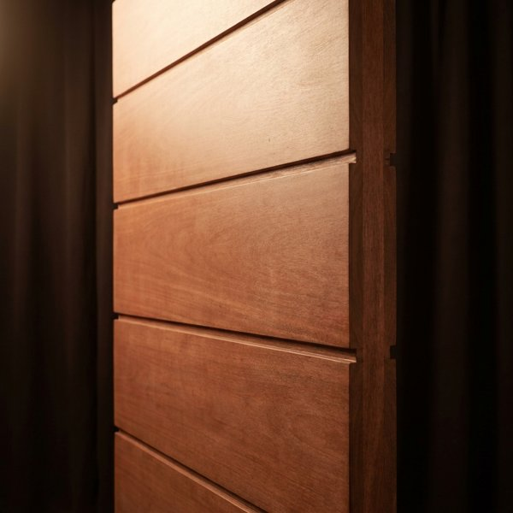

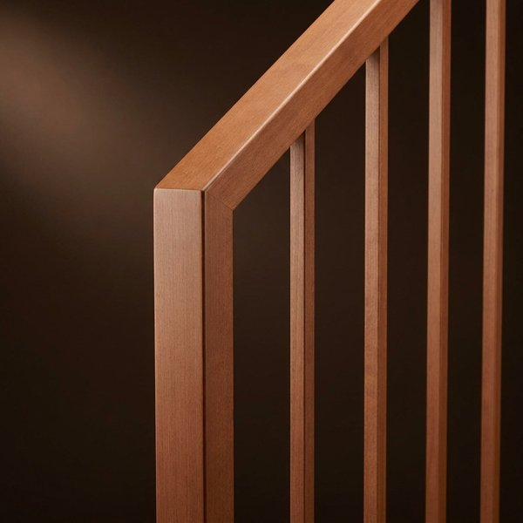
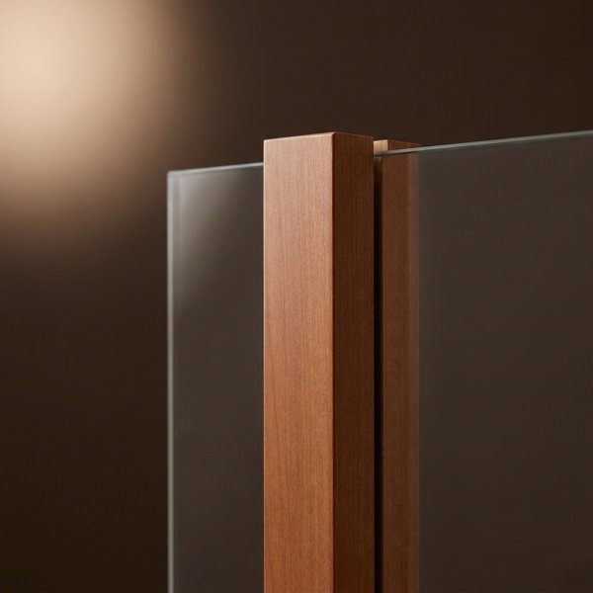
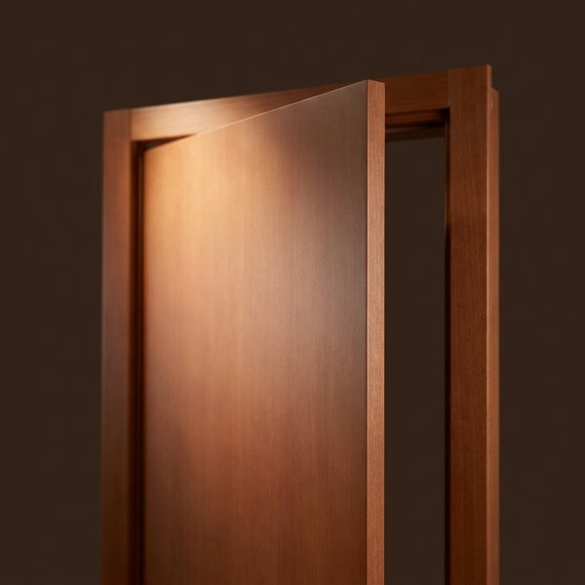

DATA CENTER APPLICATIONS
Next — applications gated by a specific test or listing
Acoustic barrier walls & equipment screens
Walkways & platforms
Railings
Window mullions
Interior doors & door protection
Industrial-grade flooring
GATED BY
GATED BY
GATED BY
GATED BY
GATED BY
GATED BY
STC / OITC lab data, field insertion loss
Published design values, connection data
Load testing to code (IBC 1607)
Thermal and structural performance data
UL 10C listing for rated openings
Rolling-load and slip testing
Each of these is a scoped test program, not a research question — and the natural first co-funded project with a customer. Timing depends on which one a customer picks up first.
Concept renderings
InventWood · Applications
Confidential

Slide 20
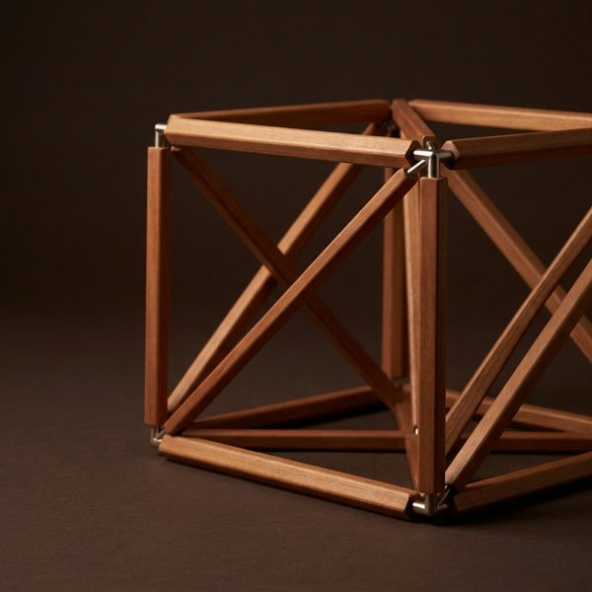
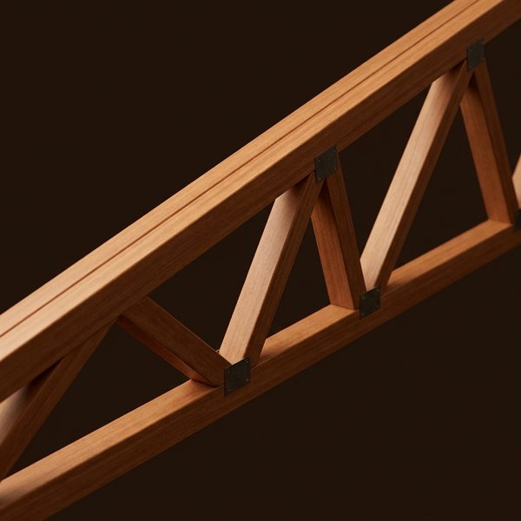
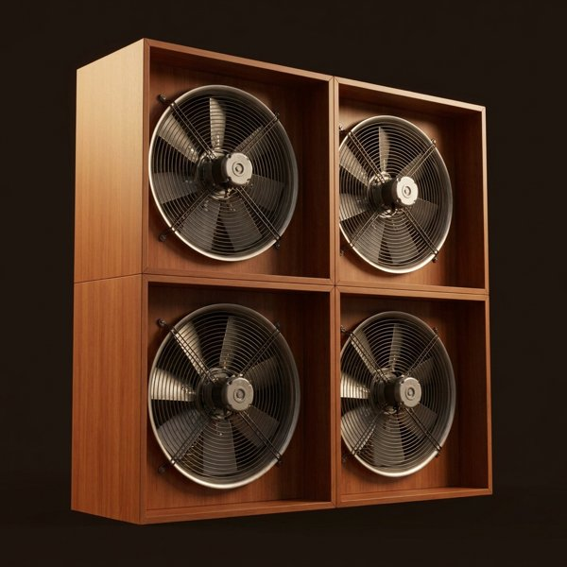
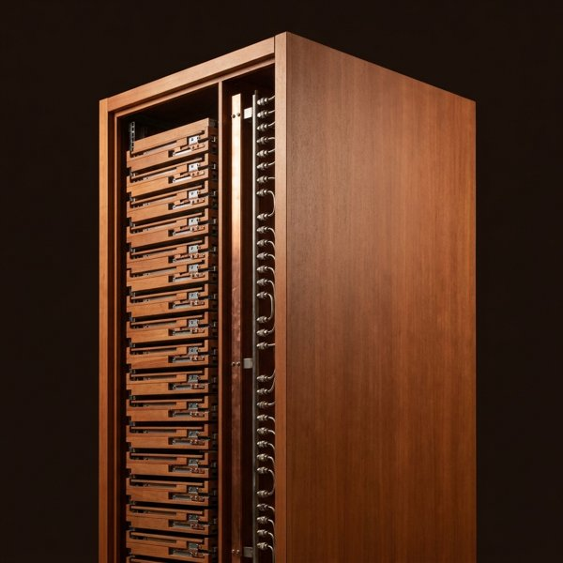
DATA CENTER APPLICATIONS
Then — structure, through the mass-timber pathway
Building enclosures & structural components
Trusses and CLT-type floor, roof & wall assemblies
The co-development target with our hyperscaler customers' architects and engineers; ultimately optimized shells and foundations
Trusses carry no fire-resistance requirement; assemblies follow E119 and the PRG 320-style qualification route
HVAC enclosures & separations
Racking & equipment supports
Insulating, lightweight, vibration-damping enclosures and air separations — not in-airstream ducting
Backplanes first (UL 94), then racking and heavy-load supports as design values and seismic qualification complete
Concept renderings · SUPERWOOD can be qualified as a new, far stronger species through the pathway mass timber has already opened in the building codes. This is the structural-steel replacement our customers are asking about, and it is SuperMill Two-scale demand.
InventWood · Applications
Confidential

Slide 21
SECTION 05
Our Customers
Who is already building with us — engagement as of September 2026

Slide 22
CUSTOMERS
Hyperscaler engagement at a glance
Microsoft
Meta
Google
BROAD ENGAGEMENT
ENGAGED FOR OVER A YEAR
ENGAGEMENT JUST BEGUN
Already builds data centers with CLT floors. Strategic interest in SUPERWOOD in the basis of design for future data centers; roof trusses leading to roofs and fast-to-build enclosures; immediate deployment of facades, interiors and fencing.
Broad engagement across the data center ecosystem. Facade applications and backplanes under way; plan to move into structural applications and racking over time.
Initial focus on replacement of structural steel.
ALSO AT THE TABLE
Vertiv · Wooden Data Center · data center operators focused on security fencing
CONSTRUCTION PARTNERS
Enthusiastic support from some of the largest data center builders — HITT and Turner — alongside engineering partners Fast + Epp and Timber Engineering
Engagement stages as reported by InventWood, September 2026. Customer names used with permission.
InventWood · Customers
Confidential

Slide 23
CUSTOMER PROFILE
Microsoft broad engagement
ON THE PUBLIC RECORD
Two Northern Virginia datacenters built with cross-laminated timber floor panels on a steel frame — an estimated 35% embodied-carbon reduction vs. conventional steel construction and 65% vs. precast concrete. Design by Gensler; structural engineering by Thornton Tomasetti.
WORKING WITH INVENTWOOD
Strategic interest
Incorporating SUPERWOOD into the basis of design for future data centers
Application areas
Roof trusses, leading to roofs and fast-to-build building enclosures — developed with their principal architecture and engineering firms
Immediate deployment opportunities
Building facades · biophilic interiors for office spaces · fencing for staff outdoor spaces · security fencing around critical outdoor infrastructure such as transformers
Concept rendering — SUPERWOOD security fencing around a transformer yard.
Source: Microsoft Source, “Microsoft builds first datacenters with wood to slash carbon emissions,” Nov 2024; Thornton Tomasetti project page.
InventWood · Customers
Confidential

Slide 24
CUSTOMER PROFILE
Meta engaged for over a year
ON THE PUBLIC RECORD
Piloting mass timber for data center administrative buildings: first completed in 2025 at Aiken, South Carolina (DPR, SmartLam), with projects under way in Cheyenne, Wyoming and Montgomery, Alabama — about a 41% reduction in the embodied carbon of the materials substituted.
WORKING WITH INVENTWOOD
Broad engagement across every part of the data center ecosystem
Conversations running for more than a year
Facade applications and backplanes under way
Backplane certification path: UL 94 (yellow card)
Structural applications and racking next
The plan is to move from skins into structure and racking over time
Concept rendering — SUPERWOOD equipment backplane in an electrical room.
Source: Meta Sustainability, “Meta pilots mass timber for more sustainable data center construction,” 31 Jul 2025.
InventWood · Customers
Confidential

Slide 25
CUSTOMER PROFILE
Google engagement just begun
WORKING WITH INVENTWOOD
Initial focus: replacement of structural steel
The structural-steel conversation starts at the qualification pathway — trusses first (no fire-resistance requirement), then assemblies
Early stage
Scope and timeline to be defined with their design teams
InventWood · Customers
Confidential

Slide 26
CUSTOMERS
A concrete path to first projects
1
Skins on one building or yard
Facades, interiors, louvers, staff-area or security fencing — installed from SuperMill One output, on a friendly site
2
Testing toward the standard the application needs
UL 94 for backplanes, STC/OITC for barriers, E119 and NFPA 285 for assemblies — scoped and co-funded with the customer
SuperMill One, Frederick, MD
3
Basis-of-design work with the customer's architect and engineer
Structural enclosure and truss solutions that can be written into the standard campus design
4
Measure the carbon delta
A baseline bill-of-materials comparison and verification plan, so each project produces defensible numbers as the LCA completes
Concept for SuperMill Two
InventWood · Customers
Confidential

Slide 27

Let's build what's next.
Alex Lau · CEO / Co-Founder · alex@inventwood.com
Lex Harris · Director, Capital Markets & IR · lex@inventwood.com

