Slide 1
Python for Advanced Students
Using Python for challenges

Slide 2
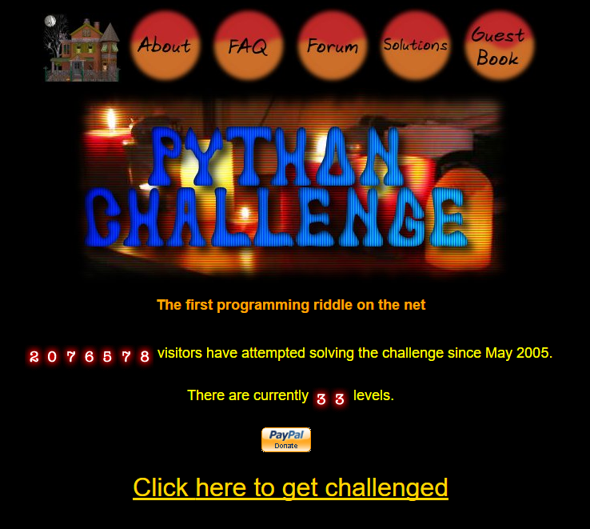

Slide 3
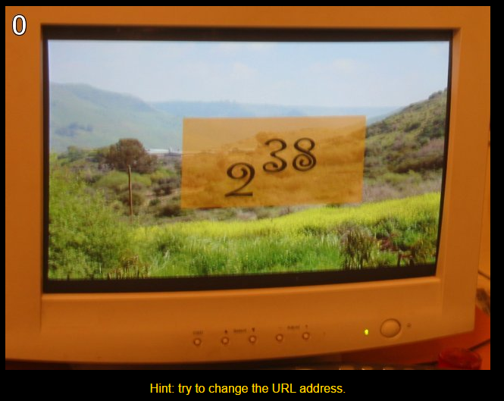
Level 0

Slide 4
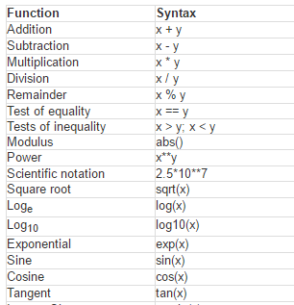
Python as a calculator

Slide 5
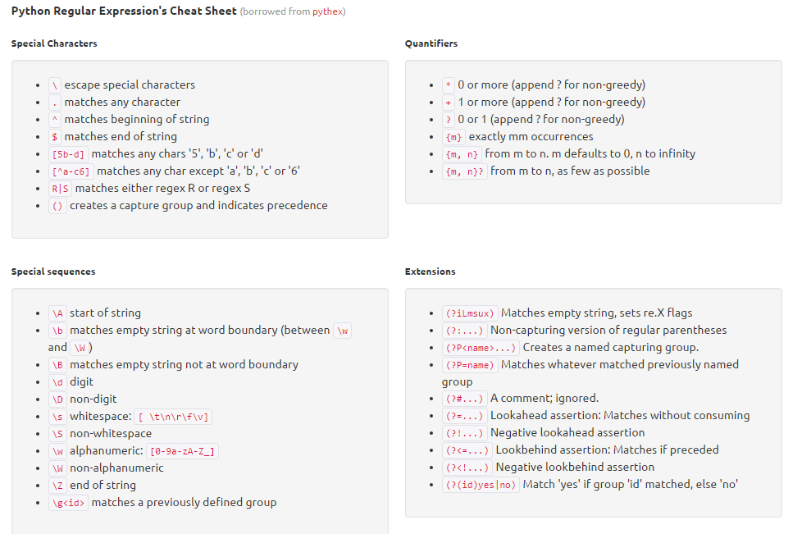
http://www.pyregex.com/

