Slide 1


Python programming

Slide 2
control flow and vars
Session 1

Slide 3
Control flow
print(“hello”)
print(“My name is Alex”)
print(“I am your new master”)
print(“This is command #4”)

Slide 4

Variables
Variables are basically boxes that you can put stuff in
They store the values you assign them

Slide 5
Example
variable1 = “Hello”
print(variable1)
variable2 = “World”
print(variable2)
variable2 = variable1
print(variable2)
Will Produce:
Hello
World
World

Slide 6
Variables
print("Hello, I am python, your servant")
master = input("What is your name, master? ")
print("I am glad to welcome you")
print(master)
print("my master")

Slide 7
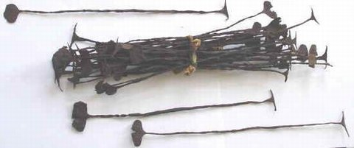
Types
A type is the kind of value that a value (and variable) can be
There are numerous kinds of types
String, Integer, Boolean are examples

Slide 8
Example
variable1 = “Hello”
type(variable1)
variable2 = 100
type(variable2)
Will Produce:
str
int

Slide 9
Types
word = "Word"
print(type(word))
number = 3
print(type(number))
fraction = 2/7
print(type(fraction))
print(fraction)
equation = 4 > 8
print(type(equation))
print(equation)

Slide 10
Boolean Operators
These are logic checks that you can use to determine when actions should happen
and, or, != (not equal), == (equal to),
> (greater than), < (less than), >= (greater than or equal to), <= (less than or equal to), and True/False

Slide 11
Important
In computers the equal sign can mean different things!!!
In Python
= → assignment (let var a take the value b)
== → comparison (if var a equals var b)

Slide 12
variable1 = 1
variable2 = 5
variable3 = 5
variable1 == variable2
variable1 != variable2
variable1 < variable2
variable1 > variable2
variable1 <= variable2
variable2 >= variable3
variable1 < variable2 and variable2 > variable3
variable1 < variable2 or variable2 > variable3
False
True
True
False
True
True
False
True

Slide 13
What can we compare?
Numbers ( 2, 3, 5, 5.5, 7.5, 8 )
Strings (“alex”, “bert”, “cindy”)
Dates and times
(for all orderable types – two values)
Numbers and strings?
Numbers and dates/times?

Slide 14
If/Else Statement
A statement that will run one set of code if a condition is met, and the other set of code if a condition is not met.
Condition is written as a Boolean expression that returns True or False

Slide 15
If/Else
person1 = input("What is the first name? ")
person2 = input("What is the second name? ")
if person1 > person2:
print(person1)
print("has won")
else:
print(person2)
print("has won")

Slide 16
Elif
You can chain if/else statements together with elif
This allows you to check for multiple conditions

Slide 17
If/Else/Elif
person1 = input("What is the first name? ")
person2 = input("What is the second name? ")
if person1 > person2:
print(person1)
print("has won")
elif person1 == person2:
print("friendship")
print("has won")
else:
print(person2)
print("has won")

Slide 18
Example
age = 20
if age < 18:
print(“You’re a minor.”)
elif age < 21:
print(“You can’t drink alcohol.”)
else:
print(“You’re an adult!”)
Will Produce:
You can’t drink alcohol.

Slide 19
While Loops
Loop while a condition is met
Runs the code inside of them every time you iterate

Slide 20
while
answer = input("Do you want to play a game? ")
while answer == "yes":
person1 = input("What is the first name? ")
person2 = input("What is the second name? ")
if person1 > person2:
print(person1)
print("has won")
elif person1 == person2:
print("friendship")
print("has won")
else:
print(person2)
print("has won")
answer = input("Do you want to play a game? ")

Slide 21
For Loops
Loop over a given range/set/list
Run the code inside of them every time you iterate

Slide 22
for in range
answer = int(input("How many times do you want to play? "))
for i in range(0,answer):
person1 = input("What is the first name? ")
person2 = input("What is the second name? ")
if person1 > person2:
print(person1)
print("has won")
elif person1 == person2:
print("friendship")
print("has won")
else:
print(person2)
print("has won")

Slide 23
strings and collections
http://enigmacode.azurewebsites.net/
https://github.com/alaudo/coderdojo-python
Session 2

Slide 24
Recap from last session
age = input("What is your age? ")
if age =< 10:
print("You are below 10!")
if age = 10:
print("You are exactly 10!")
if age => 10:
print("Your are above 10!")
How many errors can you find here?

Slide 25
Recap from last session
m = 3
s = 0
for i in range (1,m):
s = s + i
print(s)
What number will this program print?

Slide 26
while
answer = input("Do you want to play a game? ")
while answer == "yes":
person1 = input("What is the first name? ")
person2 = input("What is the second name? ")
if person1 > person2:
print(person1)
print("has won")
elif person1 == person2:
print("friendship")
print("has won")
else:
print(person2)
print("has won")
answer = input("Do you want to play a game? ")
How to remove the duplicate line?

Slide 27
Advanced loops
while True:
answer = input("Do you want to play a game? ")
if (answer != "yes"):
break
else:
person1 = input("What is the first name? ")
person2 = input("What is the second name? ")
if person1 > person2:
print(person1)
elif person1 == person2:
print("friendship")
else:
print(person2)
print("has won")
break
continue
pass

Slide 28
Strings: what do we now?

Slide 29
Strings: what do we now and what don’t?
Get with “input” command
Compare as numbers
Compare with “==“ and “!=“
Print with “print” command

Slide 30
Strings: what should we know?
Get with “input” command
Compare as numbers
Compare with “==“ and “!=“
Print with “print” command
How to check if string is empty?
How to get string length?
How to get a part of a string?
How to replace one symbol with another?
How to reverse string?
How to split string?
How to stich many strings together?

Slide 31
Strings & math
What happens if we:
string1 + string2
string1 – string2
string1 * 10
string2 / 5
string3 % 5
How can we:
stitch strings
remove part of string
copy string
format string

Slide 32
How to test for empty string?
text = input("Enter something ")
if (text):
print("This text is not empty")
else:
print("This text is EMPTY")
What about just spaces in the string?

Slide 33
How find how long a string is?
text = input("Enter something ")
print (len(text))
But how to print the text WITH numbers?

Slide 34
Pretty printing in Python?
print("My length is " + str(len("My length is")))
print("My favorite programming language is %s " % "python")
print("{} and {} are best friends".format("me", "my papa"))
print("My name is {name} and I am {age} years old".format(name = "Alex", age = 37))

Slide 35
Strings: what should we know?
Get with “input” command
Compare as numbers
Compare with “==“ and “!=“
Print with “print” command
How to check if string is empty?
How to get string length?
How to get a part of a string?
How to replace one symbol with another?
How to reverse string?
How to split string?
How to stich many strings together?

Slide 36
Pretty printing in Python?
print("I am a good programmer".replace("good","not really good"))
print("<***>".join(["one","two","three","four"]))
print(''.join(reversed("I am a good string")))
print("I am a good athlete".split(" "))

Slide 37
Lists
A list is a container that holds other objects/values
A list can be as large as you need it to be
You can access the values inside a list at any time as long as you have the list

Slide 38
Example
list1 = [“Hello!”, 22, True]
list1[0]
list2[1]
list3[2]
Will Produce:
Hello
22
True

Slide 39
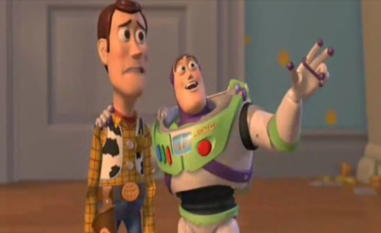
Hidden lists
for i in range(0,10):
print(i)
print(list(range(0,10)))
txt = "pizza is no longer hot"
for i in txt:
print(i)
print(list(txt))
Lists, they are everywhere… ☺

Slide 40
Browsing lists
a = "Jingle bells, Jingle bells Jingle all the way Oh what fun it is to ride"
print(a[0])
print(a[1])
print(a[0:10])
print(a[0:10:2])
print(a[::3])
print(a[::-1])

Slide 41
Browsing lists (2)
a = "Jingle bells, Jingle bells Jingle all the way Oh what fun it is to ride“
a = a.split(“ “)
print(a[0])
print(a[1])
print(a[0:10])
print(a[0:10:2])
print(a[::3])
print(a[::-1])

Slide 42
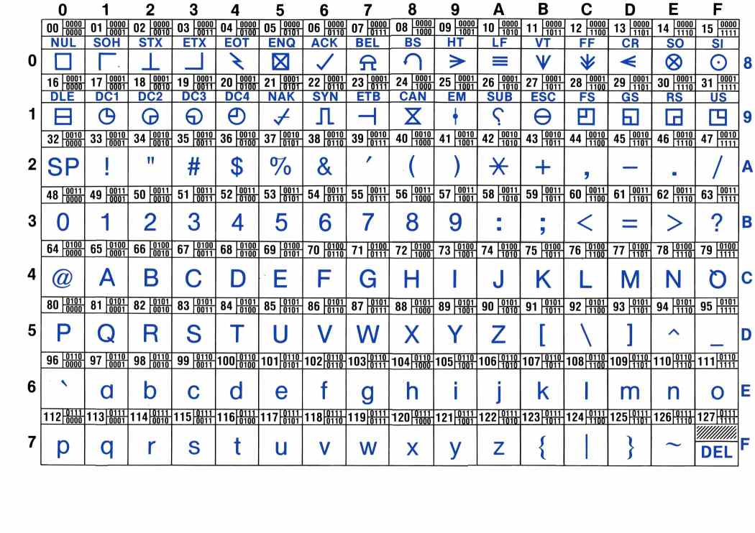

Slide 43
ASCII manipulations
a = "Jingle bells, Jingle bells Jingle all the way Oh what fun it is to ride"
l = []
for i in a:
l.append(ord(i))
print(l)
m = []
for t in l:
m.append(t + 2)
print(m)
v = []
for k in m:
v.append(chr(k))
print(''.join(v))

Slide 44
List comprehensions
a = "Jingle bells, Jingle bells Jingle all the way Oh what fun it is to ride"
l = [ord(i) for i in a]
print(l)
m = [t + 2 for t in l]
print(m)
v = [chr(k) for k in m]
print(''.join(v))

Slide 45
Challenge begins!! ☺
http://enigmacode.azurewebsites.net/
https://github.com/alaudo/coderdojo-python

Slide 46
Functions
Session 3

Slide 47
Functions
A function is a block of organized, reusable code that is used to perform a single, related action.
You call it to perform intended code
Functions can take arguments which is information that you pass through to the proceeding code

Slide 48
Example
def my_function():
print("Hello”)
my_function()
def add_two_numbers(a,b):
result = a + b
print(result)
add_two_numbers(2,6)
Will Produce:
Hello
8

Slide 49
Functional decomposition

Slide 50
Task: count sum odd numbers from 1 to 1000
for i in range (1,1000):
s = s + i
print(s)

Slide 51
Recursion

