Slide 1


Python programming intermediate course
Created by Alexander Galkin aka Alaudo
published under Creative Common License

Slide 2
About this course
This course is entirely conceived, designed and created by me, Alexander Galkin aka Alaudo.
The course consists of
this PowerPoint presentation,
the Enigma Code contest website,
GitHub repository with sample code and offline tasks with answers
The complete content is published under Creative Common license. This means you can use it to create any derivative work with proper attribution and sharing under same conditions (free).
Well, if CC license isn’t good for you, just use it as you want ☺ Just remember, our common goal is that our children learn that programming is fun and get passionate about it. As long as your work serves this goal it doesn’t you are free to do anything you want with the complete course materials.
Any comments, suggestions or criticisms send to: alexander.galkin@outlook.com

Slide 3
Course outline
Session 1: Leveling the ground (basic Python)
Session 2: Strings and collections
Session 3: Functions, Dictionaries etc..

Slide 4
control flow and vars
Session 1

Slide 5
Control flow
print(“hello”)
print(“My name is Alex”)
print(“I am your new master”)
print(“This is command #4”)

Slide 6

Variables
Variables are basically boxes that you can put stuff in
They store the values you assign them

Slide 7
Variables
print("Hello, I am python, your servant")
master = input("What is your name, master? ")
print("I am glad to welcome you")
print(master)
print("my master")

Slide 8
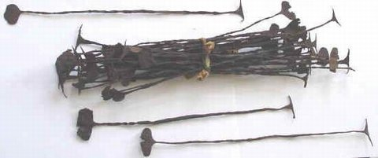
Types
A type is the kind of value that a value (and variable) can be
There are numerous kinds of types
String, Integer, Boolean are examples

Slide 9
Types
word = "Word"
print(type(word))
number = 3
print(type(number))
fraction = 2/7
print(type(fraction))
print(fraction)
equation = 4 > 8
print(type(equation))
print(equation)

Slide 10
Boolean Operators
These are logic checks that you can use to determine when actions should happen
and, or, != (not equal), == (equal to),
> (greater than), < (less than), >= (greater than or equal to), <= (less than or equal to), and True/False

Slide 11
Important
In computers the equal sign can mean different things!!!
In Python
= → assignment (let var a take the value b)
== → comparison (if var a equals var b)

Slide 12
variable1 = 1
variable2 = 5
variable3 = 5
variable1 == variable2
variable1 != variable2
variable1 < variable2
variable1 > variable2
variable1 <= variable2
variable2 >= variable3
variable1 < variable2 and variable2 > variable3
variable1 < variable2 or variable2 > variable3
False
True
True
False
True
True
False
True

Slide 13
What can we compare?
Numbers ( 2, 3, 5, 5.5, 7.5, 8 )
Strings (“alex”, “bert”, “cindy”)
Dates and times
(for all orderable types – two values)
Numbers and strings?
Numbers and dates/times?

Slide 14
If/Else Statement
A statement that will run one set of code if a condition is met, and the other set of code if a condition is not met.
Condition is written as a Boolean expression that returns True or False

Slide 15
If/Else
person1 = input("What is the first name? ")
person2 = input("What is the second name? ")
if person1 > person2:
print(person1)
print("has won")
else:
print(person2)
print("has won")

Slide 16
Elif
You can chain if/else statements together with elif
This allows you to check for multiple conditions

Slide 17
If/Else/Elif
person1 = input("What is the first name? ")
person2 = input("What is the second name? ")
if person1 > person2:
print(person1)
print("has won")
elif person1 == person2:
print("friendship")
print("has won")
else:
print(person2)
print("has won")

Slide 18
While Loops
Loop while a condition is met
Runs the code inside of them every time you iterate

Slide 19
while
answer = input("Do you want to play a game? ")
while answer == "yes":
person1 = input("What is the first name? ")
person2 = input("What is the second name? ")
if person1 > person2:
print(person1)
print("has won")
elif person1 == person2:
print("friendship")
print("has won")
else:
print(person2)
print("has won")
answer = input("Do you want to play a game? ")

Slide 20
For Loops
Loop over a given range/set/list
Run the code inside of them every time you iterate

Slide 21
for in range
answer = int(input("How many times do you want to play? "))
for i in range(0,answer):
person1 = input("What is the first name? ")
person2 = input("What is the second name? ")
if person1 > person2:
print(person1)
print("has won")
elif person1 == person2:
print("friendship")
print("has won")
else:
print(person2)
print("has won")

Slide 22
strings and collections
http://enigmacode.azurewebsites.net/
https://github.com/alaudo/coderdojo-python
Session 2

Slide 23
Recap from last session
age = input("What is your age? ")
if age =< 10:
print("You are below 10!")
if age = 10:
print("You are exactly 10!")
if age => 10:
print("Your are above 10!")
How many errors can you find here?

Slide 24
Recap from last session
m = 3
s = 0
for i in range (1,m):
s = s + i
print(s)
What number will this program print?

Slide 25
while
answer = input("Do you want to play a game? ")
while answer == "yes":
person1 = input("What is the first name? ")
person2 = input("What is the second name? ")
if person1 > person2:
print(person1)
print("has won")
elif person1 == person2:
print("friendship")
print("has won")
else:
print(person2)
print("has won")
answer = input("Do you want to play a game? ")
How to remove the duplicate line?

Slide 26
Advanced loops
while True:
answer = input("Do you want to play a game? ")
if (answer != "yes"):
break
else:
person1 = input("What is the first name? ")
person2 = input("What is the second name? ")
if person1 > person2:
print(person1)
elif person1 == person2:
print("friendship")
else:
print(person2)
print("has won")
break
continue
pass

Slide 27
Strings: what do we now?

Slide 28
Strings: what do we now and what don’t?
Get with “input” command
Compare as numbers
Compare with “==“ and “!=“
Print with “print” command

Slide 29
Strings: what should we know?
Get with “input” command
Compare as numbers
Compare with “==“ and “!=“
Print with “print” command
How to check if string is empty?
How to get string length?
How to get a part of a string?
How to replace one symbol with another?
How to reverse string?
How to split string?
How to stich many strings together?

Slide 30
Strings & math
What happens if we:
string1 + string2
string1 – string2
string1 * 10
string2 / 5
string3 % 5
How can we:
stitch strings
remove part of string
copy string
format string

Slide 31
How to test for empty string?
text = input("Enter something ")
if (text):
print("This text is not empty")
else:
print("This text is EMPTY")
What about just spaces in the string?

Slide 32
How find how long a string is?
text = input("Enter something ")
print (len(text))
But how to print the text WITH numbers?

Slide 33
Pretty printing in Python?
print("My length is " + str(len("My length is")))
print("My favorite programming language is %s " % "python")
print("{} and {} are best friends".format("me", "my papa"))
print("My name is {name} and I am {age} years old".format(name = "Alex", age = 37))

Slide 34
Strings: what should we know?
Get with “input” command
Compare as numbers
Compare with “==“ and “!=“
Print with “print” command
How to check if string is empty?
How to get string length?
How to get a part of a string?
How to replace one symbol with another?
How to reverse string?
How to split string?
How to stich many strings together?

Slide 35
Pretty printing in Python?
print("I am a good programmer".replace("good","not really good"))
print("<***>".join(["one","two","three","four"]))
print(''.join(reversed("I am a good string")))
print("I am a good athlete".split(" "))

Slide 36
Lists
A list is a container that holds other objects/values
A list can be as large as you need it to be
You can access the values inside a list at any time as long as you have the list

Slide 37
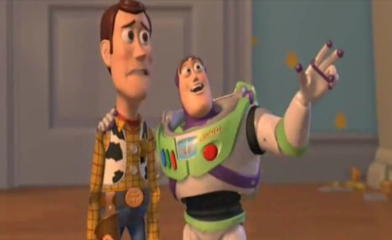
Hidden lists
for i in range(0,10):
print(i)
print(list(range(0,10)))
txt = "pizza is no longer hot"
for i in txt:
print(i)
print(list(txt))
Lists, they are everywhere… ☺

Slide 38
Browsing lists
a = "Jingle bells, Jingle bells Jingle all the way Oh what fun it is to ride"
print(a[0])
print(a[1])
print(a[0:10])
print(a[0:10:2])
print(a[::3])
print(a[::-1])

Slide 39
Browsing lists (2)
a = "Jingle bells, Jingle bells Jingle all the way Oh what fun it is to ride“
a = a.split(“ “)
print(a[0])
print(a[1])
print(a[0:10])
print(a[0:10:2])
print(a[::3])
print(a[::-1])

Slide 40
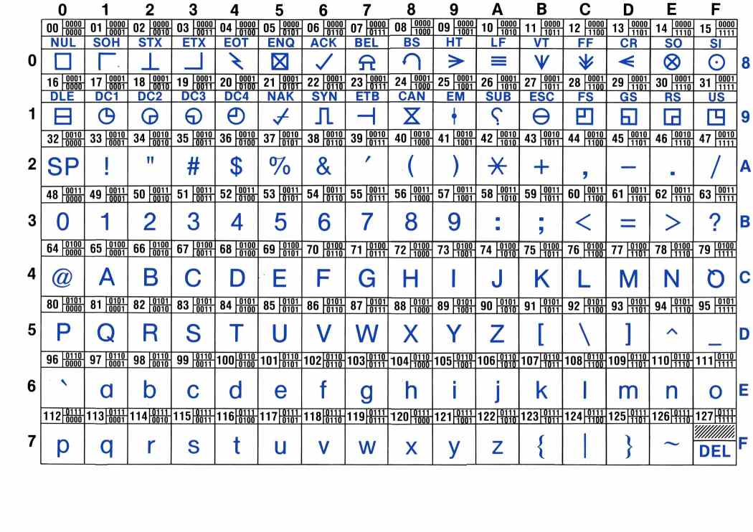

Slide 41
ASCII manipulations
a = "Jingle bells, Jingle bells Jingle all the way Oh what fun it is to ride"
l = []
for i in a:
l.append(ord(i))
print(l)
m = []
for t in l:
m.append(t + 2)
print(m)
v = []
for k in m:
v.append(chr(k))
print(''.join(v))

Slide 42
List comprehensions
a = "Jingle bells, Jingle bells Jingle all the way Oh what fun it is to ride"
l = [ord(i) for i in a]
print(l)
m = [t + 2 for t in l]
print(m)
v = [chr(k) for k in m]
print(''.join(v))

Slide 43
Challenge begins!! ☺
http://enigmacode.azurewebsites.net/
https://github.com/alaudo/coderdojo-python

Slide 44
Functions, dictionaries etc
Session 3

Slide 45
Trying to decode…
PPhhoottoonnss hhaavvee nneeiitthheerr mmoorraallss nnoorr vviissaass..
How can we decode this?

Slide 46
Trying to decode…
PPhhoottoonnss hhaavvee nneeiitthheerr mmoorraallss nnoorr vviissaass..
text = "PPhhoottoonnss hhaavvee nneeiitthheerr mmoorraallss nnoorr vviissaass.."
print(text[::2])

Slide 47
Trying to decode…
IIIInnnnssssiiiiddddeeee eeeevvvveeeerrrryyyy ssssmmmmaaaallllllll pppprrrroooobbbblllleeeemmmm iiiissss aaaa bbbbiiiigggg oooonnnneeee ttttrrrryyyyiiiinnnngggg ttttoooo ggggeeeetttt ggggoooovvvveeeerrrrnnnnmmmmeeeennnntttt ffffuuuunnnnddddiiiinnnngggg....
What about this?

Slide 48
Trying to decode…
IIIInnnnssssiiiiddddeeee eeeevvvveeeerrrryyyy ssssmmmmaaaallllllll pppprrrroooobbbblllleeeemmmm iiiissss aaaa bbbbiiiigggg oooonnnneeee ttttrrrryyyyiiiinnnngggg ttttoooo ggggeeeetttt ggggoooovvvveeeerrrrnnnnmmmmeeeennnntttt ffffuuuunnnnddddiiiinnnngggg....
text = "IIIInnnnssssiiiiddddeeee eeeevvvveeeerrrryyyy ssssmmmmaaaallllllll pppprrrroooobbbblllleeeemmmm"
print(text[::4])
How can we skip the burden of writing the same code again and again?

Slide 49
Functions
Functions are like tools: you can re-use the same tool in many situations to solve similar problems
Functions take input – something they are applied to – and return the result back
In addition to input the functions can also take any number of parameters to specify what and how the function should be applied

Slide 50
Functions as reusable components
PPhhoottoonnss hhaavvee nneeiitthheerr mmoorraallss nnoorr vviissaass..
def dedouble(text, count):
return text[::count]
print(dedouble(“PPhhoottoonnss hhaavvee”,2)) print(dedouble(“IIIInnnnssssiiiiddddeeee”,4))
We parameterize functions instead of re-writing code

Slide 51
Further decoding
.ti esu ot tnaw lliw toidi na ylno dna esu nac toidi na metsys a ngiseD
What about this?

Slide 52
Further decoding
.ti esu ot tnaw lliw toidi na ylno dna esu nac toidi na metsys a ngiseD
def palindrome(text):
return text[::-1]

Slide 53
More advanced
it. invent is do can we All all. at future the predict really can't We
What about this?

Slide 54
More advanced
it. invent is do can we All all. at future the predict really can't We
def yoda(text):
return " ".join(text.split(" ")[::-1])
Well done!!

Slide 55
Further and further
s'tI suoregnad ot eb thgir nehw eht tnemnrevog si .gnorw
What about this?

Slide 56
List: recap
How to create an empty List?
How to add element to a list?
How to test if element is in the list?

Slide 57
List: recap
How to create an empty List?
How to add element to a list?
How to test if element is in the list?
lst = []
lst.append(elem)
if elem2 in lst:

Slide 58
Further and further
s'tI suoregnad ot eb thgir nehw eht tnemnrevog si .gnorw
def mirror(text):
words = text.split(" ")
nwords = []
for w in words:
nw = w[::-1]
nwords.append(nw)
return " ".join(nwords)

Slide 59
Mastering the Ceasar shift cipher
kpfkhhgtgpeg yknn egtvckpna dg vjg fqyphcnn qh ocpmkpf, dwv yjq ectgu?
How to crack this?

Slide 60
In-place condition aka ternary operator
If takes a complete line – sometimes it is too much
You can reverse it for in-place condition
a = 4
b = 3
print (a if a > b else b)

Slide 61
Mastering the Ceasar shift cipher
kpfkhhgtgpeg yknn egtvckpna dg vjg fqyphcnn qh ocpmkpf, dwv yjq ectgu?
stoplist = [ ' ', ',', '?']
def ceasar(text, shift):
return "".join([t if (t in stoplist) else chr(ord('a') + (ord(t) - ord('a') + shift + 26) % 26 ) for t in text])

Slide 62
Simple substitution cipher
тhe$e @Яe que$т!0п$ f0Я @cт!0п, п0т $pecu1@т!0п, шh!ch !$ !d1e.
How to optimize replace here?

Slide 63
Dictionary
Like a usual dictionary
Has a key – e.g. the glossary word we look for
Contains value – e.g. the explanation for word
It helps to associate things pairwise
Most often used to find a value for a key, but can be reversed if needed (costy!)
Other names: hash, hashtable, map

Slide 64
Dictionary operations
How to create a d?
How to add an element?
How to check for element?
How to retrieve an element?
dct = { ‘a’ : ‘b’, ‘b’ : ‘c’}
dct[‘v’] = ‘w’
if (elem in dct):
dct[‘b’]

Slide 65
Simple substitution cipher
тhe$e @Яe que$т!0п$ f0Я @cт!0п, п0т $pecu1@т!0п, шh!ch !$ !d1e.
def subst(text):
s = { 'т' : 't', '$' : 's', '@' : 'a', '!' : 'i', 'Я' : 'r', '1' : 'l', 'ш' : 'w', '0' : 'o', 'п' : 'n'}
return "".join([t if not(t in s.keys()) else s[t] for t in text ])

Slide 66
Building decoding software
Total recap

Slide 67
Decoding assistant
> message .eldi si hcihw ,noitaluceps ton ,noitca rof snoitseuq era esehT Message [0]: “.eldi si hcihw ,noitaluceps ton ,noitca rof snoitseuq era esehT”
>apply palindrome 0
Message [0]: “sdsdf”
Applied k

