Slide 1
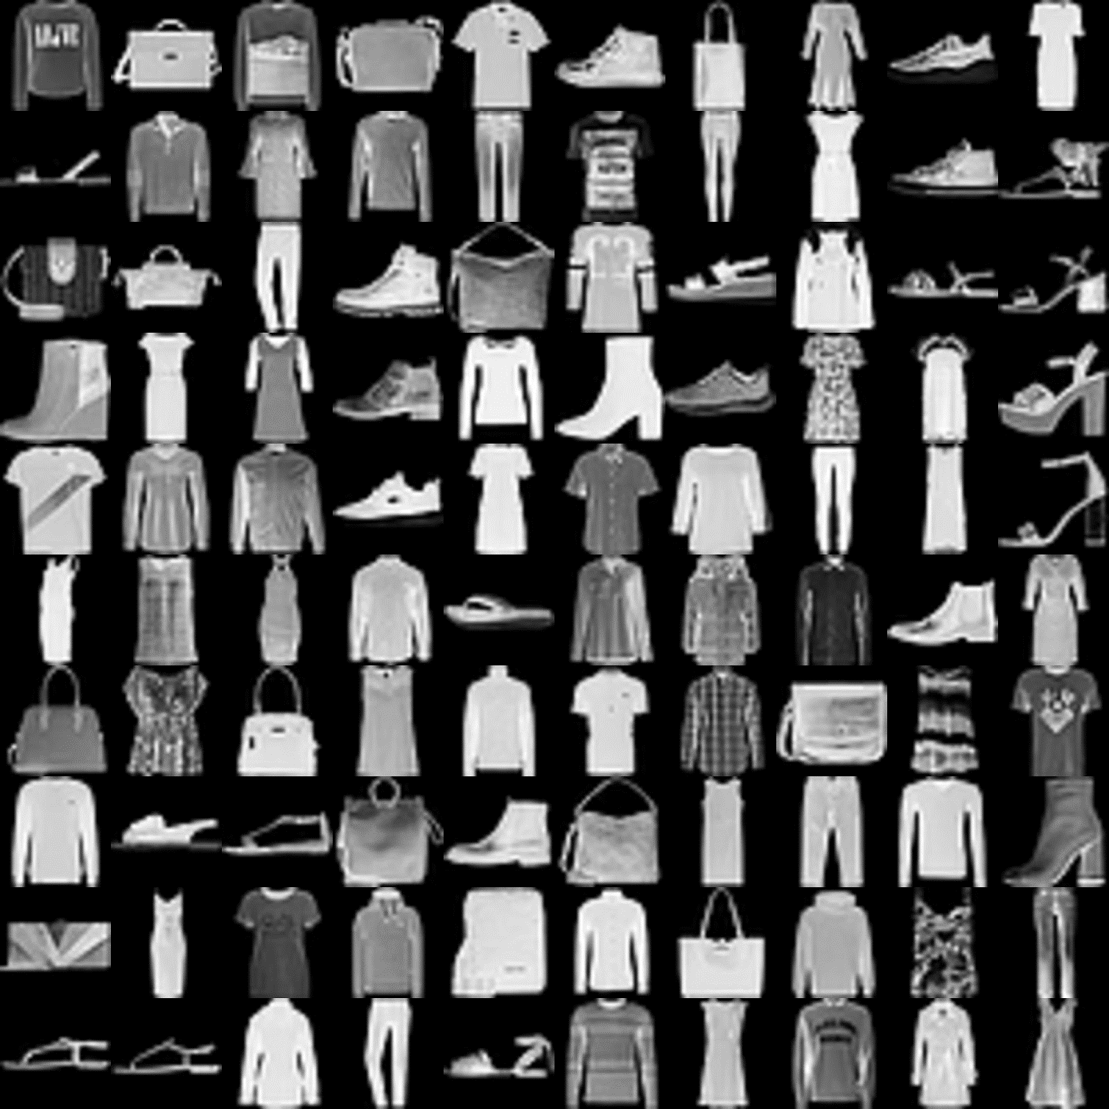
Conv
(32 3x3)
ReLU
Conv
(32 3x3)
ReLU
MaxPool
(2x2)
Conv
(64 3x3)
ReLU
Conv
(64 3x3)
ReLU
MaxPool
(2x2)
Flatten
Dense
(512)
ReLU
Dense
(10)
Softmax
70000 x 28 x 28

