Slide 1

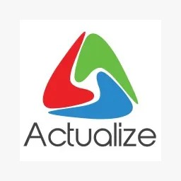
Associate Azure DevOps Engineer
- Swathi Endla
- Alavalapati Rupasree
- Sreelakshmi Lingamgunta

Slide 2
Cloud Computing with Azure
Benefits of Azure Cloud
Cloud Deployment Models
Cost Efficiency
Scalability
Automatic Updates and Maintenance
Data Backup and Recovery
Public
Private
Hybrid
Azure Services
Case Studies
Virtual Machines
Virtual Network
Database
Storage
Real-world examples of organizations leveraging Azure to improve efficiency, reduce costs, and enhance their business operations.

Slide 3
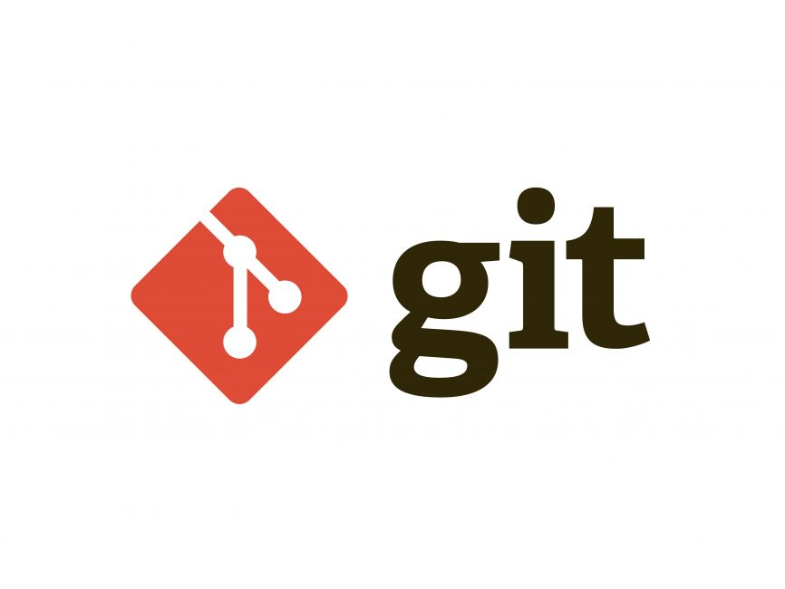
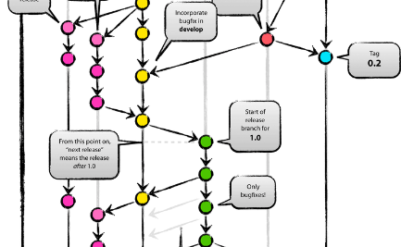
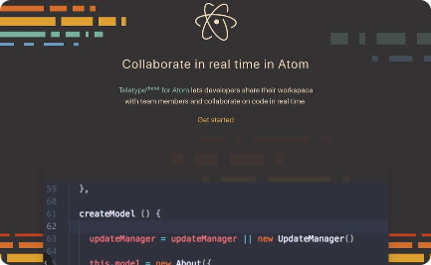
Version Control and Collaboration with Git
Git Basics
Git Workflows
Collaborative Coding
Creating repositories
Branching
Merging
Resolving conflicts
Centralized Workflow
Feature Branch Workflow
Gitflow Workflow
Discover how Git enables seamless collaboration among team members through Pull Requests, code reviews, and code versioning.

Slide 4
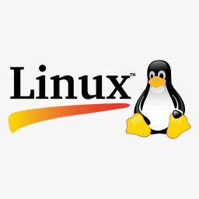
Deploying and Managing Applications on Linux
1
Linux Fundamentals
2
Application Deployment
Linux operating system
File systems
Package management
Command-line navigation.
Learn how to deploy applications on Linux servers using tools like SSH, package managers, and configuration management systems.

Slide 5

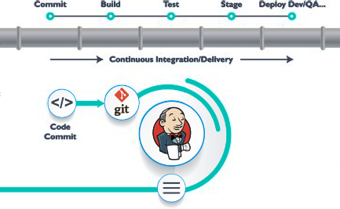
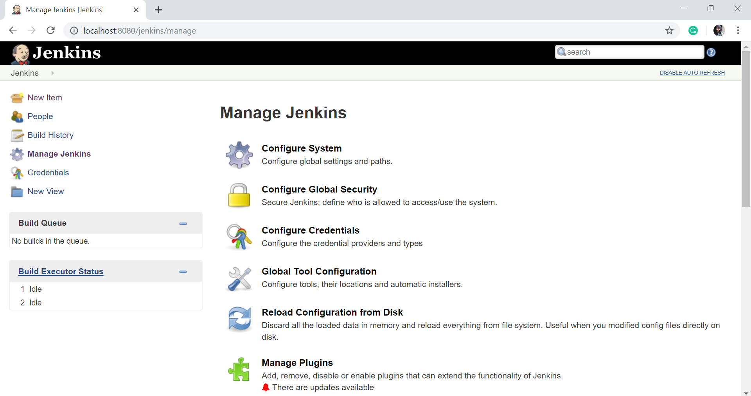
Continuous Integration and Deployment with Jenkins
Jenkins Introduction
Jenkins Pipeline
Extending Jenkins
Explore the capabilities of Jenkins, an industry-leading CI/CD tool, and learn how it automates the software development lifecycle.
Understand the power of Jenkins Pipeline to define and manage continuous integration and deployment processes as code.
Discover a wide range of Jenkins plugins that enhance its functionality and integration with other tools and technologies.

Slide 6
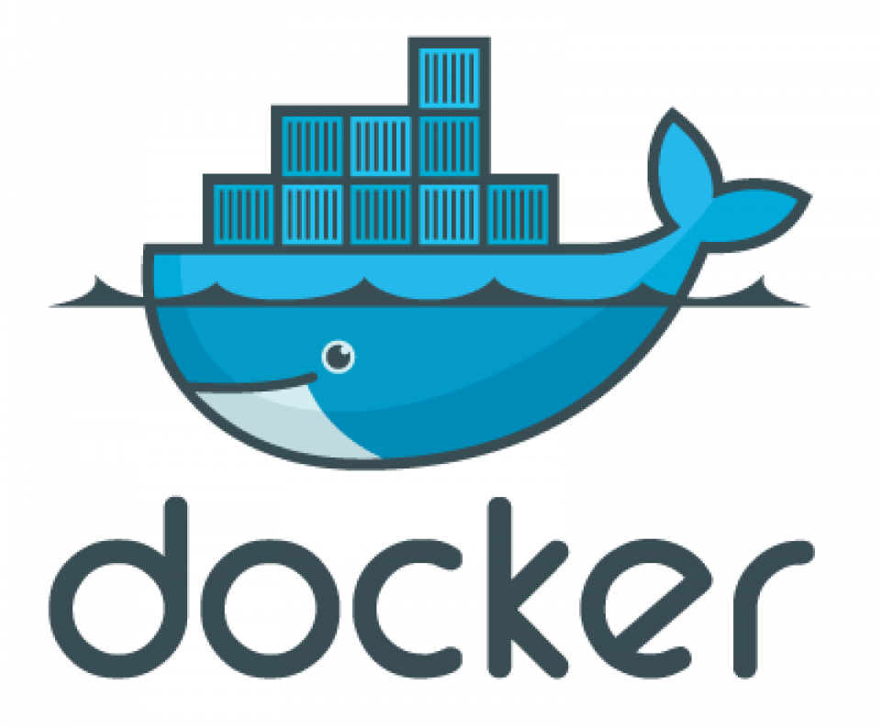
Containerization using Docker
Introduction to Containers
Working with Docker
Portability
Scalability
Image Creation
Container Creation
Docker commands
Container orchestration
Docker Compose for multi-container application management.

Slide 7
Unlocking the Power of Azure DevOps Portal
1
Azure Boards
Boards are used to maintain the progress of work
Azure Repos
2
Discover Azure Repos, a centralized version control repository integrated with Azure DevOps for efficient code management.
Azure Pipelines
3
Learn how to create and manage CI/CD pipelines using Azure Pipelines for automated build, test, and release processes.
Azure Artifacts
4
Explore Azure Artifacts for package management, including versioning, publishing, and consuming packages.
Azure Test Plans
5
Azure Test Plans is a test management module within Azure DevOps that lets users manage test plans, test suites, and test cases for everyone in the software development process

Slide 8
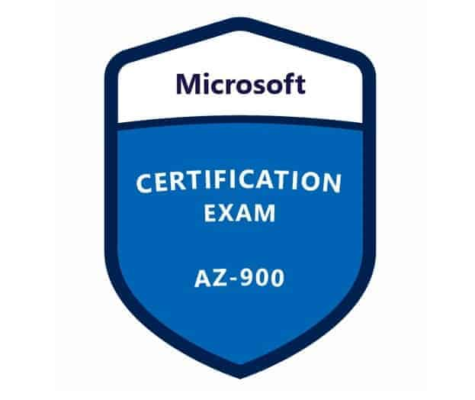
Preparing for the AZ-900 Certification
The Microsoft Azure Fundamentals (AZ-900) certification exam is for foundational knowledge of cloud services and how Microsoft Azure provides them.
The AZ-900 certification can help people who want to start a career in cloud computing, whether they have prior IT experience or not.

Slide 9


