Slide 1
Currency Arbitrage and you
Adrian Law
Benjamin Li

Slide 2
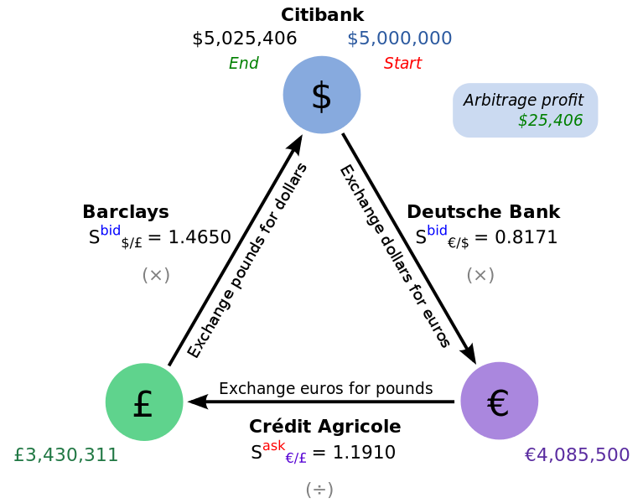
What is arbitrage and why do we care
Brief discrepancies in the foreign exchange market (Forex) due to rounding errors or high activity Using at least 3 currencies to trade in a cycle to lock in “riskless” profit
Largest financial market by a wide margin ($5.3 trillion a day in 2013)
Market participants are by large multinational banks, and hedge fund/investment managers as smaller participants
Notes:
Brief introduction using each point, short explanation of arbitrage cycle
cycle: multiple currencies, known as triangular arbitrage
Huge market means lots of trades made every day
Fairly open market, anyone can get involved
Investors: long term investments for interest rates, favorable exchange rates etc.

Slide 3
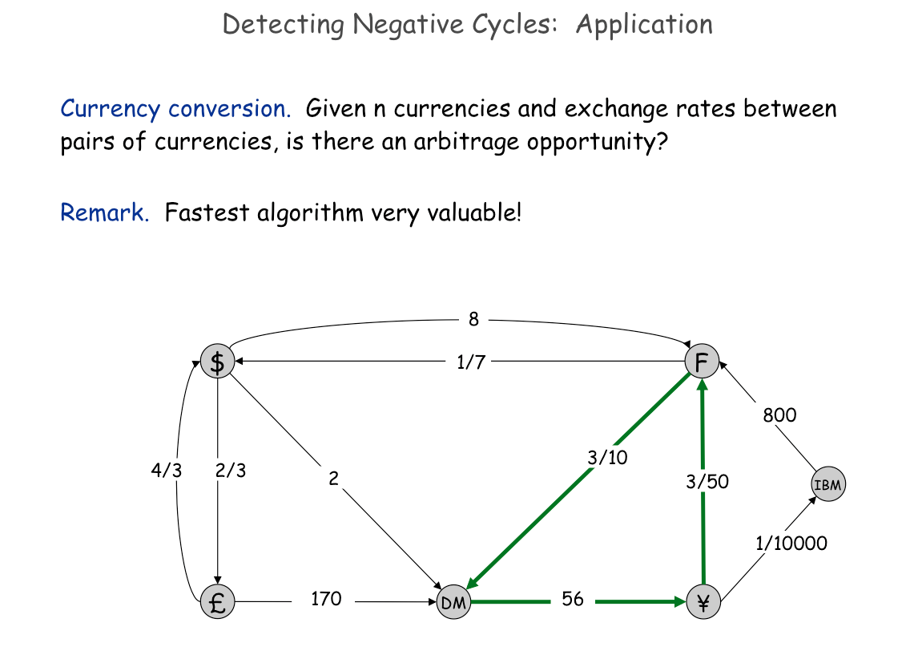
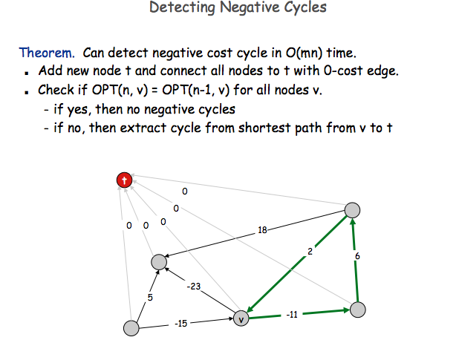
How to find Free money
Use predictive analysis i.e. corresponding factors, indicators, seasonality
High Frequency Trading = Bellman Ford (CS330)
Notes:
Predictive analysis: factors such as inflation, national interest rates, balance of trade
Factors that all affect currency value and their desirability
Able to make estimations 1 day to 1 decade ahead: long term investors like hedge funds and investment managers
HFT: algorithms to make decisions in milliseconds
Bellman Ford: polynomial algorithm that can find “negative cycles” i.e. sum of weights along a cycle is negative
Can quickly restructure currency exchange rates from previous slide to a Bellman Ford problem
Running BF every tick to find positive cycles

Slide 4
Project Goals
3 main goals:
1) Identify important trends in incidences, magnitude, and persistence of arbitrage
Distribution of arbitrage across time
Distribution of magnitude and persistence
2) Find correlation in magnitude and arbitrage if it exists
Graph correlation between magnitude and duration
Find ways to predict duration of arbitrage i.e. regression, Bayesian probabilities, clustering
3) Observe clusters of arbitrage points and attempt to group points according to stock price movements and the time of day
Look at corresponding stock data of each country
Forex opening/closing hours
Notes:
Explain motivation behind each goal w/ subpoints for deets
Emulate investors and traders: how to make informed decisions in the market to exploit arbitrage
Risk: duration Reward: cycles
Longer duration = more cycles = more profit
1
Research papers: daily seasonality of arbitrage = low number of opportunities 00:00-10:00, more during 10:00 – 22:00
Distribution: can tell us what kind of instances arbitrage is
2
Relation between magnitude and duration: is there a negative or positive relationship and reasoning behind both
Determine best method for predictions after plot, duration important to determine
3
Observe relationship of arbitrage across time of day and stock movements
There should periods of higher incidences around the same times
Find plot to show relationship of stock price movement and arbitrage
Attempt to cluster arbitrage for value, then show on graph clear distinction of groups i.e. high value clusters around extreme deviations from mean, and low value clusters closer to mean

Slide 5
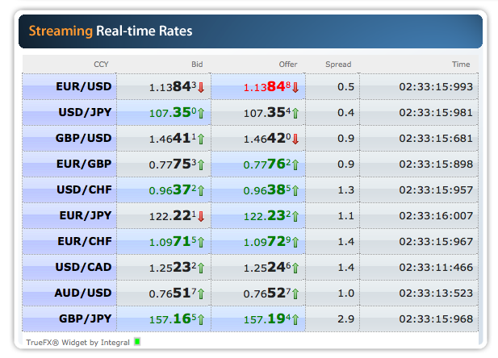
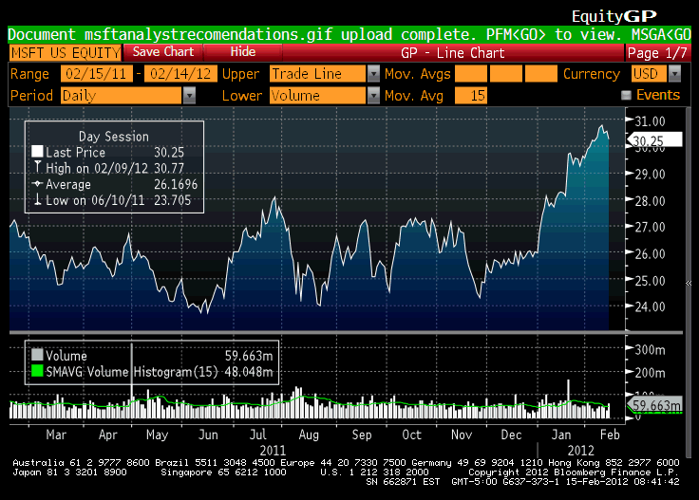
Dataset collection
TrueFX: Free to use web API for tick by tick Forex data
Bloomberg Terminal: restricted tick data for stock prices available at Questrom
Restrictions due to trading hours and availability of the Bloomberg Terminal
Notes:
How we got forex tick data
Pulled data from website as frequently as possible
6 currencies: USD, JPY, AUD, EUR, CAD, CHF
30 total exchange rates
Stock data from questrom
Bloomberg terminal: provides up to date tick data every day
Download restrictions so we could only observe a few days before and after the weekend 4/21-4/27
6 stock market indices as a proxy for economic activity at every tick
Restrictions due to trading hours, download restrictions, “refitting” of data to match scales
Restructure data to fit time scales: periods of inactivity and missing data points during trading hours means we needed to construct minute by minute data
Forex open 24h Sunday to Friday, while stock exchanges open at different periods of the day, thus some points of arbitrage cannot be represented in the stock market
Gap around 22:00 to 00:00 every day since all market data is unavailable around that period

Slide 6
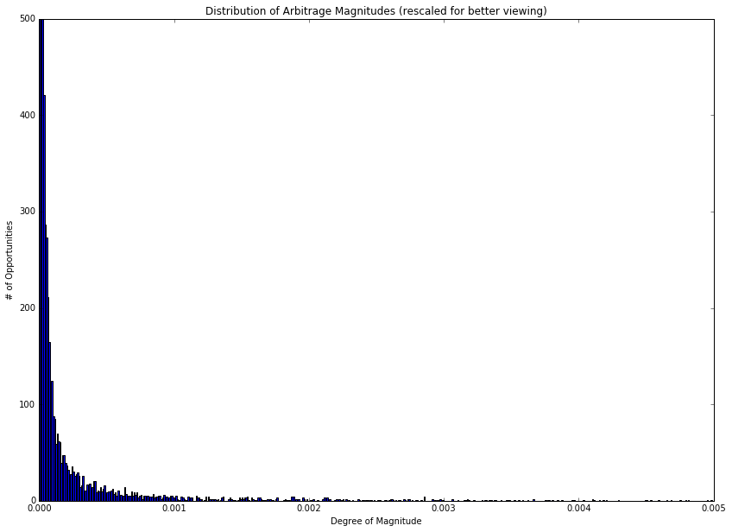
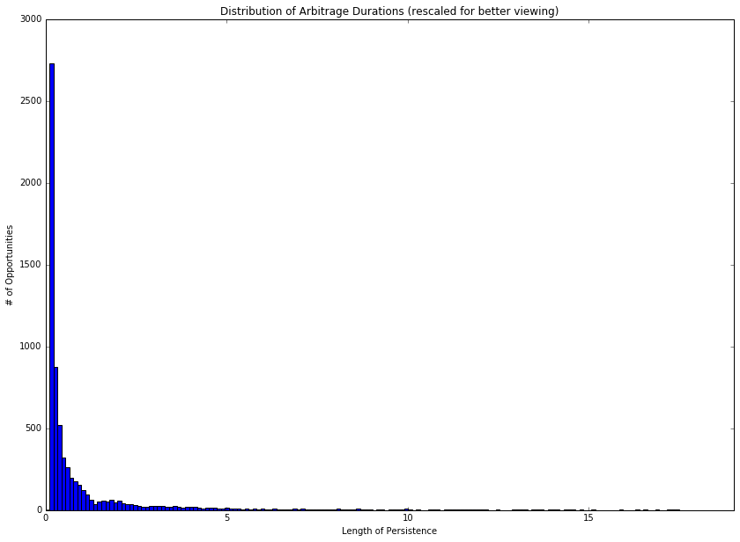
1) Distribution of Arbitrage
6889 instances across 72 hours, ~174 mins total
On average ~0.03% profit, about 1.523 seconds, max of 8% return and 2.5 minutes
Exponential distribution of both magnitude and duration
Notes:
Number of arbitrage opportunities: 6889
Min non-zero arbitrage value: 3.61000007665e-09
Max arbitrage value: 0.08038718751
Average arbitrage value:0.000337432753911
Median arbitrage value: 2.97470800001e-05
Value variance: 4.18690132428e-06
Total arbitrage time: 10494.7700117
Min arbitrage length: 0.109999895096
Max arbitrage length: 141.950000048
Average arbitrage length:1.52340978541
Median arbitrage length: 0.240000009537
Length variance: 28.7354946983

Slide 7
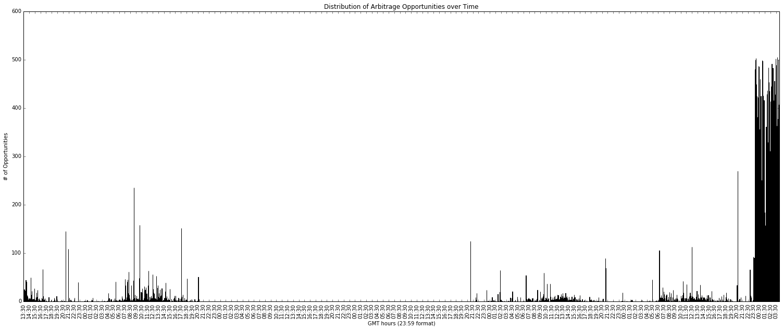
1) Distribution of Arbitrage
4/21
4/22
4/23
4/24
4/25
4/26
Spikes of arbitrage instances around ½ to 1 hour before closing hours of New York and Tokyo
Forex closed during 4/23-4/24 weekend, thus no activity until Sunday night at 8PM
4/27 is not a glitch: why was there a huge spike in arbitrage?
Notes:
GMT times
Red = NY close
Green = Tokyo close

Slide 8
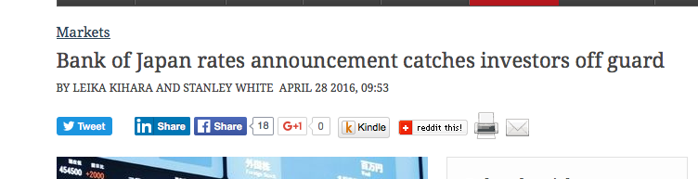
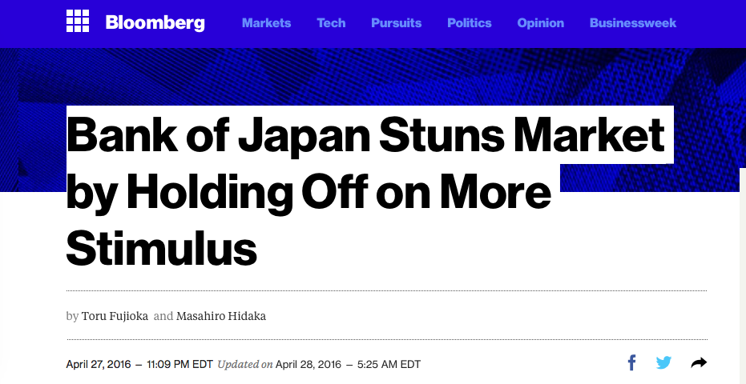
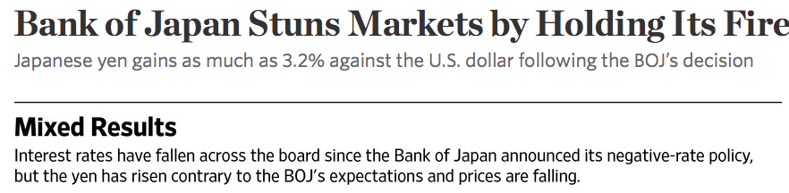
JPY: Bank of Japan keeps negative rates
Investors were surprised when the BoJ defied expectations, leading to widespread buyout of the Yen
Massive jump by the Yen led to huge discrepancies in the market = more arbitrage cycles of greater magnitude and duration
4/27:
00:00 GMT is Tokyo opening hour

Slide 9
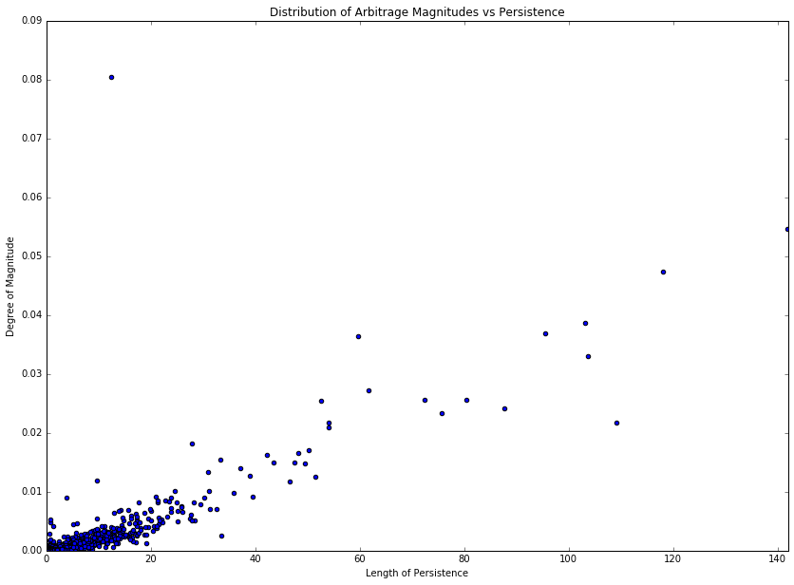
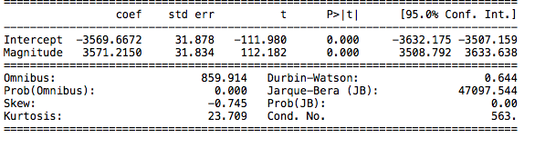
2) Correlation and Regression
A clear positive linear relationship
Pearson Correlation Coefficient = 0.8430109
Higher magnitude takes longer to adjust for in the market
Regression: clear that magnitude is a strong indicator for duration of arbitrage
Adj. R Square of 0.828
F-statistic: 1.258e+04

Slide 10
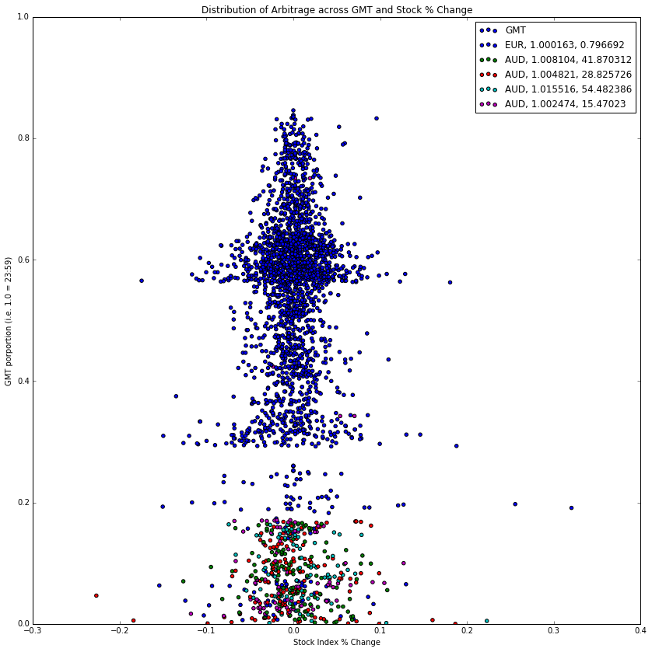
3) Clustering
Used K-Means ++ to generate clusters, elbow plot to determine K
Graphed as stock price % change vs. time of day
Weighed the “value” of the arbitrage the most heavily i.e. magnitude and persistence
Gap between 0.9 to 1.0 due to lack of stock data
Notes:
With 4/27 Data

Slide 11
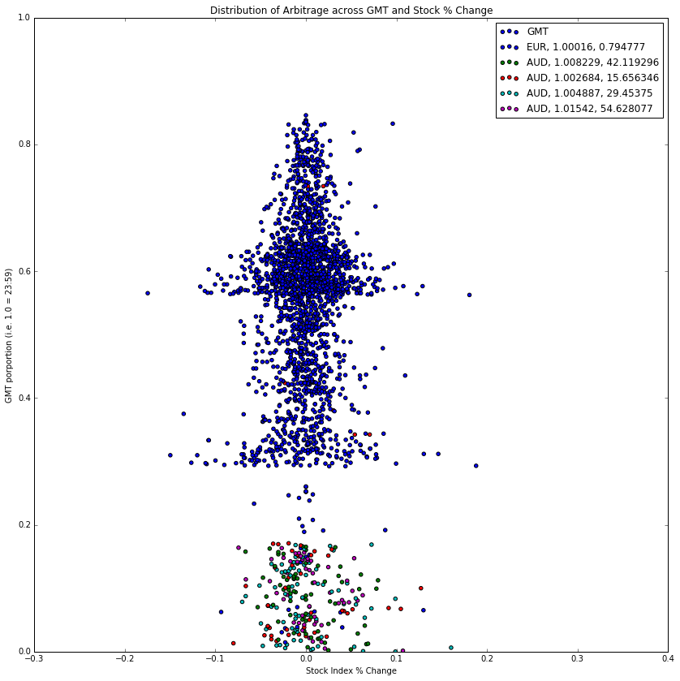
3) Clustering
Removed the outlier day; market shocks are not good when trying to infer an overall pattern
Shows that there is a clear divide between blue cluster and every other cluster around 0.29 GMT = 7:00 AM Sydney closing hour
However no clear relationship between price % change and arbitrage
Notes:
Without 4/27 Data

Slide 12
3) Clustering
Blue: Low value
Nearly all but JPY and most AUD: ('EUR', 683), ('USD', 574), ('CHF', 498), ('CAD', 323), ('AUD', 32)
Purple, Red, Green then Cyan of high value clusters in ascending order
Heavily comprised of AUD, JPY always 2nd:[('AUD', 74), ('JPY', 54)]
[('AUD', 71), ('JPY', 53)]
[('AUD', 52), ('JPY', 36)]
[('AUD', 41), ('JPY', 37), ('EUR', 4), ('CHF', 3), ('USD', 1), ('CAD', 1)]
Cosine Similarity very high for all clusters, 0.8686 to 0.99997
Notes:
With 4/27 Data
Red = NY
Blue = Sydney
Purple = London

Slide 13
conclusion
Direct linear relationship: high correlation between magnitude and duration, very useful for traders and analysts
Intraday seasonality: Opening hours of bigger markets and closing hours of smaller markets are riper grounds for arbitrage compared to regular trading hours
No stock market to Forex relationship: in the timespan that we have observed there isn’t enough conclusive evidence in the clustering or regressions that market forces influence each other
Market shocks are important driving forces: When prices rapidly move, discrepancies are harder to fix in supply and demand markets

Slide 14
Future improvements
Collect much more data, confirm linear relationship of magnitude and duration
Observe more market shocks and get a better understanding of their effects
Look at other potential factors that may influence currencies prices i.e. commodities prices like Oil, Natural Gas, manufactured goods that involve hard currencies or government bonds that determine interest rates
Design a recommendation system: using our current dataset as training, build a model that can accurately predict the duration of arbitrage opportunities based off of Bayesian probabilities

Slide 15

Thank you
References:
Aiba, Yukihiro; Hatano, Naomichi; Takayasu, Hideki; Marumo, Kouhei; Shimizu, Tokiko (2002). "Triangular arbitrage as an interaction among foreign exchange rates". Physica A: Statistical Mechanics and its Applications
Fenn, Daniel J.; Howison, Sam D.; McDonald, Mark; Williams, Stacy; Johnson, Neil F. (2009). "The Mirage of Triangular Arbitrage in the Spot Foreign Exchange Market". International Journal of Theoretical and Applied Finance

