Slide 1
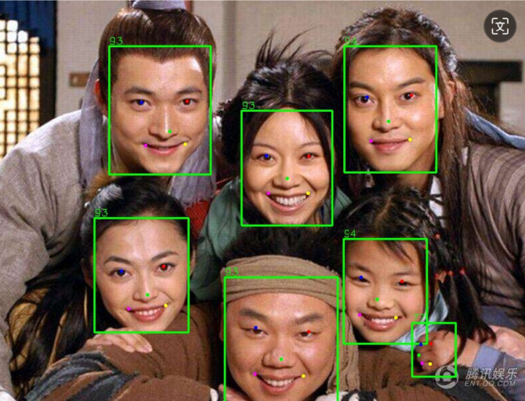
rgain= 1.44657916547806 ,bgain= 0.8277762478066301
分为9个：
rgain= 1.50528570840028 ,bgain= 0.7504305195072715
rgain= 1.3738505385402442 ,bgain= 0.8757984500627786
rgain= 1.3484794982134627 ,bgain= 0.8635378823698402
rgain= 1.492247968474727 ,bgain= 0.784280803853089
rgain= 1.4606922037429886 ,bgain= 0.81755762073365
rgain= 1.4448588252604144 ,bgain= 0.8249180997336553
rgain= 1.5605910552585371 ,bgain= 0.713559154846219
rgain= 1.5367873824202218 ,bgain= 0.8422246850390054
rgain= 1.3828687587186286 ,bgain= 0.9215888954518605

Slide 2

rgain= 1.305020777162561 ,bgain= 0.9917175798079616
分为4个：
rgain= 1.3457687834515524 ,bgain= 1.0858477644137343
rgain= 1.323341102285748 ,bgain= 1.0892625178630515
rgain= 1.295082298701824 ,bgain= 0.8882663550840038
rgain= 1.3381122102649703 ,bgain= 0.9375961151377238

