Slide 1

Dylan Ables, Bee Bussell, Andrew Lay, Haoyu Li, Weilin Ouyang

Slide 2
About The Game
FireBox is intended to be a simple game that emphasizes a core fighting game fundamental.
Fireball beats waiting, Jump beats fireball, and uppercut beats jump, and waiting beats uppercut.
The game should be simple all around to emphasize this point.
Has movement, jumping, fireball, kick, and uppercut.

Slide 3
Tool
Godot
Git
Language
GDscript
Godot Shader Language

Slide 4
Play it Yourself
https://bsbussell.github.io/FireBoxHTML/
or
(https://bit.ly/231Box)

Slide 5
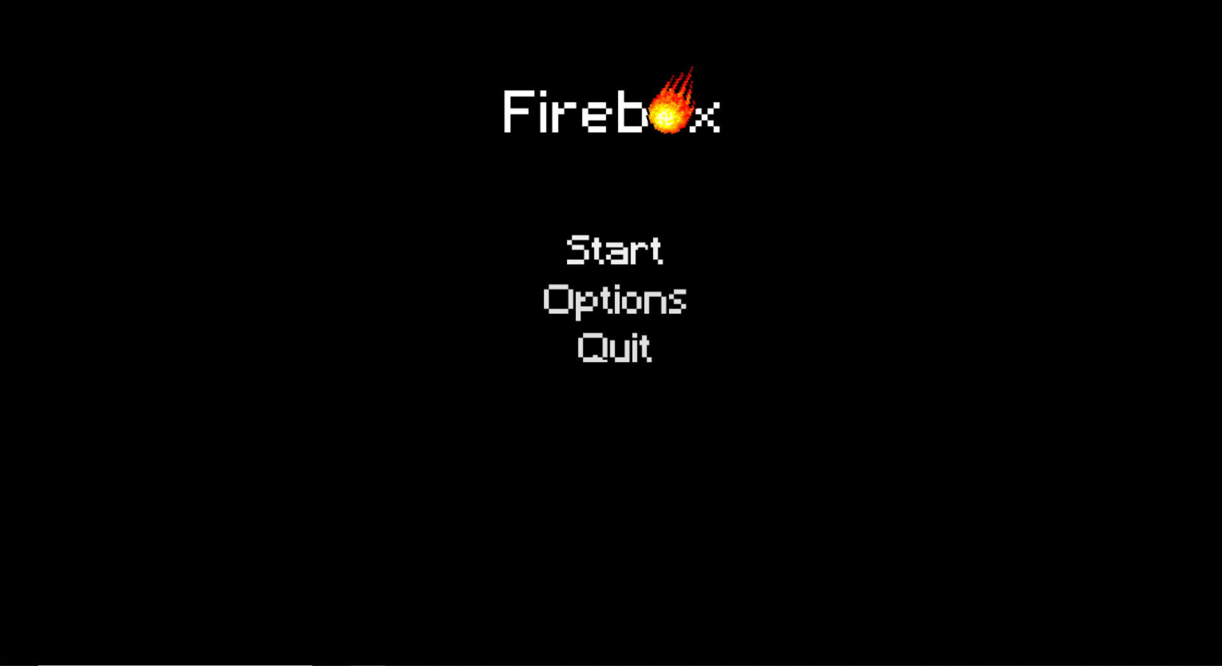
Main menu

Slide 6
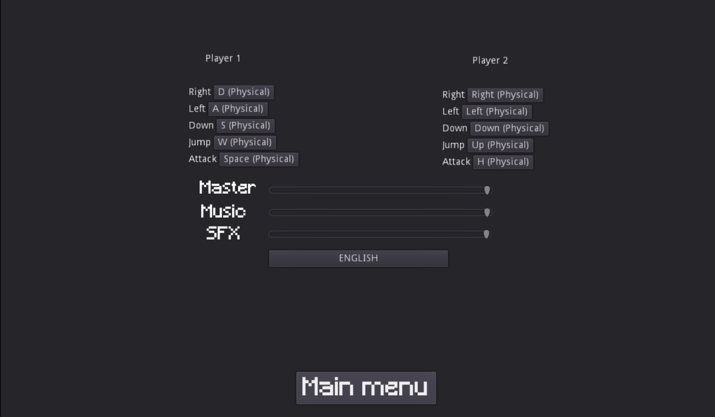
Settings

Slide 7
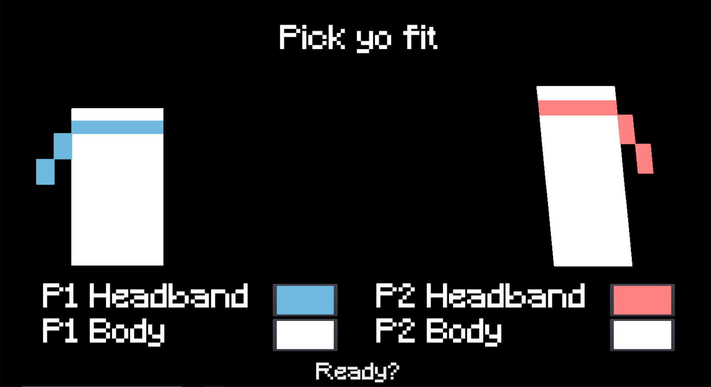
Character

Slide 8
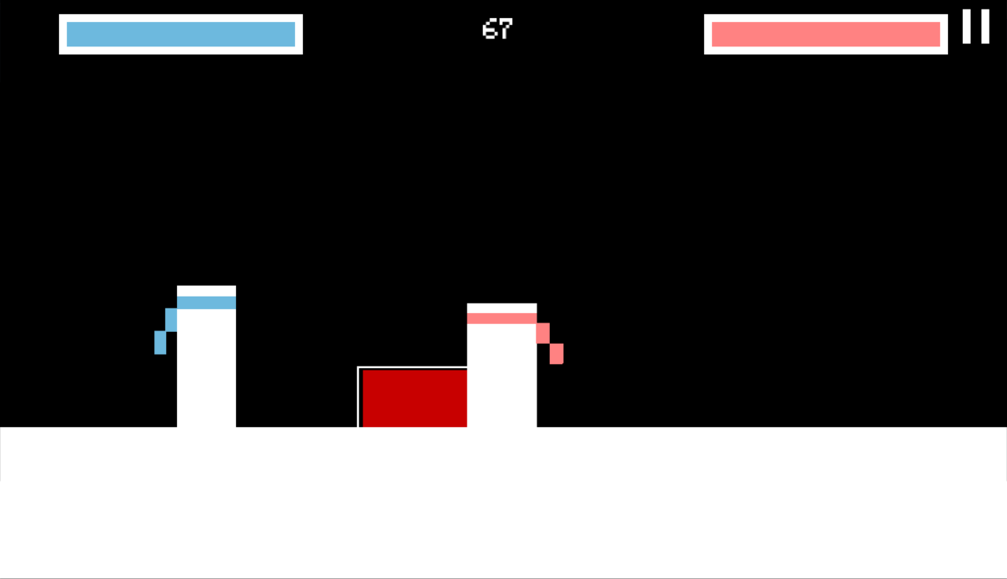
Battle

