Slide 1


ATULYA
ROBOISM
Name - Alay Kabir Roll No.:- 21JE0075
Division -IOT

Slide 2



Understanding the Problem
IOT
One of the issues is to track the location of the package in cheap and efficient way.
The safety and maintainence of the package if something happens that damages the product. Fire is one such issues.

Slide 3




Idea & Approach
The vehicle tracking system will send you the location to your mobile phone along with the Google map coordinate. You can request the location at any time & view the location on Google Maps installed on your mobile phone.
This is a cheaper solution than a two-way GPS communication system where the communication is done in both ways with GPS satellites. This project uses only one GPS device and two-way communication is achieved using a GSM modem. The GSM modem with a 4G SIM card is used for communication between the device and mobile phone.

Slide 4


Components Required
IOT
Sensors: LM35
Arduino UNO
BreadBoard
SIM 900 GSM Module
Telecom Sim
Neo-6M GPS Module
Wires

Slide 5


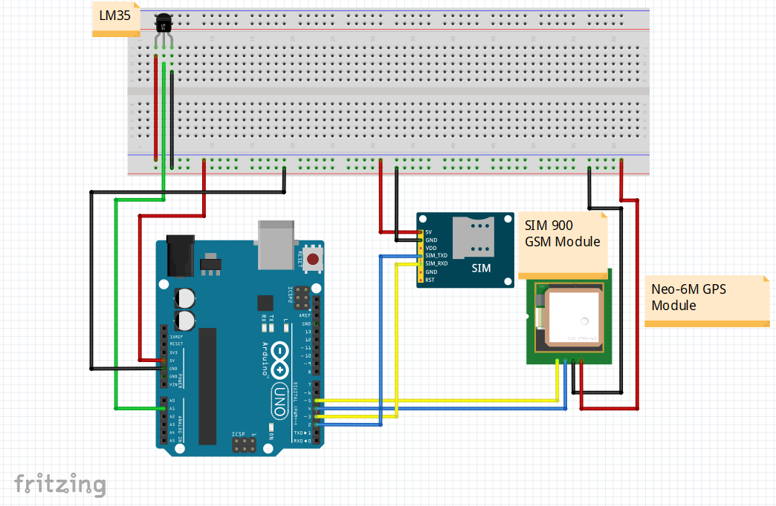

Circuit Diagram
IOT

Slide 6
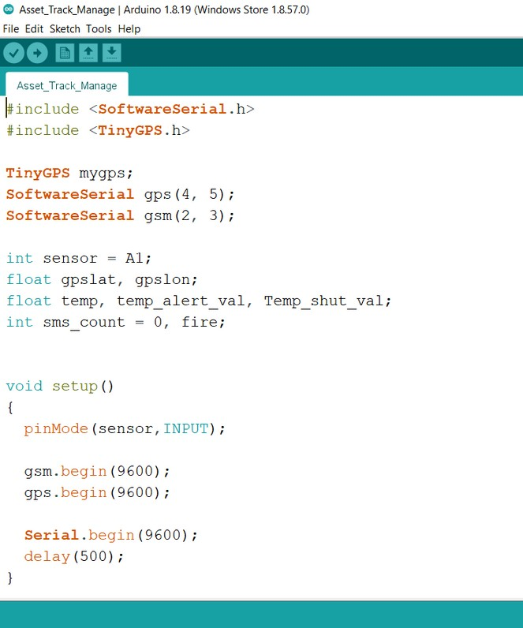
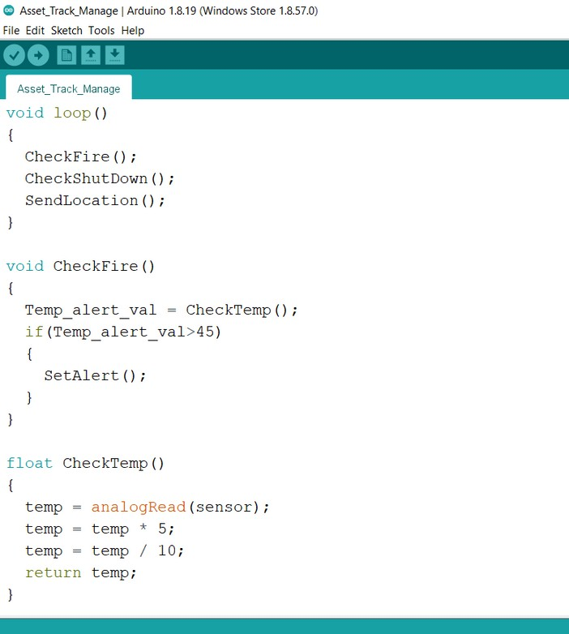
Code
IOT

Slide 7
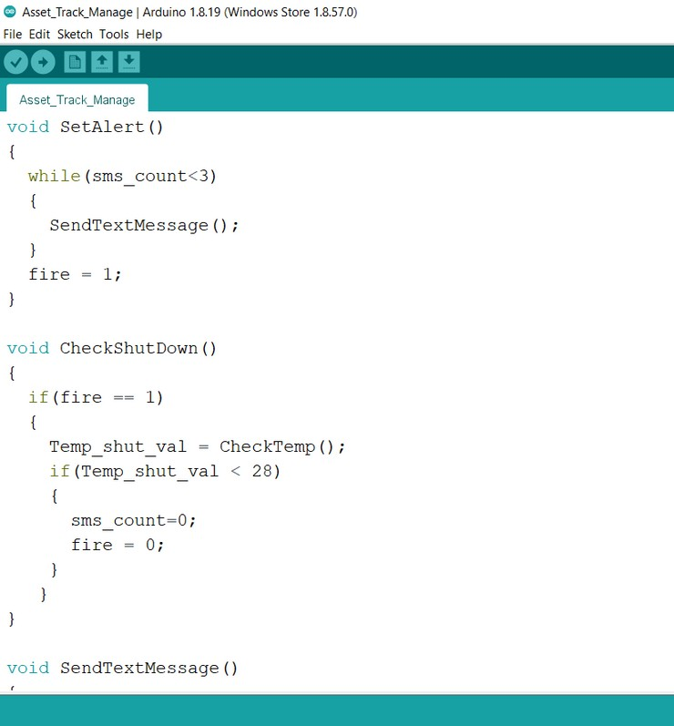
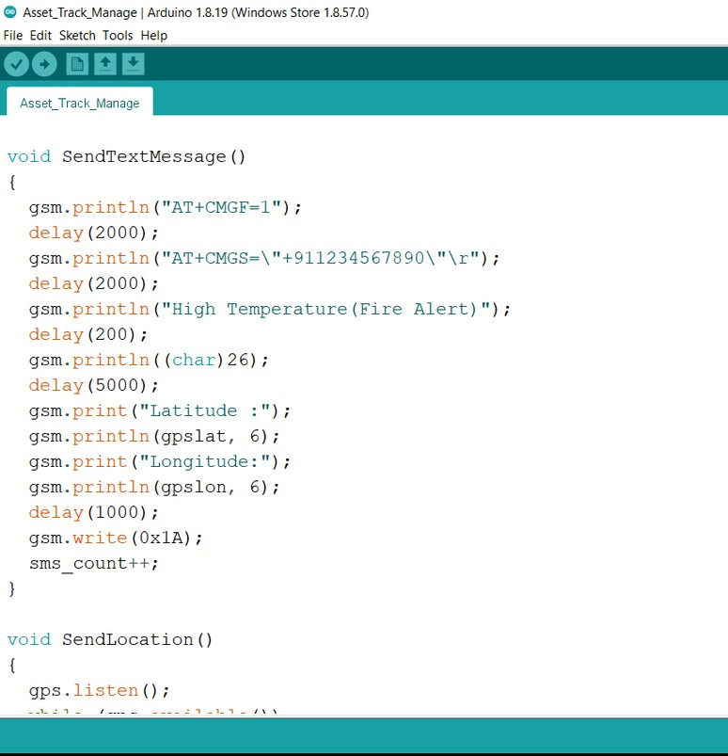
Code
IOT

Slide 8
IOT

Slide 9
IOT
GitHub Link
https://github.com/alaykabir/RoboISM_IOT_Atulya

Slide 10




IOT
Resources
https://www.pjrc.com/teensy/td_libs_TinyGPS.html https://www.realtimenetworks.com/blog/dos-and-donts- of-using-asset-tracking-tags

Slide 11


THANK YOU
IOT

